Slide 1
Reference Measurements
M. Schwarz
Acknowledgements:
S. Albright, C. Grindheim, A. Lasheen, G. Papotti, J. Repond, T. Argyropoulos, E. Shaposhnikova, PS/SPS operators, BLonD dev team
LIU-SPS BD WG meeting, 16/01/2020

Slide 2
Motivation
Was impedance reduction campaign during LS2 successful?
Compare reference measurements (and simulations) pre- and post-LS2
Outline
Flat-Bottom instability threshold for 1x12 bunches
Long bunches

Slide 3
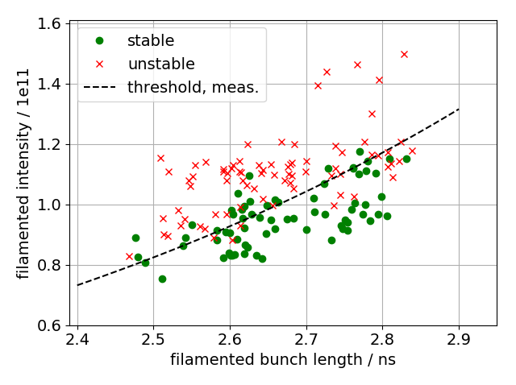
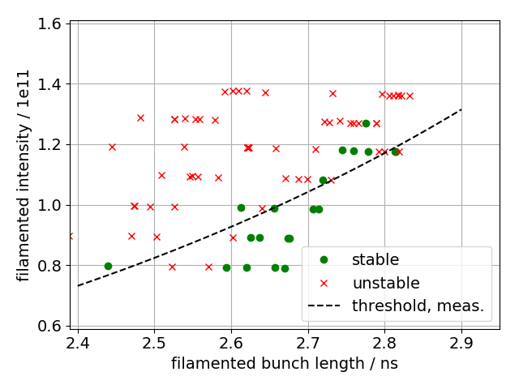
Flat-Bottom instability
1x12b, Q20 optics, feedback off, phase loop on, V₂₀₀=4.5MV, 800 MHz TWC off
Measured threshold at ~1.2e11 p/b
Reproduced in simulations (including frequency shift of 200 MHz TWCs due to HOM couplers)
Measurement
Simulation, pre LS2

Slide 4
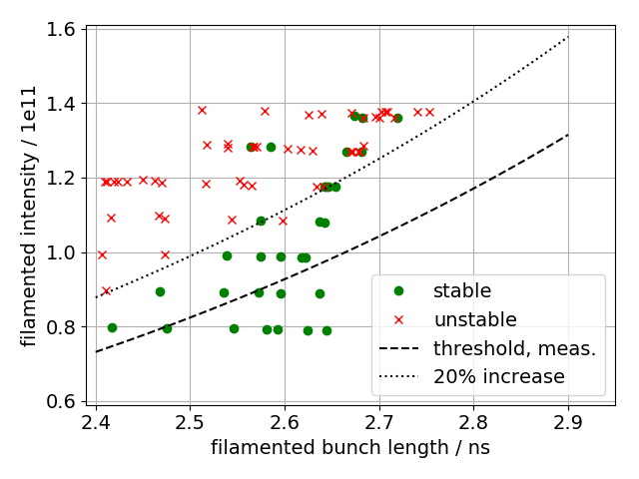
Simulations: 1x12 bunches pre- and post-LS2
20% reduction of TWC impedance → 20% increase in threshold → 20% less beam loading, smaller filamented bunch length $τ∼1/{\sqrt[4]{V_{RF}−V_{ind}}}$
More HOM damping → reduced threshold
pre-LS2
post-LS2

Slide 5
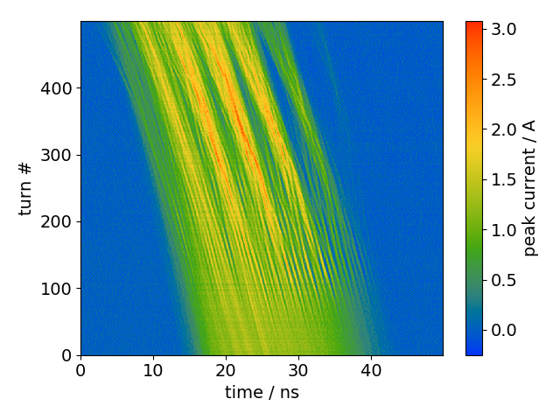
Long bunches
Inject long bunches (~30ns) with RF off
Formation of substructures during debunching gives information about impedance source driving instability, T. Bohl et al., PRL 78, 3109 (1997)
Measurements performed by Giulia and Theo in 2018 [LIU-SPS BD WG 18/10/23 meeting]; only Q20 analyzed here
profiles

Slide 6
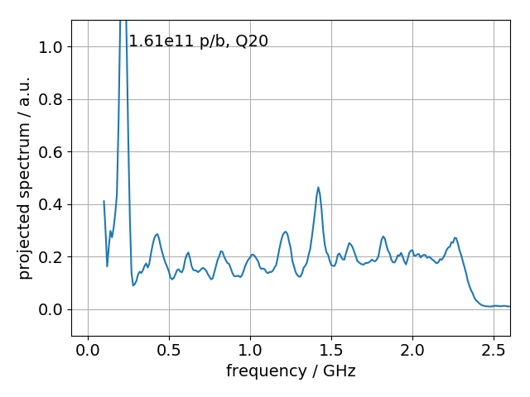
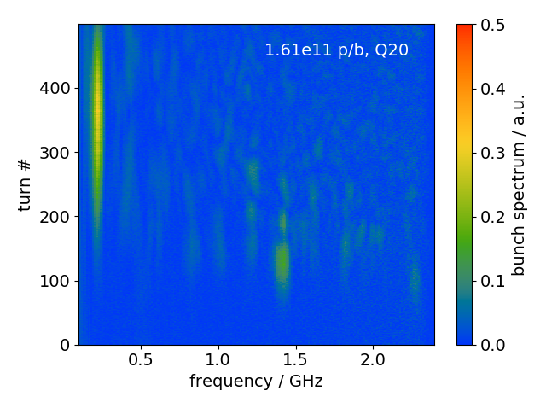
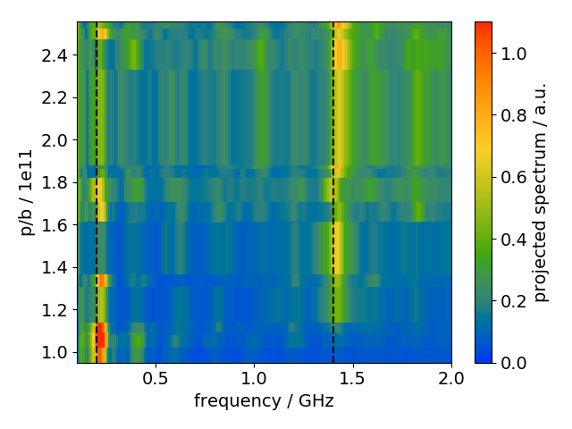
Long bunches: analysis
profiles
ignore $f<100$MHz
project
FFT
scan intensity

Slide 7
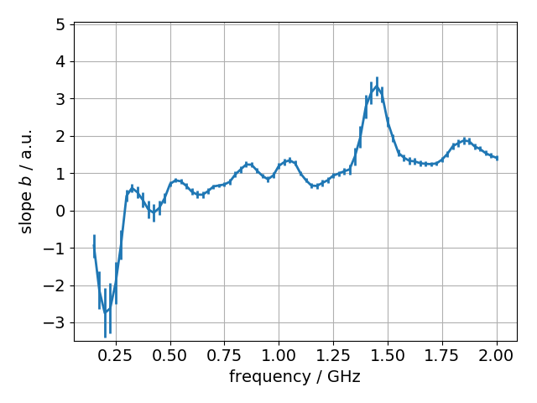
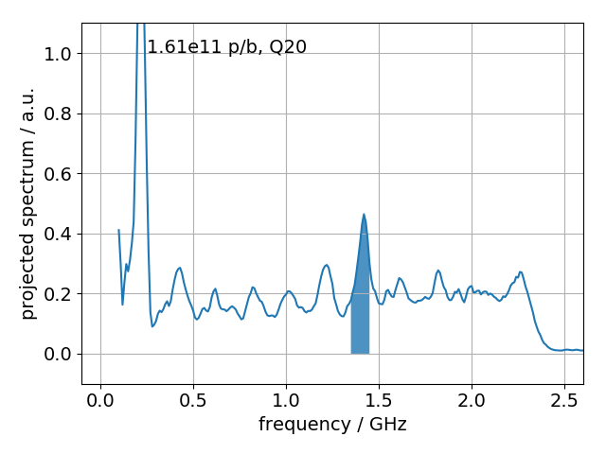
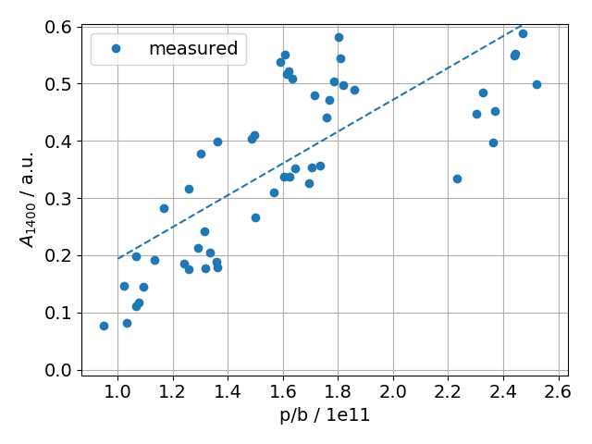
Long bunches: analysis
plot $b(f_{center})$
$A(f_{center},n)$: sum of projected spectrum at $f_{center}±50$MHz for given intensity $n$
based on:
A. Lasheen et al., PRAB, 034401 (2018)
Amplitude $A(f_{center}=const,n)$ → linear fit $A_{f_{center}}\left(n\right)=a+b n$

Slide 8
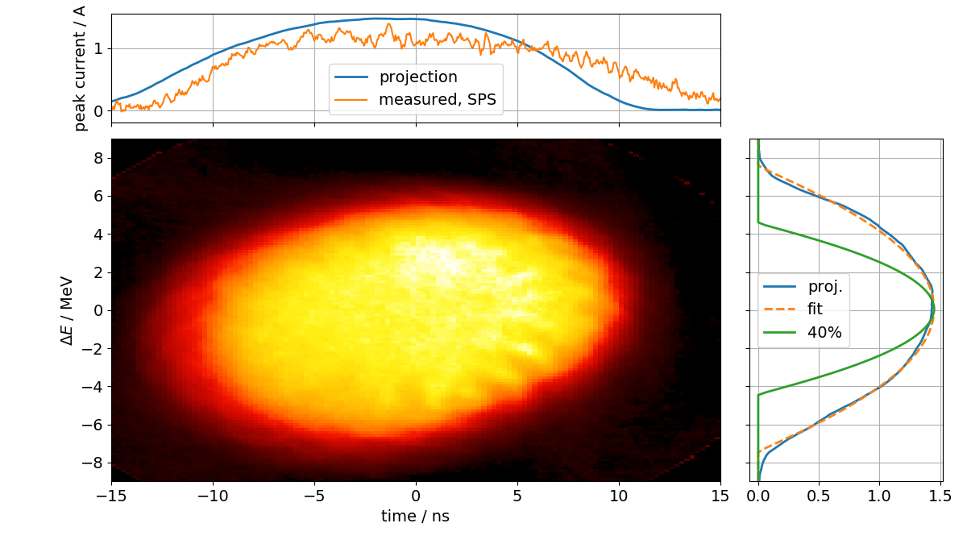
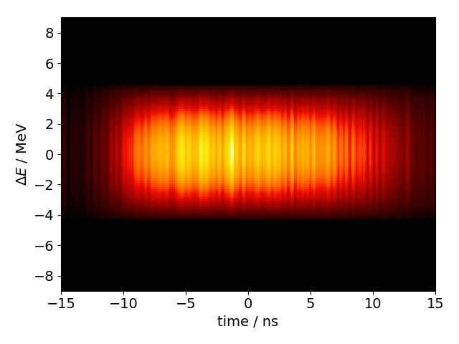
Long bunches: simulation
Create initial macro-particle distribution based on tomography data from PS
Reconstructed phase space has too large energy spread (no intensity effects, constant RF voltage in reconstruction) and too smooth profile
Use product of measured profile and fit to energy projection (and reduce energy spread by ~40%)
Use BCT in SPS to obtain bunch intensity
simulation

Slide 9
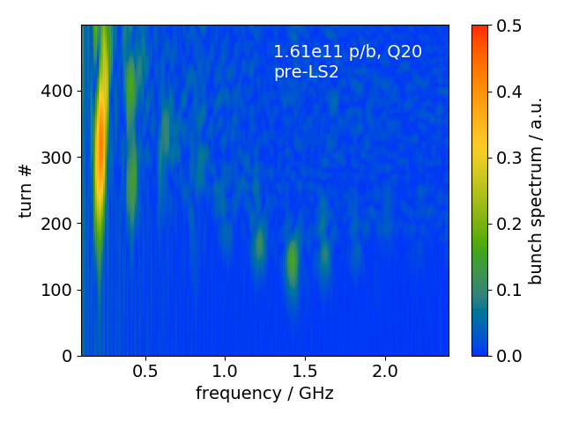
Long bunches: measurements vs simulation
Example for 1.61e11 p/b
measurement
simulation

Slide 10
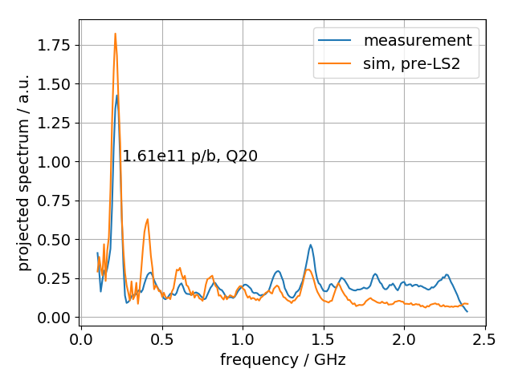
Long bunches: measurements vs simulation
example for 1.6e11 p/b
stronger peaks at 200 and 400 MHz in simulation
peak at 1.4 GHz reproduced
no peak at 1.8 GHz in simulation

Slide 11
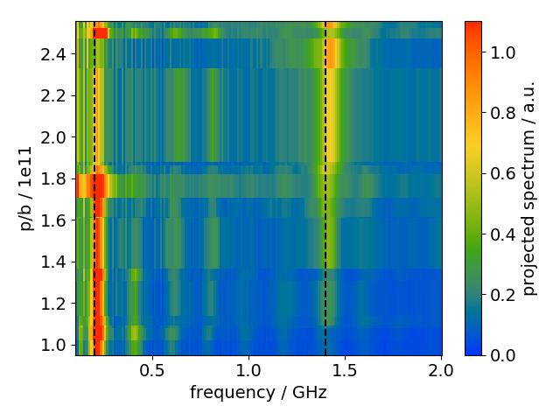
Long bunches: measurements vs simulation
Scan intensity (same intensity as in measurements)
measurement
1.4GHz line from flanges reproduced in simulation

Slide 12
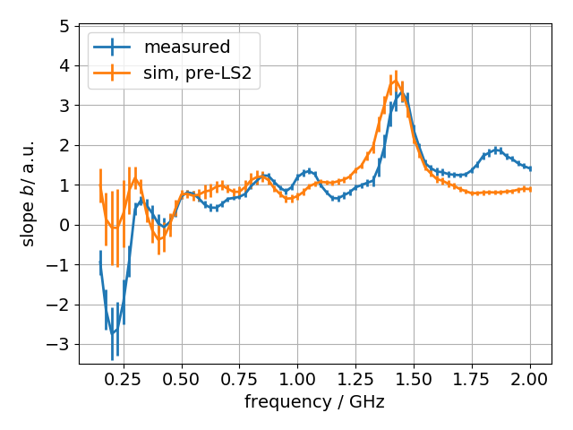
Long bunches: measurements vs simulation
Good agreement between measured and simulated slope, but …
‘dip’ at 200 MHz not as pronounced as in measurements
no peak at ~1.8 GHz in simulations

Slide 13
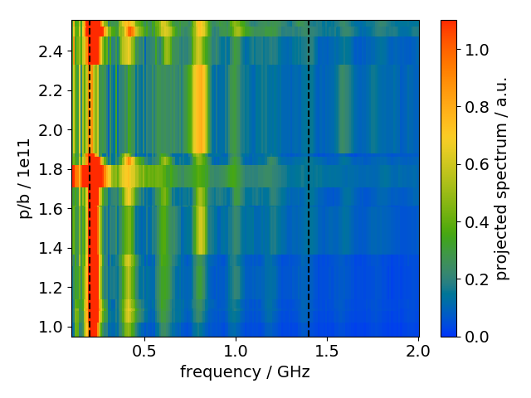
Long bunches: simulation pre- and post-LS2
Simulate using the post-LS2 SPS impedance model:
shielding of flanges during LS2 →1.4GHz line disappears
strong peak at 800 MHz appears
sim, pre-LS2
sim, post-LS2

Slide 14
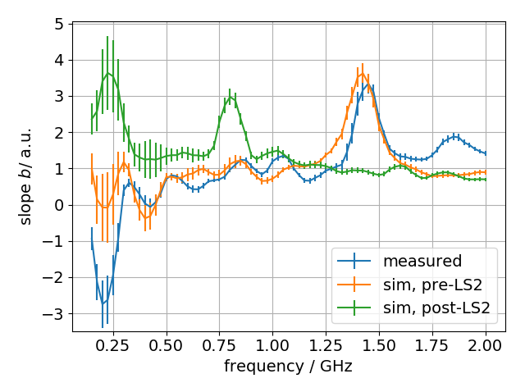
Long bunches: simulation pre- and post-LS2
In post-LS2 simulation:
no peak at 1.4 GHz due to shielding of flanges
strong peak at 800 MHz

Slide 15
Long bunches: improved tomography
Use RF program and intensity effects for tomographic reconstruction (using BLonD for tracking with present PS impedance model and new tomography algorithm for the reconstruction) (S. Albright, C. Grindheim, A. Lasheen)
need to adjust PS impedance for best convergence
no adjustment of momentum spread in SPS
Courtesy: A. Lasheen

Slide 16
Long bunches: improved tomography
Example for 1.6e11 p/b
measurement
simulation, improved tomography

Slide 17
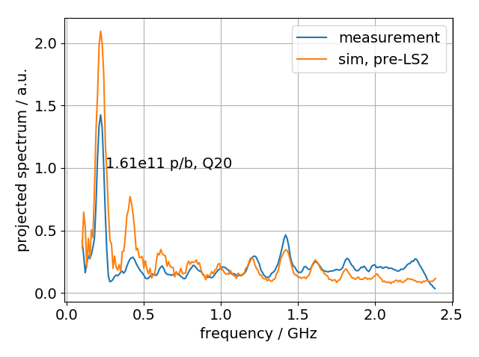
Long bunches: improved tomography
stronger peaks at 200 and 400 MHz in simulations
peaks at 1.4 and 1.8 GHz observed in simulations

Slide 18
Summary
Flat-bottom instability:
measured threshold reproduced in simulations
expect increase in threshold by ~20% and shorter filamented bunch length
Long bunches:
reproduced measurements in simulation
expect disappearance of 1.4 GHz peak and prominent peak at 800 MHz
I will gladly receive questions…
… and forward them to Ivan.Karpov@cern.ch!
Thank you for your attention and farewell!

Slide 19
Appendix
LIU-SPS BD WG meeting, 19/12/19

Slide 20
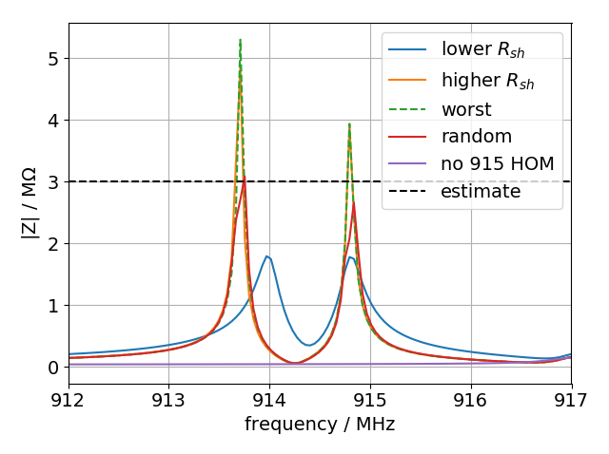
Models for 915MHz HOMs
lower R_{sh}: R_{sh}~2MΩ, Q~5k (in current longitudinal SPS impedance model)
higher R_{sh} (open boundary conditions): R_{sh}~5MΩ, Q~18k (see appendix for exact values)
worst case: higher R_{sh} model, where f_{r} of the two modes at (nearly) integer multiples of f_{rev} (next slide)
random: each cavity HOM (4 3-sections, 2 4-sections) has f_{r} randomly shifted by ±50kHz
‘higher R_{sh} model’ has larger R_{sh}, but reduced R/Q compared to ‘lower R_{sh}’ model
3MΩ estimate from fixed target beam (I. Karpov, LIU-SPS BD WG meeting)

Slide 21
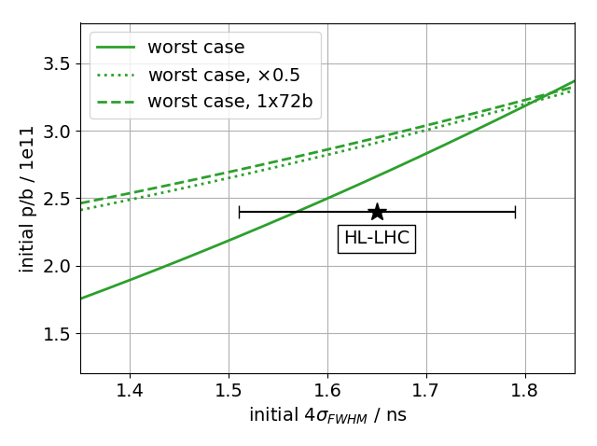
Damping 915 MHz HOM
4x72b, flat top, V₈₀₀/V₂₀₀=0.16, including voltage limitation due to beam loading
factor 2 reduction of R and Q (R/Q=const) yields single batch threshold

Slide 22
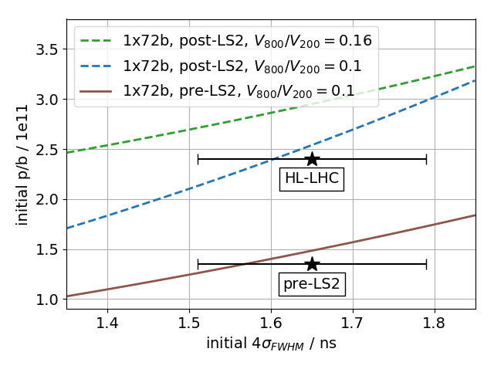
Single batch thresholds, pre- and post-LS2
1x72b, pre-/post-LS2 impedance model, V₂₀₀=7,10 MV, beam loading limitation included (750kW pre-LS2)

