Slide 1
Update on the effect of the 940 MHz resonance from the RF200 MHz cavities on the SPS horizontal beam stability
E. Métral, G. Rumolo, B. Salvant, C. Zannini
S. Antipov, H. Bartosik, A. Farricker, P. Kramer, N. Nasresfahani, C. Vollinger

Slide 2
PyHEADTAIL multi-bunch simulation with and without HOM at 939.45 MHz
Simulation without HOM
SPS impedance (wall and kickers)
Damper
Simulation with HOM
SPS impedance (wall and kickers)
Damper
Resonator at 939.45 MHz. Scan of Q and R to investigate different scenarios

Slide 3
R/Q threshold as function of R
$τ_{0}$ growth time without HOM
$τ_{1}$ growth time with HOM
$\frac{τ_{0}}{τ_{1}}<1.01$ (1% threshold)
$\frac{τ_{0}}{τ_{1}}<1.1$ (10% threshold)
Several simulations have been performed
R swept from 19 MΩ/m to 158 MΩ/m
For each R several Q values have been simulated to estimate the threshold

Slide 4
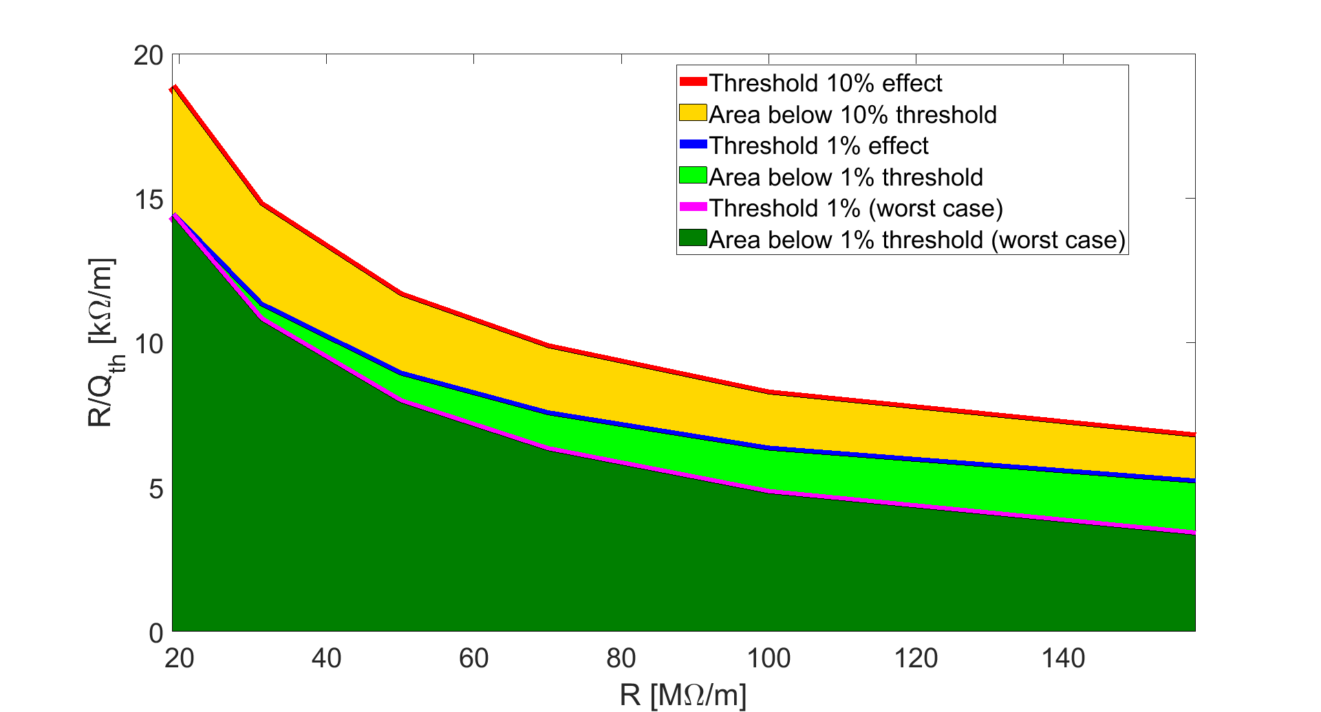
R/Q threshold as function of R

Slide 5
Open questions
Cavity impedance fits into the stable area?
What about the fixed target beam?

Slide 6
Open questions
Cavity impedance fits into the stable area?
What about the fixed target beam?

Slide 7
R/Q threshold as function of R
A. Farricker, C. Vollinger, E. Shaposhnikova, E. Montesinos, H. Damerau, M. Schwarz, N. Nasresfahani, P. Kramer, R. Calaga. Decision on initial HOM coupler configuration for 3 and 4 section cavities. Presented at the SPS RF upgrade coordination meeting , 19-07-2019
Terminations (FPCs are terminated with short) |  |  |  |  |  | Terminations (FPCs are terminated with load)
3-section |  |  | 4-section |  |  | 3-section |  |  | 4-section
Freq (MHz) | Rx (MΩ/m) | Rx/Q (kΩ/m) | Freq (MHz) | Rx (MΩ/m) | Rx/Q (kΩ/m) | Freq (MHz) | Rx (MΩ/m) | Rx/Q (kΩ/m) | Freq (MHz) | Rx (MΩ/m) | Rx/Q (kΩ/m)
939.1 | 4*17.5 | 4*1.81 | 939.2 | 2*146.4 | 2*2.6 | 938.7 | 4*2.18 | 4*1.33 | 938.9 | 2*3.85 | 2*1.35
939.9 | 4*33.31 | 4*0.66 | 939.67 | 2*157.8 | 2*2.7 | 939.6 | 4*2.75 | 4*1.26 | 939.67 | 2*14 | 2*3
 |  |  |  |  |  |  |  |  | 940 | 2*6 | 2*0.97

Slide 8
R/Q threshold as function of R
Expected trend when adding the effect of other modes

Slide 9
Open questions
Cavity impedance fits into the stable area?
What about the fixed target beam?

Slide 10
Fixed target beam parameters
Nppb = 1e10
Bunch spacing = 5 ns
Number of bunches = 4200
RF voltage = 1.5 MV
Injection momentum = 14 GeV/c
Bunch length (4σ) = 4 ns
momentum compaction factor = 0.001928
tunes x/y = 26.62/26.58
Chromaticity = -0.1

Slide 11
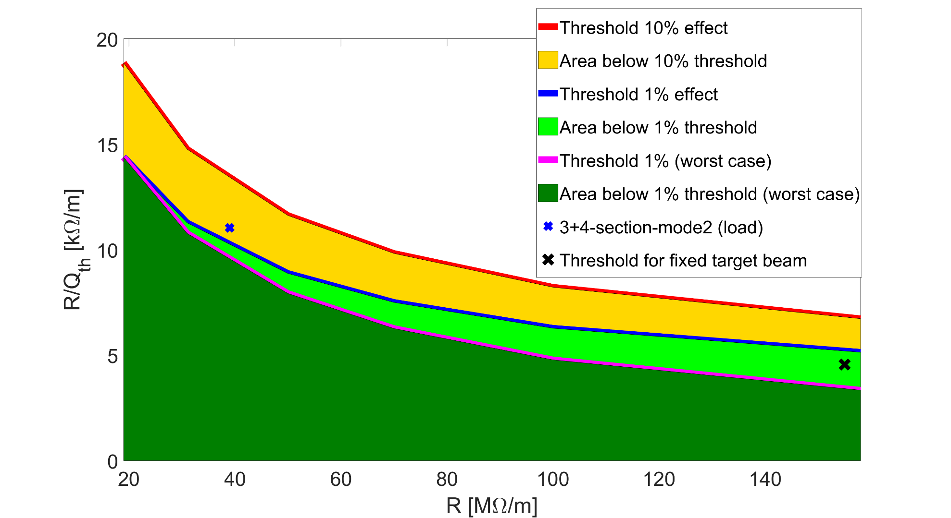
R/Q threshold as function of R

Slide 12
Summary
Based on the numbers presented at the SPS RF upgrade meeting on 19.07.2019 the cavity horizontal HOM impedance could be critical for LHC beam stability
How this impedance compare with the pre-LS2 case?
Transverse damping scheme should not be relaxed
The impedance threshold is not expected to be significantly reduced with fixed target beam.

Slide 13
Thank you for your attention

Slide 14
Appendix

Slide 15
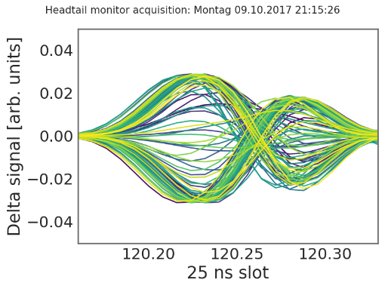
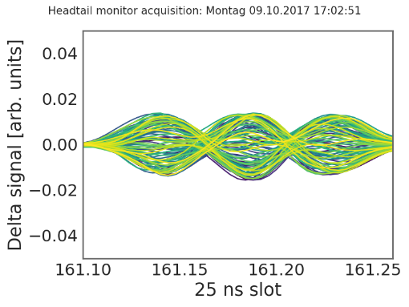
Multi-bunch horizontal instability observed during run II
ξ_{H}~0.1–0.2
2018 MDs observations
Stable with 1 batch at 2e11
Unstable with 4 batches at 2e11 with BS = 200ns
Mode1 or Mode2 instability depending on chroma
Stabilization at chromax about 0.6
Stabilization with batch spacing >500 ns
Some stabilization with octupoles
Instability threshold at about 1.8e11
ξ_{H}~0.3–0.5
Development of a dedicated model for multi-bunch simulations
Important to use analytical models to minimize numerical artefacts
Stabilization above 2.1e11 ppb not evident during 2018 MDs

