Slide 1
Effect of 915 MHz HOM on fixed target beam (longitudinal)
Ivan Karpov
Acknowledgments:
Elena Shaposhnikova, Giulia Papotti, Markus Schwarz
LIU-SPS BD WG meeting, 21.11.2019

Slide 2
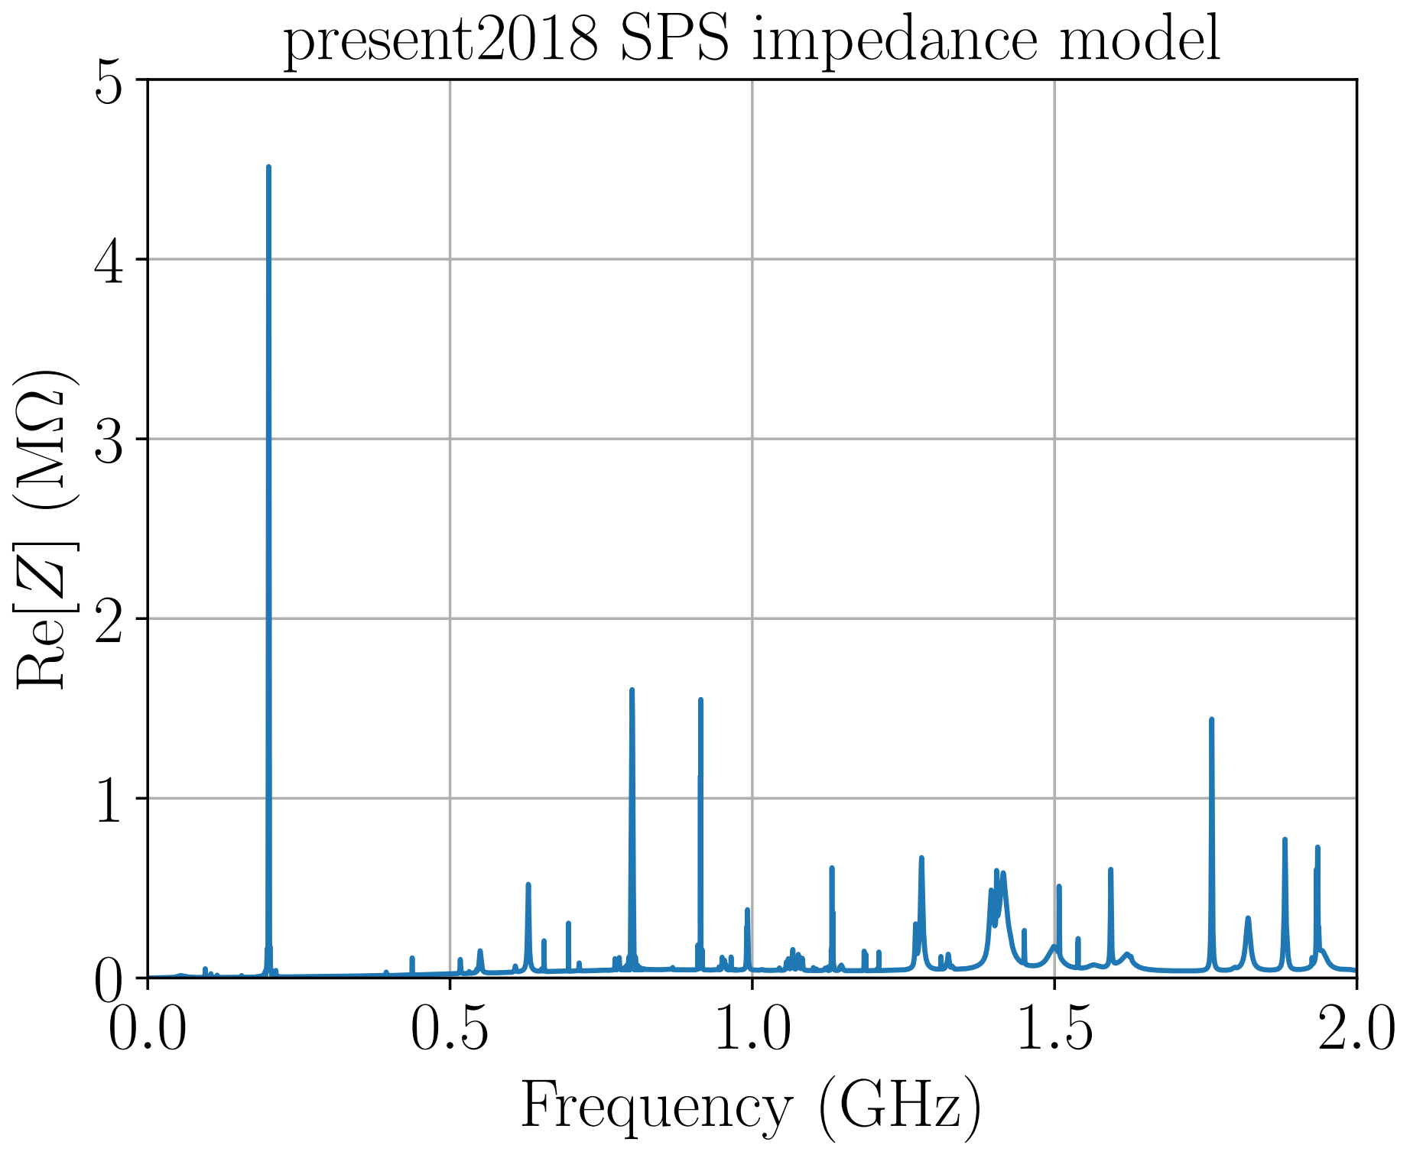
Longitudinal instabilities of fixed target beams
Higher-Order-Mode (HOM) at 915 MHz can potentially drive coupled bunch instability due to high quality factor (above 3000). Already seen in simulations for 4 LHC batches (M. Schwarz).
For fixed target beam, the effect could be even stronger. Indeed, the line in the unstable beam spectrum was observed for total number of protons around $4×{10}^{12}$ (E. Shaposhnikova, 1999).
For $≈4000$ bunches macro-particle simulations are computationally expensive.
→ Analytical approach based on Lebedev equation (A. N. Lebedev, 1967) and corresponding stability diagrams (V. Balbekov, S. Ivanov, 1987) is used to evaluate instability thresholds

Slide 3
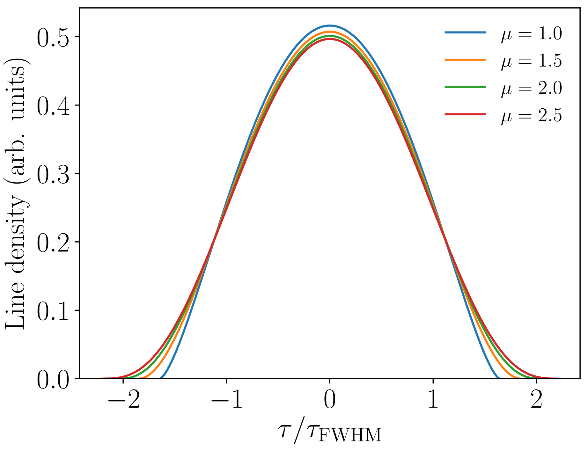
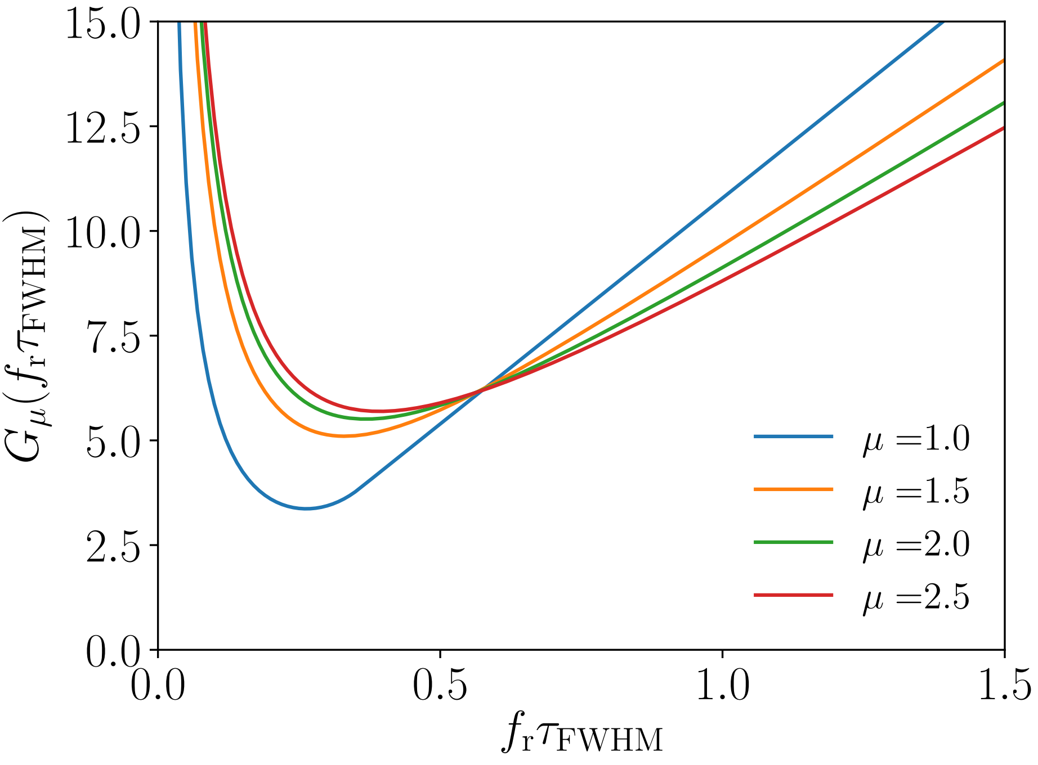
Threshold of longitudinal CBI
Assumptions:
Single rf system (no 800 MHz was used)
Uniformly filled machine ($M$ bunches)
Short bunches (asymmetry is neglected for $φ_{s}≠π$)
$Δf_{r}=\frac{f_{r}}{2Q}≪\frac{1}{t_{bb}}, and Δf_{r}≪\left|f_{r}−\frac{k}{2t_{bb}}\right|$
$$τ_{FWHM}=$$
$$τ_{full}\sqrt{1−2^{\frac{2}{2μ+1 }}}$$
$$λ\left(τ\right)∝{\left[1−{\left(\frac{2τ}{τ_{full}}\right)}^{2}\right]}^{μ+1/2}$$
For binomial distribution, line density is
Threshold:
$$R_{sh}<\frac{V_{rf }{\left(πf_{rf}τ_{full}\right)}^{3}}{32MeN_{p}f_{0}}χ\left(φ_{s}\right)G_{μ}\left(f_{r}τ_{full}\right)$$
$$G_{μ}\left(x\right)=\frac{x}{μ\left(μ+1\right)}\min_{y∈\left[0,1\right]}{{\left[{\left(1−y^{2}\right)}^{μ−1}J_{1}^{2}\left(πxy\right)\right]}^{−1} }$$
$$χ\left(φ_{s}\right)=−\cos{φ_{s}}\left(1+\frac{5}{3}\tan^{2}{φ_{s}}\right)$$
We need evolution of parameters through the cycle

Slide 4
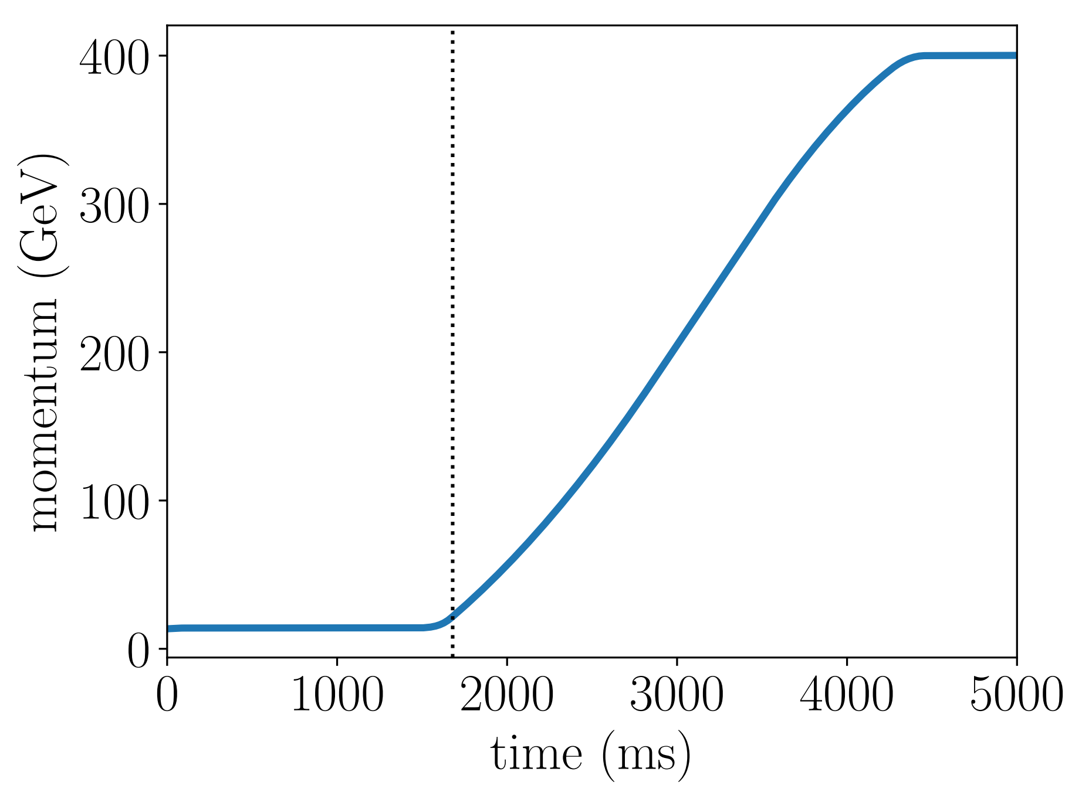
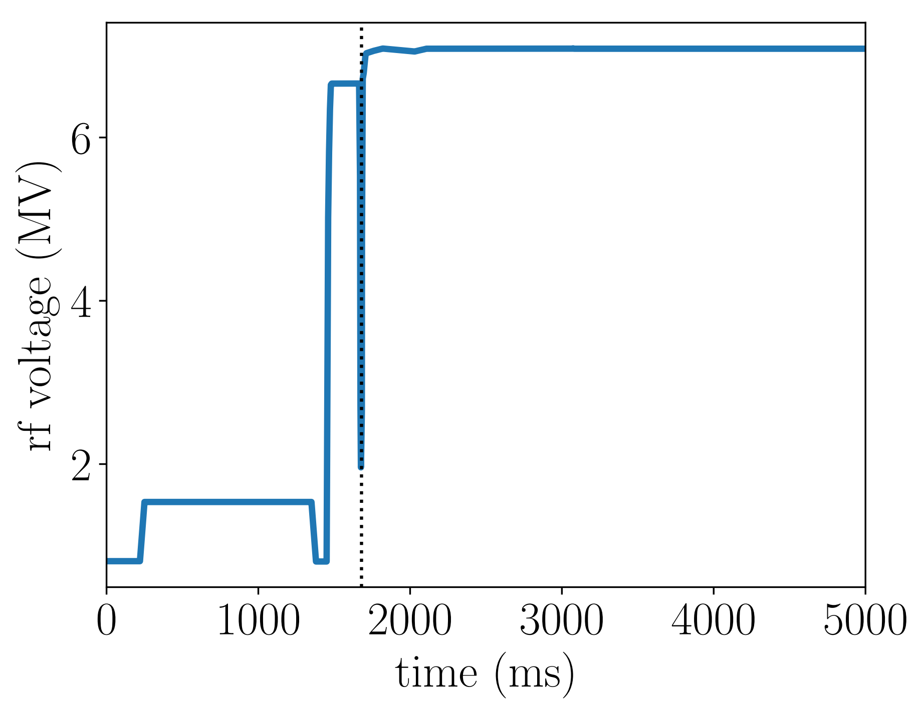
Beam and rf parameters during cycle
Voltage increase to avoid losses after emittance blow-up
Transition crossing
$$p_{s}$$
$$V_{rf}$$
Transition crossing
Injection of batch 1
Injection of batch 2

Slide 5
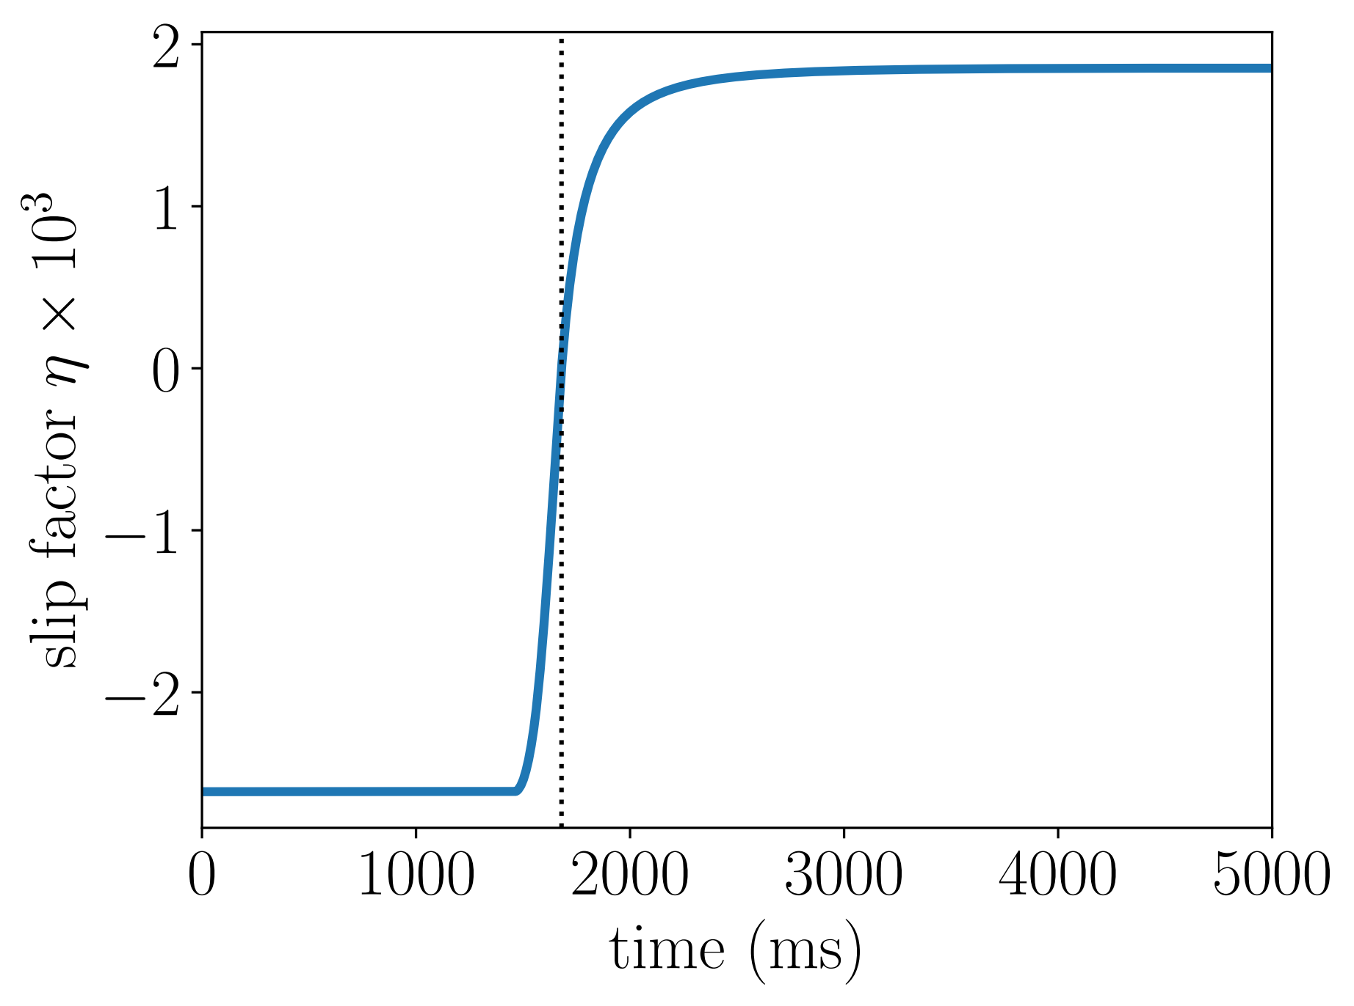
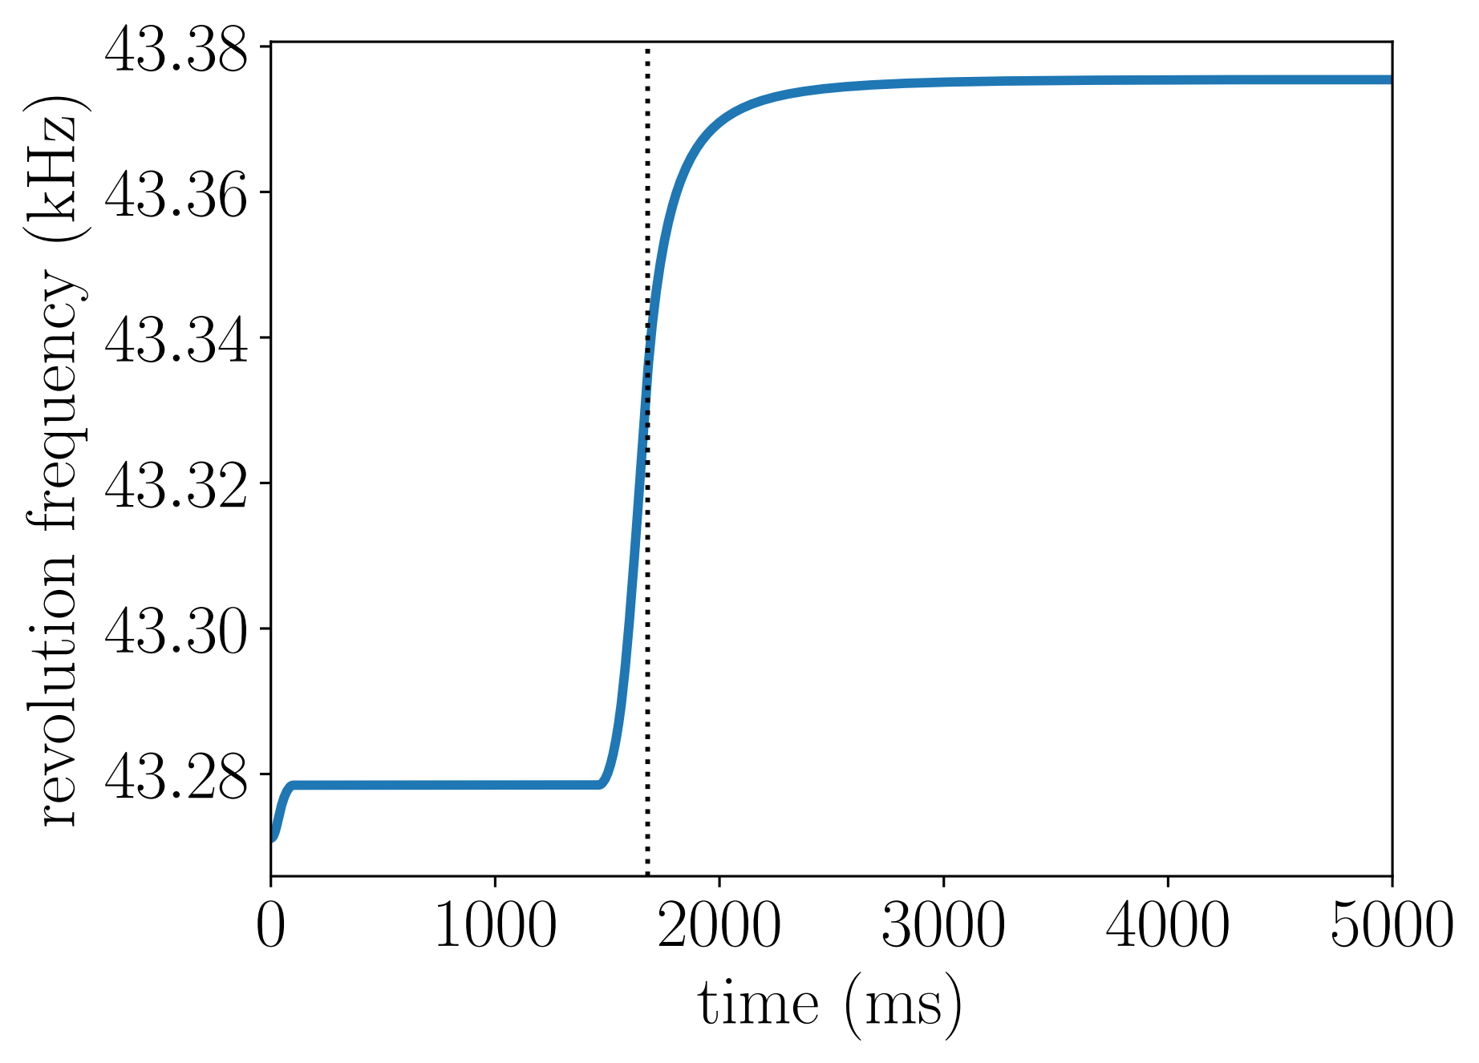
Beam and rf parameters during cycle
Transition crossing
Transition crossing
$$f_{0}$$
$$η$$

Slide 6
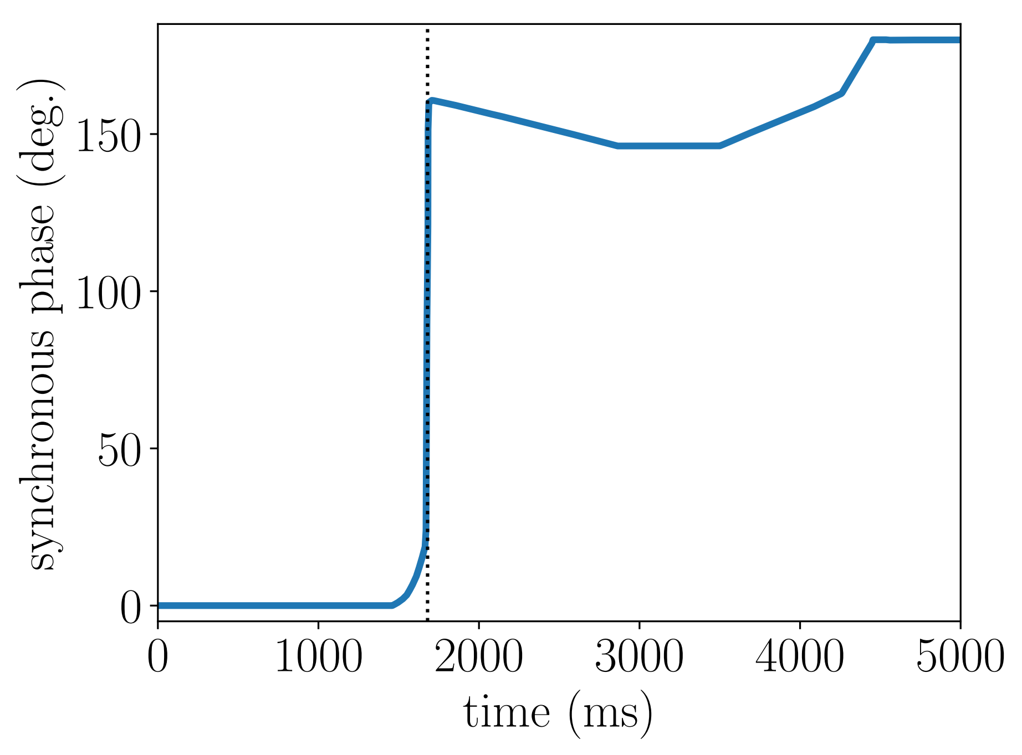
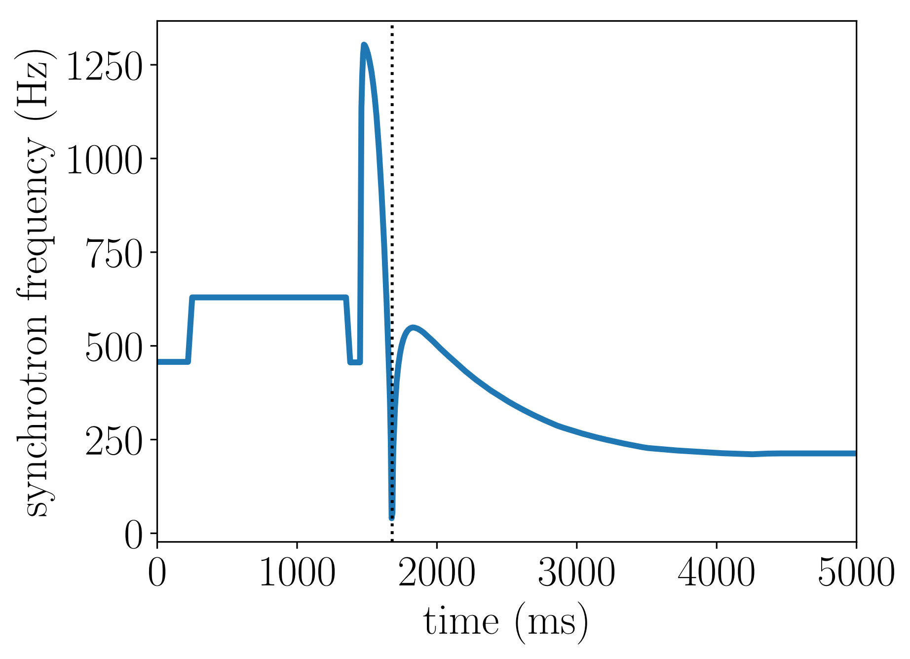
Beam and rf parameters during cycle
Transition crossing
Transition crossing
$$f_{s}$$
$$φ_{s}$$

Slide 7
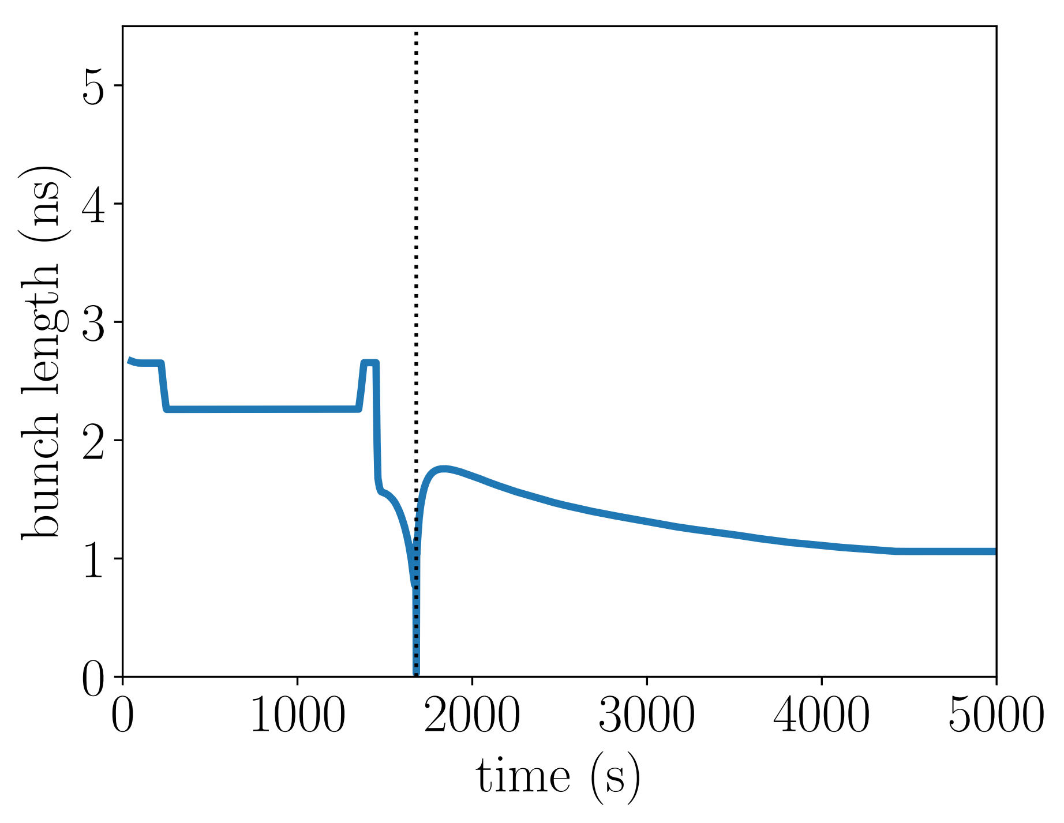
Bunch length during cycle
(E. Shaposhnikova, LIU-SPS collimation review, 2013)
Bunch length is defined by emittance and V
For calculations, there is big uncertainty due to unknown particle distribution and blow-up during transition crossing
Batch 1
CNGS cycle
$$MN_{p}=3.6×{10}^{13}$$
Batch 2
In short bunch approximation, the length of equivalent Gaussian bunch is
$$τ_{4σ}=\frac{2}{\sqrt{2\ln{2}}}τ_{FWHM}=\sqrt{\frac{2\left|η\right|ε_{2σ}}{π^{2}f_{s0}β^{2}E}}$$
To fit bunch length in observations, $ε_{2σ}=0.085$ eVs is assumed before transition and after transition emittance blows up by factor of 3

Slide 8
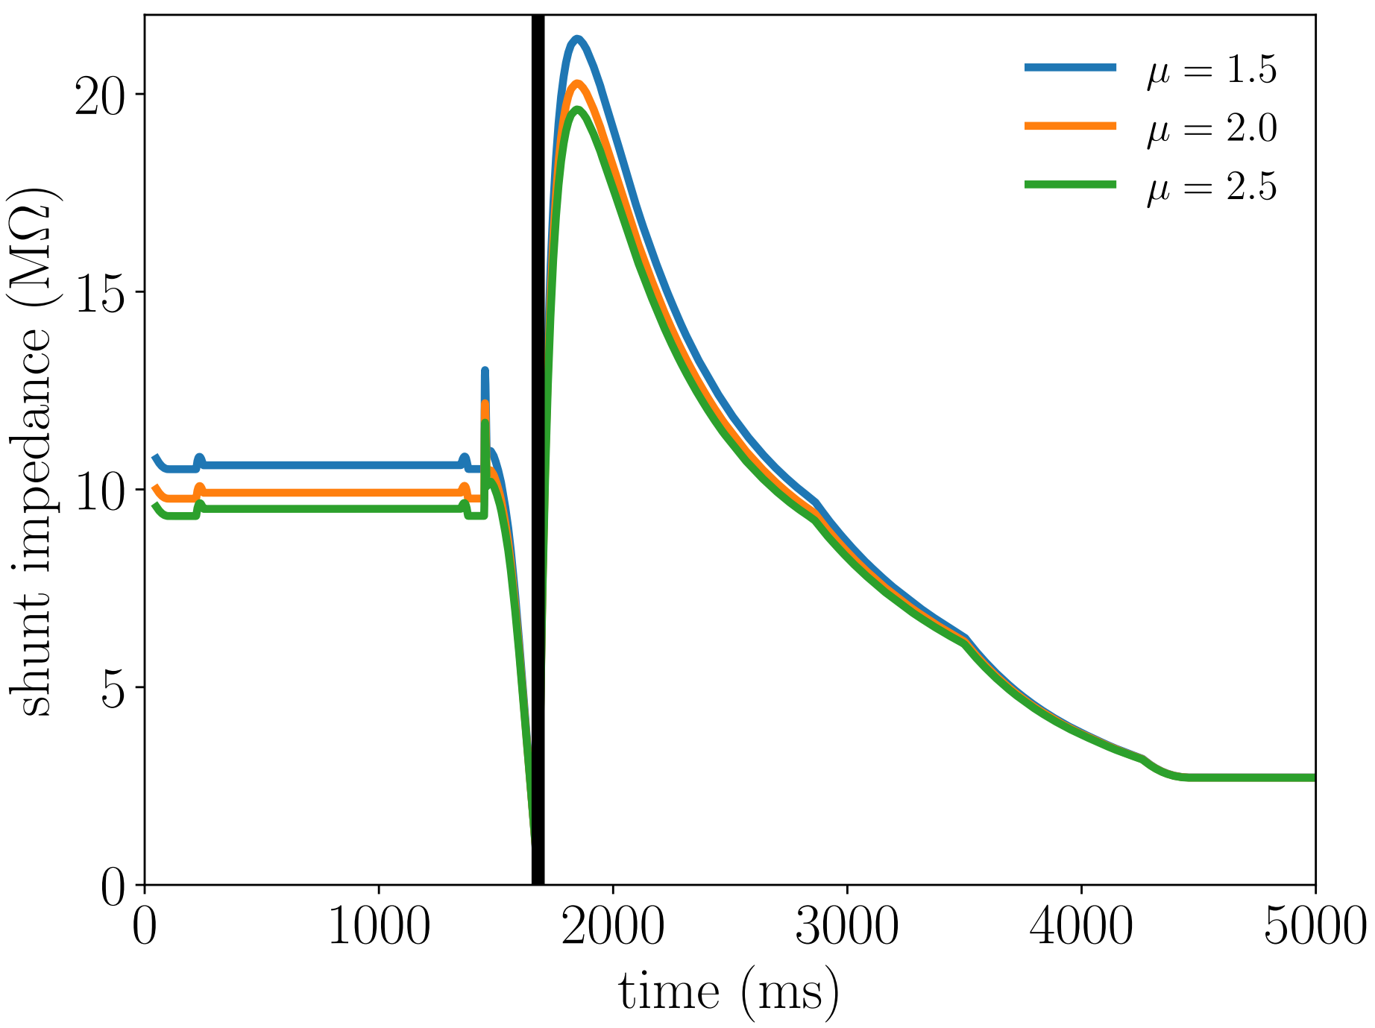
Thresholds during cycle for 915 MHz HOM
Total intensity $hN_{p}=4.4×{10}^{12}$
Thresholds approach to zero before and after transition crossing
Towards the end of acceleration $R_{sh}^{thr}≈3 MΩ$
Thresholds are 10 times lower for nominal intensity

Slide 9
Summary
Thresholds of longitudinal coupled bunch instability during the cycle were evaluated:
Analytical calculations confirm very low intensity threshold due to 915 MHz HOM for fixed target beam observed in measurements.
Absolute threshold depends on assumptions about beam emittance and particle distribution
Next steps:
To which intensity stabilization with 800 MHz rf system can be achieved?
Use of Q20 optics?

Slide 10
Thank you for your attention!

Slide 11
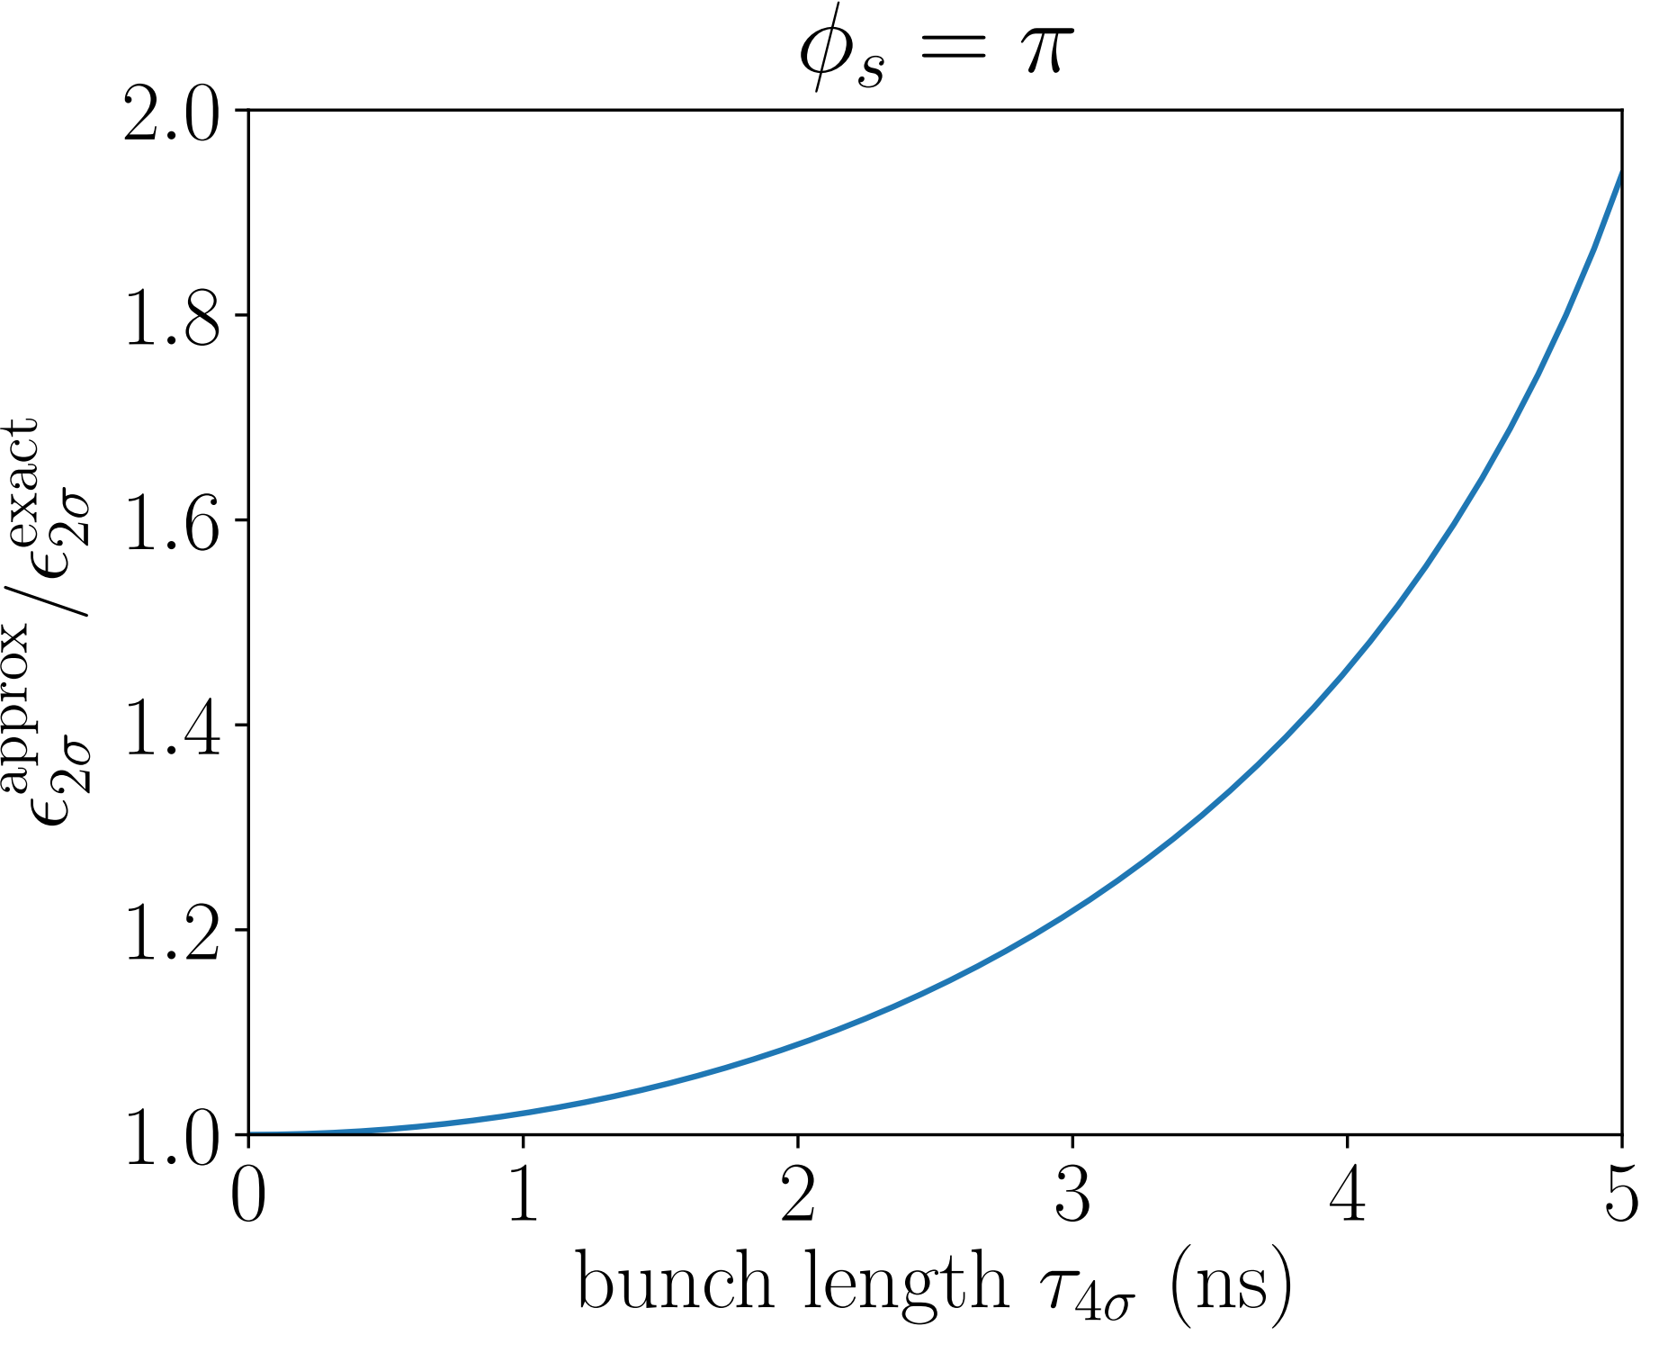
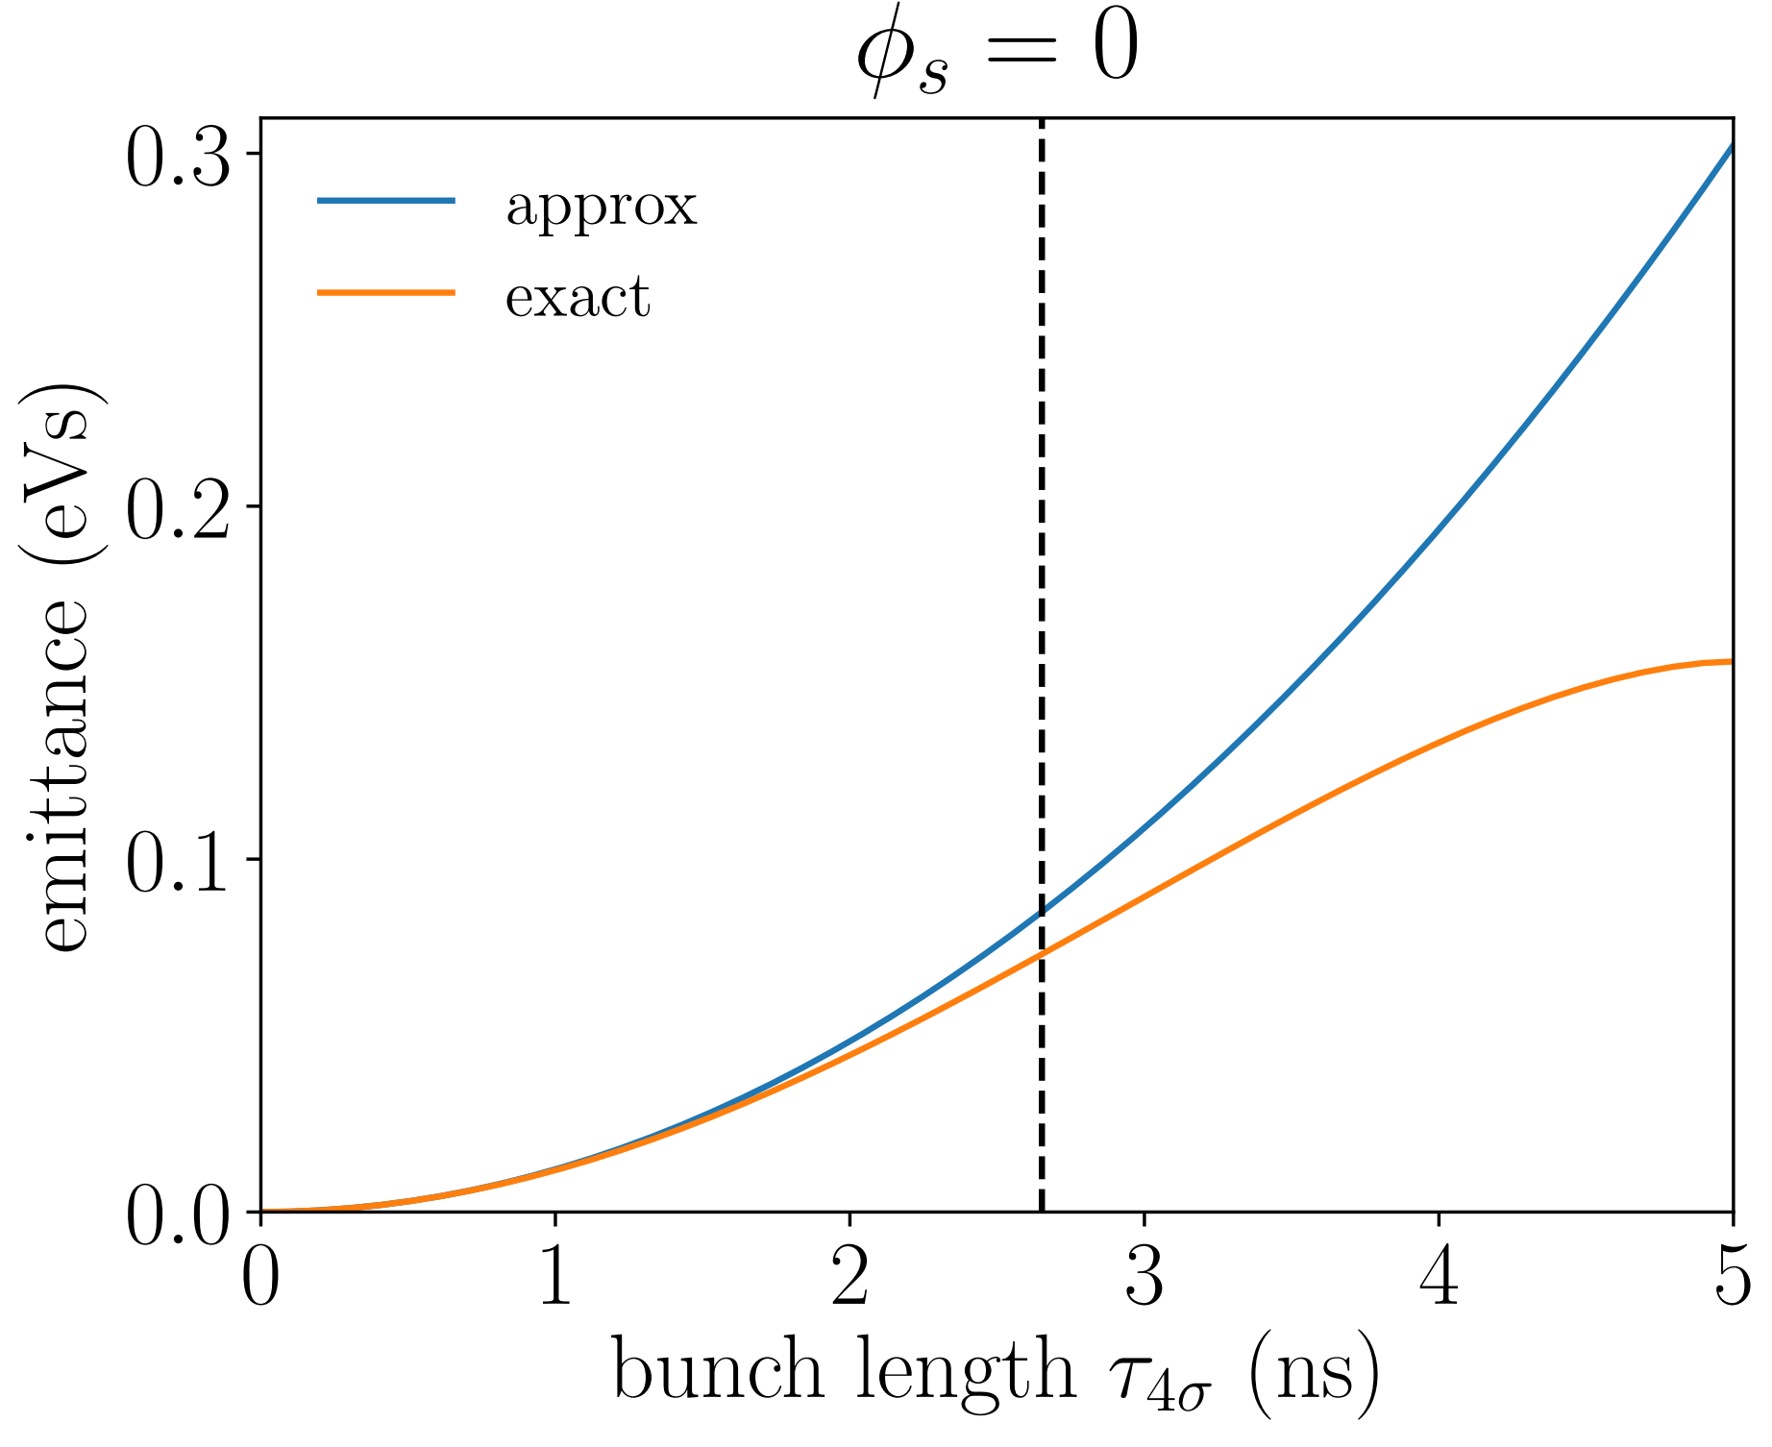
Approximate vs exact emittance
Parameters at injection

Slide 12
Parameters during cycle

