Slide 1
SPS- LHC Energy Matching
V. Kain, K. Li, J. Wenninger
12. September

Slide 2
Motivation
LHC capturing with larger voltage than matched to avoid capture losses while allowing for significant energy mismatch between SPS and LHC
But: power consumption might become limiting with HL-LHC

Slide 3
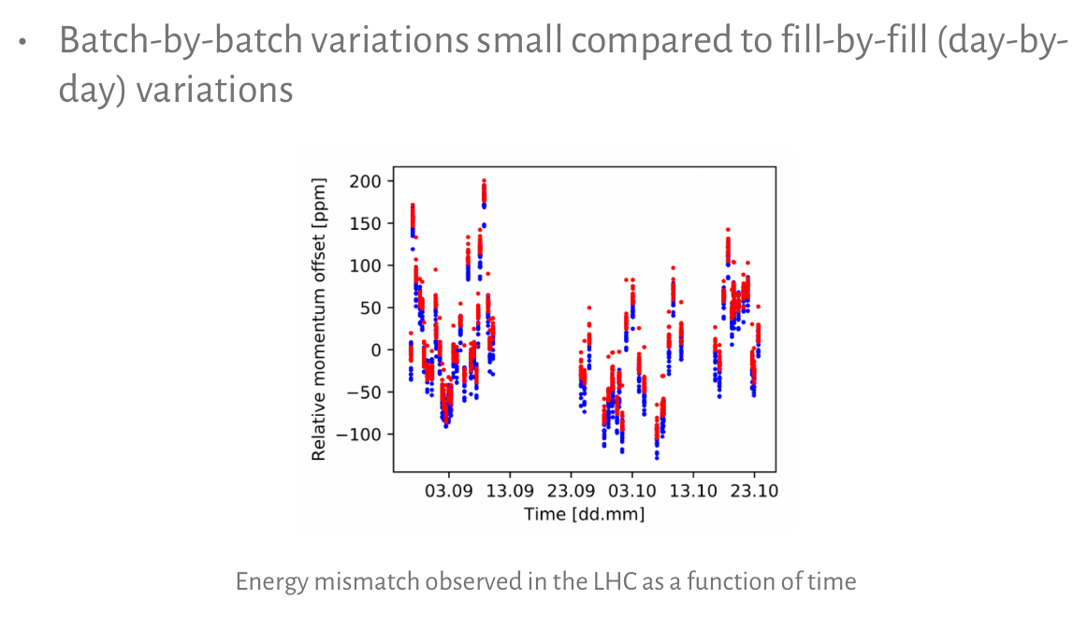
From H. Timko SPS to LHC energy matching
https://indico.cern.ch/event/809651/

Slide 4
From H. Timko SPS to LHC energy matching
https://indico.cern.ch/event/809651/

Slide 5
What is almost for free?
Active energy mismatch damping in SPS and/or LHC operation
Identification of the source? ← work on this as well during 2021, specifically we will investigate SPS bends, temperature dependence, tides, etc.
Fill-by-fill correction (using e.g. 12 b) could be tested in the LHC in 2021 ← this is what we propose
Passive damping: longitudinal damper using LHC ACS cavities
Bandwidth and damping achievable?
Reviewing thresholds
Review BLM dump thresholds at capture and start of ramp

Slide 6
Proposal
Fill-by-fill measurement on 12 bunches and, depending on threshold, feedforward correction with calculated value from IQC.
Use either synchro error or injection oscillation (wrt to orbit) of first octant
Can correct for beam 1 and beam 2 individually.
Correction done with YASP (currently use as input synchro error) using orbit correctors

Slide 7
YASP has all the required functionality
Slides by Jörg for 2015 training

Slide 8
YASP has all the required functionality
Slides by Jörg for 2015 training

Slide 9
Side-effects
Energy change (due to simulated “main field” change) → tune change, that needs to be compensated
To be able to start the ramp: the current machine settings need to correspond to the first point of the ramp function
→ need to incorporate
Proposal
→ After injection is finished revert orbit corrector and tune trims
And then start ramp…

Slide 10
Summary
Propose to use the orbit correctors in the LHC to follow energy drifts on a fill-by-fill basis
Correct with the 12 bunch injection
All ingredients are already available. Tests should be carried out with systems as they are (semi-manual)
Only IQC thresholds to be added.
After test phase and positive experience: investigate automation of various steps
Additional recommendations:
Review BLM thresholds for capture losses in the LHC
Investigate source of energy changes.

