Slide 1
Update on synchronous phase measurements
M. Schwarz
Acknowledgements:
A. Farricker, I. Karpov, A. Lasheen, E. Shaposhnikova, G. Papotti, PS & SPS operators

Slide 2
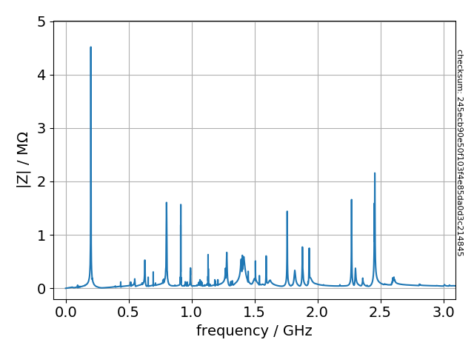
SPS impedance and synchronous phase
Resistive impedance leads to energy loss
The synchronous phase of the bunch shifts, to compensate for energy loss
Measurements of the synchronous phase can be used to test the SPS impedance model
First performed in 2003 [E. Shaposhnikova, EPAC 2004, WEPLT036]
Measurements in 2018 with two bunches spaced 1.5μs apart (first bunch has low intensity)

Slide 3
Measurement of synchronous phase
To obtain reference phase, use leading bunch of (smaller) intensity as reference, with trailing bunch separated by ~1.5μs
Obtain bunch position and bunch length
from FWHM
by fitting to a ‘binomial-μ’ profile
Obtain relative phase by $∆φ=\frac{2π}{T_{RF}}\left({\text{pos}}_{1}−{\text{pos}}_{0}\right)\%T_{RF}$
For absolute phase, assume same distribution (i.e. bunch length) $φ_{1}=\frac{Δφ}{N_{1}−N_{0}}N_{1}$

Slide 4
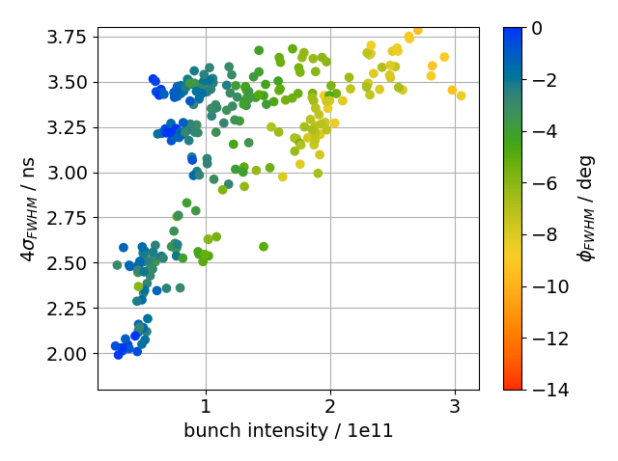
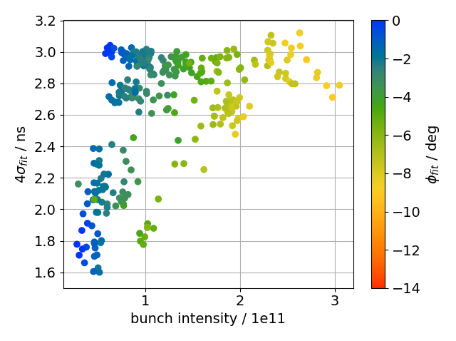
Measurement of synchronous phase
Qualitative expected behavior: larger shift for higher intensity or shorter bunch length
Different bunch lengths obtained from FWHM or by fitting to a ‘binomial-μ’ profile

Slide 5
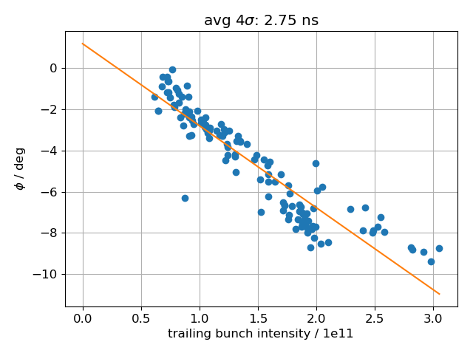
Measured energy loss
$\sin\left(φ_{s}\right)=\frac{U_{0}}{e V}≅φ_{s}$
Bunch: $U(N,σ)=eV φ_{s}(N,σ)$
For same bunch shape ($σ=const$):
$$U\left(N\right)=eV φ_{s}\left(N\right)≅eV \text{slope} N$$
Normalized energy loss per particle $\overline{U}$:
$$\overline{U}=U/{N/{10}^{10}}={10}^{10}eV \text{slope}$$
Bin data with respect to bunch length (10 bins of width ±200ps)
Obtain ‘slope’ from linear fit

Slide 6
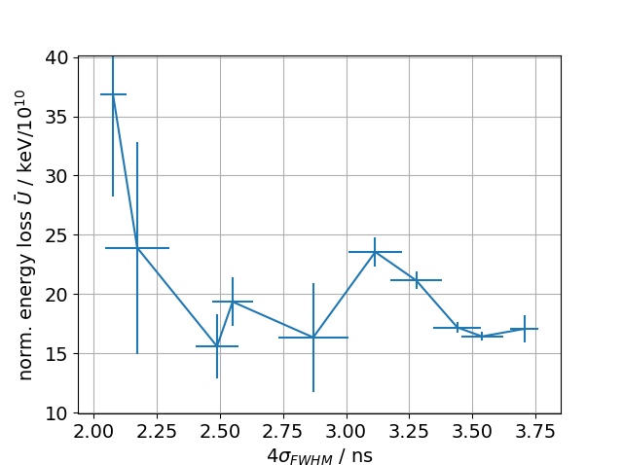
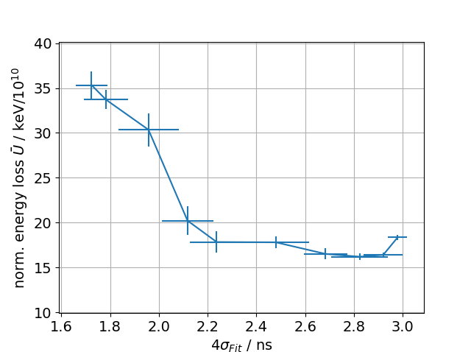
Measured energy loss
Both methods give similar energy loss, but
energy loss $\overline{U}$ obtained from FWHM has ‘peak’ for large bunch lengths, whereas $\overline{U}$ from fitting to a ‘binomial-μ’ profile shows a plateau

Slide 7
Comparing to impedance model
Textbook equations don’t give correct answers (tested for simplified impedance model, see appendix); reason still under investigation
Use BLonD to create matched distributions:
Fit ‘binomial-μ’ profile to measured profiles
Use ‘matched_from_line_density’ function to create ‘binomial-μ’ distribution with same parameters as measured profile, matched using the SPS impedance model
Track for 1000 turns (~12 synchrotron periods)
Do same data analysis on simulated profiles as with measured profiles

Slide 8
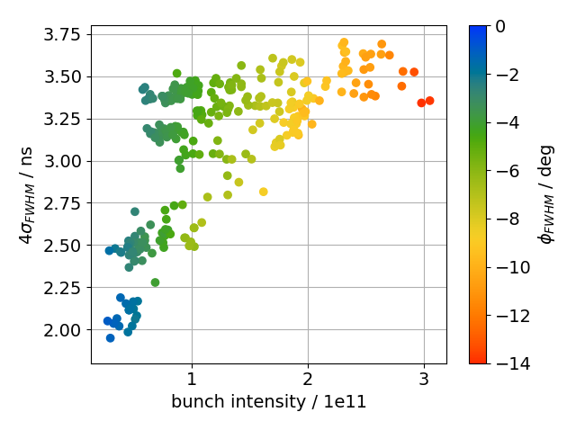
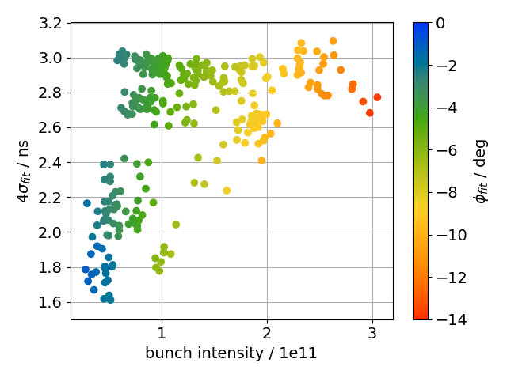
Simulation of synchronous phase
Qualitative expected behavior: larger shift for higher intensity or shorter bunch length
Different bunch lengths obtained from FWHM or by fitting to ‘binomial-μ’ profile

Slide 9
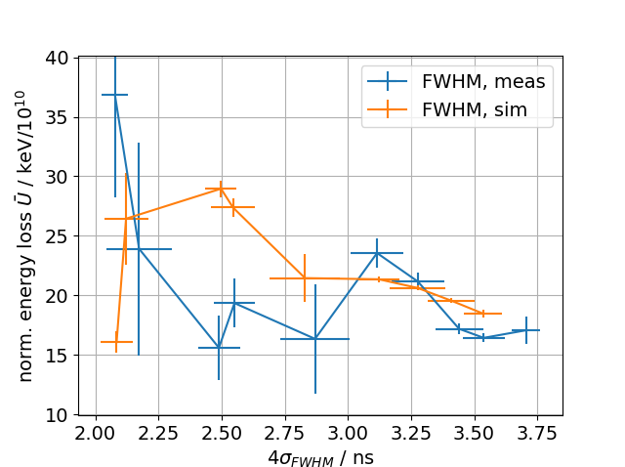
Measured vs simulated energy loss
No trend when comparing measured and simulated energy loss obtained from FWHM data

Slide 10
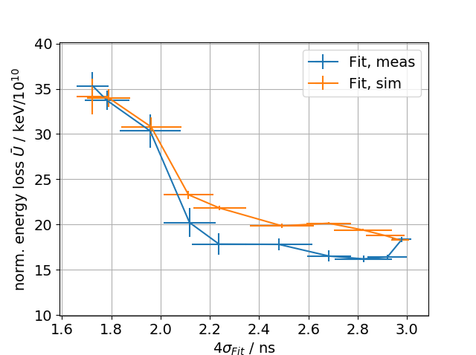
Measured vs simulated energy loss
No trend when comparing measured and simulated energy loss obtained from FWHM data
Shapes of measured and simulated energy loss obtained from fitting to ‘binomial-μ’ profile agree well. Higher simulated energy loss for large bunch lengths

Slide 11
Summary
Two methods were used to obtain bunch position and bunch length (either FWHM or fitting to a ‘binomial-μ’ profile); both for measured and simulated profiles
The impedence model was compared to measurements by creating matched bunches with same parameters as measured bunches
Using FWHM data does not give conclusive results
Using fit data gives qualitative and quantitative agreement (expect for large bunch lengths)
Next steps
Investigate why textbook equations give wrong results
Use ABWLM data
Thank you for your attention!

Slide 12
Comparison with simplified impedance model
Create matched bunch from ‘matched_from_line_density’ for a single resonator
Compute energy loss
from loss factor (see book by Zotter)
from synchronous phase shift with perturbation theory (see book by Ng)
‘Measure’ by computing average bunch position or position of maximum
obtain slope by fitting line to cases of same bunch length but different intensities

Slide 13
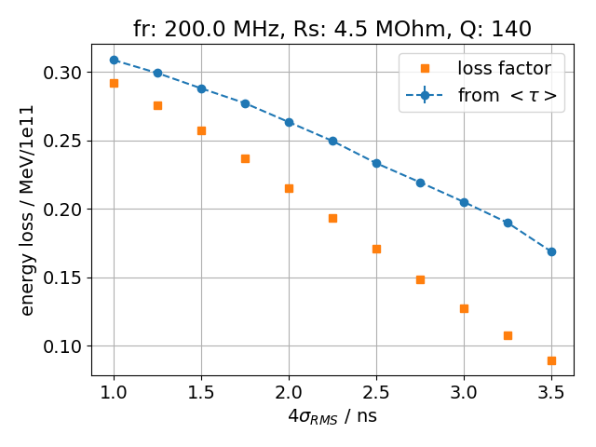
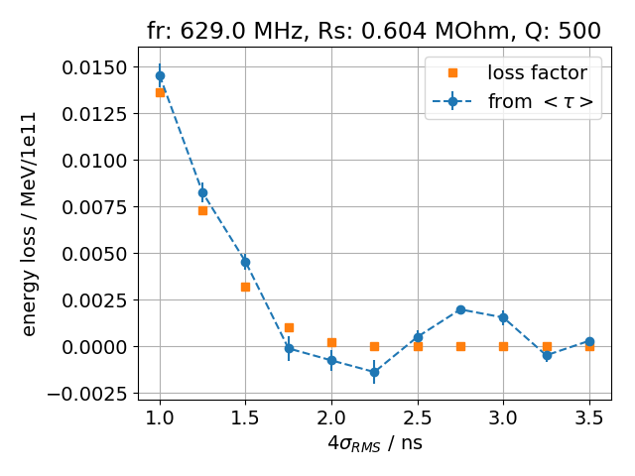
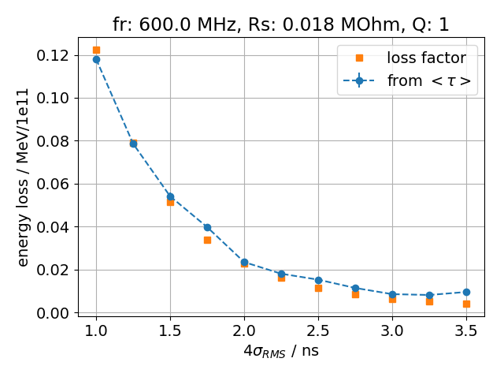
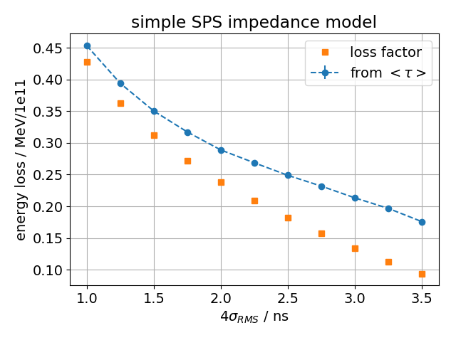
Comparison with simplified impedance model
Energy loss from average position agrees with ‘loss factor’ for HOM and Kickers, but not for fundamental TWC
TWC HOM
Kickers
TWC

Slide 14
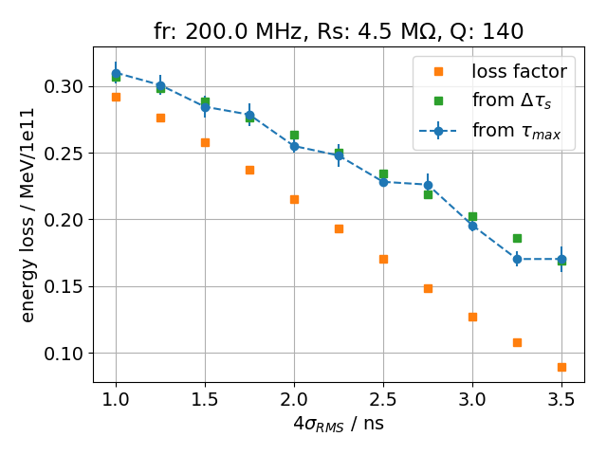
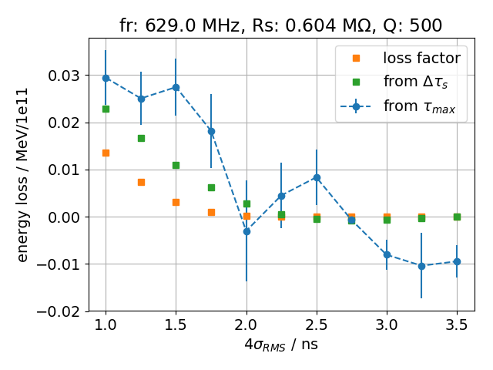
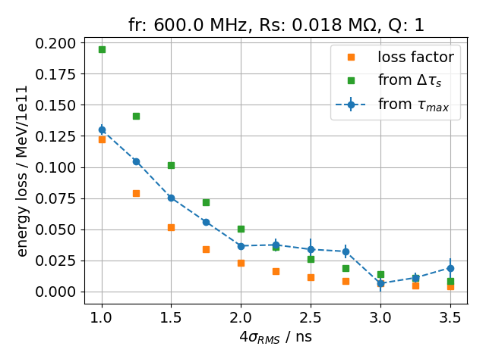
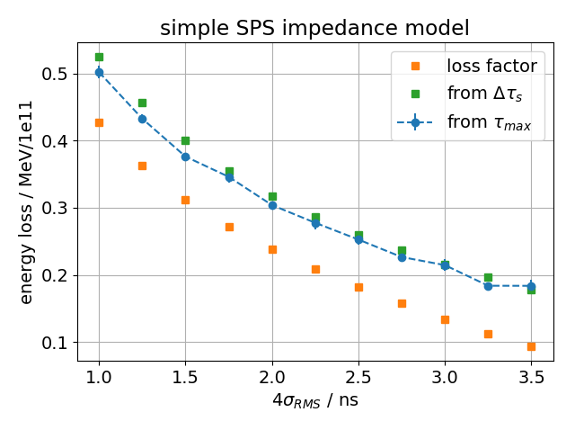
Comparison with simplified impedance model
Energy loss from maximum position agrees with synchronous phase shift for fundamental TWC, but not for HOM and Kickers
Kickers
TWC
TWC HOM

