Slide 1
Effect of 200 MHz TWC frequency shift on instabilities
M. Schwarz
Acknowledgements:
A. Farricker, A. Lasheen, G. Papotti, J. Repond, E. Shaposhnikova, H. Timko,
BLonD dev team
LIU-SPS BD WG meeting, 28 March 2019

Slide 2
Motivation
Previous simulations used model of 200 MHz TWC assumed resonant frequency at 200.222 MHz
But resonant frequencies of real cavities are shifted by [C. Vollinger et al.]
-90kHz for 5-section cavity
-127kHz for 4-section cavity
What is the impact of this frequency shift on (flat-bottom) instability?
Outline
Estimation based on coupled bunch theory
Simulations with 12 bunches
Comparison with measurements

Slide 3
Coupled bunch instability
Assume equally spaced bunches (full SPS with 25ns bunch spacing)
TWC impedance given by ‘Dome’ equation
For coupled bunch mode , frequencies are , ,
Fourier transform of unstable beam
For multipole , , distribution function
Here we use μ=2.5, τ=3ns, 1e11 ppb
Eigenvalue problem: ,
Growth rate of mode given by (negative implies growing mode)
[E. Shaposhnikova, CERN-SL-99-040-HRF, 1999]

Slide 4
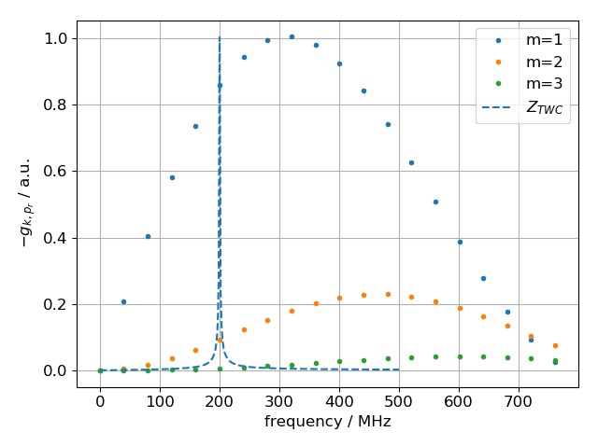
Coupled bunch instability
Eigenvalue problem:
For narrow resonance,
only two frequencies at contribute
Growth rates ,
Approximate growth rate:
[E. Shaposhnikova, CERN-SL-99-040-HRF, 1999]

Slide 5
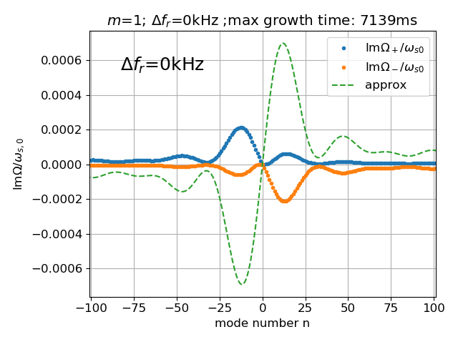
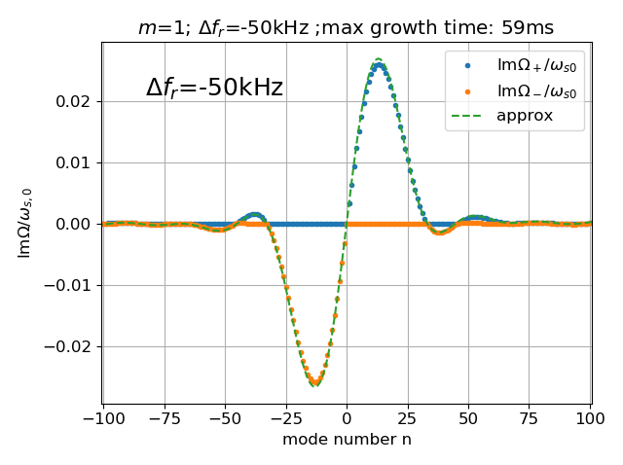
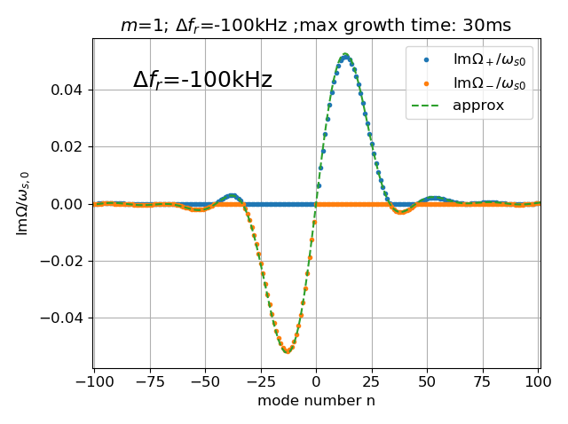
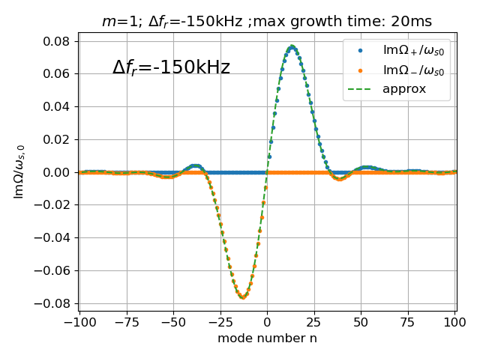
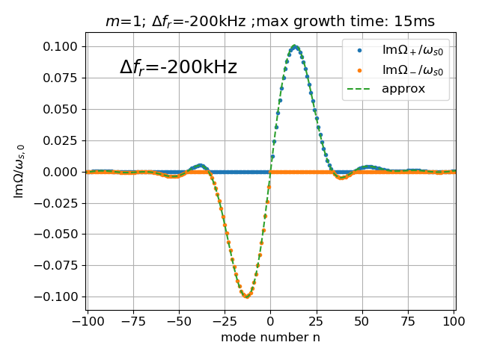
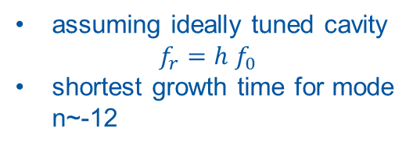
Growth rates, m=1
assuming ideally tuned cavity
$$f_{r}=h f_{0}$$
shortest growth time for mode
n~-12

Slide 6
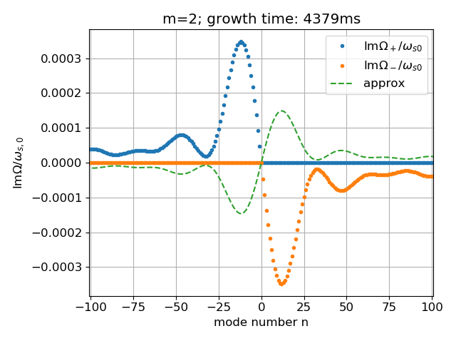
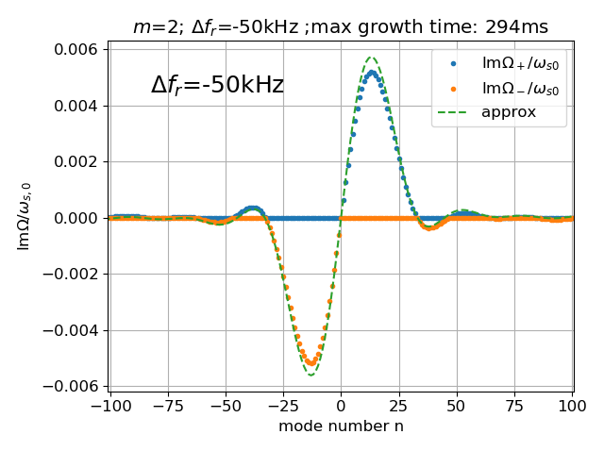
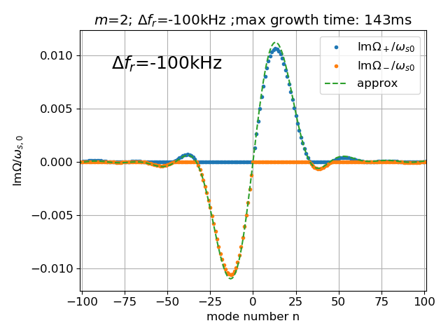
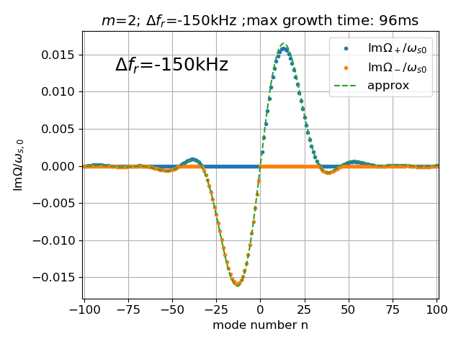
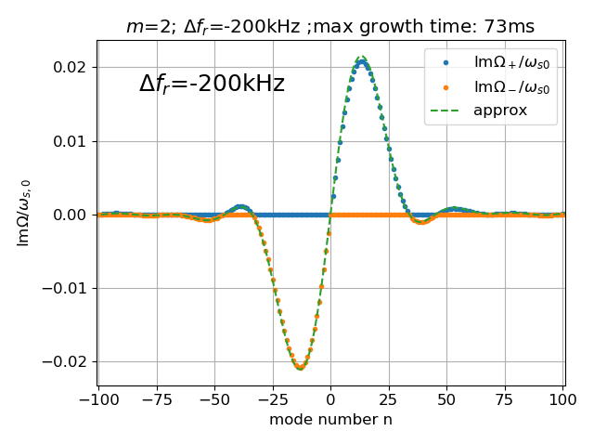
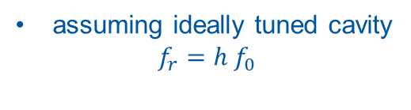
Growth rates, m=2
assuming ideally tuned cavity
$$f_{r}=h f_{0}$$

Slide 7
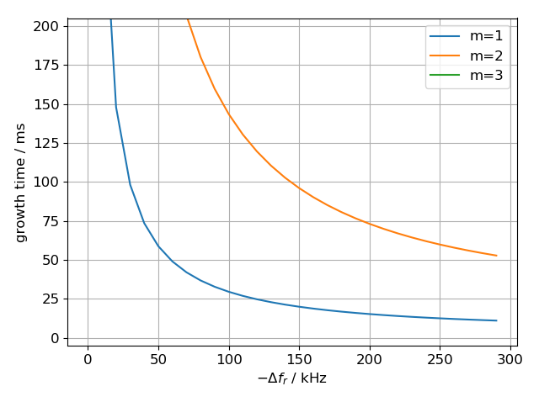
Instability growth times
Growth time of instability quickly decreases when cavity is detuned
Dipole mode (m=1) has the shortest growth time

Slide 8
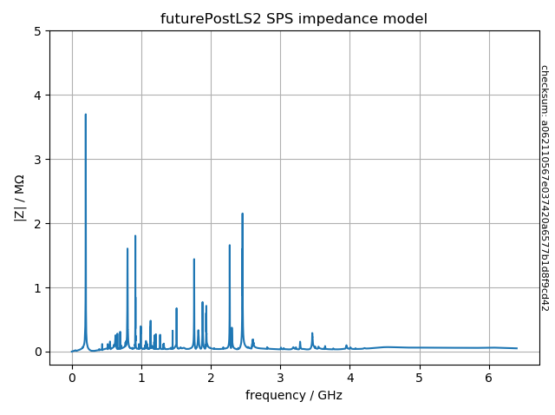
Simulation setup for BLonD
Initial bunches are obtained by simulating bunch rotation in the PS (no intensity effects) with fixed μ=2.0 (BLonD convention) and varying emittance
2 million macro-particles per bunch;
12 bunches
Include frequency shift of 200 MHz TWC
(frequency shift of 0 kHz corresponds to
f_{r} of 200.222 MHz)
Present case:
  -90 kHz for 5-section cavity
  -127 kHz for 4-section cavity
Use full SPS impedance model
Phase loop; no feedback
V₂₀₀=4.5 MV, Q20, at flat bottom
https://gitlab.cern.ch/longitudinal-impedance/SPS/tree/clean-up

Slide 9
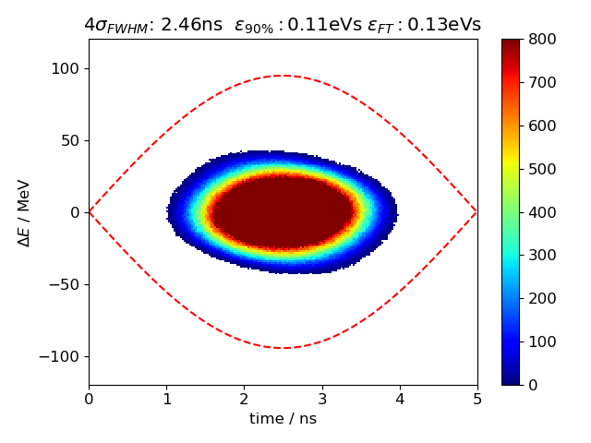
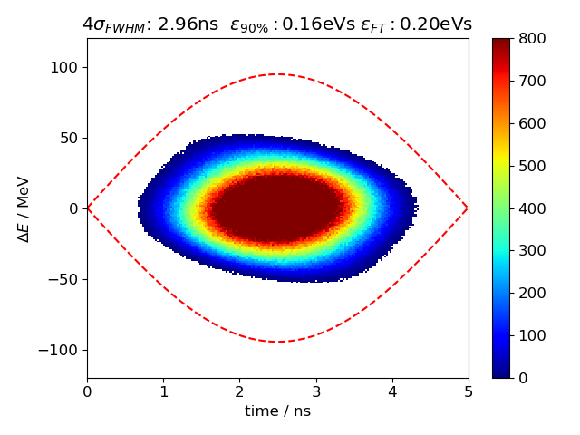
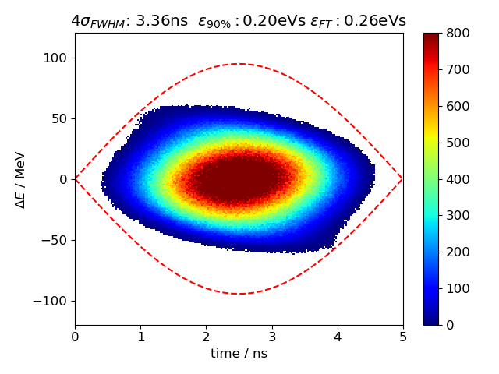
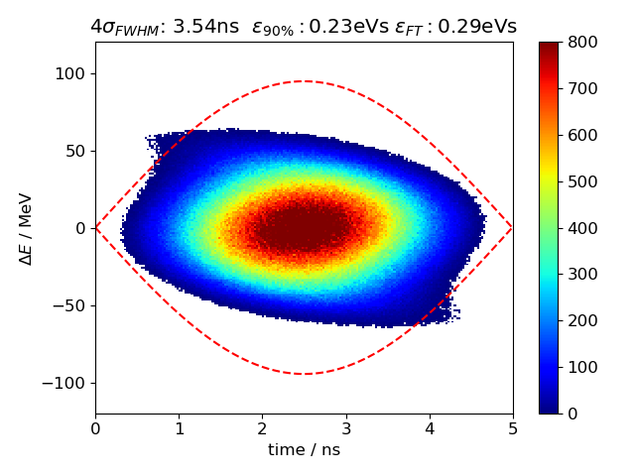
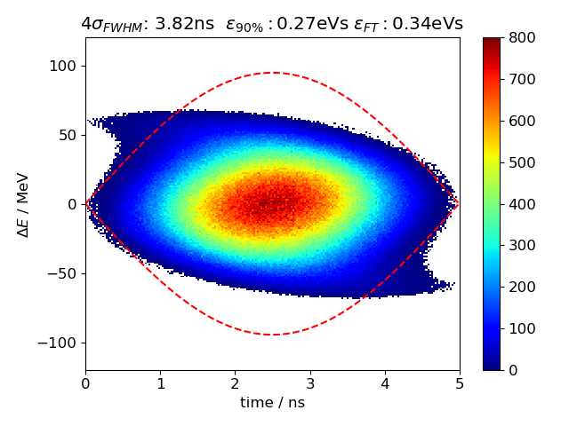
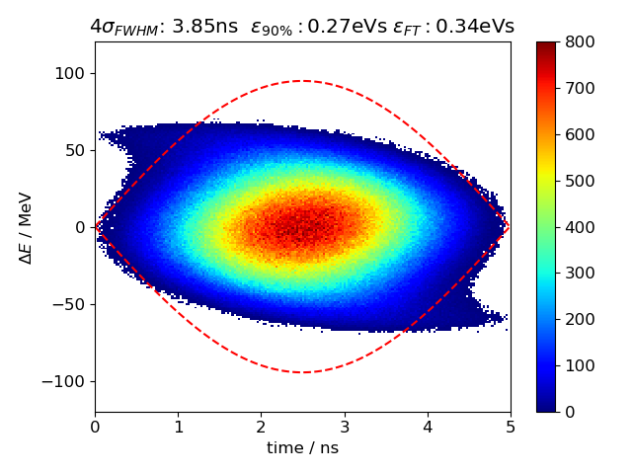
Initial bunch profiles

Slide 10
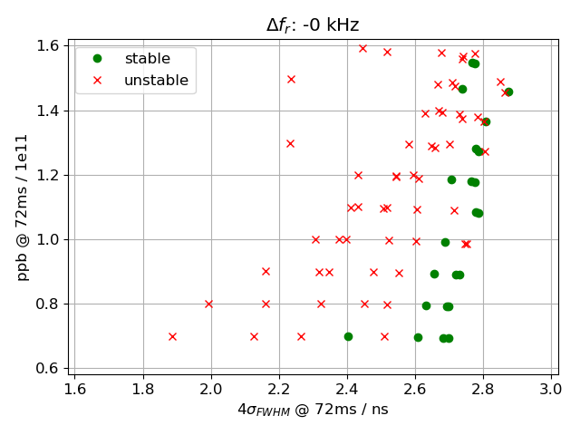
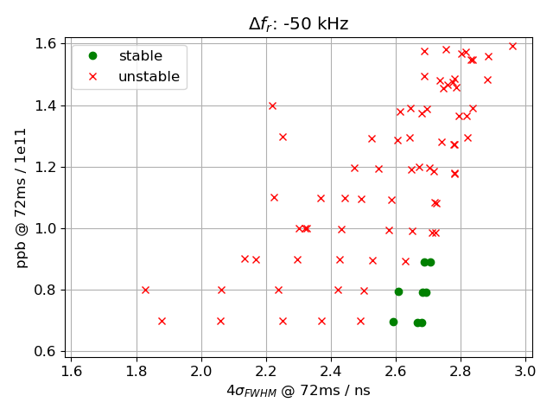
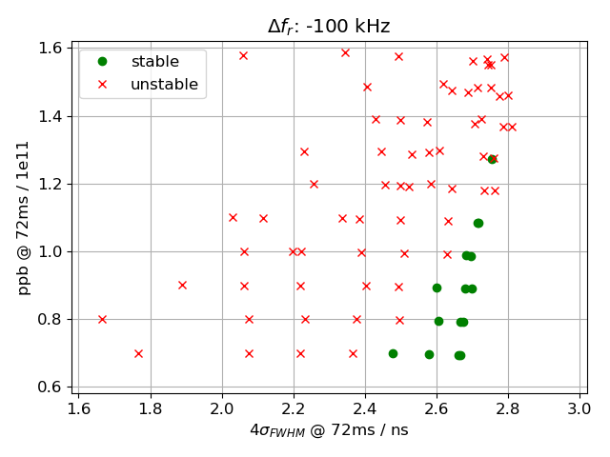
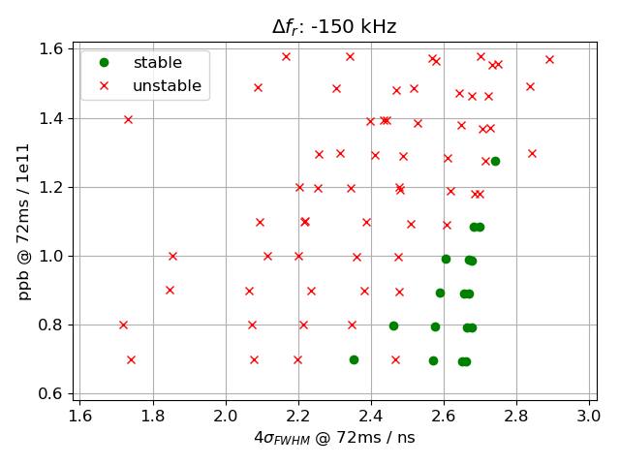
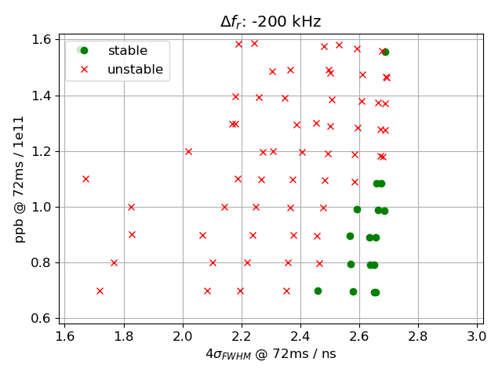
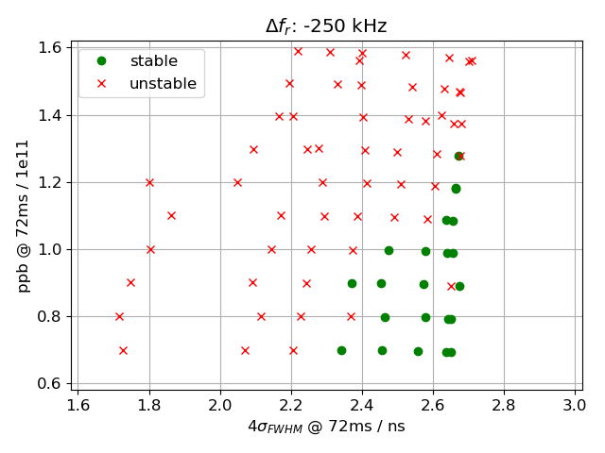
Threshold vs frequency shift

Slide 11
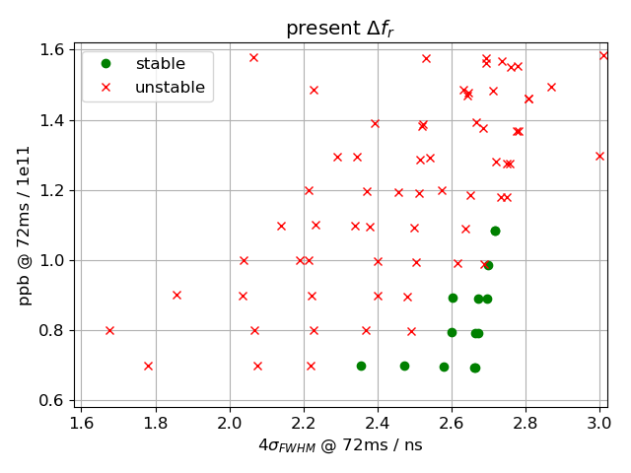
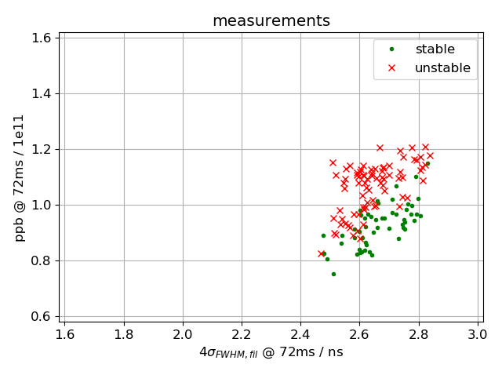
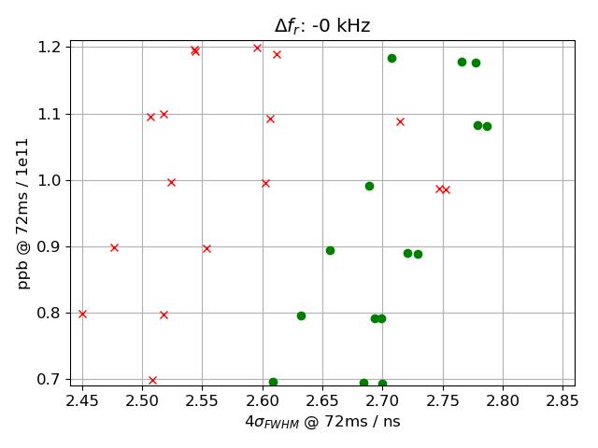
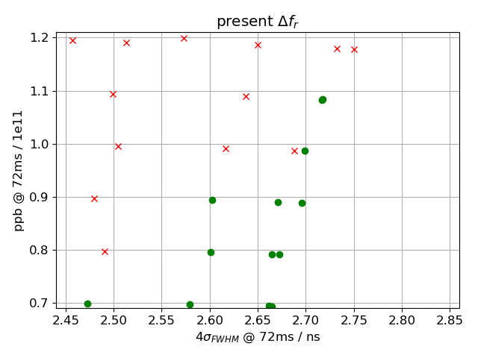
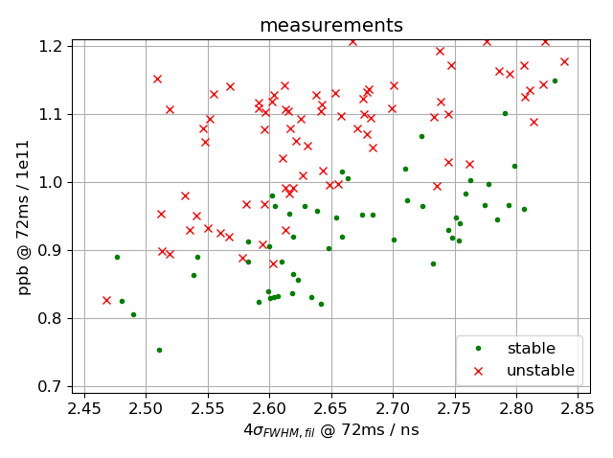
Threshold vs frequency shift

Slide 12
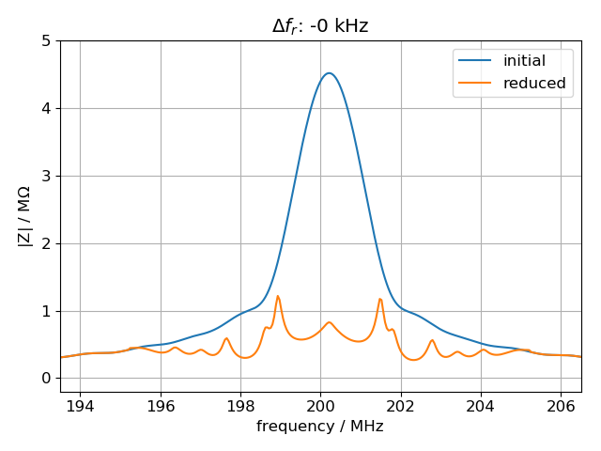
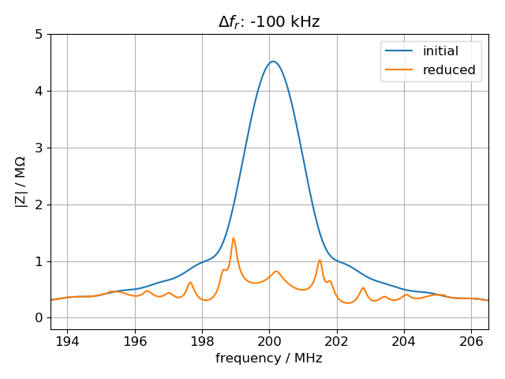
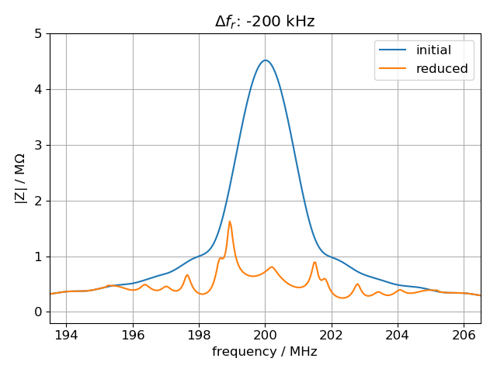
Frequency shift and feedback
Without frequency shift of 200 MHz TWC, ‘reduced’ impedance is symmetric around f_{r}
This symmetry is broken when introducing a finite frequency shift

Slide 13
Summary
Coupled bunch theory (for M=924 bunches) gives that mode (n,m)=(-12,1) is the fastest growing mode; growth time quickly decreases when resonant frequency is shifted
When including frequency shift in simulations, better agreement with measurements is achieved (but only few simulated bunch lengths)
Next steps
Take feedback into account
Simulate with LIU parameters (72 bunches, 2.6e11 ppb)
… continue with analyzing synchronous phase shift measurements
Thank you for your attention!

Slide 14
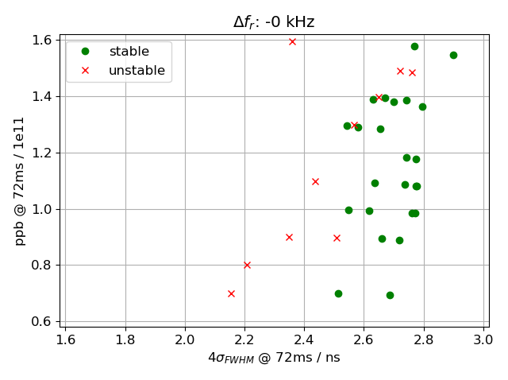
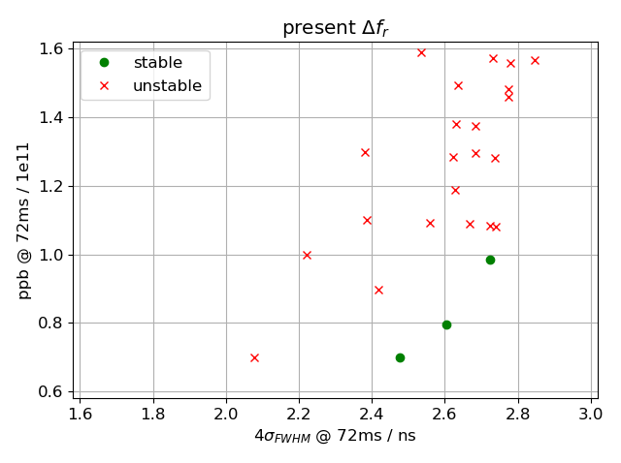
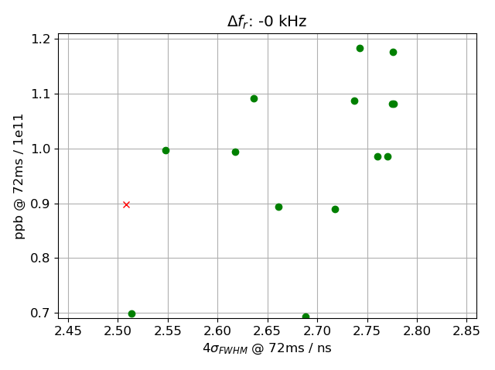
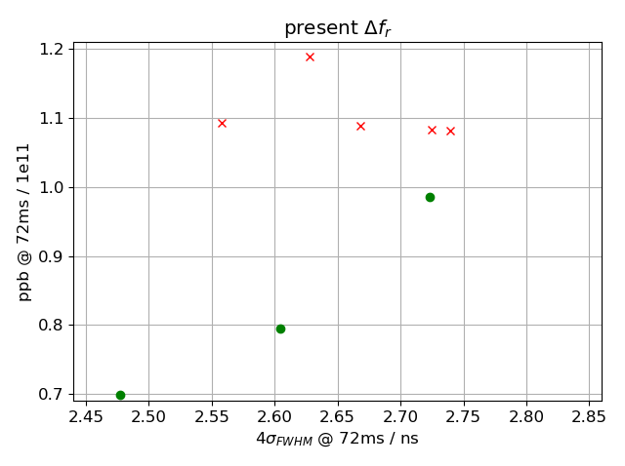
Threshold vs frequency shift; f_{r}=200.265MHz
Simulations ongoing

Slide 15

200MHz TWC impedance
present
Present:
-90kHz for 5-section cavity
-127kHz for 4-section cavity

