Slide 1
Recent longitudinal measurements with high intensity beams
Participants:
H. Bartosik, T. Bohl, A. Lasheen, G. Papotti, M. Schwarz, E. Shaposhnikova
Acknowledgements:
J. Repond, SPS and PS operator team

Slide 2
Flat bottom instability for different machine and beam parameters
Setup:
MD 19 July 2018: 48 bunches, 25ns spacing, BCMS, Q20
Intensity variable: protons per bunch 1.3e11, 1.6e11, 2.2e11
longitudinal emittance variable: 0.23, 0.3, 0.35 eVs (nominal)
800 MHz cavity voltage V₈₀₀: 0, 5%, 10% (nominal), 12.5%, 15%, 20% of V₂₀₀
FeedBack: on, FeedForward: on, Phase loop: on, long. damper: on
V₂₀₀ = 4.5 MV, V₈₀₀ variable
Consider data at flat bottom up to 19.2 s; then ramp
Three to ten acquisitions per case

Slide 3
LLRF power limitations at high intensities
Amplifier power (for cavity 4) exceeds 1MW for 2.2e11 ppb
2.2e11 ppb, emittance: 0.23 eVs, V800/V200=0.2
1MW
1.6e11 ppb, emittance: 0.3 eVs, V800/V200=0.2
1MW
1.3e11 ppb, emittance: 0.3 eVs, V800/V200=0.2
1MW

Slide 4
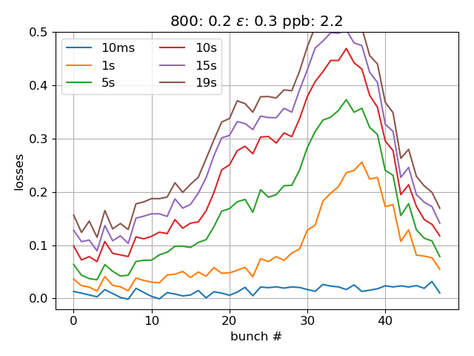
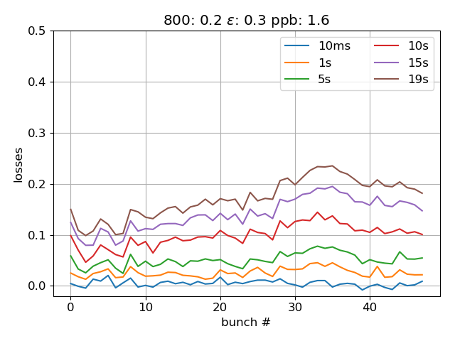
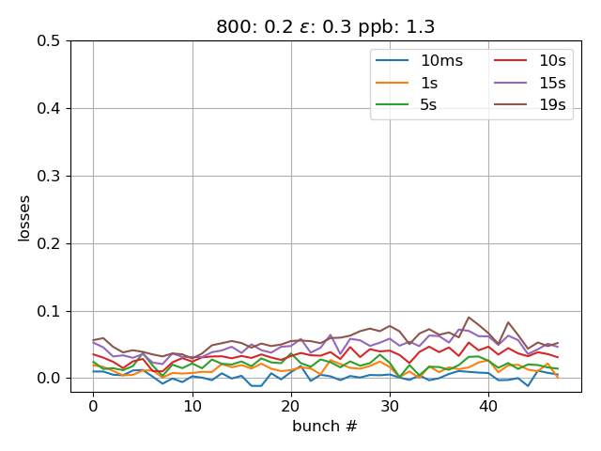
LLRF power limitations at high intensities
Bunch-by-bunch losses (emittance 0.3eVs, V800/V200=0.2)
1.6e11 ppb
1.3e11 ppb
2.2e11 ppb
Large losses due to uncompensated beam loading for bunches in tail of batch for 2.2e11 ppb!

Slide 5
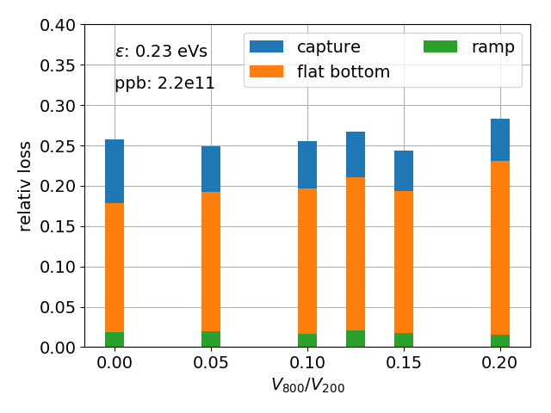
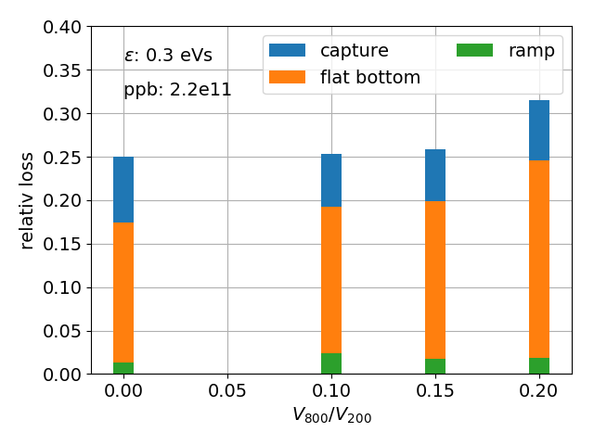
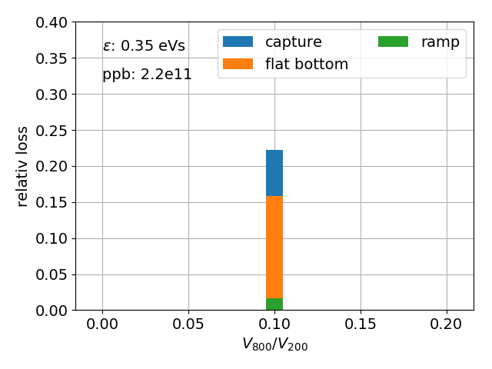
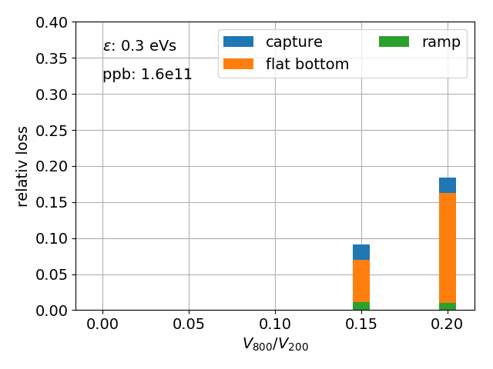
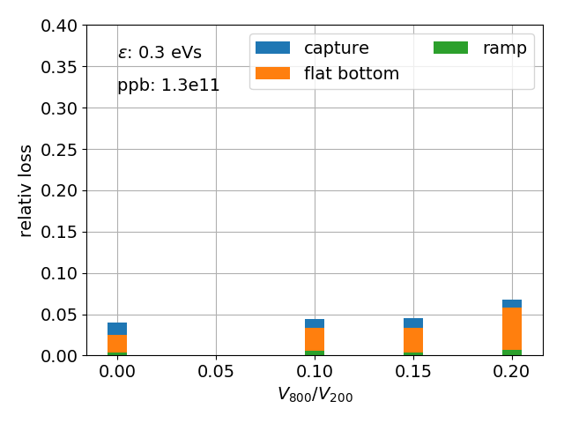
Losses vs emittance, intensity, and 800 MHz cavity
Capture loss:
$(int_{bunch}\left(0s\right)−int_{bunch}(500ms))/int_{bunch}(0s)$
minimum losses
Flat-bottom loss:
$(int_{bunch}\left(500ms\right)−int_{bunch}(19.2s))/int_{bunch}(0s)$
Ramp loss:
$(int_{bunch}\left(19.2ms\right)−int_{bunch}(19.8s))/int_{bunch}(0s)$
Further analysis in progress!

Slide 6
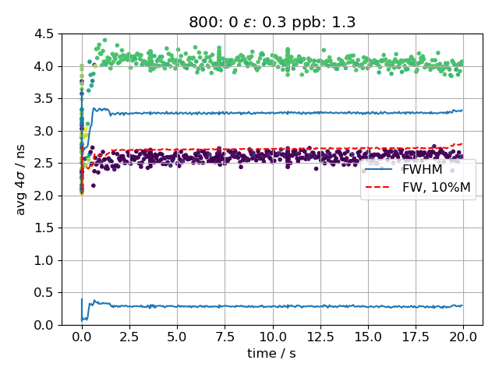
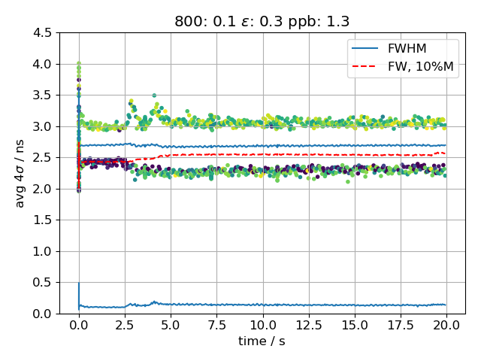
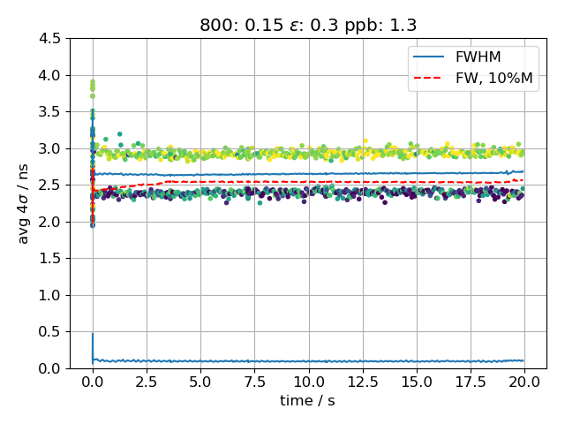
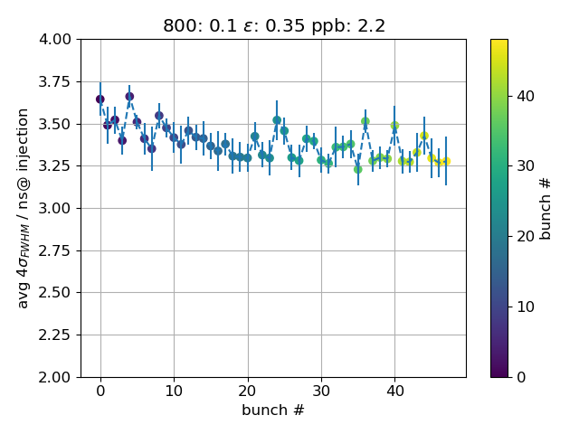
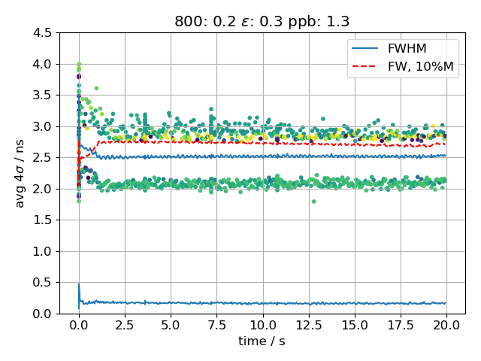
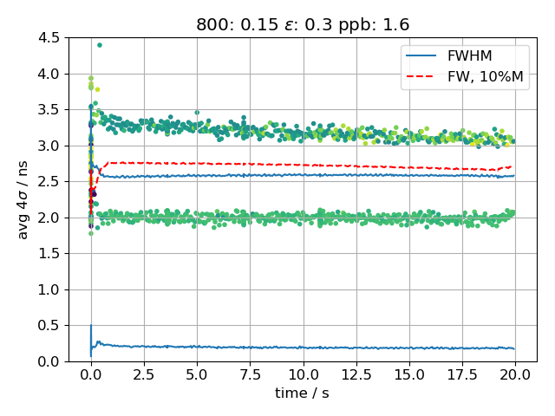
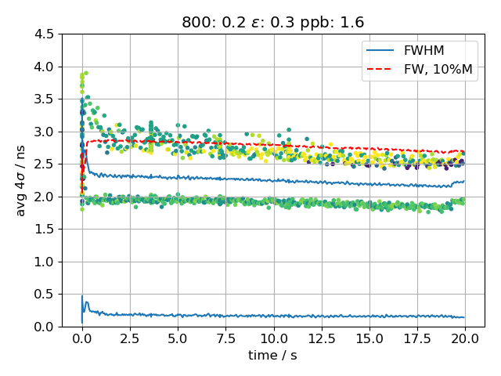
Bunch length along cycle: 1.3e11 ppb; 0.3 eVs
800 off
unstable
800: 10%
stable
800: 15%
stable
800: 20%
shortening
800: 15%
1.6ppb
800: 20%
1.6ppb

Slide 7
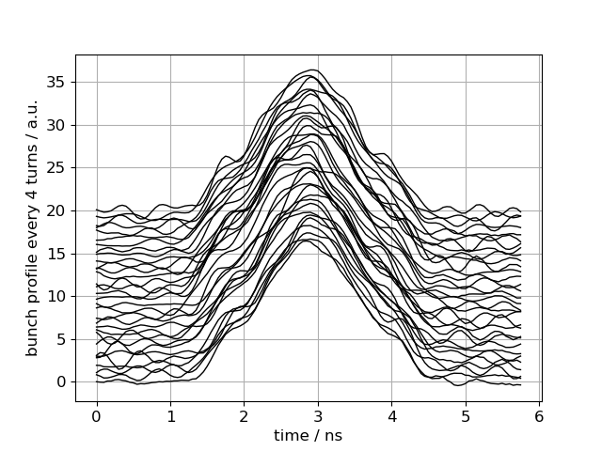
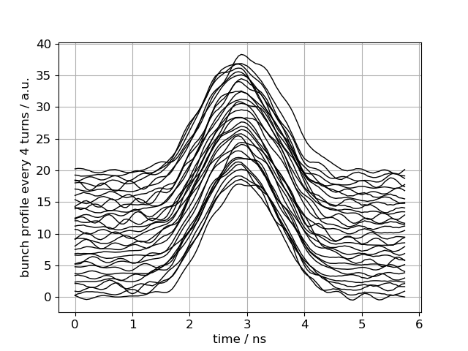
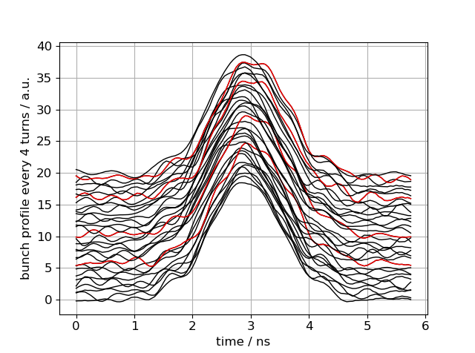
Bunch profiles: 1.3 ppb, emittance 0.3eVs
V800 off
unstable
V800/V200 = 0.15 stable
V800/V200 = 0.20 shortening
Bunch profiles (for bunch 0) every 4th turn at 3.6s
Repeated pattern; further mode analysis needed

Slide 8
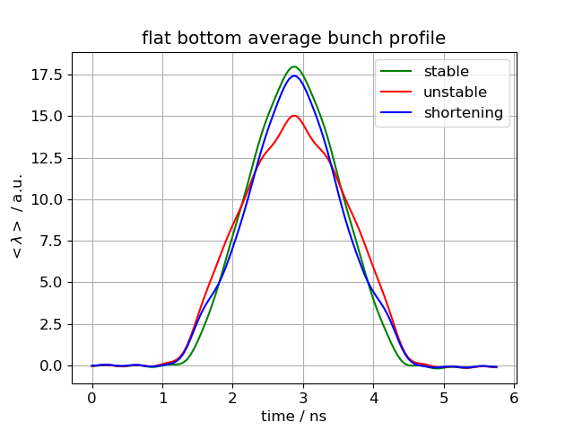
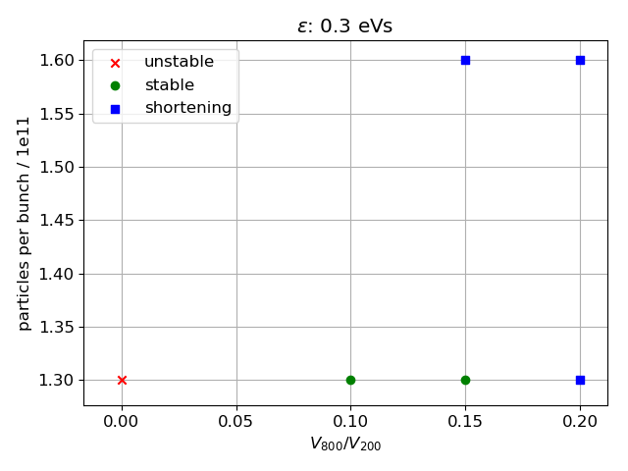
Average bunch profile at flat bottom
1.3e11 ppb
Instability vs bunch intensity and V800

Slide 9
Summary and next steps
Measurement of flat-bottom instability for different intensities and longitudinal emittances
High intensities: large losses due to uncompensated beam loading
Instability for low intensities: occurrence and type of instability depends on V₈₀₀ and beam intensity
Next steps:
More systematic studies at nominal to medium intensities
Mode analysis of bunch profiles to characterize type of instability
Acquisition also with the ABWLM system
Logging of bunch length, intensity, and peak along cycle (mean, min, max, std) in Timber
Comparing with data acquired by scope give nice agreement in bunch intensity and profile peak value, but offset in bunch length (maybe due to low signal, different acquisition rates, … investigation on going)
Simulation of flat-bottom instability (fixing phase-loop gain; scanning impedances)
Thank you for your attention!

Slide 10
Average bunch profile: 1.3 ppb, emittance 0.3eVs
V800 off
instability at 0.5s
V800/V200 = 0.15
stable
V800/V200 = 0.20
shortening up to 1s
Bunch profile average of each trace
minus
bunch profile average of flat-bottom (2.5s to 19.2s)

Slide 11
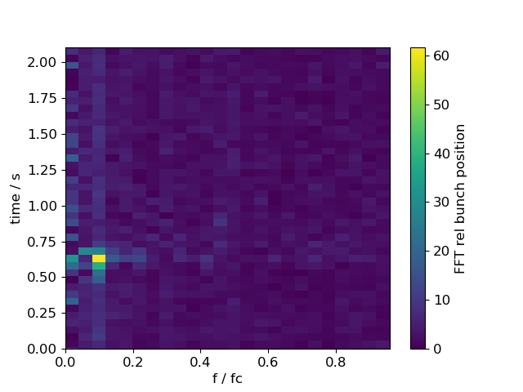
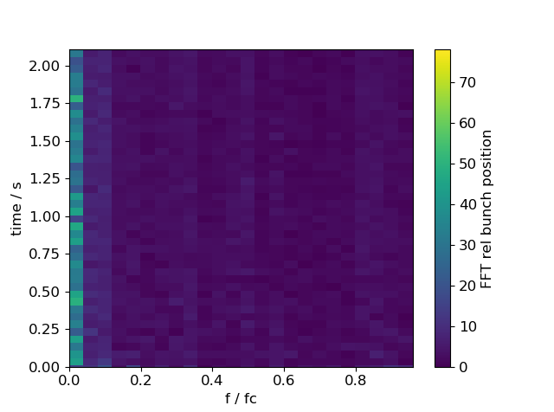
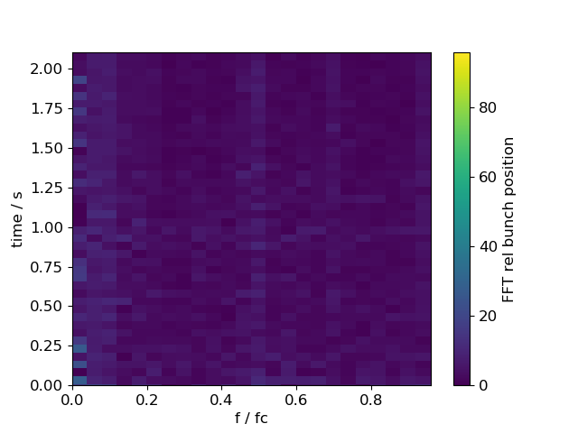
Average bunch profile: 1.3 ppb, emittance 0.3eVs
V800 off
instability at 0.5s
V800/V200 = 0.15
stable
V800/V200 = 0.20
shortening up to 1s
Bunch profile average of each trace
minus
bunch profile average of flat-bottom (2.5s to 19.2s)

Slide 12
LLRF power limitations at high intensities
Amplifier power (cavity 4)
2.2e11 ppb, emittance: 0.23 eVs, V800/V200=0.1
2.2e11 ppb, emittance: 0.3 eVs, V800/V200=0.1

Slide 13
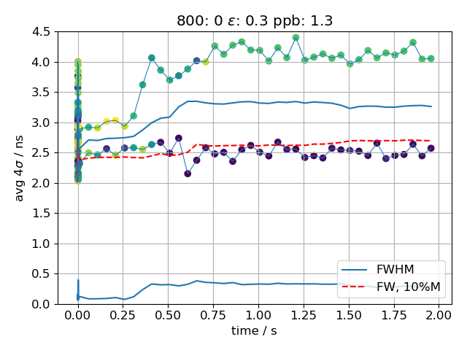
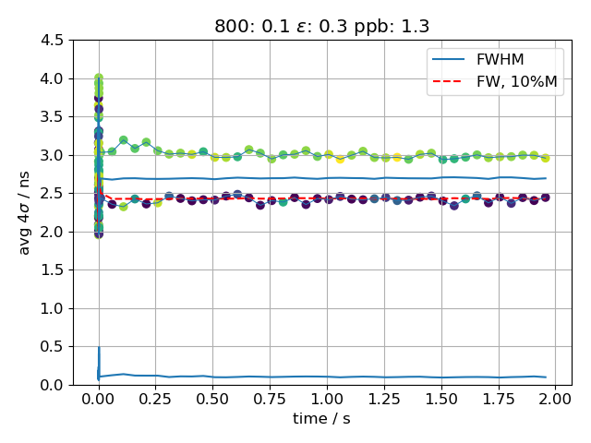
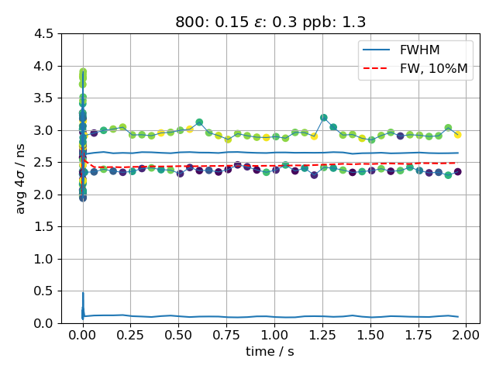
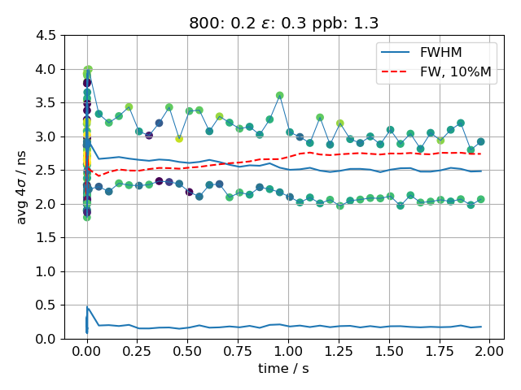
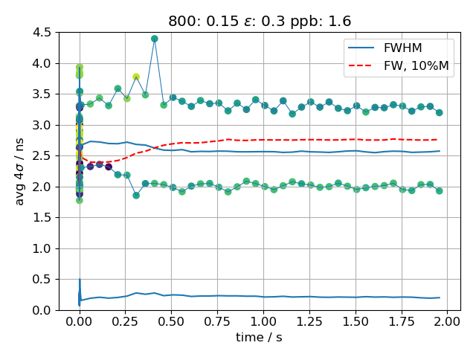
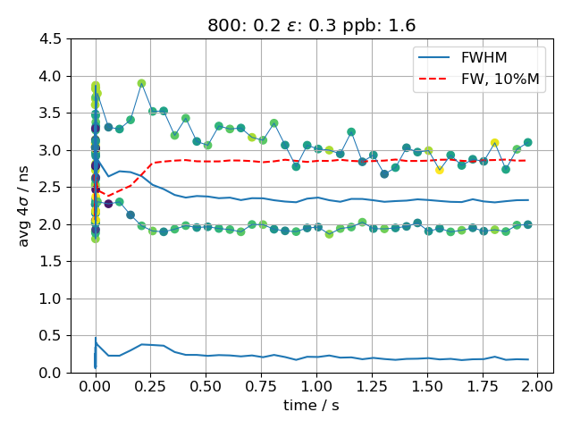
Bunch length during first 2s: 1.3e11 ppb; 0.3 eVs
unstable
stable
stable
shortening
1.6ppb
1.6ppb

Slide 14
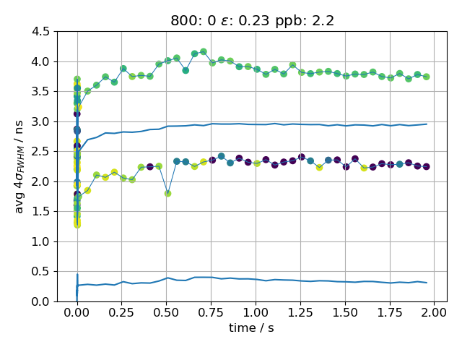
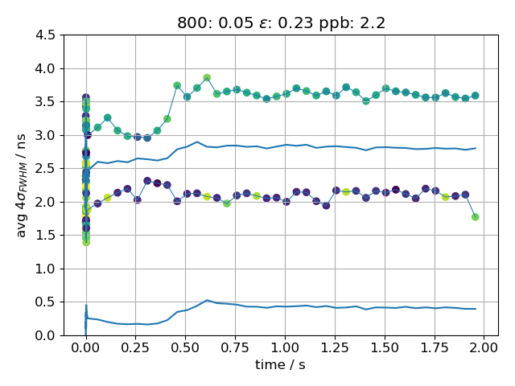
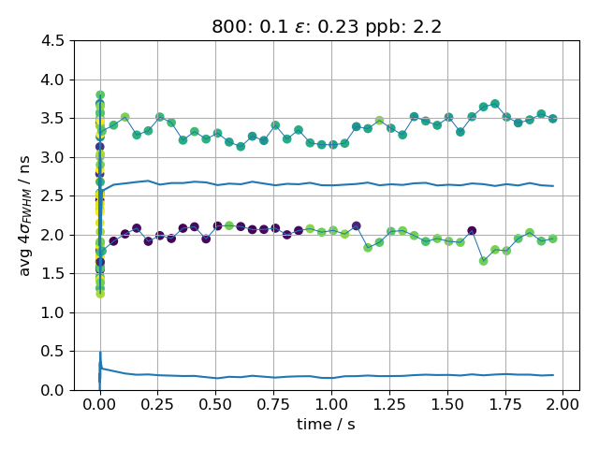
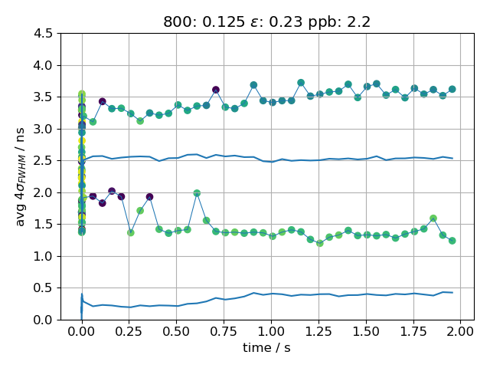
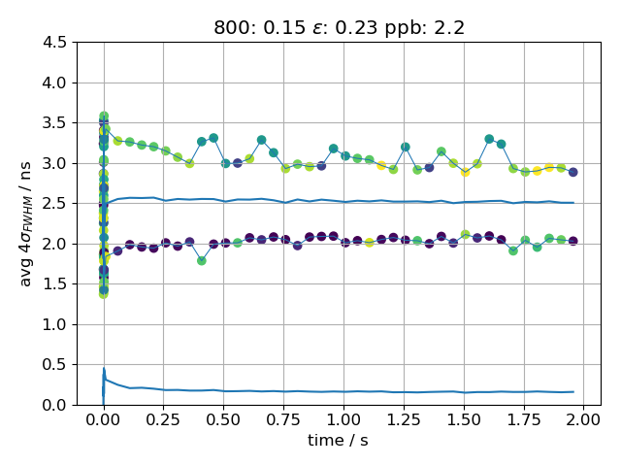
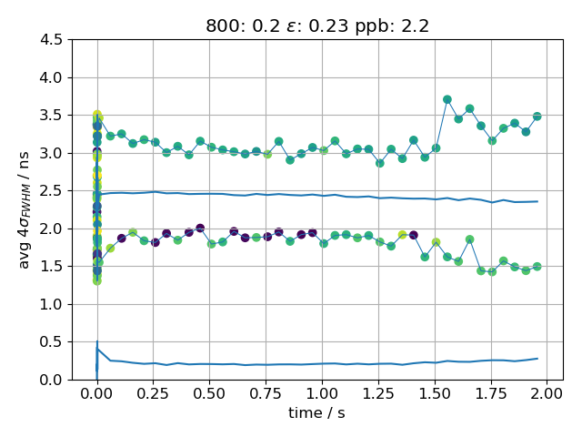
bunch length: 2.2e11 ppb; 0.23 eVs
…

Slide 15
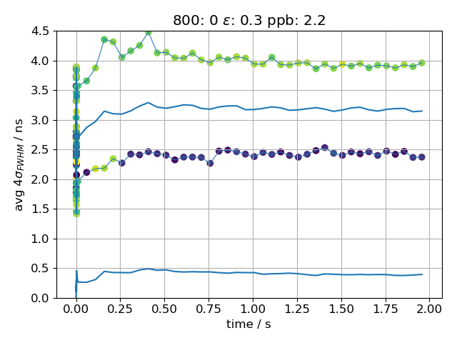
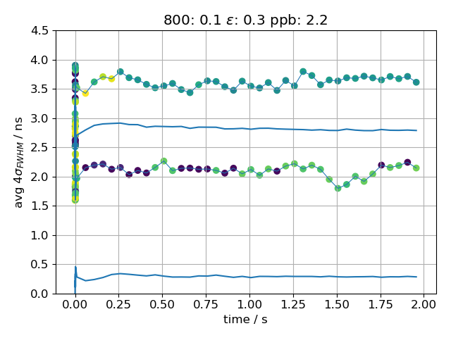
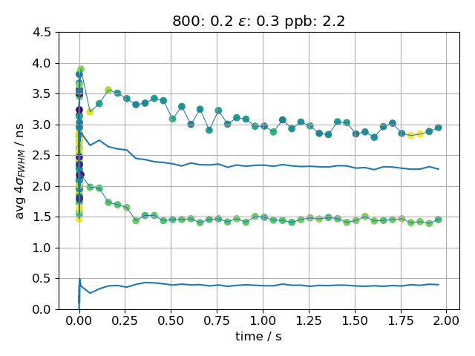
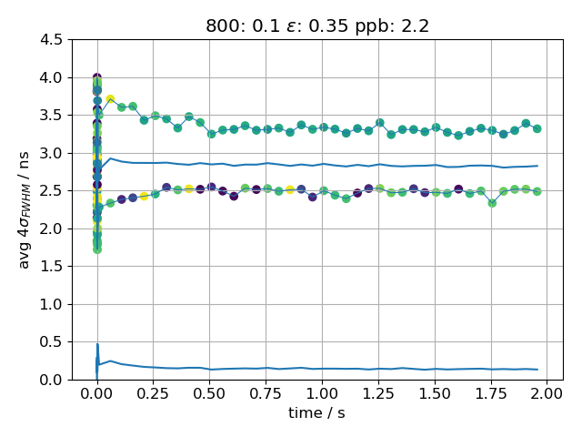
bunch length: 2.2e11 ppb; 0.3 eVs
…
bunch length: 2.2e11 ppb; 0.35 eVs

