Slide 1
Overview of recent MDs in the SPS
H. Bartosik, T. Bohl, M. Carla’, L. Carver, H. Damerau, V. Kain, A. Lasheen, K. Li, G. Papotti, J. Repond, M. Schwarz, E. Shaposhnikova,
SPS & PS operators
LIU SPS-BD working group meeting, 25 September 2018

Slide 2
Overview of MDs and ongoing studies
Mini scrubbing run for vacuum recovery in sector 3 (following hole in magnet)
  Evolution of transverse emittance during scrubbing monitored (measurements with increasing number of bunches but with ~nominal intensity)
High intensity and multi-bunch proton MDs
  Studies of longitudinal instability at flat bottom (see Markus’ presentation)
  Acceleration of trains of 12 bunches with high intensity to 450 GeV
  Headtail monitor acquisitions for different chromaticity settings – not able to reproduce horizontal instability from 2017 so far (next attempt thisThursday)
Single bunch proton MDs
  Measurements of synchronous phase shift (see Aaron’s presentation)
  Reconfiguration of octupole scheme to minimize Q’’ in Q20 deployed and improvement confirmed
Ions
  Setting up and comparison of performance between Q20 and Q26 on short MD cycles

Slide 3
Acceleration of 4x12 bunches with 2e11 p/b
Aim is to check intensity reach
  short trains due to reduced beam loading
  Longitudinal instability thresholds
Results so far (in 2 Thursday sessions)
  Achieved 2e11 p/b at flat top stable with 4x12 bunches BCMS (BQM OK for LHC extraction)
  250 ns batch spacing
  Need to inject 2.35e11 p/b (→ 85% transmission due to uncaptured beam and losses at start ramp)
  Emittances at flat top around 3 um
  Measurements of longitudinal profiles for assessing beam stability
  Transverse instabilities encountered in first session (chromaticity had to be raised) could not be reproduced in second session (reason unclear, first session was right after dipole exchange)
  Losses during acceleration are concentrated in a few locations with high dispersion → BLM thresholds need to be increased otherwise beam dumped during the ramp (425)
To be done
  Try to localize losses at TIDP momentum scraper to cope with losses (in preparation of sending this beam to LHC during last LHC MD block)

Slide 4
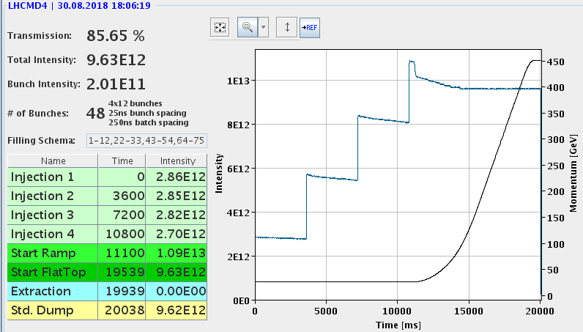
Acceleration of 4x12 bunches with 2e11 p/b
losses due to uncaptured beam
losses out of the bucket due to limited RF power

Slide 5
Reconfiguration of Landau octupole scheme
Octupole scheme reconfigured during Technical Stop
  Old scheme induced large Q’’ in Q20 → “unusable” for LHC beams because of incoherent losses
  New scheme uses additional (already existing) octupoles with strategically chosen polarity
  Intervention went rather smooth
Expected reduction of octupole induced Q’’ in Q20 confirmed in measurements
  Now octupoles can be used to generate amplitude detuning for Landau damping for LHC beams
  Gives us margin for future high intensity beams
  Detailed measurements for other optics ongoing
reconfiguration

Slide 6
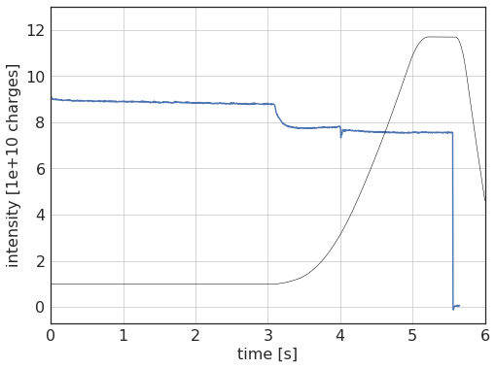
Ions for LHC
A series of parallel MDs devoted to comparison of Q20 / Q26 performance
  Q26 expected to provide better transmission (more aperture available, transition crossing at higher energy and faster, …)
  Tested the 4 bunches (100 ns) and 3 bunches (75 ns) schemes in both optics
  During MDs so far, Q26 showed better transmission on short flat bottom cycle (including ramp)
  Q26 favorable also after LS2 (no need for bunch rotation after slip stacking)
Q26 cycle for parallel MDs

Slide 7
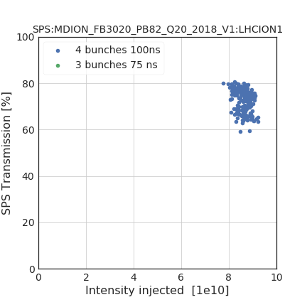
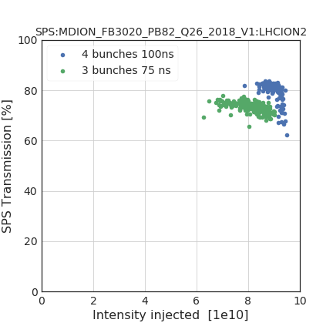
Ions for LHC
A series of parallel MDs devoted to comparison of Q20 / Q26 performance
  Q26 expected to provide better transmission (more aperture available, transition crossing at higher energy and faster, …)
  Tested the 4 bunches (100 ns) and 3 bunches (75 ns) schemes in both optics
  During MDs so far, Q26 showed better transmission on short flat bottom cycle (including ramp)
  Q26 favorable also after LS2 (no need for bunch rotation after slip stacking)
Q20
Q26
data from 31.08.

Slide 8
Ions for LHC
A series of parallel MDs devoted to comparison of Q20 / Q26 performance
  Q26 expected to provide better transmission (more aperture available, transition crossing at higher energy and faster, …)
  Tested the 4 bunches (100 ns) and 3 bunches (75 ns) schemes in both optics
  During MDs so far, Q26 showed better transmission on short flat bottom cycle (including ramp)
  Q26 favorable also after LS2 (no need for bunch rotation after slip stacking)
Thomas analyzded data from several MDs this year
  Q26 tranmission better
  Knobs to tune transition crossing seems to be more efficient in Q26
preliminary

Slide 9
Ions for LHC
A series of parallel MDs devoted to comparison of Q20 / Q26 performance
  Q26 expected to provide better transmission (more aperture available, transition crossing at higher energy and faster, …)
  Tested the 4 bunches (100 ns) and 3 bunches (75 ns) schemes in both optics
  During MDs so far, Q26 showed better transmission on short flat bottom cycle (including ramp)
  Q26 favorable also after LS2 (no need for bunch rotation after slip stacking)
Thomas analyzded data from several MDs this year
  Q26 tranmission better
  Knobs to tune transition crossing seems to be more efficient in Q26
Ions run will be using Q26 optics this year!

Slide 10
Outlook (probably not complete)
6 Thursday MD blocks left, to be used to finish:
  Longitudinal instability at flat bottom – identify the source and characterize threshold
  Horizontal instability at flat bottom
  Longitudinal instabilities along the ramp
  Loss localization on TIDP for acceleration of 4x12 high intensity bunches
Parallel MDs
  Measurements of synchronous phase shift
  Reference measurements: Impedance (longitudinal & transverse), optics, …
  Losses with post acceleration in PS
  Tune ripple measurements & space charge
  Resonance compensation in preparation for ions
Ions
  Studies on long flat bottom cycle during ion period (flat bottom losses, transition)
  Slip stacking studies

