Slide 1
stabilizing (?) 4 x 12 x 2e11 ppb
G.Papotti, H. Bartosik, T. Bohl, V. Kain, E. Shaposhnikova

Slide 2
outline
task: prepare 4 batches of 12 bunches of 2e11ppb for extraction to the LHC (LHC MD on heat load)
  LHCMD4 on 2018-10-18 (LHCMD25ns_4inj_Q20_2018_V1, id 14438)
list of parameters changed for the longitudinal plane
  LLRF: feedforward off, feedback on, LD1 (changed phase offset), LD3 off
  TWC200 V_{tot}
  TWC800 V_{tot}
  controlled emittance blow up at SPS
  controlled emittance blow up at PS

Slide 3
Some observations during high intensity MD (Q20)
Used optimized voltage ratio 800/200 MHz through the cycle
We saw that stability was improved with
  FB on and FF off
  Longitudinal damper on (especially for 2nd injection of 24 bunches)
  Injection into 5.5 MV (instead of 4.5 MV)
  Larger injected (from PS) emittance
Difficulty to achieve required emittance blow-up for all bunches
  Shift of max frequency from 0.86 f_{s0} to 0.75 f_{s0}
  Advancing start of BUP from usual 15.6 s to 13.3 s (with smooth function)
Some bunches were always unstable (at the end of the 2nd batch most of the time), max bunch length at extraction up to 2.6 ns

Slide 4
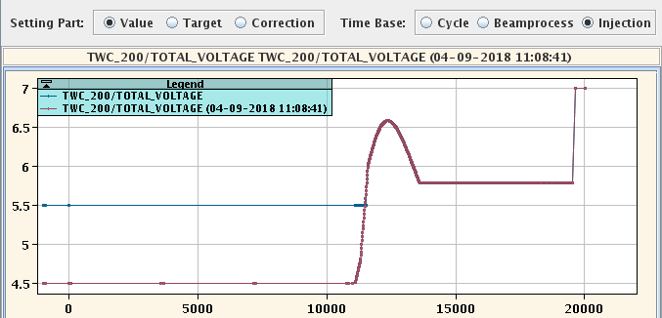
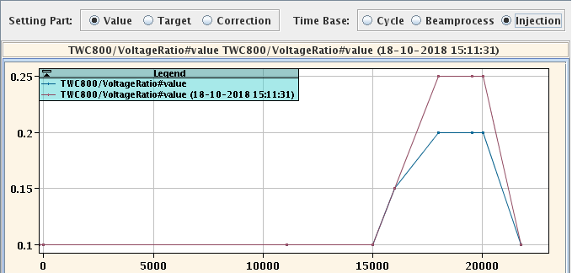
TWC200 and TWC800: Vtot

Slide 5
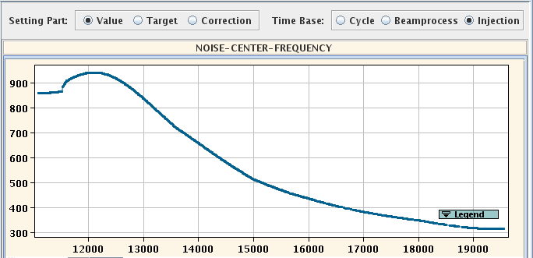
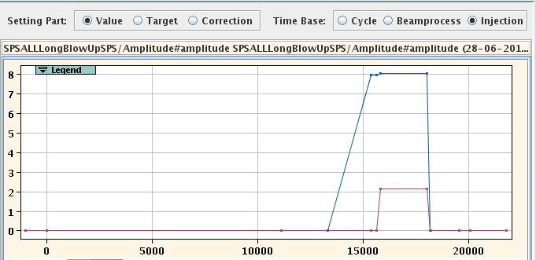
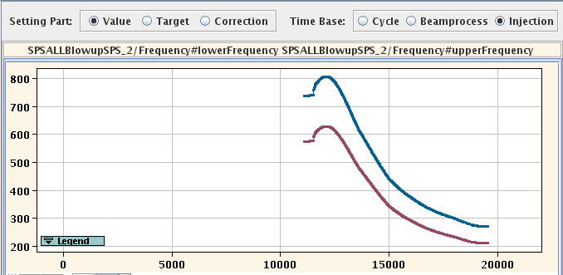
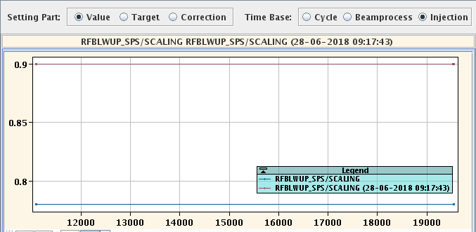
SPS longitudinal blow up

Slide 6
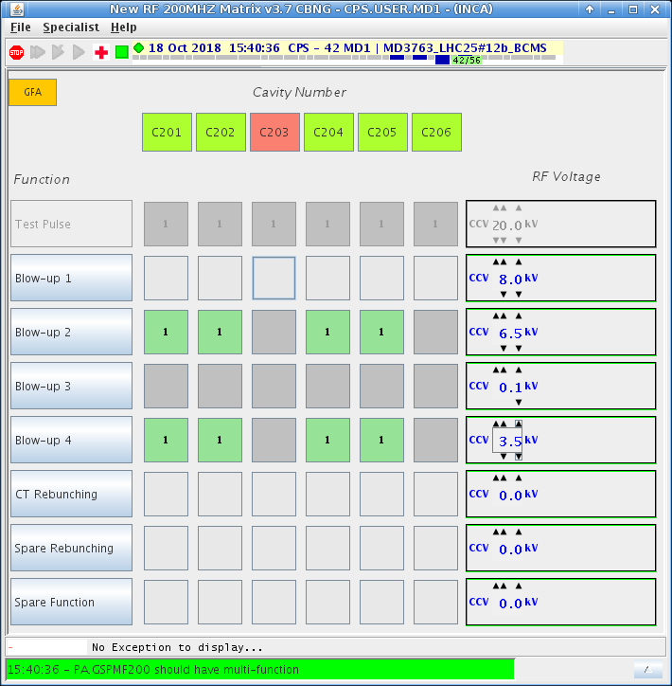
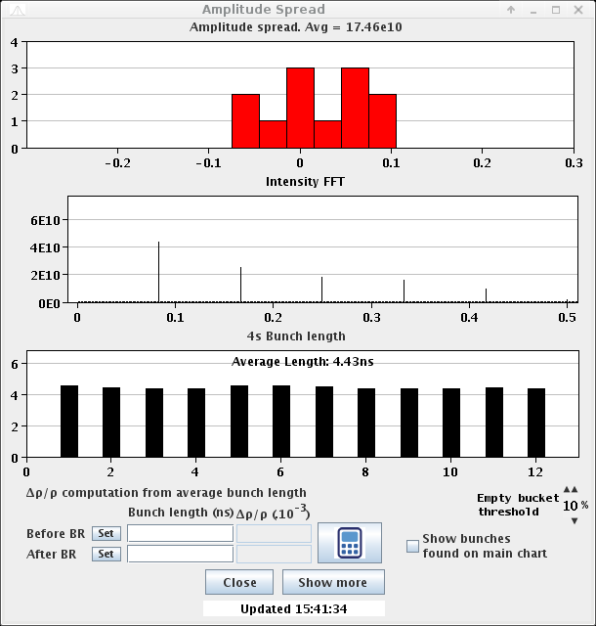
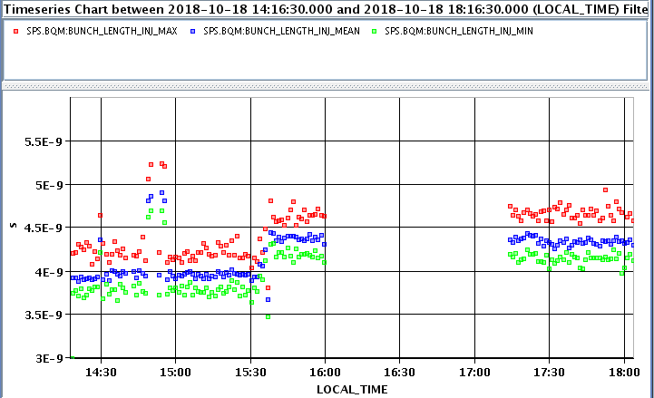
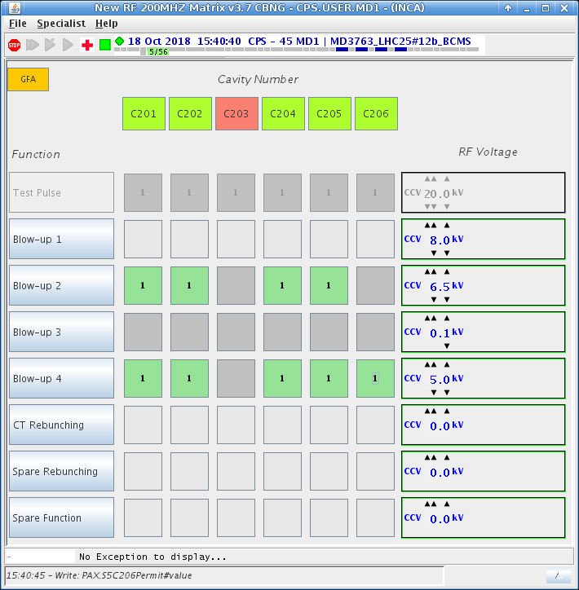
longitudinal blow up at the PS
thanks Heiko

Slide 7
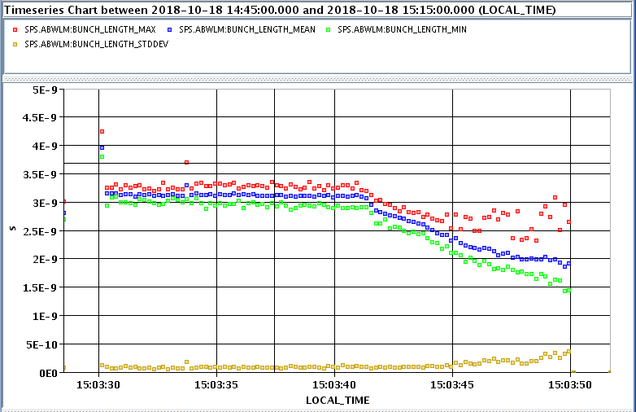
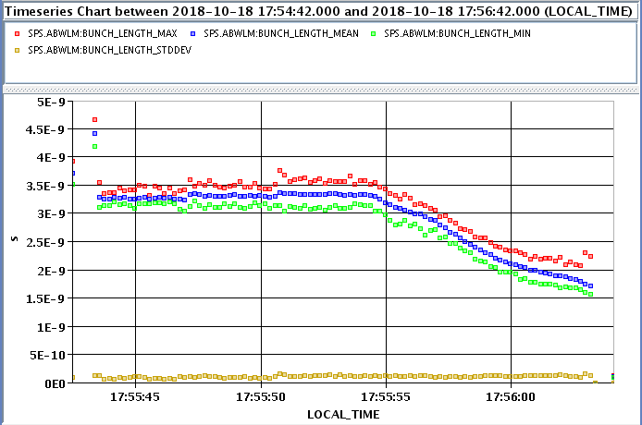
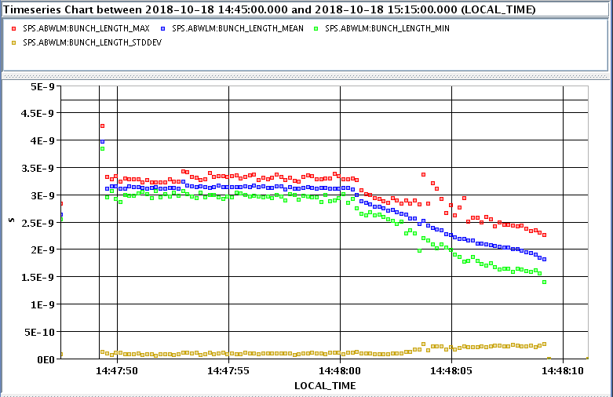
examples
df

Slide 8
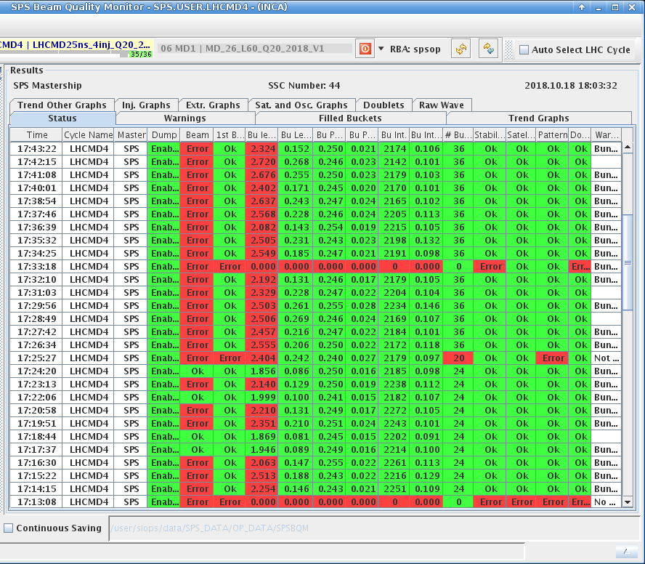
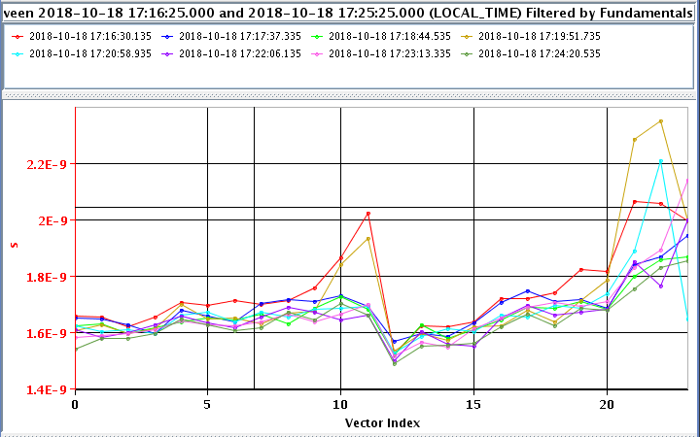
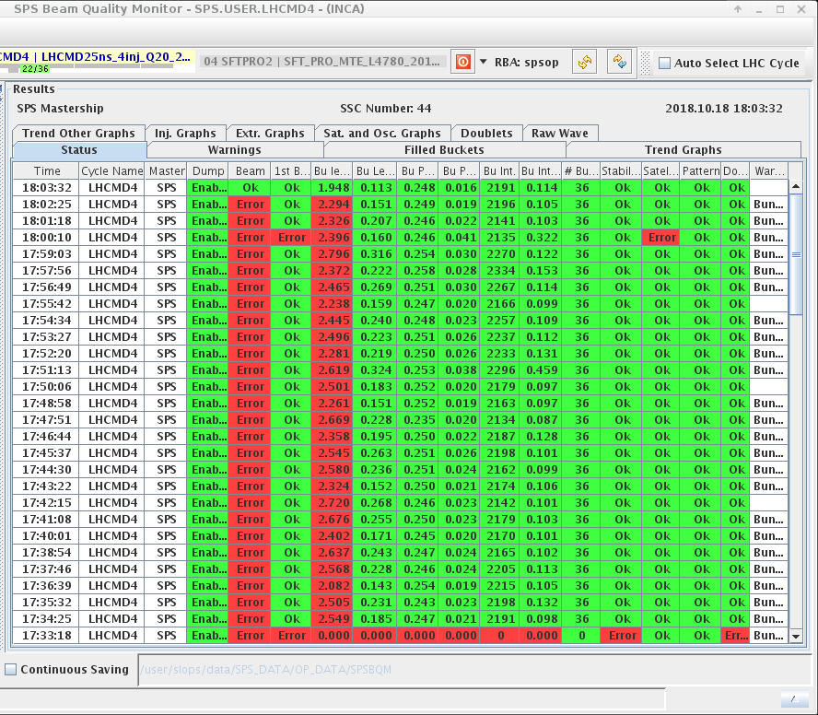
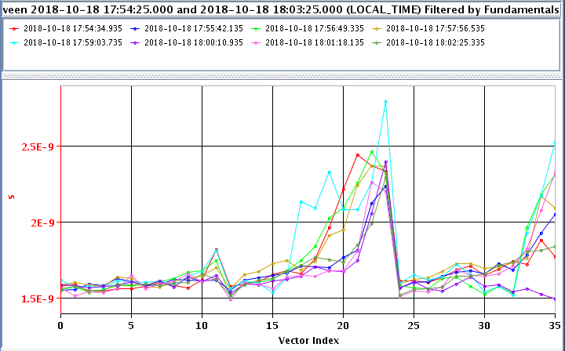
results
1.7e11 ppb feasible
  but Gianni not interested
2e11 ppb
  2 batches: ~acceptable
    BQM τ_{max} =2.0 ns (was 1.9 ns)
  3 batches: tbc
    often only one bunch too long
  4 batches: argh!
    LHC needs 4
    LHC might have to do with lower intensity

Slide 9
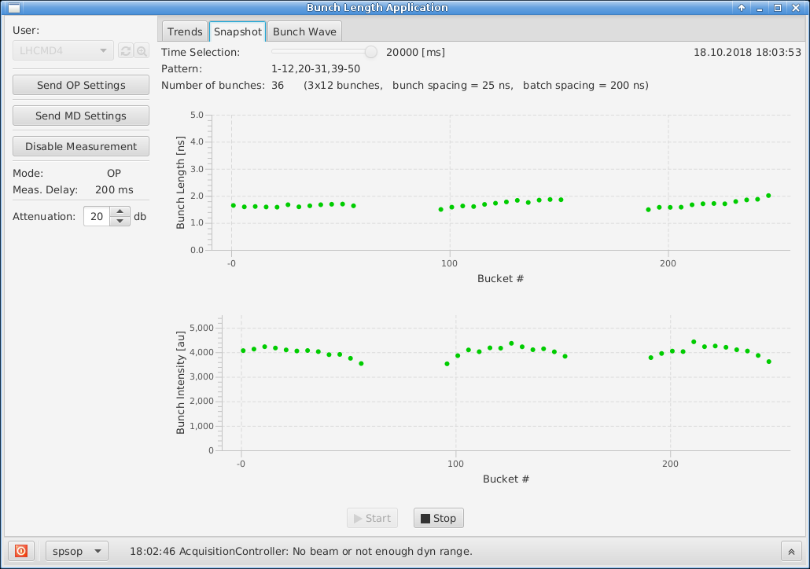
“the last hope”: the last shot of last Thursday

Slide 10
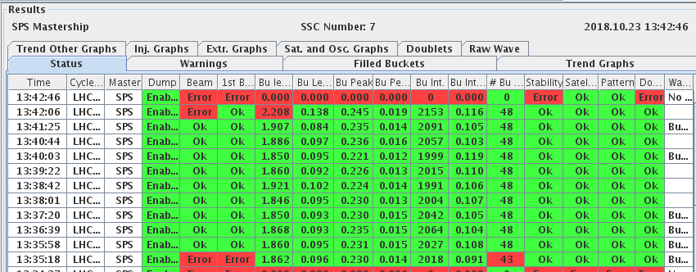
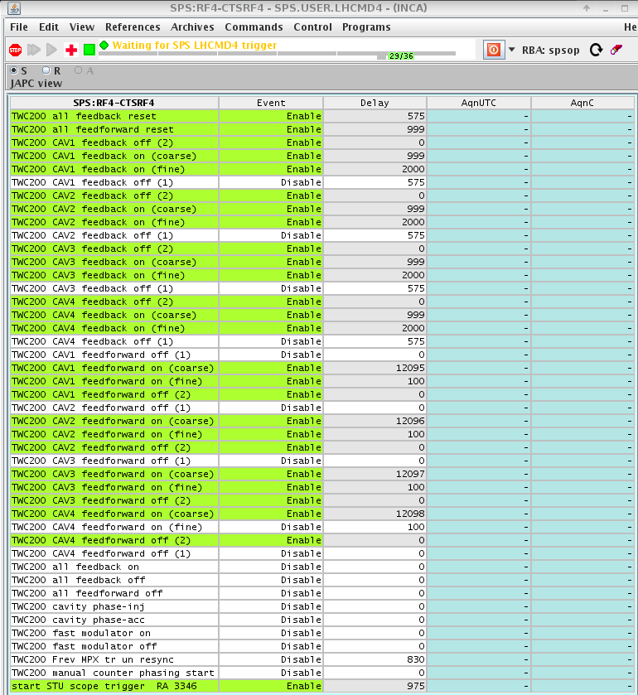
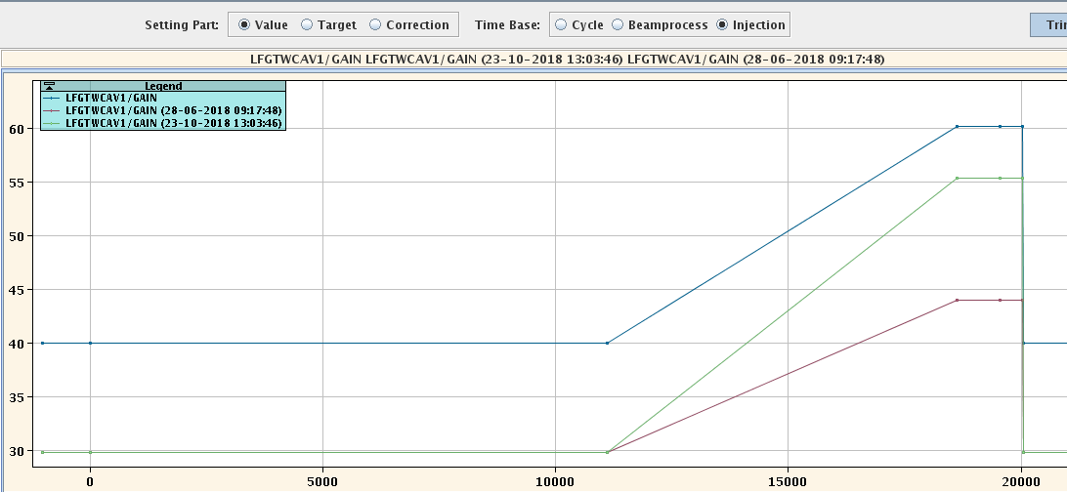
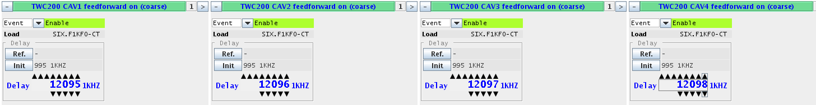
today, 12:20-14:10 “fresh off the press”
4 x 12 x 1.80-1.85-1.9 e11 ppb ok
ffwd on at the end of the flat bottom, scattered start
long. blow up off
LD1 gain increased
phase between TWC200 and TWC800 not scanned due to lack of time

Slide 11
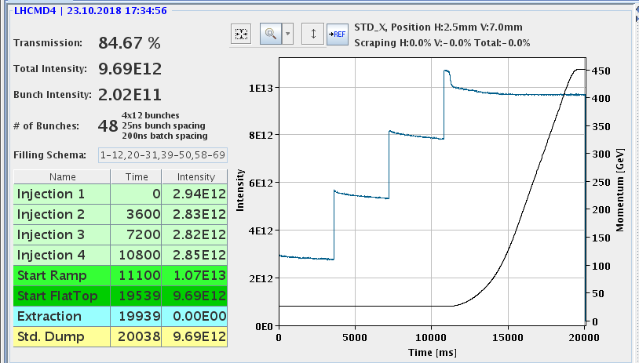
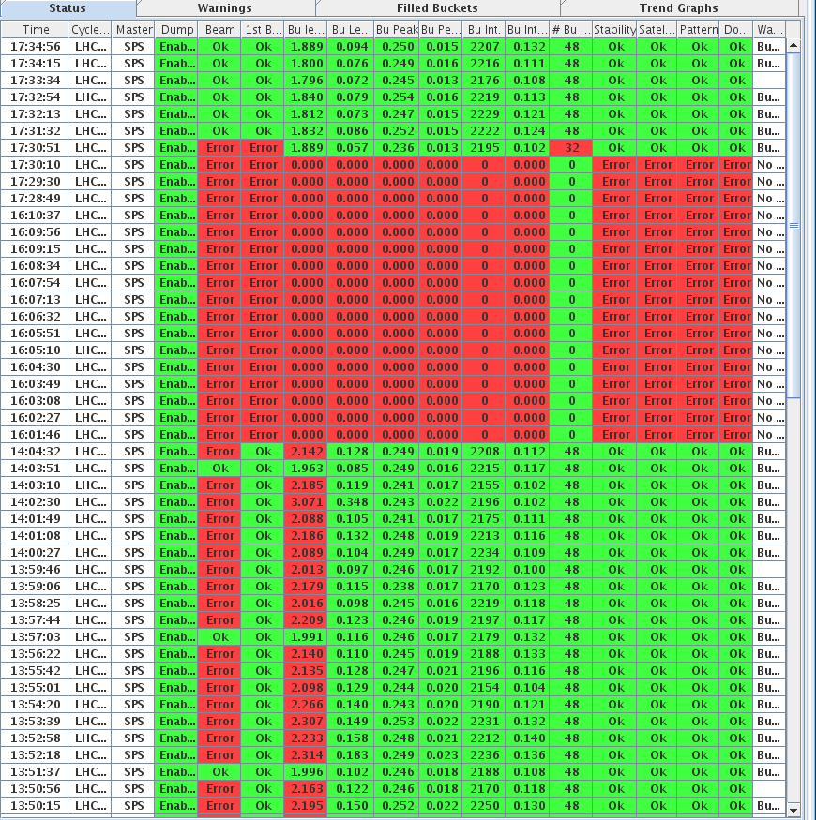
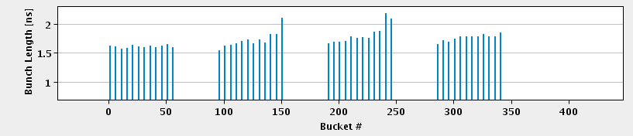
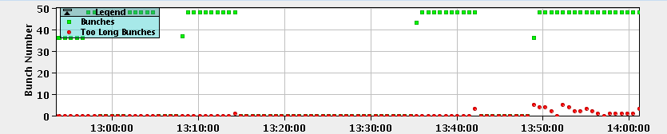
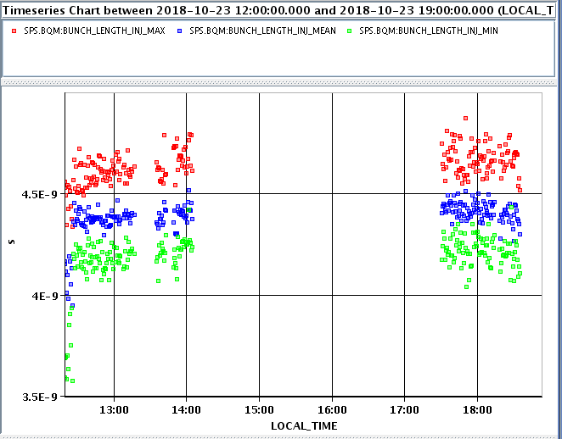
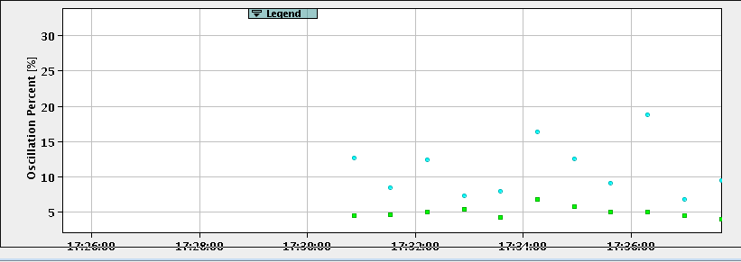
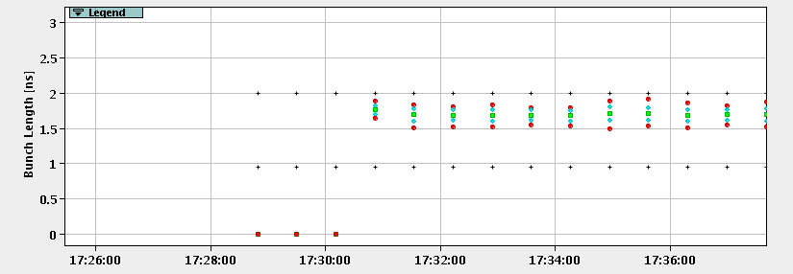
2e11 achieved in the afternoon
2e11

Slide 12
What can be done for run 3
Optimisation of the 800 MHz voltage amplitude and phase during the ramp taking into account intensity effects (with new, upgraded impedance model of the SPS)
Automatic calculation of optimised settings for controlled emittance blow-up (frequency band) taking into account
  voltage program for 2 RF systems (available now for f_{s0} calculation),
  intensity effects using
    Injected emittances
    bunch length evolution during ramp
    future SPS impedance model

