Slide 1
verification of high freq impedance sources with long bunches and debunching
T. Argyropoulos, G. Papotti, E. Shaposhnikova
acks: A. Lasheen, H. Damerau, PSB and PS operators
for the beam preparation

Slide 2
(selected) references
T. Bohl, T. Linnecar, E. Shaposhnikova, Phys. Rev. Lett. v. 78, 1997, 3109
“Identification of the SPS impedance at 1.4 GHz”. T. Argyropoulos et al., IPAC13
A. Lasheen et al., Phys. Rev. Accelerators and Beams 21, 034401, 2018

Slide 3
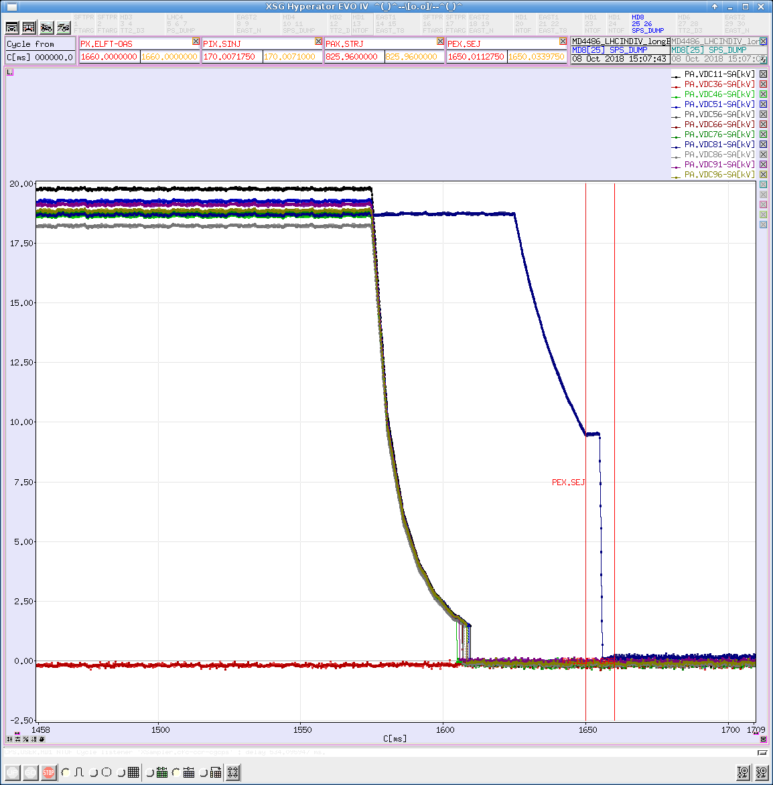
measurement setup
2 MD sessions on 2018-10-01 and -08, resp. Q26 and Q20 optics
MD_26_L7200_Q20_North_Extraction_2018_Debunching (id 14948)
MD_26_L7200_Q26_North_Extraction_2018_V1_Debunching (id 15000)
PSB: scan intensity for intensity threshold
PS: long bunches extracted (25-30 ns)
no bunch rotation, 20-40 MHz cavities off
only 1 10 MHz cavity, V = 10 kV at extraction
(initial 19 kV were too much, too high momentum spread)
SPS: RF off, observe the beam debunch after injection
initial cycle sanity check with single bunch for basic parameters

Slide 4
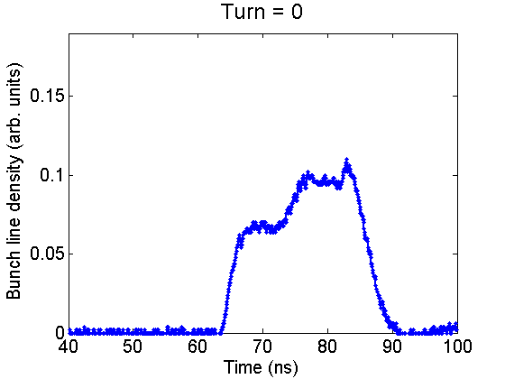
visual example
with Q26 optics

Slide 5
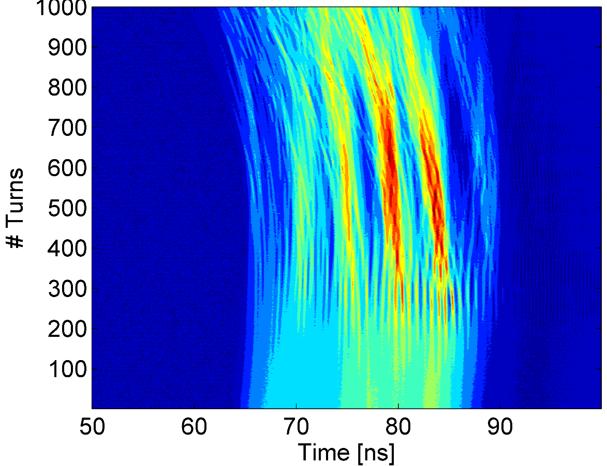
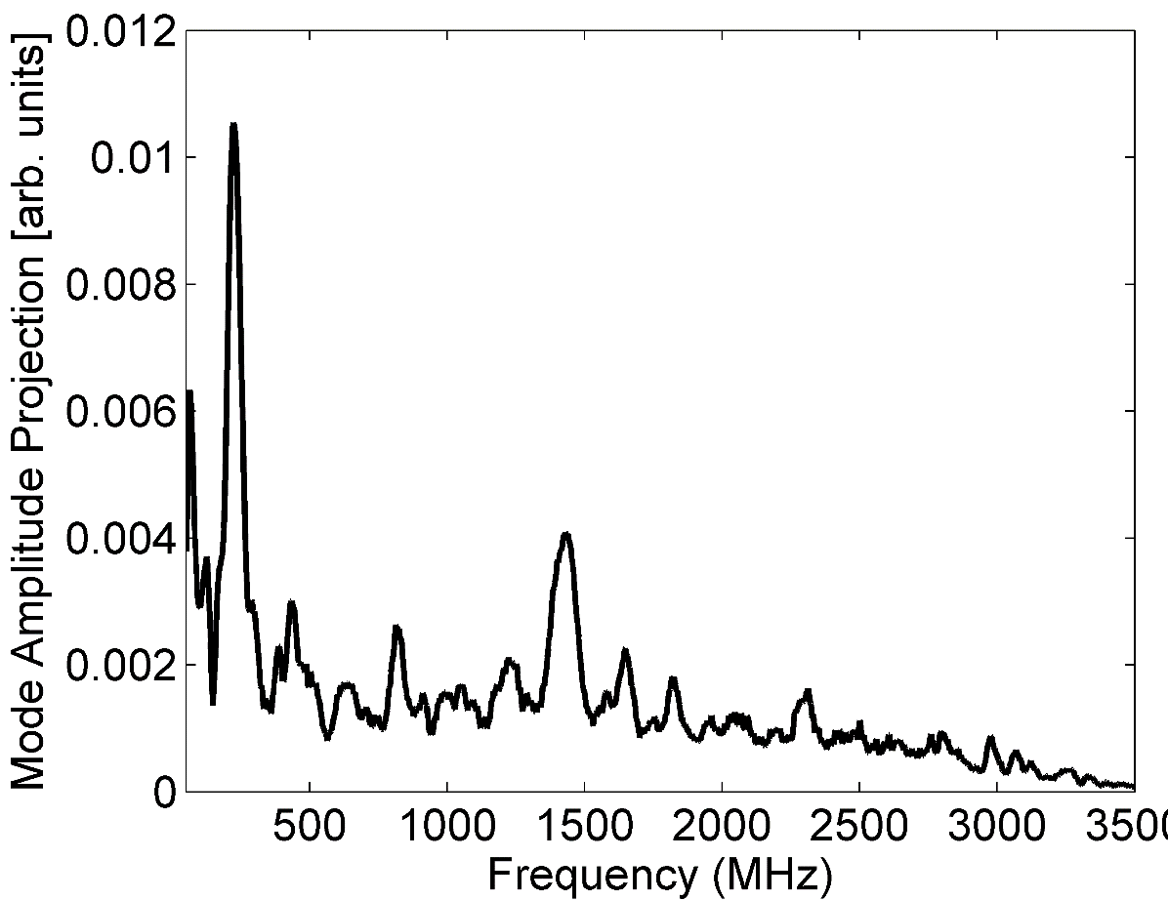
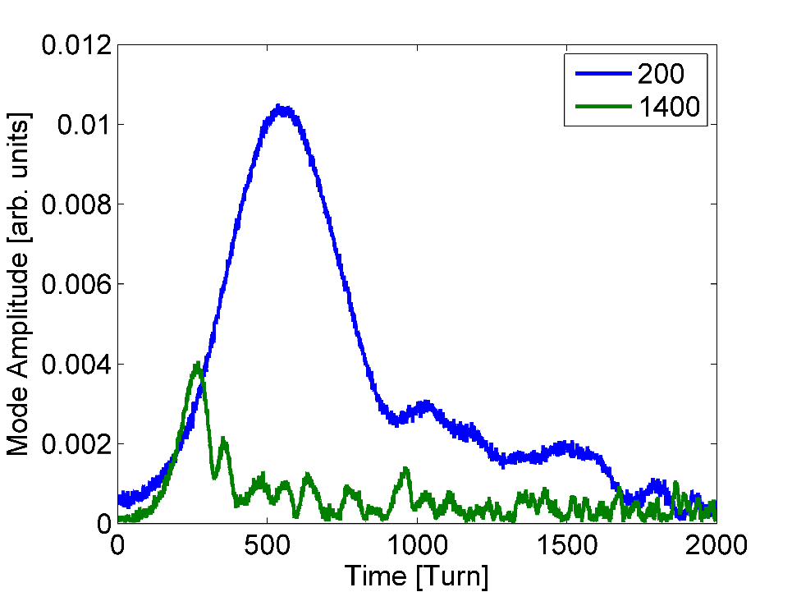
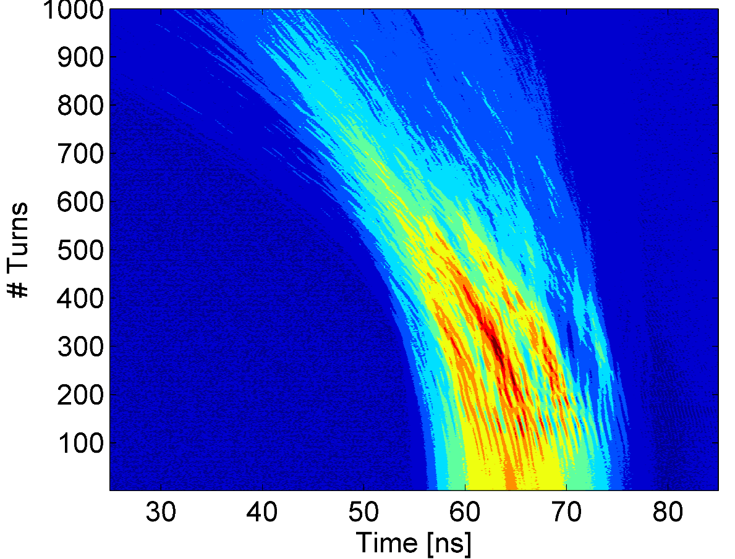
analysis
can extrapolate one
measurement to one number:
ratio between mode amplitude
at 1.4 GHz and 200 MHz
A₁₄₀₀/A₂₀₀
can do the same for Q20
(faster debunching)
Q26, 1.14e11 ppb
MD120
T. Argyropoulos

Slide 6
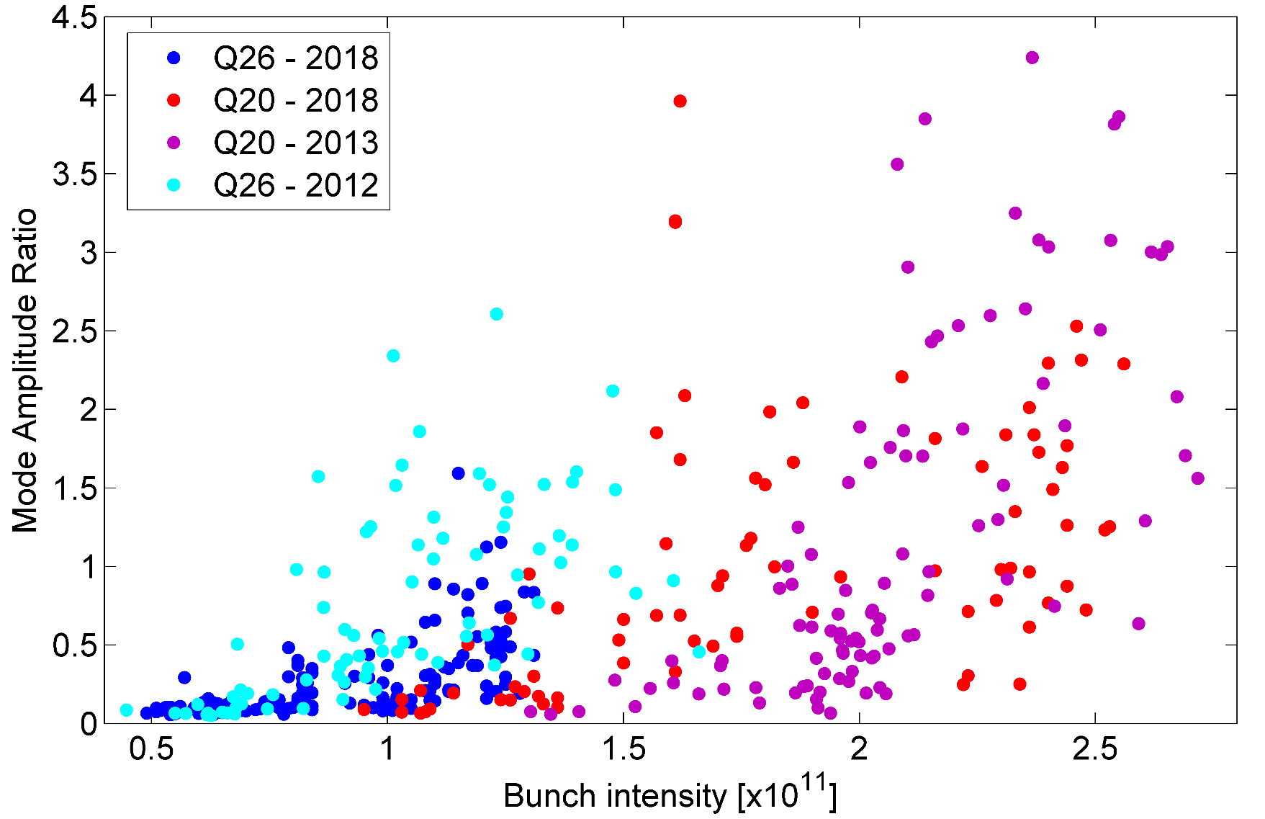
results
Q20 ok agreement with 2013
Q26 maybe not exactly the same threshold as 2012

