Slide 1
SPS experience for LHC ion run
R. Alemany, T. Argyropoulos, H. Bartosik, T. Bohl, M. Carla’, H. Damerau, V. Kain, G. Kotzian, K. Li, G. Papotti, A. Saa Hernandez, M. Schwarz, E. Shaposhnikova, F. Velotti
SPS & PS operators
LIU SPS beam dynamics meeting, 18 December 2018

Slide 2
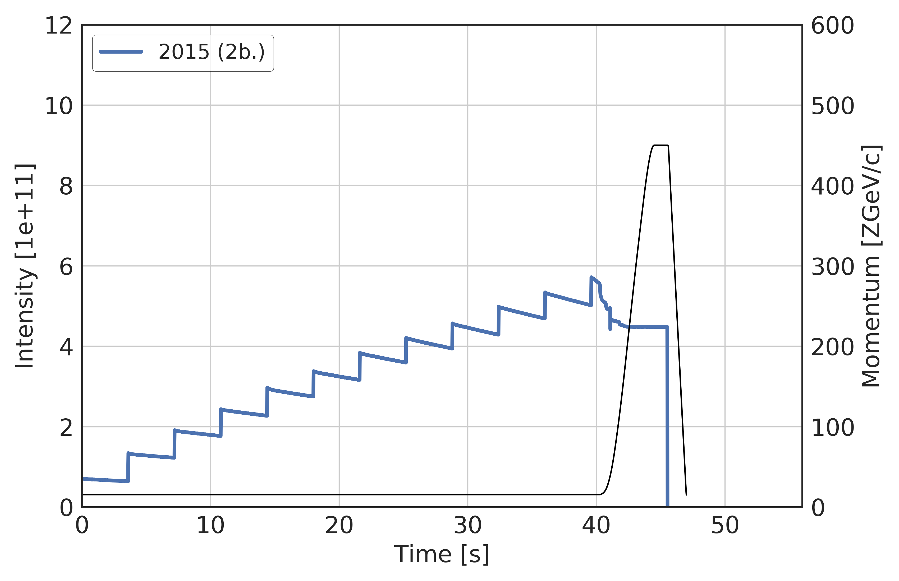
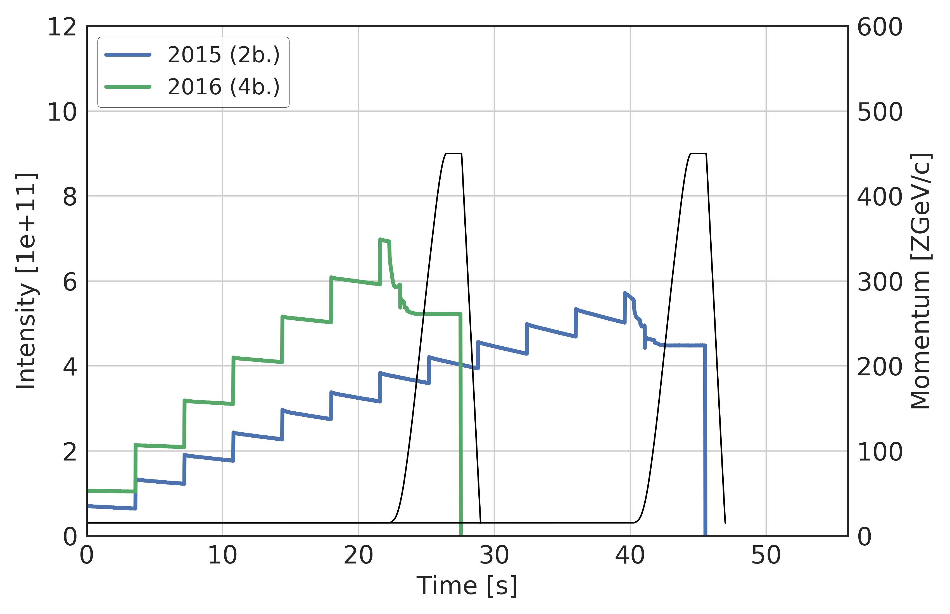
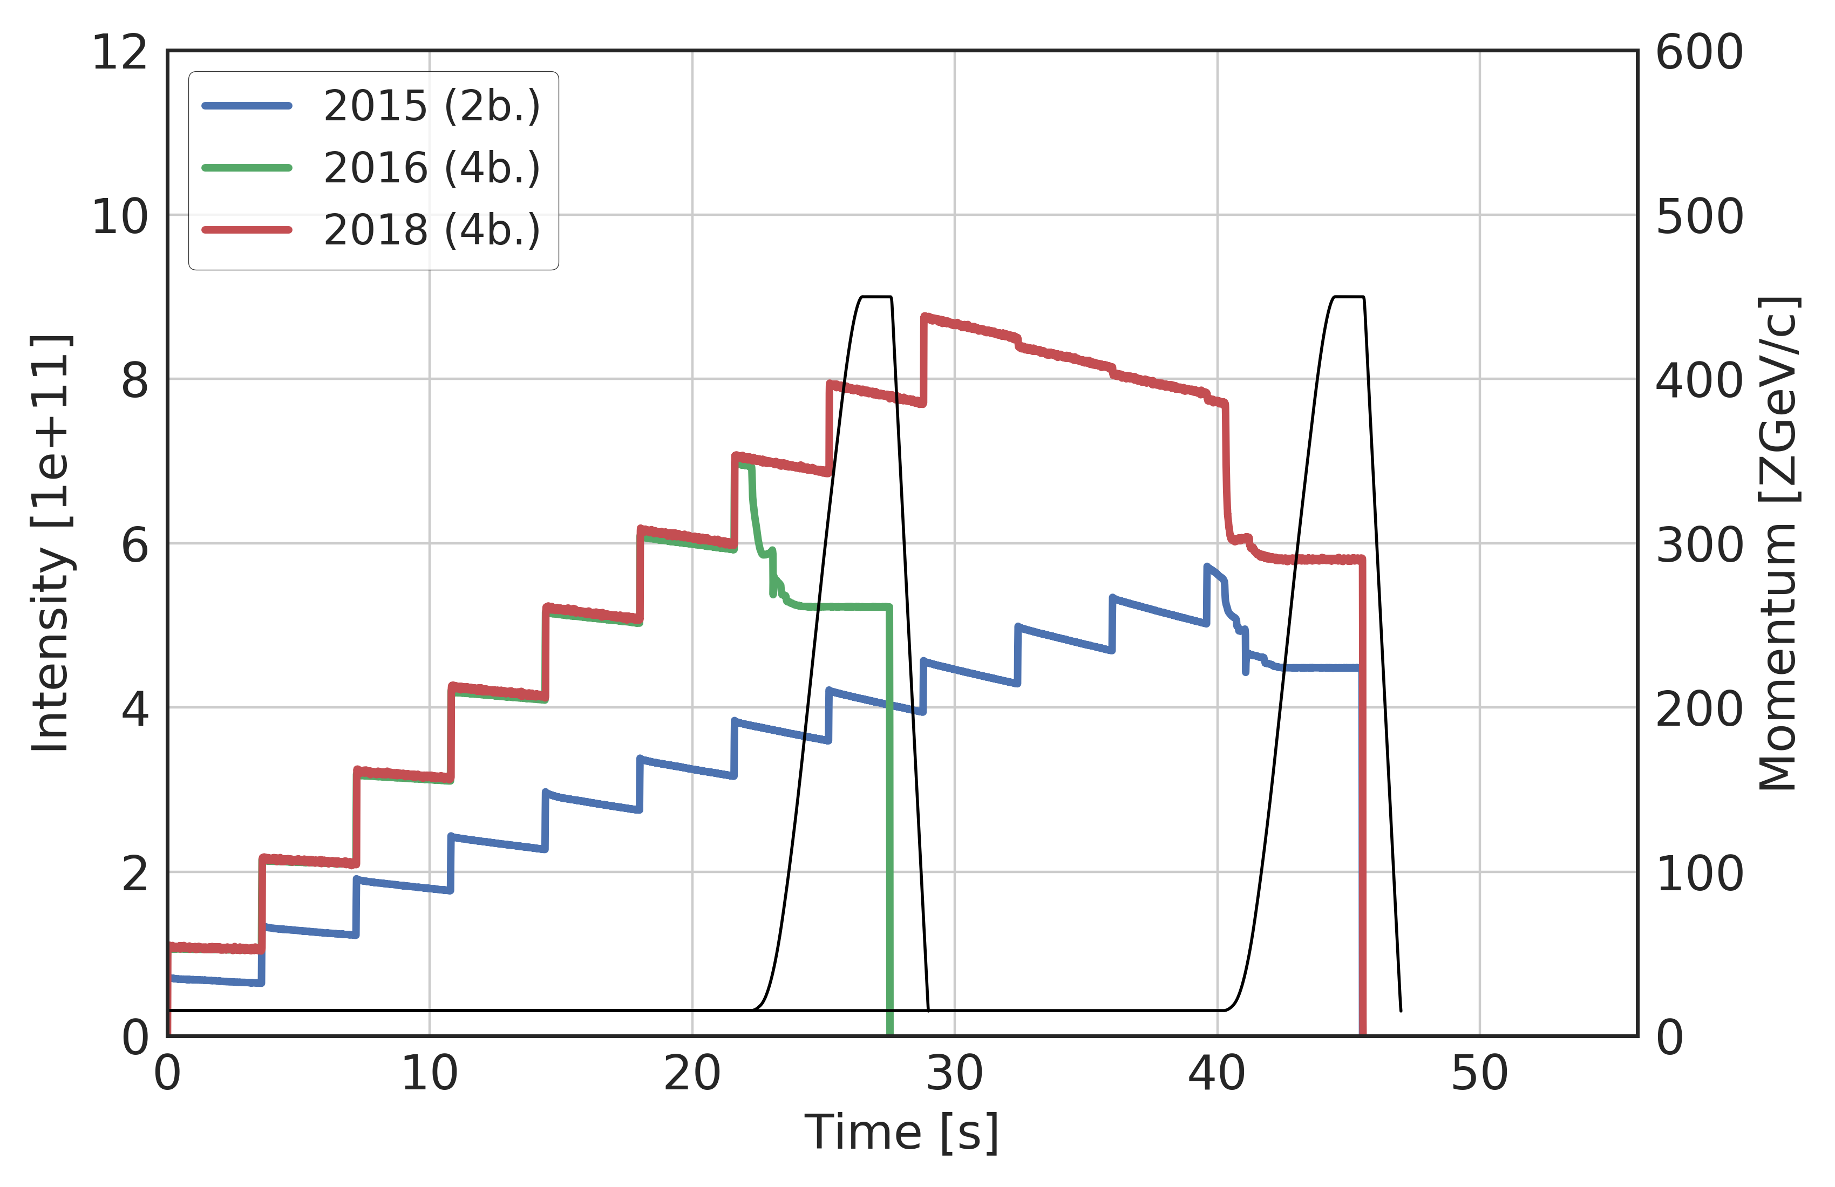
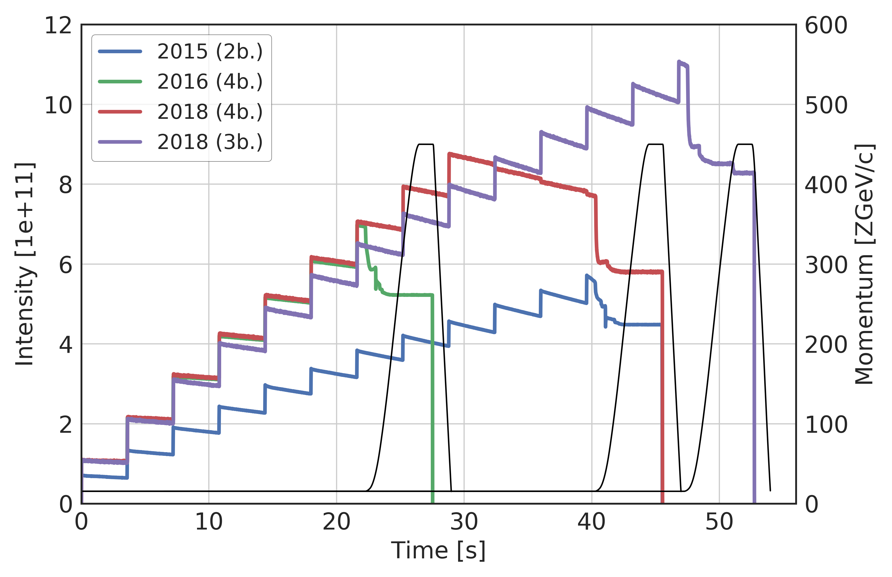
SPS cycles and beams used
First half of the 2018 run with 4 bunch (100 ns) scheme
Cycle prepared for 12 injections – LHC took only 9 injections due to abort gap settings
Similar transmission in Q26 (2018) as in Q20 (2016)
Second half with 3 bunch (75 ns) scheme
Cycle with up to 14 injections
Scraping had been requested by LHC

Slide 3
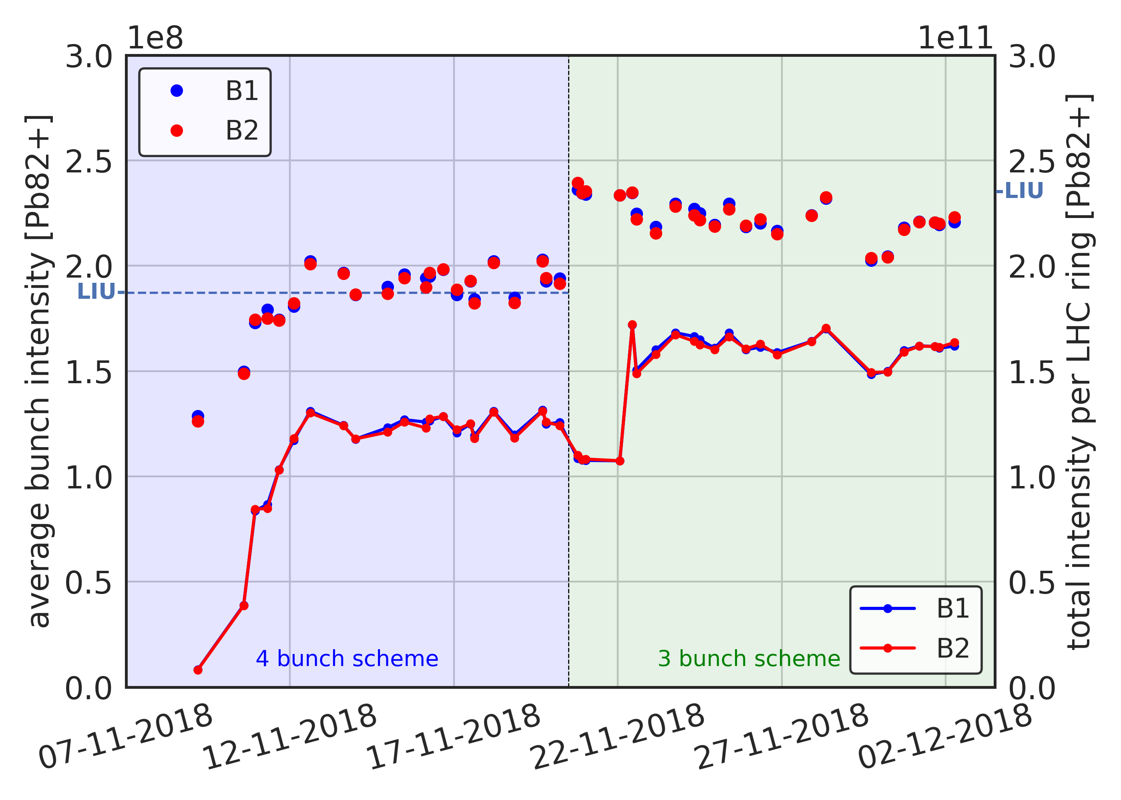
Intensity evolution LHC Pb-Pb run 2018
733 bunches in LHC
648 bunches in LHC

Slide 4
Intensity evolution LHC Pb-Pb run 2018
1.6e11
733 bunches in LHC
648 bunches in LHC

Slide 5
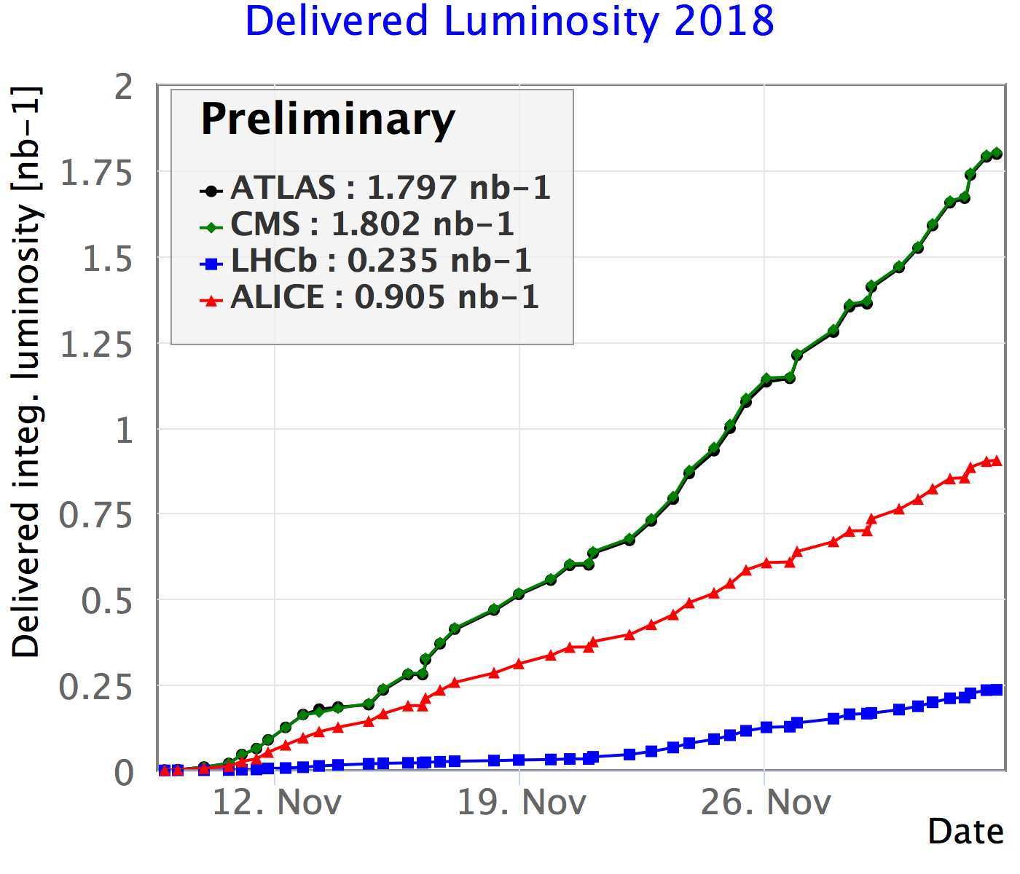
Integrated luminosity in LHC
HL-LHC goal: 2.85 nb⁻¹ (in ALICE, ATLAS, CMS)
2015
2015
~39 × (2015)

Slide 6
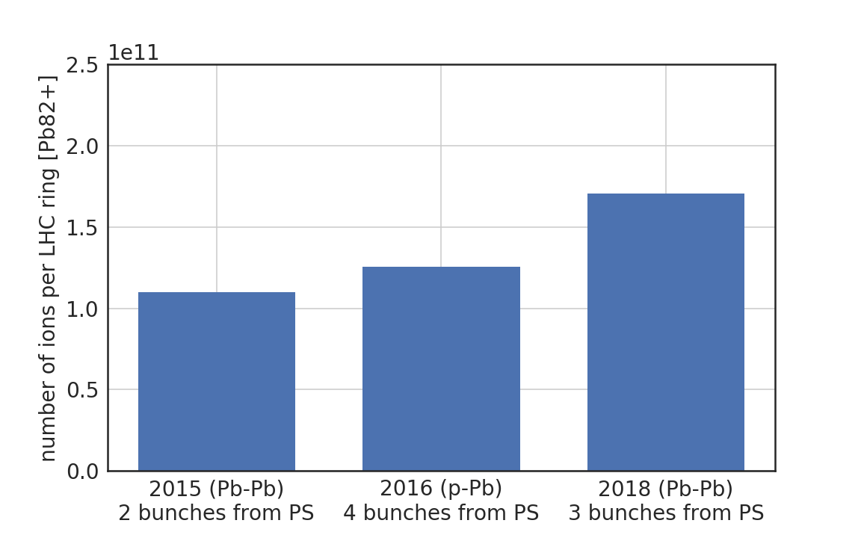
Pb-ion performance over the last years
LIU goal (2.35e11)
75 ns
spacing
slip stacking
100 ns spacing
100 ns spacing
100 ns
spacing
100 ns
spacing

Slide 7
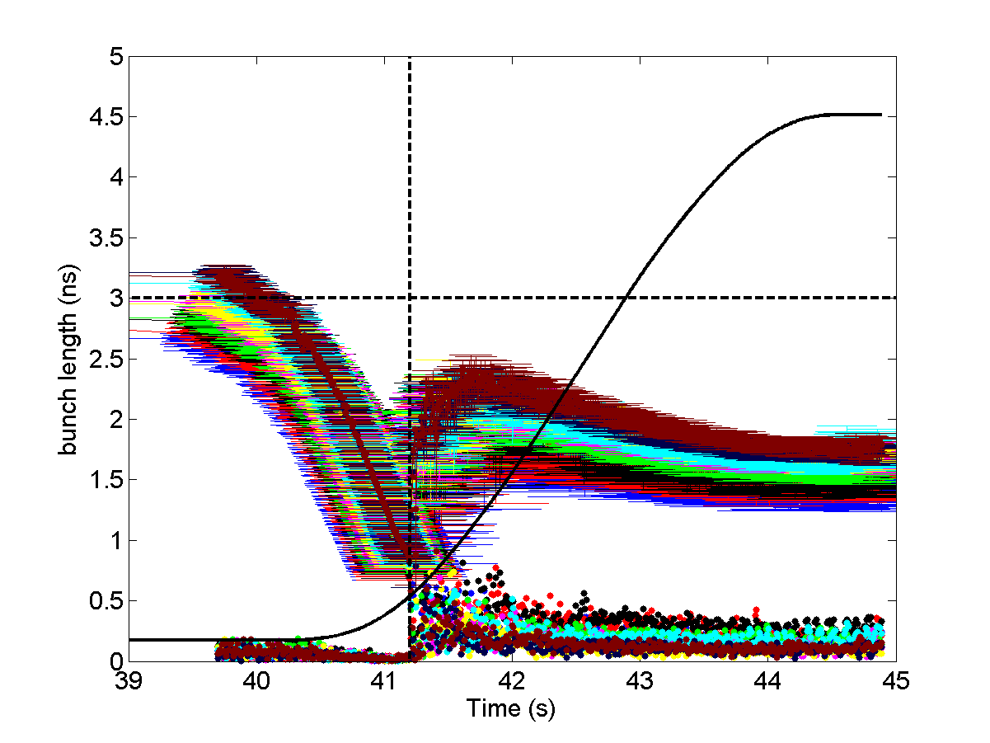
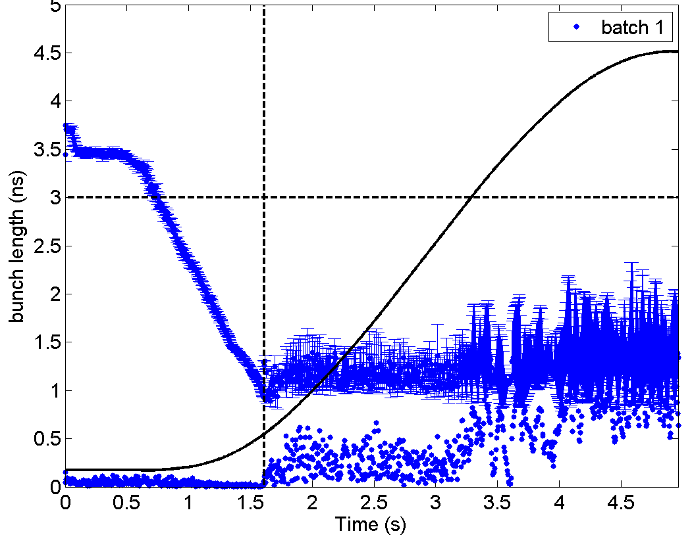
Issues with longitudinal stability
Significant reduction of intensity and bunch length along the SPS batch at end of flat bottom
leads to instability of the shortest (and less intense) bunches
Transition crossing
Adjustments are done using many knobs (2 main: transition timing and radial beam displacement)
Instability and emittance blow-up during transition crossing lead to better beam stability later on
Will be improved after LS2 due to LLRF (phase discriminator) upgrade
But … bunches crossing transition without significant blow-up become unstable later
Had to run with relaxed BQM settings
bunch length tolerance 2.2 ns, …
No particular issue from LHC side!

Slide 8
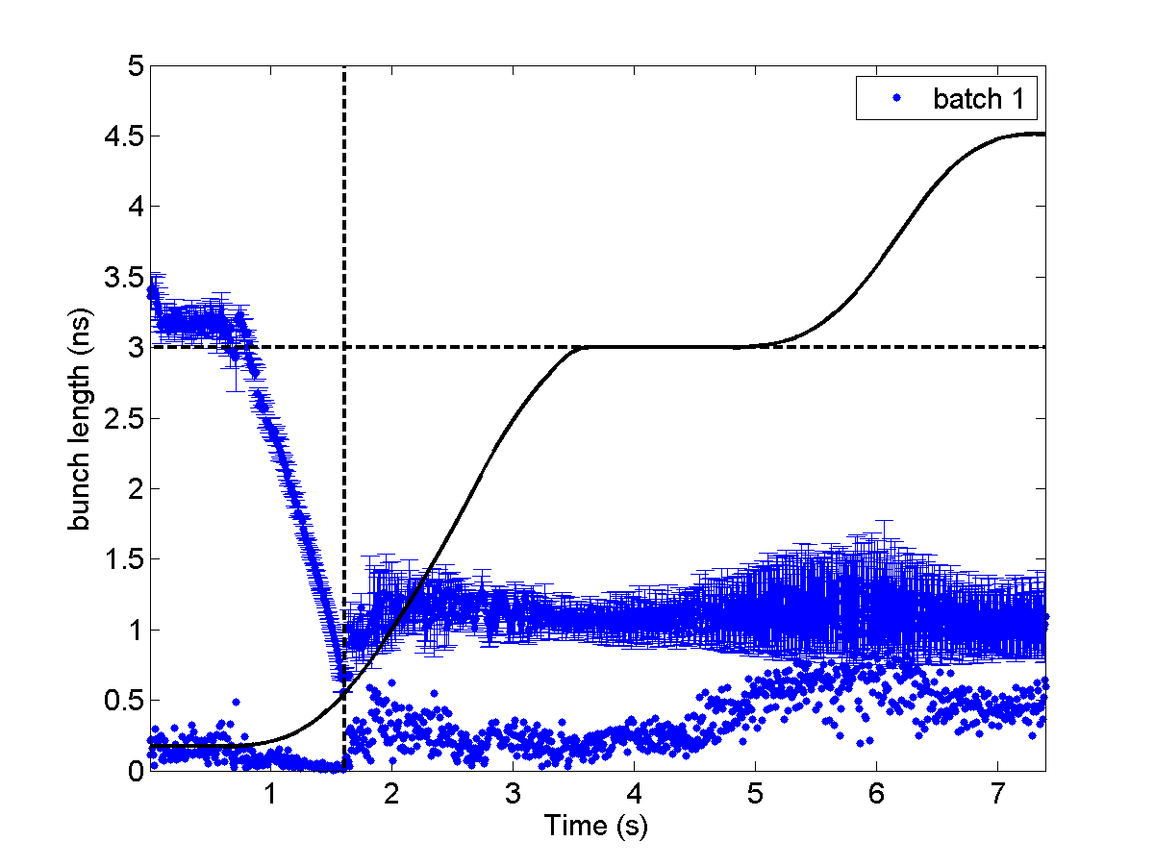
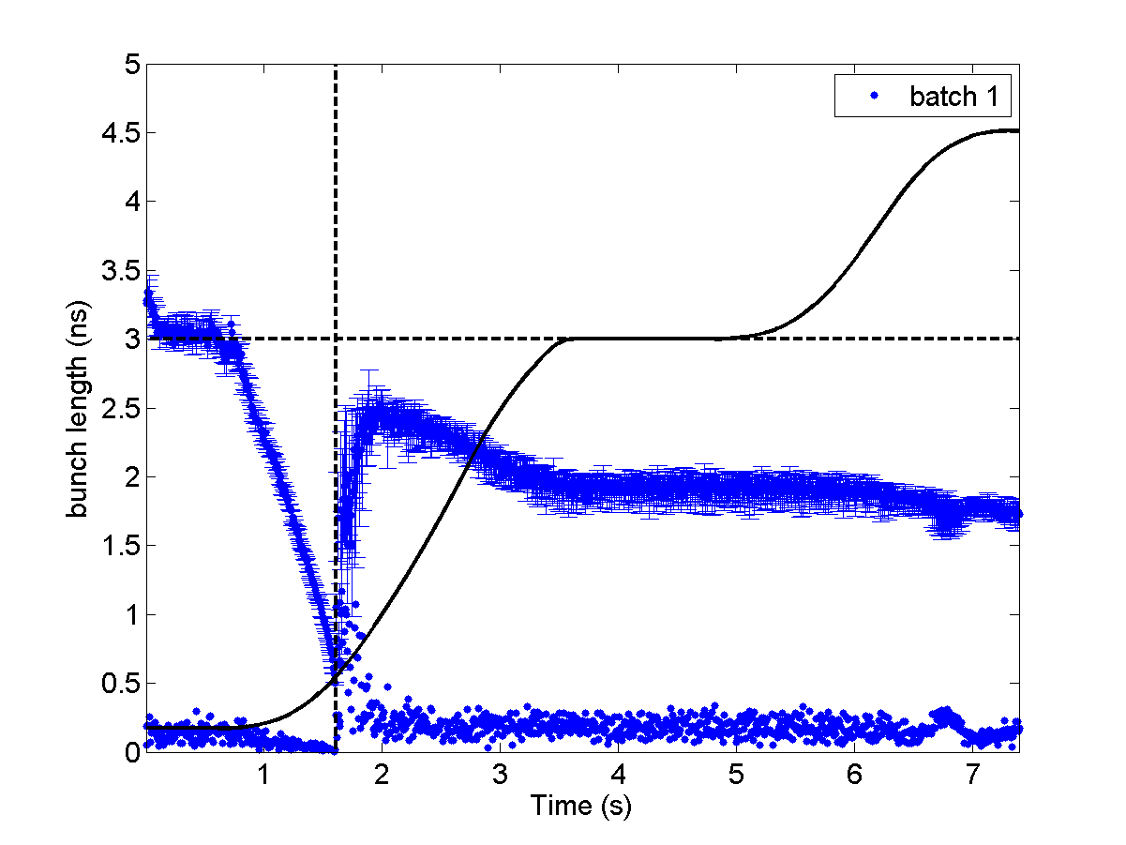
Observations during slip-stacking MD
Radial displacement at intermediate flat portion (20 mm) didn’t lead to BCT losses
maybe we can displace only one beam and simplify slip-stacking?
Instability is often starting at the plateau
reduction in the synchrotron frequency spread?
Slip-stacking of unstable beam will be difficult and not reproducible
Need to find mitigation measures for beam stabilisation before and during slip-stacking
Beam becoming unstable on flat portion
Beam stable after blow-up at transition

Slide 9
Possible stabilisation of the ion beam
800 MHz RF system was finally applied during one MD after deployment for ions
relative phase was not specifically calibrated for ion operation
no effect on beam was observed
can be used only after transition crossing (too late?)
if used during slip-stacking – need separate control of each cavity (as 200 MHz) – not available
Controlled emittance blow-up
very difficult in a single RF system due to small frequency spread
In double RF can be done only after transition crossing (too late?)
large bunch-by bunch variation in bunch length (> 50%) and then in synchrotron frequency shift
Feasibility of controlled blow-up needs to be studied during LS2 in simulations for realistic bunch-by-bunch particle distribution and SPS impedance model
before transition crossing in a single RF
after transition in double RF with phase noise or phase modulation of 800 MHz

Slide 10
Summary & Outlook
Very successful ion run for the SPS and all injectors
High intensity beam delivered by Linac3/LEIR and PS
No particular issue related to 75 ns beam
Q26 re-deployed with no big difference wrt. Q20 (Q26 required to avoid bunch rotation after slip stacking in the future!)
Reached expected total intensity in LHC (67% of LIU intensity) with 3 bunch 75 ns scheme
Longitudinal instabilities encountered after transition crossing (as with Q20)
MDs devoted to tune scans and tests in view of slip stacking (data analysis ongoing)
Test of 6 bunch scheme successful – option for slip stacking commisioning (low bunch intensity)
Outlook: slip stacking
Reaching LIU goal requires slip stacking (in first run after LS2)
Achieving longitudinal stability of ion bunches is big challenge, but pre-requisite to slip stacking
Simulation studies during LS2 for achieving longitudinal stability and optimizing slip stacking manipulations
Will need commitment of all people involved to make it operational in first year after LS2

