Slide 1
SPS space charge studies in presence of power converter ripple
H. Bartosik, F. Schmidt
LIU-SPS-BD meeting, 13 February 2018

Slide 2
Outline
Introduction
Experiment
Discussion on resonances
Comparison with simulations
Conclusions and outlook

Slide 3
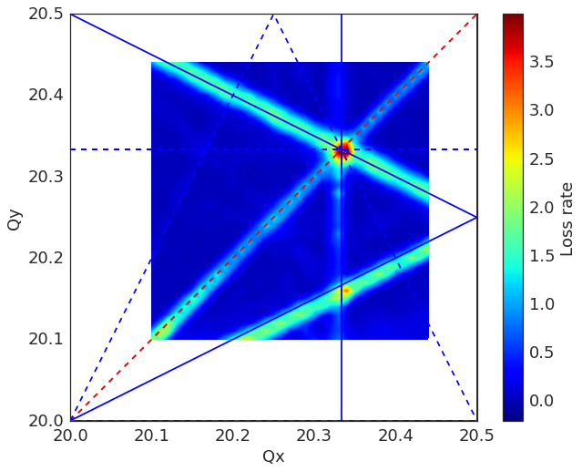
Introduction
It started as benchmarking experiment of the 3rd order horizontal resonance …
  In particular relevant for ion operation
Reference: experimental “zero” intensity tune scan
  Quite clean resonance diagram
  Mostly the 3rd order resonances seem to be excited (by residual sextupole errors)
proton working point
ion working point
resonances:
red: systematic
blue: non-systematic
– upright
- - skew

Slide 4
Space charge in bunched beams
Space charge in beams with transverse Gaussian distribution have a tune spread
  Spread and maximum tune shift depends on local line density
  Due to synchrotron motion, particles can cross resonances
y
x
Q_{y}
z
Particles close to the peak line density (often in the bunch center) will have the largest tune spread
Q_{x}

Slide 5
Space charge in bunched beams
Space charge in beams with transverse Gaussian distribution have a tune spread
  Spread and maximum tune shift depends on local line density
  Due to synchrotron motion, particles can cross resonances
y
x
Q_{y}
z
The tune spread is reduced for particles
further away from the peak line density
Q_{x}

Slide 6
Space charge in bunched beams
Space charge in beams with transverse Gaussian distribution have a tune spread
  Spread and maximum tune shift depends on local line density
  Due to synchrotron motion, particles can cross resonances
y
x
Q_{y}
z
The tune spread is reduced for particles
further away from the peak line density
Q_{x}

Slide 7
Space charge in bunched beams
Space charge in beams with transverse Gaussian distribution have a tune spread
  Spread and maximum tune shift depends on local line density
  Due to synchrotron motion, particles can cross resonances
y
x
Q_{y}
z
The tune spread is reduced for particles
further away from the peak line density
Q_{x}

Slide 8
Space charge in bunched beams
Space charge in beams with transverse Gaussian distribution have a tune spread
  Spread and maximum tune shift depends on local line density
  Due to synchrotron motion, particles can cross resonances
y
x
Q_{y}
z
The tune spread is reduced for particles
further away from the peak line density
Q_{x}

Slide 9
Space charge in bunched beams
Space charge in beams with transverse Gaussian distribution have a tune spread
  Spread and maximum tune shift depends on local line density
  Due to synchrotron motion, particles can cross resonances
y
x
  Depending on the working point, mostly particles in the longitudinal core or in the longitudinal tail will see the resonance
Q_{y}
z
Q_{x}

Slide 10
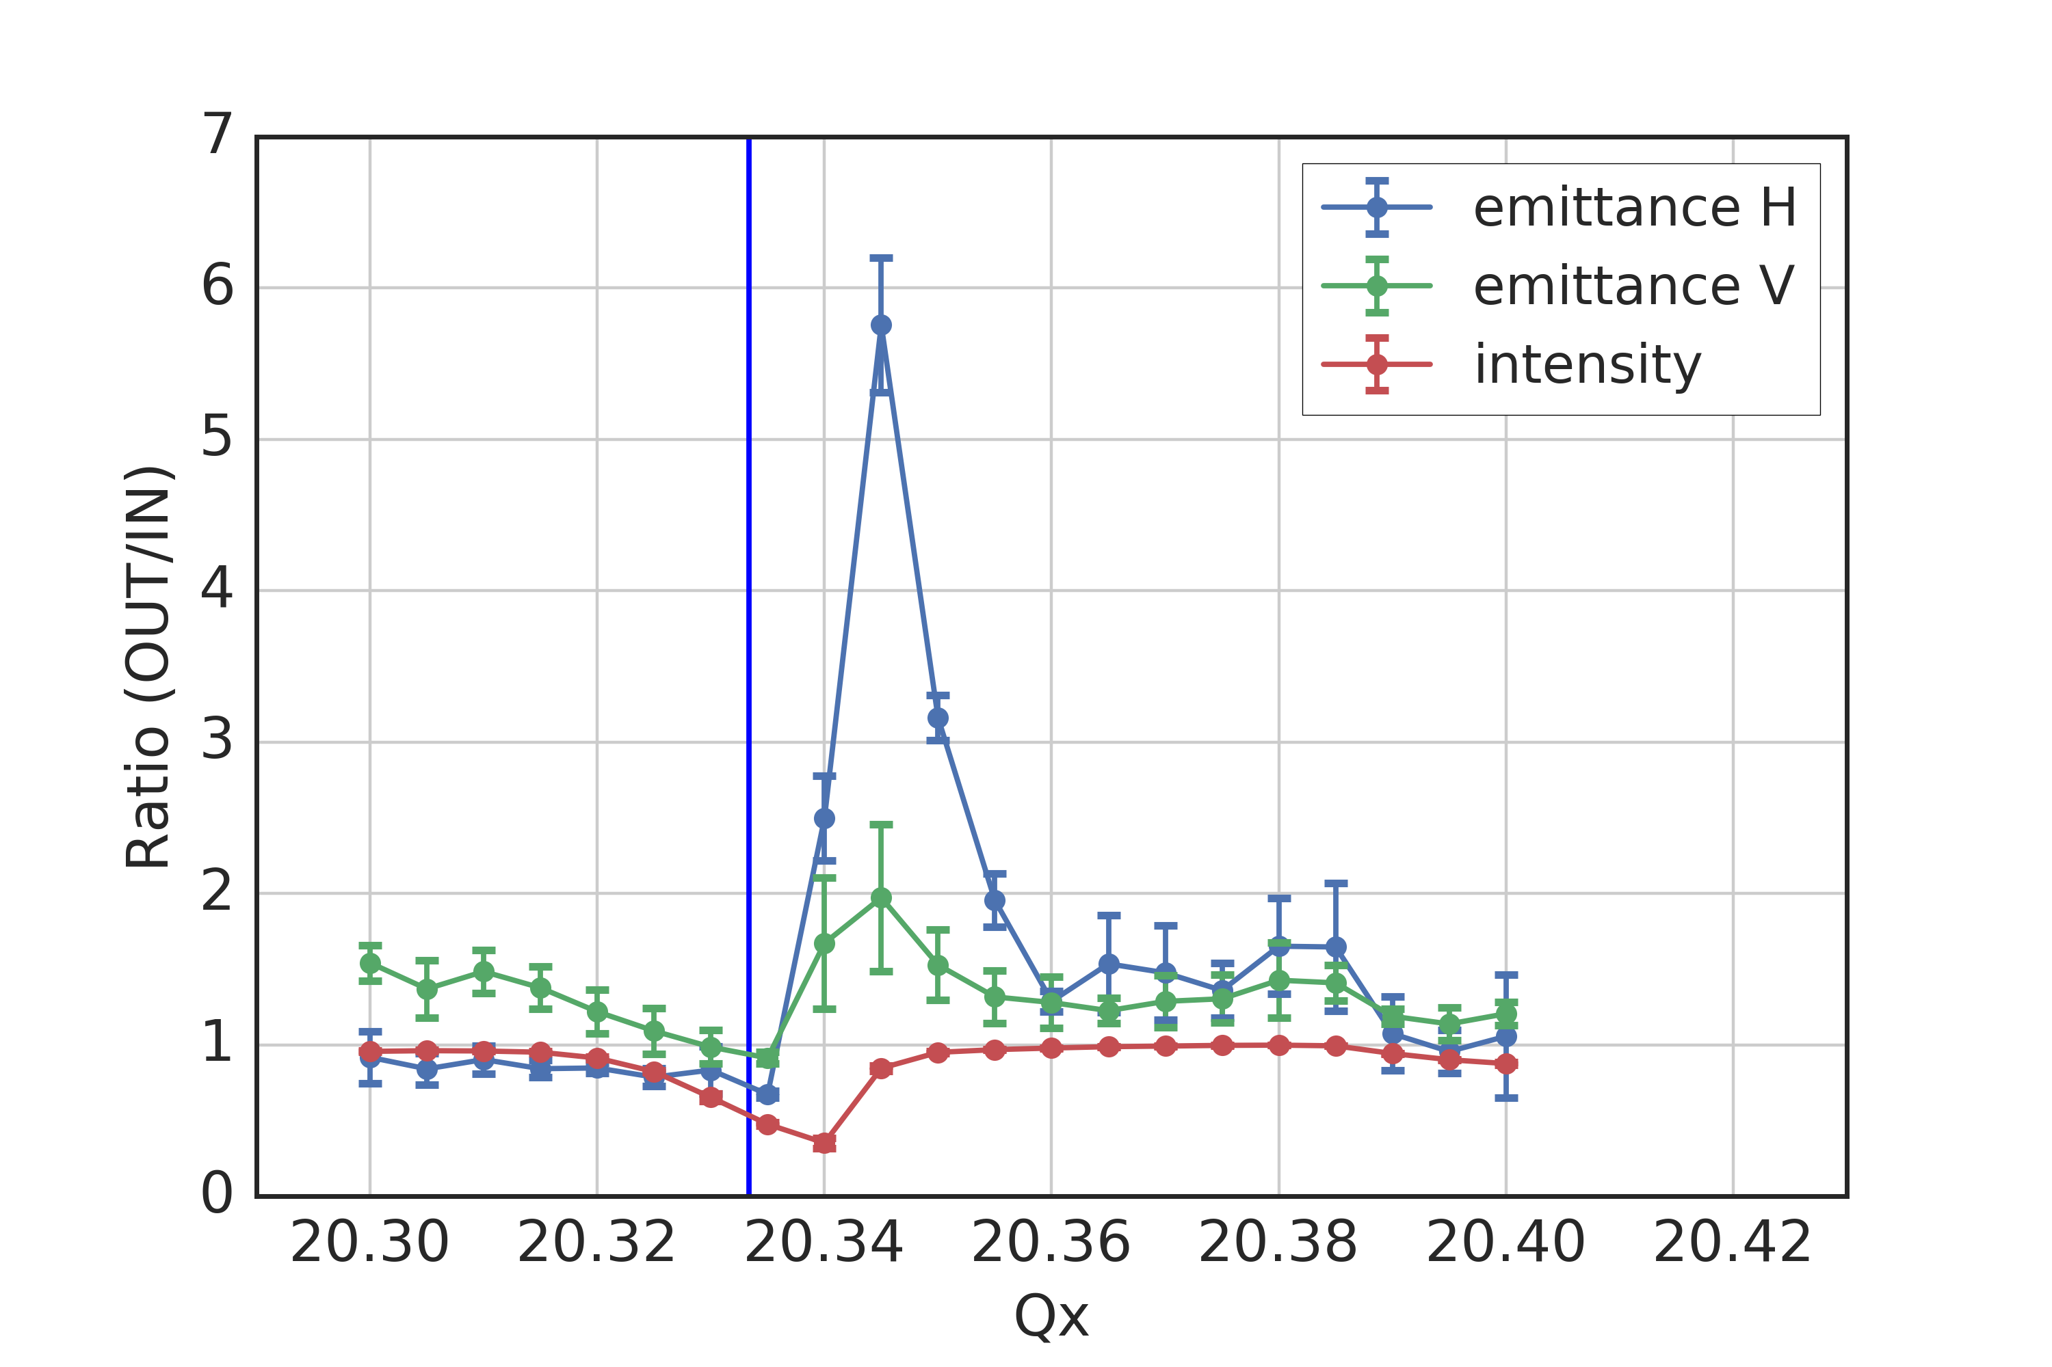
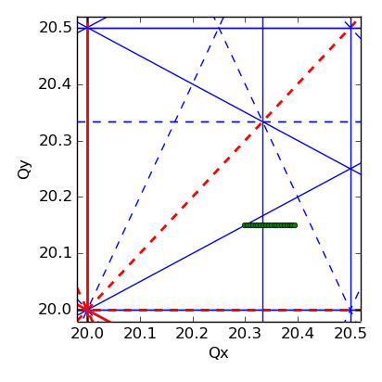
Experiment
  Tunes kept constant during ~3 s storage
  A sextupole is excited voluntarily starting from 160 ms after injection
  Space charge tune shift ΔQx/ΔQy ~ -0.06/-0.1 , 1/Qs ~ 70 turns
3 Qx = 61

Slide 11
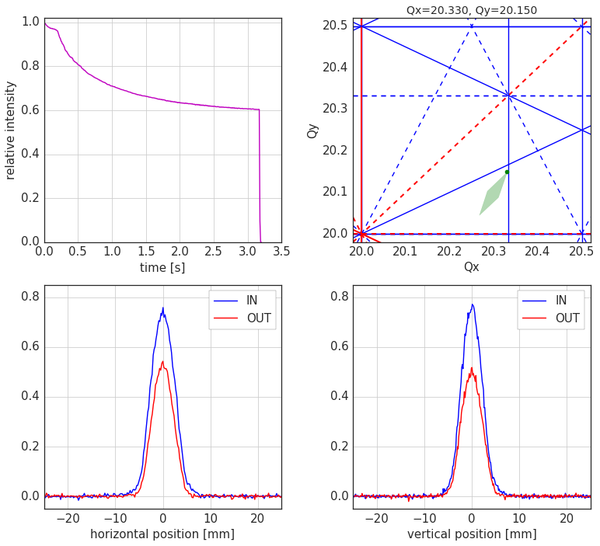
Experiment
  Tunes kept constant during ~3 s storage
  A sextupole is excited voluntarily starting from 160 ms after injection
  Space charge tune shift ΔQx/ΔQy ~ -0.06/-0.1 , 1/Qs ~ 70 turns
3 Qx = 61

Slide 12
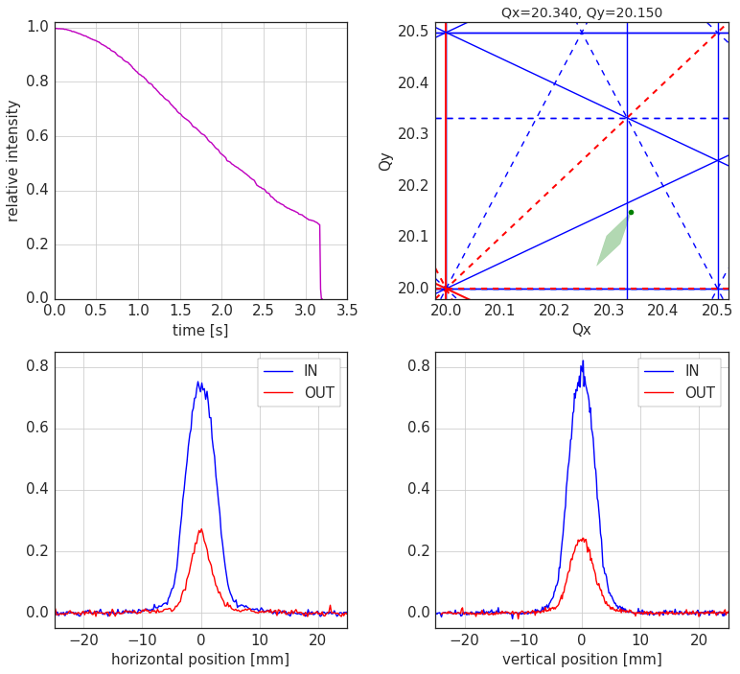
Experiment
  Tunes kept constant during ~3 s storage
  A sextupole is excited voluntarily starting from 160 ms after injection
  Space charge tune shift ΔQx/ΔQy ~ -0.06/-0.1 , 1/Qs ~ 70 turns
3 Qx = 61

Slide 13
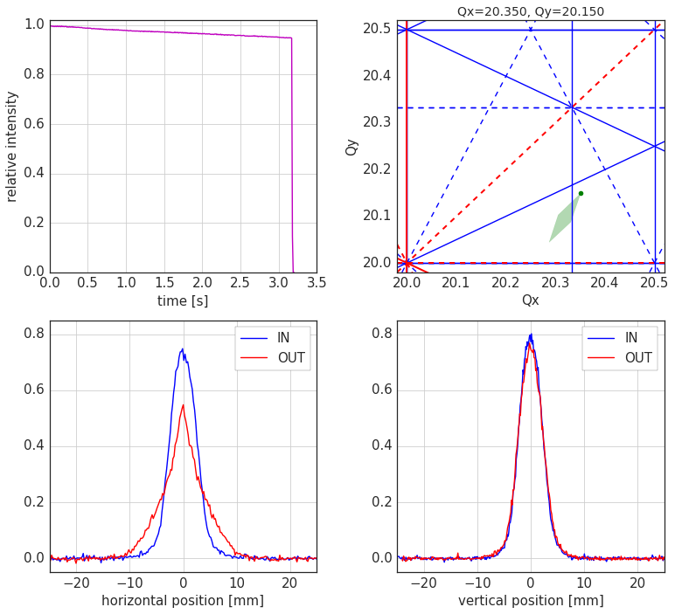
Experiment
  Tunes kept constant during ~3 s storage
  A sextupole is excited voluntarily starting from 160 ms after injection
  Space charge tune shift ΔQx/ΔQy ~ -0.06/-0.1 , 1/Qs ~ 70 turns
3 Qx = 61

Slide 14
Experiment
  Tunes kept constant during ~3 s storage
  A sextupole is excited voluntarily starting from 160 ms after injection
  Space charge tune shift ΔQx/ΔQy ~ -0.06/-0.1 , 1/Qs ~ 70 turns
3 Qx = 61

Slide 15
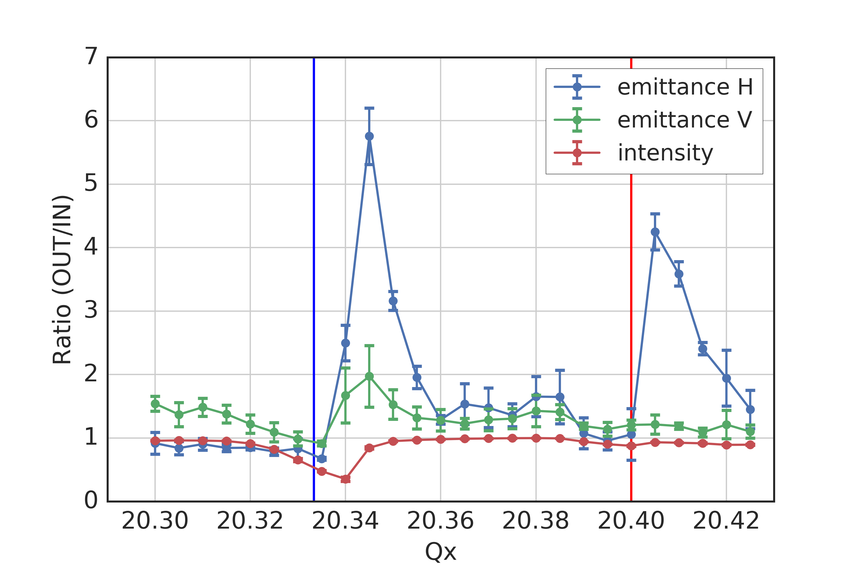
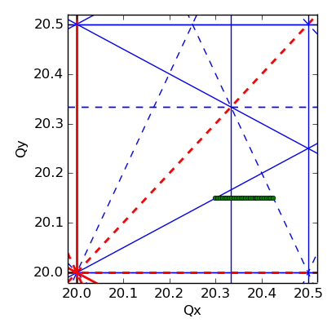
Experiment
  Tunes kept constant during ~3 s storage
  A sextupole is excited voluntarily starting from 160 ms after injection
  Space charge tune shift ΔQx/ΔQy ~ -0.06/-0.1 , 1/Qs ~ 70 turns
  Unexpected beam response due to resonance at Qx = 20.4
?
?
3 Qx = 61

Slide 16
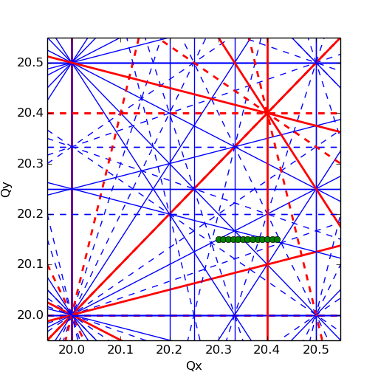
Resonances at Qx = 20.40 (I)
Systematic 5th order resonance: 5 Qx = 102 (not suppressed by periodicity)
  Driven by b5 components (decapole) in main dipoles …
  … which also produce Q’’’ non-linear chromaticity
Resonances up to 5th order
measurement vs. fitted model
significant Q’’’ due to b5 in dipoles
Red: systematic
Blue: non-systematic
– upright
- - skew

Slide 17
Resonances at Qx = 20.40 (II)
Structure resonances driven by non-linear space charge potential
  For a Gaussian transverse distribution
  the transverse space-charge potential can be decomposed in series of pseudo mulipoles*:
  Composed of all even order normal multipoles
  Periodic modulation of potential due to variation of beam size around the machine can result in resonance excitation (“structure resonances”)
* S.Y.Lee et al.: “Emittance growth mechanisms for space-charge dominated beams in fixed field alternating gradient and proton driver rings”, New Journal of Physics 8, 291 (2006)

Slide 18
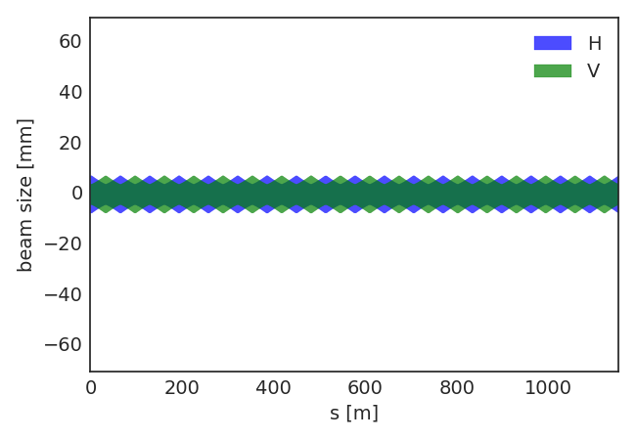
Resonances at Qx = 20.40 (II)
10th order structure resonance: 10 Qx = 204
  Driven by non-linearity of Gaussian space charge potential and beam size modulation
  SPS has 6-fold symmetry with 108 regular FODO cells in total (main lattice harmonic: 108)
3σ beam size without dispersion
(1 sextant)
(beam parameters from experiment)

Slide 19
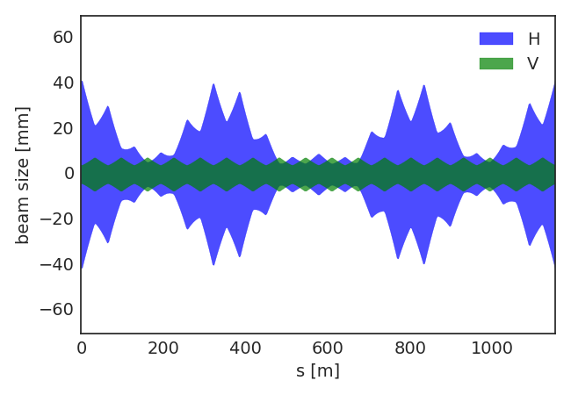
Resonances at Qx = 20.40 (II)
10th order structure resonance: 10 Qx = 204
  Driven by non-linearity of Gaussian space charge potential and beam size modulation
  SPS has 6-fold symmetry with 108 regular FODO cells in total (main lattice harmonic: 108)
  Beam size variation due to dispersion generates additional lattice harmonics
3σ beam size including dispersion
(1 sextant)
(beam parameters from experiment)

Slide 20
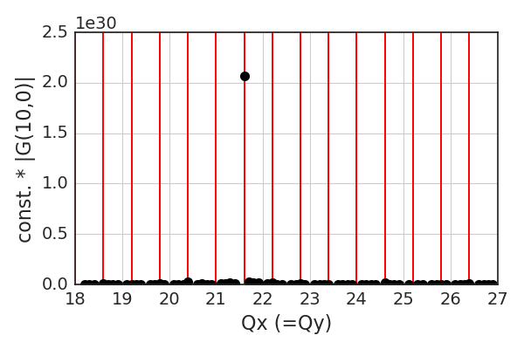
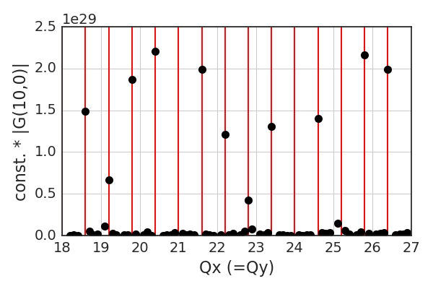
Resonances at Qx = 20.40 (II)
10th order structure resonance: 10 Qx = 204
  Driven by non-linearity of Gaussian space charge potential and beam size modulation
  SPS has 6-fold symmetry with 108 regular FODO cells in total (main lattice harmonic: 108)
  Beam size variation due to dispersion generates additional lattice harmonics
  Excitation of 10th order resonance clearly seen in driving term of space charge potential
δp/p(rms) = 0
δp/p(rms) = 1.7e-3
– systematic
resonance at Qx=21.6
(harmonic 216=2*108)
also resonance at Qx=20.4

Slide 21
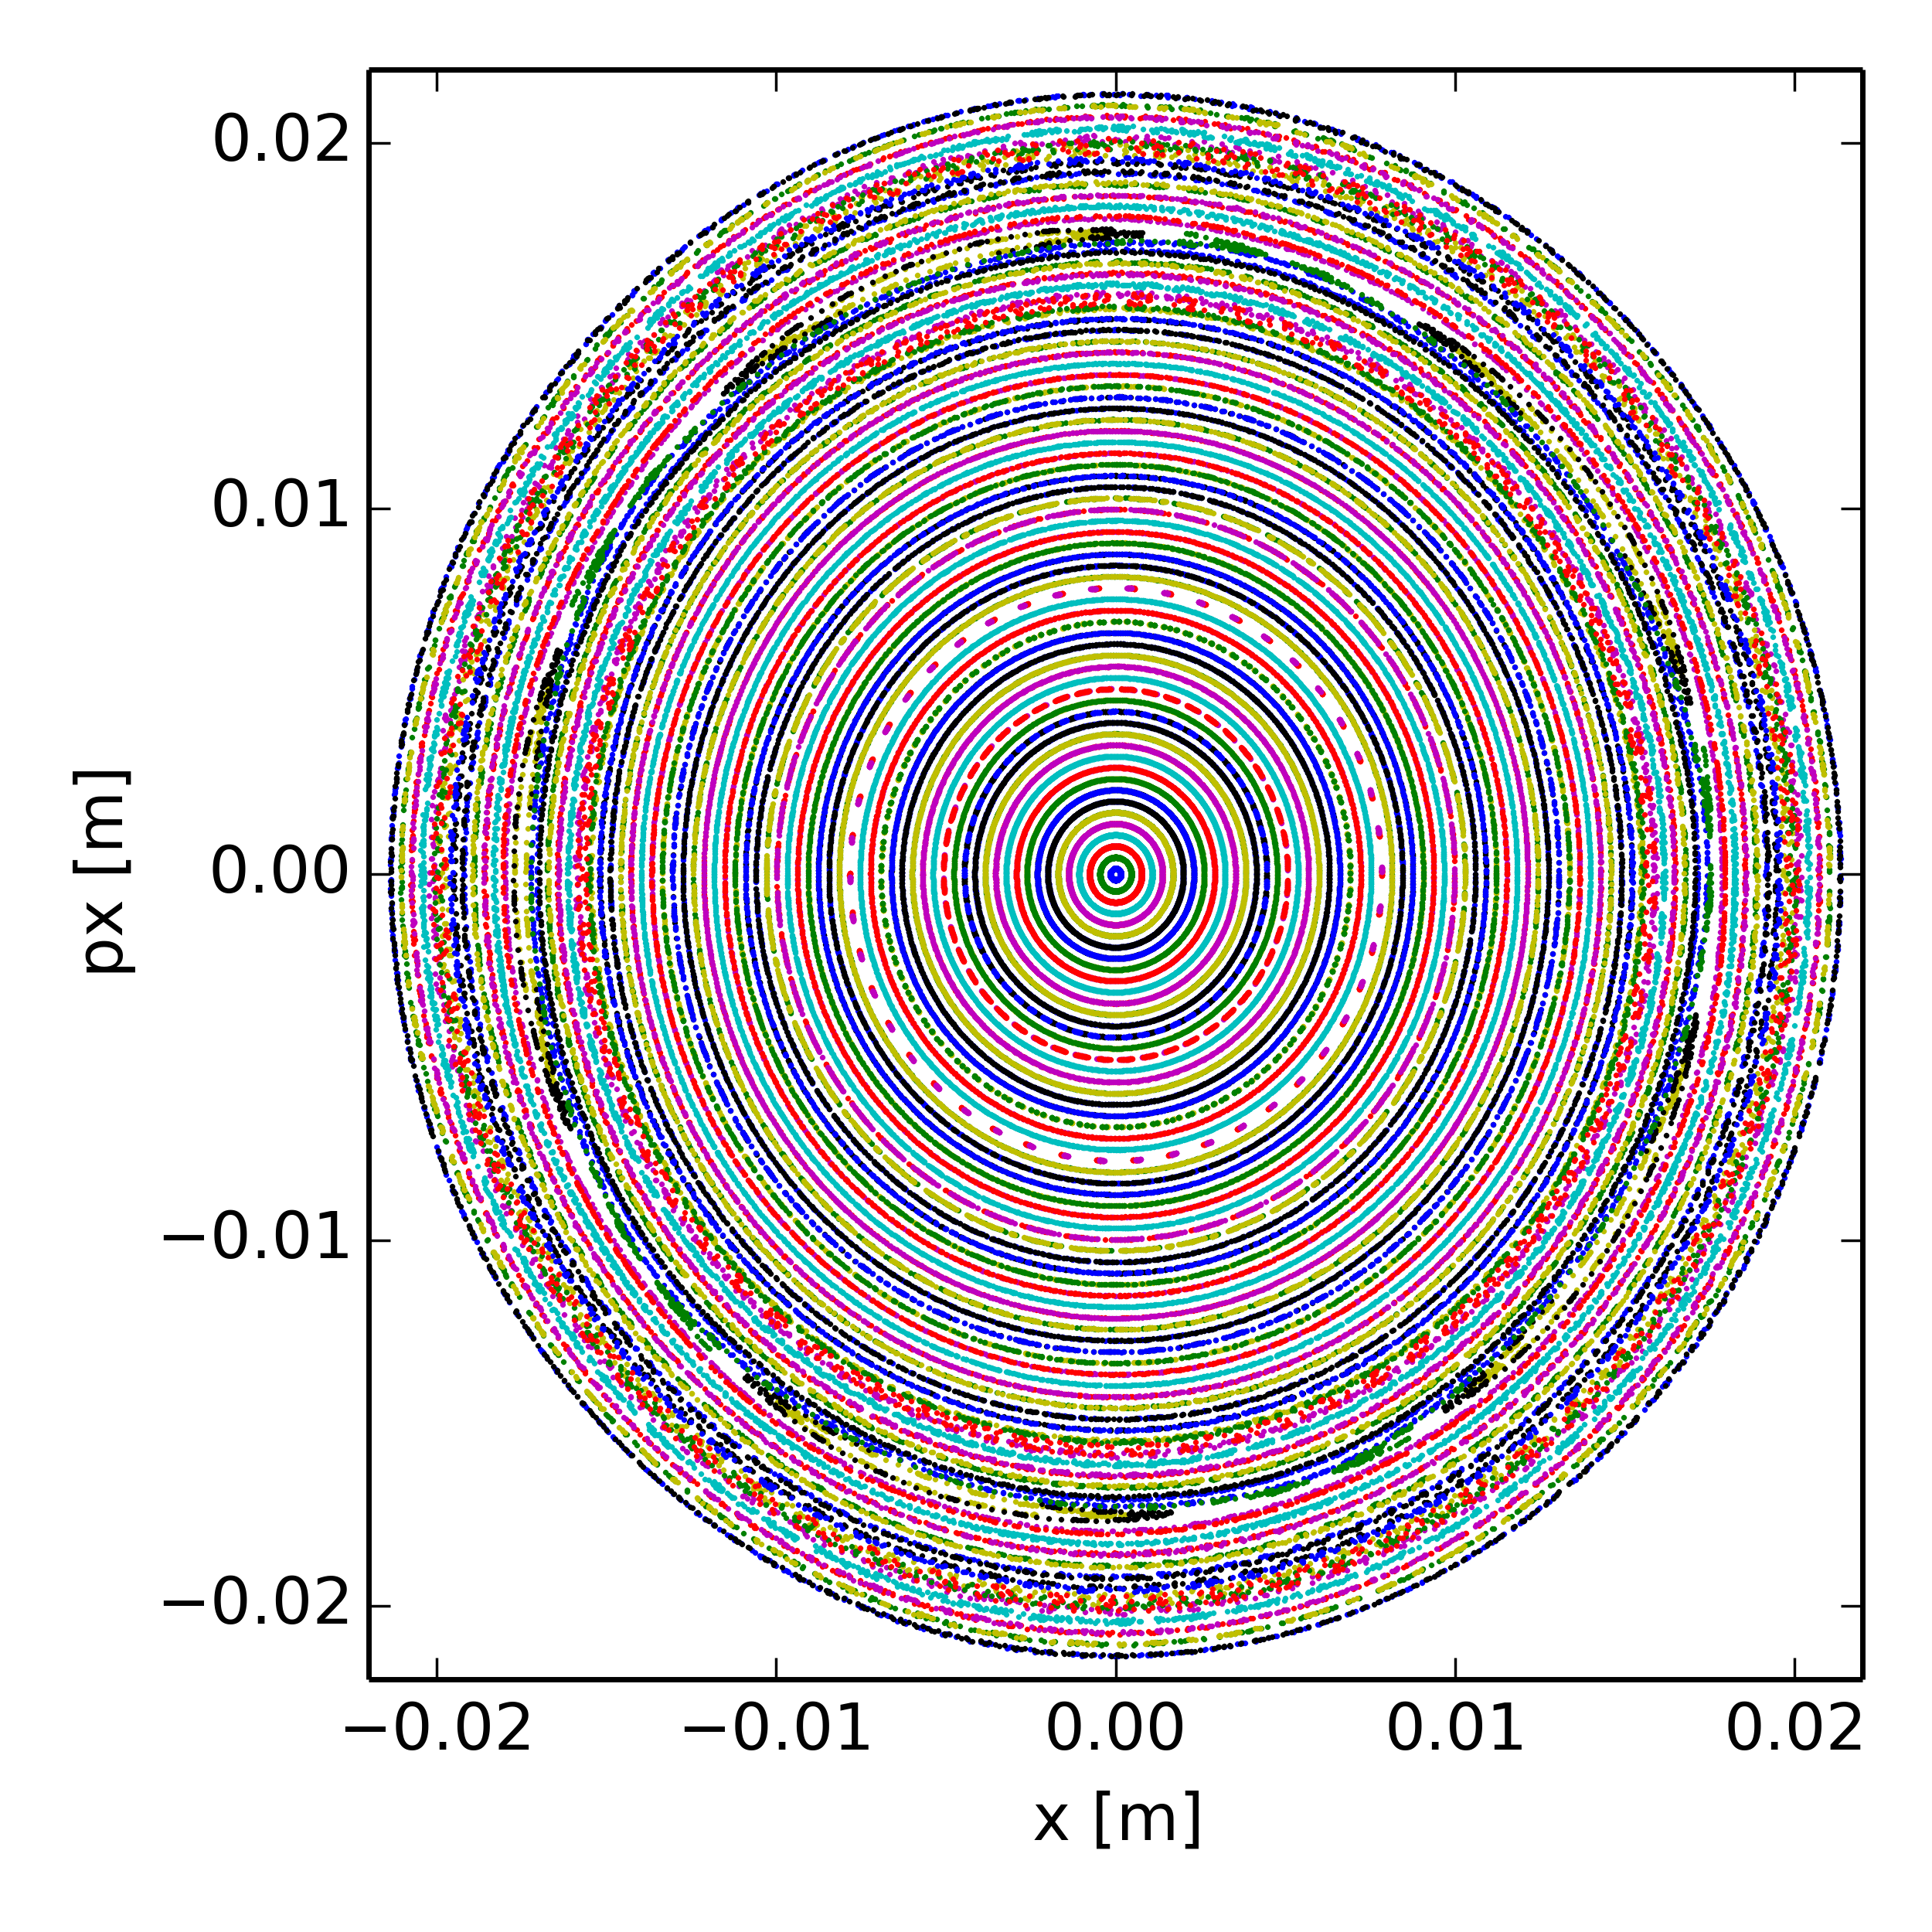
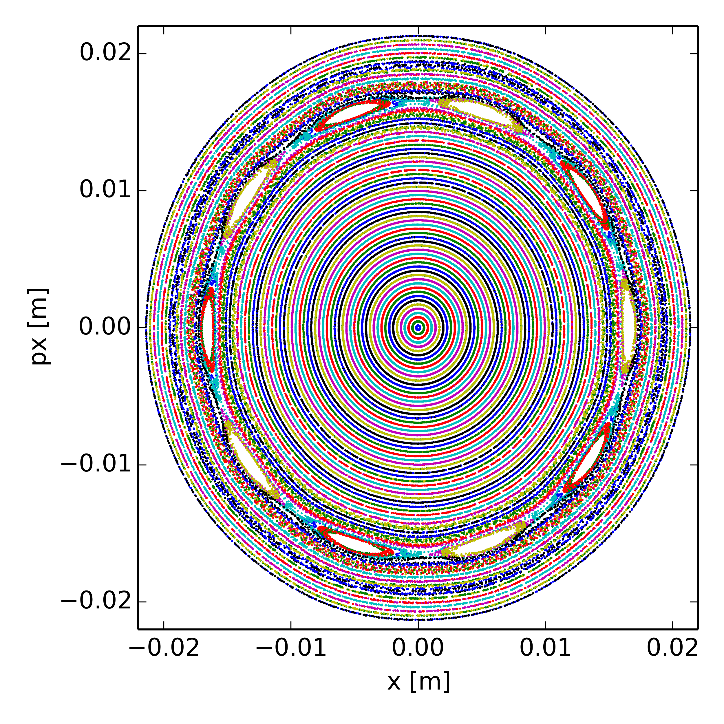
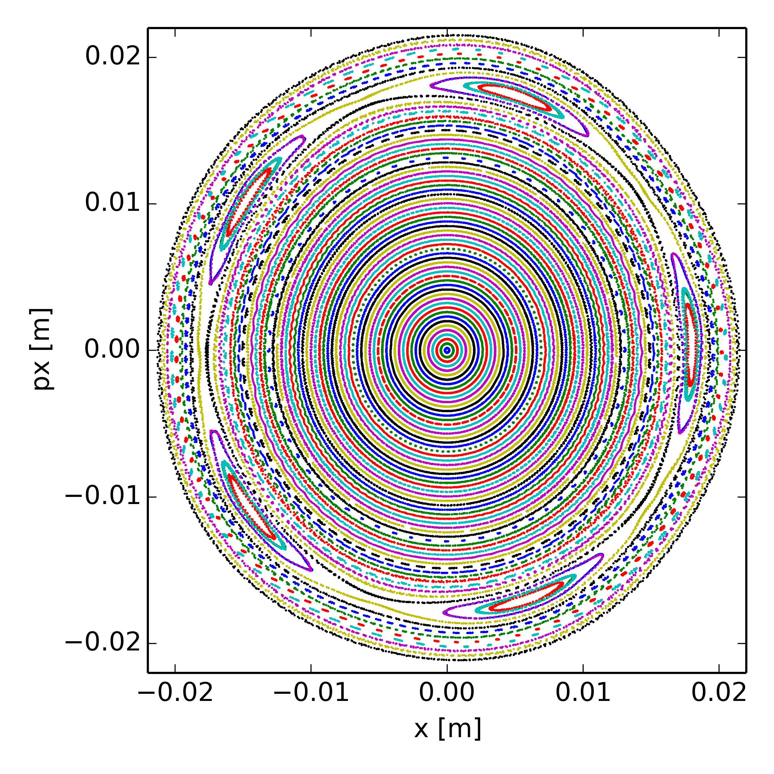
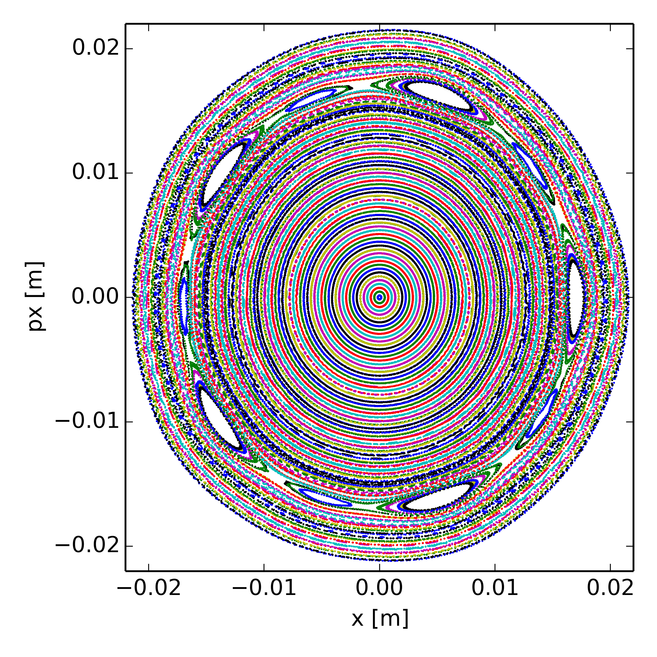
Poincaré maps at Qx = 20.40 (dp/p = 0)
space charge potential for beam without momentum spread
space charge potential for realistic beam incl. momentum spread
“no” resonance
10th order
bare lattice
(no nonlinear magnetic elements)
5th order
5th + 10th order
nonlinear model
(including b5 from dipoles)

Slide 22
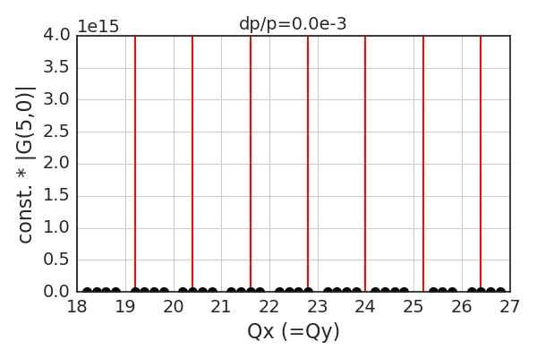
Resonances at Qx = 20.40 (III)
5th order resonance due to space charge potential for off-momentum particles
  Gaussian space charge potential has all even orders of (“pseudo”-) multipoles
  Particles with non-zero dp/p will see a feed-down effect of the “b6” from space charge

Slide 23
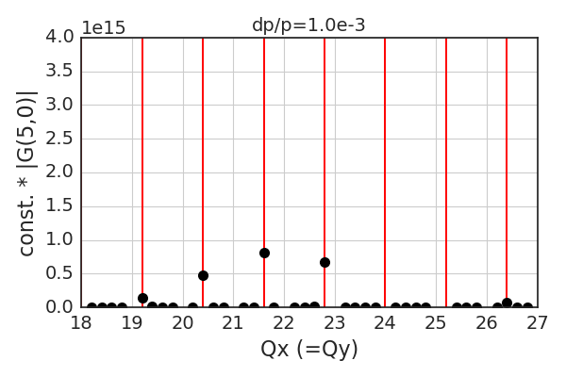
Resonances at Qx = 20.40 (III)
5th order resonance due to space charge potential for off-momentum particles
  Gaussian space charge potential has all even orders of (“pseudo”-) multipoles
  Particles with non-zero dp/p will see a feed-down effect of the “b6” from space charge

Slide 24
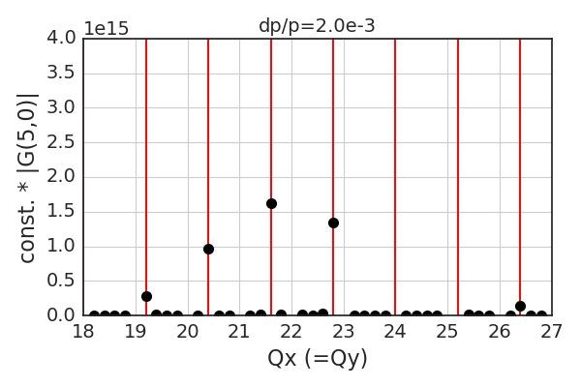
Resonances at Qx = 20.40 (III)
5th order resonance due to space charge potential for off-momentum particles
  Gaussian space charge potential has all even orders of (“pseudo”-) multipoles
  Particles with non-zero dp/p will see a feed-down effect of the “b6” from space charge

Slide 25
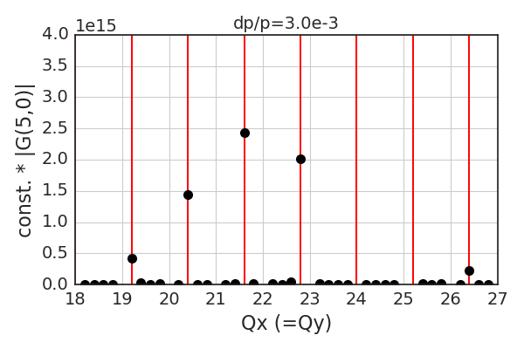
Resonances at Qx = 20.40 (III)
5th order resonance due to space charge potential for off-momentum particles
  Gaussian space charge potential has all even orders of (“pseudo”-) multipoles
  Particles with non-zero dp/p will see a feed-down effect of the “b6” from space charge

Slide 26
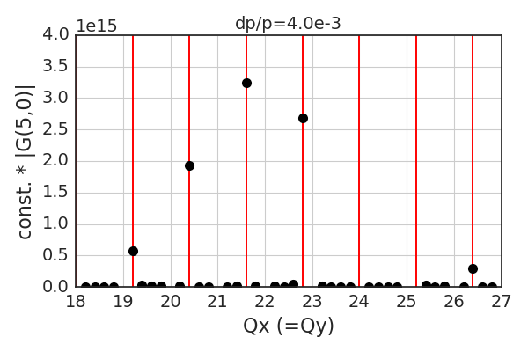
Resonances at Qx = 20.40 (III)
5th order resonance due to space charge potential for off-momentum particles
  Gaussian space charge potential has all even orders of (“pseudo”-) multipoles
  Particles with non-zero dp/p will see a feed-down effect of the “b6” from space charge

Slide 27
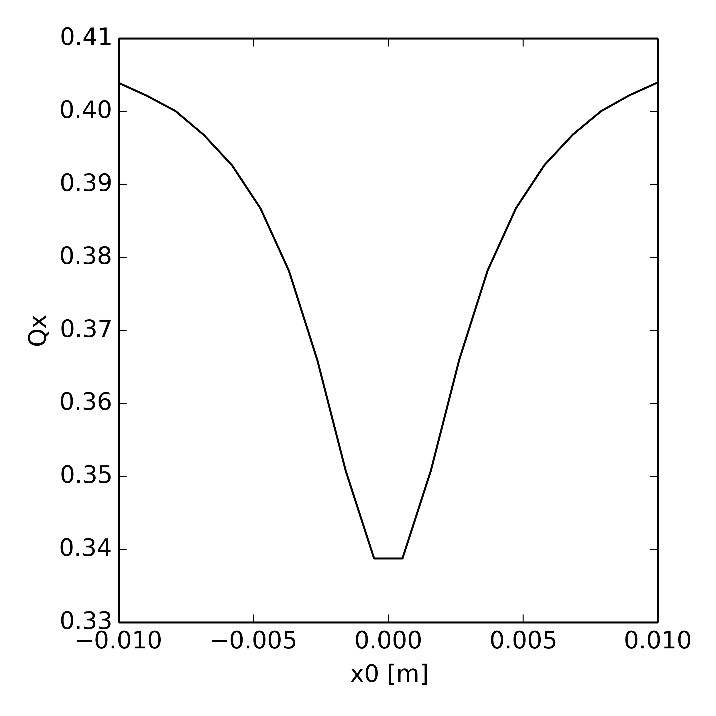
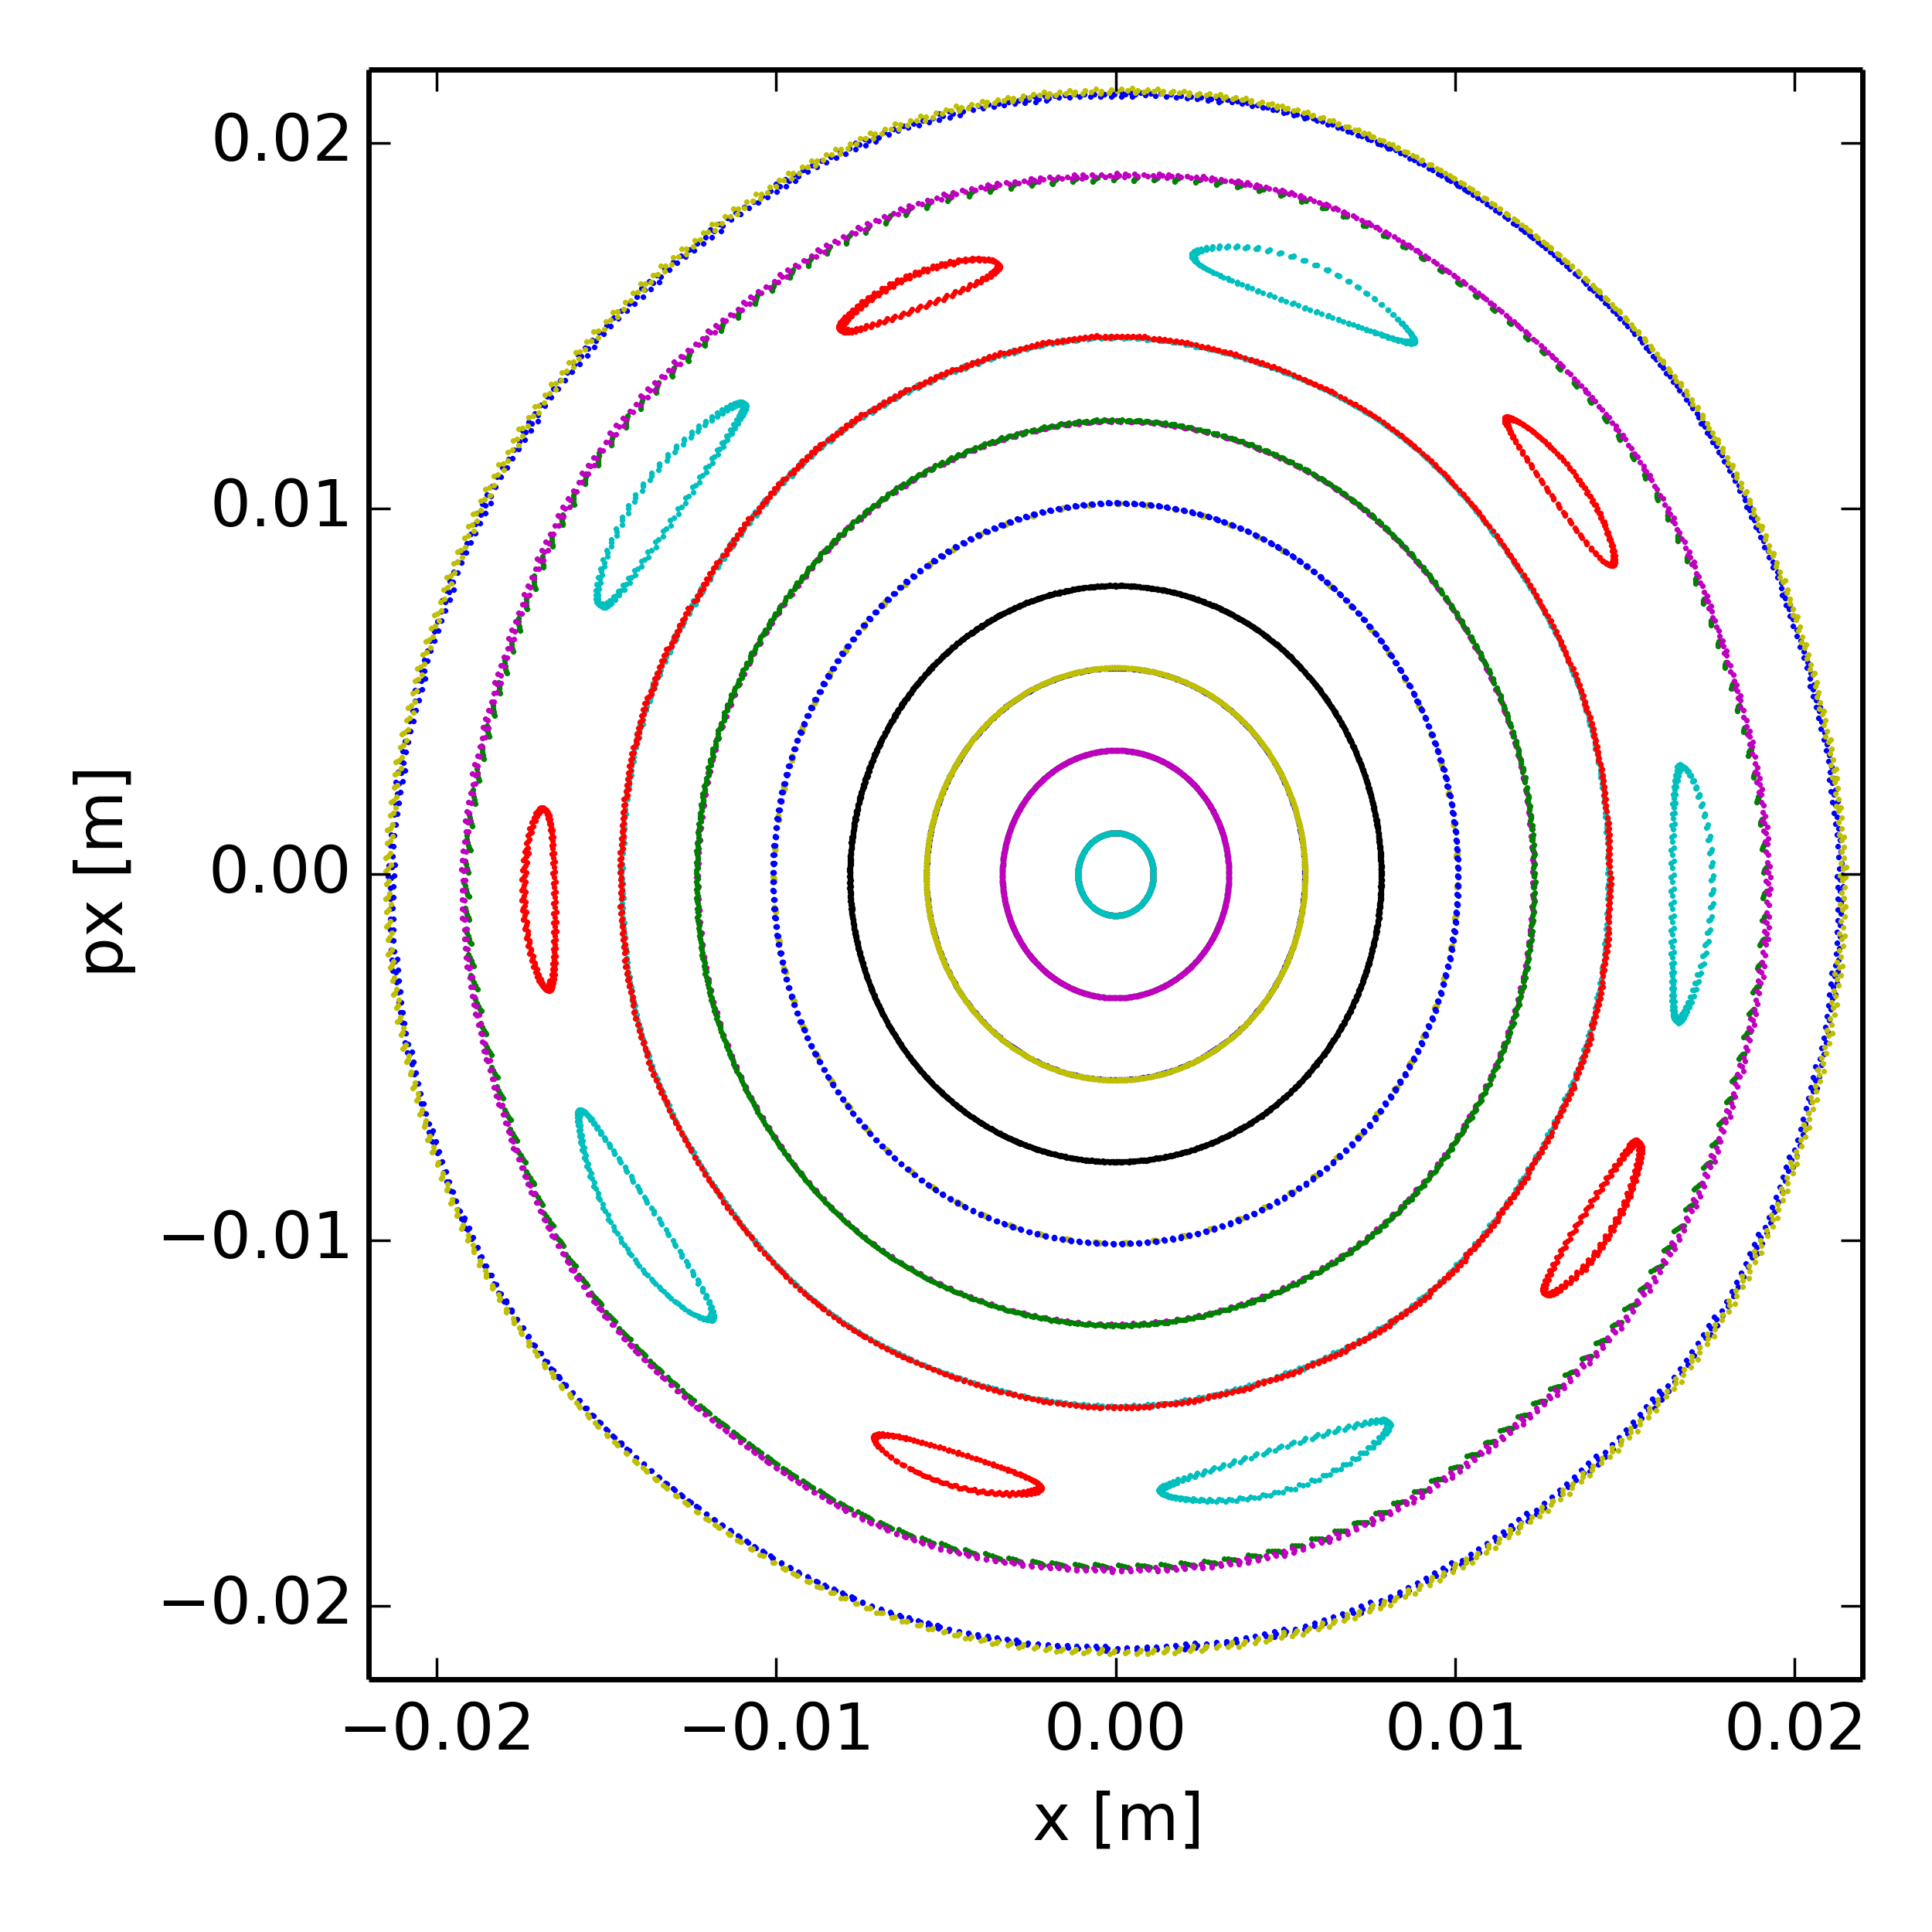
Poincaré maps at Qx = 20.40 (various dp/p)
Only space charge, no high order magnet multipoles in the model
dp/p =0
(10th order resonance)

Slide 28
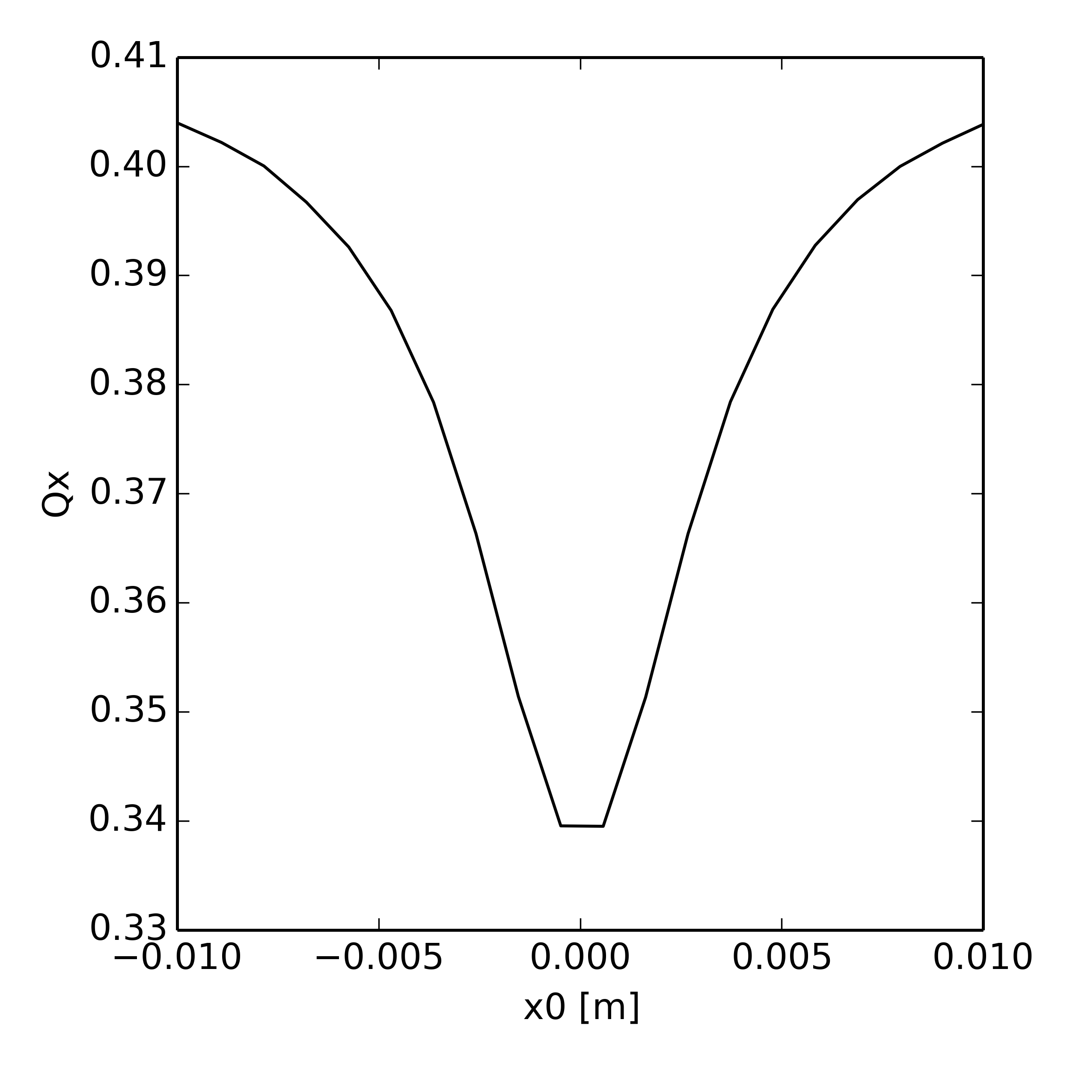
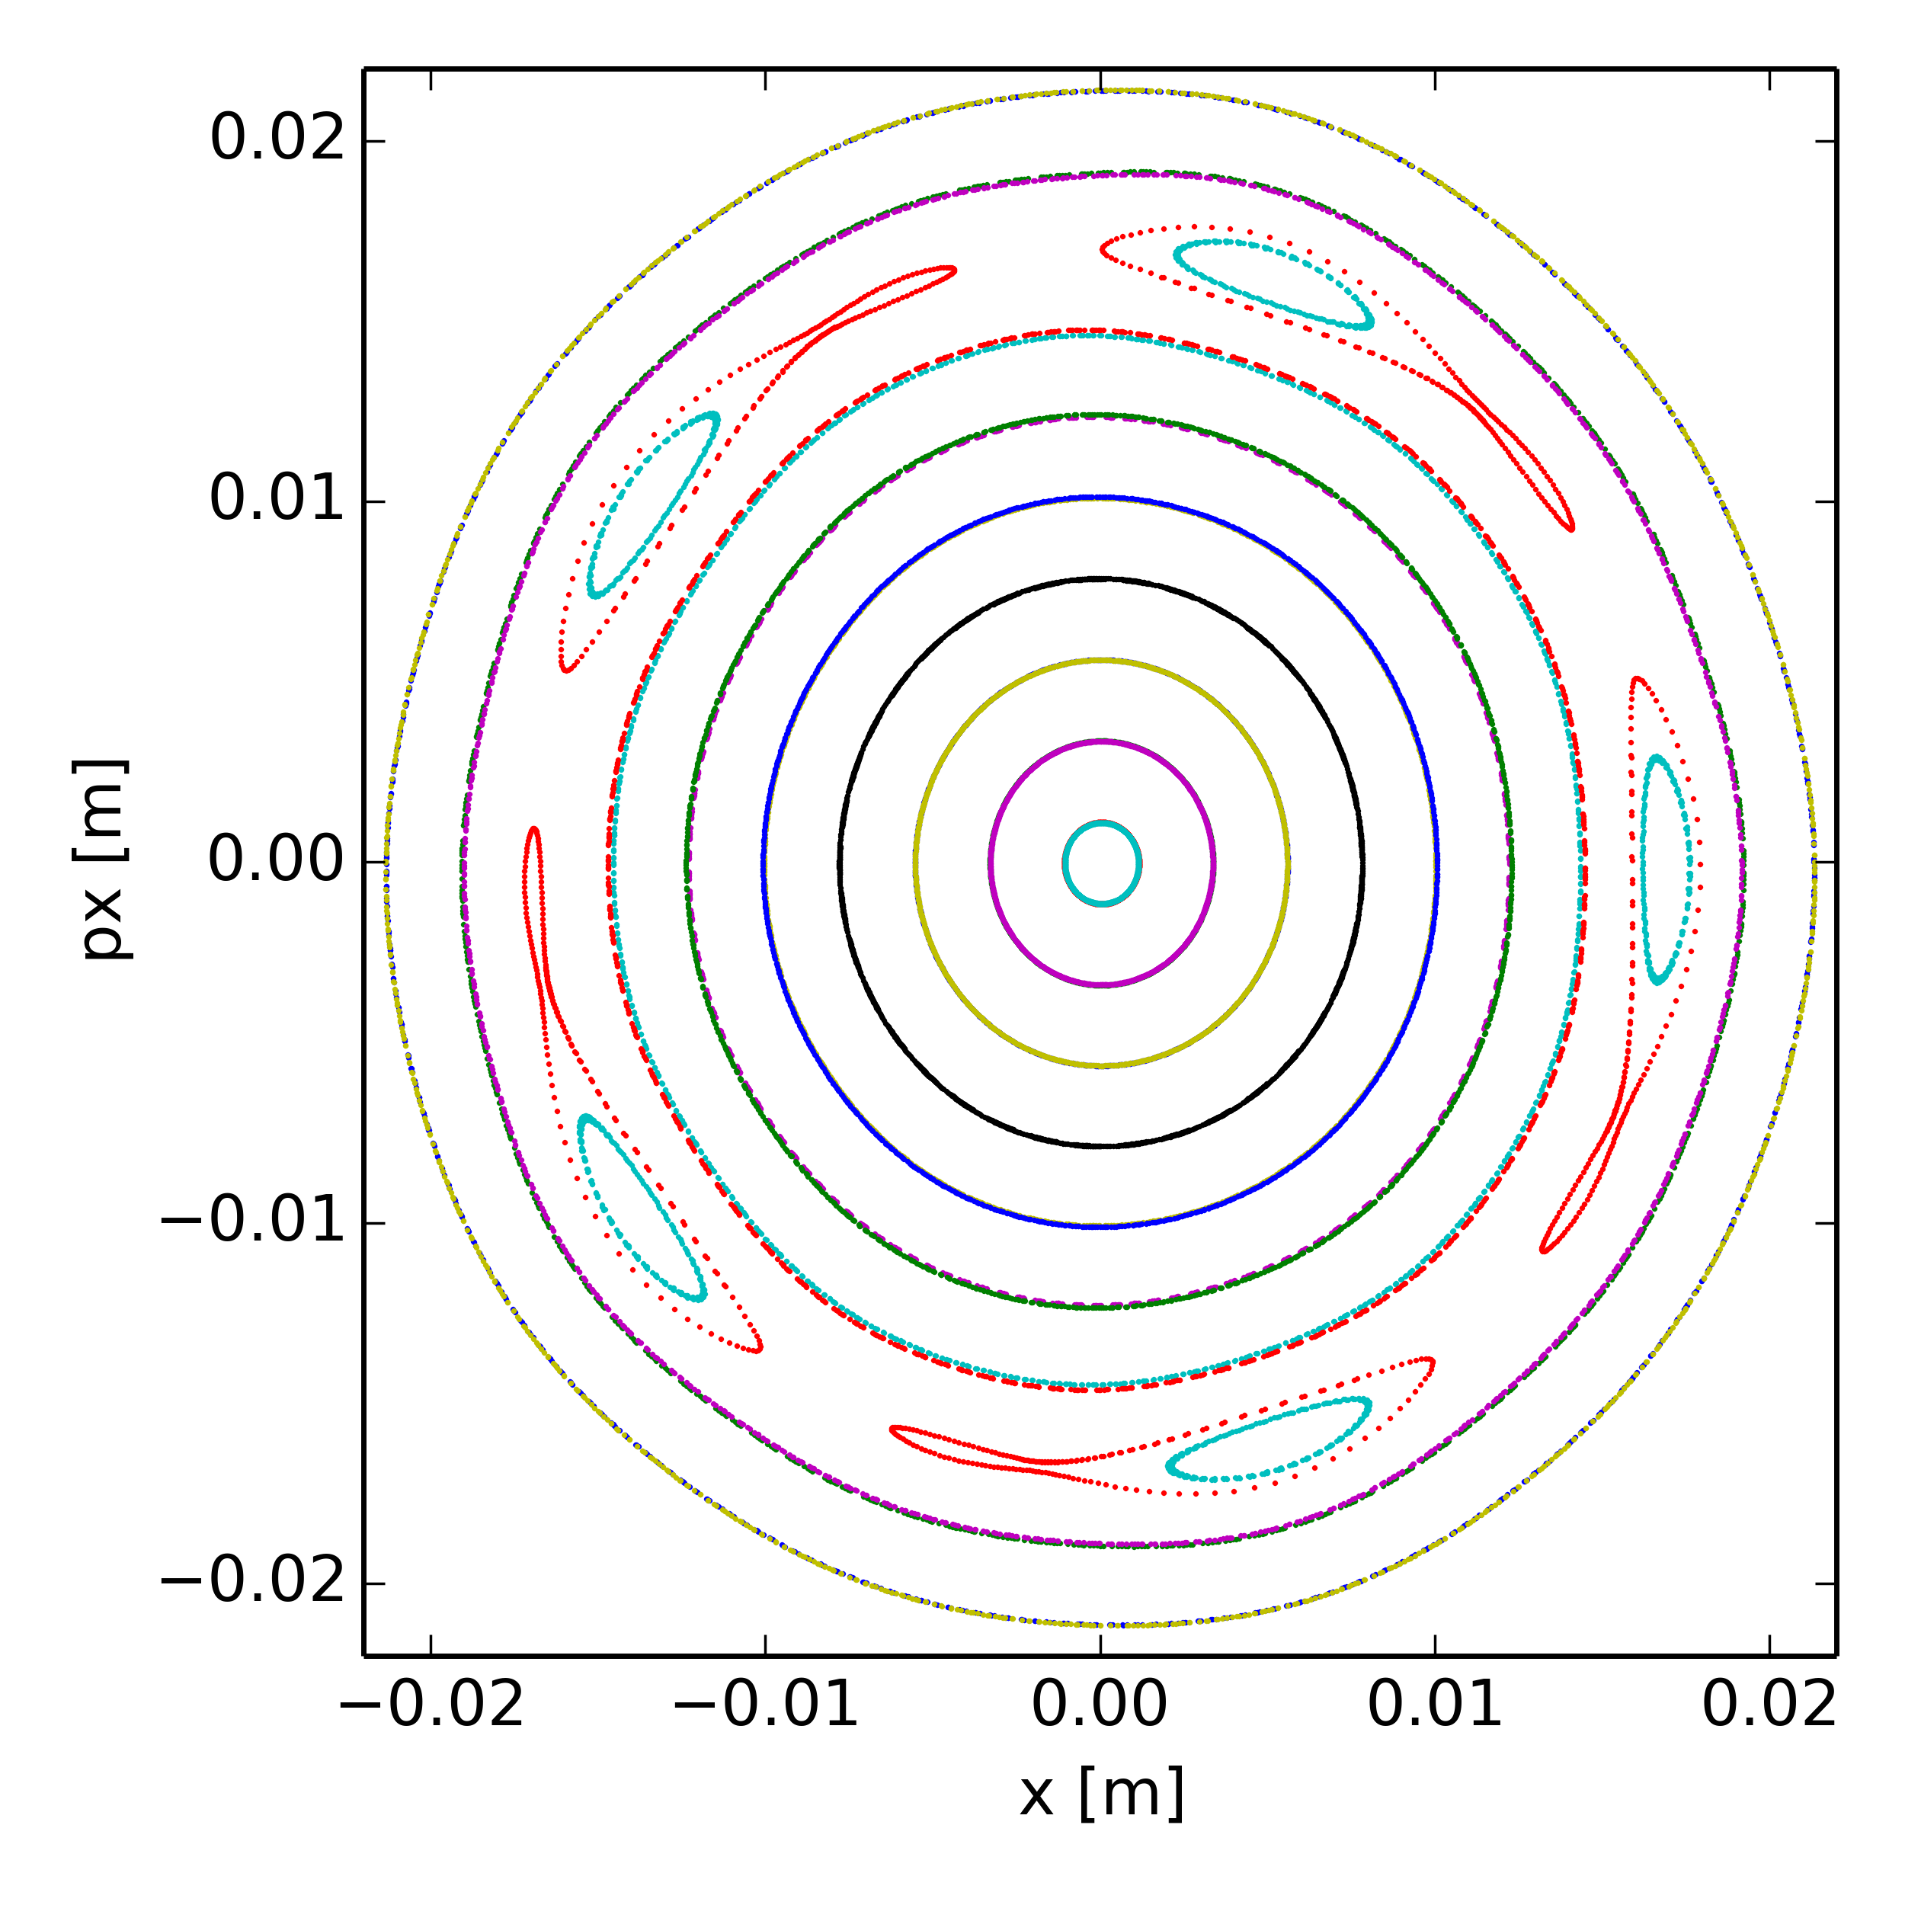
Poincaré maps at Qx = 20.40 (various dp/p)
Only space charge, no high order magnet multipoles in the model
dp/p =0.25e-3
(10th + 5th order resonance)

Slide 29

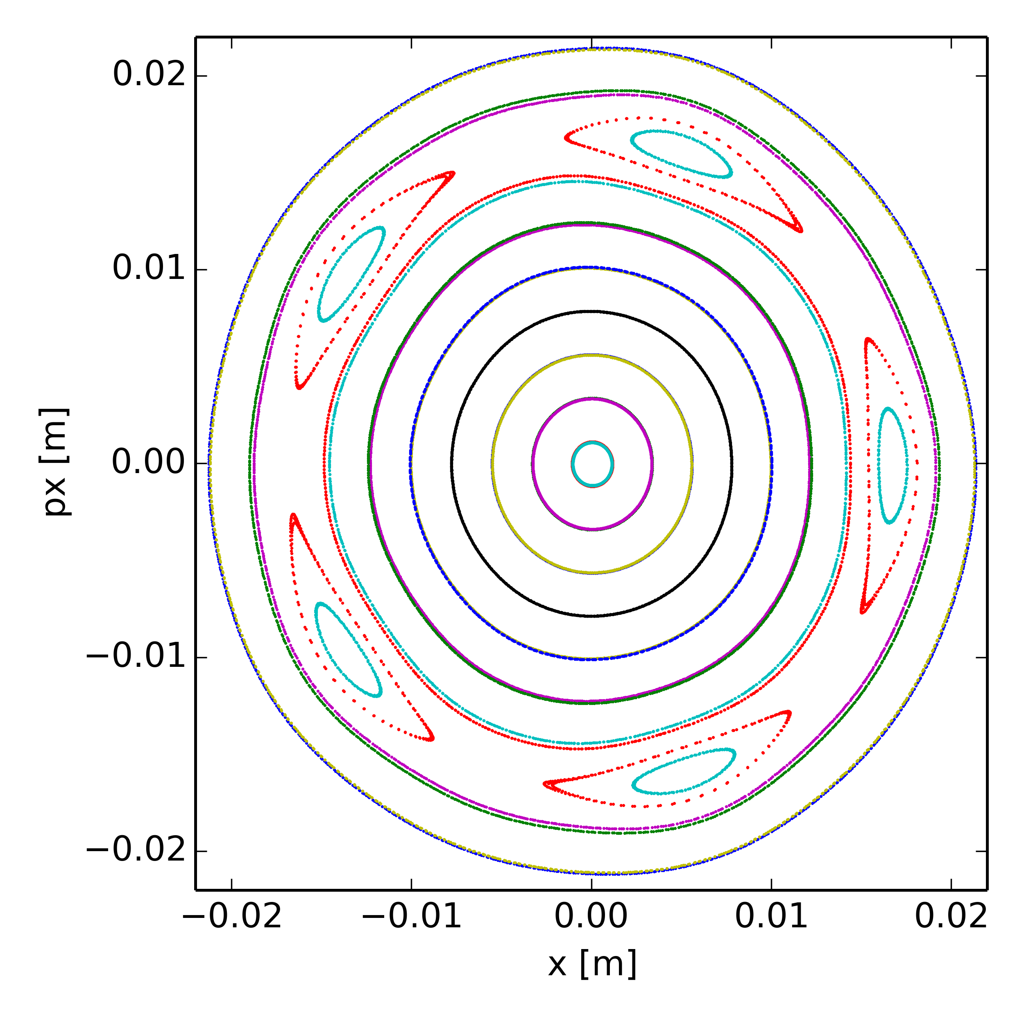
Poincaré maps at Qx = 20.40 (various dp/p)
Only space charge, no high order magnet multipoles in the model
dp/p =0.50e-3
(5th order resonance dominates)

Slide 30
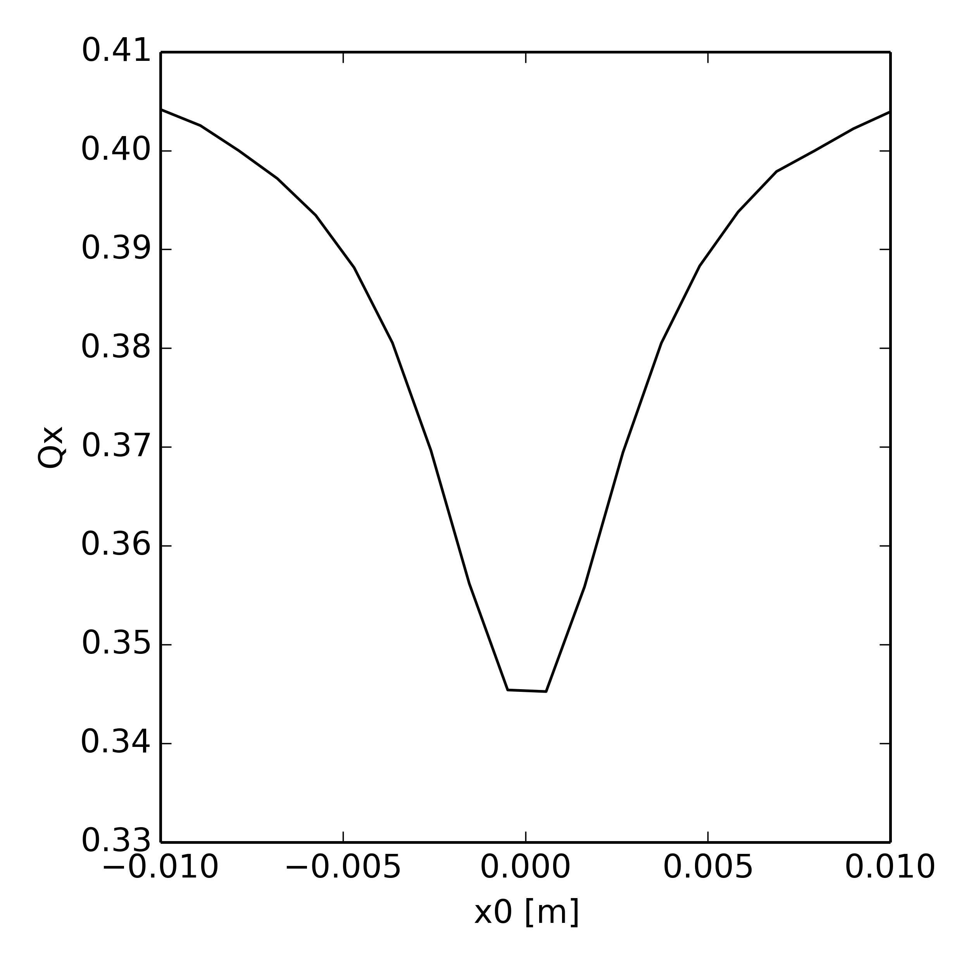
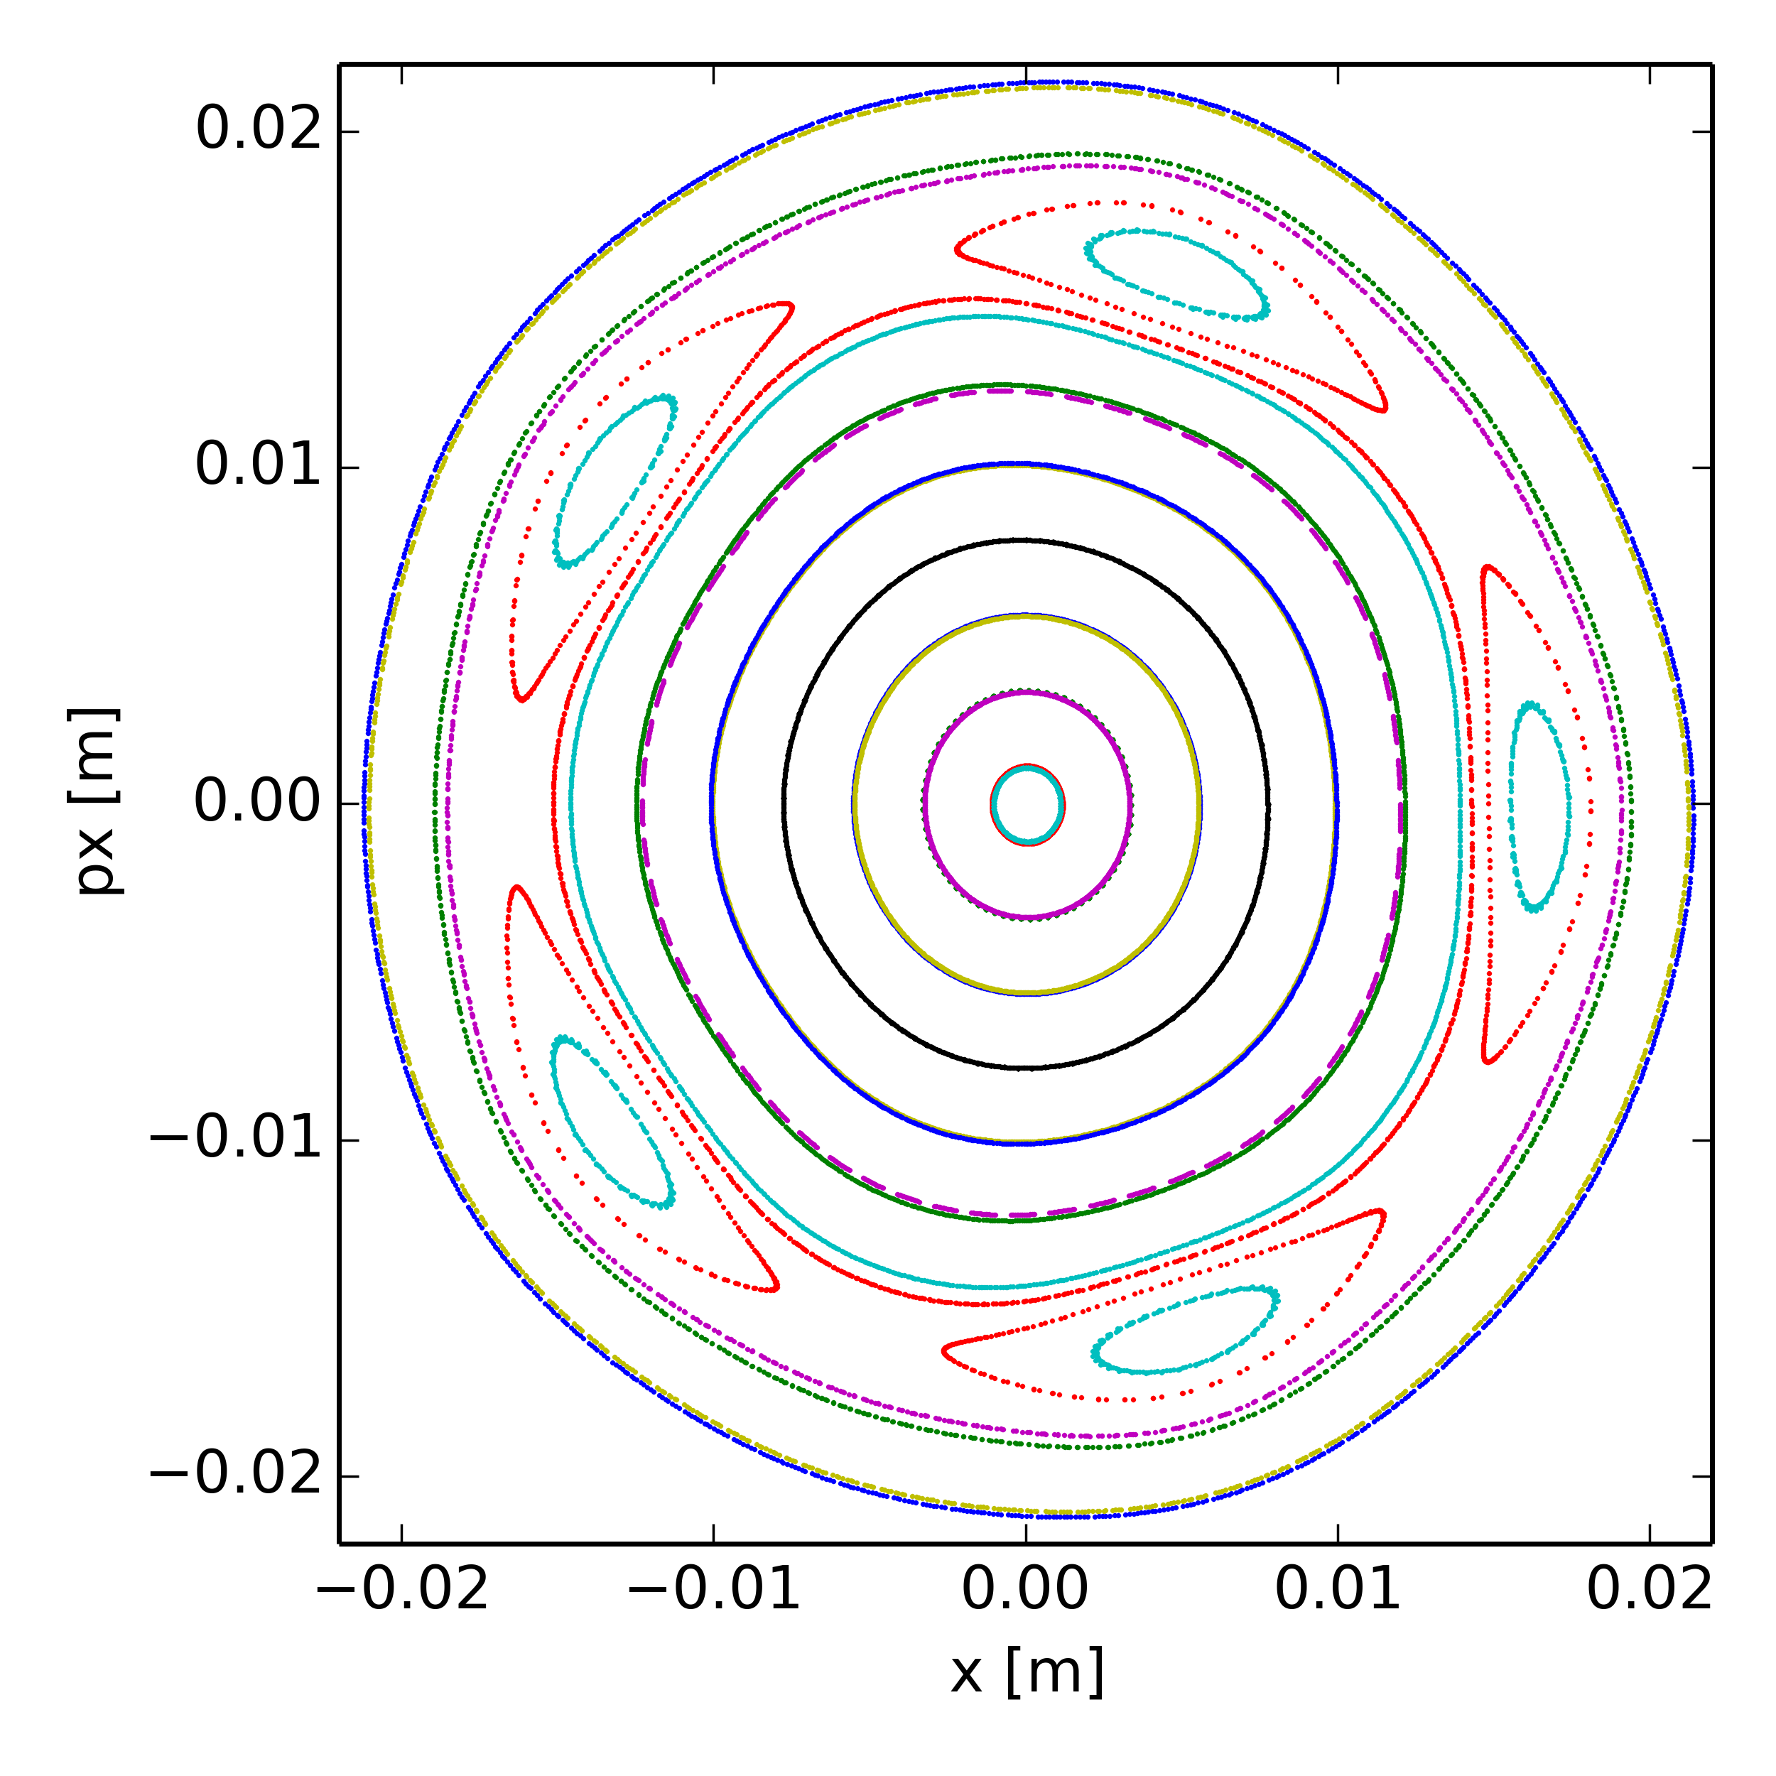
Poincaré maps at Qx = 20.40 (various dp/p)
Only space charge, no high order magnet multipoles in the model
dp/p =0.75e-3
(5th order resonance dominates)

Slide 31
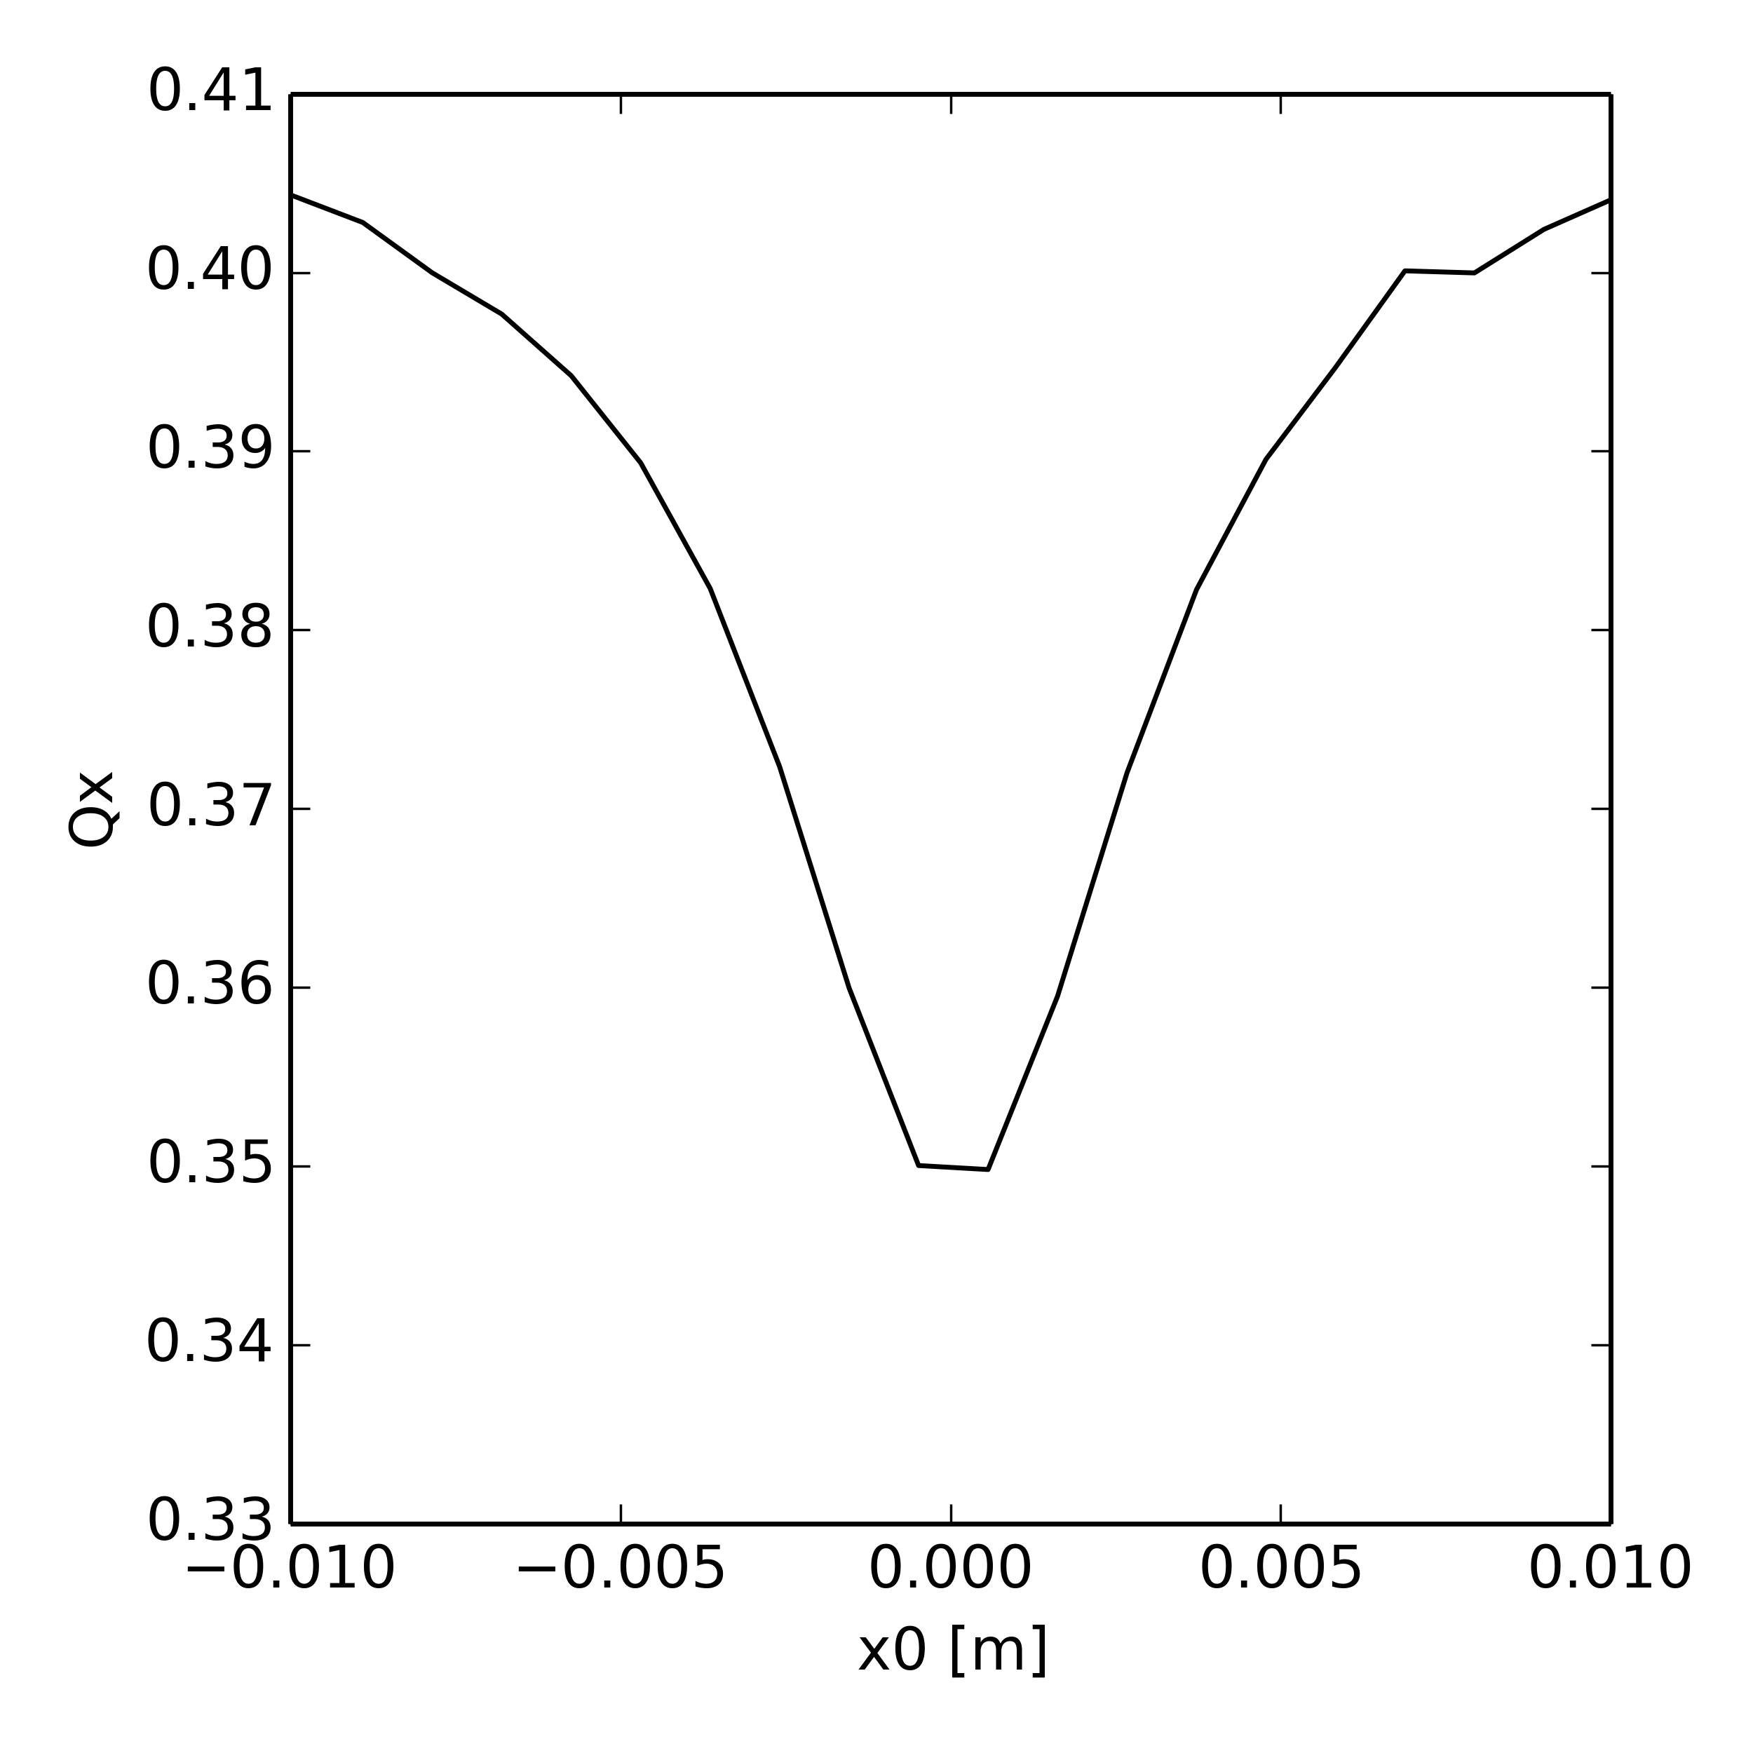
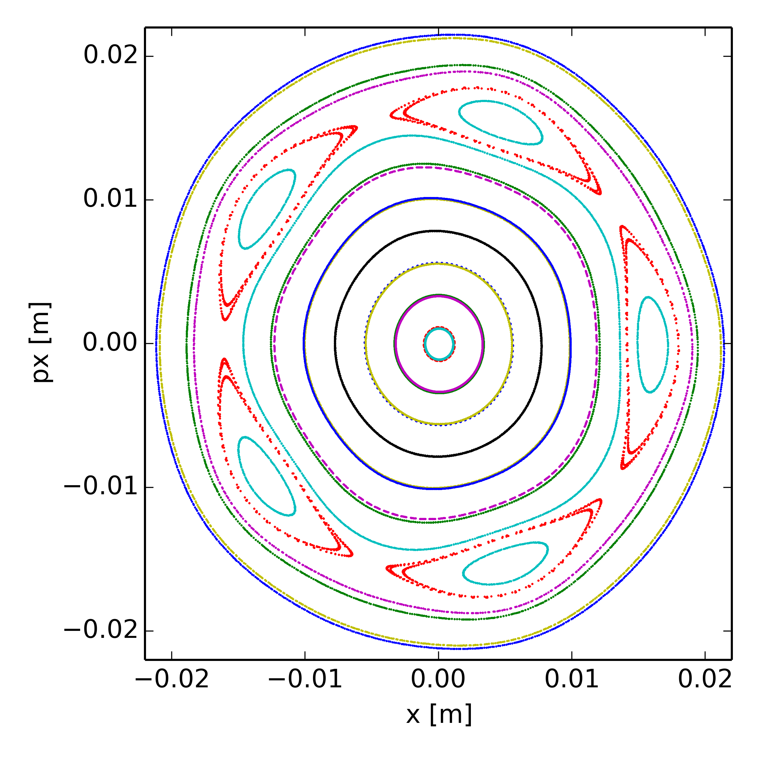
Poincaré maps at Qx = 20.40 (various dp/p)
Only space charge, no high order magnet multipoles in the model
dp/p=1.00e-3
(5th order resonance dominates)

Slide 32
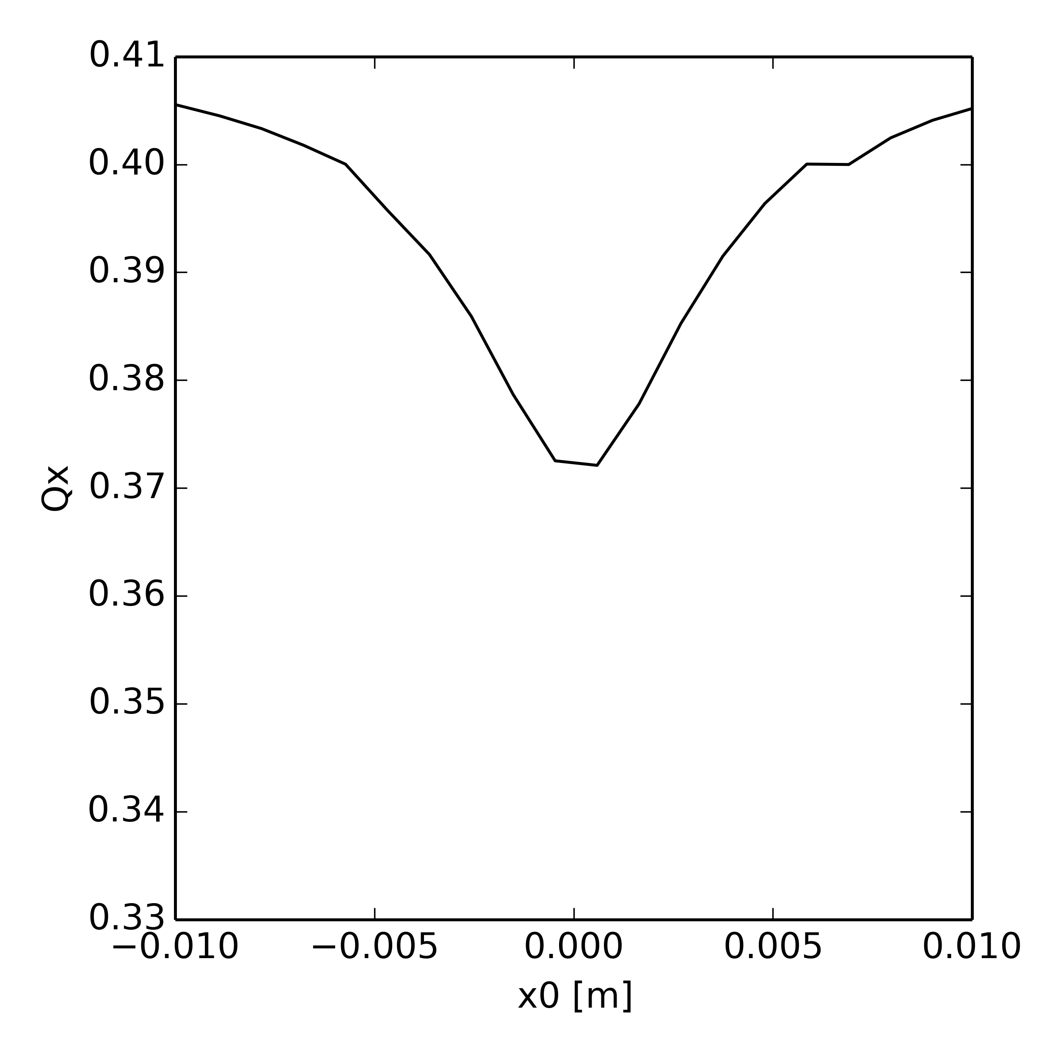
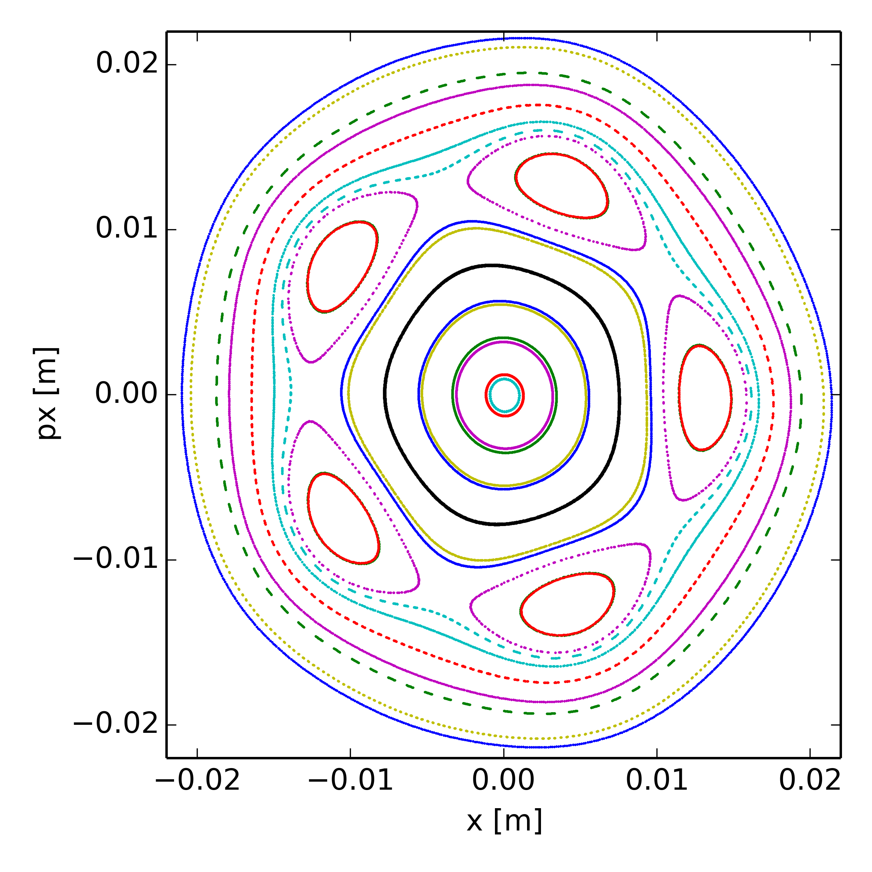
Poincaré maps at Qx = 20.40 (various dp/p)
Only space charge, no high order magnet multipoles in the model
dp/p=2.00e-3
(5th order resonance dominates)

Slide 33
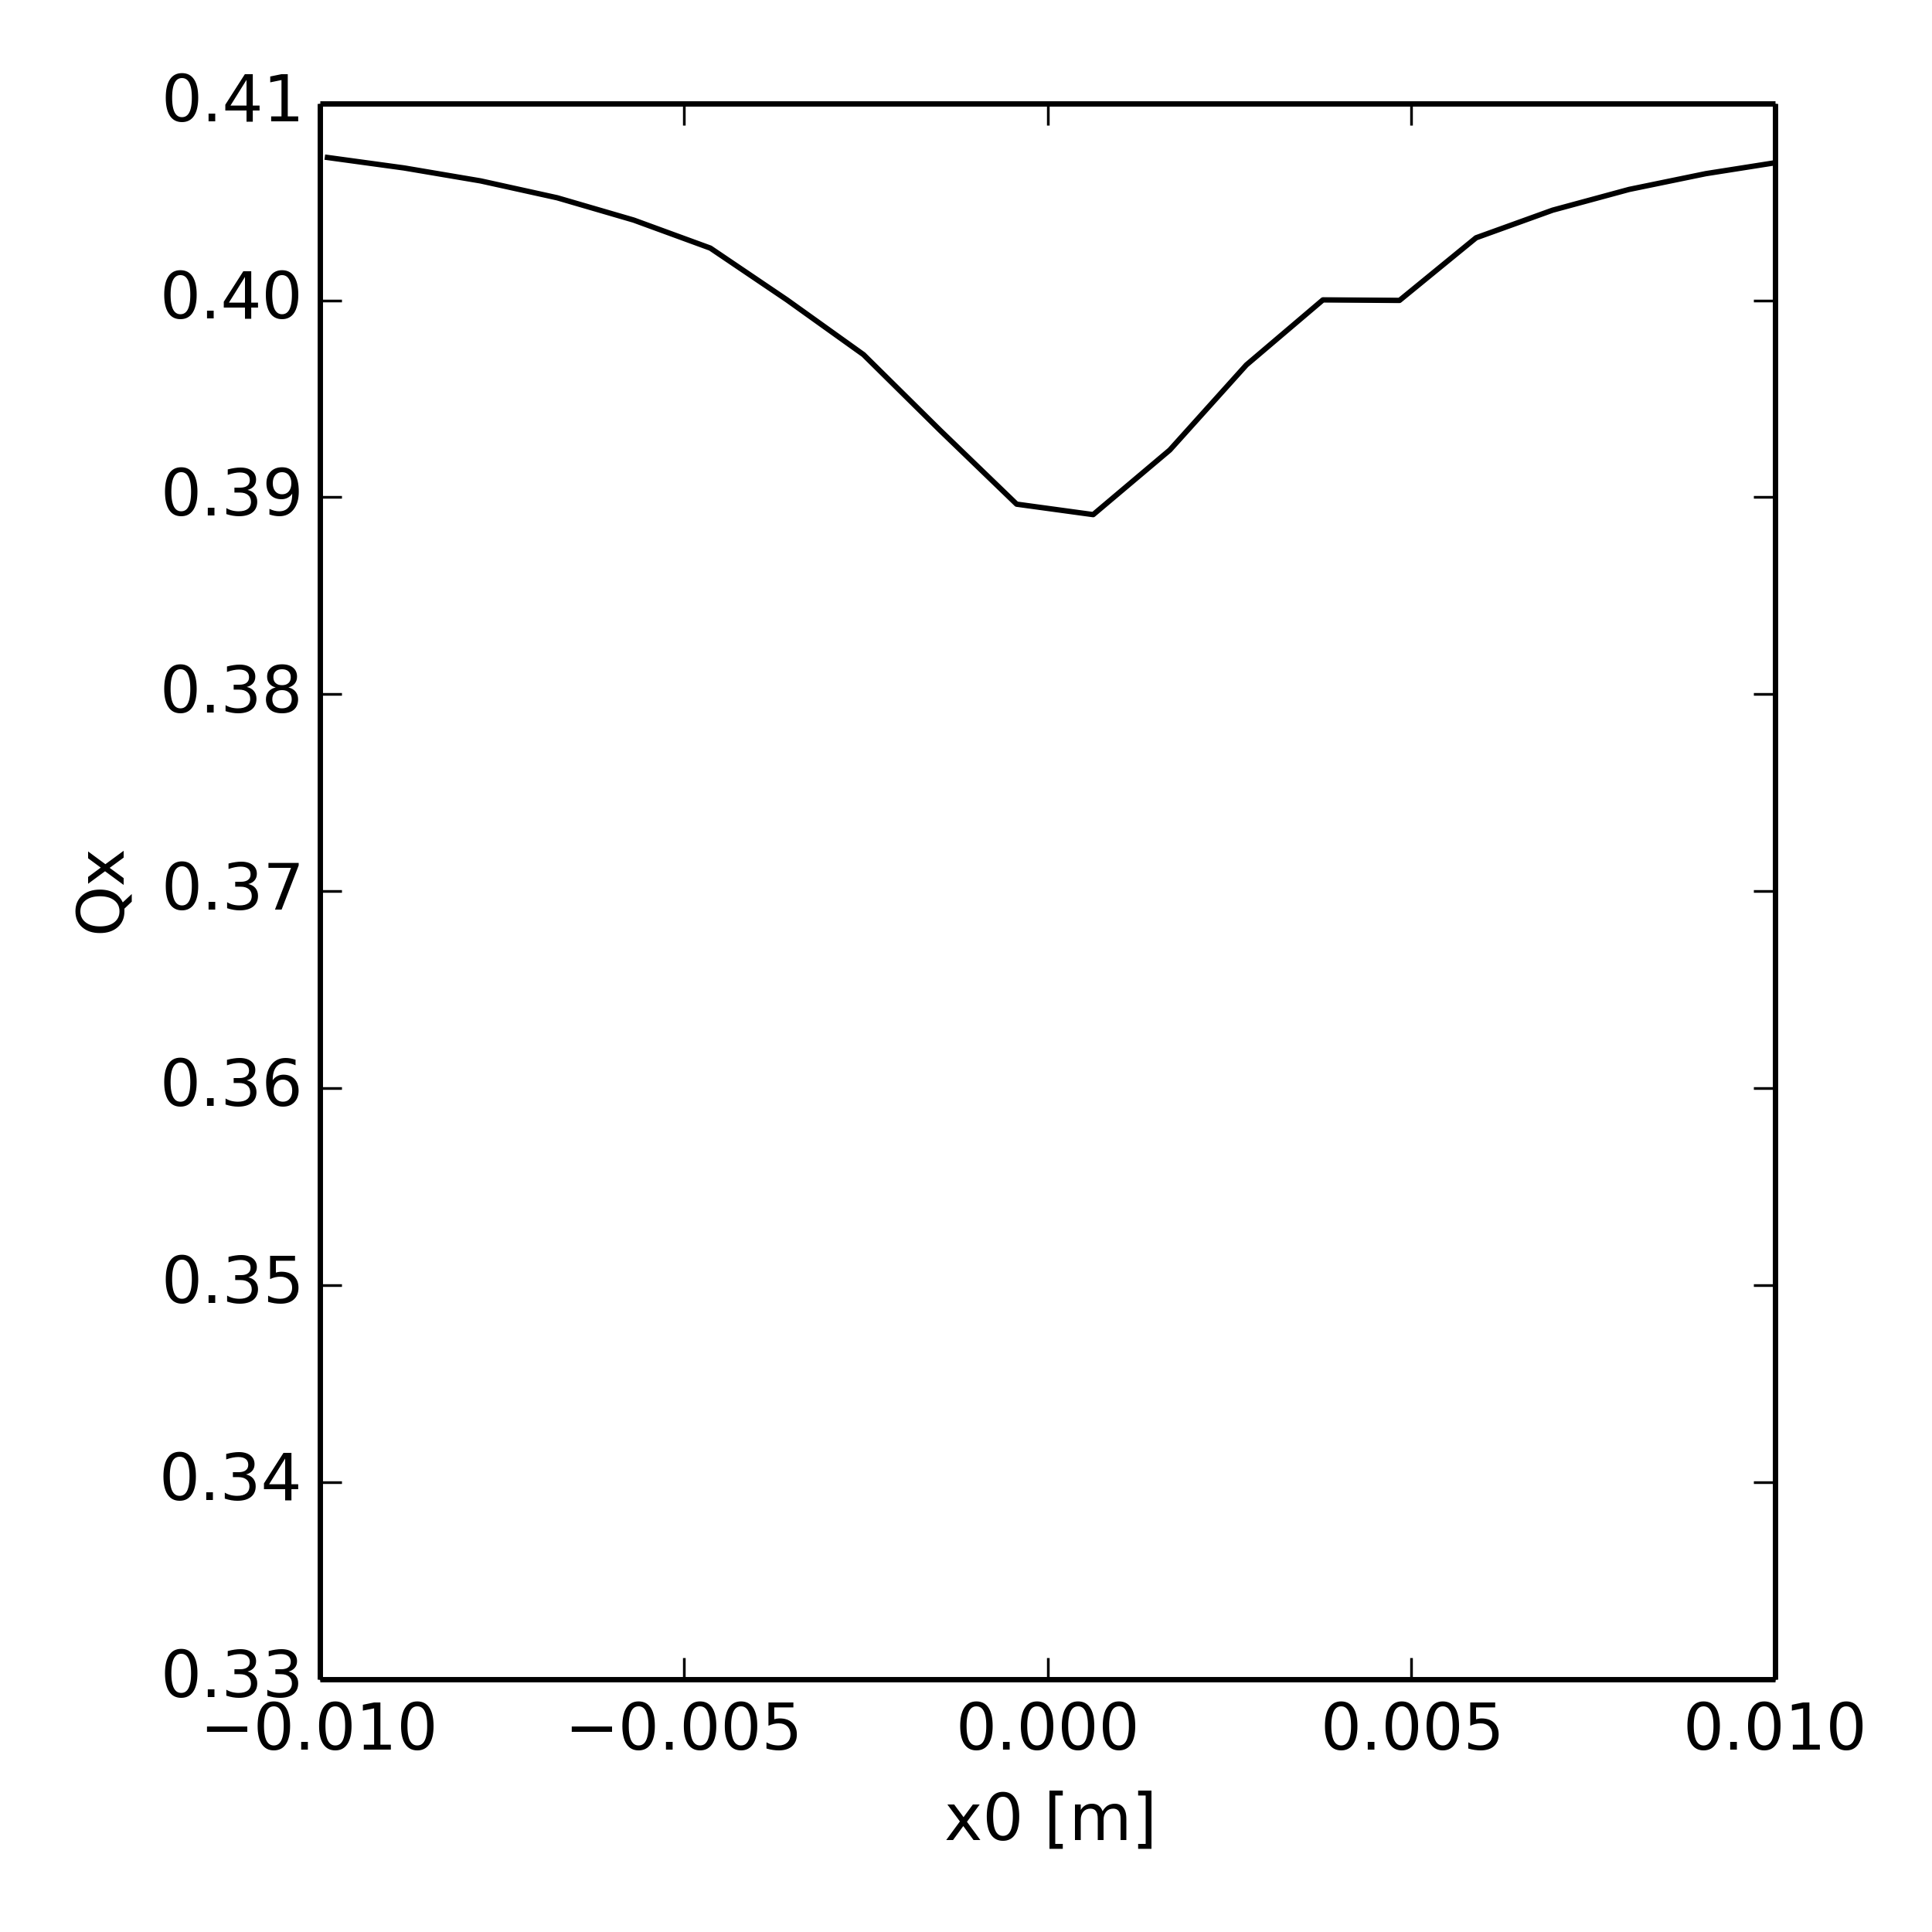
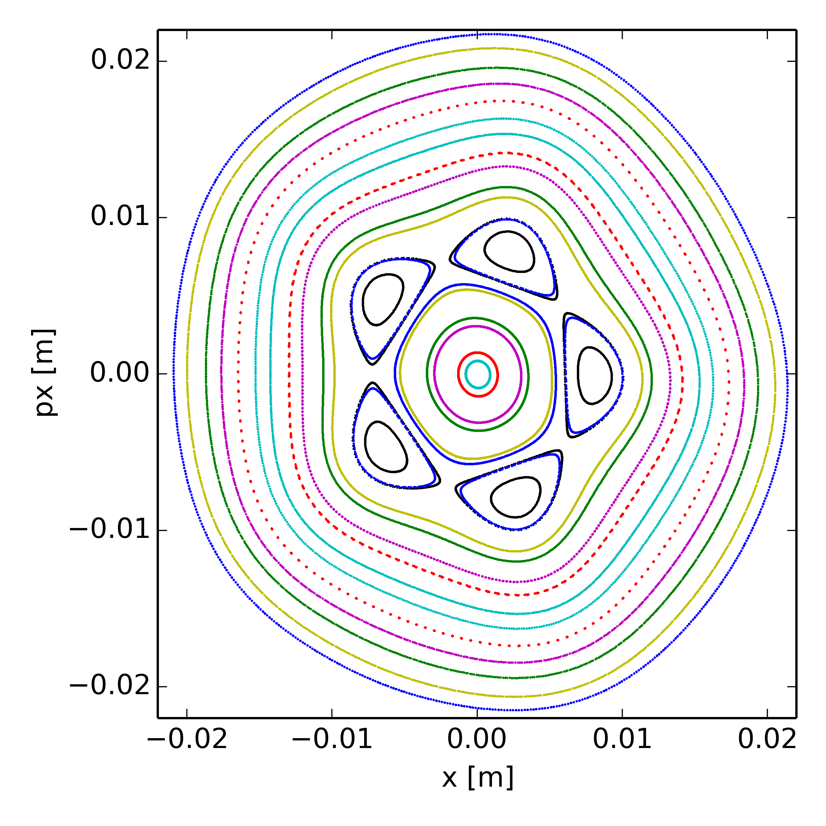
Poincaré maps at Qx = 20.40 (various dp/p)
Only space charge, no high order magnet multipoles in the model
dp/p=3.00e-3
(5th order resonance dominates)

Slide 34
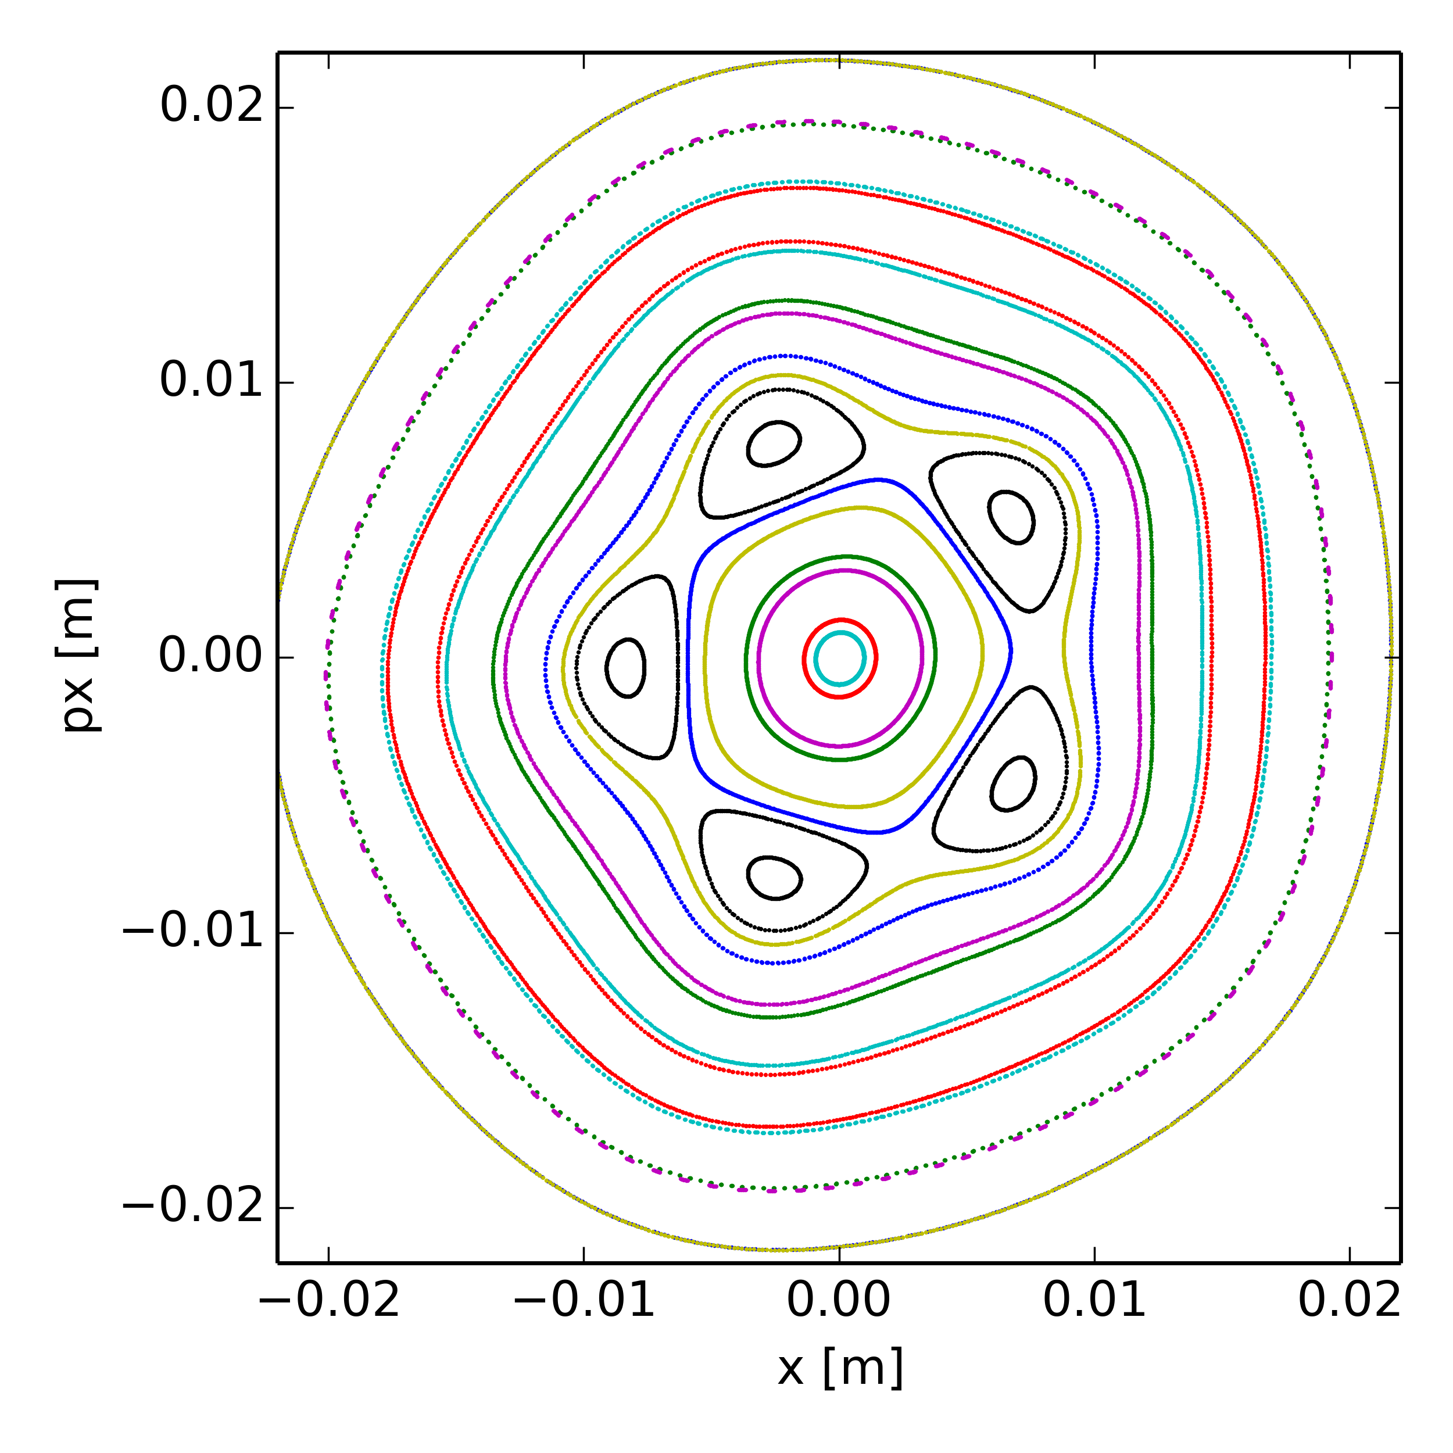
Poincaré maps at Qx = 20.40 (various dp/p)
Only space charge, no high order magnet multipoles in the model
Phase of 5th order resonance flips when going from positive to negative dp/p
dp/p=-3.00e-3
dp/p=3.00e-3

Slide 35
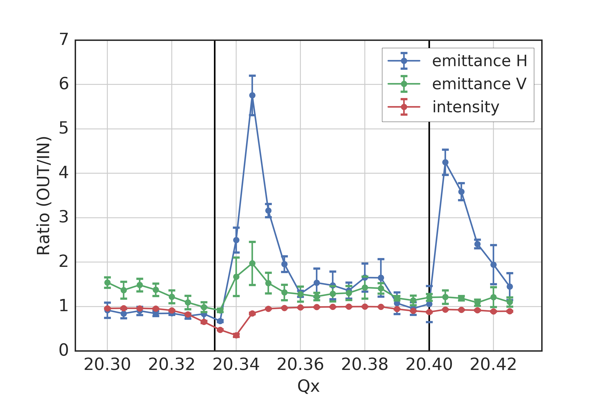
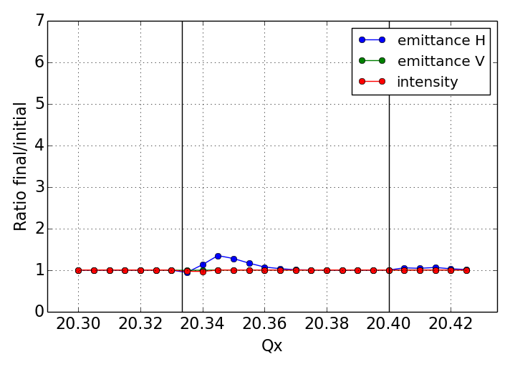
Measurements vs. simulations
Simulations using PTC-pyORBIT
  Frozen space charge model (non-adaptive)
  SPS nonlinear model – multipole errors (only systematic) up to b6
  5000 particles tracked for 140k turns (i.e. 3 s as in the experiment)
  Single sextupole excited as in experiment (starting from 0.16 s)
measurements
simulations
???

Slide 36
Measurements vs. simulations
Simulations using PTC-pyORBIT
  Frozen space charge model (non-adaptive)
  SPS nonlinear model – multipole errors (only systematic) up to b6
  5000 particles tracked for 140k turns (i.e. 3 s as in the experiment)
  Single sextupole excited as in experiment (starting from 0.16 s)
Impact of Power converter ripple from SPS quadrupoles?
  108 focusing quadrupoles (QFs) in series, 108 de-focusing quadrupoles (QDs) in series
  600 Hz ripple from 12 pole rectification suppressed by active filters
  Measured power converter current shows harmonics at multiples of 50 Hz
  Chain of magnets act as low-pass filter, vacuum chamber acts as additional filter (skin effect)
  Effective field modulation taking into account shielding effects amounts to ~ +/- 1e-4 relative to DC field → low frequency tune variation on the order of +/- 2e-3 (due to tunes of ~20!)
measurements
simulations
Measured ripple spectrum (QFs)
Measured vs. effective current deviation (QFs)

Slide 37
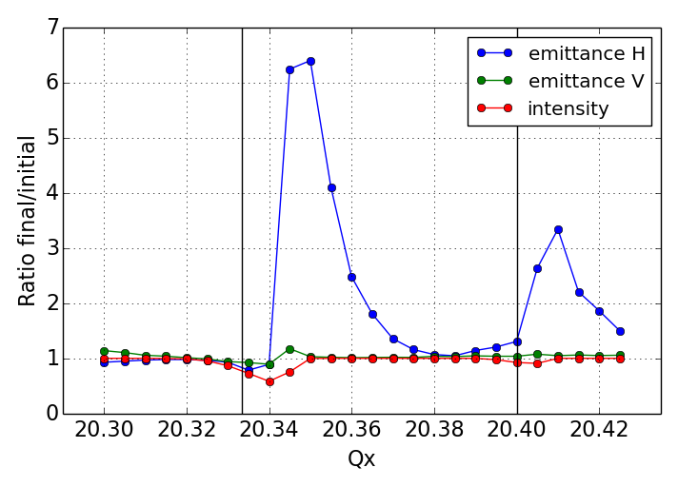
Measurements vs. simulations
Simulations using PTC-pyORBIT
  Frozen space charge model (non-adaptive)
  SPS nonlinear model – multipole errors (only systematic) up to b6
  5000 particles tracked for 140k turns (i.e. 3 s as in the experiment)
  Single sextupole excited as in experiment (starting from 0.16 s)
  Filtered quadrupole ripple on QFs and QDs taken into account (results in tune modulation similar to chromaticity but for all particles)
measurements
simulations
simulations with Q-ripple
???

Slide 38
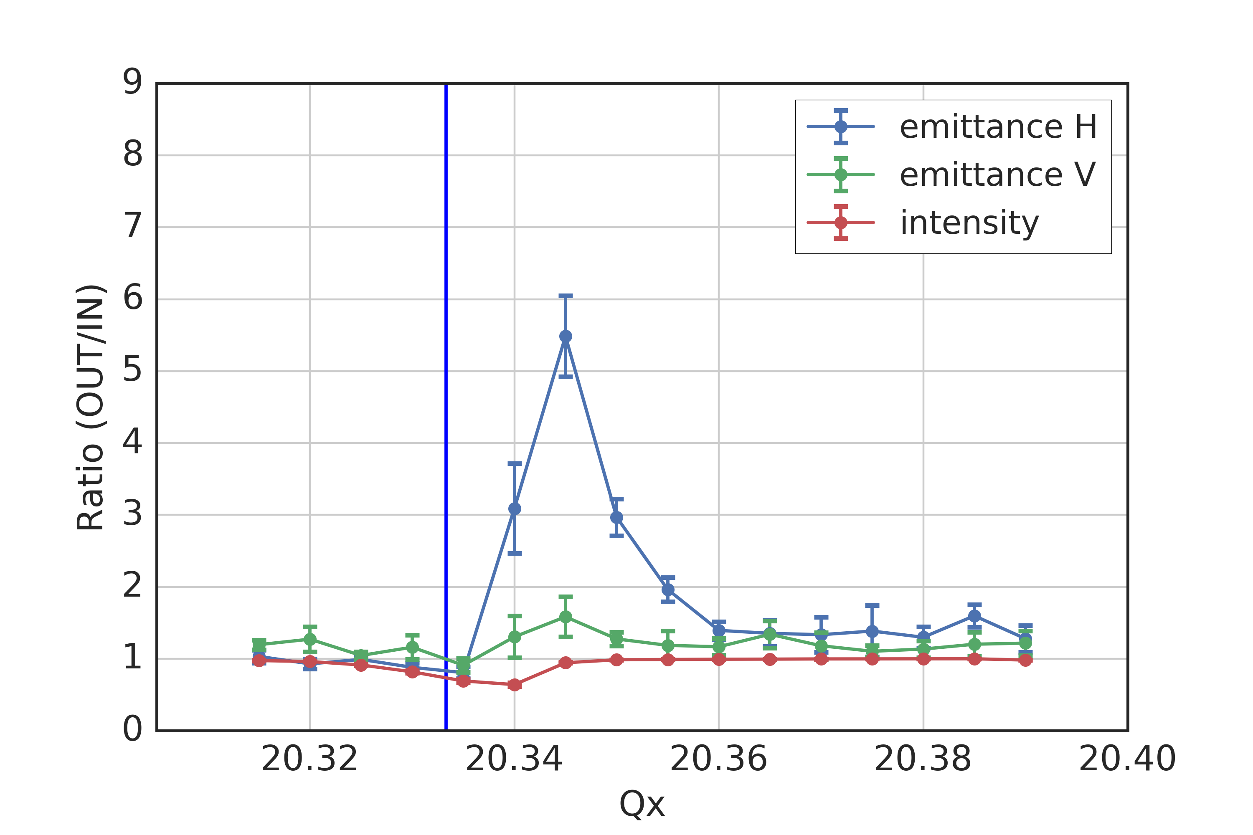
Measurements with different Q-ripples
Same experimental setup as before (single sextupole excites resonance)
Measurement with natural ripple
Measured QF spectrum

Slide 39
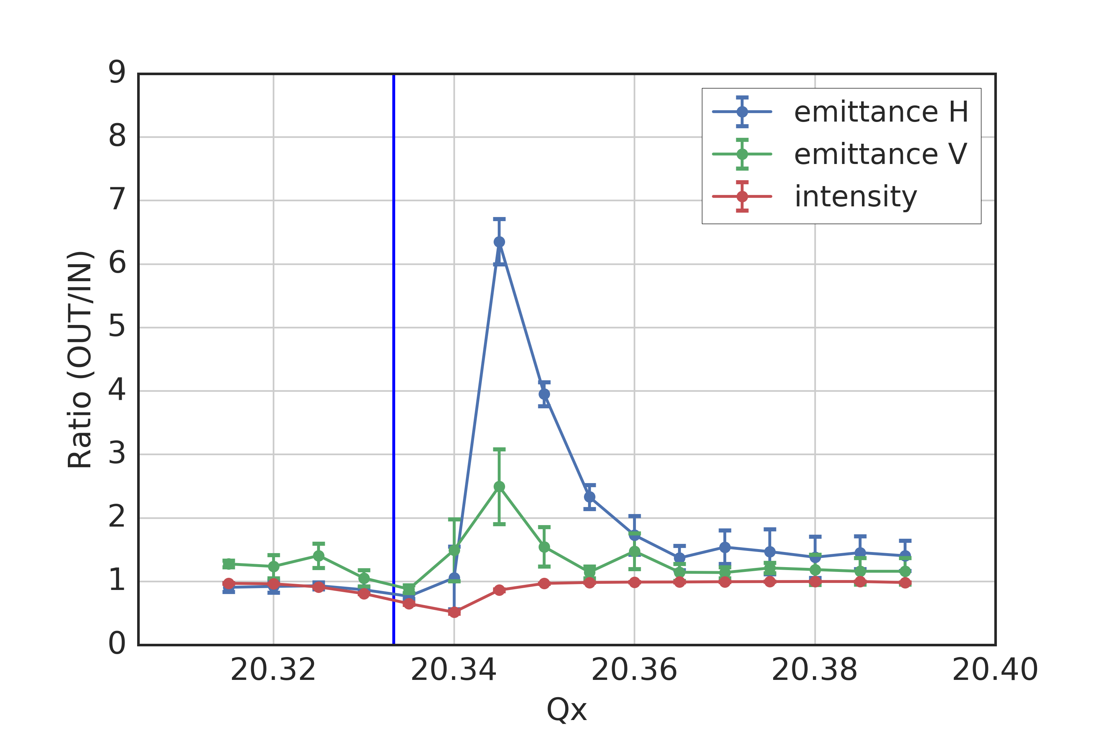
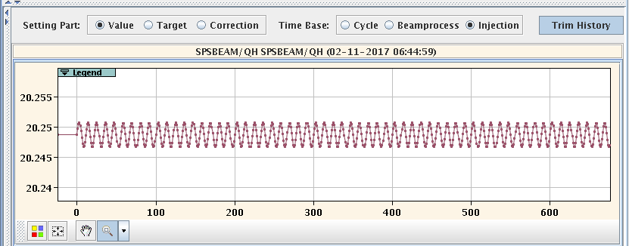
Measurements with different Q-ripples
Same experimental setup as before (single sextupole excites resonance)
Introduced voluntary Q-ripple (different amplitudes) by programming QH function
Measurement with voluntary Qx ripple: ±2e-3 @ 90 Hz
Measured QF spectrum
Voluntary Qx ripple

Slide 40
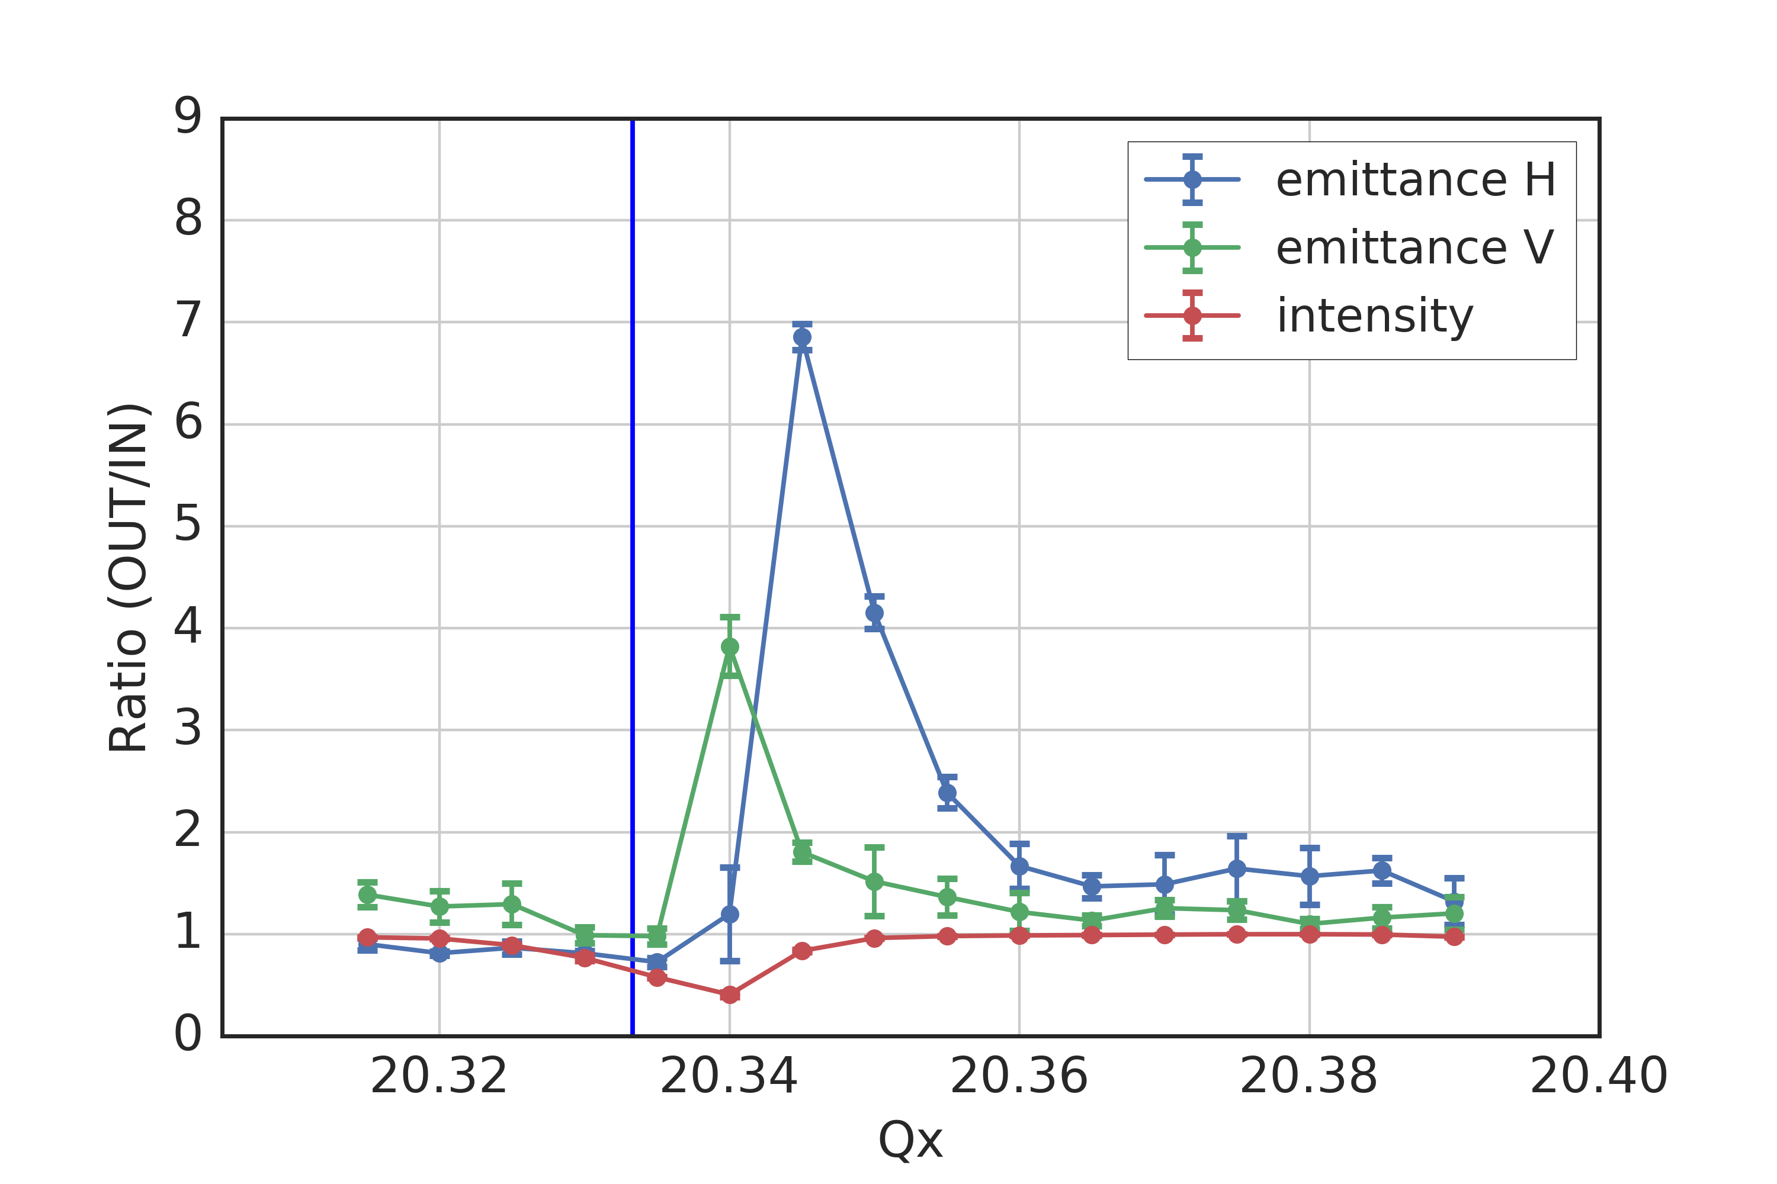
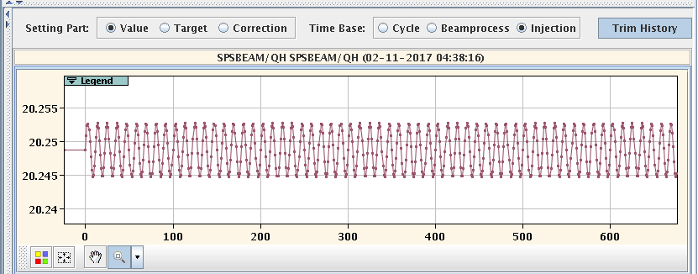
Measurements with different Q-ripples
Same experimental setup as before (single sextupole excites resonance)
Introduced voluntary Q-ripple (different amplitudes) by programming QH function
Measurement with voluntary Qx ripple: ±4e-3 @ 90 Hz
Measured QF spectrum
Voluntary Qx ripple

Slide 41
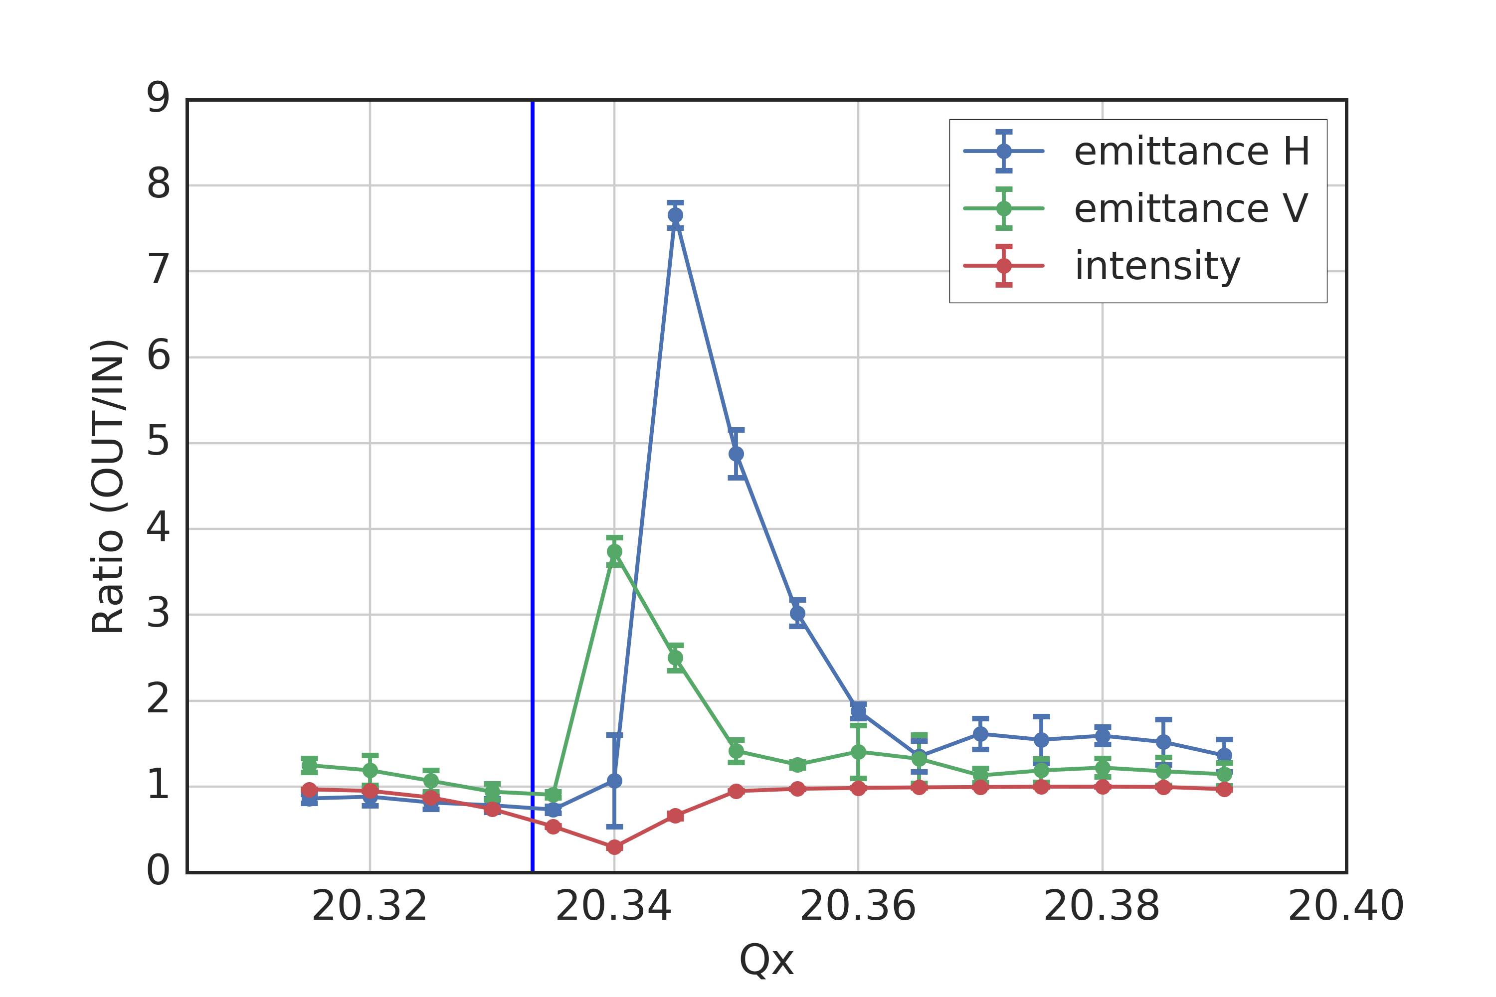
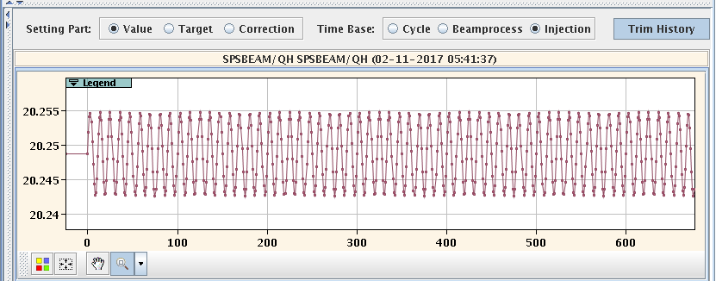
Measurements with different Q-ripples
Same experimental setup as before (single sextupole excites resonance)
Introduced voluntary Q-ripple (different amplitudes) by programming QH function
Measurement with voluntary Qx ripple: ±6e-3 @ 90 Hz
Measured QF spectrum
Voluntary Qx ripple

Slide 42
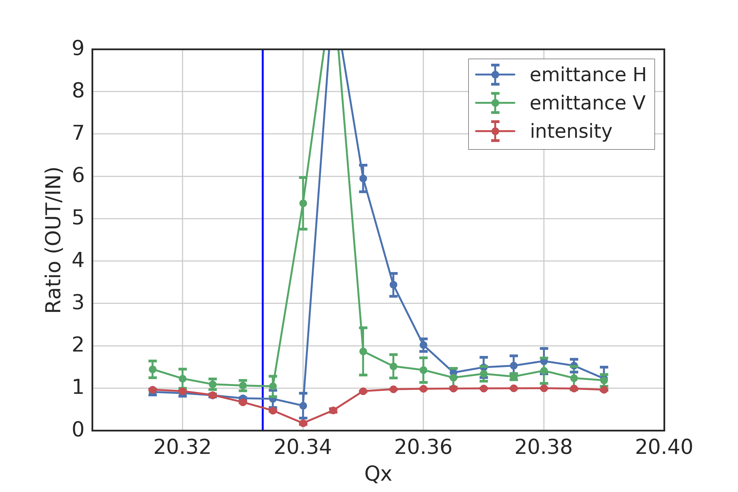
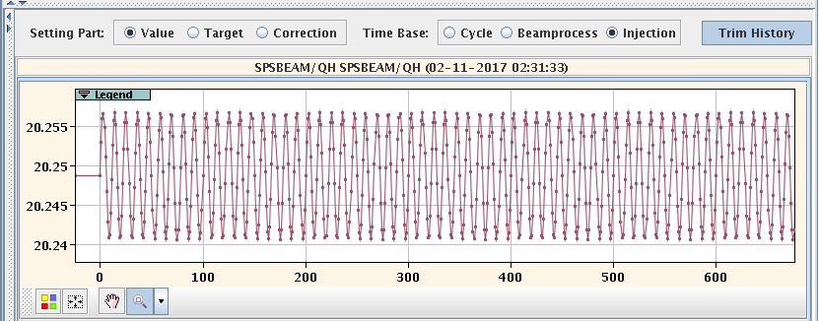
Measurements with different Q-ripples
Same experimental setup as before (single sextupole excites resonance)
Introduced voluntary Q-ripple (different amplitudes) by programming QH function
  Clear effect on emittance growth and losses
Measurement with voluntary Qx ripple: ±8e-3 @ 90 Hz
Measured QF spectrum
Voluntary Qx ripple

Slide 43
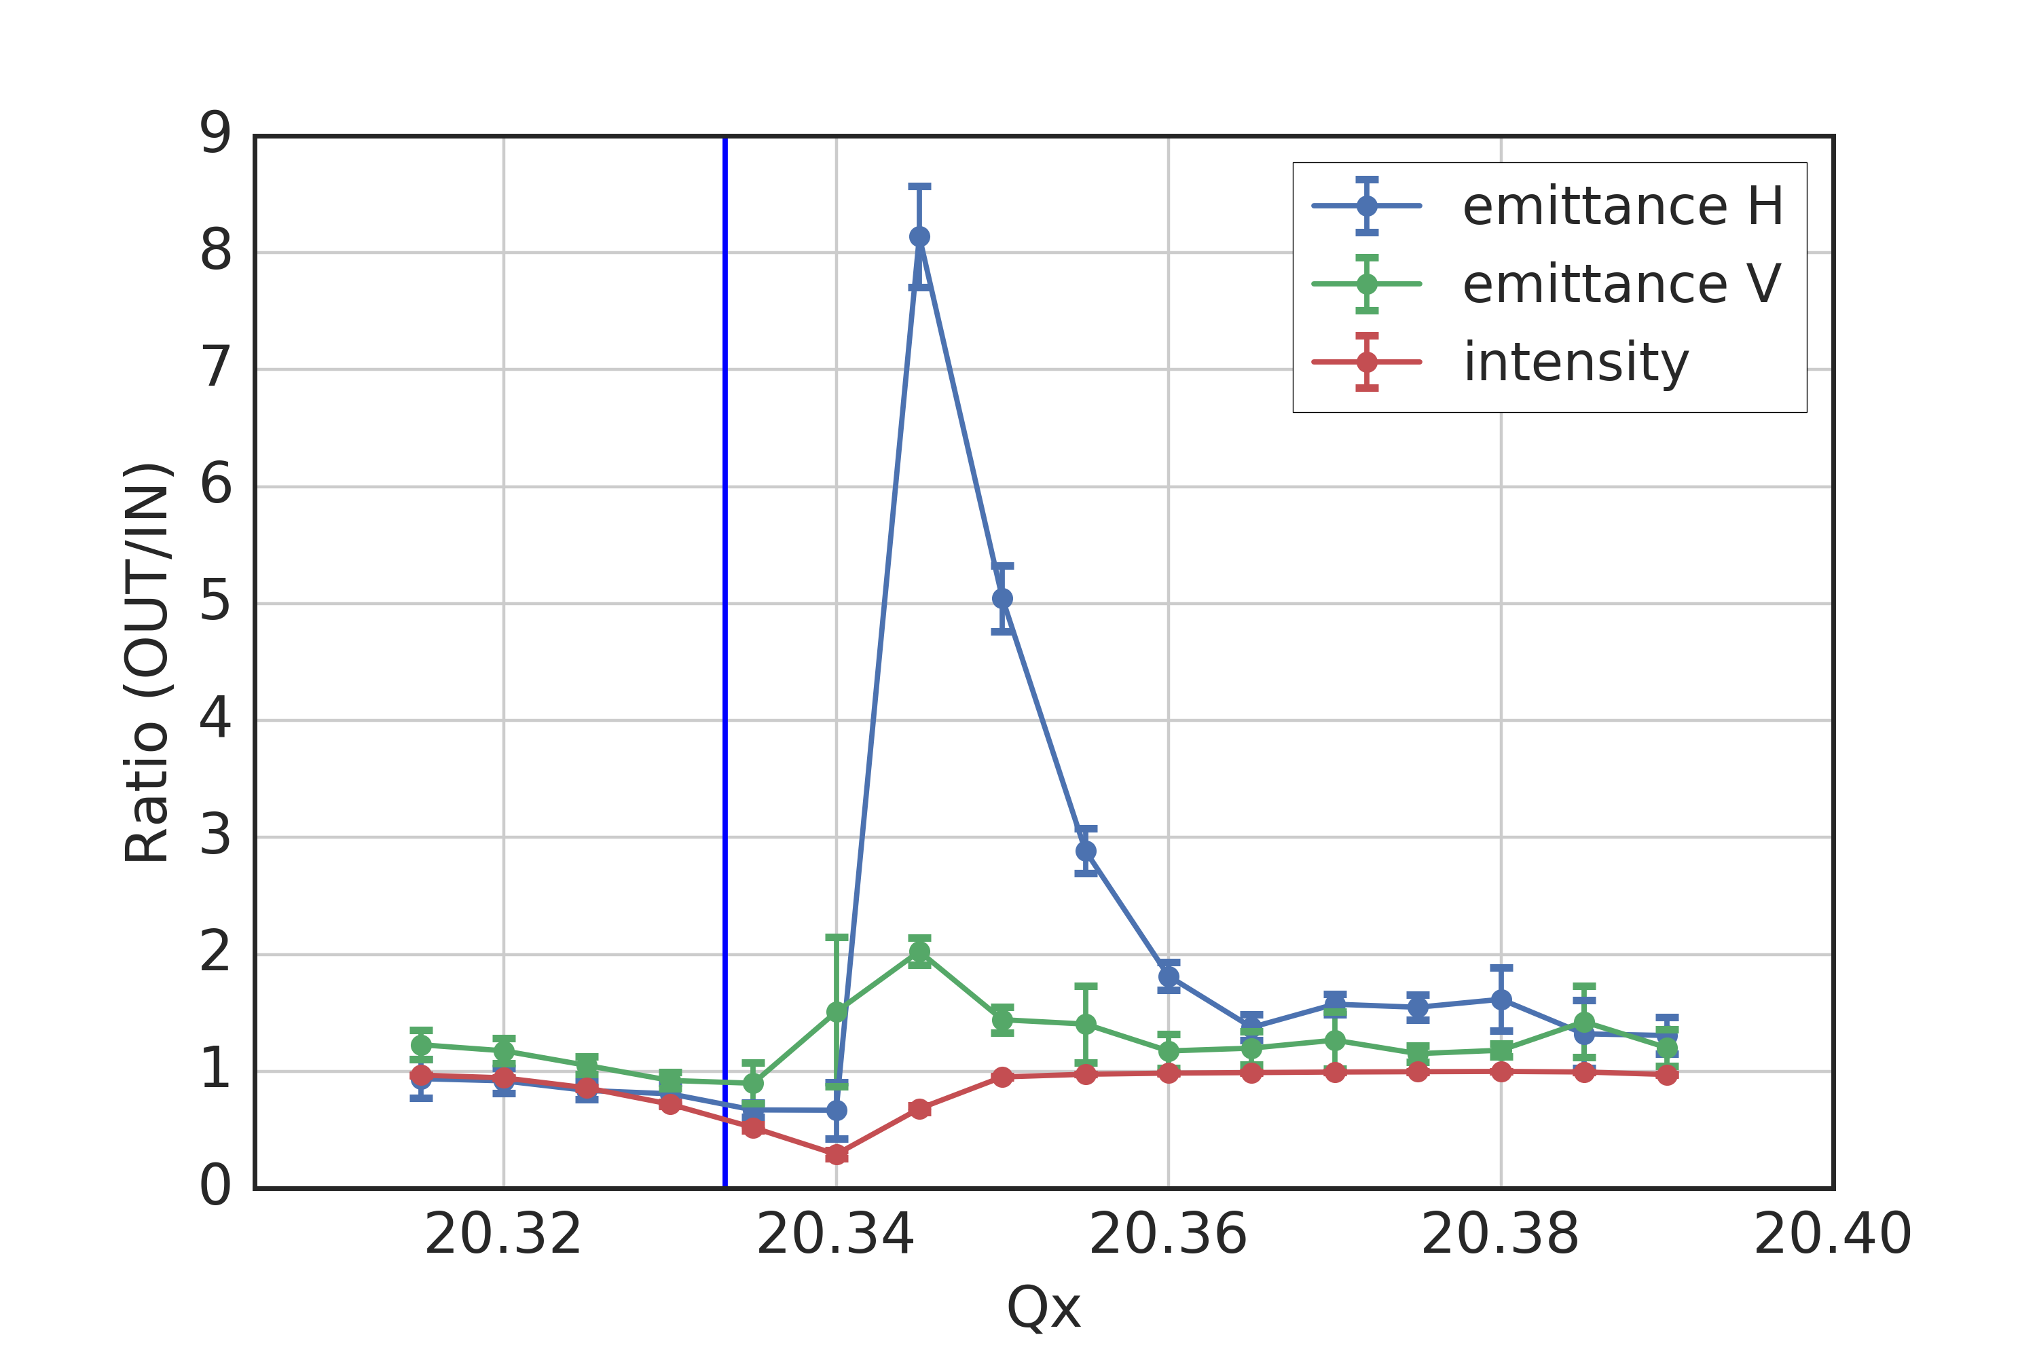
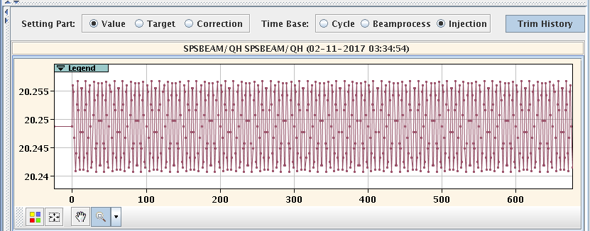
Measurements with different Q-ripples
Same experimental setup as before (single sextupole excites resonance)
Introduced voluntary Q-ripple (different amplitudes) by programming QH function
  Clear effect on emittance growth and losses (also for different ripple frequencies)
Measurement with voluntary Qx ripple: ±8e-3 @ 180 Hz
Measured QF spectrum
Voluntary Qx ripple

Slide 44



Measurements with different Q-ripples
Same experimental setup as before (single sextupole excites resonance)
Introduced voluntary Q-ripple (different amplitudes) by programming QH function
  Clear effect on emittance growth and losses (also for different ripple frequencies)
Measurement with voluntary Qx ripple: ±8e-3 @ 9 Hz
Measured QF spectrum
periodic losses
(9Hz as tune ripple)
Voluntary Qx ripple

Slide 45
Summary & Outlook
Experiment in SPS shows beam response at horizontal Qx = 20.4 resonance(s)
  Systematic 5th order resonance driven by b5 errors of dipoles
  10th order resonance driven by dispersion induced modulation of Gaussian space charge potential
  5th order resonance driven by Gaussian space charge potential for off momentum particles (feed-down of b6)
  Most likely the 5th order driven by space charge is the dominant one (under study)
Experiment can be reproduced by simulations with frozen model if quadrupole ripple is taken into account
  The quadrupole ripple induces a tune modulation similar to chromaticity (but for all particles)
  Due to high tunes in SPS, the tune ripple can result in relatively strong tune modulation
Measurements with voluntary ripple on main quadrupoles
  Voluntarily enhanced quadrupole ripple shows clear impact on losses and emittance blow-up

Slide 46
Thank you for your attention!

Slide 47

Measurements vs. simulations
Simulations using PTC-pyORBIT
  Frozen space charge model (non-adaptive)
  SPS nonlinear model – multipole errors (only systematic) up to b4
  5000 particles tracked for 140k turns (i.e. 3 s as in the experiment)
  Single sextupole excited as in experiment (starting from 0.16 s)
  Filtered quadrupole ripple on QFs and QDs taken into account (results in tune modulation similar to chromaticity but for all particles)
measurements
simulations
simulations with Q-ripple
Errors up to b4
strong response at both resonances, as effective chromaticity larger due to missing b5 component
???

