Slide 1
PS bunch capture with transient beam loading in SPS s LIU-SPS Beam Dynamics Working Group 06/04/2017
A. Lasheen
Acknowledgments: P. Baudrenghien

Slide 2
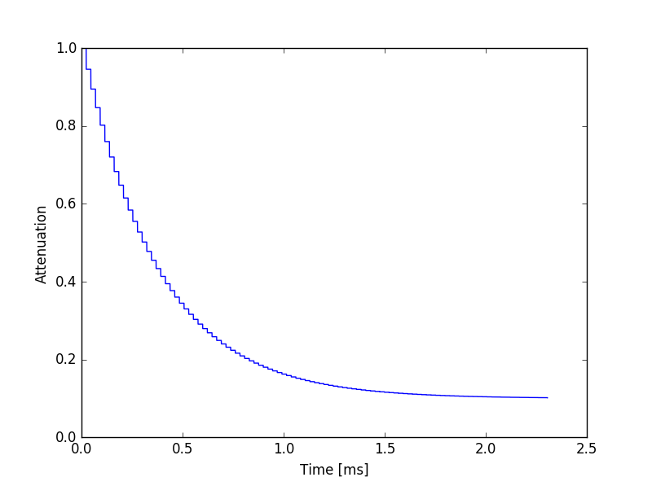
“Almost” dynamic one-turn delay feedback
Initial simulations were done to include a more dynamics representation of the one-turn delay feedback (OTBF) effect
The typical time is given by the bandwidth of the OTBF transfer function with $1/{\left(2πΔf_{−3dB}\right)}$
Values assumed for preliminary calculations: ${Δf}_{−3dB}≈200−400$ Hz, impedance reduction by 10 after transient

Slide 3
PS-SPS transfer with transient effects
Longitudinal emittance in the PS: 0.4 eVs (100%) (injected bunch length in SPS: 4-4.1ns)
Injection in SPS bucket: Q20 optics and RF voltage 4.5 MV
Injection phase is adjusted to minimize the dipole oscillations at injection (no phase loop in the model).
Particles in the external part of the bucket are considered lost (orange, 90%)

Slide 4
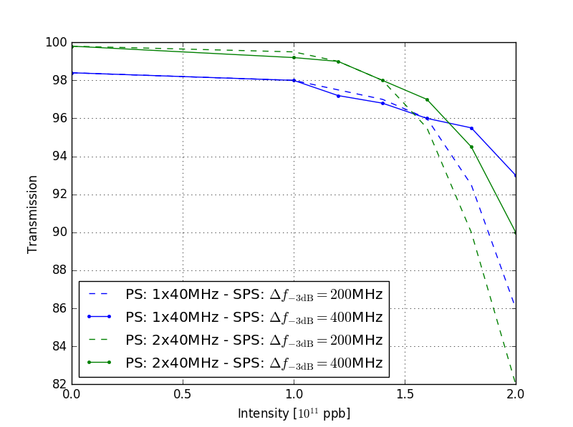
Losses as a function of intensity, OTFB BW, PS rotation
Preliminary: quite large error bars should be included (depending on how well the injection phase is adjusted)

