Slide 1
Follow-up of new design of vacuum flange shielding
C. Vollinger, LIU BD WG meeting, 02-March-17

Slide 2
RECAP from last meeting
Braided RF-shield for SPS VF was presented in LIUBDWG meeting on 02-Feb-17 and in IWG meeting #7 on 17-Feb-17;
Action items to be followed up…

Slide 3
Action items to be followed up… (1/2)
My understanding: “Pumping port style shield” were selected due to availability for EYETS installation. Due to difficulties with the sliding fingers (as observed for PP installation), they are not an option any more. (is this confirmed?)
2. In IWG, TE/VSC stated that similar design like “braided” shields was rejected about 6 years ago due to problems with individual strand breaking that could cause aperture reduction (if they bend in). See also next slide. Pending action item for TE/VSC to provide information about that study!
3. Time line for the shield decision; how can the information be provided, what exactly is required? RF-evaluation is completed. From impedance reduction point of view, the braided shields are superior. Input from TE/VSC needed!
4. Decision to be taken about the closing of the gasket gap.

Slide 4
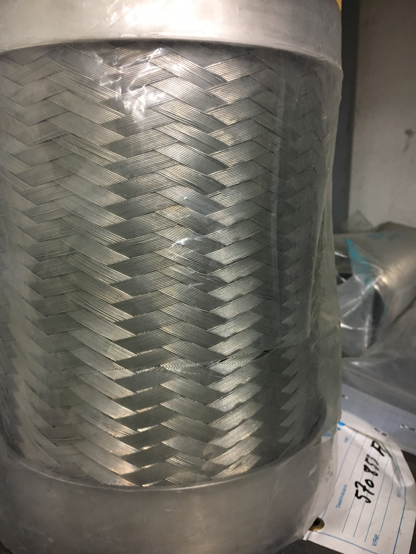
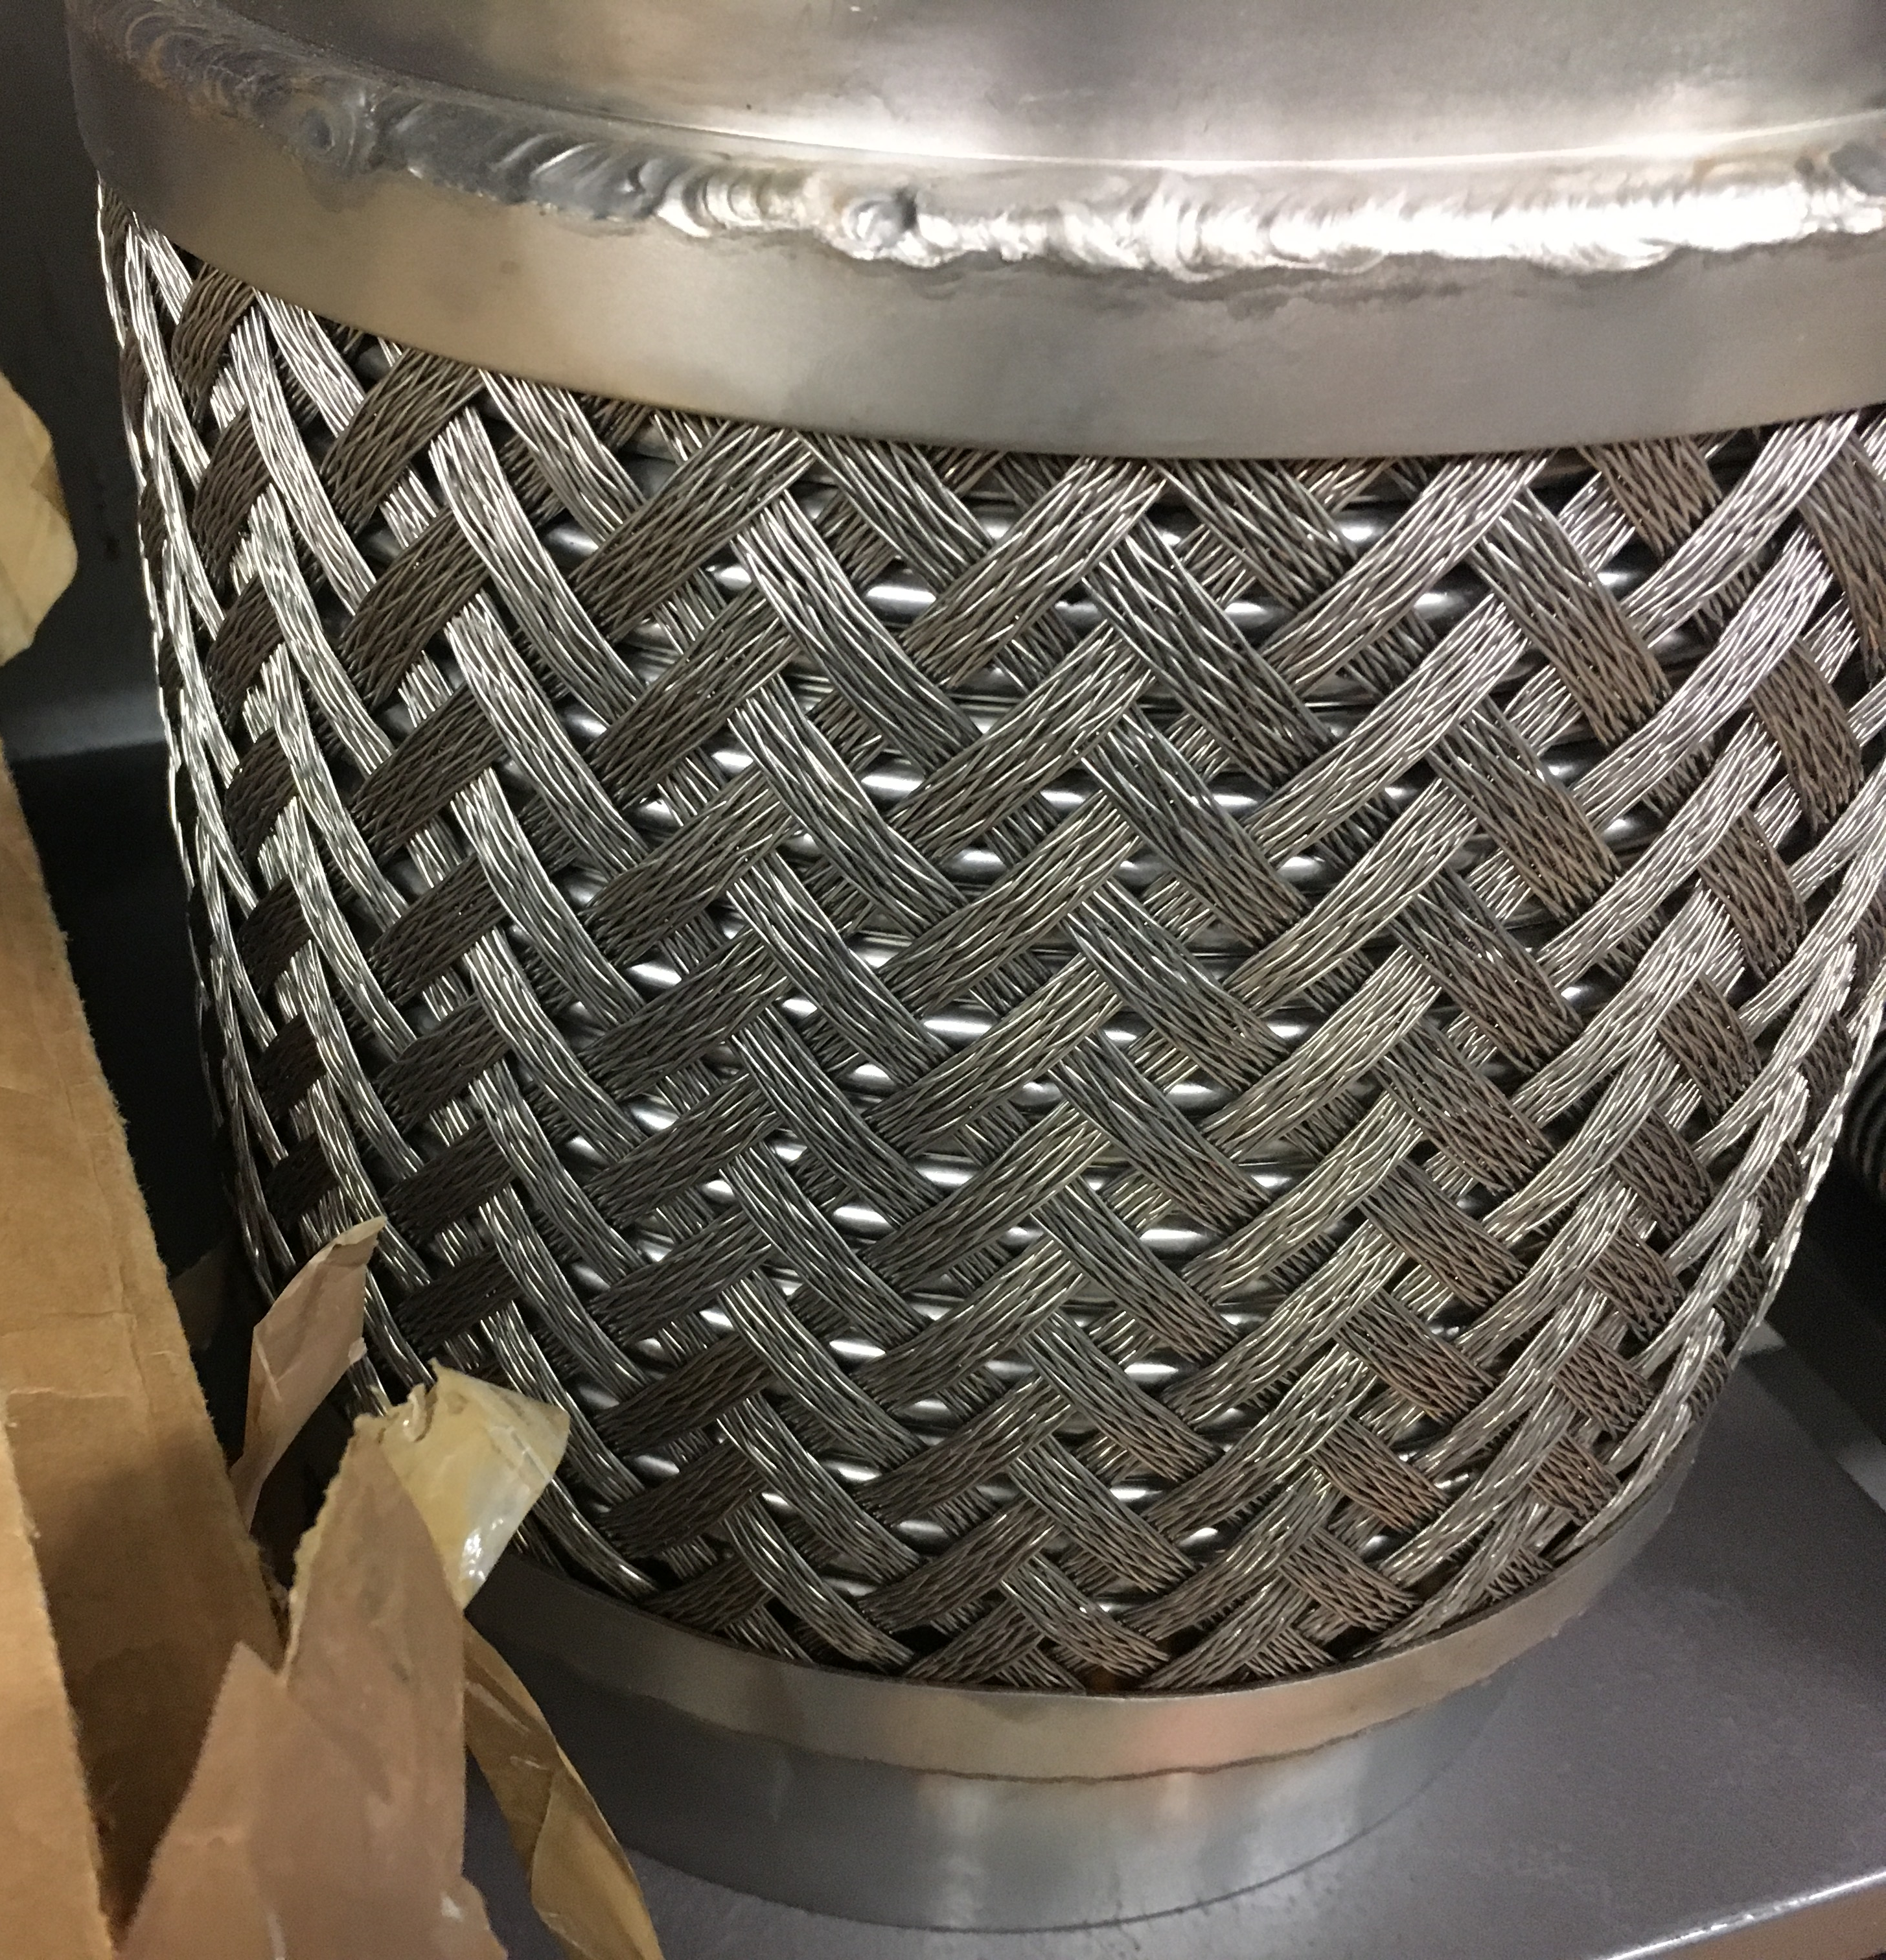
Action items to be followed up… (2/2)
Meeting with TE/CRG expert where similar braid structures are routinely used:
in-house experience with suppliers exist and a contact is provided to RF-group.
Large variety of braids are nowadays available (see below), diamond size of braid opening can be “freely chosen”.
Braids exist in all flexibility ranges (i.e. to allow lateral and longitudinal movements).
No breaking was ever observed on the braids even with heavy duty movements (e.g. as bellows protectors).

Slide 5
Many thanks!

