Slide 1
SPS Impedance Model Update Aaron Farricker

Slide 2
Outline
Missing Impedance
Possible Candidates
Addition Impedance Contributions
Relocation of the Beam Dump

Slide 3
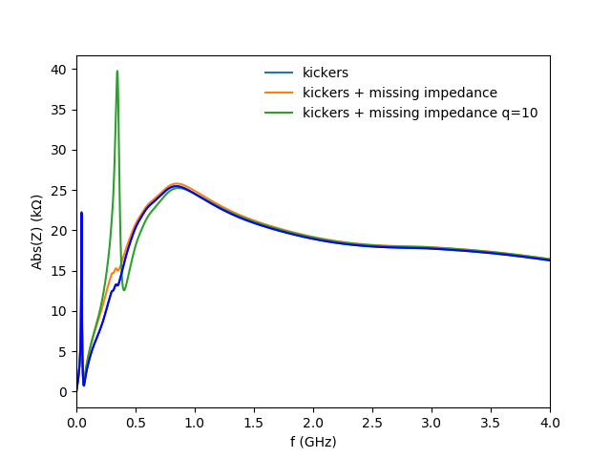
Missing Impedance
Beam measurements suggest we have impedance missing from our model at 350 MHz
Likely sources for this are the SPS kickers and/or equipment which has a large transverse size
Being able to identify the source for this would give confidence to how the impedance analysis is performed
A. Lasheen 04/08/17
Courtesy of J. Repond

Slide 4
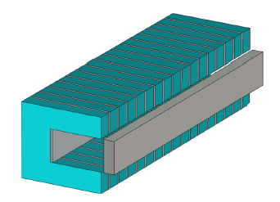
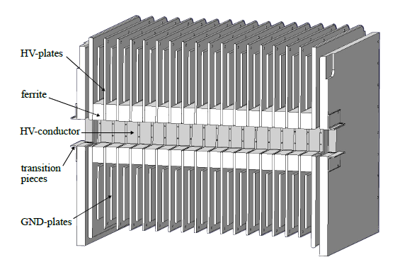
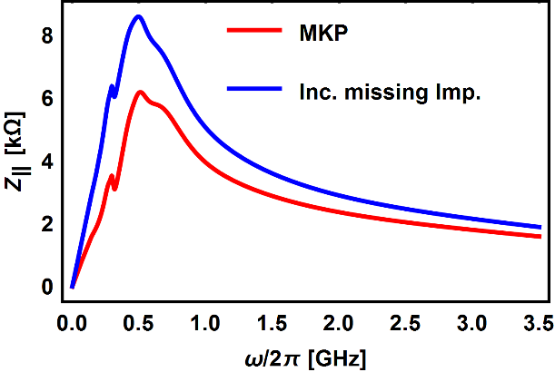
Possible Candidate – SPS Kickers
The current data in our impedance model comes from C.Zannini
The models are significantly different from the true geometry
This could easily be the source of the impedance that we believe is missing
MKP model by C.Zannini
MKP CAD Model M. Beck
Change in the impedance of the MKP kickers due to this extra resonance

Slide 5
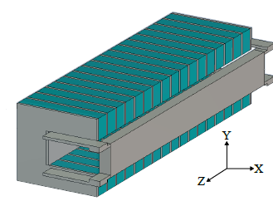
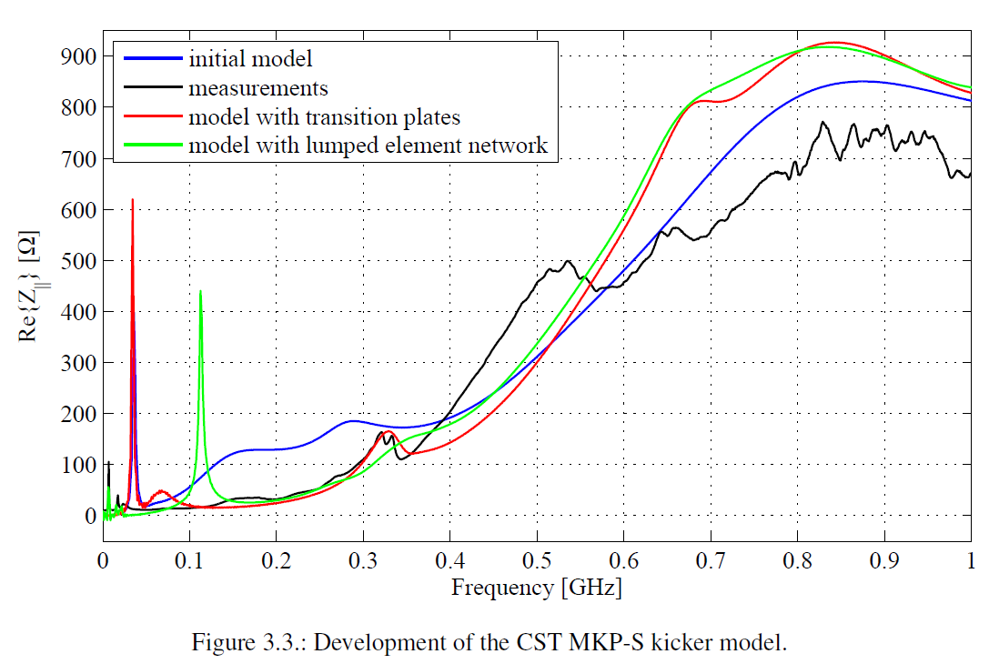
Possible Candidate – SPS Kickers
The MKP kicker was remodeled by M. Beck
This significantly changed the impedance particularly at low frequency
The general agreement with measurements is pretty good
There is a region of disagreement from 400 MHz

Slide 6
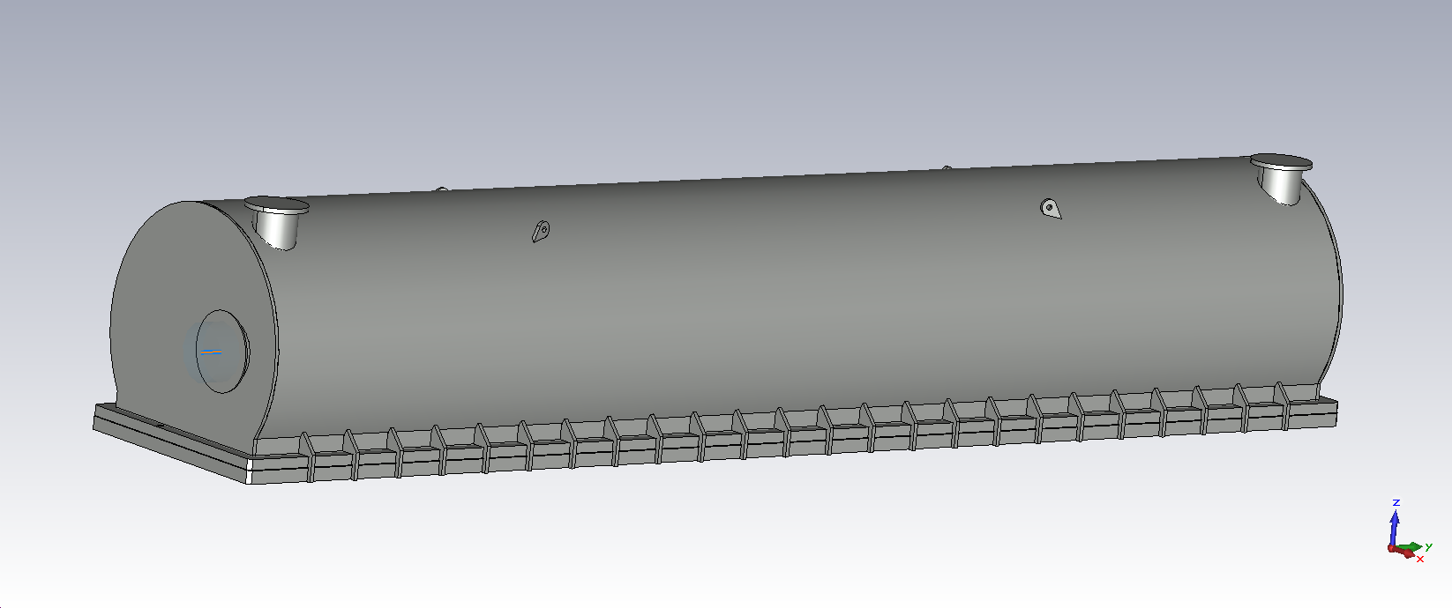
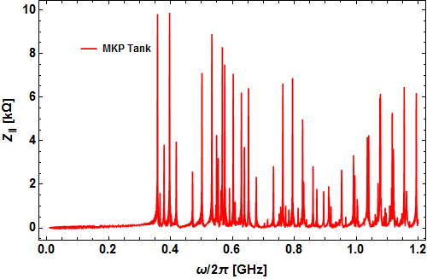
Possible Candidate – SPS Kickers
The bulk of the 3.5 m tank is shielded by the kicker
However each tank contains multiple magnets which may allow the beam to couple to the tank
The kicker would then damp the resonances giving the Q we are looking for
This is under further investigation as the layout of the magnets is still an open question
MKP Tank Integration Model
MKP Tank Impedance

Slide 7
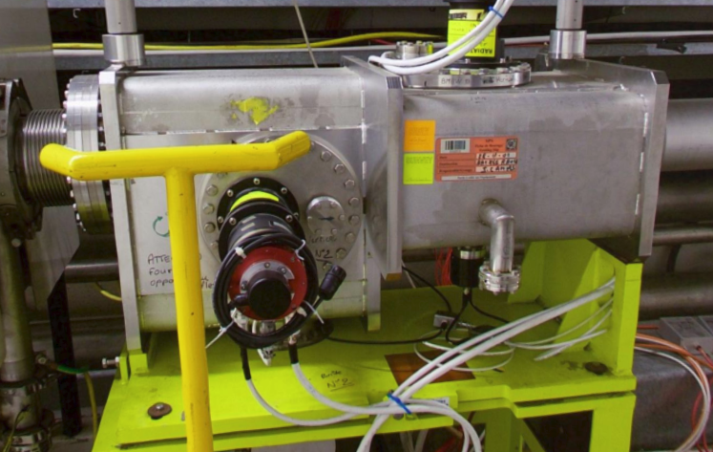
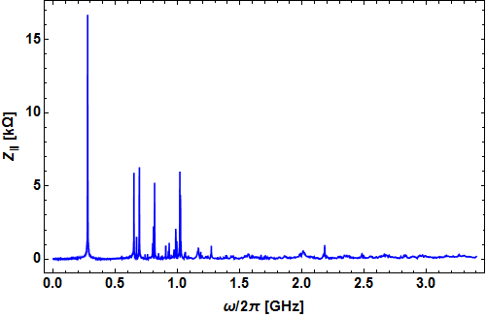
Possible Candidate – SPS Wire Scanner
An alternate source could be the BWSA wire scanners
There are two in the machine currently (BWSA.41420 and BWSA.51995)
The tanks are large and will therefore have low frequency resonances
Quick simulations of tank suggests a resonance may be present in our region of interest
Further investigation is ongoing
BWSA.41420
BWSA Tank Impedance

Slide 8
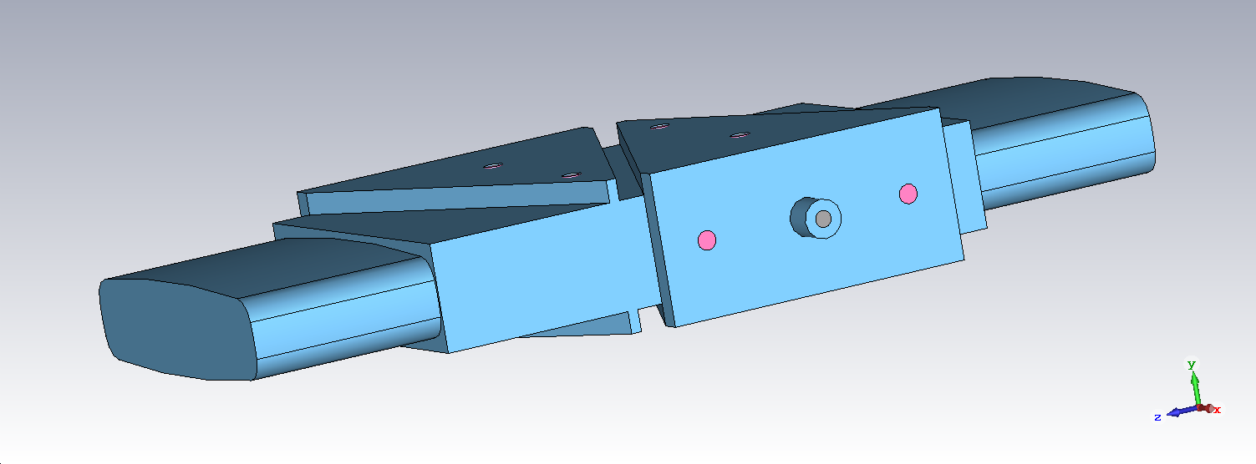
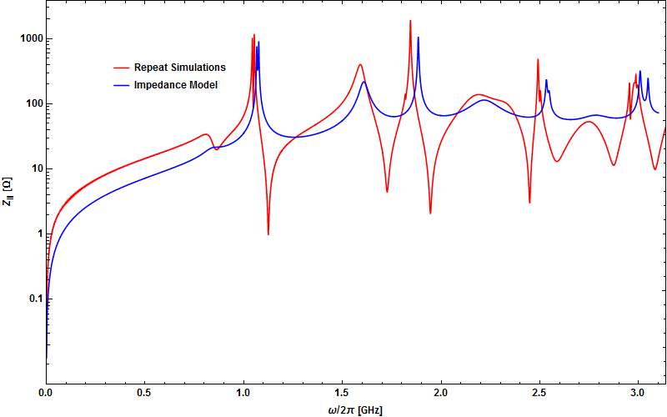
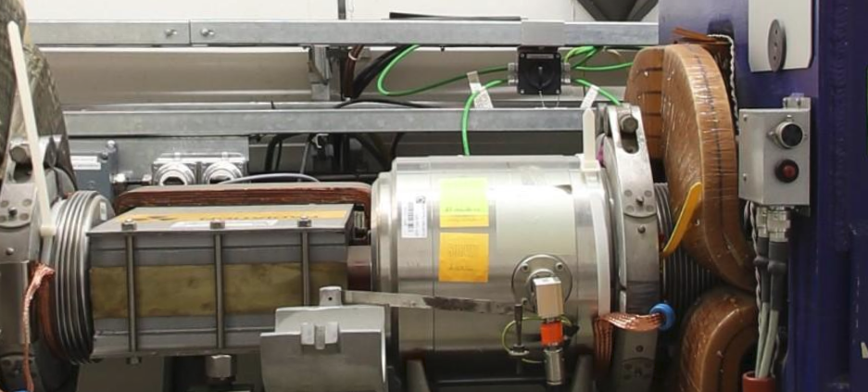
Further Source of Impedance – BPH
BPH Model B. Salvant
The 106 BPH monitors next to QF magnets are a significant source of impedance
We had a concern that they may be contributing more impedance than though
I found the model which was provided by C. Zannini to J. Varela and simulations indicate this is what is in the model
This model looks very different than the BPH installed in the machine
BPH Model Impedance

Slide 9
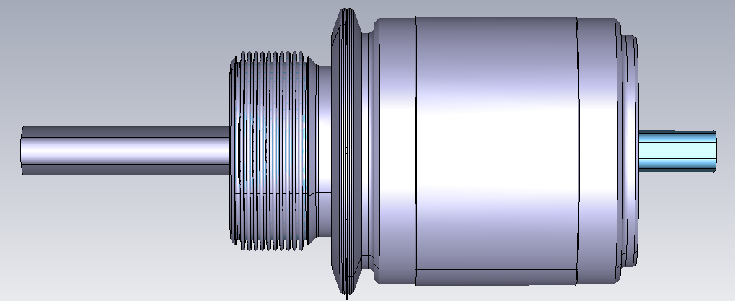
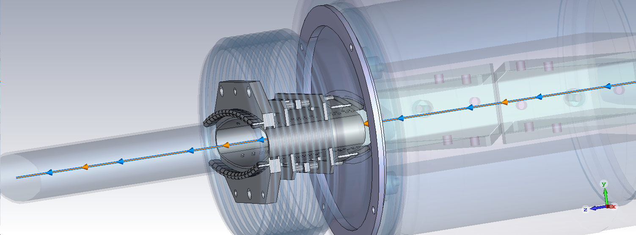
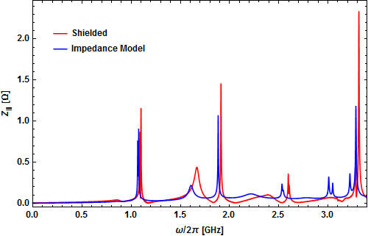
BPH – Currently In the Machine
BPH Tank and bellow Model T. Kaltenbacher
Of the 106 BPH installed 67 are shielded and the model is a good representation
There are however 39 BPH’s without shielding which are included in the model as shielded
This will be a significant additional source of impedance to the current machine

Slide 10
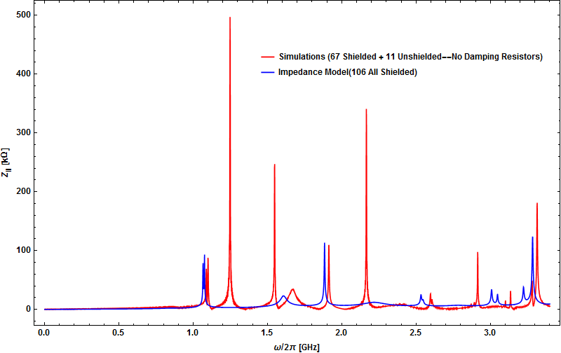
BPH – Currently In the Machine
Comparing the effect of 11 unshielded and 67 shielded BPH to the model shows significant differences
The remaining 25 not included have damping resistors which have not been simulated yet
For simulations of the current machine this is potentially an issue but shielding of all the BPH’s is ongoing

Slide 11
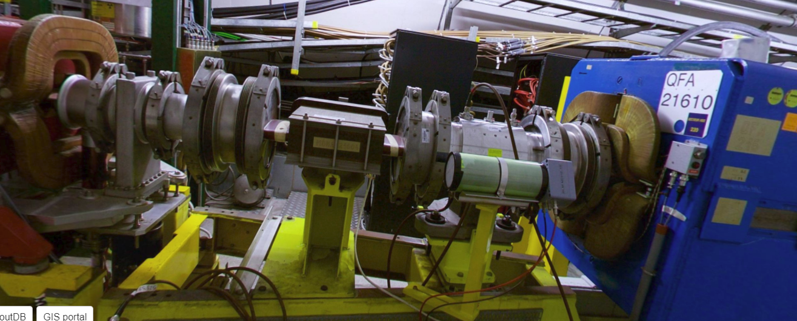
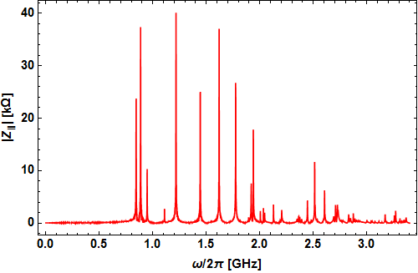
BPCE’s Before QFA’s
There are 12 BPCE’s installed before the large aperture quadrupoles
These are essentially cavities depending on the neighboring beam pipes and configurations
There is clearly a significant impedance but each BPCE is different due to the beam pipes
Therefore simulating each one will take some time

Slide 12
LSS1 and LSS5
As the SPS beam dump is being relocated during LS2 the sections LSS1 and LSS5 are being swapped
This presents an opportunity to check the current impedance of this section and reduce the existing impedance in the process
This will require a significant amount of time and effort but we should be rewarded with information of the current impedance and the future impedance of these sections post LS2

Slide 13
Conclusion
We believe the kickers may be responsible for the missing impedance at low frequency the analysis is ongoing
Another possible contributor is the wire scanner again the analysis is ongoing
Additional impedance in the machine may come from unshielded BPH’s and from the BPCE’s
Both LSS1 and LSS5 will be analyzed and then optimized for impedance—where possible—in the coming months

