Slide 1
Summary from high intensity run
(transverse)
H. Bartosik for the e-cloud team, SPS-OP and all other participants
LIU-SPS-BD meeting, 19.10.2017

Slide 2
Outline
Overview and timeline
Transverse instability studies
Tune shift along the bunch train
Transverse emittance studies
Transmission
Tune scan
Summary and conclusions

Slide 3
Schedule
Planned in 2 blocks equivalent to 4 MD blocks
Participation from teams in ABP, ABT, OP, RF
  Monday 9.10.2017: 9:00 – 9:00 → 24h
  Wednesday 11.10.2017: 8:00 – 00:00 → 16h

Slide 4
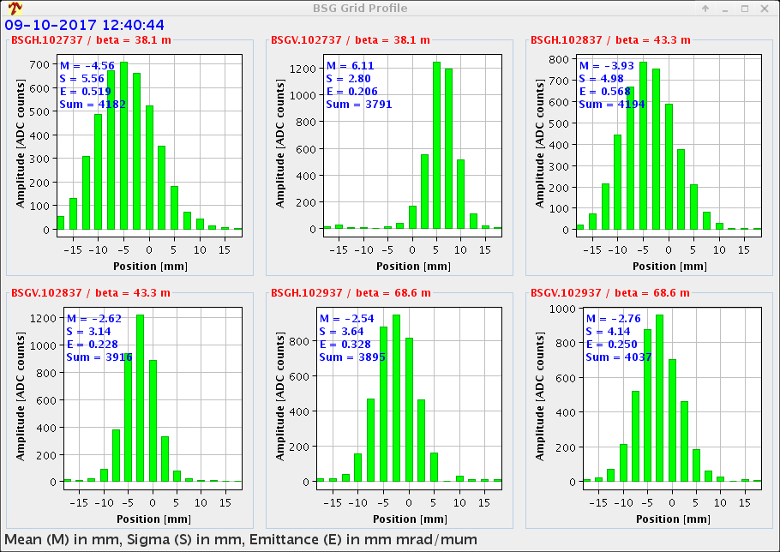
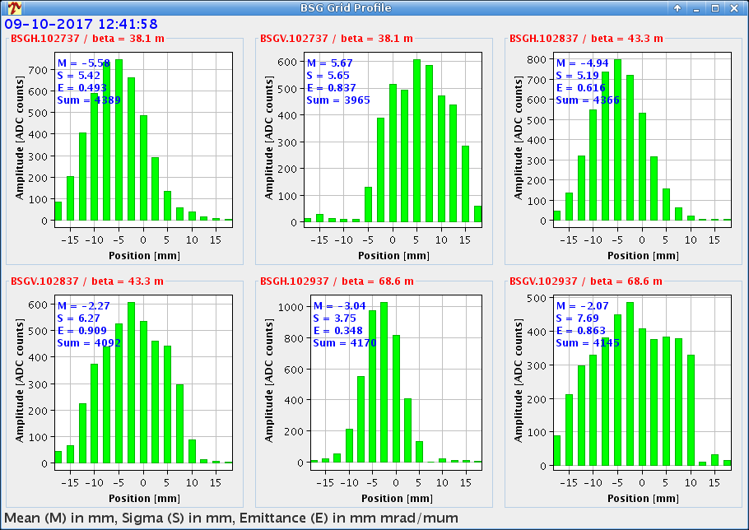
Block 1 (Monday) – overview
9h
12h
15h
18h
21h
0h
3h
6h
9h
Setting up
Struggling to inject second batch
Good shot
  Scrubbing cycle (Q20) with long flat bottom
  Nominal longitudinal parameters from PS
  Fast losses at injection of second batch
  No obvious signs of instabilities
  Longitudinal beam quality in PS improved
  TT10 SEM grids showed blown-up beams
  → vertical instabilities at flat-top in the PS
  Decided to use only 48 bunches beams
  (BCMS and standard with 2e11 p/b)
Bad shot

Slide 5
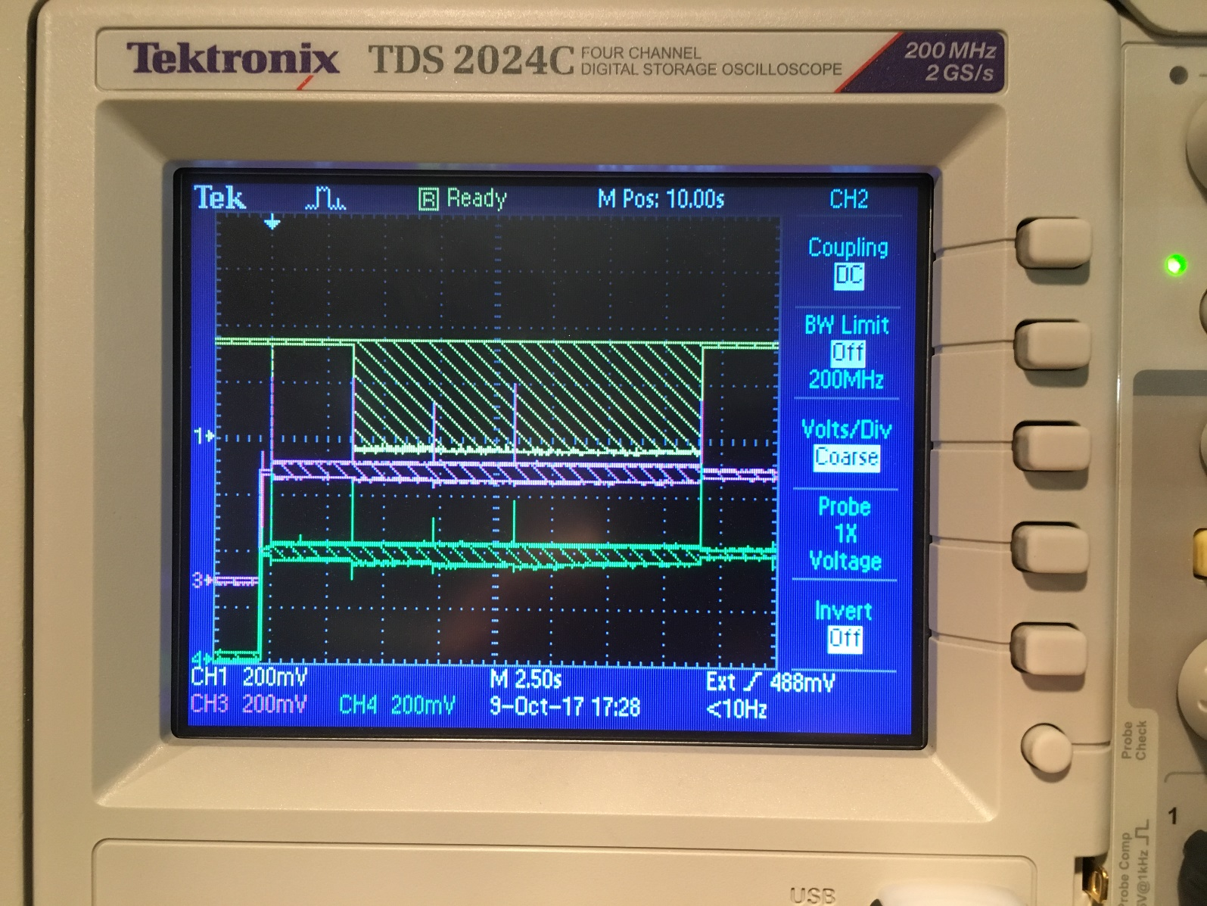
Block 1 (Monday) – overview
9h
12h
15h
18h
21h
0h
3h
6h
9h
Longitudinal studies
Observation of longitudinal instability at flat bottom
RF power limit reached with second injection of 48 bunches (2e11 p/b)

Slide 6
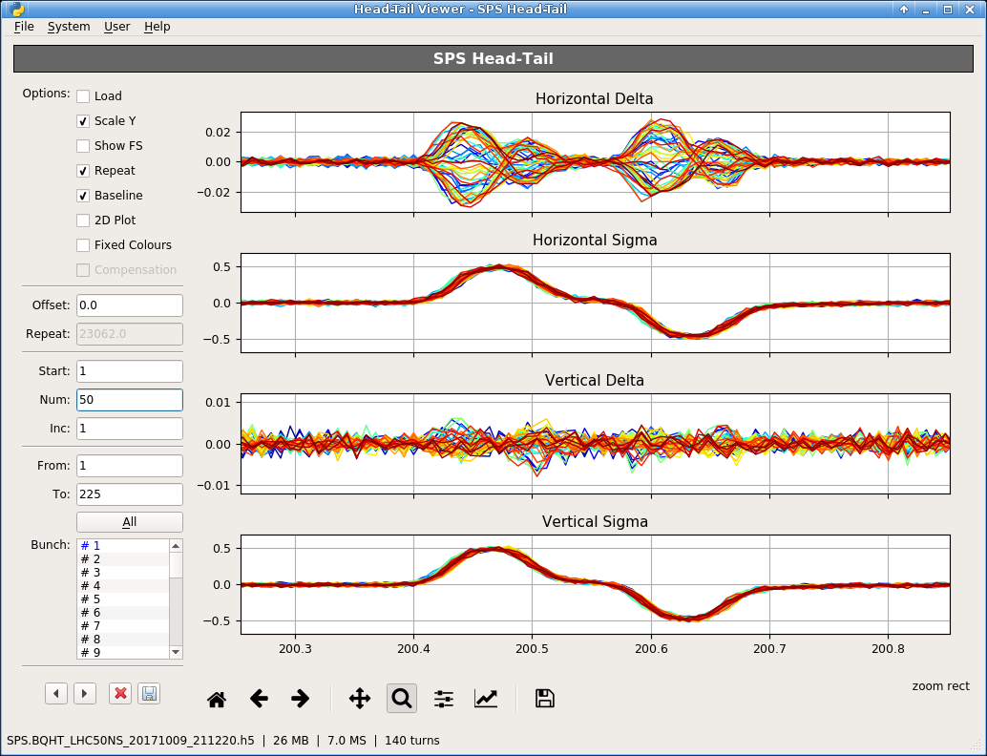
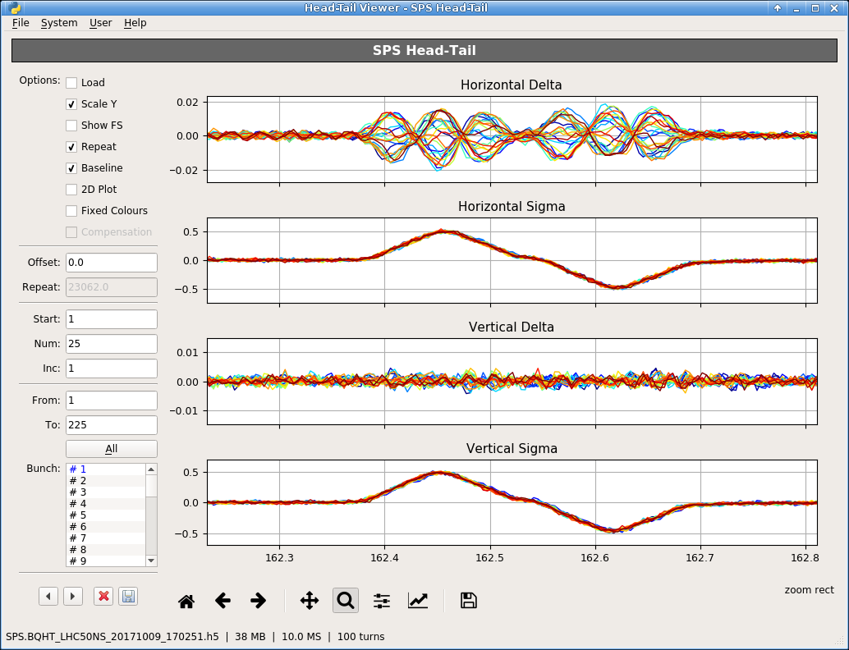
Block 1 (Monday) – overview
9h
12h
15h
18h
21h
0h
3h
6h
9h
Studies in the transverse plane with 4 x 48 standard 25 ns
Horizontal head tail instability
Measurements of tune shift along the batch
Lower chroma
  20 MHz coupled bunch instability (as in 2015)
  is NOT observed
  Horizontal single bunch head tail instability
  Chroma scans – octupole scans to explore
  beam stability limits
  Lifetime studies as function of chroma / octupoles
Higher chroma

Slide 7
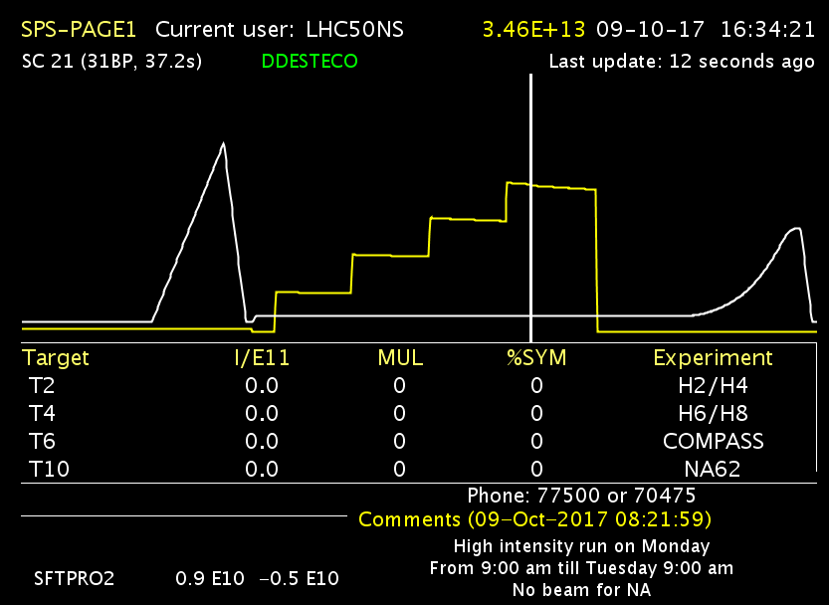
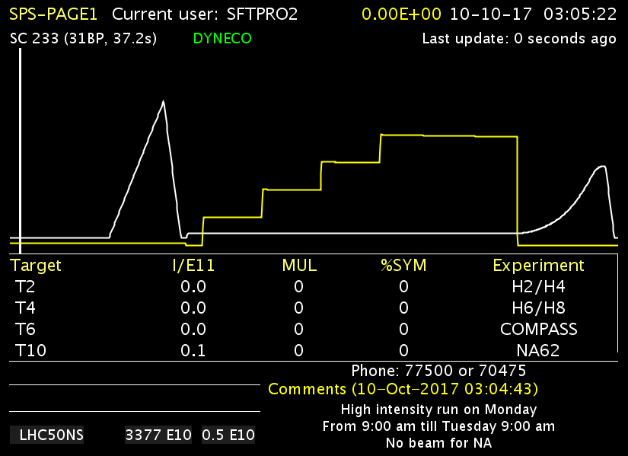
Block 1 (Monday) – overview
9h
12h
15h
18h
21h
0h
3h
6h
9h
Comparison of transmission between BCMS and standard beam
Measurement of emittance evolution

Slide 8
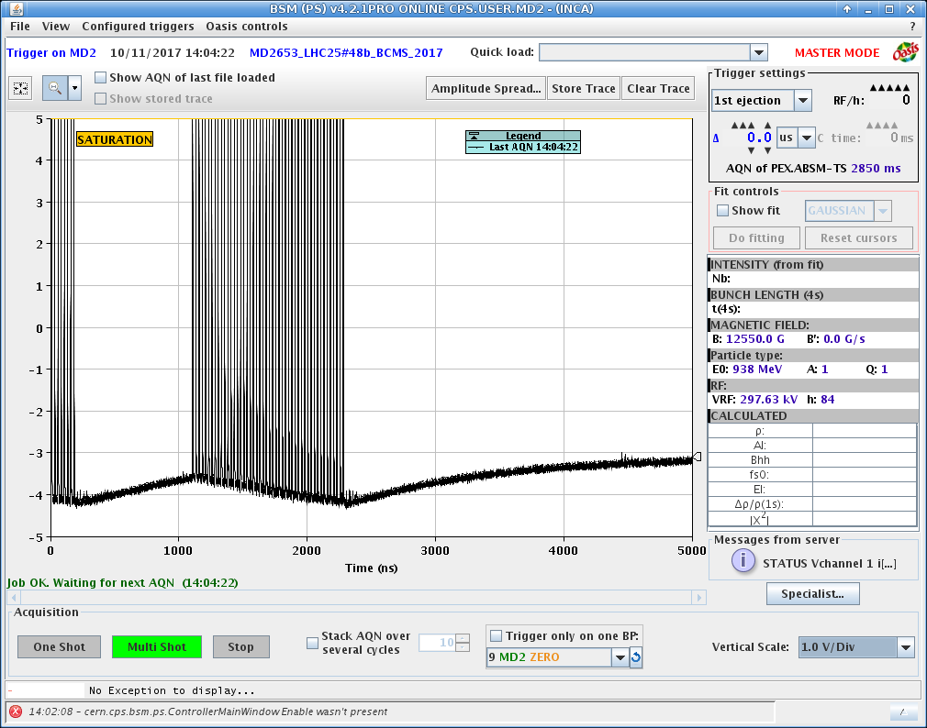
Block 2 (Wednesday) – overview
8h
10h
12h
14h
16h
18h
20h
22h
0h
Beam quality from PS not optimal – required some work from PS colleages
Observation of satellite bunches in PS (some remain in the ring after extraction)
Tune scans to check if flat bottom losses related to working point

Slide 9
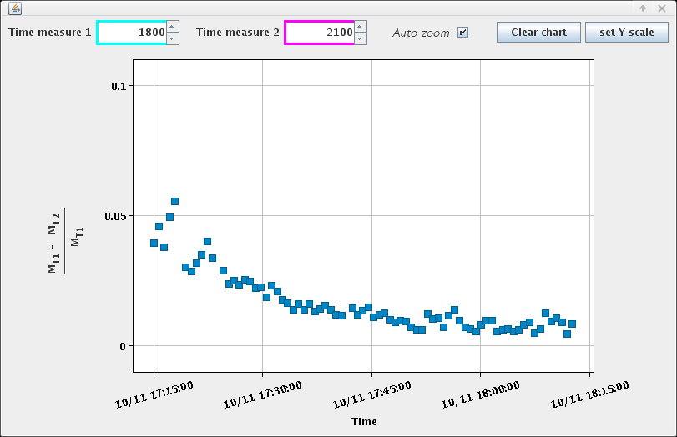
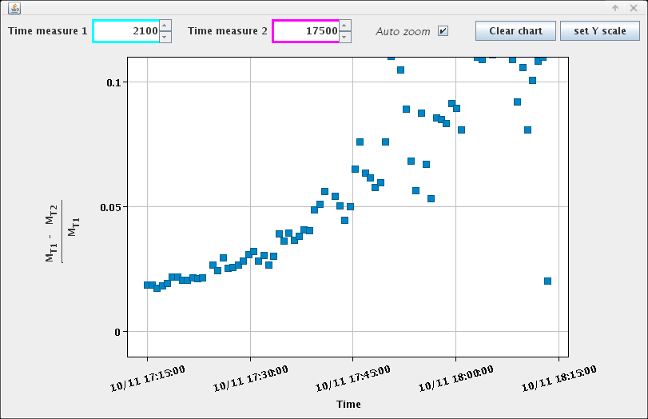
Block 2 (Wednesday) – overview
8h
10h
12h
14h
16h
18h
20h
22h
0h
Longitudinal studies
Losses as function of RF voltage (with Q-kicks to clean un-captured beam)
losses at 1st Q-kick (uncaptured beam)
losses along remaining flat bottom
Increasing RF voltage
Increasing RF voltage

Slide 10
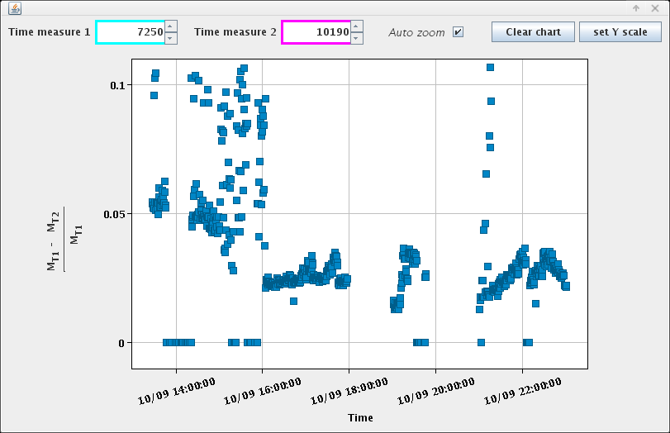
Transverse instability studies
  Lifetime computed
  from the BCT
scans
Octupoles
Chromaticity

Slide 11
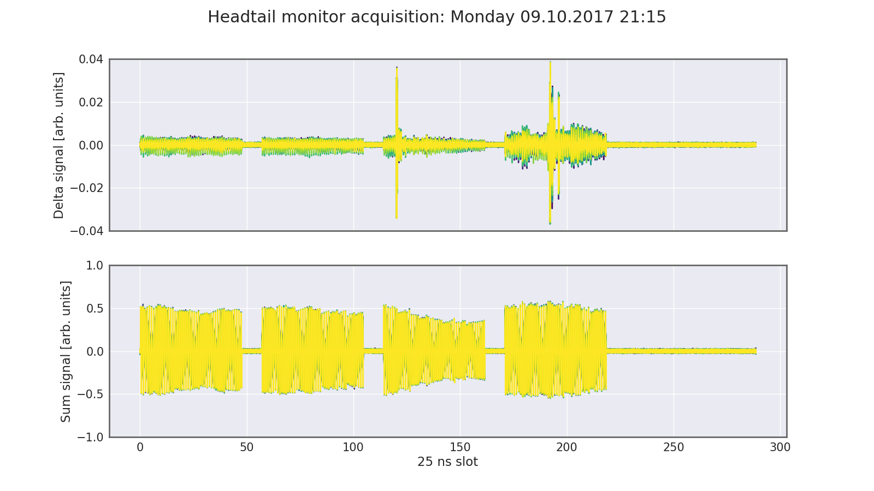
Transverse instability studies
Chromaticity
QPH setting
0.5
0.3
0.1

Slide 12
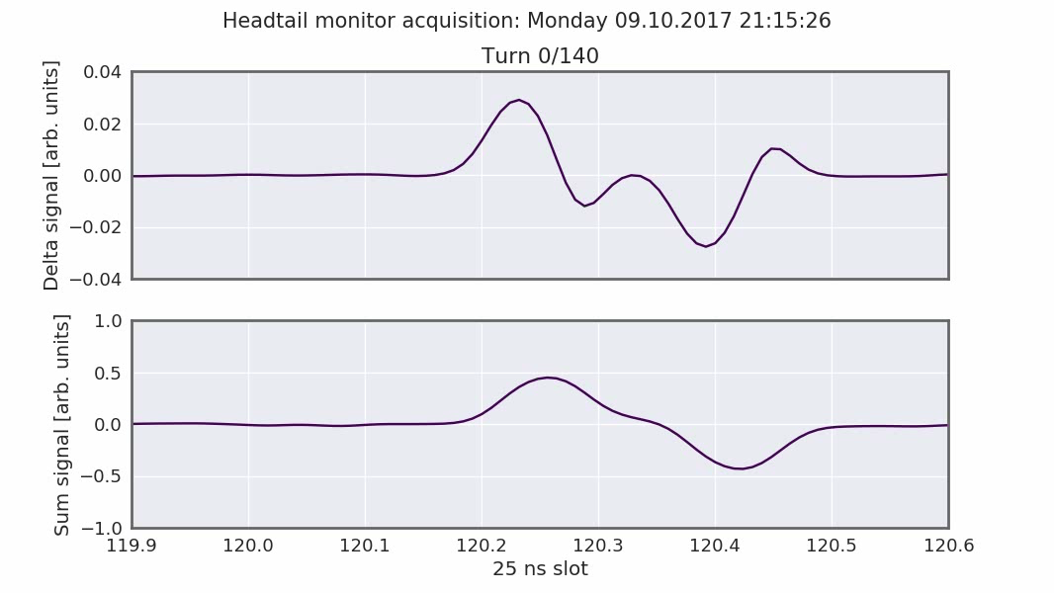
Transverse instability studies
Chromaticity
QPH setting
0.5
0.3
0.1

Slide 13
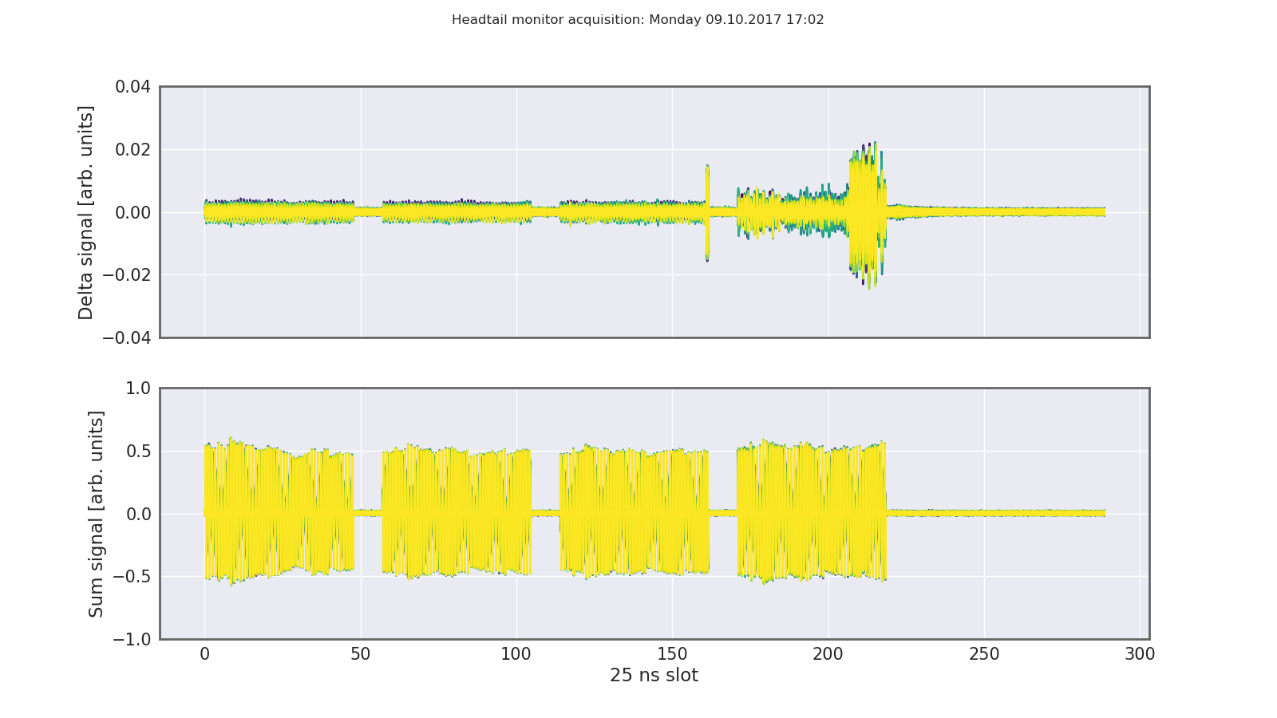
Transverse instability studies
Chromaticity
QPH setting
0.5
0.3
0.1

Slide 14
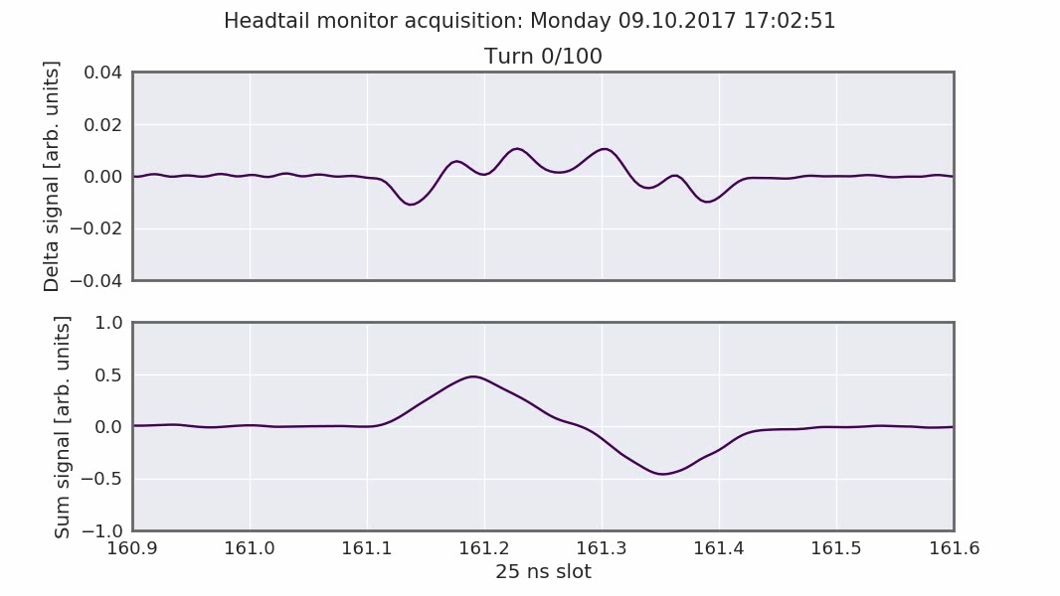
Transverse instability studies
Chromaticity
QPH setting
0.5
0.3
0.1

Slide 15
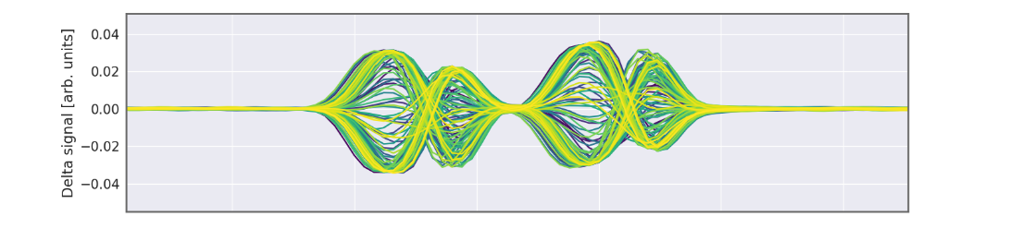
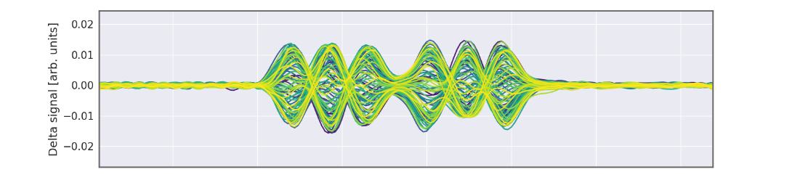
Transverse instability studies – summary
The 20 MHz coupled bunch instability from 2015 was not observed (now higher gain at 20 MHz in the transverse damper, but also only 4 x 48 bunches …)
In presence of the transverse damper, 4 x 48 bunches exhibit single bunch instabilities in the later batches
Single bunch instabilities change and can be cured with chromaticity
  ξ_{H} ~ 0.1 – 0.2 → mode 1
  ξ_{H} ~ 0.3 – 0.5 → mode 2
  ξ_{H} > 0.5 → instability mostly suppressed
Also cured with octupoles (KLOF > 1.5)
  maybe a mixture of detuning with amplitude and Q‘‘ (to be investigated)
Impact on transmission
  Due to large chromatic detuning - to be analyzed if losses mainly from uncaptured beam …

Slide 16
Tune shift along the bunch train
Quite large in V (accumulating along train)

Slide 17
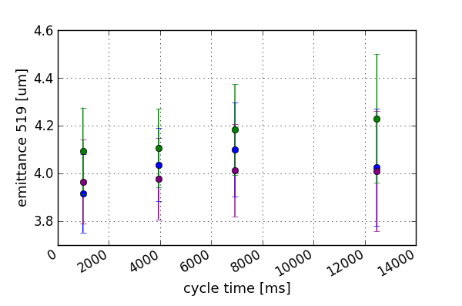
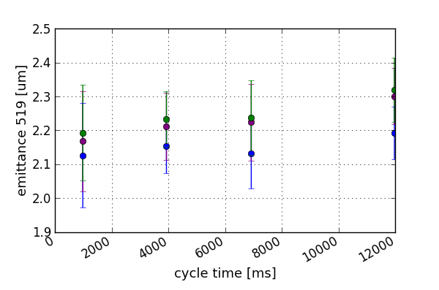
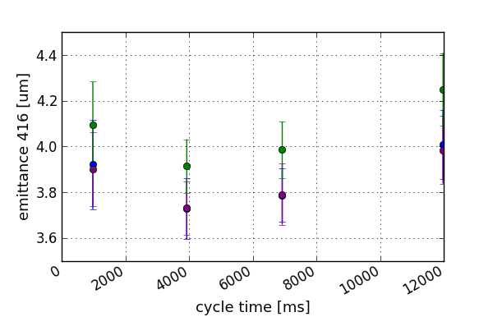
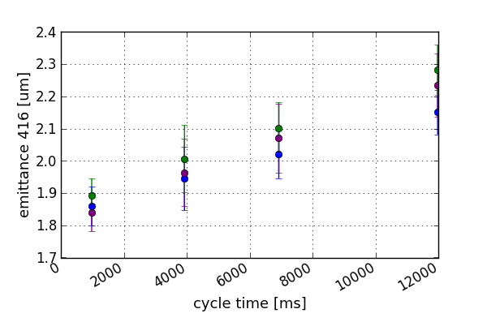
Transverse emittance studies
Emittances measured for different beams and different intensities
  Further data analysis to follow
Standard beam, 2e11 p/b
BCMS beam, 2e11 p/b
horizontal
horizontal
vertical
vertical

Slide 18
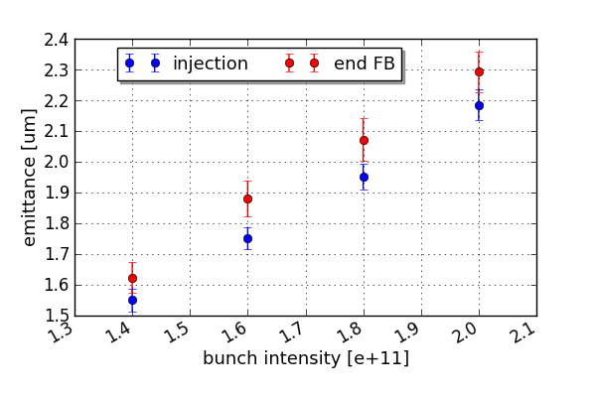
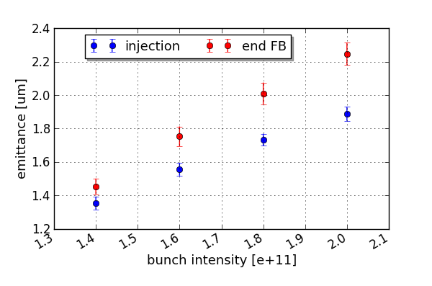
Transverse emittance studies
Emittances measured for different beams and different intensities
  Further data analysis to follow
horizontal
vertical
BCMS beam

Slide 19
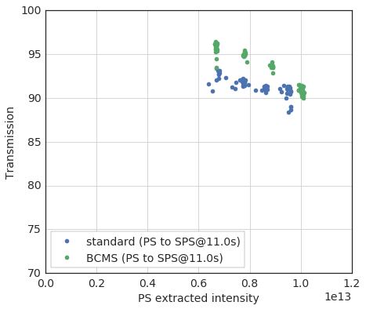
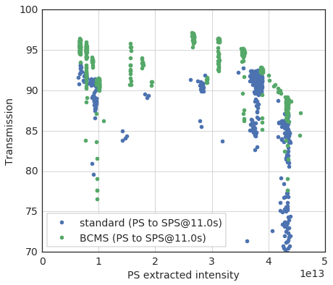
Transmission – BCMS vs. standard 25 ns
Measurements from Monday, batches of 48 bunches for both beams
  Generally transmission is quite OK
  Transmission of BCMS beam better than 25 ns standard due to smaller (horizontal) emittance
  The transmission from PS to SPS is degrading with intensity for BCMS
1 batch
4 batches

Slide 20
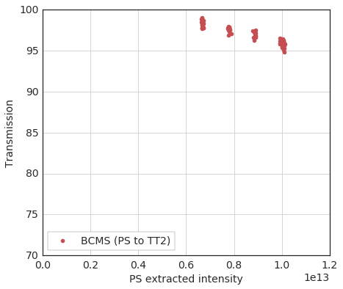
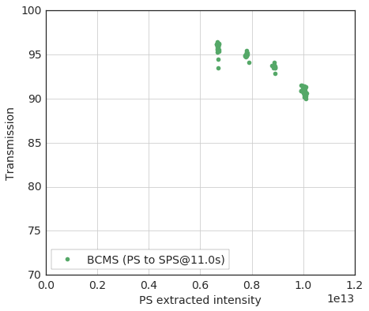
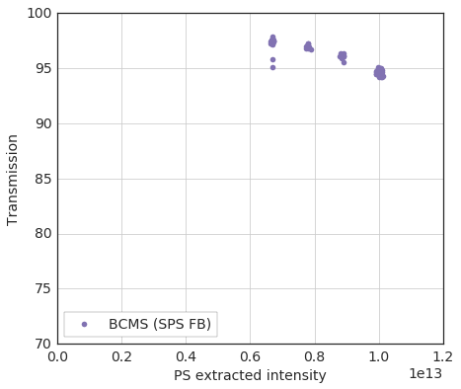
Transmission – BCMS vs. standard 25 ns
Measurements from Monday, batches of 48 bunches for both beams
  Generally transmission is quite OK
  Transmission of BCMS beam better than 25 ns standard due to smaller (horizontal) emittance
  The transmission from PS to SPS is degrading with intensity for BCMS – also due to PS
1 batch
Losses between PS ring and TT2 also increasing with intensity …
Looks like ombination of losses at PS extraction / in TT2 and losses in SPS
= +
Losses in SPS also increasing with intensity, but not so bad after all

Slide 21
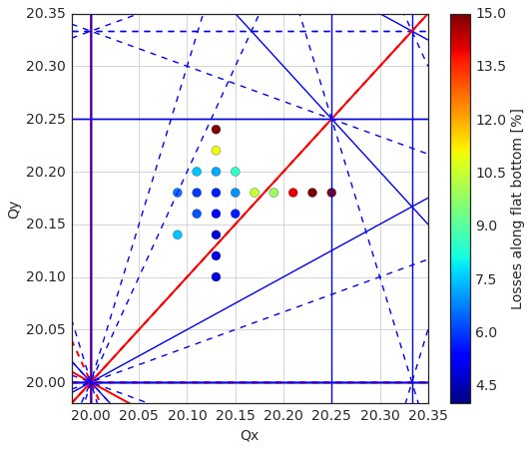
Tune scan
Tune scans to check if flat bottom losses related to working point
  Usual working point (20.13/20.18) close to optimum – losses can be higher for other working points (in particular when increasing the tunes…)
  Still to be investigated in detail which resonances are the detrimental ones taking into account the coherent and incoherent tune shifts …
Losses as function of coherent tunes
bare tunes are shifted compared to measured coherent tunes like this:

Slide 22
Summary and conclusions
Not so bad after all ;-)
Intense 40 hours of high intensity beam studies
  Concentrated on batches with 48 bunches (direct comparison BCMS vs. standard)
  Beam quality better compared to 2015 (e.g. nominal longitudinal parameters)
  In the future, maybe it would be a good idea to do these high intensity studies more regularly …
Progress in characterizing transverse (horizontal) instability
  With 4 x 48 bunches and (sufficient) gain at 20 MHz in transverse damper, coupled bunch instability not observed up to 2e11 p/b
  Horizontal head tail instability requires high chromaticity and / or octupoles with impact on transmission – to be clarified if “mostly” uncaptured beam is affected
Transmission degrading with “intensity” – but mechanisms become clearer
  BCMS beams have better transmission compared to standard due to smaller emittance
  Momentum spread and horizontal emittance is critical due to limited horizontal aperture in QDs – increasing emittance with intensity can appear as correlation of losses with intensity
  Losses at PS extraction and / or TT2 to be looked at in more detail
  Operational working point close to optimum
Studies on emittance
  Some blow-up observed (especially with BCMS beams) – to be further investigated

Slide 23
Thank you for your attention!

