Slide 1
Measured beam losses in Q20 and Q22 cycles
M. Schwarz
Acknowledgements:
A. Lasheen, J. Repond, P. Baudrenghien, E. Shaposhnikova T. Bohl, G. Papotti, H. Bartosik, M. Patecki, PS and SPS operator team

Slide 2
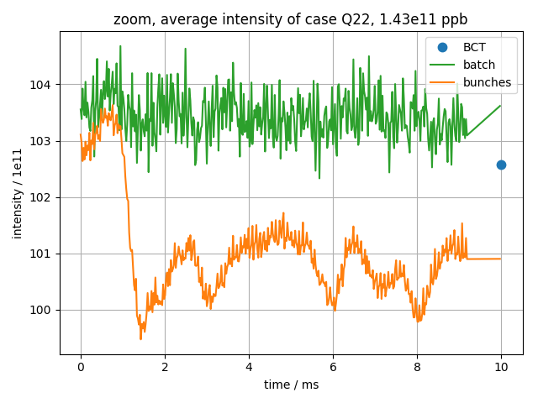
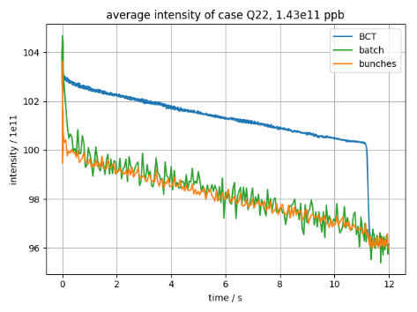
Types of losses in SPS
Fit intensity by $I\left(t\right)=m t+b+A exp\left({−t}/τ\right)$
$m$: linear loss rate
$τ$: decay time
BCT: intensity of BCT (after 10 ms)
Bunch intensity: intensity obtained by integrating over bunches
Batch intensity: intensity obtained by integrating over batch profile (including ‘empty’ buckets)
Two types of losses:
Losses at injection
Continuous losses at flat-bottom

Slide 3
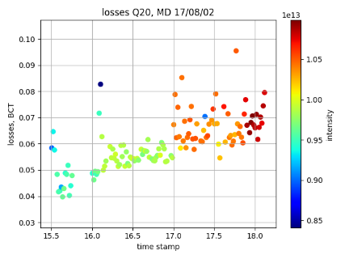
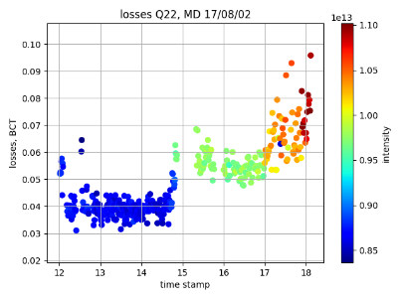
MD 17/08/02
Common settings:
72 bunches, 25ns spacing
Flat-bottom 0-11.1s, ramp to 450GeV 11.1-19.5s, flat-top 19.5-20s
Here: data from injection to first part of ramp (11.830s ~ 29 GeV)
About 10 acquisitions per data point
Q20 optics:
V₂₀₀ = 4.5 MV, V₈₀₀ = 0.45 MV
FF off, FB on, PL on, SL on
Momentum aperture δ = 6.1e-3
f_{s0} = 777Hz, T_{s0} = 1.29ms
Q22 optics:
V₂₀₀ = 3.0 MV (3.3 MV), V₈₀₀ = 0.1V₂₀₀
FF off, FB on, PL on, SL on
Momentum aperture δ = 7.7e-3
f_{s0} = 513Hz (538Hz), T_{s0} = 1.95ms (1.86ms)

Slide 4
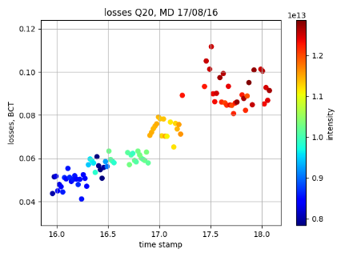
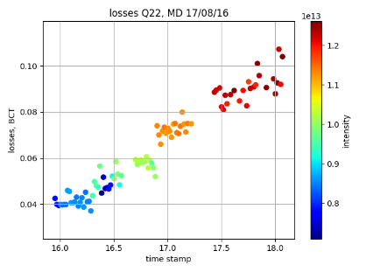
MD 17/08/16
Common settings:
72 bunches, 25ns spacing
Flat-bottom 0-11.1s, ramp to 450GeV 11.1-19.5s, flat-top 19.5-20s
Here: data from injection to first part of ramp (11.830s ~ 29 GeV)
About 5 acquisitions per data point
Q20 optics:
V₂₀₀ = 4.5 MV, V₈₀₀ = 0.45 MV
FF off, FB on, PL on, SL on
Momentum aperture δ = 6.1e-3
f_{s0} = 777Hz, T_{s0} = 1.29ms
Q22 optics:
V₂₀₀ = 3.3 MV (5 MV), V₈₀₀ = 0.1V₂₀₀
FF off, FB on, PL on, SL on
Momentum aperture δ = 7.7e-3
f_{s0} = 537Hz (662 Hz), T_{s0} = 1.86ms (1.51 ms)

Slide 5
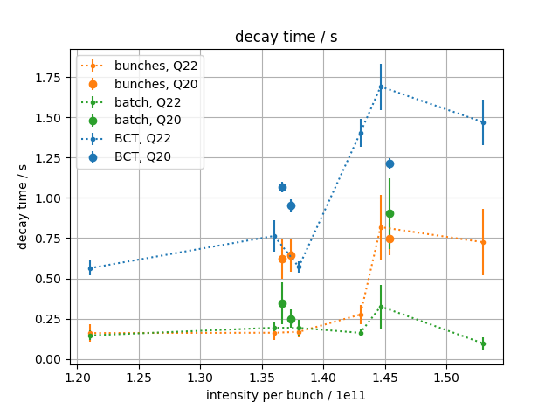
Decay time

Slide 6
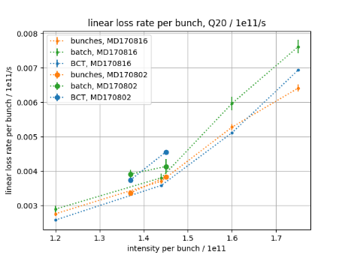
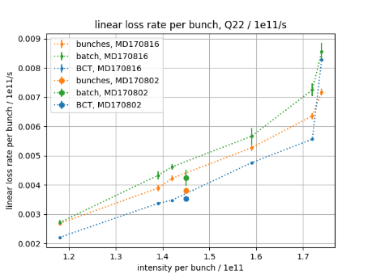
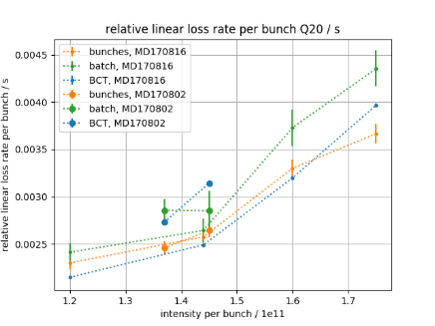
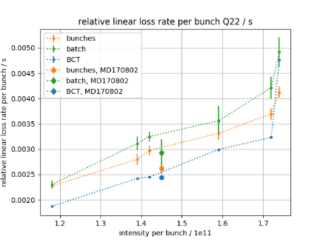
Linear loss rate $m$
Increase
V₂₀₀ -> 5MV at FB

Slide 7
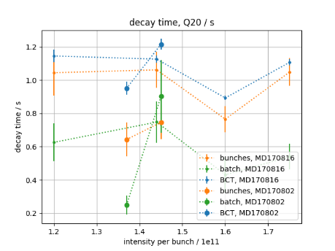
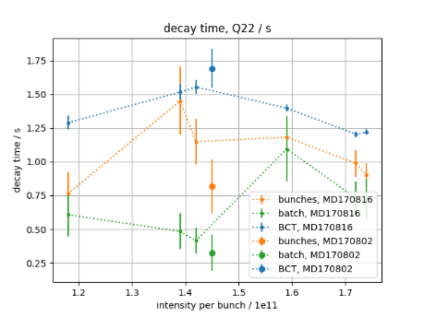
Decay time $τ$
No clear dependence on intensity!
Increase
V₂₀₀ -> 5MV at FB

Slide 8
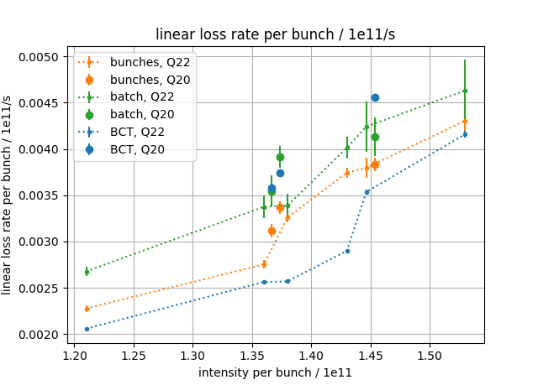
Linear loss rate

Slide 9
Summary
Linear loss rate $m$ at flat-bottom depends on intensity and voltage
Decay time τ dependence less obvious…
Next steps
Measrue linear loss rate $m$ at flat-bottom for different flat-bottom voltage
Thank you for your attention!

Slide 10
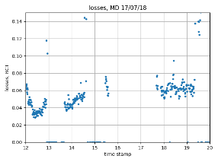
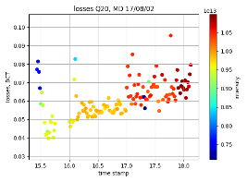
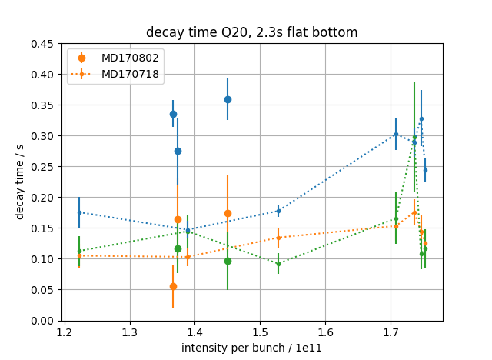
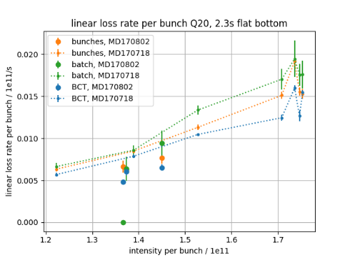
Q20 MD comparison
MD 17/07/18:
Flat-bottom 0-2.3 s, vertical tune kick at 2s
Fit intensity from 7ms to 2.3 s (1.95s for BCT)
MD 17/08/02:
Flat-bottom 0-11.1s
To compare, fit intensity from 8ms to 2.3s only

