Slide 1
Impact of remanent fields on SPS chromaticity
H. Bartosik, V. Kain, M. Schenk, F. Schmidt
26 May, 2016

Slide 2
Introduction
Motivation for developing non-linear model
  Non-linear model of SPS is basic ingredient for studying incoherent (and coherent!) effects for LHC beams
Measurements in 2015
  At 26 GeV/c but with both optics (Q20 and Q26)
  For maximum machine reproducibility: use same super cycle composition in both optics (SFTPRO + measurement cycle)
  Using BBQ pickup with chirp excitation to measure tune
  Precision of tune measurement significantly improved by averaging over flat bottom
  Spread in vertical tune measurement due to impedance and intensity variation (corrected)
  Very clean results also in vertical when correcting for detuning with intensity (fit up to 5th order)
  Performed combined fit for both optics at the same time → Indications for contribution of remanent fields from sextupole and octupole magnets
Measurements this year
  Nonlinear chromaticity for different settings of sextupole and octupole magnets on preceding cycle

Slide 3
Errors considered in MADX model
Systematic mulitpole errors on SPS main magnets
  These errors are mainly due to remanent fields from ramping to top energy
Fit procedure
  calculate the response matrix for all multipole errors on the nonlinear chromaticity in MADX-PTC
  apply an SVD algorithm
  SVD can be applied to one measurement set individually, or to multiple sets at the same time (a good non-linear model should be able to predict the chromaticity for all optics)
first allowed multipole error of quadrupoles
allowed multipole errors of dipoles
Remanent fields of main component in sextupoles and octupoels

Slide 4
Individually fitted MADX models
Measured chromaticity can be well reproduced

Slide 5
Individually fitted MADX models
Measured chromaticity can be well reproduced
Model for one optics cannot predict chromaticity in other optics
  especially linear and quadratic terms!
Q26 model applied to Q20

Slide 6
Result for COMBINED fit of both optics
Consistent model for both optics
  Need to consider remanent fields of about 1% of the peak field of sextupoles and octupoles

Slide 7
Fitting results summary
Remanent sextupole fields in dipoles even change sign!
Considered remanent fields of chromaticity sextupoles!
Had to allow for different values in the two optics
good agreement between the two optics

Slide 8
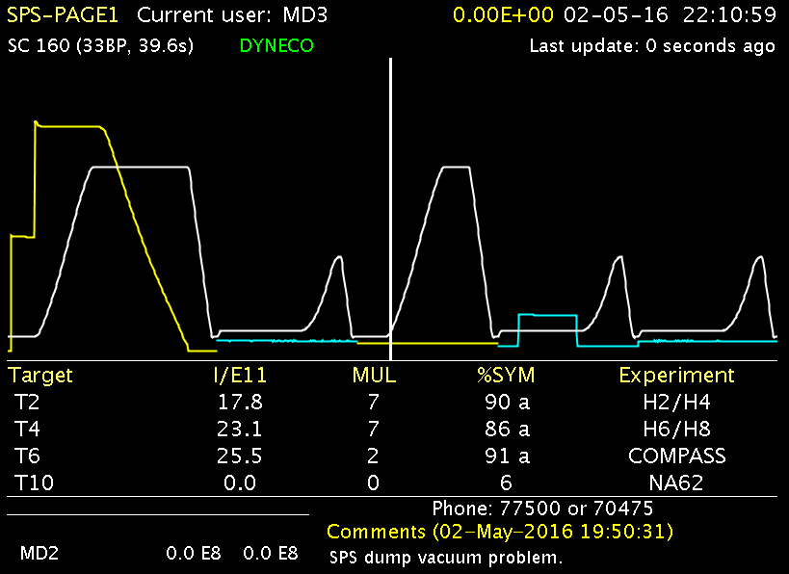
Measurements 2016
Can we measure the impact of remanent fields on chromaticity directly?
400 GeV MD cycle with variable sextupole and octupole settings
26 GeV cycle for measuring chromaticity without changing settings

Slide 9
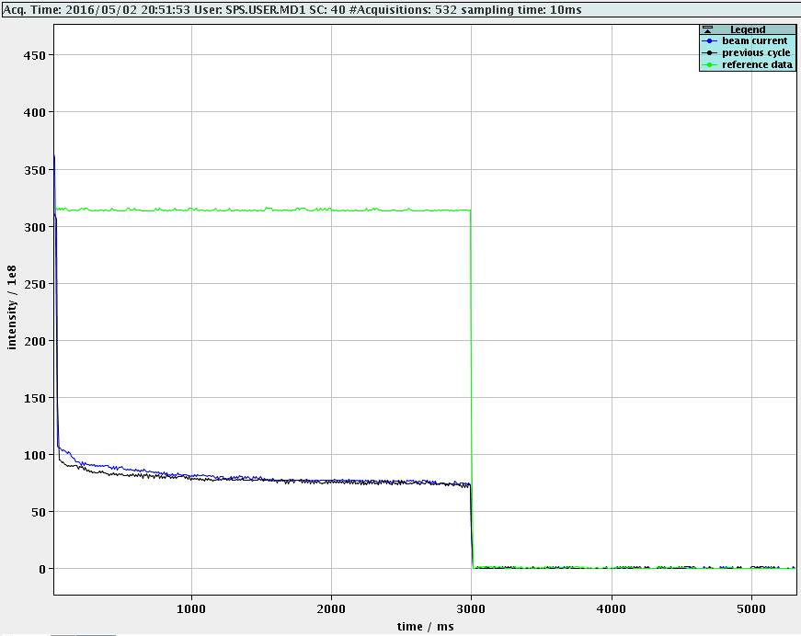
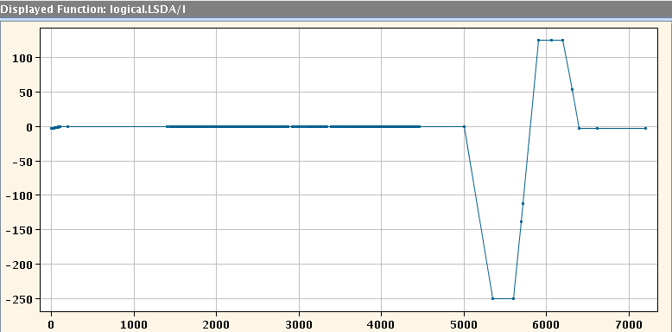
First test of de-Gaussing sextupoles
Vertical chromaticity on MD cycle becomes negative
LSD chromatic sextupoles on 400 GeV cycle
opposite sign for de-Gauss
beam unstable
usual ramp to 250 A
… had to increase chromaticity setting on MD cycle!

Slide 10
Remanent fields of chromaticity sextupoles
de-Gaussed sextupoles
Machine adjusted to maintain positive chromaticity
sextupole currents on 400 GeV cycle

Slide 11
Remanent fields of chromaticity sextupoles
standard settings
… Q’y changes by about 15!!
sextupole currents on 400 GeV cycle
… Q’x changes by a few units

Slide 12
Remanent fields of chromaticity sextupoles
simple de-Gauss with 20 A
sextupole currents on 400 GeV cycle

Slide 13
Remanent fields of chromaticity sextupoles
simple de-Gauss with 40 A
sextupole currents on 400 GeV cycle

Slide 14
Remanent fields of chromaticity sextupoles
simple de-Gauss with 50 A
… Q’y close to complete de-Gauss
sextupole currents on 400 GeV cycle
… Q’x close to complete de-Gauss

Slide 15
Remanent fields of octupoles
de-Gaussed sextupoles
de-Gaussed sextupoles + octupoles*
… Q’’y changed by about 1300!
Q’y | 0.9 | 1.0
Q’’y | 613 | -703
Q’’’y | 229e4 | 212e4
… still second order chromaticity even with de-Gaussed octupoles!
… Q’’x changed by about 650!
Q’x | 16.2 | 15.9
Q’’x | 1172 | 1810
Q’’’x | -293e4 | -302e4
* All octupoles (apart from 2 extraction octupoles which could not be powered yet)

Slide 16
Summary and conclusions
Impact of remanent fields on chromaticity at 26 GeV experimentally confirmed
  Effect from sextupoles (on linear chromaticity) stronger in vertical plane
  Ramping the sextupoles to 50 A in opposite polarity compensates large part of their remanence
  Remanence of extraction sextupoles also affect chromaticity (results not shown here)
  Effect from octupoles (on second order chromaticity) also stronger in vertical plane
Next steps
  Measurements of non-linear chromaticity in both optics (Q20 and Q26) in the same conditions with de-Gauss of sextupoles and octupoles → check combined non-linear model
  Measurement of amplitude detuning → consistent with MADX model?
  Investigate possible sources of Q’’ with MADX model (e.g. feed-down from b5 in dipoles?)
  Investigate possibilities for deploying de-Gauss on sextupoles and octupoles operationally
  Measurement of resonance driving terms for cross-check

Slide 17
Thank you for your attention!

Slide 18
SPS optics
Multipolar components sampled differently due to different dispersion function
Q20
Q26

Slide 19
Correction for detuning due to impedance
data normalized to 4e10 p/b based on SPS impedance model
No correction in horizontal needed

