Slide 1
Studies of LHC beam losses at PS/SPS transfer - update
H. Bartosik, T. Bohl, S. Cettour Cave, H. Damerau, V. Kain,
C. Kornelis, E. Shaposhnikova, A. Lasheen
Acknowledgements: A. Huschauer
LIU-SPS BD, 25.08.2016

Slide 2
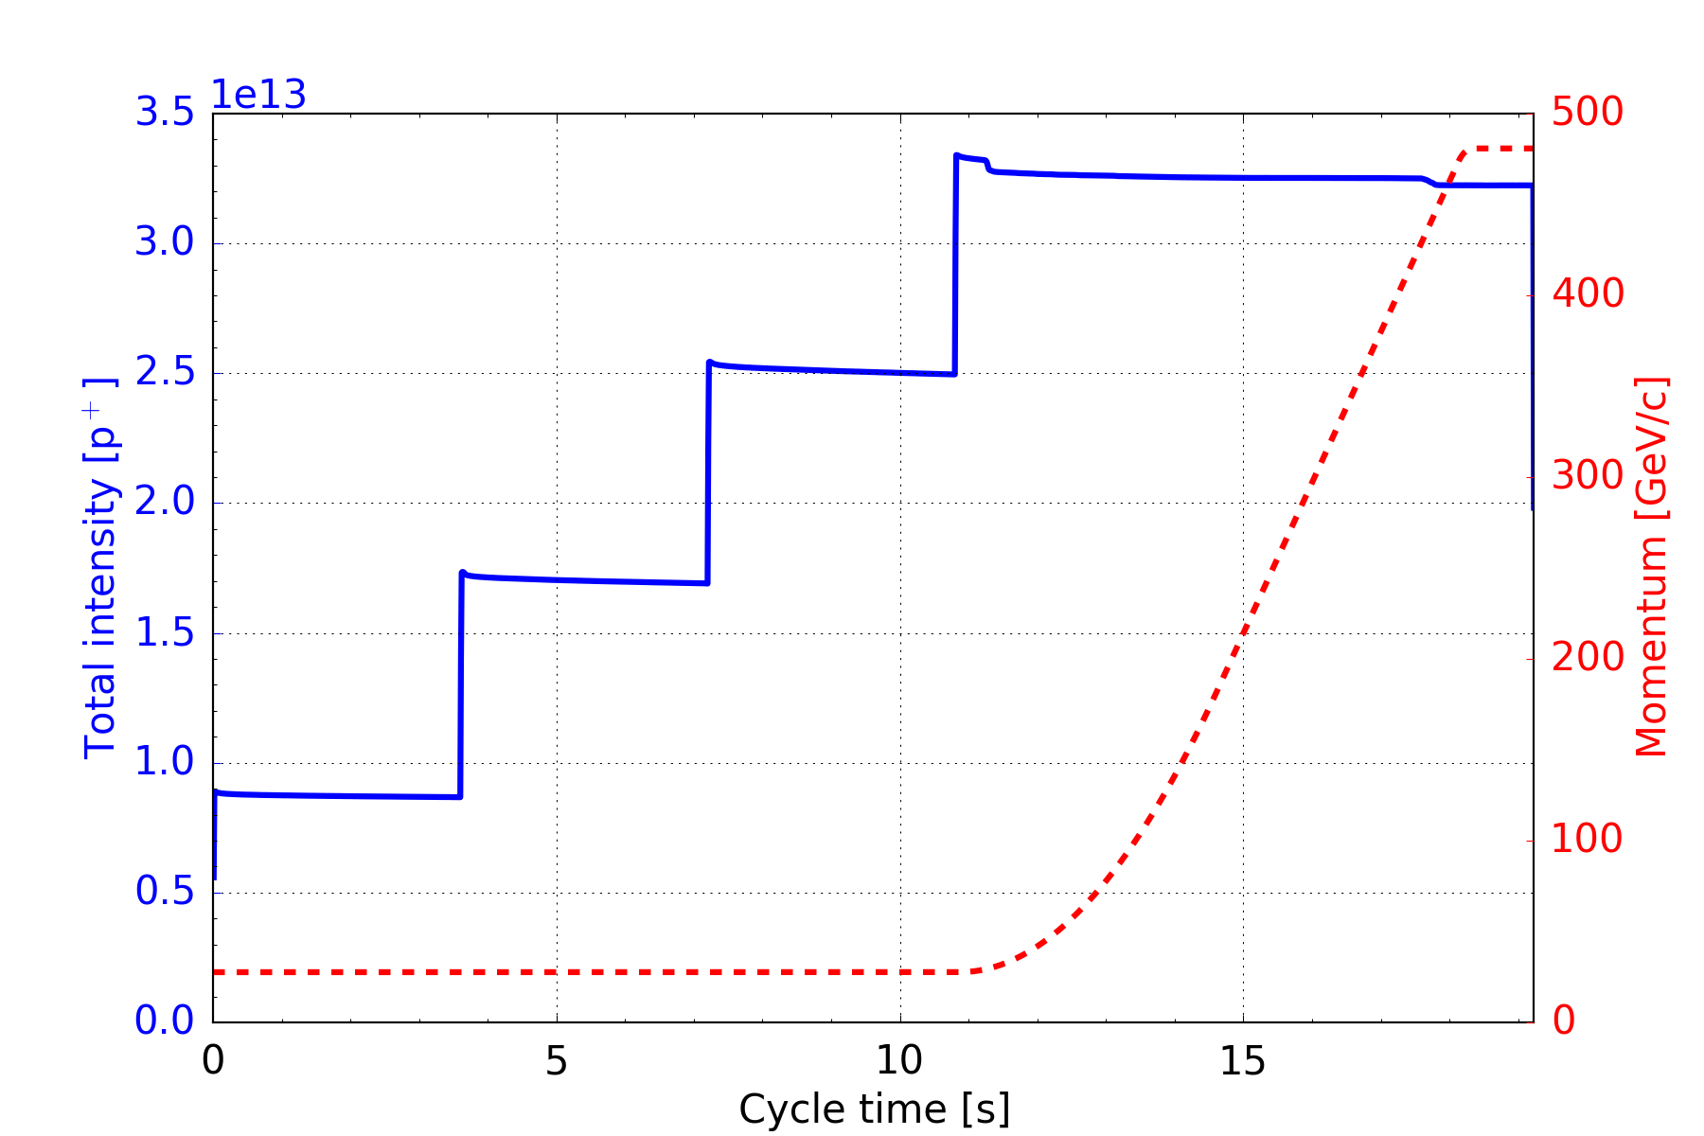
Introduction: SPS cycle (nominal intensity)
Within 11 s, 4 batches of 72 bunches each are injected at 26 GeV/c.
from last meeting
Loss of circulating un-captured beam due to injection kicker
Questions
What is the nature of the incoherent losses on flat bottom?
How will these losses behave with LIU intensity?
incoherent losses
total losses ~5%

Slide 3
Cleaning of un-captured beam with Q-kicker
BCMS beam on special MD cycle (6 bp flat bottom + ramp to 28 GeV/c plateau)
  48 bunches, ~1.35e11 p/b injected, 4 ns bunch length at injection
  Programmed constant bucket area of 0.6 eVs
  Maximum vertical tune kicker strength on empty buckets
  About 3.5% losses due to uncaptured beam
  About 2% loses at start of acceleration due to particles spilling out of the bucket
from last meeting
enhanced
loss rate
same loss rate
loss rate like 800 MHz OFF
tune kicker
tune kicker
same total transmission

Slide 4
Cleaning of un-captured beam with Q-kicker
BCMS beam on special MD cycle (6 bp flat bottom + ramp to 28 GeV/c plateau)
  48 bunches, ~1.35e11 p/b injected, 4 ns bunch length at injection
  Programmed constant bucket area of 0.6 eVs
  Maximum vertical tune kicker strength on empty buckets
  About 3.5% losses due to uncaptured beam
  About 2% loses at start of acceleration due to particles spilling out of the bucket
from last meeting
enhanced
loss rate
loss rate like 800 MHz OFF

Slide 5
Losses as function of longitudinal emittance
LHC25ns beam with 72 bunches with half of nominal intensity
  Longitudinal emittance is varied with controlled blow-up in the PS
  Transmission clearly degrades with larger emittance (also slightly the flat bottom losses)
  About 1% of losses remaining even for smallest longitudinal emittance (other effects?)
  Quantitative comparison with nominal intensity to be done …

Slide 6
Losses as function of longitudinal emittance
LHC25ns beam with 72 bunches with half of nominal intensity
  Longitudinal emittance is varied with controlled blow-up in the PS
  Transmission clearly degrades with larger emittance (also slightly the flat bottom losses)
  About 1% of losses remaining even for smallest longitudinal emittance (other effects?)
  Quantitative comparison with nominal intensity to be done …

Slide 7
Quick test with both 40 MHz cavities
LHC25ns nominal beam on special MD cycle
  Operational intensity with 72 bunches
  Loss reduction by about 2% with both 40 MHz cavity used for PS bunch rotation (with optimal settings of 2015, Heiko)
total losses until 28 GeV
flat bottom losses
~ 2%
operational
settings
gap of additional 40 MHz
open (no voltage)
both 40 MHz
active

Slide 8
Summary & Outlook
Additional studies confirm that longitudinal losses dominate
  Lower limit of losses with low intensity at about 1% with longitudinal emittance of 0.2 eVs
  Additional 40 MHz cavity reduces losses on LHC25ns beam by about 2%
Next steps for additional 40 MHz
  Deploy on all operational LHC beams
  Studies for optimized settings (experimental and simulations, Heiko and Helga)
Further experiments to distinguish e-cloud from other longitudinal effects
  Scaling of bunch-by-bunch losses as function of intensity and train length
  Further characterization of losses with high intensity 25 ns beam (like 2015 scrubbing run)
  8b+4e vs. 25 ns standard/BCMS
Simulations to compare e-cloud with longitudinal impedance for LIU intensity
  Stable phase shift due to e-cloud for best guess of SEYs
  Bunch-to-bunch stable phase shift due to longitudinal impedance for 72 bunches

Slide 9
Thank you for your attention!

