Slide 1
Update on studies of LHC beam losses
8b4e vs 25 ns standard
H. Bartosik, T. Bohl, H. Damerau, E. Shaposhnikova
LIU-SPS BD, 03.11.2016

Slide 2
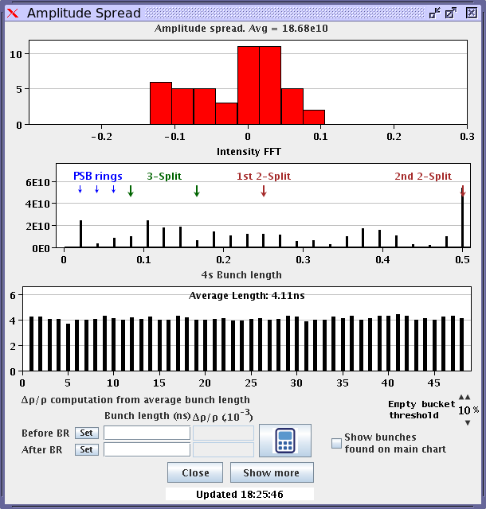
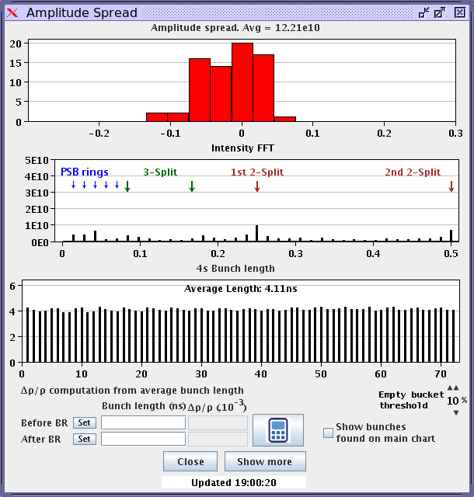
8b4e vs. 25 ns standard beam
Same total current in SPS (same PSB users for both beams)
  8b4e with 48 bunches, ~2e11 p/b injected, 4.1 ns bunch length at injection
  25 ns standard with 72bunches, ~1.33e11 p/b injected, 4.1 ns bunch length at injection
8b4e
standard

Slide 3
8b4e vs. 25 ns standard beam
Same total current in SPS (same PSB users for both beams)
  8b4e with 48 bunches, ~2e11 p/b injected, 4.1 ns bunch length at injection
  25 ns standard with 72bunches, ~1.33e11 p/b injected, 4.1 ns bunch length at injection
  Higher losses for 8b4e beam (flat bottom and ramp)
  Single bunch effects …
8b4e
standard 25ns
tune kicks
only 4 shots with 8b4e due to ZS sparking …

Slide 4
8b4e vs. 25 ns standard beam
injected
injected

Slide 5
Effect of RF loops on losses
LHC 25ns standard beam
  25 ns standard with 72bunches, ~1.33e11 p/b injected, 4.1 ns bunch length at injection
  Acceleration to 28 GeV

Slide 6
Conclusions
8b4e vs. 25ns standard beam with same total current
  Same pattern of losses along the train for both beam types
  Losses higher for 8b4e (no ecloud expected!)
  Higher intensity per bunch for 8b4e more important than e-cloud effects (PWD, …?) for the intensities tested
Effect of RF loops on losses
  Losses can be enhanced by bad setting of damper gain, but no improvement achieved
  No big effect from feedforward
  Marginal (if any) improvement by moving phase loop sampling gate to center of train

Slide 7
Thank you for your attention!

