Slide 1
SPS instabilities during ramp (preliminary results)
T. Argyropoulos
Acknowledgements: T. Bohl, A. Lasheen, J. E. Muller, E. Shaposhnikova, J. E. Varela
LIU-SPS BD WG 29/01/2015

Slide 2
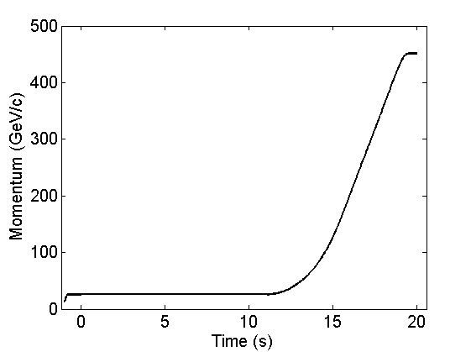
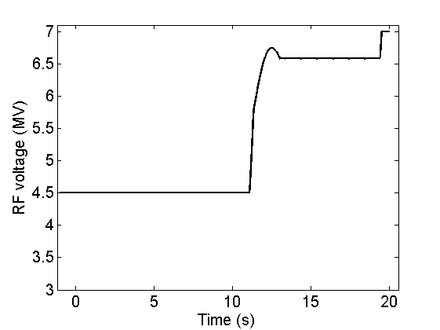
Measurements@08/10/2014
Aim: instability threshold in a single RF system with 12 bunches to compare with simulations
Beam parameters: 12 bunches of nominal longitudinal emittance and varying intensity
FF and LD were OFF but FB was ON, except in few measurement at low intensity, phase-loop was ON
New LHC cycle was used: LHC_25ns_SLOW_Q20_2014_V1

Slide 3
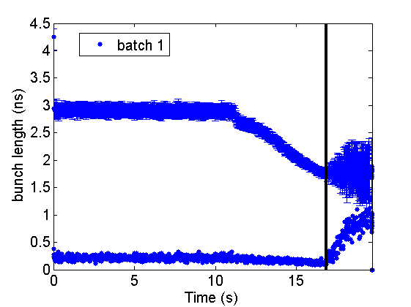
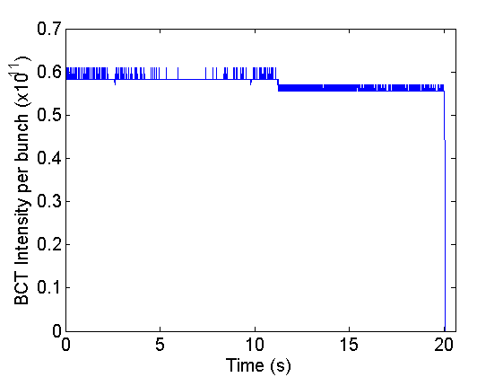
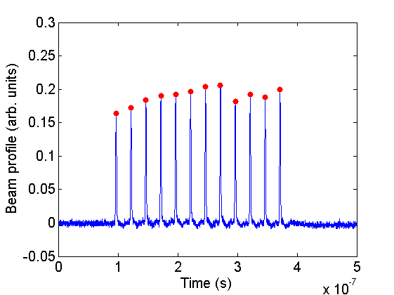
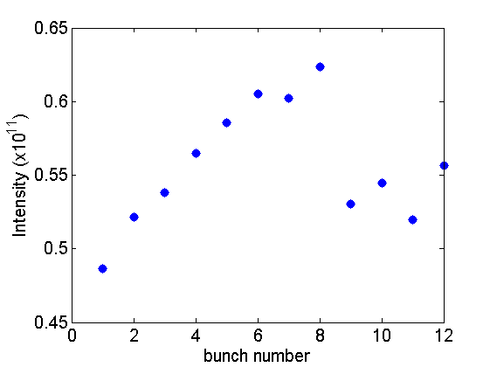
Example of measurements
Example when FF/FB/LD were off (similar threshold when FB was ON)
265 GeV/c
Normalized
Intensity

Slide 4
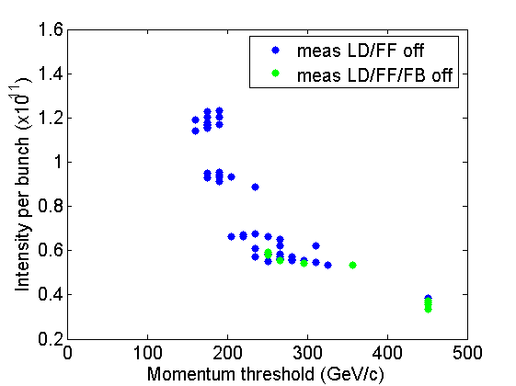
Summary of measurements
Instability threshold in energy versus the bunch intensity
Scatter due to variation in beam parameters:
bunch length, emittance, intensity per bunch
Intensity threshold for
stable beam at flat top
0.38x10¹¹ p/b < N_{p} < 0.53x10¹¹ p/b
Simulations using the SPS longitudinal impedance model to reproduce these results

Slide 5
Simulation procedure
Simulations performed using my Matlab code (multi-bunch) (will be benchmarked with BLonD code when ready)
Distribution function: $F\left(H\right)={(1−H/{H_{0}})}^{2}$
150k macroparticles per bunch to be faster (maybe noise issues…)
Bunches initially matched to the bucket (with intensity effects) at different times (energies) during cycle
Momentum and voltage programs same as in measurement
No phase-loop, FF, FB, LD used

Slide 6
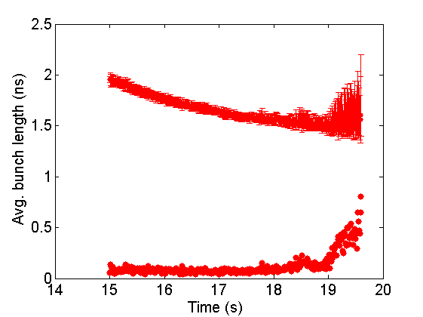
Simulation example
Starting the simulations at 15 s during the cycle similar results as in measurements were obtained
Example of ε_{l} = 0.55 eVs (full emittance per bunch) and N_{p} = 0.6x10¹¹ p/b
~ 355 GeV/c

Slide 7
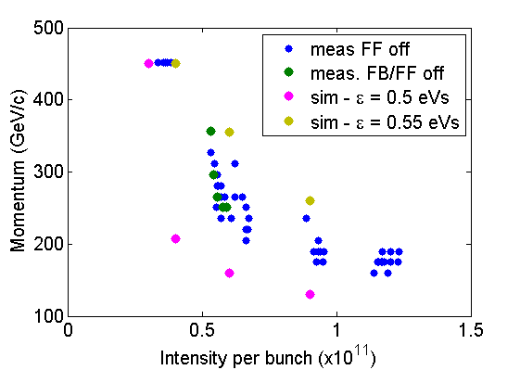
Simulations vs measurements
Instability threshold in energy versus the bunch intensity
But for absolute value of threshold still not yet there:
simulation of the full ramp
difference in bunch length and intensity of the bunches within the batch
phase-loop used in measurements
noise due to limited number of macroparticles

Slide 8
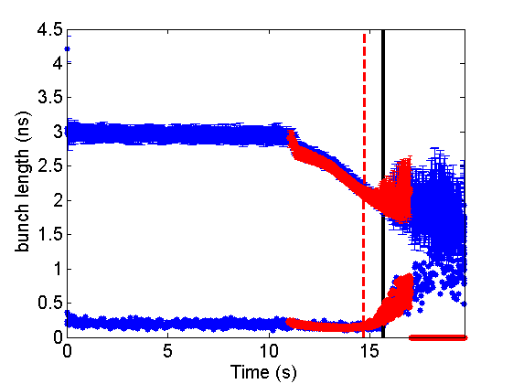
Simulation vs measurement (1)
Matching simulations with specific measurement with intensity ~1.2x10¹¹ p/b with FB ON
Simulation of the full ramp
Good agreement between the two
Different fit of bunch profiles between measurements (fwhm) and simulations (rms, scaled up by 10%)
Slightly lower threshold: should be increased by decreasing the numerical noise (more macroparticles)
Phase-loop is also expected to increase a bit the threshold
meas.
sim.

Slide 9
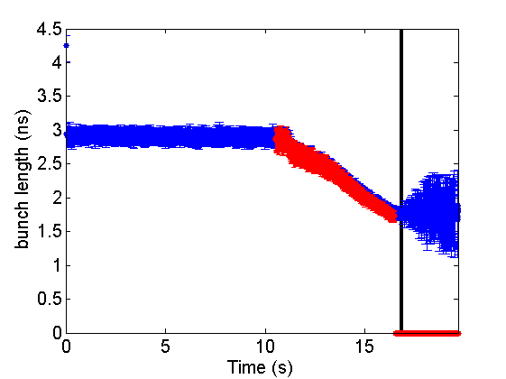
Simulation vs measurement (2)
Matching simulations with specific measurement with intensity ~0.6x10¹¹ p/b with FB OFF
Simulation of the full ramp
Double the number of macropartilces (300k) → less numerical noise
meas.
sim.
Good agreement between the two for the moment (but still running)
fwhm in both
No phase-loop

Slide 10
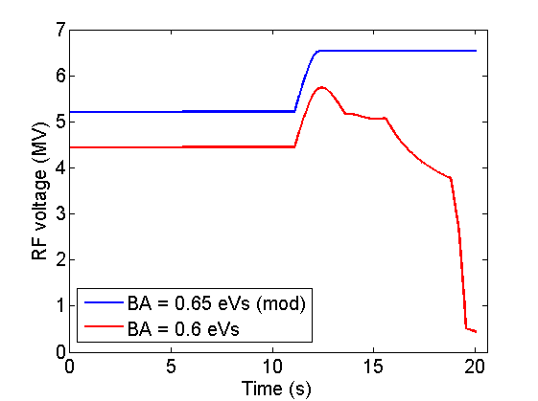
Voltage dependence of threshold
At flat top (meas. and sim. for single bunch) show that higher RF voltage gives higher instability threshold
Opposite during ramp: lower voltage is better for stability
→ simulations started to verify (and understand) this effect (for single bunch to be faster)
Voltage programs designed for constant bucket area
Later is planned to compare with measurements

Slide 11
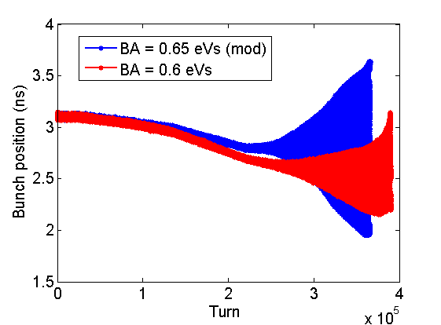
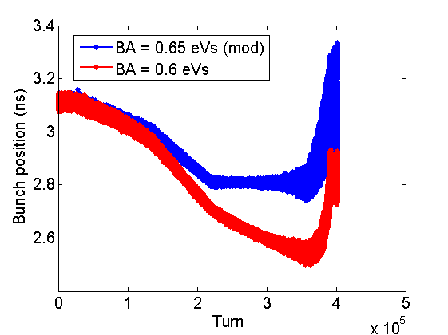
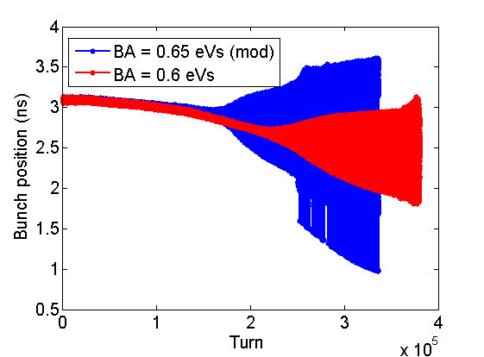
Voltage dependence of threshold
Single bunch simulations through the full ramp with ε_{l}=0.55 eVs and 300k macroparticles
Higher threshold for lower voltage (as observed in measurements)! → But not very clear difference
Studies are
ongoing
N_{p} = 0.8x10¹¹ p
N_{p} = 0.6x10¹¹ p
N_{p} = 1.0x10¹¹ p

