Slide 1
Multi-bunch simulations
T. Argyropoulos,
Acknowledgements: A. Lasheen, J. E. Muller, E. Shaposhnikova
LIU-SPS BD WG 18/06/2015

Slide 2
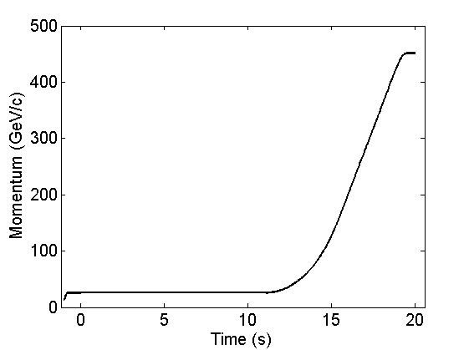
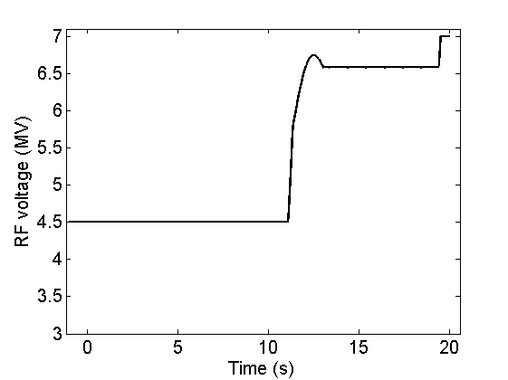
Introduction
Measurements during MDs in 2014/2015 for different number of bunches in single and double RF systems → instability threshold during cycle for various intensities
Macroparticle simulations using BLonD (only 12 bunches for now) to compare with measurements → verify the SPS longitudinal impedance model → identify the sources of instability (vacuum flanges etc.) → make estimations for the future.
Simulations in a single RF system → faster to run and less complications compared to double RF (phase between the RF systems due to beam loading compensation in 200 MHz)
Momentum and TWC200 voltage programs

Slide 3
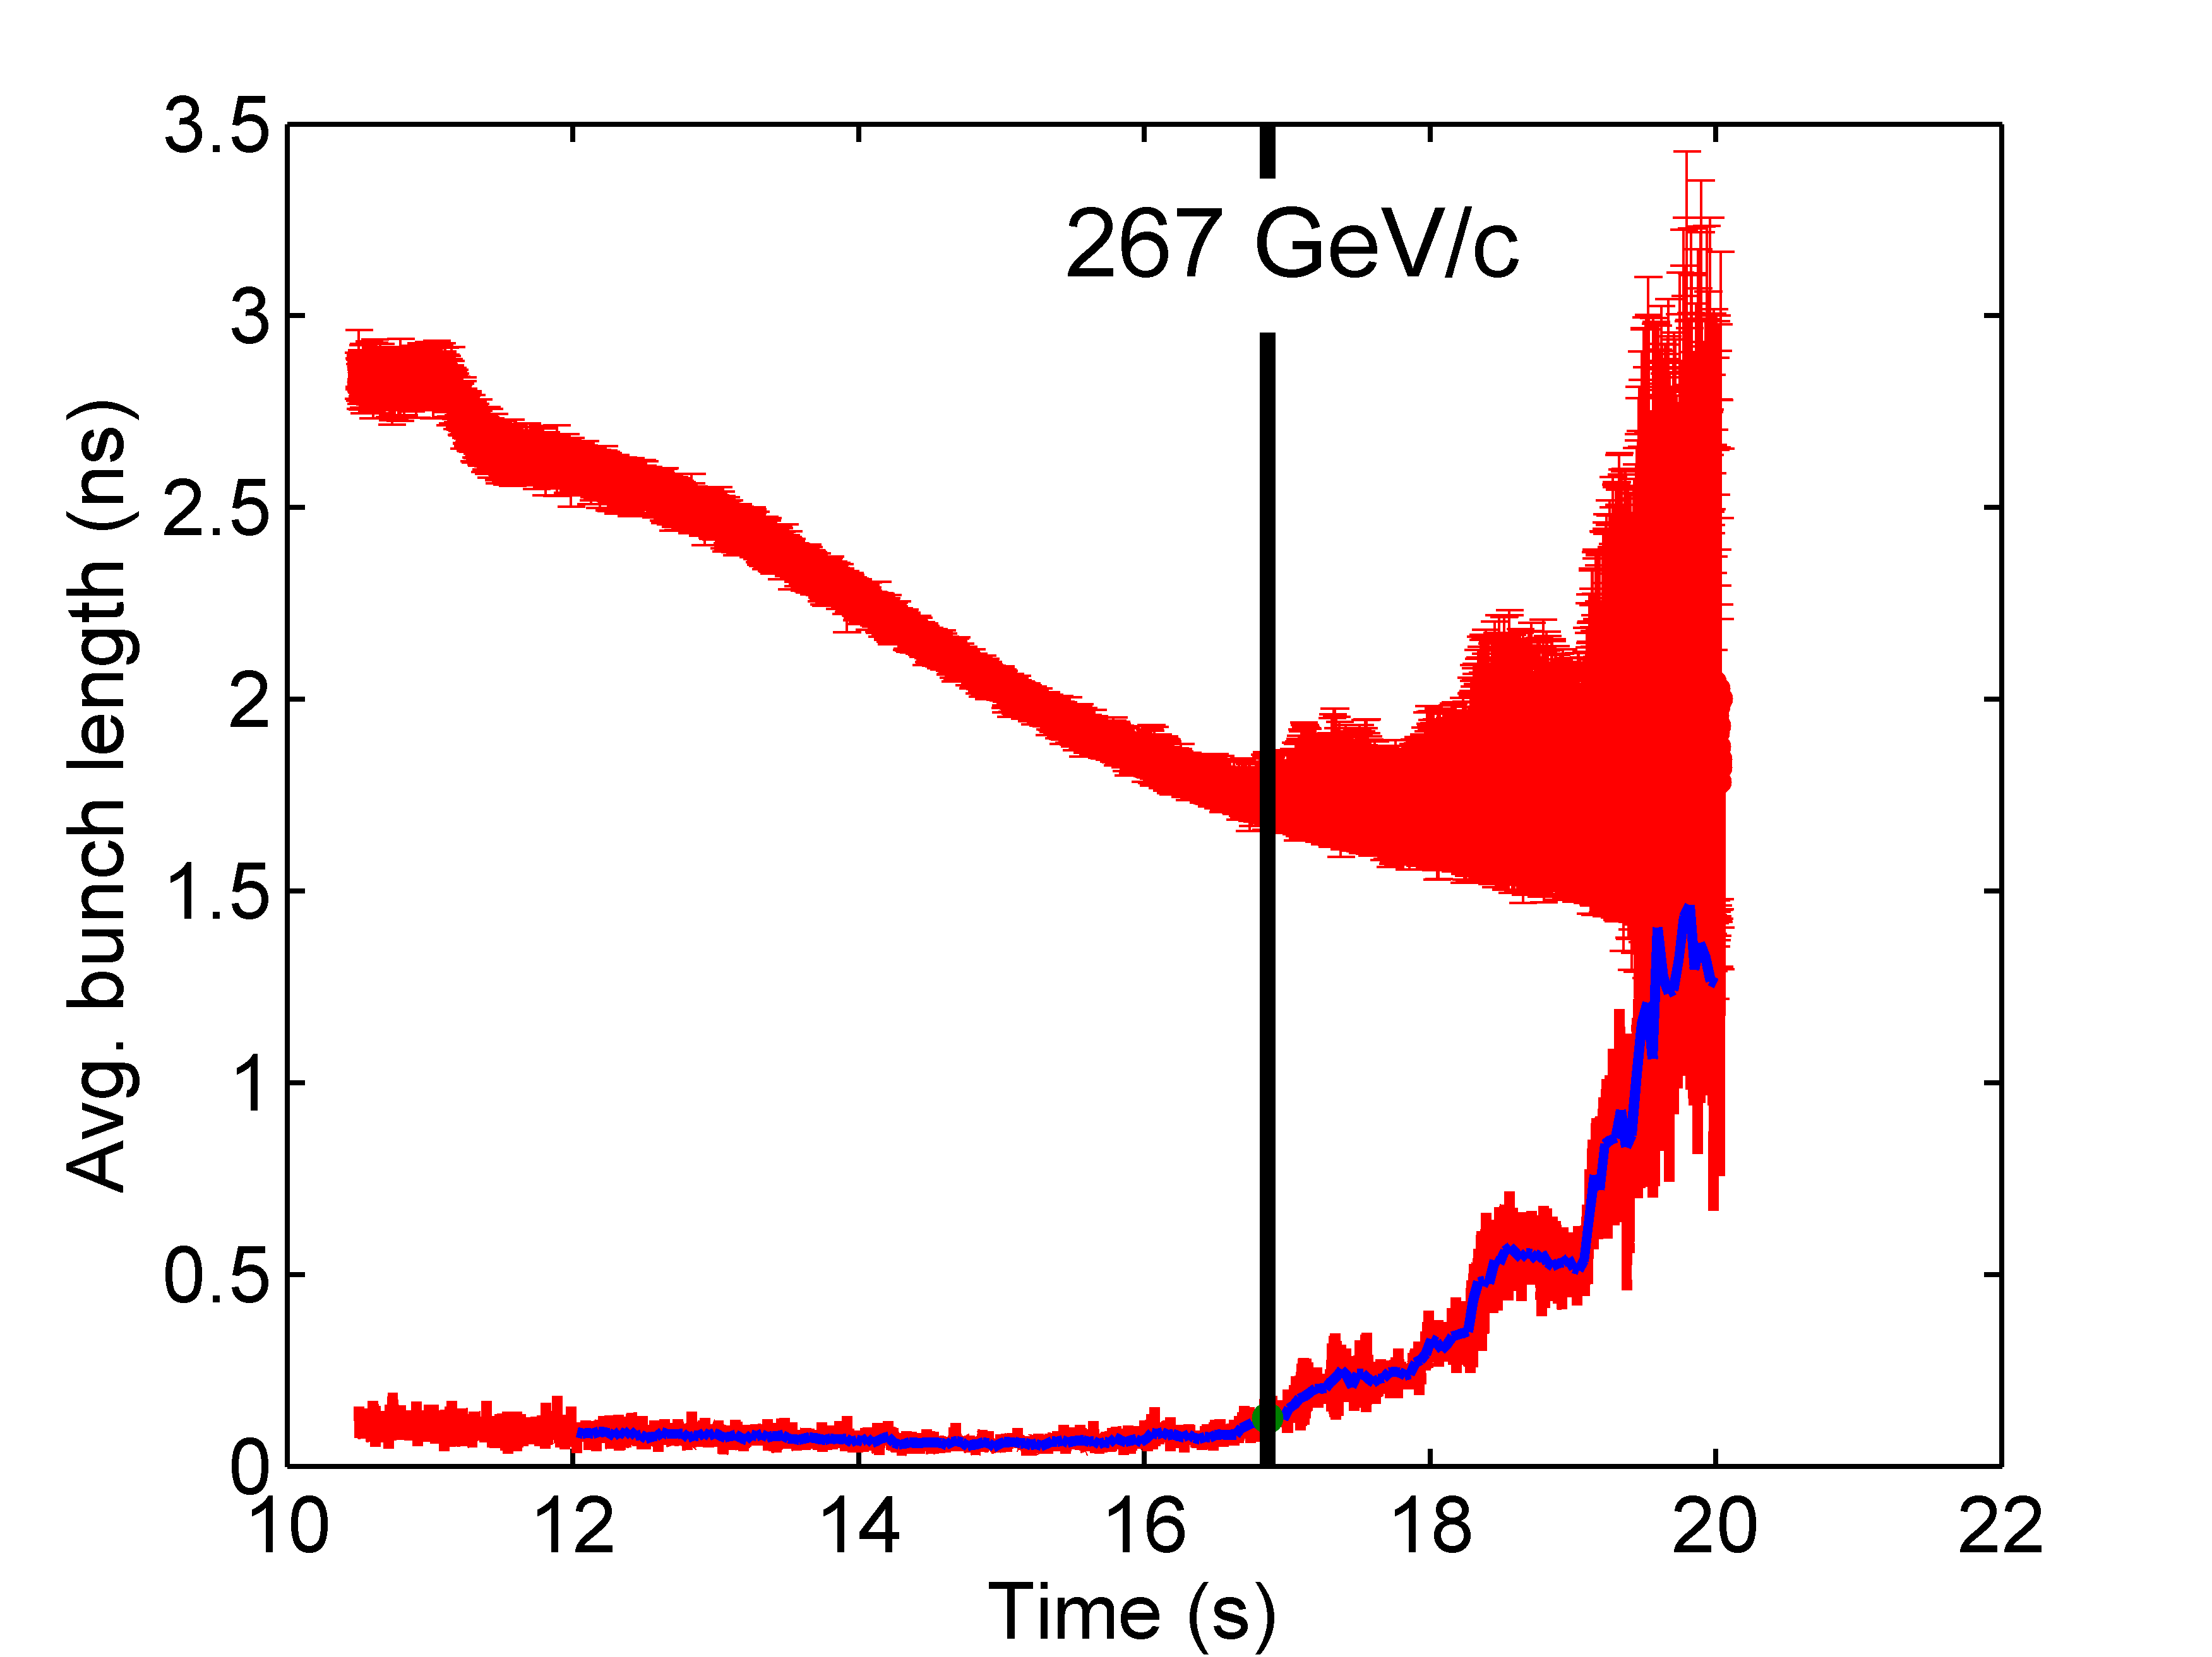
Example of simulations
Example: simulations in single RF with full SPS impedance model for
N = 9.8x10¹⁰ p/b and ε=0.5 eVs
Same data analysis as in the measurements but same bunch parameters (emittance, intensity) along the batch (not the case in measurements)

Slide 4
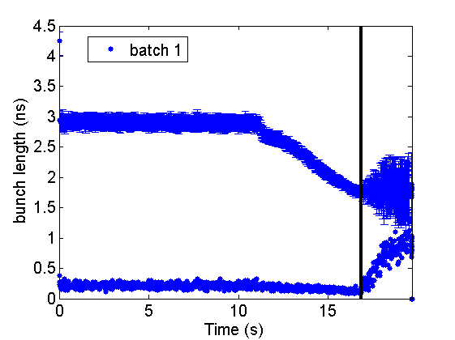
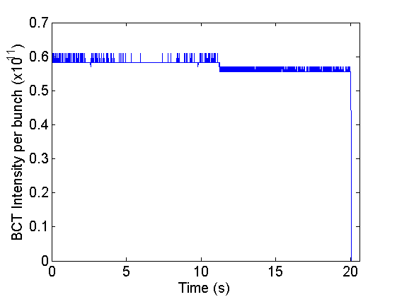
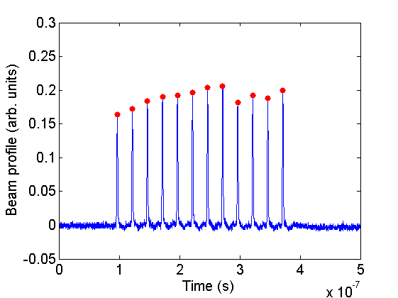
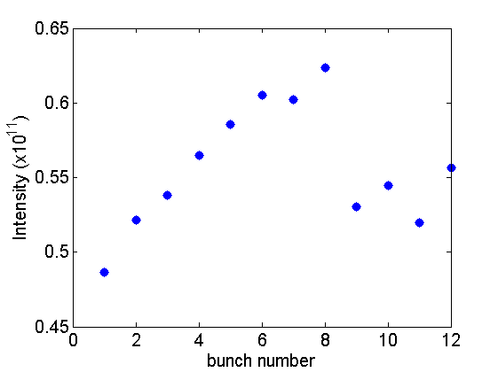
Example of measurements
Example from MD at 08/10/2014
265 GeV/c
Normalized
Intensity

Slide 5
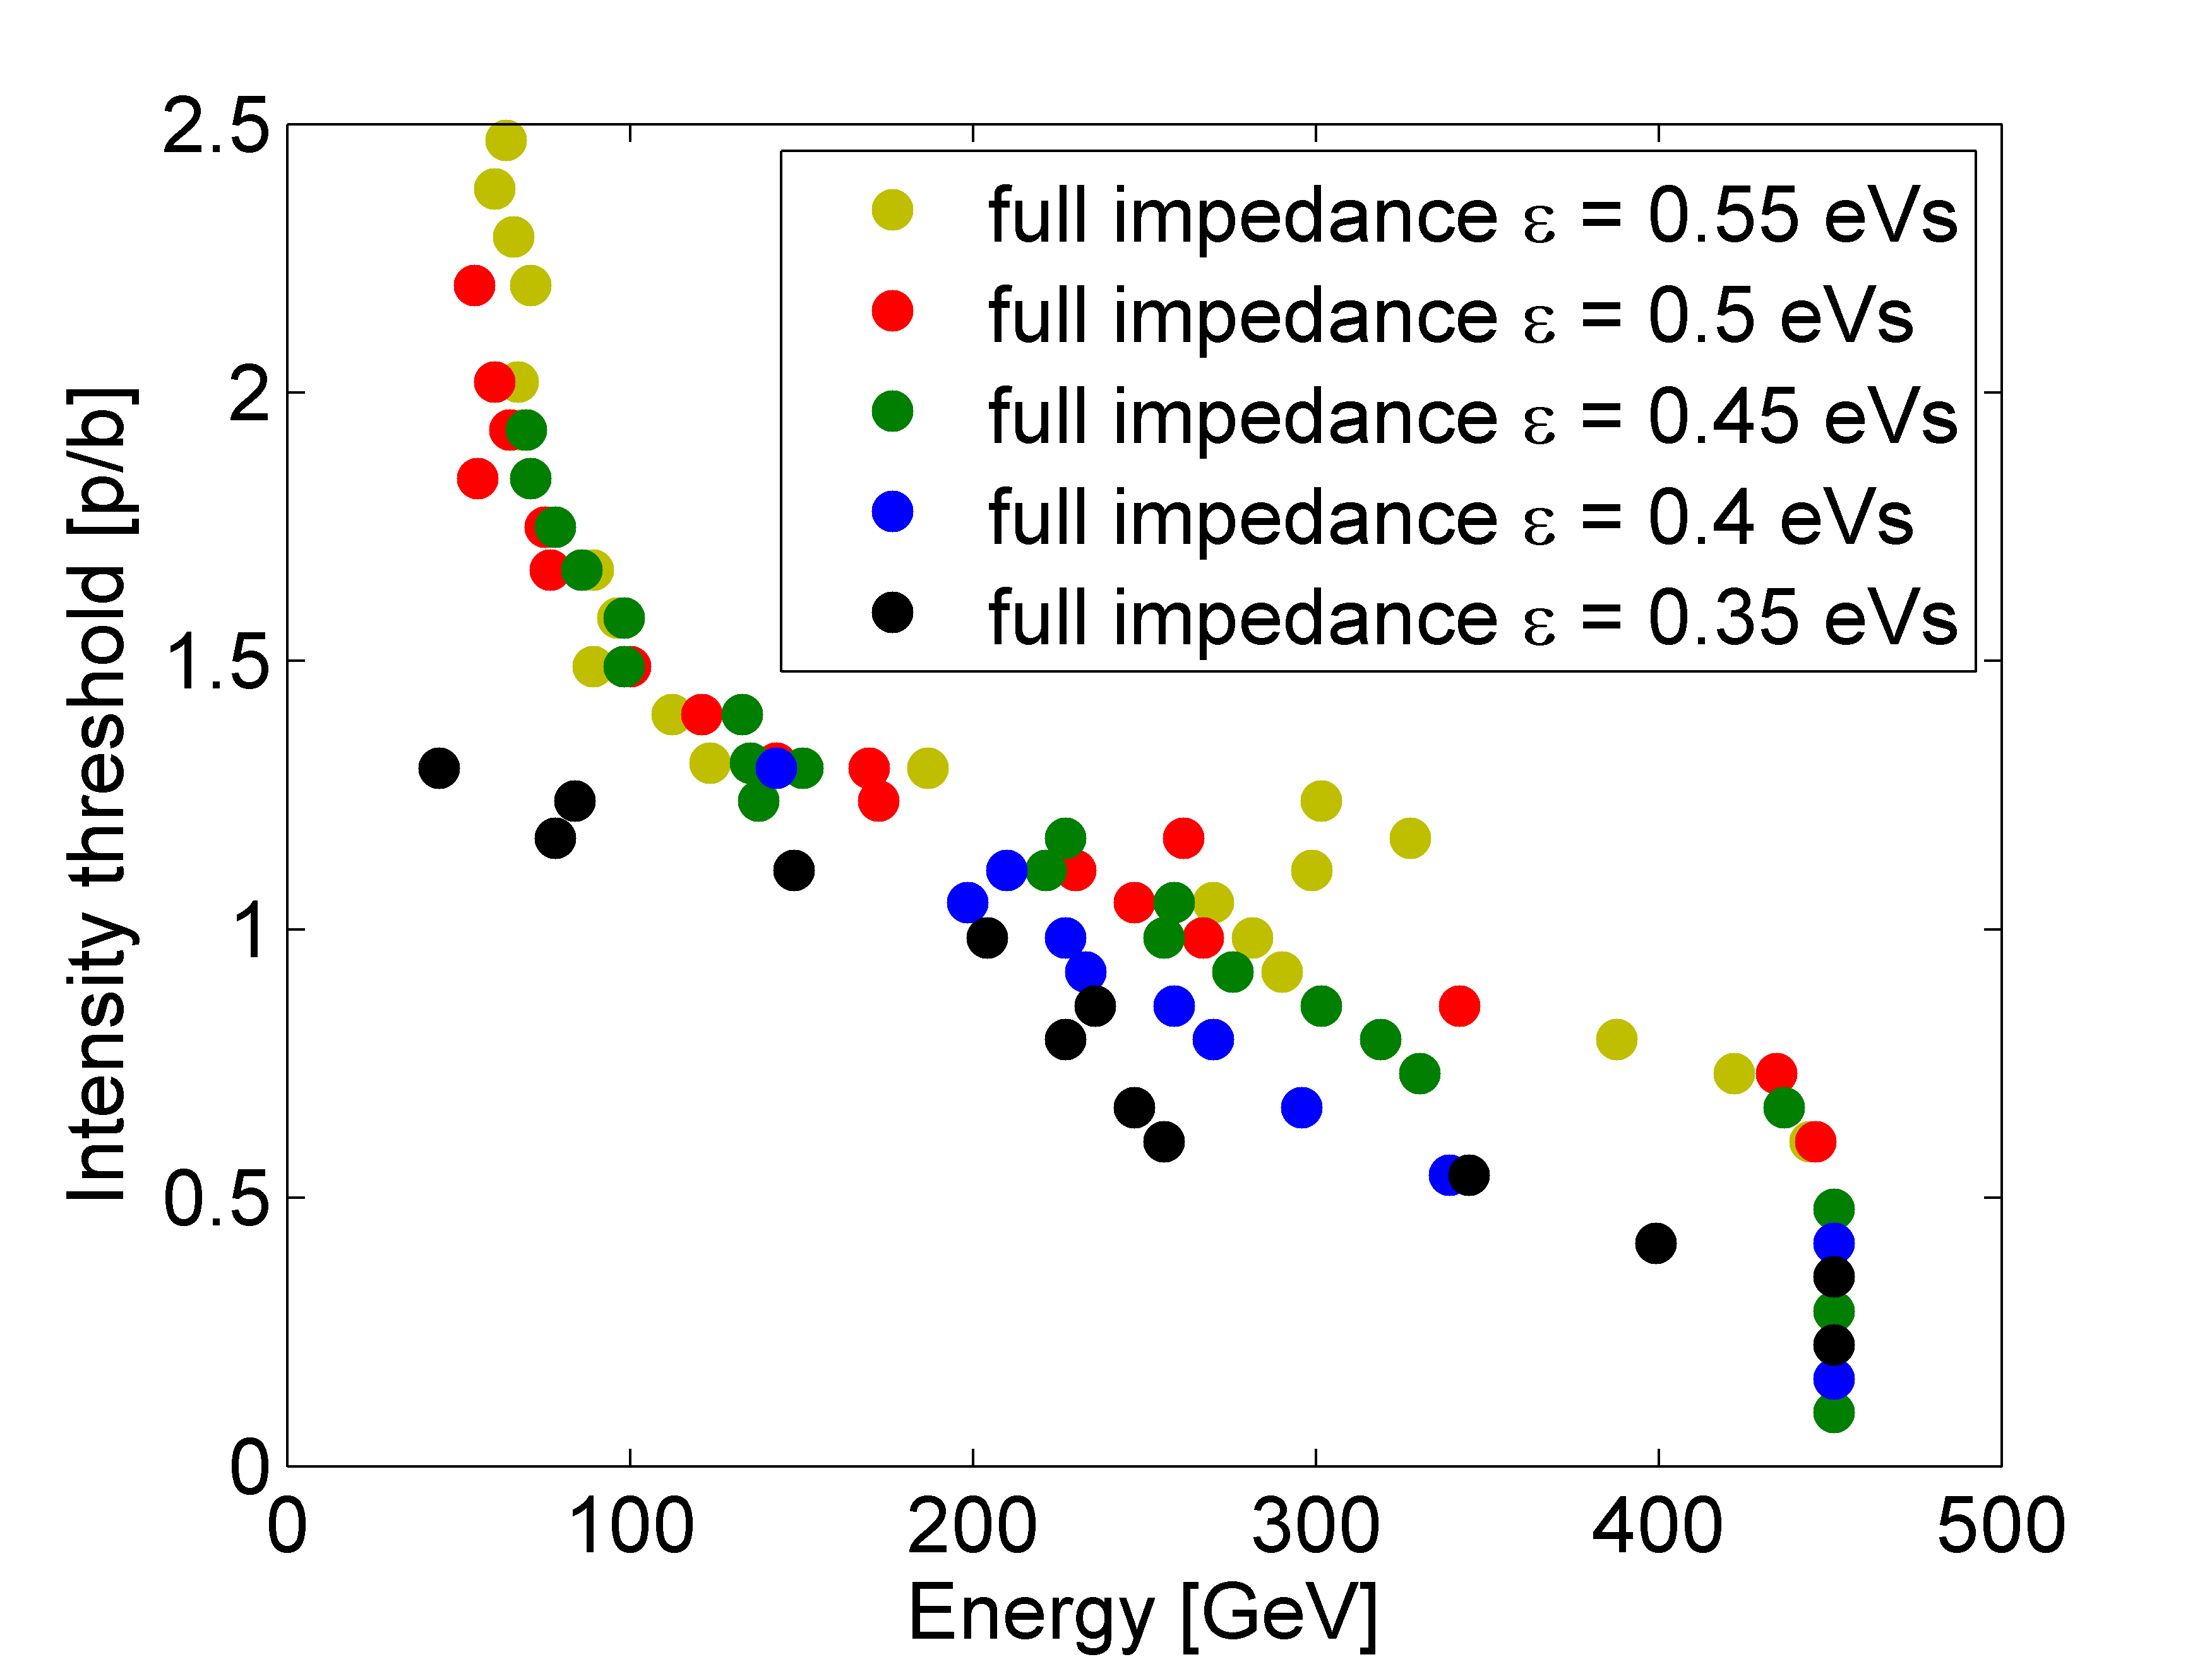
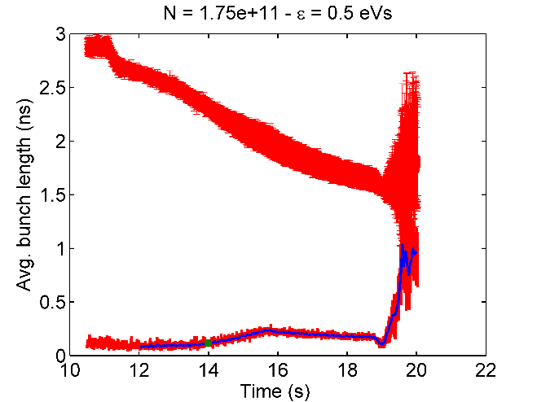
Simulations with full Imp. model
Instability threshold during cycle for different emittances
Small changes in the stability threshold
At high intensities beam blows up early during the cycle

Slide 6
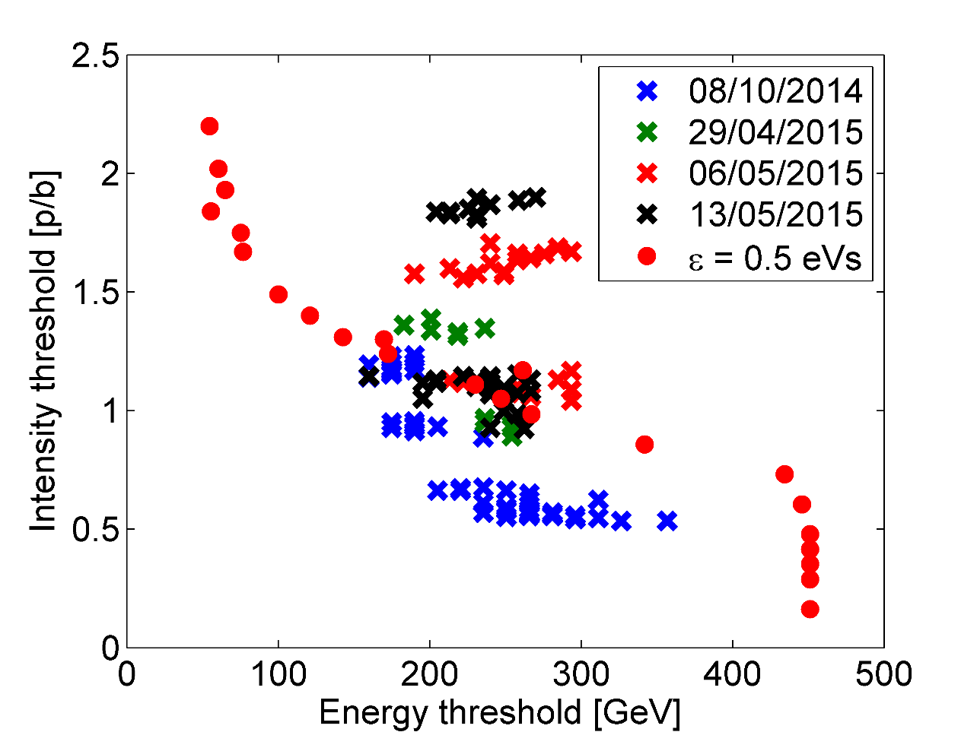
Simulations vs measurements
For the case of ε = 0.5 eVs (similar bunch emittance with measurements)
Similar threshold at N~1x10¹¹ p/b
Much lower for higher intensities

Slide 7
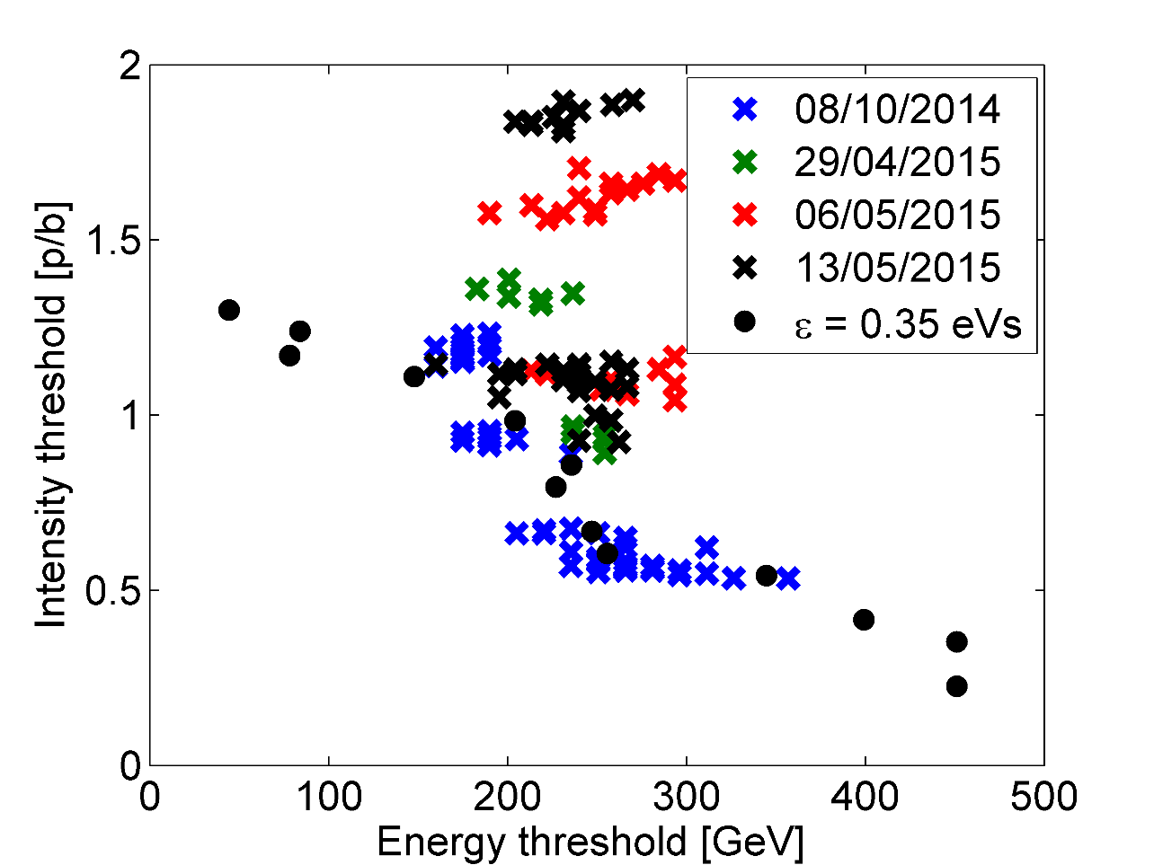
Simulations vs measurements
For lower intensities only data from an MD in 2014 → better agreement with sim of ε=0.35 eVs but much lower emittance!

Slide 8
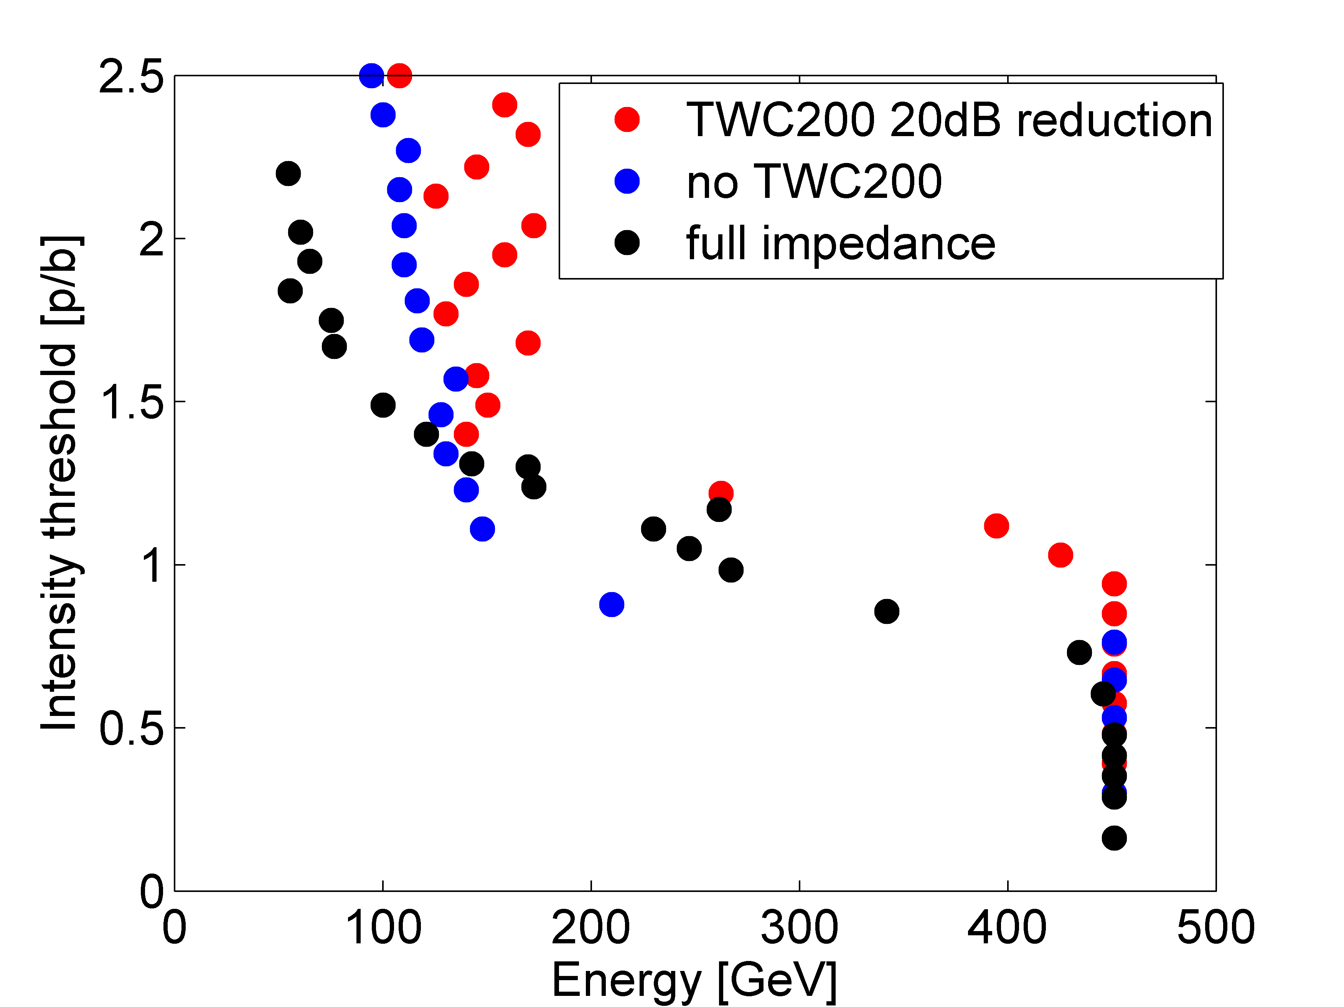
Simulations vs measurements
In reality the impedance of TWC200 is very much reduced by the FB/FFW.
No FB/FF models included in simulations for the moment.
Simulations for ε=0.5 eVs
Without TWC200 impedance, stability threshold at flat top is increased (N_{thr}~0.8E11)→ but lower threshold for higher intensities
With 20dB reduction of the TWC200 induced voltage: at flat top N_{thr}~1E11 → still above 1.3E11 p/b threshold too low compared to measurements
No change in threshold with intensity as in measurements

Slide 9
First conclusions
Some discrepancy between simulations and measurements of 12 bunches
Possible reasons:
Difference in initial conditions (bunch by bunch variation in measurements in emittance and intensity)
Effect of bunch distribution: F(H) = (1-H/H₀)^{1.5} was used only
Better simulation of LLRF (FB/FF, phase loop) should be included
Impedance model is not complete (TWC HOM?)
…
Nevertheless we can still estimate the contribution of different impedances

Slide 10
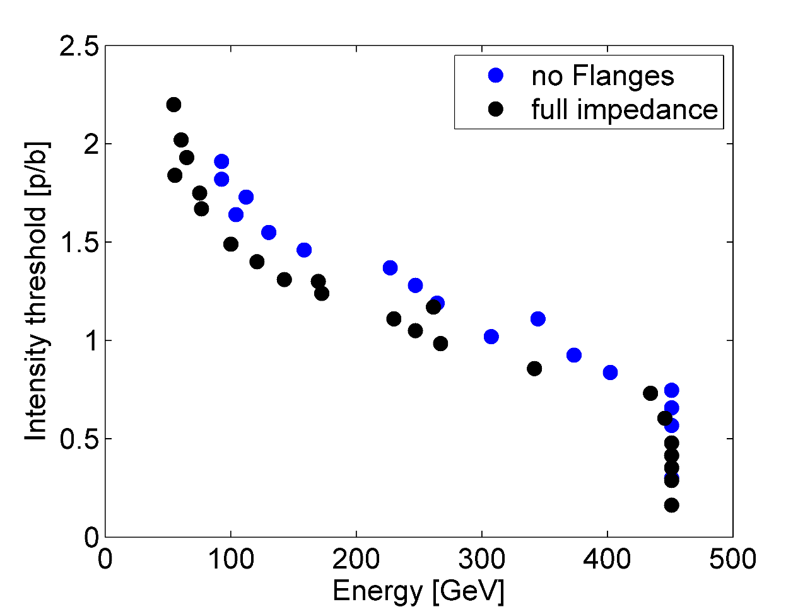
Effect of vacuum flanges
Simulations without the vacuum flanges and for ε=0.5 eVs
Stability threshold at flat top is increased by almost factor of 2 (N_{thr} from 0.45E11 to 0.8E11)
Not the same during the ramp → possible different types of instabilities: LLD during cycle mw type at flat top(?)

Slide 11
Effect of different impedances
Simulations to identify the effect of other impedance elements were also carried out (many more are needed).
Table: instability threshold (x10¹⁰ p/b) at flat top. The impedance elements that are written are always included.
TWC200 | + | - | + | + | - | - | - | - | 20dB less
TWC800 | + | + | + | + | + | + | + | - | +
Flanges | + | + | - | + | + | - | + | - | +
Kickers | + | + | + | - | + | + | - | + | +
HOM | + | + | + | + | - | + | + | + | +
ε=0.35 eVs | 3.5 | 6.0 | 6.0 | 7.5 |  | 10.0 |  | 4.0 | 6.5
ε=0.5 eVs | 5.5 | 8.0 | 7.5 | 9.0 | 8.0 | 12.0 | 12.0 | 6.5 | 10.5
ε=0.6 eVs | 6.5 |  | 8.5 |  | 9.0 |  | 12.5 |  | 12.5
The table needs to be completed (and understood) and also necessary to repeat it for a double RF system

Slide 12
Summary
Removing the flanges reduces the instability threshold at flat top by almost a factor of 2
Not so much increase during cycle → different types of instabilities
Perhaps for a double RF system we are concerned mainly for the instability at flat top → reducing the impedance of the vacuum flanges will help! (to be confirmed in simulation)
Simulations in double RF are on-going → more delicate due to the phase error between the RF systems (FF/FB) → start from single bunch simulations (Alex)
In addition instability at flat bottom observed during the last MD in double RF system operation → needs to be understood and simulated

