Slide 1
MD: SPS Working Point Scan for High-Brightness Single-Bunch Beams
H. Bartosik, A. Oeftiger, F. Schmidt, M. Titze

Slide 2
Motivation
What is the optimal working point for high brightness beams?
present operation with Qx=20.13/Qy=20.18 is good for operational beam parameters
current tune spread limit ~0.21
Explore tune diagram in vertical plane for Qy > 20.25
limits?
which resonances are involved?
What is the loss mechanism on the flat bottom?
scaling of losses with brightness and with intensity?
due to space charge or lattice resonance?

Slide 3
Experimental Setup
Cycle: MD_26_L7200_Q20_2014_V1
Q20 optics
small chromaticity
amplitude detuning corrected in horizontal plane (LOF -1)
RF voltage 4.5MV at 200MHz (single harmonic)
flat bottom cycle (3.3s)
Beam type: LHC_INDIV with high brightness
intensity: 2.0e11 (± 10%)
emittance:
horizontal: 0.85 (± 10%)
vertical: 1.1 (± 5%)
bunch length: ~3.3ns
space charge tune spread:
horizontal: 0.10
vertical: 0.19

Slide 4
Wire Scanners at PS Extraction
“65.H”: epsn_x = 0.835
“85.V”: epsn_y = 1.104

Slide 5
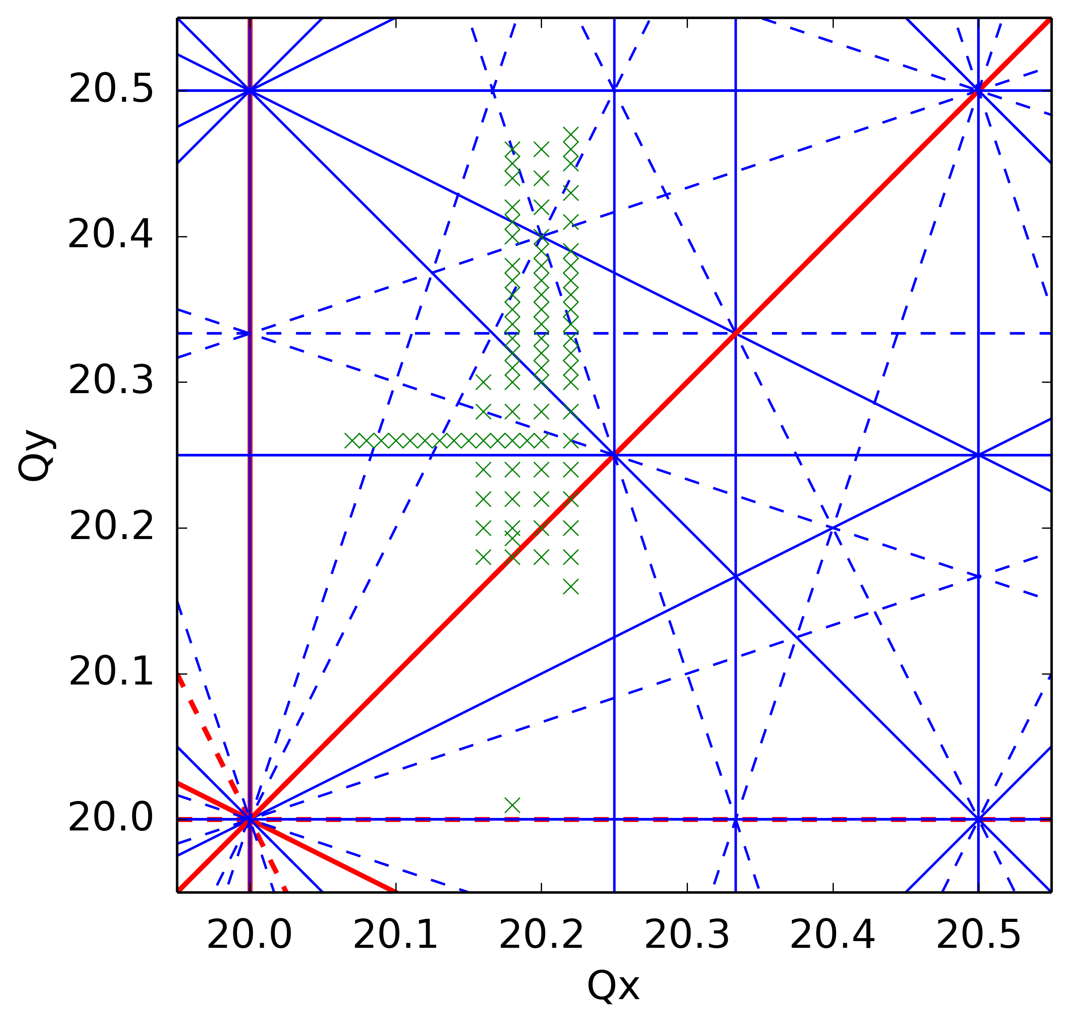
Working Points Studied So Far:

Slide 6
For Each Working Point…
intensities and emittances measured at
in: 200ms
out: 3200ms

Slide 7
For Each Working Point…
5 wire scanner measurements for each transverse plane,
Gaussian fits in light colours

Slide 8
For Each Working Point…
horizontal emittance: dispersion significantly contributes to wire scanner measurements!
extract bunch length from mountain range
determine $δ_{rms}$ via equi-Hamiltonian
subtract dispersive contribution

Slide 9
For Each Working Point…
emittance: linear fit, interpolation to 2e11

Slide 10
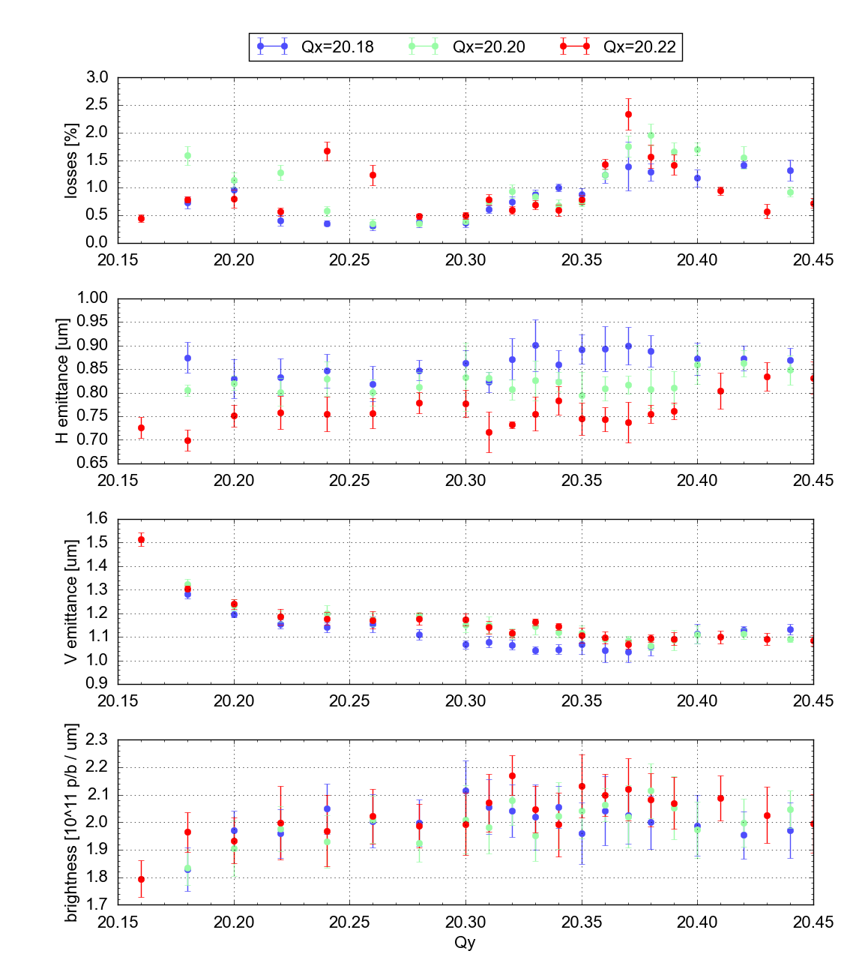
Results: Overview

Slide 11
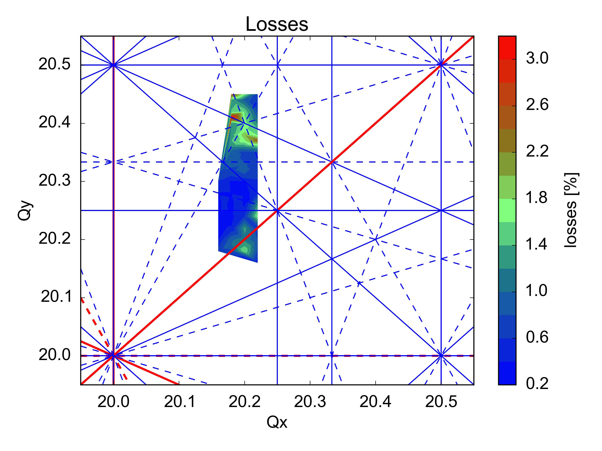
Results: Tune Diagram
Slow
(during 3s, LHC flat-bottom 10.8s)
which resonance?
further studies with reduced brightness!
??

Slide 12
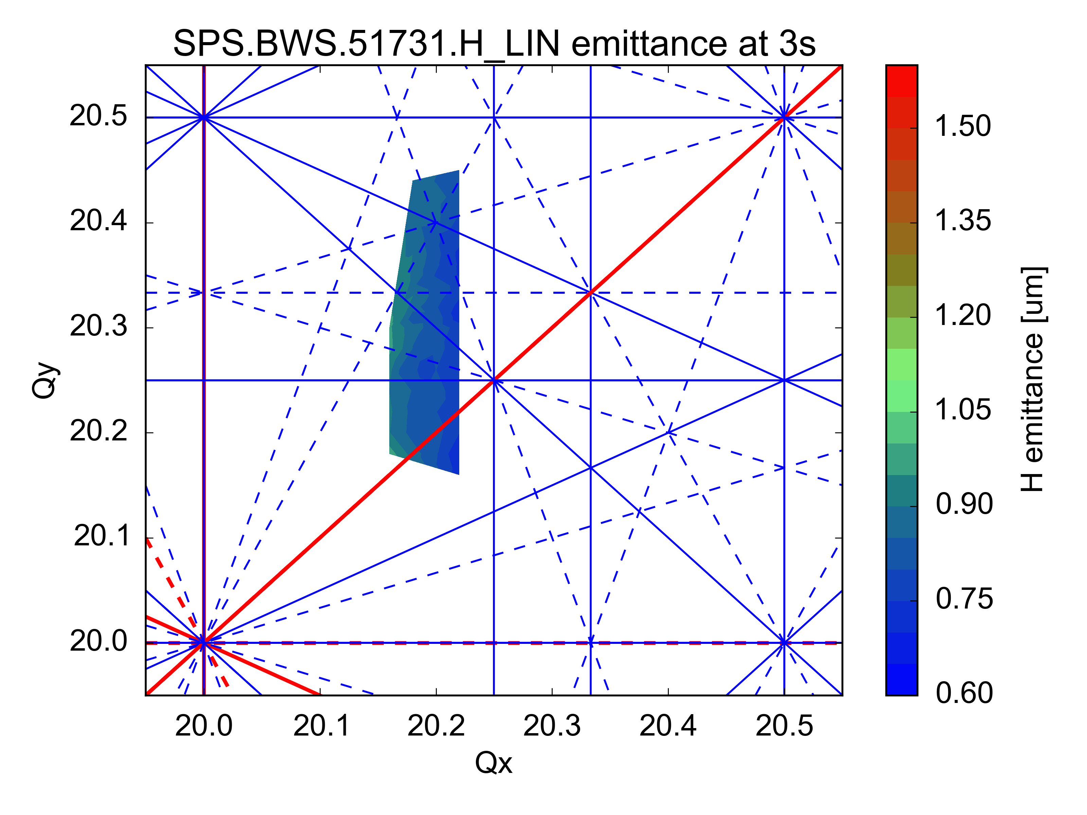
Results: Tune Diagram
Improves with distance from horizontal integer resonance

Slide 13
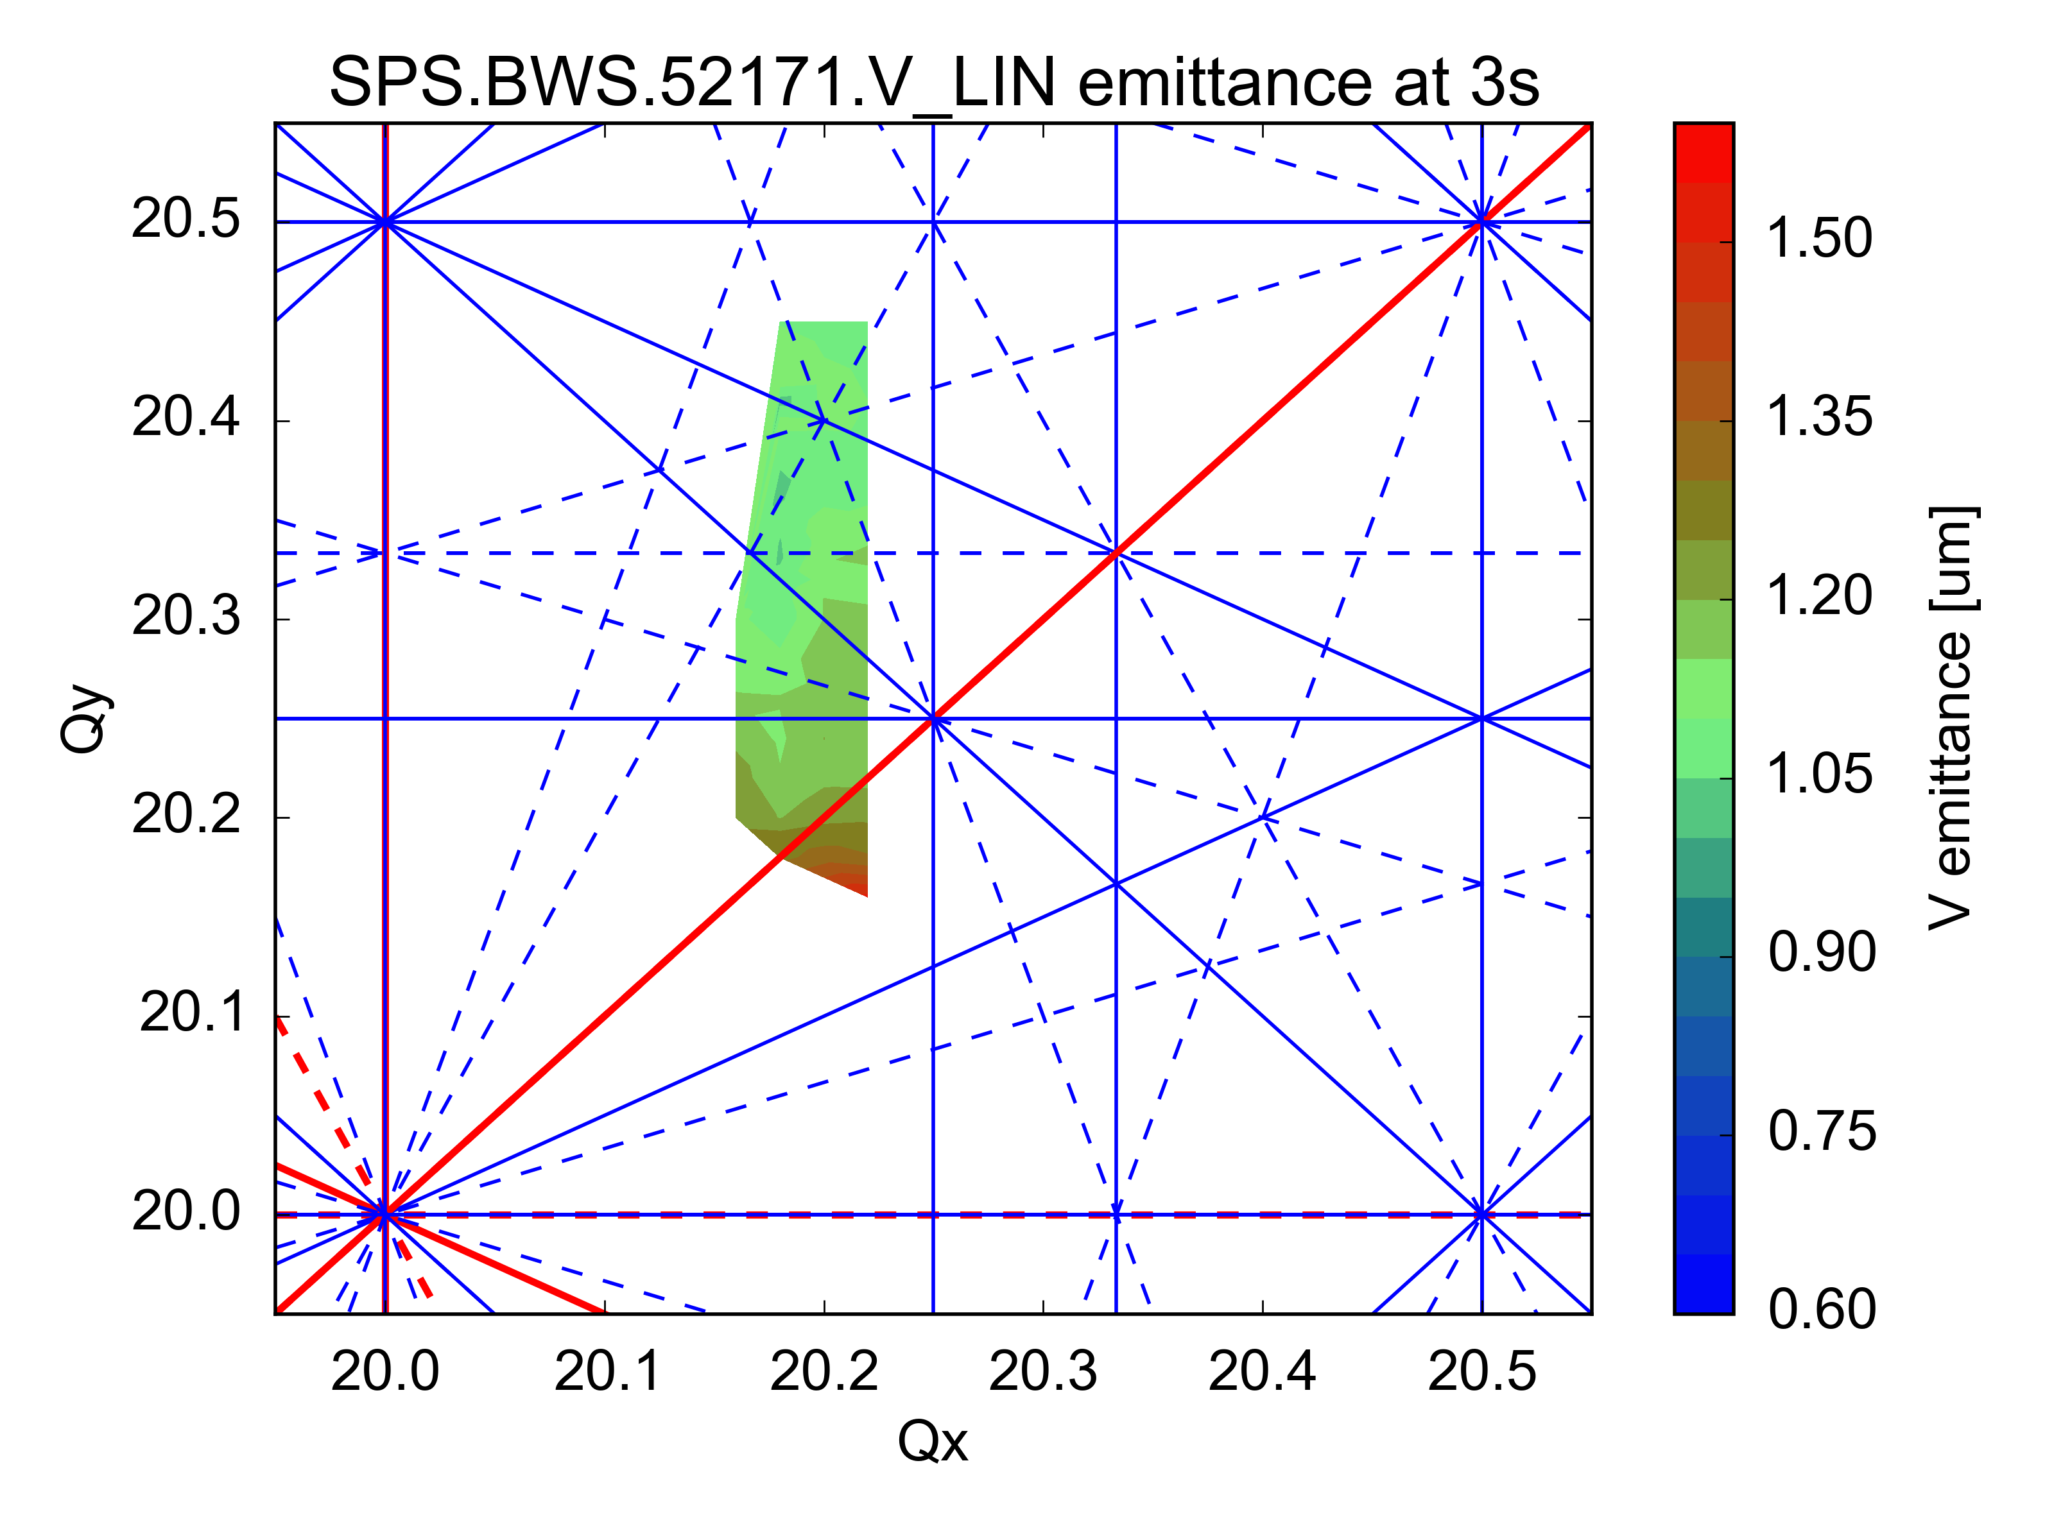
Results: Tune Diagram
Improves with distance from vertical integer resonance

Slide 14
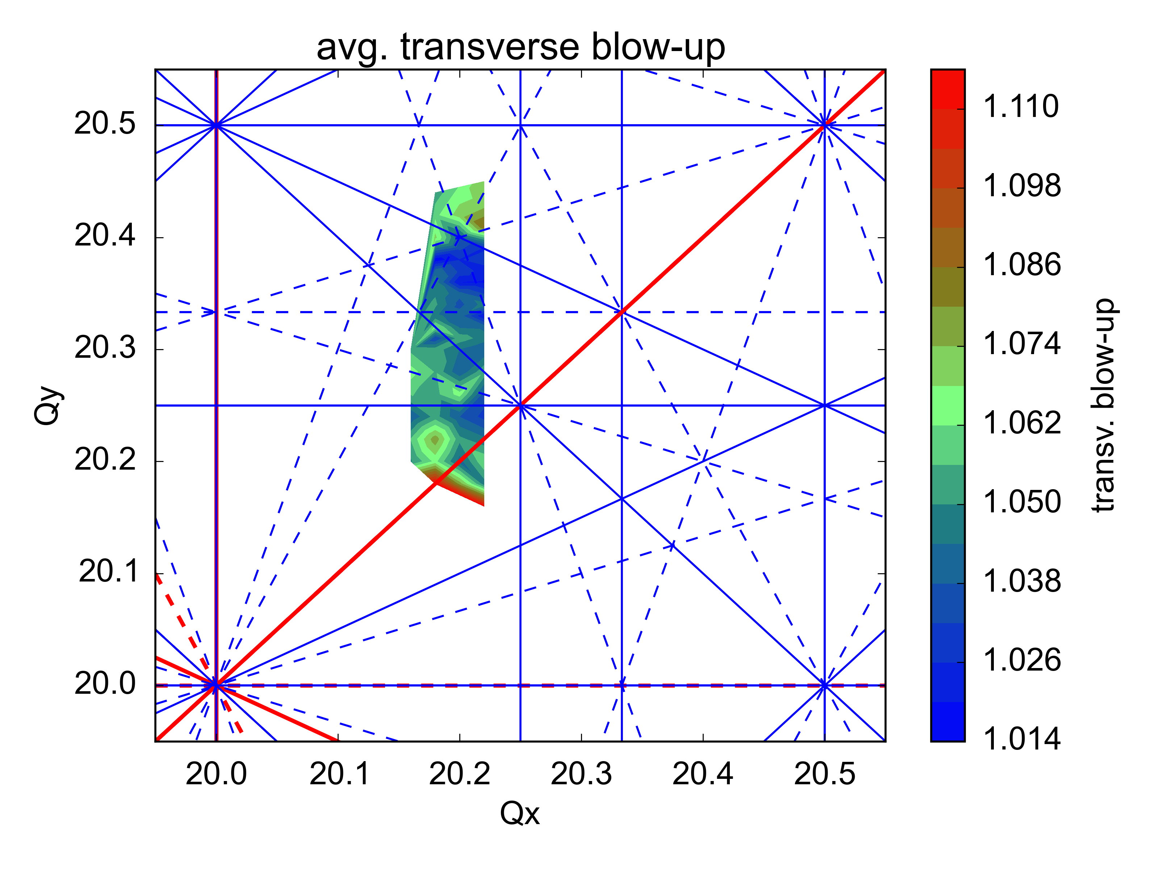
Results: Tune Diagram

Slide 15
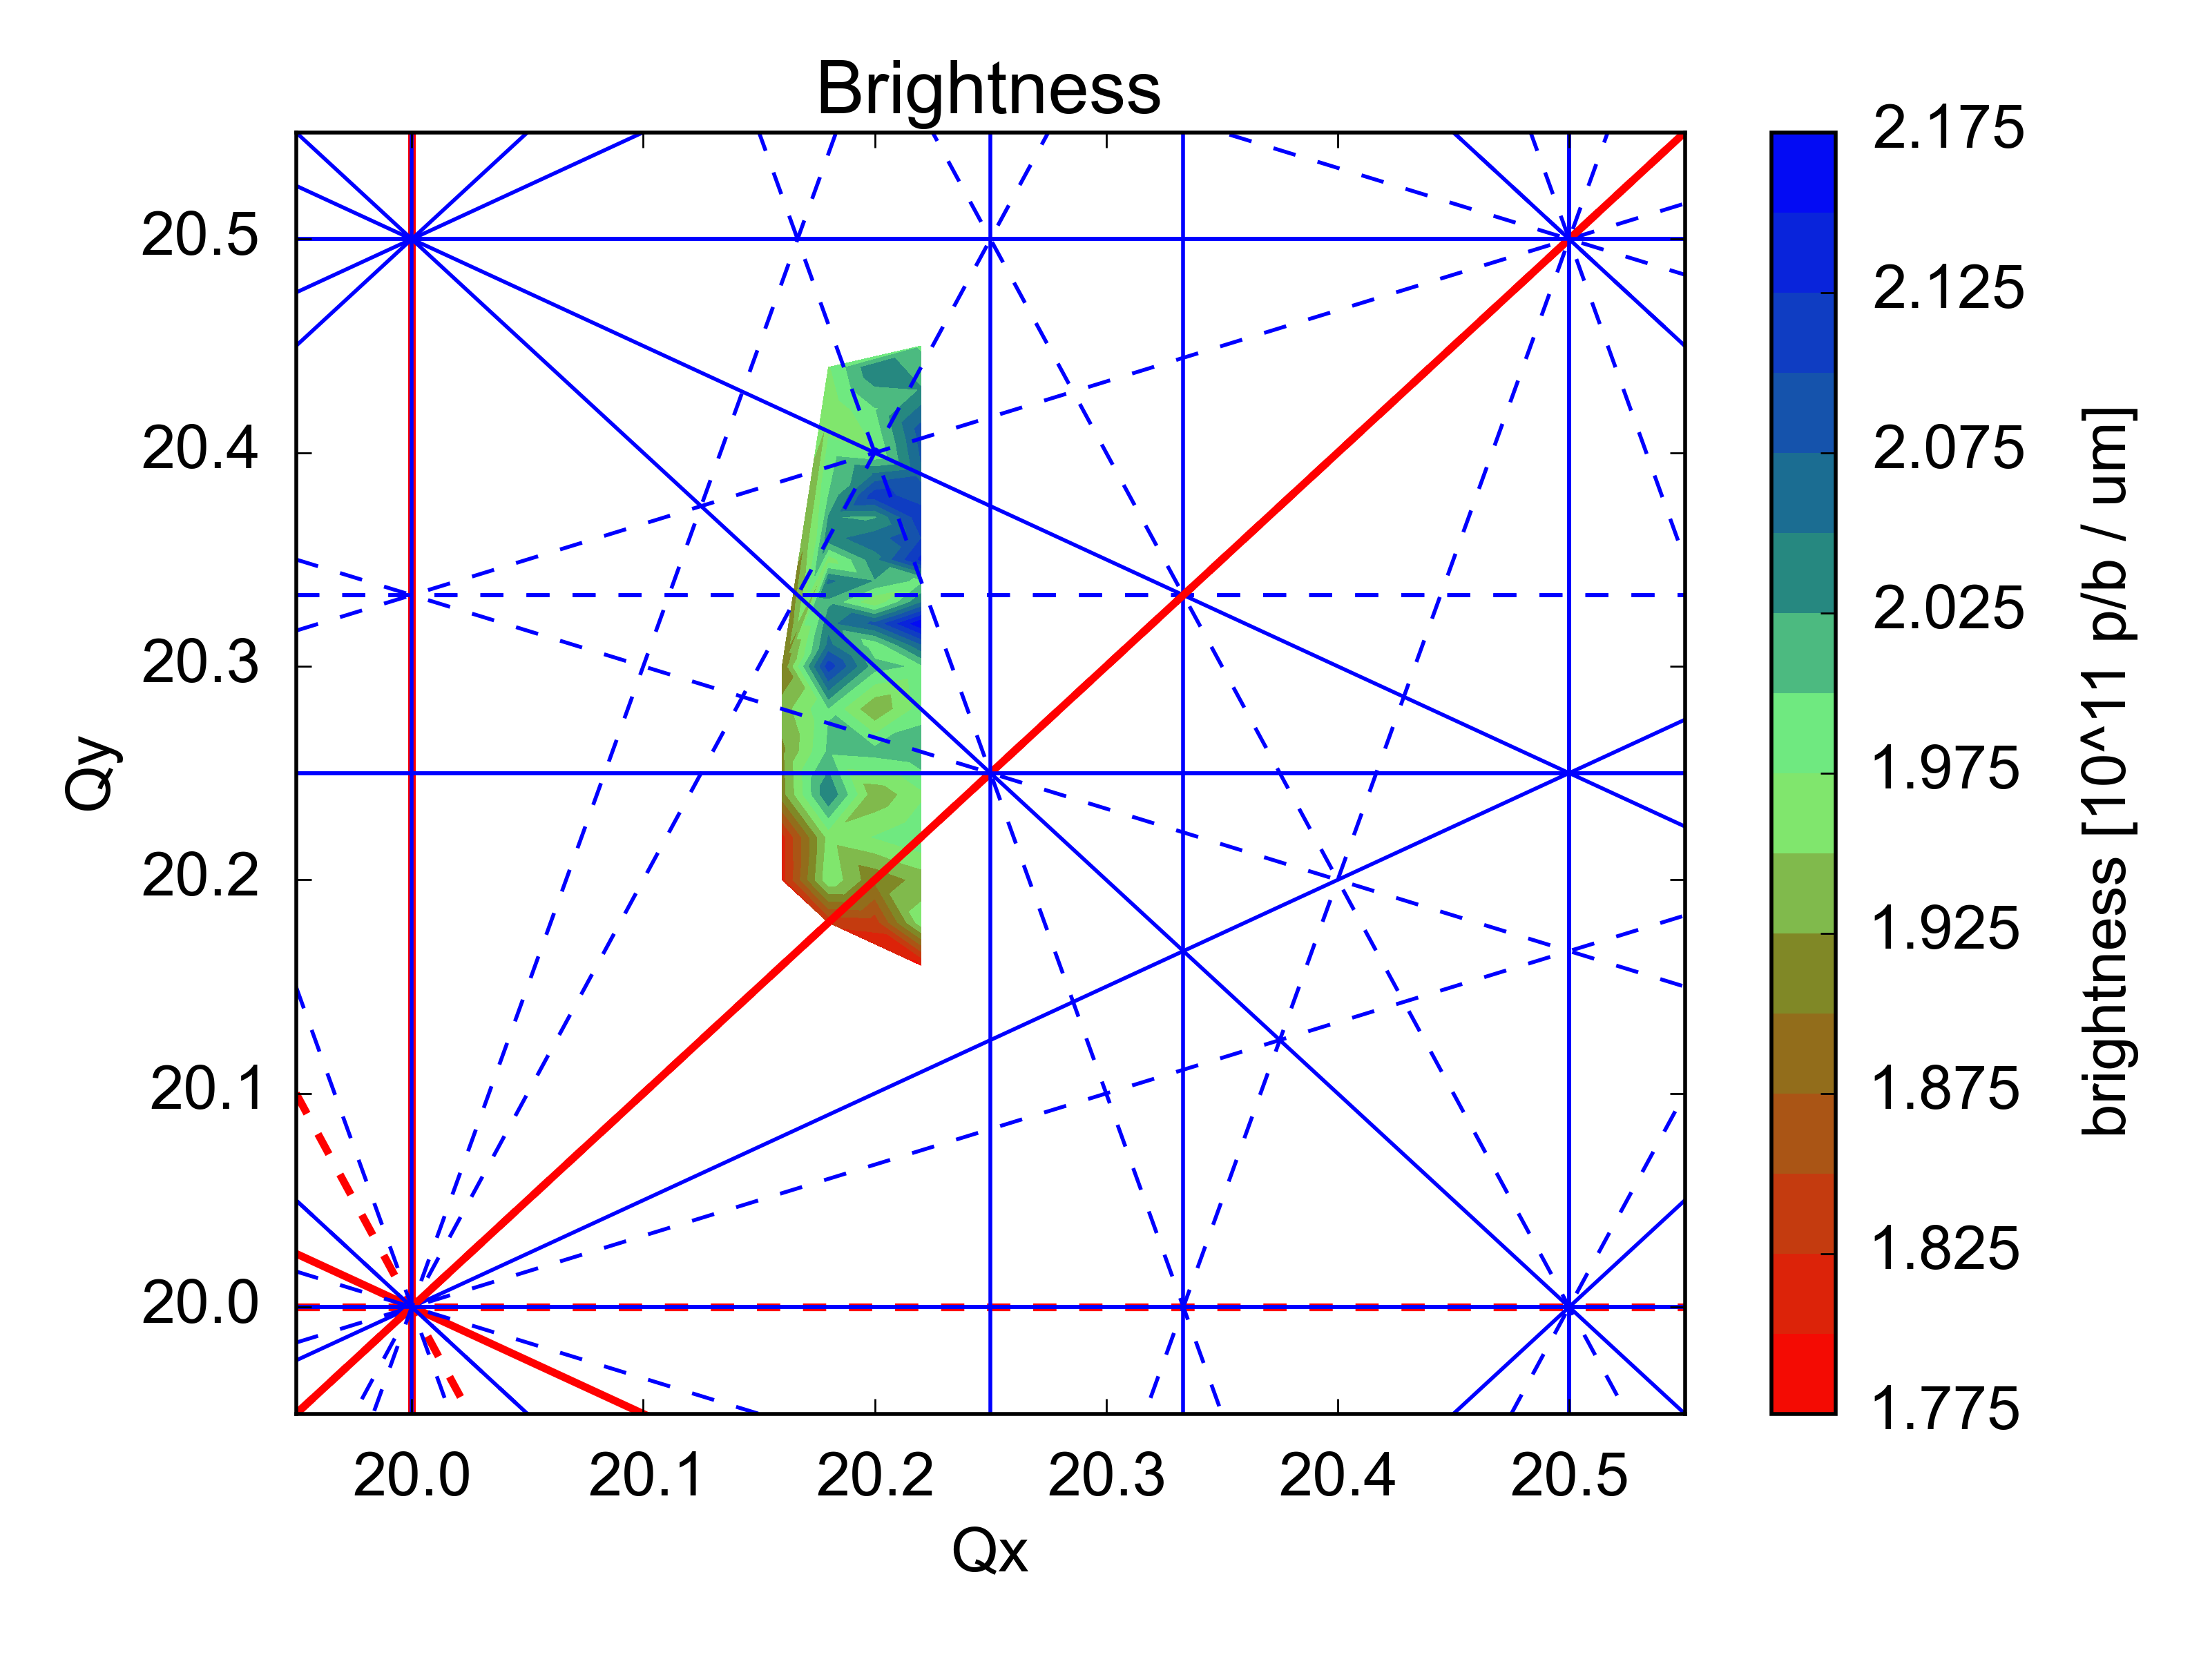
Results: Tune Diagram

Slide 16
Summary and Next Steps
Summary:
wire scanner emittances @PS extraction and @SPS injection in good agreement
significant contribution from dispersion to horizontal profiles
tune diagram above Qy=0.25 seems to be accessible
higher brightness reachable?
Next Steps:
vertical tune scan for Qx > 20.22
identify resonance (which creates losses) via
beams with reduced brightness
pencil beams
compare losses for beams with different brightness

Slide 17
Thank you for your attention!

