Slide 1
End-of-year talk
LIU-SPS BD WG meeting 03.12.15

Slide 2
Our meetings in 2015
During year - 9 meetings of LIU-SPS BD WG
(as in 2013, but 10 in 2014 and 12 in 2012 :-)
Main topics:
SPS impedance and instabilities
Space charge
Main speakers: usual suspects
H. Bartosik (7 talks)
A. Lasheen (6 talks) & J. Varela (6 talks)
Minutes: what we would do without Hannes?!

Slide 3
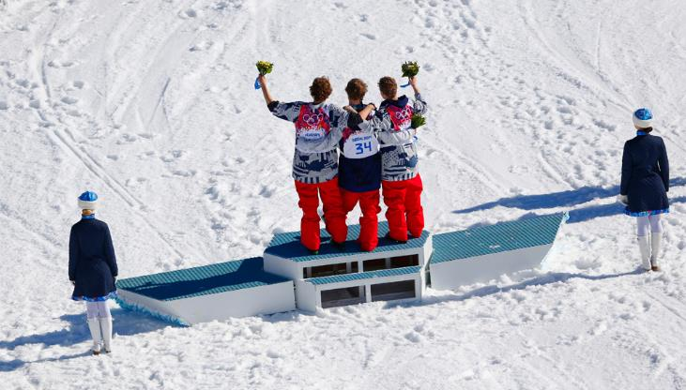
Thanks to all speakers and participants!

Slide 4
Priorities for BD studies in 2015 (from 2014 end-of-year talk)
Two important decisions to be taken (for LS2?):
aC-coating versus scrubbing – end 2015
SPS impedance reduction (flanges) – mid 2015
Measurements with multi-bunch beams:
Scrubbing run
12-24-36-48… bunches of different intensity
Simulations of multi-bunch beams:
Code development (BLonD)
Ramp & Phase Loop
Doublets for LHC: losses, long ramp, bunch rotation

Slide 5
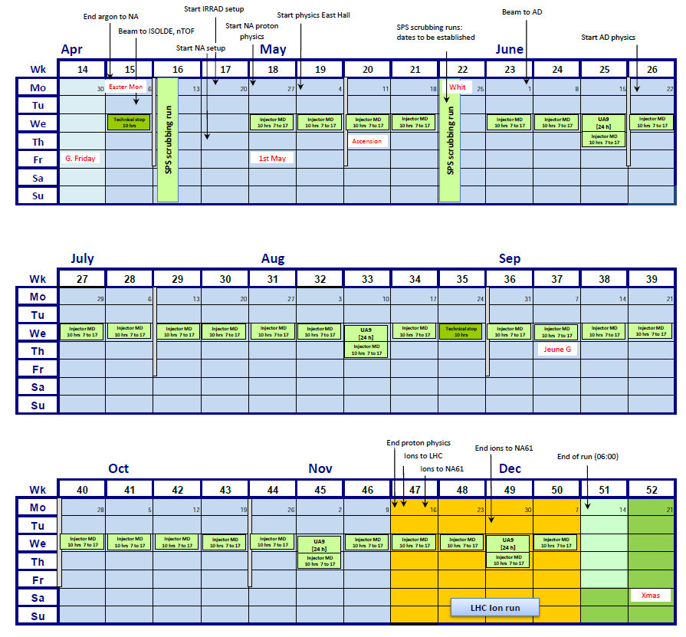
Large number of MDs!

Slide 6
Summary of 2015 beam studies
E-cloud: scrubbing, high intensity beam, losses
Operation with nominal 25 ns beams
Pushing intensity of 25 ns beam to maximum:
limited by e-cloud and beam loading
SPS MDs:
optics and space charge
synchrotron frequency shifts
instability thresholds

Slide 7
Main achievements in 2015
Scrubbing as a baseline (at least till LS3 ☺)
Further improved SPS impedance model (TW RF)
Particle simulations and measurements for a single bunch and multi-bunch beams
Impedance reduction as a baseline:
Vacuum flanges
HOMs in 200 MHz (800 MHz ?)
MKP?
Space charge and WP understanding
Nonlinear optics studies
LIU/HL-LHC Day: options to study: Q22, 80 bunches
Further development of simulation code (BLonD)

Slide 8
Ions in LIU-SPS BD WG: what can be done already in 2015?
Scan of working point, to check lifetime vs Qx/Qy
Transmission vs beam intensity & emittance (effect of IBS?)
Transverse damper: (damping of all batches?)
RF capture/transmission/transition crossing: any more optimisation possible?
Measurements for the slip stacking:
lifetime without the phase loop
momentum aperture (in TT2/TT10 at top energy and in SPS ring for various energies)
Q26 vs Q20?

Slide 9
Challenges for 2016
SPS impedance
Refinement of the model (1 Ohm inductance?)
Follow-up of the impedance reduction
Solution for HOMs damping: design of the improved HOM (~630 MHz) couplers – end 2016
Increase in intensity:
losses
instabilities
Ions in LIU-SPS

Slide 10
Happy New Year!

