Slide 1
Analysis of schemes for doublet production
J. F. Esteban Müller, E. Shaposhnikova
Acknowledgments:
T. Argyropoulos, H. Bartosik, T. Bohl, G. Iadarola, G. Rumolo, H. Timko
LIU-SPS BD WG – 30 January 2014

Slide 2
Outline
Introduction
Schemes:
  LHC at injection
  SPS at injection
  SPS at 200 GeV
  SPS at flat top
Conclusions

Slide 3
Introduction (I)
Special beam made of bunch doublets is considered for scrubbing of the LHC
  Enhance e-cloud → Reduction of the scrubbing time needed (Simulations by G. Iadarola & G. Rumolo)
Doublets spacing:
  Split in the LHC → 2.5 ns
  Split in the SPS → 5 ns: Preferred option

Slide 4
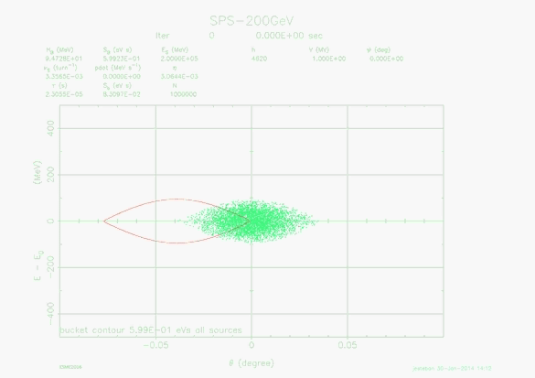
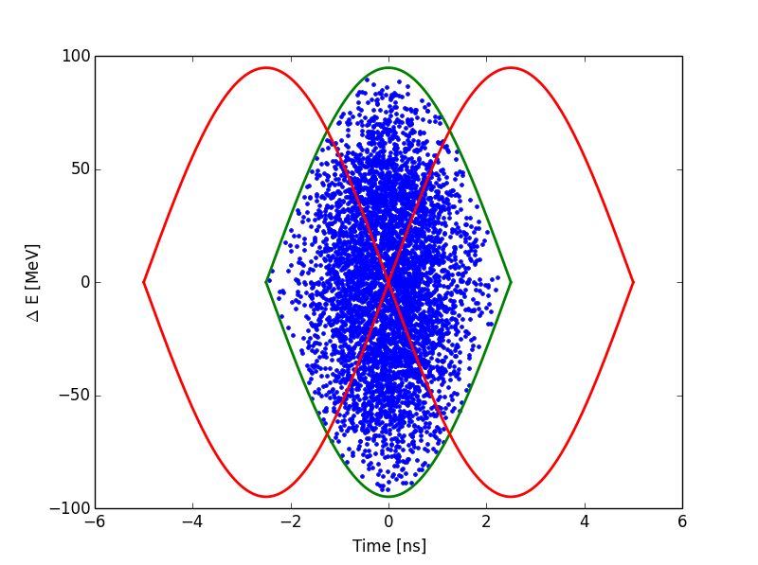
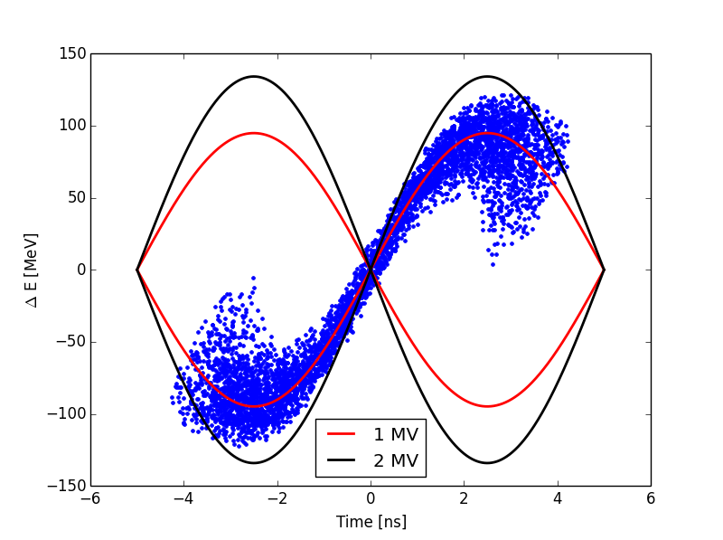
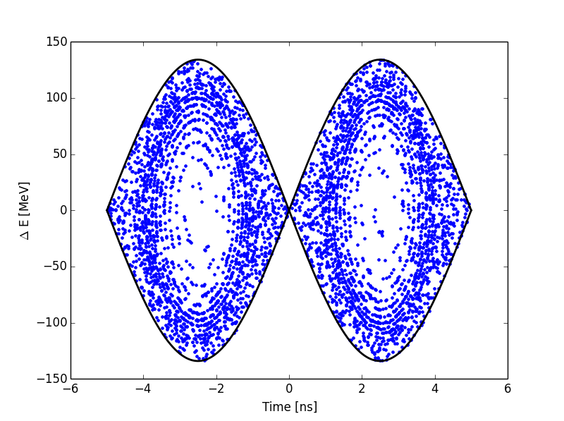
Introduction (II)
Splitting process:
Small energy spread needed to reduce losses and emittance blow-up → Minimum initial voltage
RF phase shift of 180º or injection to unstable phase
Particles move away from unstable phase
When particles are around the new stable phase, voltage quickly increased to capture them
Filamentation → Emittance ≈ bucket area

Slide 5
Introduction (III)
Main issues:
  Particle losses
  Emittance blow-up
  25 ns high intensity (> 1.5x10¹¹ ppb)→ Slower acceleration in SPS due to the power limitation
Simulations using ESME without intensity effects
  Losses and emittance blow-up may be underestimated
  Minimum voltage in the SPS was chosen taking into account the beam loading
4 different schemes:
  LHC at injection
  SPS at injection
  SPS at 200 GeV
  SPS at flat top
800 MHz RF system off during splitting to minimize losses, because it operates in BSM

Slide 6
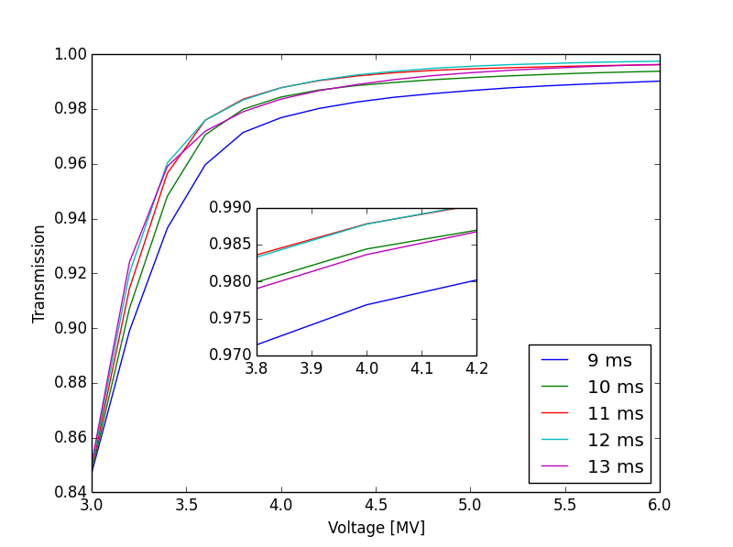
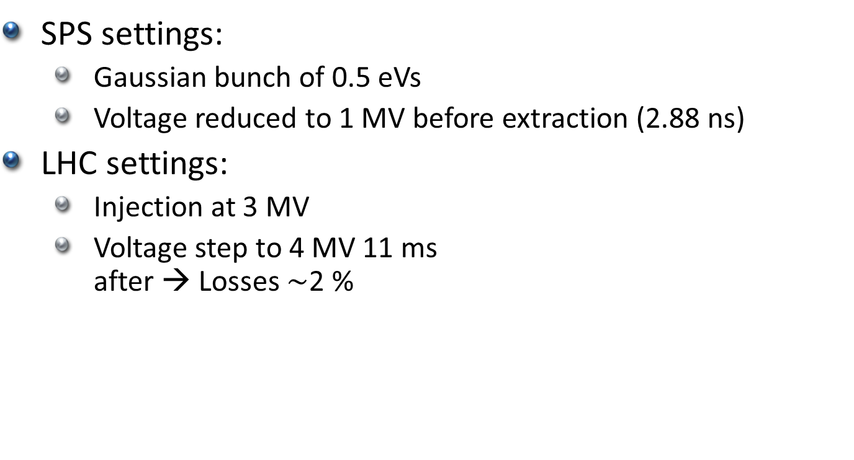
LHC at injection (I)
SPS settings:
  Gaussian bunch of 0.5 eVs
  Voltage reduced to 1 MV before extraction (2.88 ns)
LHC settings:
  Injection at 3 MV
  Voltage step to 4 MV 11 ms
  after → Losses $\sim$2 %

Slide 7
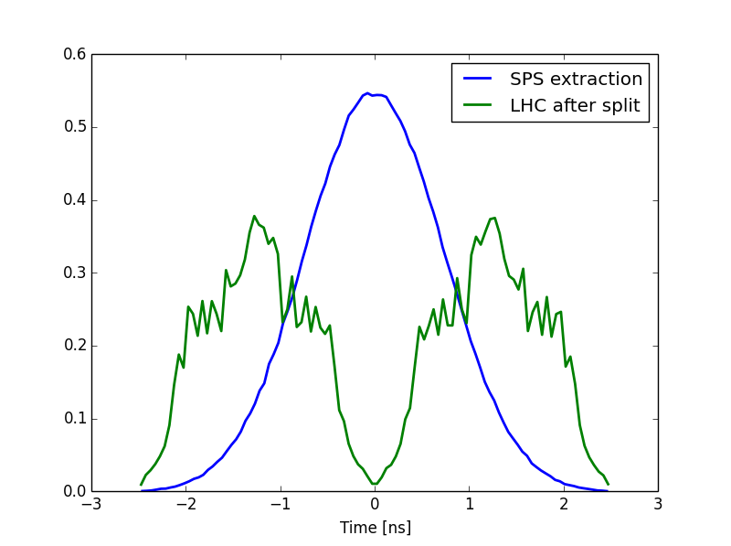
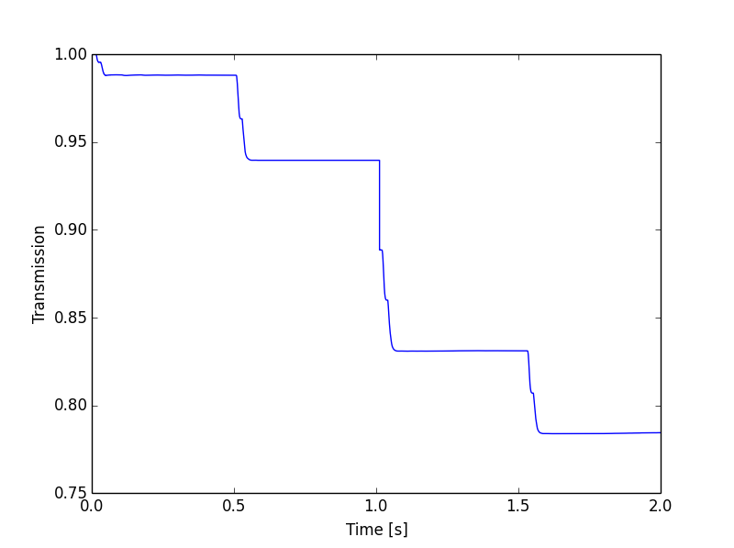
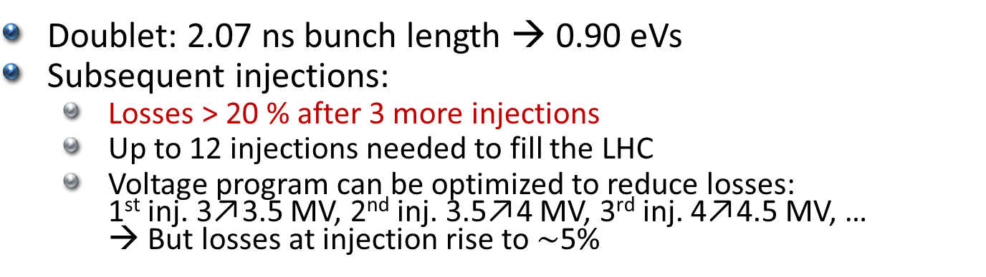
LHC at injection (II)
Doublet: 2.07 ns bunch length → 0.90 eVs
Subsequent injections:
  Losses > 20 % after 3 more injections
  Up to 12 injections needed to fill the LHC
  Voltage program can be optimized to reduce losses:
  1st inj. 3↗3.5 MV, 2nd inj. 3.5↗4 MV, 3rd inj. 4↗4.5 MV, …
  → But losses at injection rise to $\sim$5%

Slide 8
Summary: LHC at injection
Advantages:
  Doublets issues restricted only to the LHC
  No special RF hardware required
Disadvantages:
  High losses at high energy
  Large emittance blow-up
  2.5 ns doublet spacing is less efficient than 5 ns

Slide 9
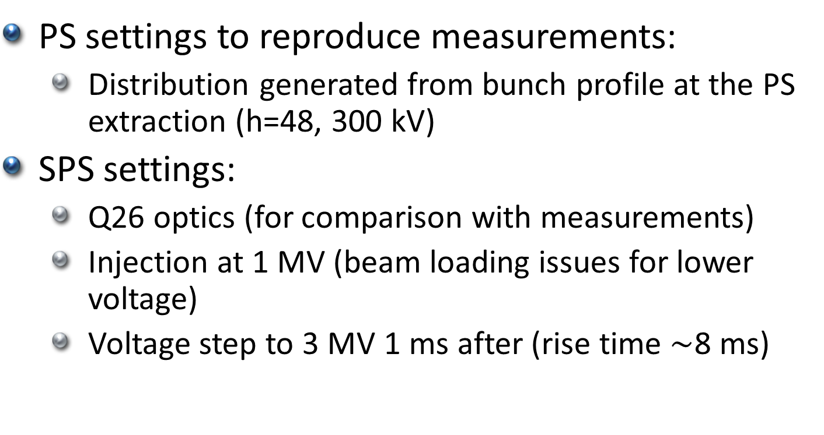
SPS at injection (I)
PS settings to reproduce measurements:
  Distribution generated from bunch profile at the PS extraction (h=48, 300 kV)
SPS settings:
  Q26 optics (for comparison with measurements)
  Injection at 1 MV (beam loading issues for lower voltage)
  Voltage step to 3 MV 1 ms after (rise time $\sim$8 ms)

Slide 10
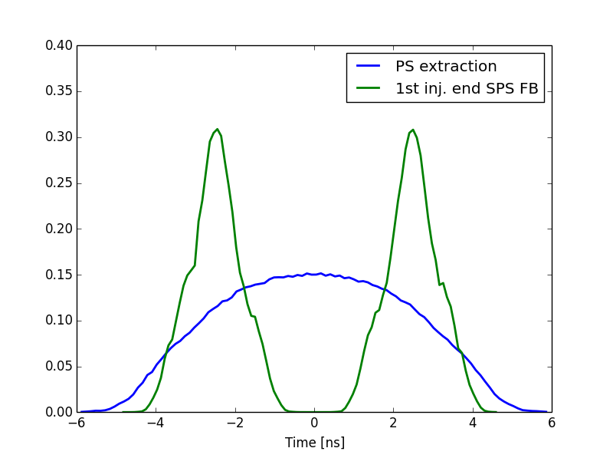
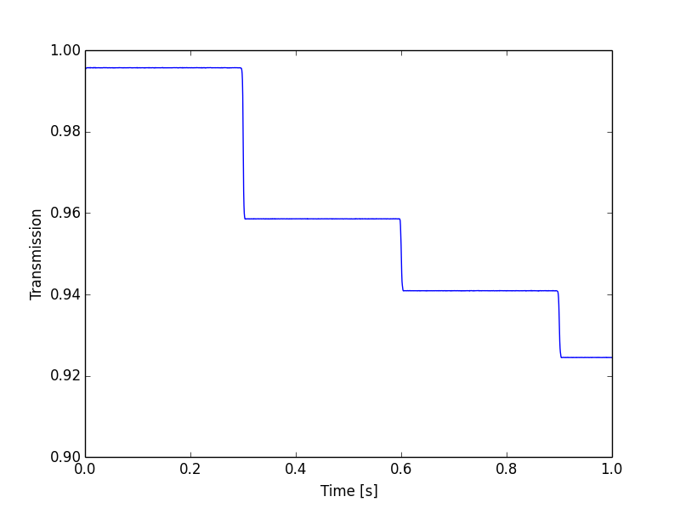
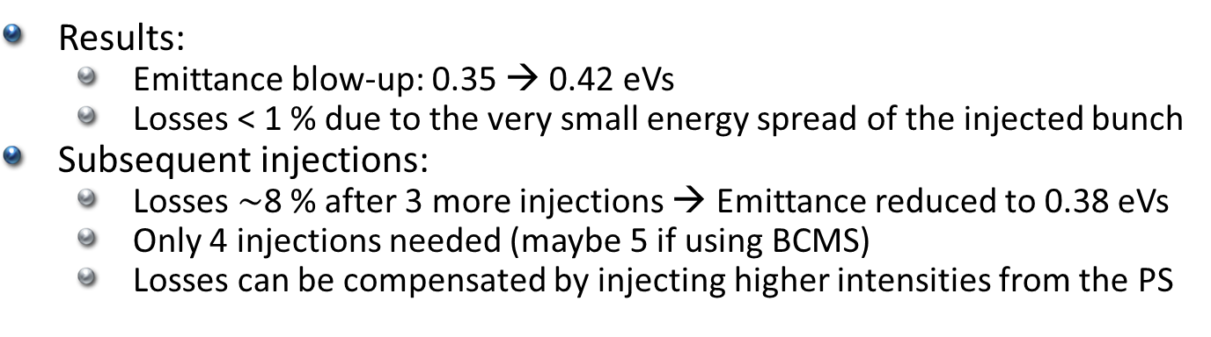
SPS at injection (II)
Results:
  Emittance blow-up: 0.35 → 0.42 eVs
  Losses < 1 % due to the very small energy spread of the injected bunch
Subsequent injections:
  Losses $\sim$8 % after 3 more injections → Emittance reduced to 0.38 eVs
  Only 4 injections needed (maybe 5 if using BCMS)
  Losses can be compensated by injecting higher intensities from the PS

Slide 11
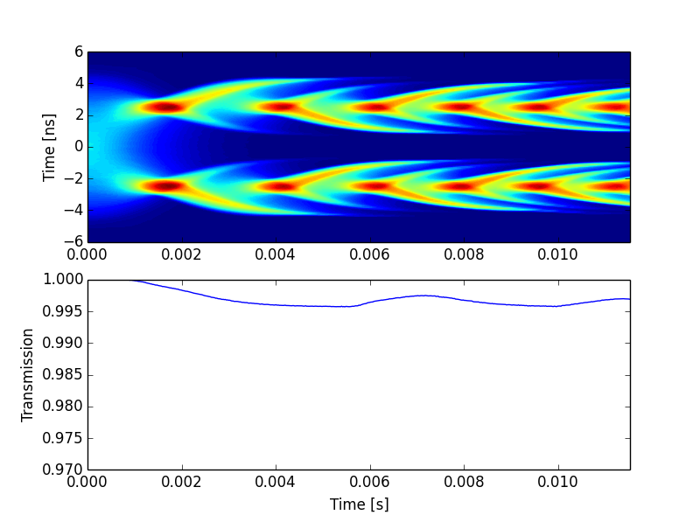
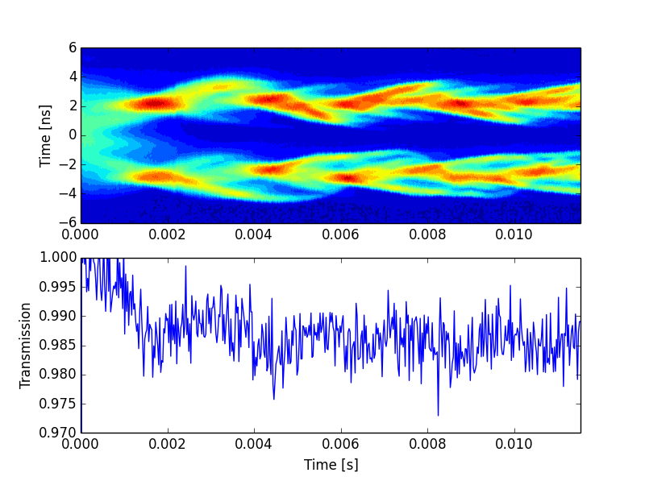
SPS at injection (III)
Comparison with measurements:
  Splitting well reproduced
  Losses slightly higher in measurements → Effects not included in simulations as injection phase error, energy mismatch or intensity effects
Simulations
Measurements
T. Argyropoulos, H. Bartosik, T. Bohl, G. Iadarola, G. Rumolo, H. Timko

Slide 12
Summary: SPS at injection
Advantages:
  Acceptable losses and at low energy
  Small emittance blow up
  Already tested during MDs
  No special RF hardware required
Disadvantages:
  e-cloud can be an issue with this beam at injection energy
  Low level RF and transverse damper should work from injection to flat top

Slide 13
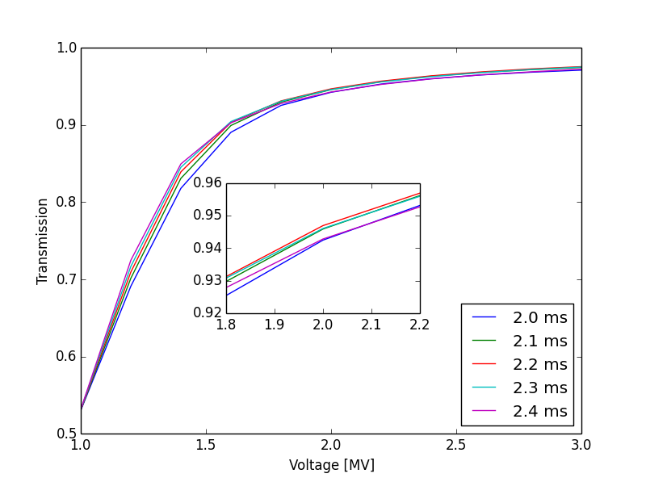
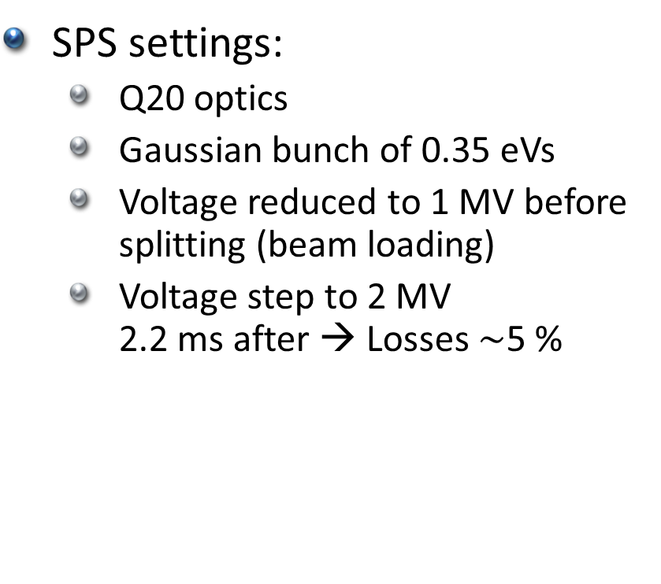
SPS at 200 GeV (I)
SPS settings:
  Q20 optics
  Gaussian bunch of 0.35 eVs
  Voltage reduced to 1 MV before splitting (beam loading)
  Voltage step to 2 MV
  2.2 ms after → Losses $\sim$5 %

Slide 14
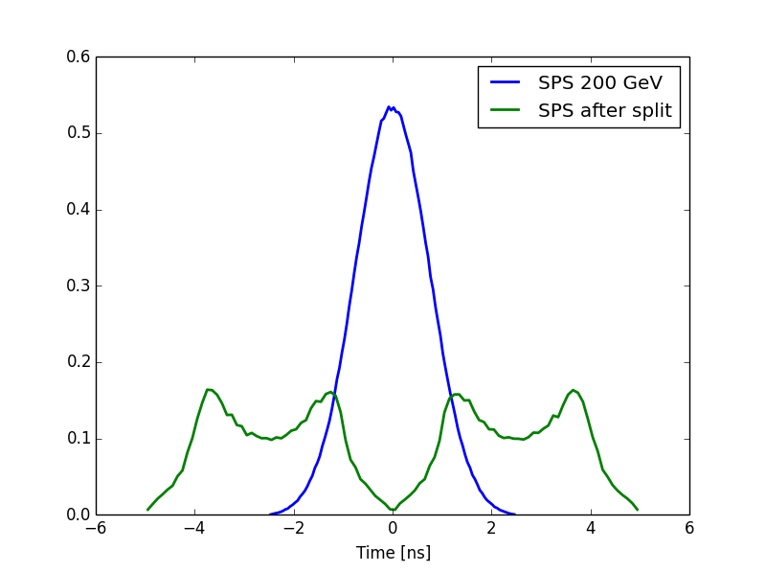
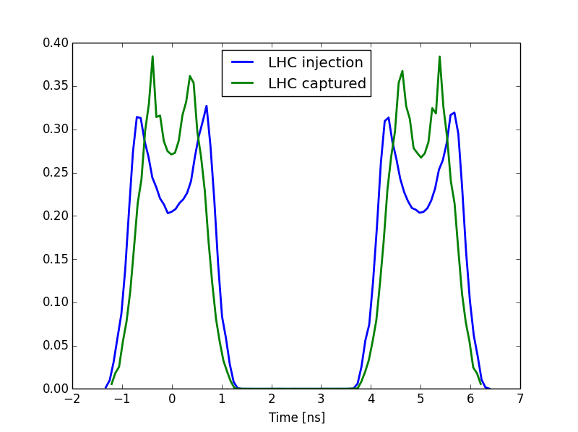
SPS at 200 GeV (II)
Emittance blow-up: 0.35 → 0.82 eVs
Acceleration to 450 GeV: Voltage program for 1 eVs bucket area (q_{p} = 0.9)
Voltage at SPS extraction 7 MV
LHC injection: 6 MV → emittance blow-up to 1.04 eVs

Slide 15
Summary: SPS at 200 GeV
Advantages:
  E-cloud weaker at 200 GeV
Disadvantages:
  Special RF hardware required for the phase jump
  Longer SPS cycle
  Larger emittance blow-up
  Higher losses at higher energy (200 GeV)

Slide 16
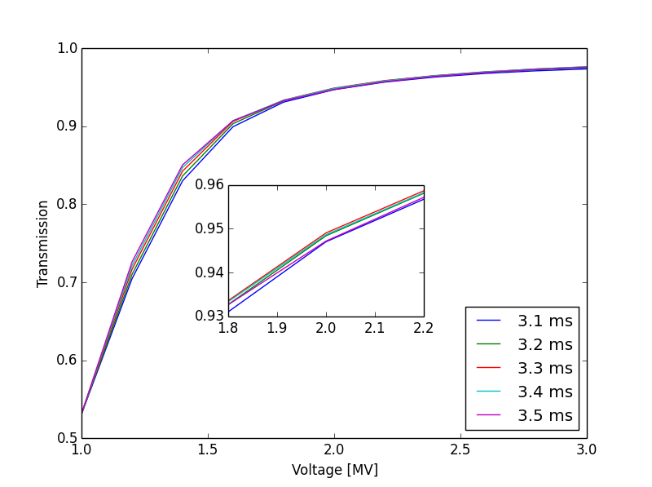

SPS at flat top (I)
SPS settings:
  Q20 optics
  Gaussian bunch of 0.5 eVs
  Voltage reduced to 1 MV before splitting (beam loading)
  Voltage step to 2 MV
  3.3 ms after → Losses $\sim$5 %

Slide 17
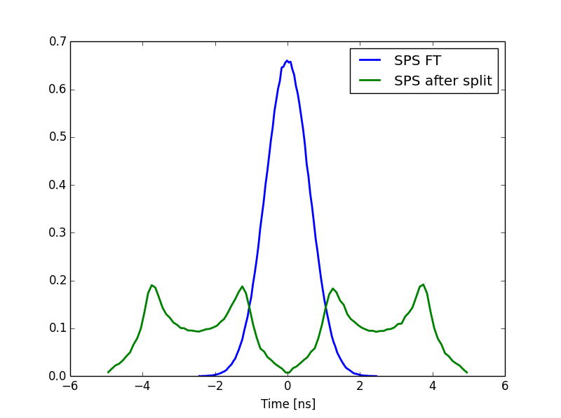
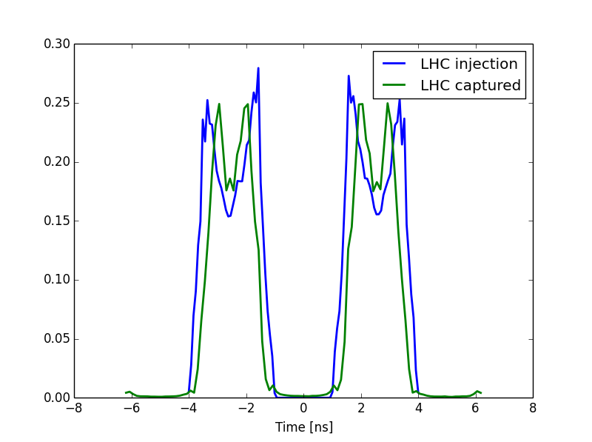
SPS at flat top (II)
Emittance growth: 0.5 → 1.36 eVs
Voltage at SPS extraction 7 MV (2.99 ns bunch length)
LHC injection: 6 MV
  Emittance reduced to 1.2 eVs
  15 % injection losses
  1 % satellites

Slide 18
Summary: SPS at flat top
Advantages:
  E-cloud weaker at 450 GeV
Disadvantages:
  Special RF hardware required for the phase jump
  Larger emittance blow-up
  High losses at high energy in both SPS and LHC

Slide 19
Conclusions
The preferred scheme is the SPS at injection:
  5 ns doublet spacing
  Acceptable losses and at low energy
  Small emittance blow up
  Already tested during MDs
  No special RF hardware required
If e-cloud is too strong at 26 GeV:
  SPS scrubbing run with doublets
  Use the scheme “SPS at 200 GeV”

