Slide 1
Stripline kicker for HBFS: beam coupling impedance calculations

Slide 2
Overview
Goal
Impedance calculations
Longitudinal Impedance
Transverse impedance

Slide 3
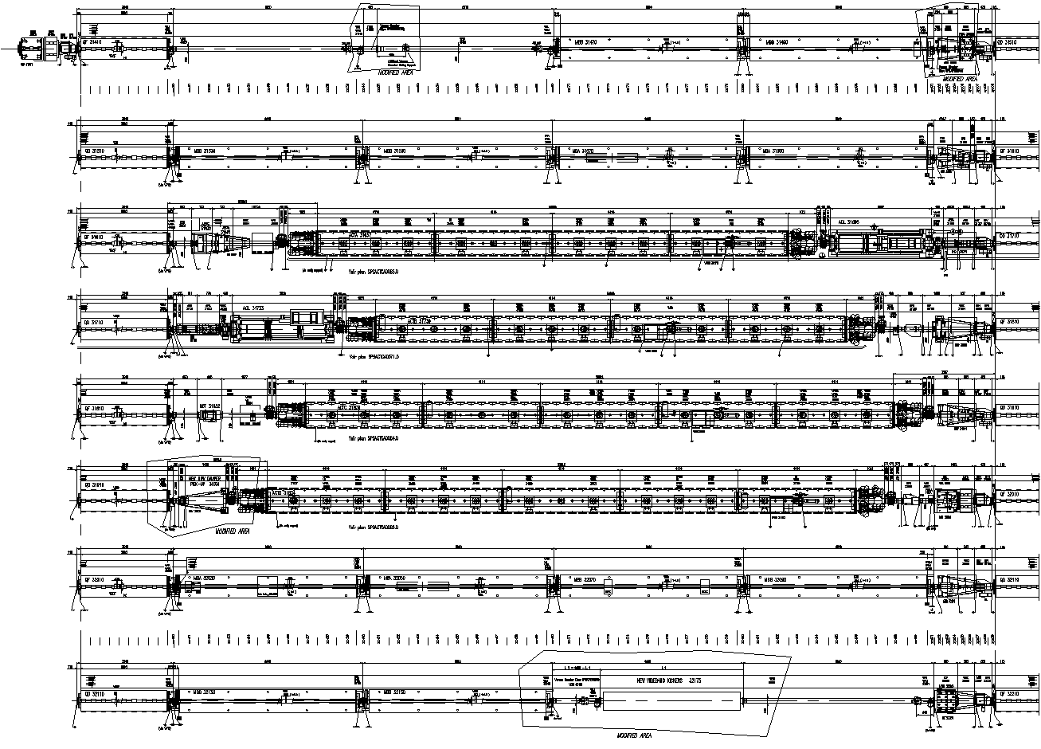
Position of the HBWD
Second half of period 321 of the SPS, close to MBB22150
E. Montesinos

Slide 4
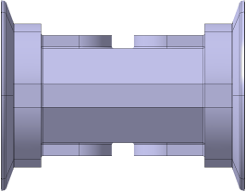
Machine integration
E. Montesinos
Present SPS scheme
Magnet
6660 mm vacuum Pipe
Magnet
Pipe

Slide 5
One kicker
E. Montesinos
Lb and Lk lengths are still under calculation
Approximate values are Lb ~ 188 mm and Lk ~ 252 mm
Magnet
Pipe
Pipe
Pipe
L_{b}
L_{k}
L_{b}
L_{b} + L_{k}
L_{b} + L_{k}

Slide 6
Machine integration
E. Montesinos
Agreed goal is two kickers in the SPS
Option A with 3 elliptical bellows
Option B is with two circular bellows and one elliptical bellows
Magnet
Pipe
Pipe
Magnet
Pipe
Pipe

Slide 7
Overview
Goal
Impedance calculations
Longitudinal Impedance
Transverse impedance

Slide 8
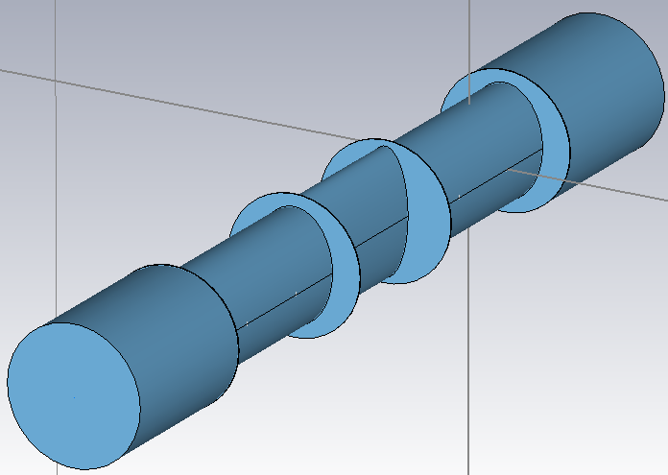
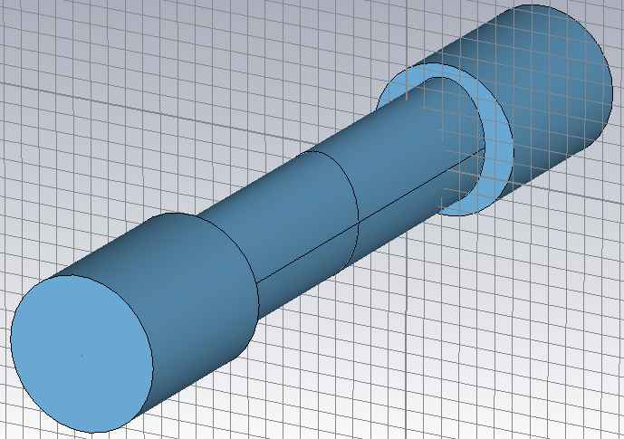
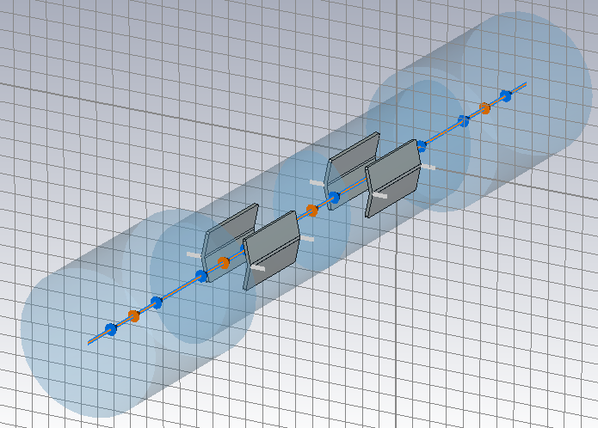
Longitudinal impedance
With flange (elliptical bellows)
With flange (circular bellows)
Without flange

Slide 9
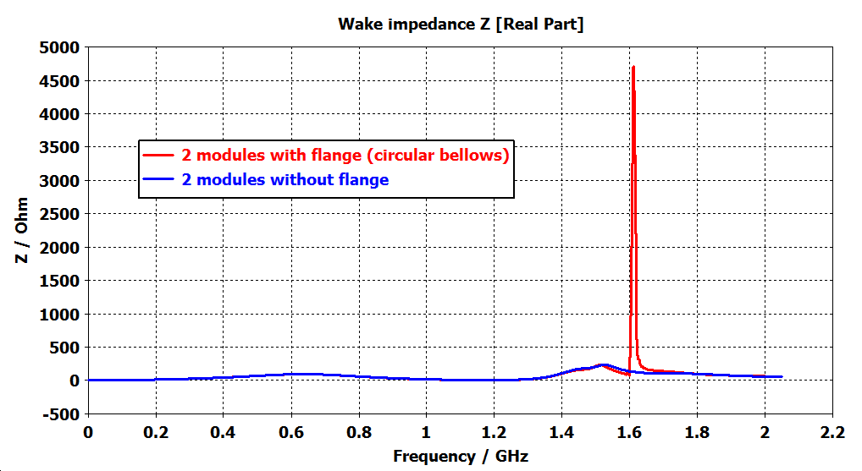
Longitudinal impedance: circular bellows
Because of the flange a broadband resonance appears below 2GHz

Slide 10
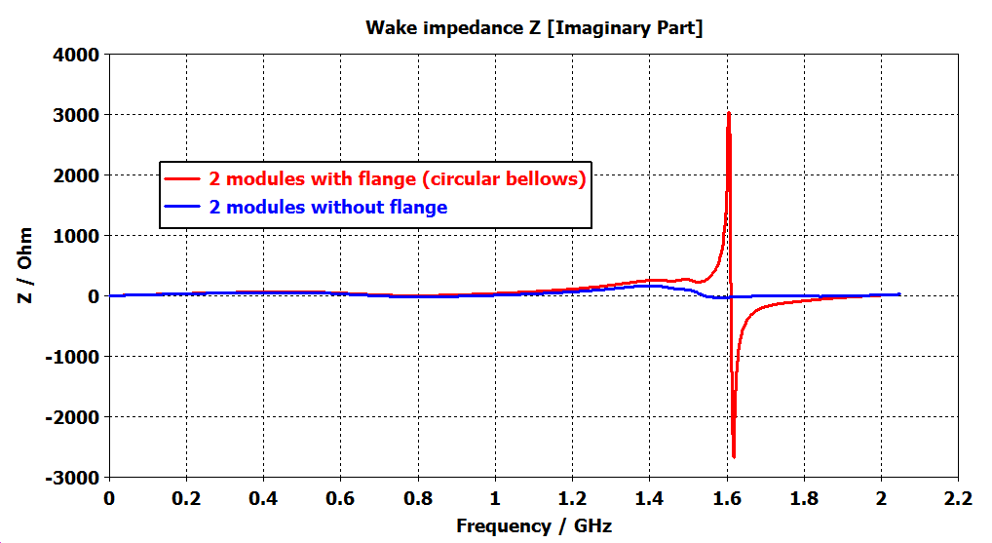
Longitudinal impedance: circular bellows
Because of the flange a broadband resonance appears below 2GHz

Slide 11
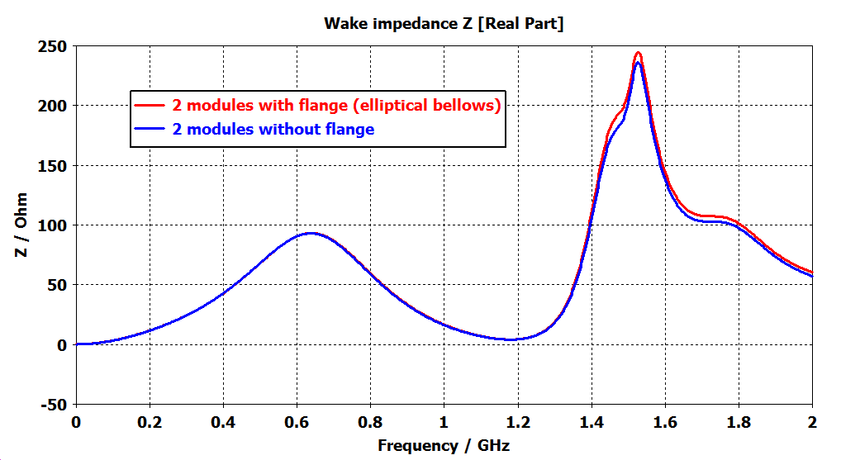
Longitudinal impedance: elliptical bellows
The real part of the longitudinal impedance remains unchanged below 2 GHz

Slide 12
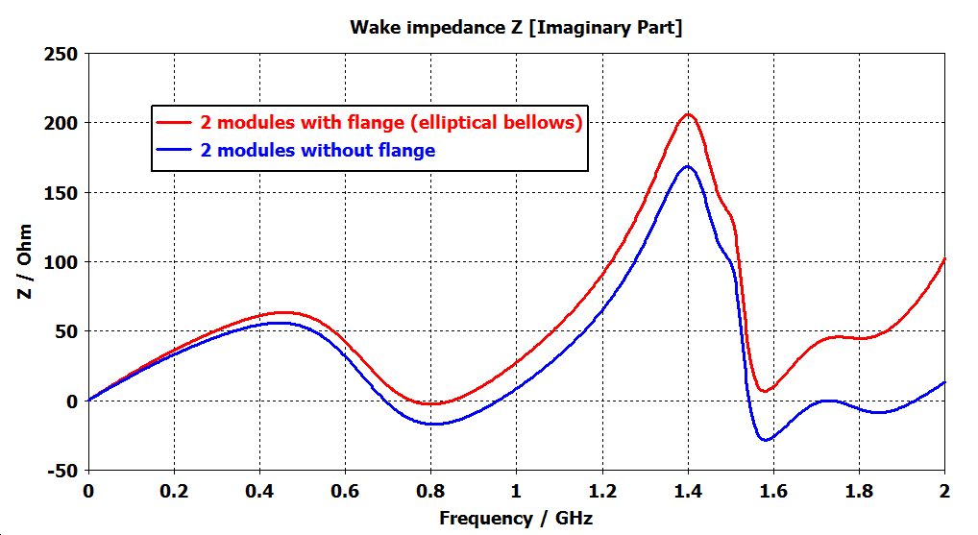
Longitudinal impedance: elliptical bellows
Slight increase of the imaginary part

Slide 13
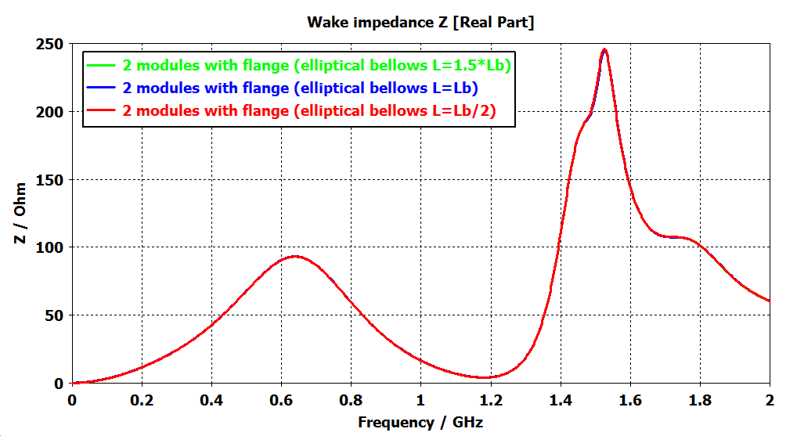
Longitudinal impedance: elliptical bellows
The longitudinal impedance does not depend on the length of the elliptical bellows

Slide 14
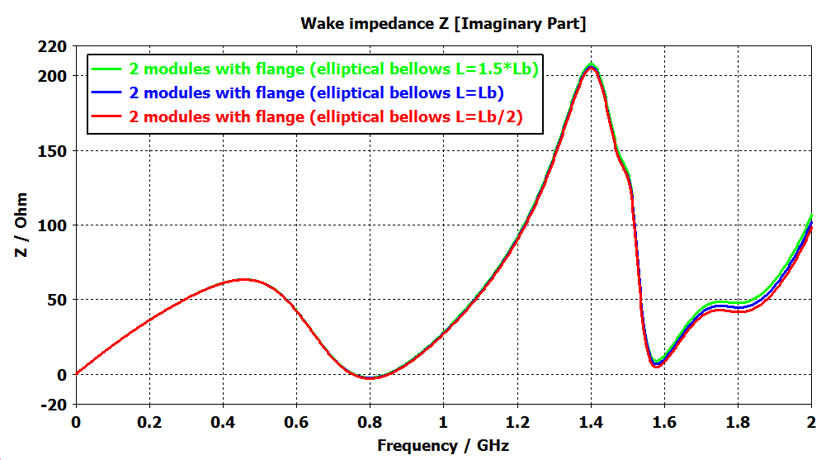
Longitudinal impedance: elliptical bellows
The longitudinal impedance does not depend on the length of the elliptical bellows

Slide 15
Overview
Goal
Impedance calculations
Longitudinal Impedance
Transverse impedance

Slide 16
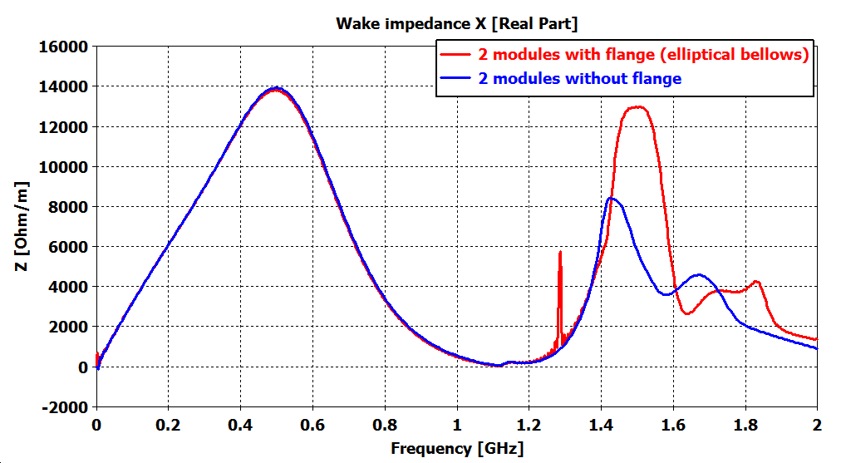
Transverse impedance
Mode of the transition pieces (elliptical pipe)

Slide 17
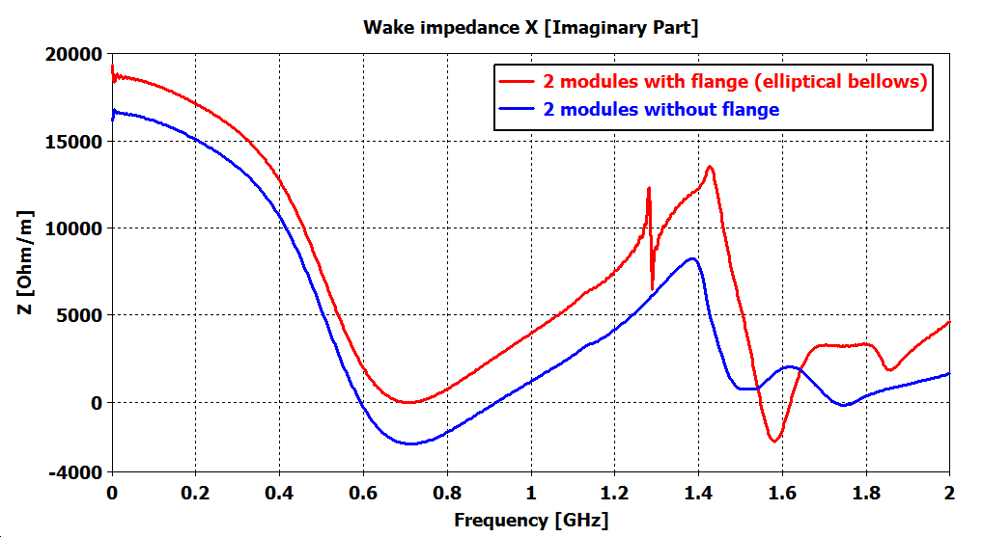
Transverse impedance
The effective vertical impedance for 2 stripline kicker modules is expected to be about 0.1% of the total SPS vertical impedance

Slide 18
Summary
The case of circular bellows seems to be the more dangerous in terms of impedance
In the case of elliptical bellows, the transition pieces between the kicker modules will have a small effect on the longitudinal impedance
For two kicker modules the transverse impedance is expected to be about 0.1% of the total SPS vertical impedance

Slide 19
Thank you for your attention

Slide 20
Appendix

Slide 23
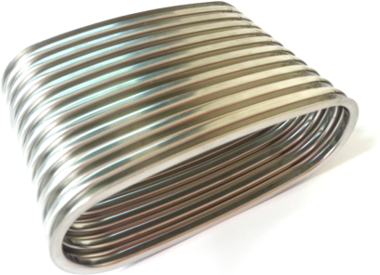
Bellows
E. Montesinos
Non-circular flexible bellows
one available even if to be modified

Slide 24
Cross section (vertical)
E. Montesinos
156 mm
55 mm
92 mm
40 mm
Distance between flanges = 2.2 mm

Slide 25
Cross section (horizontal)
E. Montesinos
156 mm
145 mm
129 mm
Distance between flanges = 2.2 mm

