Slide 1
2014 scrubbing run 2: news hot from the oven
The scrubbing team, i.e. H. Bartosik, G. Iadarola, K. Li, L. Mether, A. Romano, G. Rumolo, B. Salvant, M. Schenk, T. Argyropoulos, T. Bohl,, J. Esteban Muller,
G. Kotzian, E. Shaposhnikova, M.Taborelli
Thank to: E. Carlier, H. Damerau, B. Goddard, S. Hancock, W. Höfle, V. Kain, K. Cornelis, T. Levens, H. Neupert, G. Papotti, R. SalemmeD. Valuch, C. Yin Vallgren and the SPS OP crew

Slide 2
Scrubbing run in week 50: overview
days
MD3: 26.4 s, 26 GeV/c
High intensity 25 ns beam
LHC25NS: 22.8s, 450 GeV/c
LHCMD4: 31s, slow ramp to 450 GeV/c
Monday
High intensity 25 ns beam (up to 1.9e11 p/b injected) on flat bottom cycle
Lifetime quite poor
Instability after injection of 2nd batch
Emittance blow-up in last part of trains (starting from 2nd batch), especially horizontal
Clear horizontal instability at end of train
Intensity scan during the night (but problems in PSB RF)

Slide 3
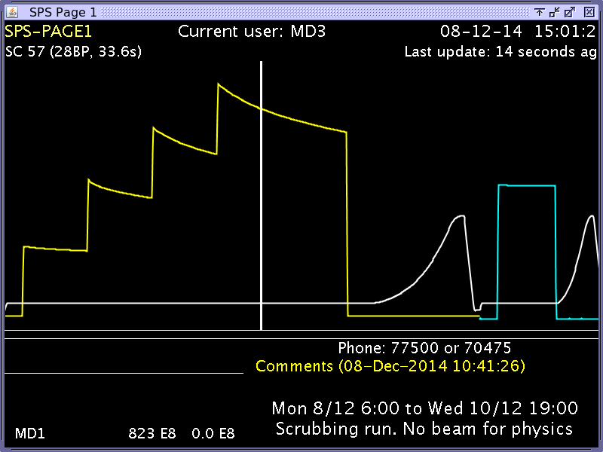
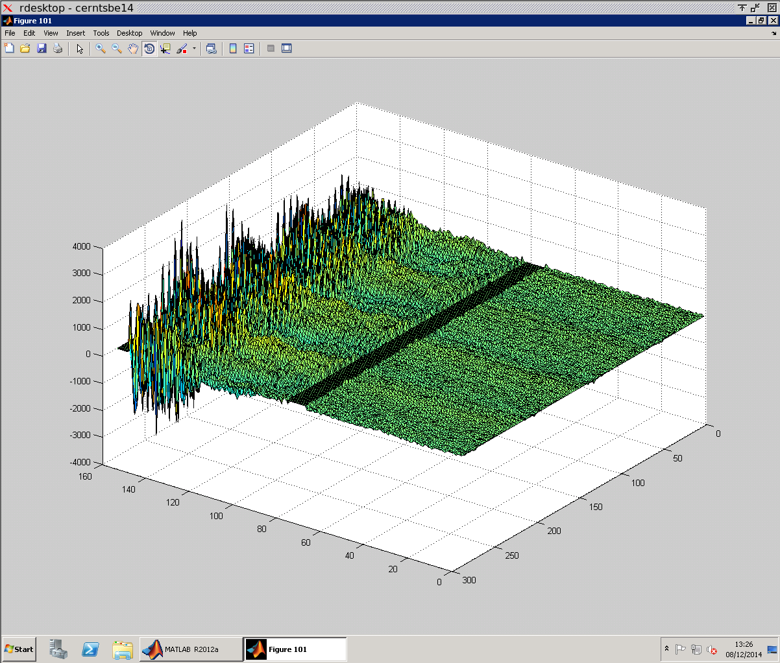
Monday: High intensity LHC beams
Up to 1.9e11 p/b injected into the SPS
Poor lifetime, instabilities at tail of batches, emittance growth

Slide 4
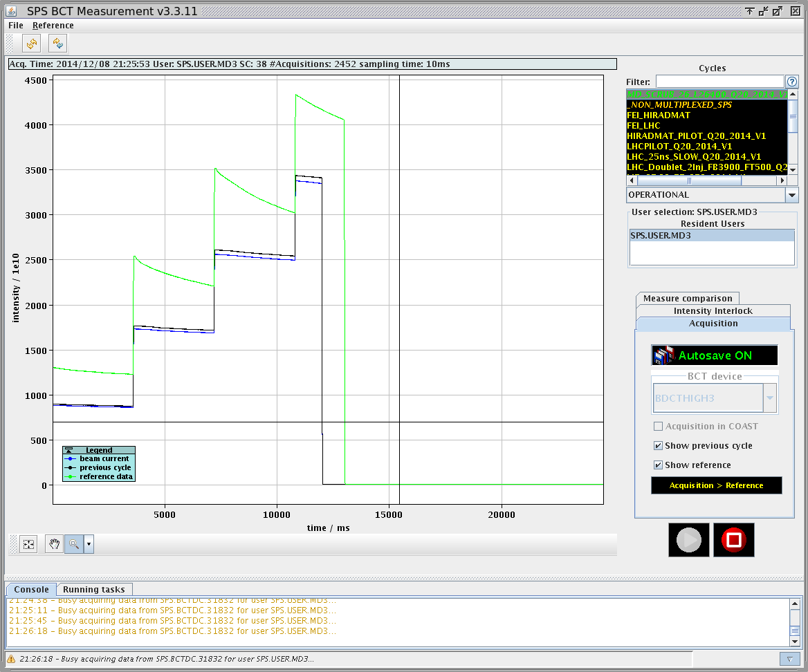
Monday: from high intensity LHC beams back to nominal

Slide 5
Scrubbing run in week 50: overview
days
MD3: 26.4 s, 26 GeV/c
LHCMD4: 31s, slow ramp to 450 GeV/c: doublet
LHC25NS: 22.8s, 450 GeV/c: doublet
Tuesday
Long acceleration cycle (firs setup with 12 bunches)
Doublet beam (up to 1.9e11 p/b injected)
Instabilities on the slow ramp
Losses on flat bottom and beginning of ramp, increasing significantly with the amount of beam injected
Doublets also on cycle with standard ramp in parallel
Intensity on flat top similar in both cases, maximum of about 1.4e11 p/doublet
RF problems in PS during the night

Slide 6
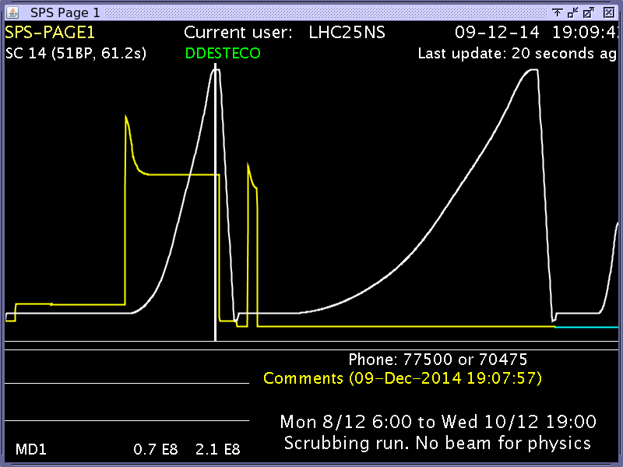
Tuesday: attempt to accelerate doublet on slow and nominal ramp

Slide 7
Scrubbing run in week 50: overview
days
MD3: 26.4 s, 26 GeV/c
LHCMD4: 31s, slow ramp to 450 GeV/c
LHC25NS: 22.8s, 450 GeV/c
8b+4e
BCMS
LHC25NS: 22.8s, 450 GeV/c
MD3: 26.4 s, 26 GeV/c
High intensity 25 ns beam
Wednesday
Scrubbing with high intensity standard beam on flat bottom cycle
8b+4e beam on LHC cycle (1.6e11 p/b injected, 1.4e11 p/b at flat top)
Well behaved electron cloud-wise (as predicted)
Pressure spike on ZS (impedance?)
BCMS in good shape (1.35e11 p/b injected, 1.15e11 p/b at flat top), but still large losses at beginning of ramp

Slide 8
Scrubbing run in week 50: overview on pressure behaviour on an arc gauge (not a-C coated)

Slide 9
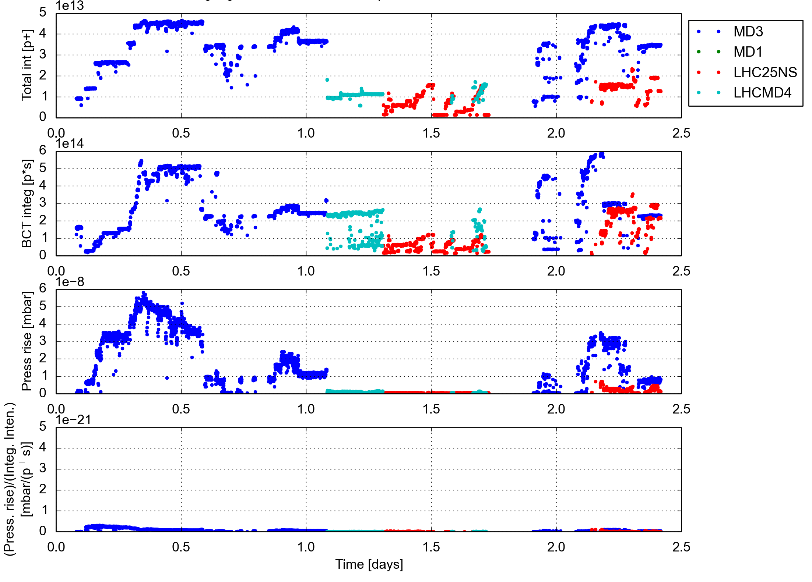
Scrubbing run in week 50: overview on pressure behaviour on an arc gauge (a-C coated)

Slide 10
Summary
High intensity LHC beam (4 batches 72b) at 26 GeV/c
Strong electron cloud effects
Poor lifetime, emittance blow up at the tails of the batches
Coherent instabilities contributing to the blow up (not suppressed by transverse damper and/or high chromaticity)
Doublet beam accelerated to 450 GeV/c
Many transverse instabilities observed on the slow ramp
Maximum intensity at flat top 1.3e11 p/doublet both on slow and nominal LHC filling ramp
Beam quality strongly degraded (emittance blow up)
Other LHC beam variants tested
8b+4e well behaved in terms of electron cloud (as expected), but sparking and outgassing on ZS (impedance problem?), up to three batches accelerated to 450 GeV/c
BCMS in good shape, less electron cloud thanks to shorter batches, up to three batches accelerated to 450 GeV/c
For both cases, quite large losses at start of the ramp
In general, more scrubbing accumulated, but much more still needed to allow stable operation at higher bunch intensities….

Slide 11
Thank you for your attention!

