Slide 1
Update on the Reduction of the SPS Vacuum Flanges Impedance
Jose E. Varela
With input from J.A Ferreira and E. Montesinos.

Slide 2
Outline
Introduction
The SPS Vacuum Flanges
Impedance Reduction Alternatives
Partial Shielding + Damping
The Wire Array
The Sheet Shield
Flange Redesign
Conclusions

Slide 3
The SPS Vacuum Flanges
The longitudinal impedance of the SPS vacuum flanges has been calculated and measured during the last year.
Initial considerations on how to reduce the impedance of these elements were presented in the last LIU-SPS BD WG meeting.
The different possibilities considered previously have been narrowed down to the two most promising ones.
Some initial discussions have been held with Jose A. Ferreira and E. Montesinos to start accounting for mechanical/vacuum restrictions and look into possible implementations.

Slide 4
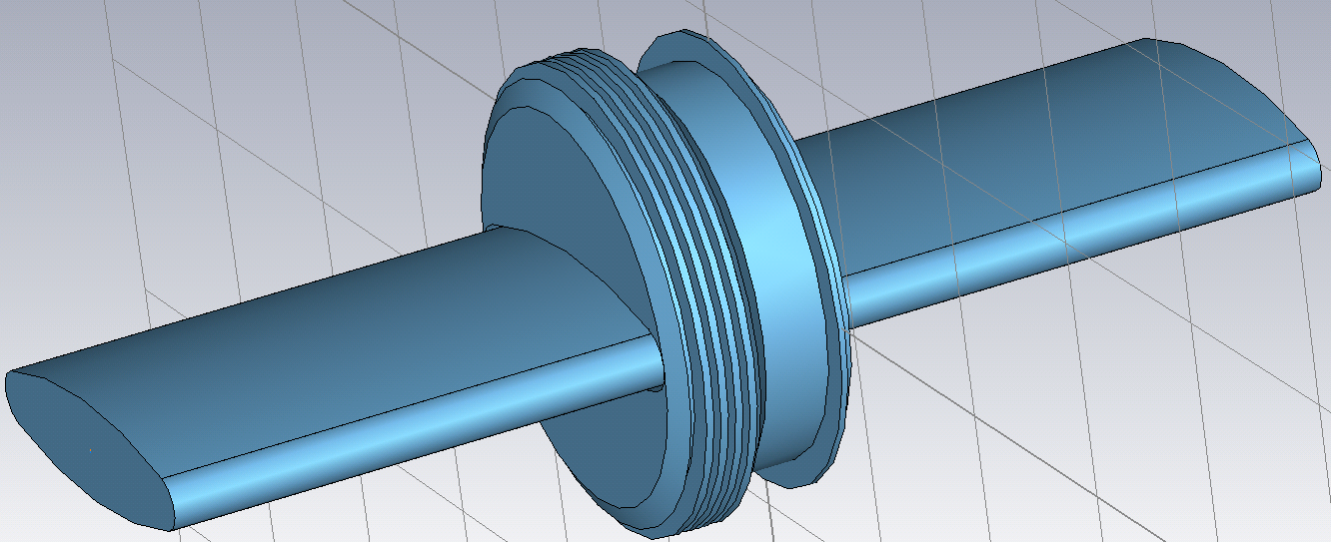
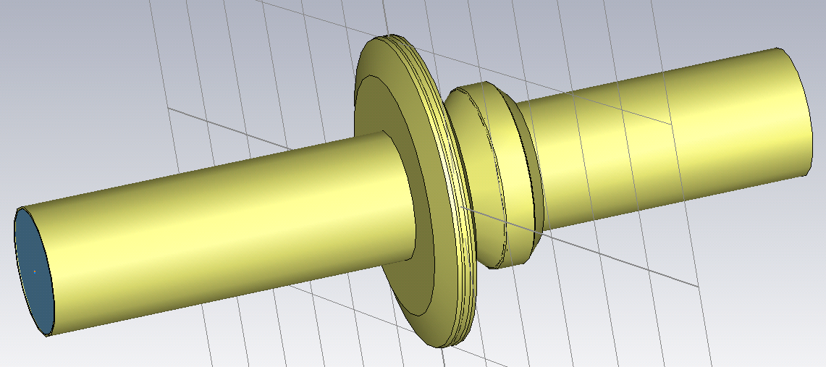
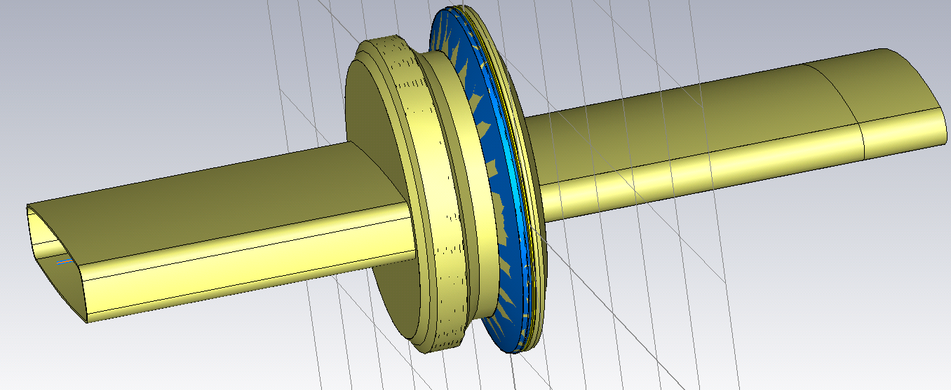
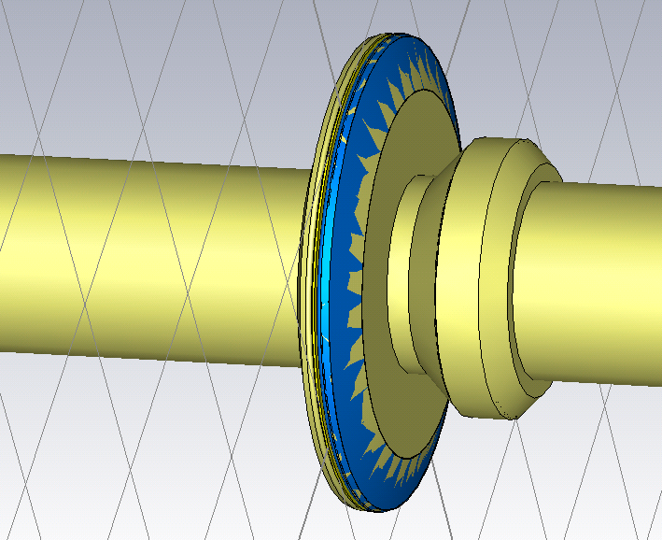
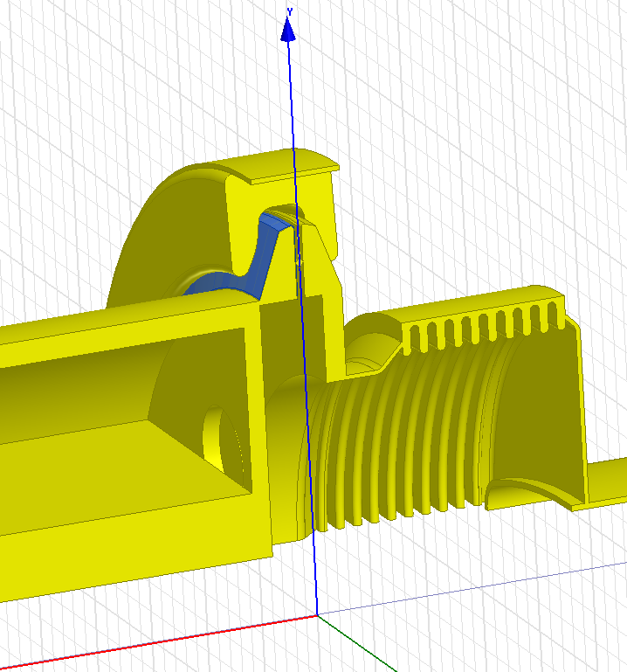
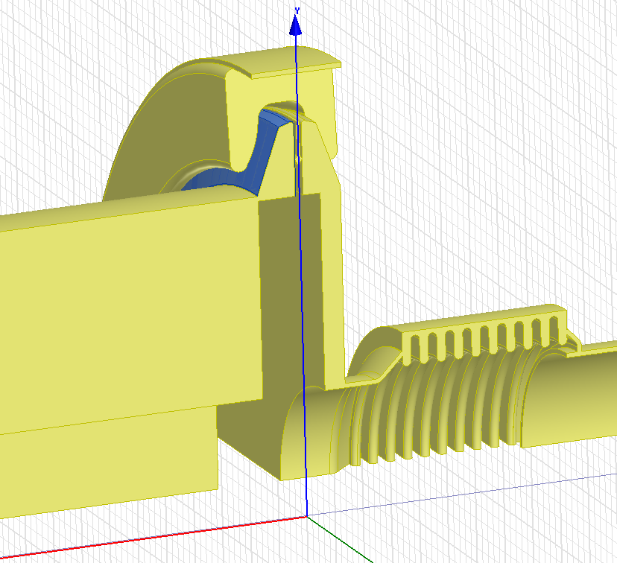
The SPS Vacuum Flanges
Reminder!
It is important to differentiate between the different flange types.

Slide 5
The SPS Vacuum Flanges
Group I
Non-enamelled QF – QF
≈26
Enamelled QF - MBA
≈ 97
Non-Shielded, enamelled BPH - QF
≈ 39 + 62
Total > 162 + 62

Slide 6
The SPS Vacuum Flanges
Group II
Non-enamelled QD-QD
≈75
Enamelled QD-QD
≈ 99
Enamelled BPV - QD
≈ 90
Total > 265

Slide 7
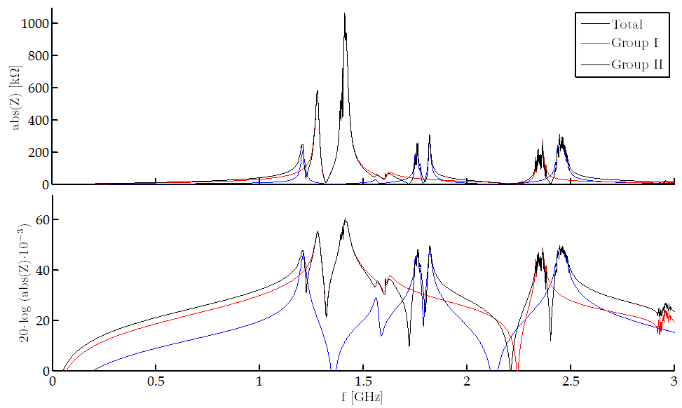
The SPS Vacuum Flanges
Longitudinal Impedance of the SPS Vacuum Flanges – Scattered Resonance Version

Slide 8
Outline
Introduction
The SPS Vacuum Flanges
Impedance Reduction Alternatives
Partial Shielding + Damping
The Wire Array
The Sheet Shield
Flange Redesign
Conclusions

Slide 9
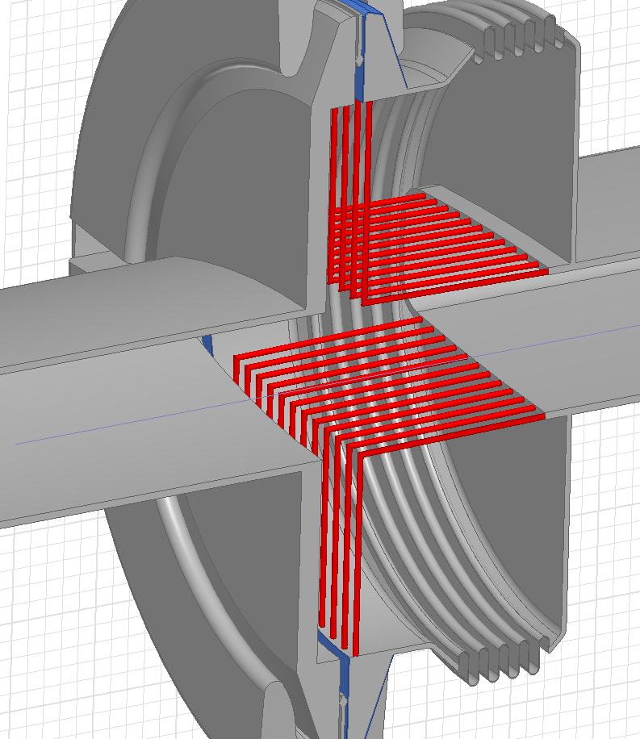
Partial Shielding + Damping (I)
An array of longitudinal wires or a thin metallic sheet can significantly reduce the R/Q of a longitudinal resonance without restricting the bellows functionality.
This solution would not short-circuit the enamel.
Wire number & thickness can be optimized.
Covering the gap on the left plays an important role.
Conceptual
Drawings
For further impedance reduction, the remaining space can be used for damping.

Slide 10
Outline
Introduction
The SPS Vacuum Flanges
Impedance Reduction Alternatives
Partial Shielding + Damping
The Wire Array
The Sheet Shield
Flange Redesign
Conclusions

Slide 11
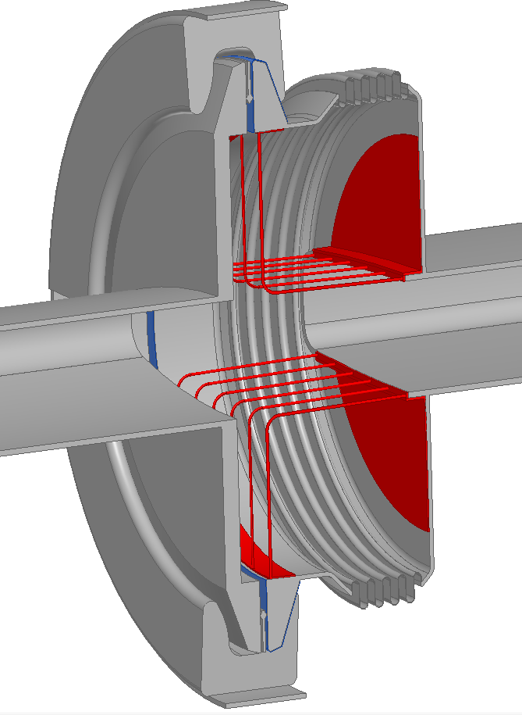
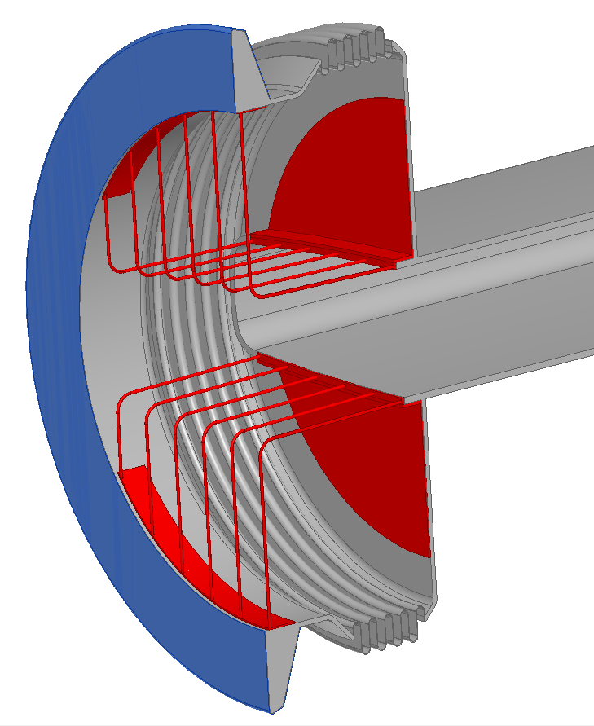
The Wire Shield (I)
An array of longitudinal can significantly reduce the R/Q of a longitudinal resonance without restricting the bellows functionality.
The ‘Wire Shield’ (highlighted in red) structure could be spot welded in 4 + 4 points to the current flange walls.
Possible
Implementation
Spot Welding Points

Slide 12
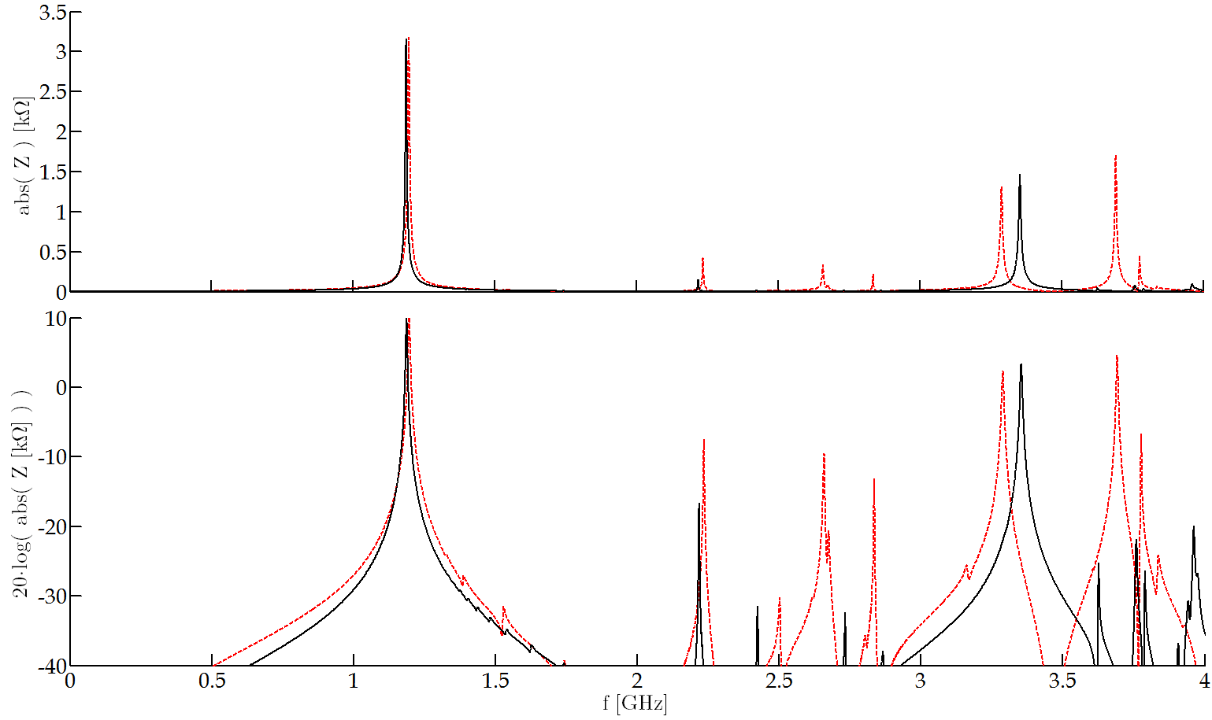
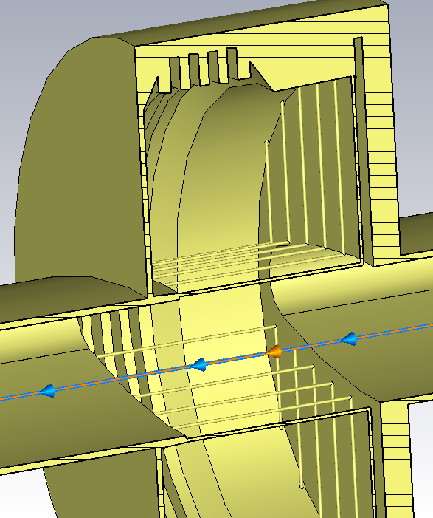
The Wire Shield (II)
An array of longitudinal wires can significantly reduce the R/Q of a longitudinal resonance without restricting the bellows functionality.
Comparison between the longitudinal impedance of an 11 and 27 wire shields.
 | f [GHz] | Z [kΩ] | Q | R/Q [Ω]
Reference* | 1.4 | 144 | 1800 | 80
11 Wire Shield | 1.2 | 3.2 | 225 | 14
27 Wire Shield | 1.2 | 3.2 | 285 | 11
Factor ≈ 5 – 8 reduction in R/Q
* Impedance of a QF-QF closed vacuum flange without damping resistor.
Red – 11 Wires
Black – 27 Wires
The gap was filled
in both cases

Slide 13
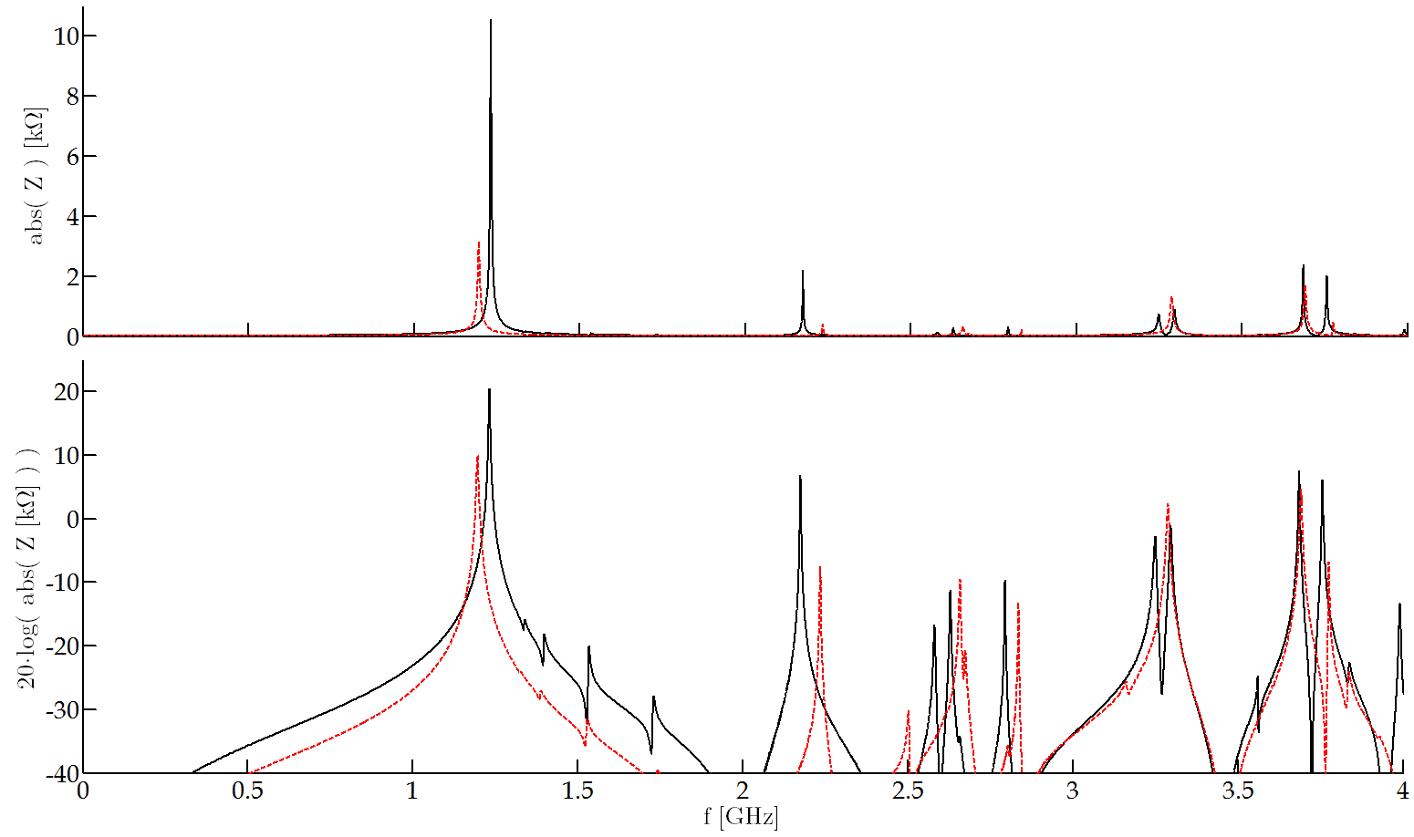
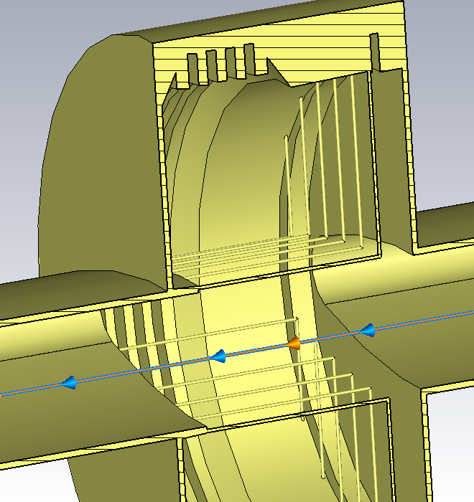
The Wire Shield (III)
An array of longitudinal wires or a thin metallic sheet can significantly reduce the R/Q of a longitudinal resonance without restricting the bellows functionality.
Comparison between the longitudinal impedance of two 11 wire shields, with and without gap
 | f [GHz] | Z [kΩ] | Q | R/Q [Ω]
Reference* | 1.4 | 144 | 1800 | 80
11 Wires: Filled Gap | 1.2 | 3.2 | 225 | 14
11 Wires: Unfilled Gap | 1.2 | 10.6 | 410 | 26
Filling the gap reduces the R/Q factor ≈2
* Impedance of a QF-QF closed vacuum flange without damping resistor.
Red – Filled Gap
Black – Unfilled Gap

Slide 14
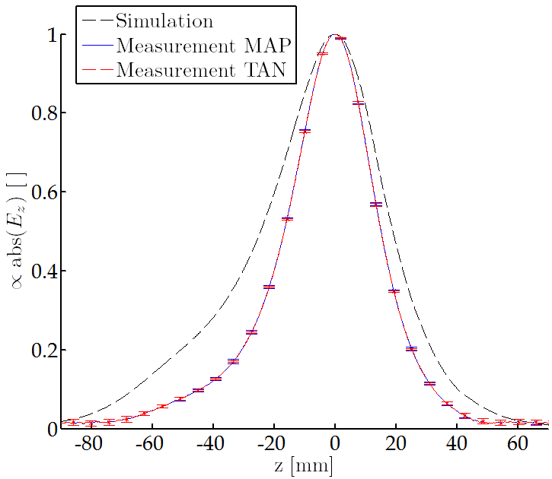
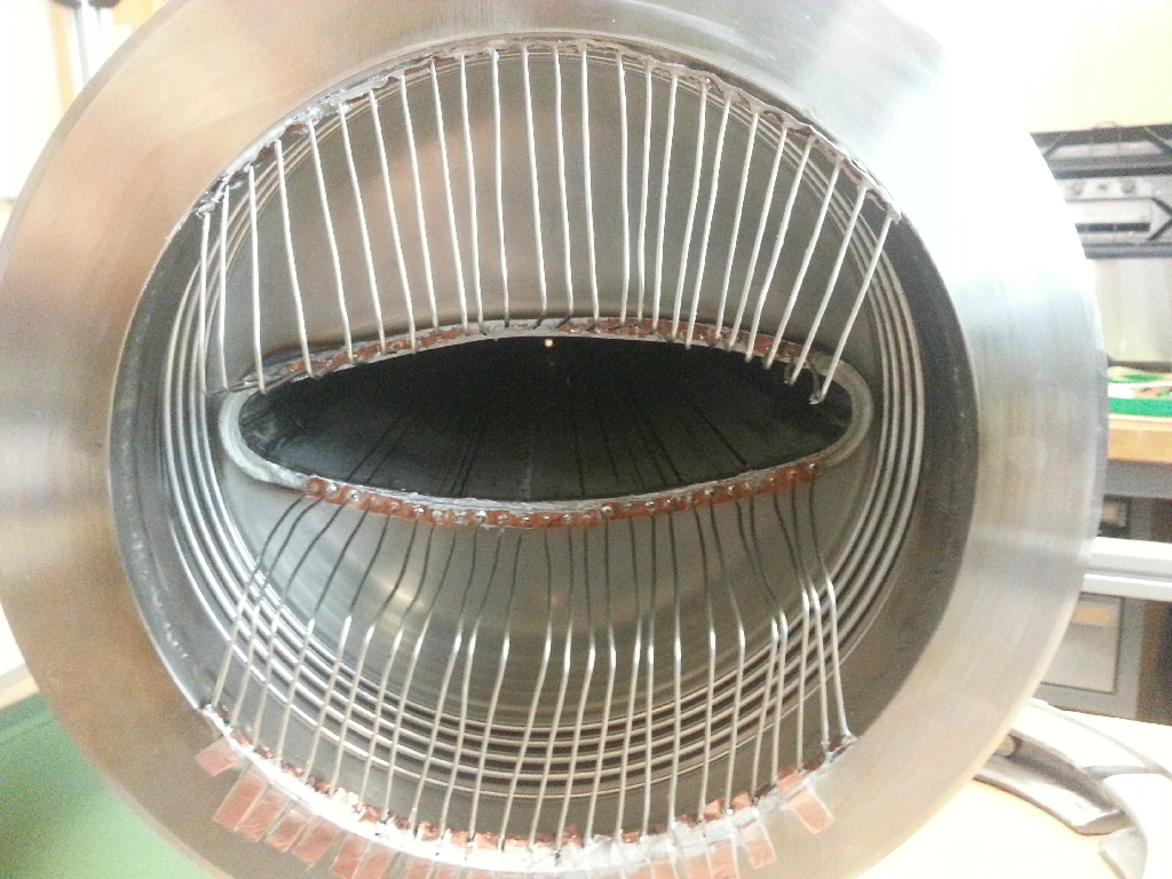
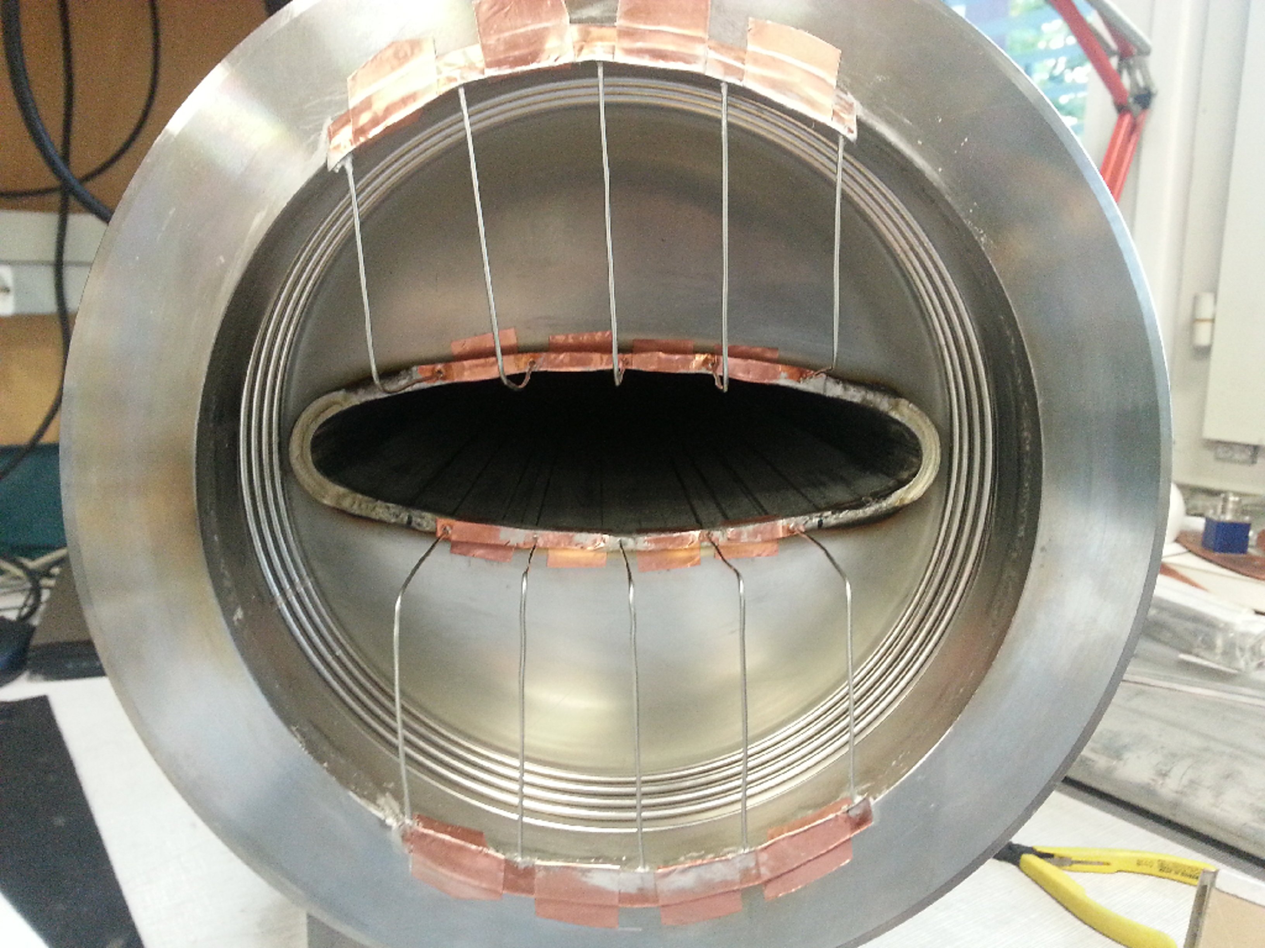
The Wire Shield (IV)
An array of longitudinal wires can significantly reduce the R/Q of a longitudinal resonance without restricting the bellows functionality.
Bead-pull measurements of a 5 wire ‘bricolage’ shield.
 | f [GHz] | Z [kΩ] | Q | R/Q [Ω]
Simulation | 1.2 | 10 | 346 | 29
Measurement | 1.2 | >4 | >187 | 21
The bricolage shield left a narrower gap

Slide 15
Outline
Introduction
The SPS Vacuum Flanges
Impedance Reduction Alternatives
Partial Shielding + Damping
The Wire Array
The Sheet Shield
Flange Redesign
Conclusions

Slide 16
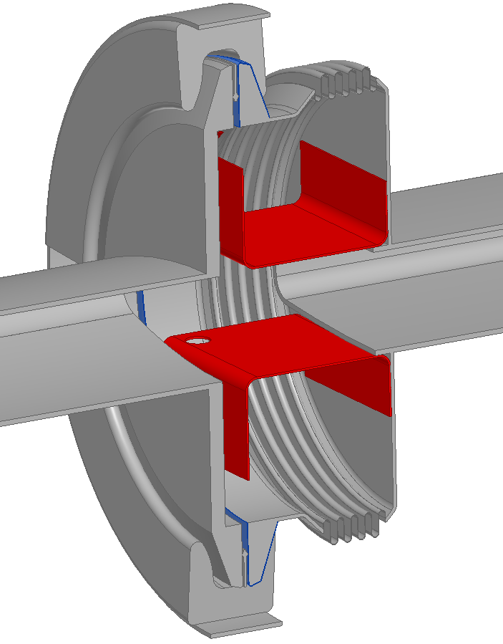
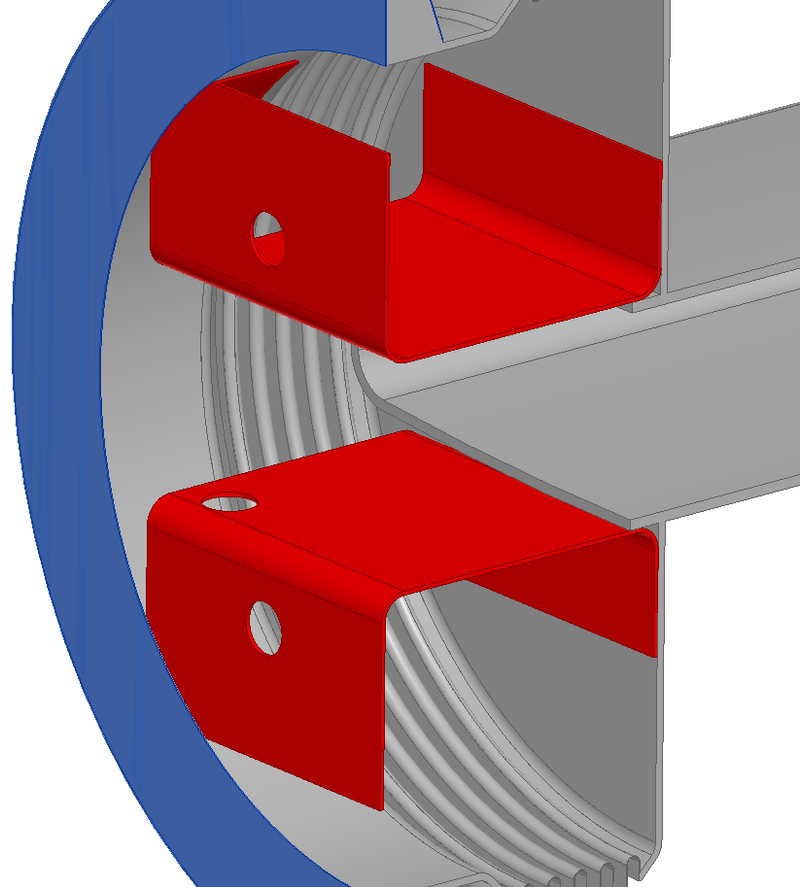
The Sheet Shield (I)
A thin metallic sheet can significantly reduce the R/Q of a longitudinal resonance without restricting the bellows functionality.
The ‘Sheet Shield’ (highlighted in red) structure could be spot welded in 4 + 4 points to the current flange walls.
The holes for the spot welding gun could be bigger or with a different shape if needed.
Spot Welding Points
Conceptual
Drawings
Holes for the spot welding gun

Slide 17
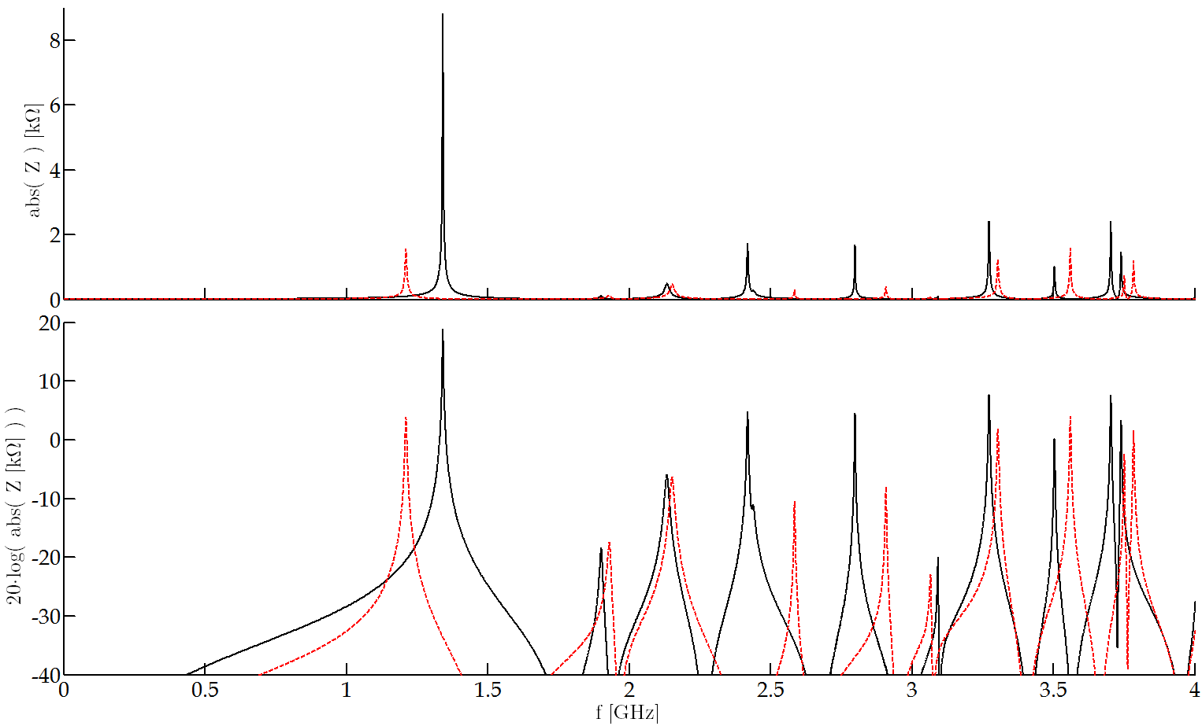
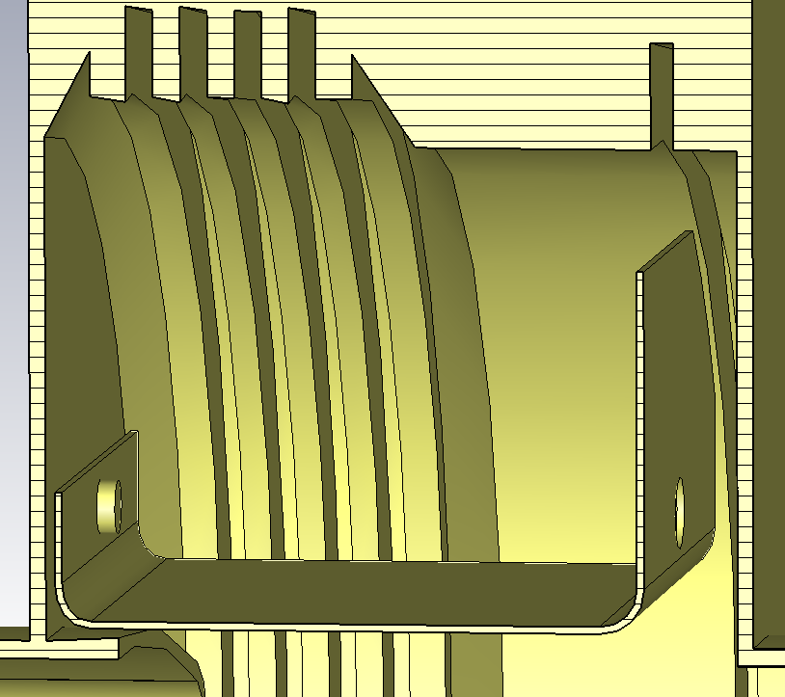
The Sheet Shield (II)
A thin metallic sheet can significantly reduce the R/Q of a longitudinal resonance without restricting the bellows functionality.
Comparison between the longitudinal impedance of two sheet shields, with and without gap.
 | f [GHz] | Z [kΩ] | Q | R/Q [Ω]
Reference* | 1.4 | 144 | 1800 | 80
Sheet Shield: Filled Gap | 1.2 | 1.5 | 245 | 6
Sheet Shield: Unfilled Gap | 1.3 | 9 | 525 | 16
Filling the gap reduces the R/Q factor ≈2.5
Factor ≈ 5 – 12 reduction in R/Q
* Impedance of a QF-QF closed vacuum flange without damping resistor.
Initial
Imperfection Assessment

Slide 18
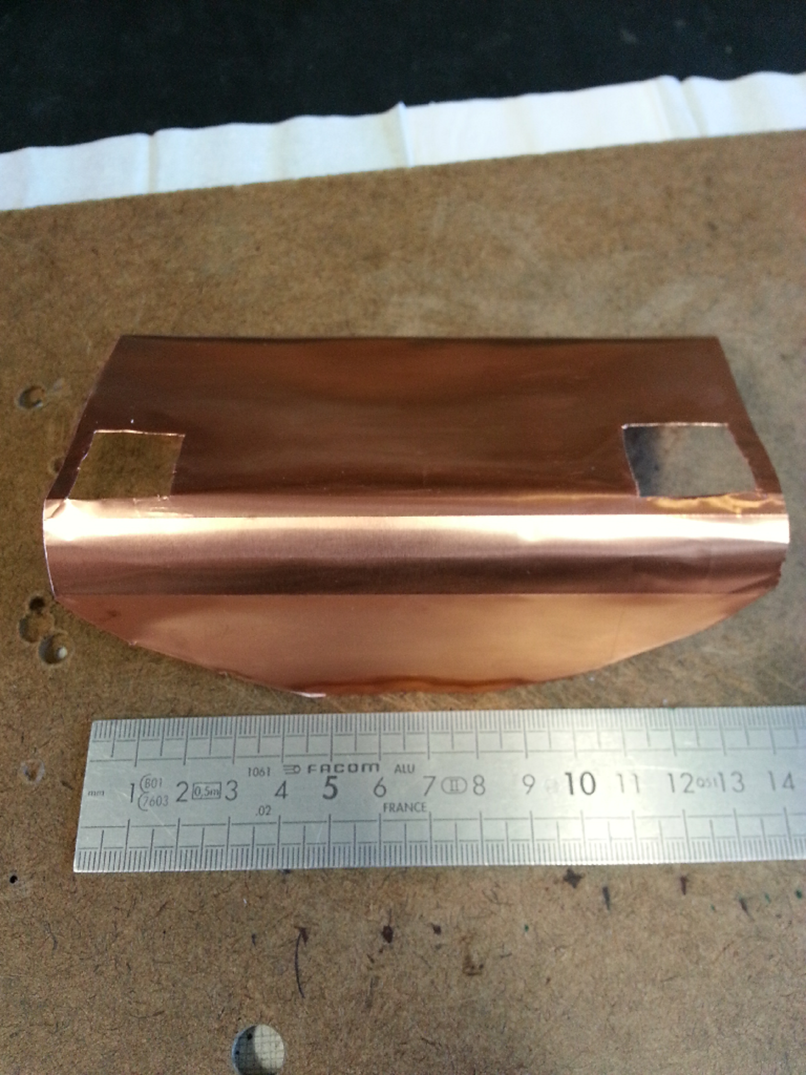
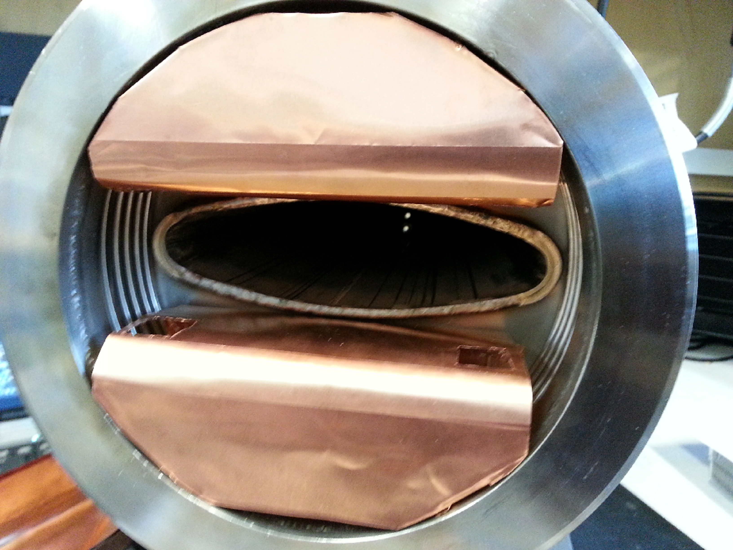
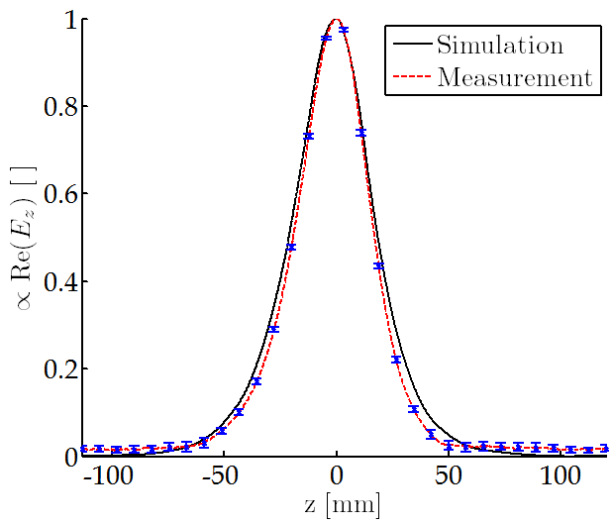
The Sheet Shield (III)
An array of longitudinal wires can significantly reduce the R/Q of a longitudinal resonance without restricting the bellows functionality.
Bead-pull measurements of a ‘bricolage’ sheet shield.
 | f [GHz] | Z [kΩ] | Q | R/Q [Ω]
Measurement | 1.4 | >0.7 | >55 | 13.3
Simulation Wake | 1.3 | 9 | 525 | 16
Simulation Eigenmode | 1.3 | 8.6 | 510 | 17
The bricolage shield left a narrower gap

Slide 19
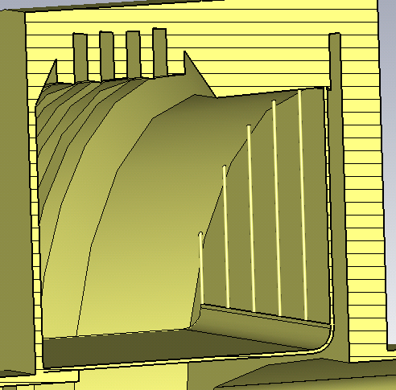
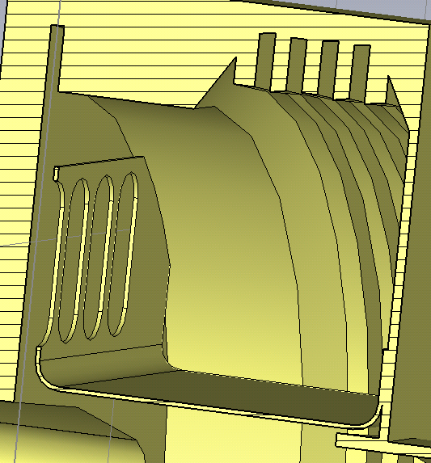
The Combos
Any combination of sheet and wires/holes should give similar R/Q reduction.
Some of these combinations have already been simulated.
These two examples make the shield installation easier without sacrificing too much R/Q reduction.

Slide 20
Outline
Introduction
The SPS Vacuum Flanges
Impedance Reduction Alternatives
Partial Shielding + Damping
The Wire Array
The Sheet Shield
Flange Redesign
Conclusions

Slide 21
Partial Shielding + Damping (II)
I.- The goal of the partial shielding is to reduce the R/Q.
 | f [GHz] | Z [kΩ] | Q | R/Q [Ω]
Reference* | 1.4 | 144 | 1800 | 80
Wire Array | 1.2 | 3.2 | 285 | 11
Metallic Sheet | 1.2 | 1.5 | 245 | 6
* Impedance of a QF-QF closed vacuum flange without damping resistor.
The array of metallic wires and the thin metallic sheet are ‘equivalent’ from a longitudinal mode point of view.
A factor ≈ 8-12 reduction in the R/Q can be achieved with the proposed configuration.
Both alternatives intrinsically lower the Q some extend (factor ≈6) due to the additional losses.
II.- Once the R/Q has been reduced, additional damping can be introduced to push the impedance further down.
Using current damping resistors, the resulting Q should be lower than 100.

Slide 22
Partial Shielding + Damping (III)
A first look at the mechanical aspects including installation difficulties:
The Wire Array:
Probably, the best way to fabricate/build it would be 3D metallic printing.
Could cause outgassing problems – To be assessed
The other building alternatives would be, in principle, more expensive but also possible.
The cost would highly depend on the number of wires (trade-off).
Installation via spot welds.
The Thin Metallic Sheet:
In principle, a very cheap solution in terms of manufacturing ( proposed by E. Montesinos ).
Metallic Sheet
0.15 - 0.2mm thick Stainless Steel
Copper sheet as in the bricolage setup ( fixed with a spot welded screw )
Stamp
Shield Bending
Could give rise to higher impedance if certain parts are not in good contact.
Initial study show additional high frequency modes (>2GHz).
Installation via spot welds.
Additional studies concerning induced currents in the shields, heating, how to ensure that the shield won’t go into the aperture, installation difficulties… will be needed.

Slide 23
Partial Shielding + Damping (IV)
Very Rough estimation of cost/time:
Number of flanges to act upon: ≈165 – 200 (only Short Straight Sections considered)
Maybe something could be done with flanges of group II.
Cost:
The wire array: Unknown (depends on many different things)
The thin metallic sheet: Very cheap.
For the installation:
A team of two people would be needed
+ Moving all the BPHs
+ Moving other stuff in the SSSs.
Time
1 day/flange
≈ 15-30 weeks
Two people 15 – 30 weeks ≈ 75 kCHF – 150 kCHF
Possible synergies with other projects to reduce cost?
The SPS tunnel will be very busy during LS2 (cavity rearrangement, etc…) could cause difficulties.

Slide 24
Outline
Introduction
The SPS Vacuum Flanges
Impedance Reduction Alternatives
Partial Shielding + Damping
The Wire Array
The Sheet Shield
Flange Redesign
Conclusions

Slide 25
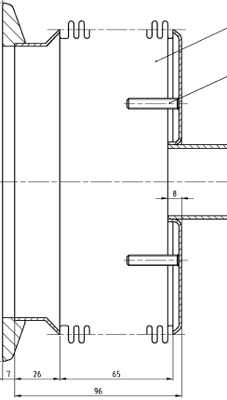
Flange Redesign (I)
This solution minimizes the impedance and is enamel compatible.
Its cost is, on the other hand, the highest.
From the impedance point of view it is clear what to do. Mechanical restrictions/difficulties have to be consider.
Schematically, one would expect to have something like:
Flanges without gap
MBA / QF Bellows
Conceptual
Drawings

Slide 26
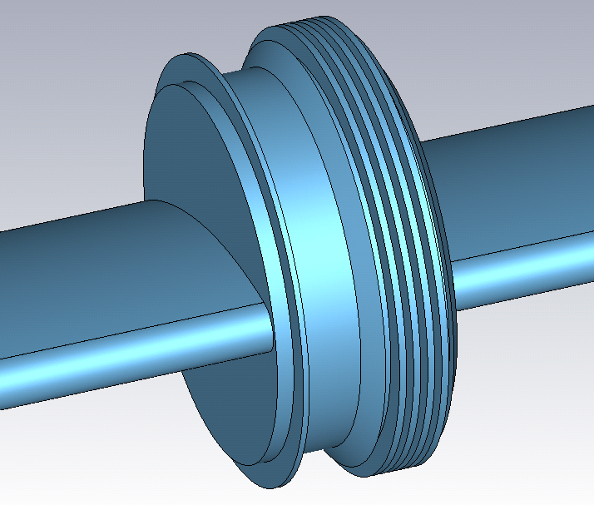
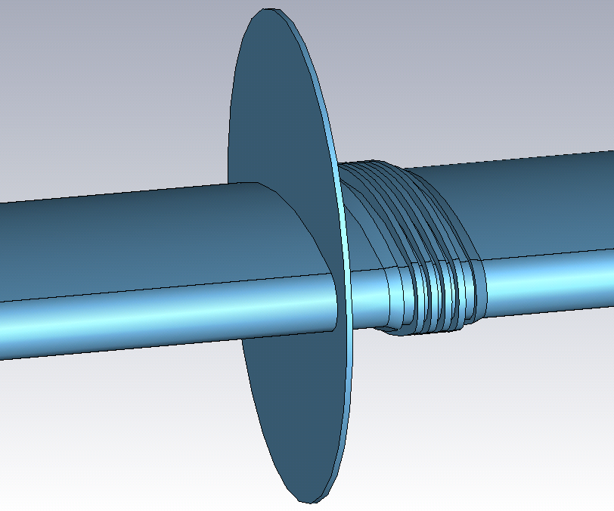
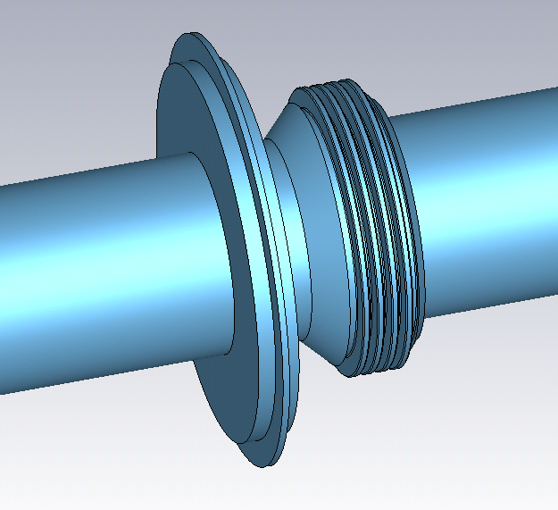
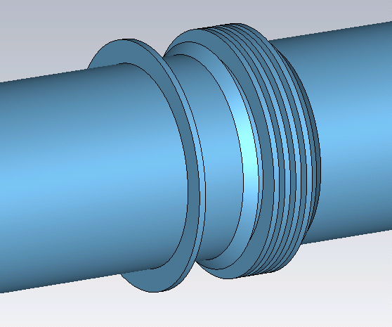
Flange Redesign (II)
This solution minimizes the impedance and is enamel compatible.
Its cost is, on the other hand, the highest.
From the impedance point of view it is clear what to do.

Slide 27
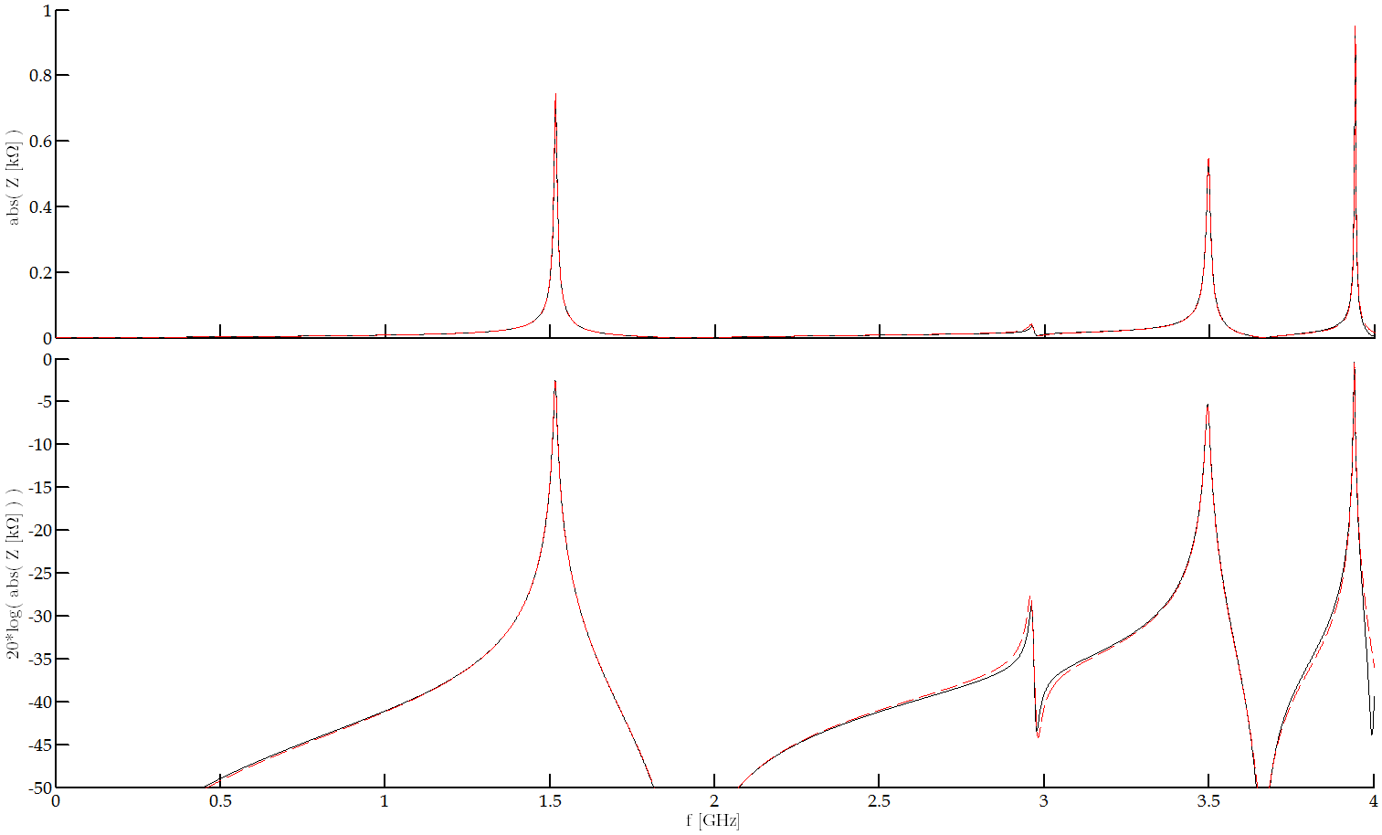
Flange Redesign (III)
 | f [GHz] | Z [kΩ] | Q | R/Q [Ω]
Reference* | 1.4 | 144 | 1800 | 80
Wire Array | 1.2 | 3.2 | 285 | 11
Metallic Sheet | 1.2 | 1.5 | 245 | 6
Redesign | 1.5 | 0.75 | 185 | 4
Redesign of a QF-QF closed flange.
Gap filling and QF bellows.
* Impedance of a QF-QF closed vacuum flange without damping resistor.
Tweaking the vacuum seal would reduce the impedance further
Of course, impedance-wise, this is the best solution.
The modes could be further damped (not straight forward).

Slide 28
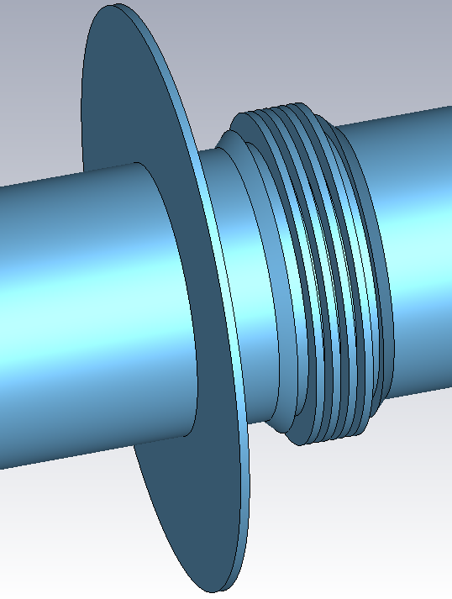
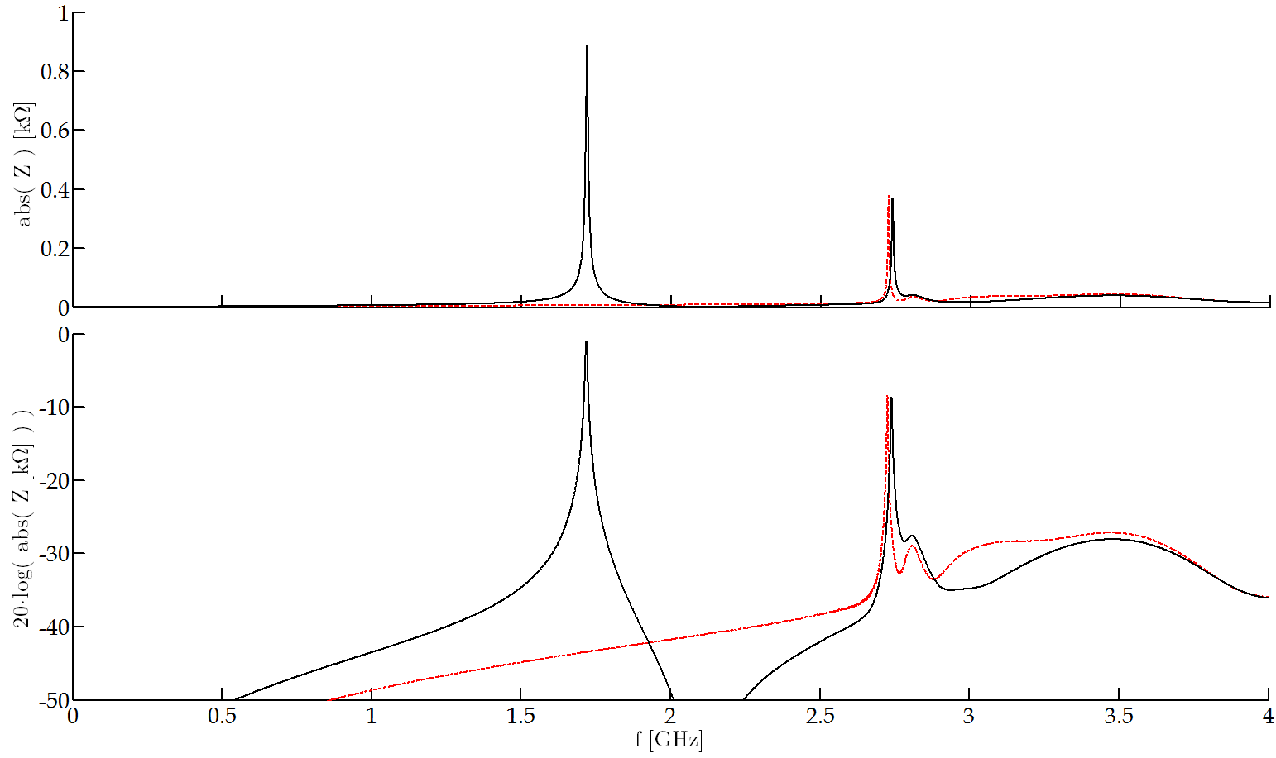
Flange Redesign (IV)
Redesign of a QD-QD closed flange.
Gap filling and QD bellows redesign.
New QD bellows
Current Impedance for this type of flange
Tweaking the vacuum seal or producing smaller clamps would reduce the impedance further
f [GHz] | Z [kΩ] | Q | R/Q [Ω]
1.76 | 18.7 | 1050 | 18
2.45 | 17.2 | 1415 | 12

Slide 29
Flange Redesign (V)
Very Rough estimation of cost/time:
Number of flanges to act upon: ≈425 – 550 (only Short Straight Sections considered)
Considering both flange groups.
Cost:
≈ 4 – 6 kCHF per position.
425 - 550 flanges ≈ 1.5 - 3 MCHF (should be lower for a big order)
For the installation:
A team of three people would be needed
+ Removing all the BPMs (cutting and welding new flange)
Transport issues could arise
+ Changing the pipe of Sextupoles/Octupoles.
Cutting and welding in rad workshop ( could be arranged temporarily in the tunnel )
Time
≈ 15-30 weeks
With harmonic workflow 4 day/flange
2 days per Sextupole / Octupole
Three people 15 – 30 weeks ≈ 110 kCHF – 225 kCHF
Possible synergies with other projects to reduce cost?
The SPS tunnel will be very busy during LS2 (cavity rearrangement, etc…) could cause difficulties.

Slide 30
Outline
Introduction
The SPS Vacuum Flanges
Impedance Reduction Alternatives
Partial Shielding + Damping
The Wire Array
The Sheet Shield
Flange Redesign
Conclusions

Slide 31
Conclusions
Two main possibilities studied:
Partial shielding:
R/Q reduction factor 8-12 could be achieved.
Cost of shield production is unknown
Different possible implementations.
Only ‘half’ of the flanges (≈200) could be acted upon.
15 - 30 weeks of work
Order of magnitude cost: 250 kCHF
Flange Redesign:
Minimum impedance. R/Q reduction factor 20.
Cost per flange 4 – 6 kCHF
All flanges could be changed (≈550).
15 – 30 weeks of work
Order of magnitude cost: 1.5 - 3 MCHF
We already have elliptical bellows in the PS
Final solution to the problem
Both options pose logistic problems as the SPS tunnel will be very busy during LS2.
Many thanks to J.A. Ferreira and E. Montesinos.

