Slide 1
Ways to Reduce the Impedance of the SPS Vacuum Flanges
Jose E. Varela
With input from Fritz Caspers.

Slide 2
Outline
Introduction
The SPS Vacuum Flanges
Impedance Reduction Alternatives
Damping
Shielding
Shielding + Damping
Flange Redesign
Conclusions

Slide 3
The SPS Vacuum Flanges
The longitudinal impedance of the SPS vacuum flanges has been calculated and measured during the last year.
The main contributors were identified and their impedance between 1 and 2GHz was characterized.
Recently, the focus has been put in computing the ‘broad-band’ impedance model. This process is still undergoing.
Today’s presentation will focus on the different possible alternatives to reduce the longitudinal impedance of the SPS vacuum flanges.

Slide 4
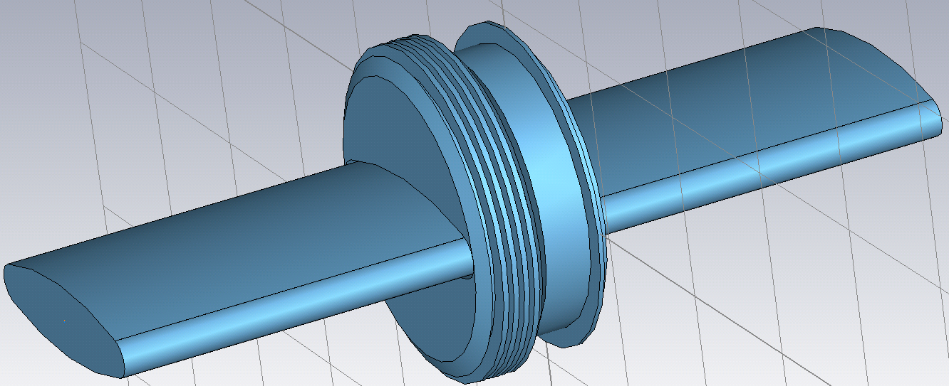
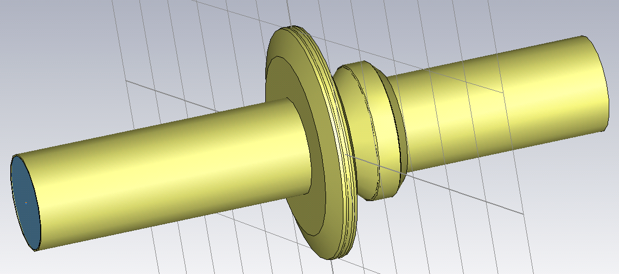
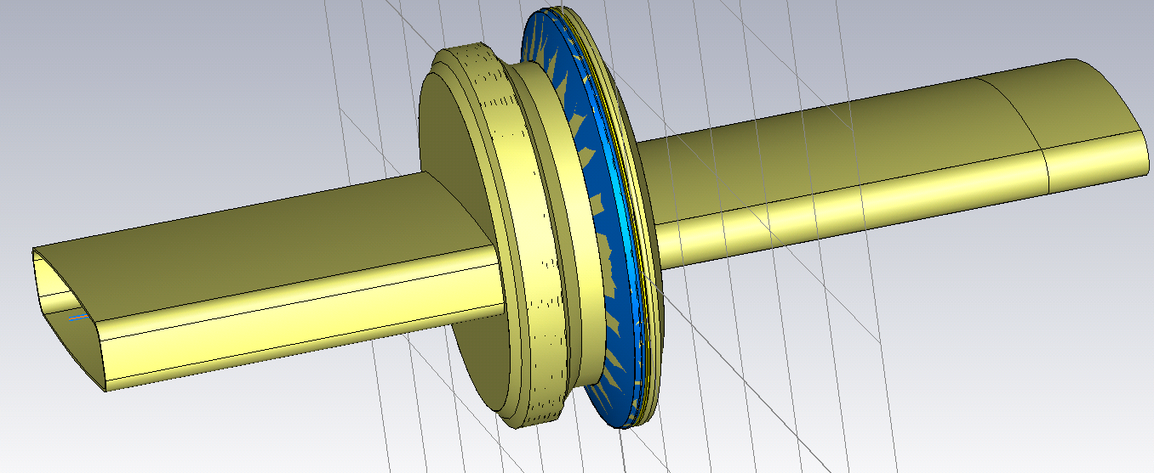
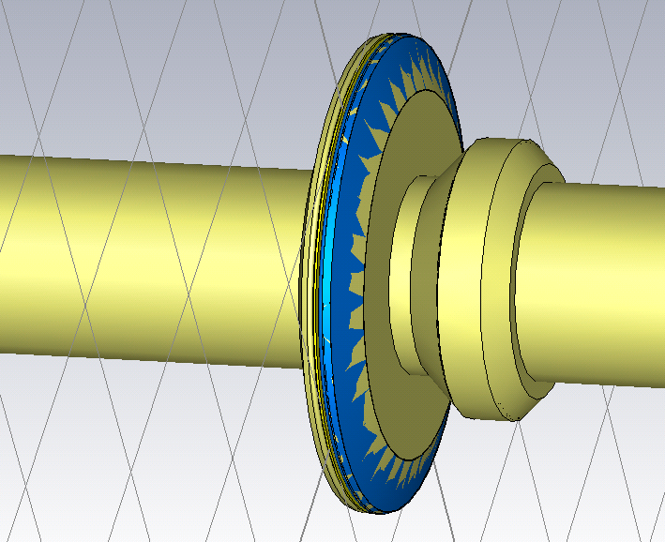
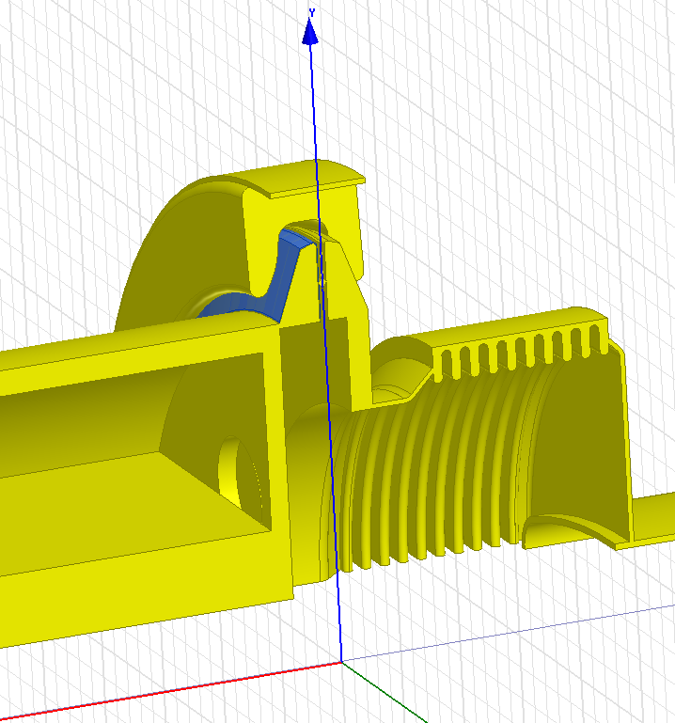
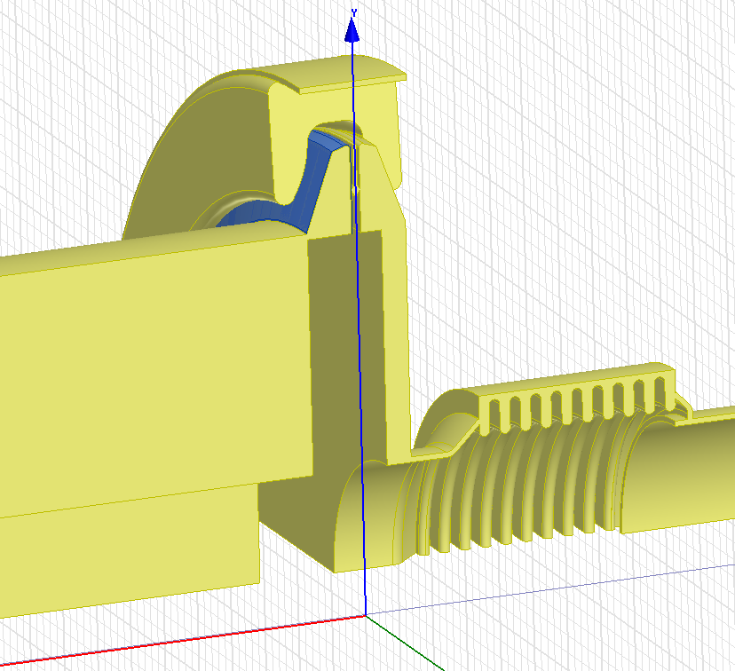
The SPS Vacuum Flanges
It is important to differentiate between the different flange types.

Slide 5
The SPS Vacuum Flanges
Group I
Non-enamelled QF – QF
≈26
Enamelled QF - MBA
≈ 97
Non-Shielded, enamelled BPH - QF
≈ 39

Slide 6
The SPS Vacuum Flanges
Group II
Non-enamelled QD-QD
≈75
Enamelled QD-QD
≈ 99
Enamelled BPV - QD
≈ 90

Slide 7
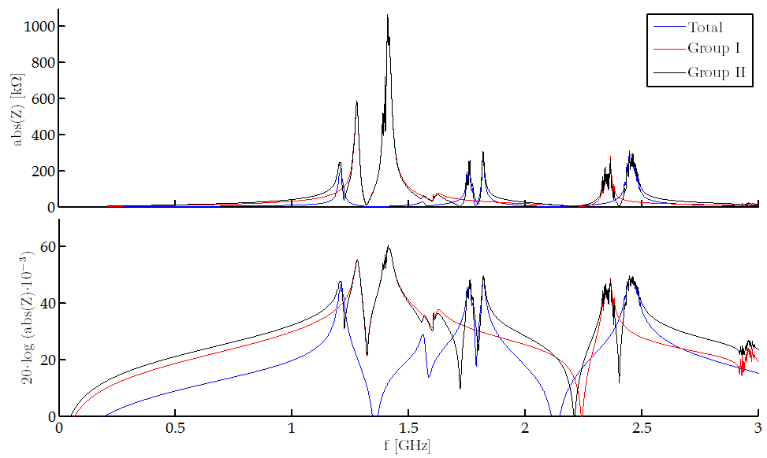
The SPS Vacuum Flanges
Scattered Resonance Model

Slide 8
Outline
Introduction
The SPS Vacuum Flanges
Impedance Reduction Alternatives
Damping
Shielding
Shielding + Damping
Flange Redesign
Conclusions

Slide 9
Impedance Reduction Alternatives
Depending on the impedance reduction strategy, some pros and cons arise.
DAMPING:
Damping the Qs below 20 is a challenging task that will require a lot of RF optimization.
Group I:
Several strategies possible.
Group II:
Completely different solution needed.
Some modes will be very difficult/not possible to damp due to aperture restrictions.
SHIELDING:
Probably, very challenging from a mechanical point of view. A very robust design is needed.
Group I:
It is possible to minimize the impedance.
Misplaced shields can introduce additional impedance at lower frequencies (as we just saw).
Group II:
Completely different solution needed
Some modes will be very difficult/not possible to shield.
FLANGE REDESIGN:
The most expensive possibility.
Impedance can be minimized.

Slide 10
Outline
Introduction
The SPS Vacuum Flanges
Impedance Reduction Alternatives
Damping
Shielding
Shielding + Damping
Flange Redesign
Conclusions

Slide 11
Damping
As aforementioned, flanges belonging to groups I and II have to be treated differently. We will focus only on the first group, i.e. the one responsible for the 1.4GHz impedance.
It has to be noted that depending on the type of flange (and the presence of damping resistor inside) the 1.4GHz resonance has a Q of 75, 200 or 1320.
The objective is to damp the Q below 20.
There are several possible strategies to damp the 1.4GHz resonance:
Redesign the damping resistors
Continue to use the damping resistors and add an additional loss mechanism.
Use a mode coupler.
Any combination of the above…
All the different alternatives require an optimization effort that takes time.
Trade-offs have to be assessed carefully:
The above options can damp the 1.4GHz mode, but will often give rise to other modes that we don’t have now.

Slide 12
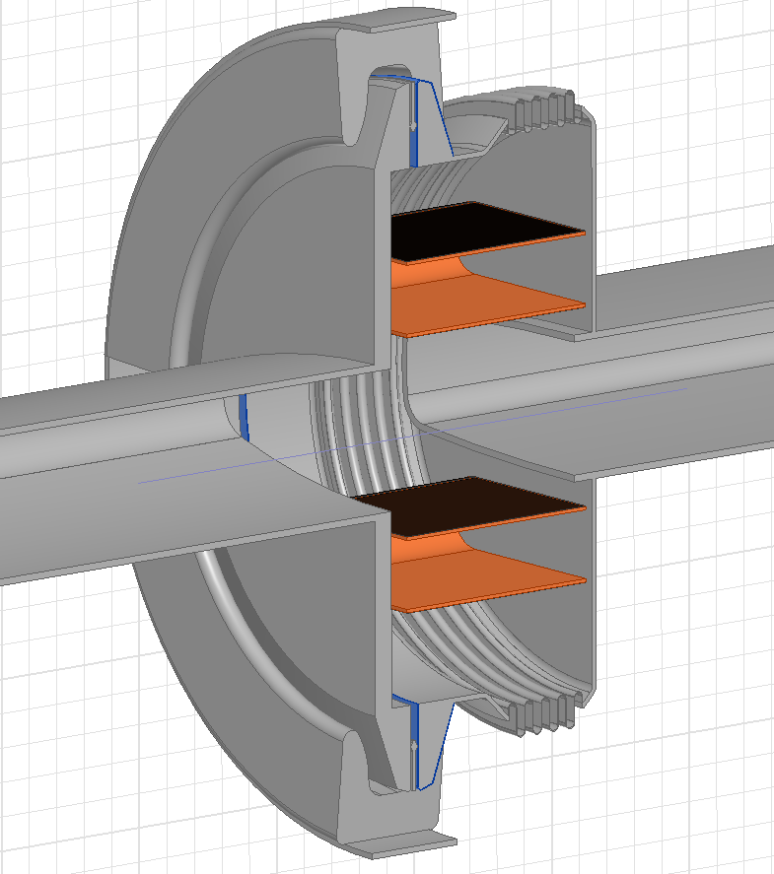
Damping Resistor Redesign
Damping resistors could be redesign to lower the Q below 20.
Current damping resistors damp the 1.4GHz mode down to 75 or 200 (depending on the flange type) with some (small) de-tuning.
Possible Implementation
Design objectives have to be set, for instance:
f [GHz] | Z [Ω] | Q | R/Q [Ω]
0.635 | 150 | 1.25 | 120
1.792 | 60 | 1.75 | 35
2.090 | 12 | 0.65 | 18
2.450 | 110 | 15 | 7
Would exchanging the current impedance by this one help?
Optimization needed.
Trade-offs have to be considered.

Slide 13
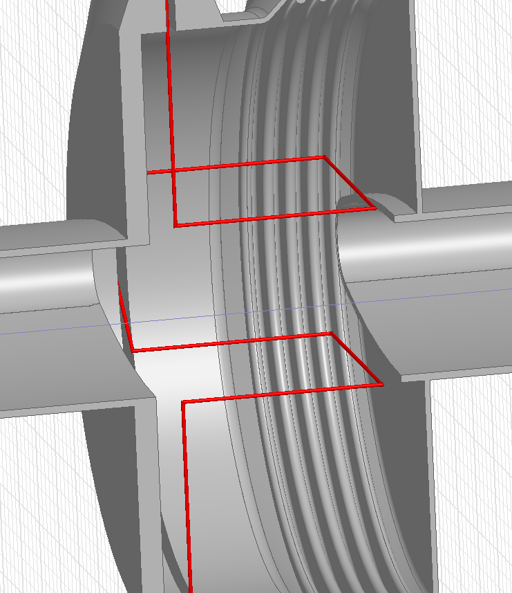
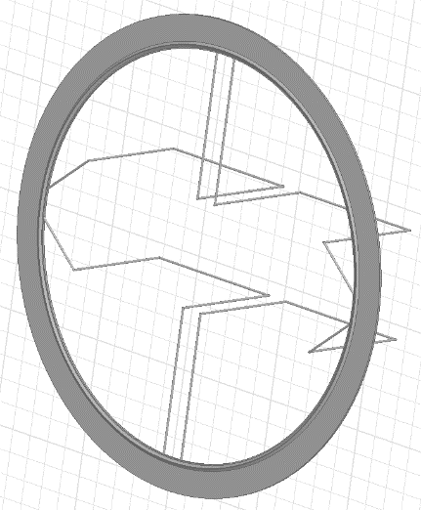
Additional Loss Mechanism (I)
Additional loss mechanisms can be added to the current damping resistors to take the Q down to 20.
Possible Implementation
As proposed by Fritz, adding correctly oriented ‘loops’ to the seals would result in lower Q values.
An empty non-enamelled QF-QD flange can be modelled by:
f [GHz] | Z [kΩ] | Q* | R/Q [Ω]
1.400 | 138 | 1750 | 79
2.360 | 23 | 1600 | 14.4
Including the damping loops:
f [GHz] | Z [kΩ] | Q* | R/Q [Ω]
0.638 | 8 | 155 | 51
1.220 | 30 | 272 | 110
1.575 | 11 | 200 | 5.5
2130 | 10 | 395 | 25
Optimization needed.
Trade-offs need to be considered.
*Damping resistor not considered in this simulation.

Slide 14
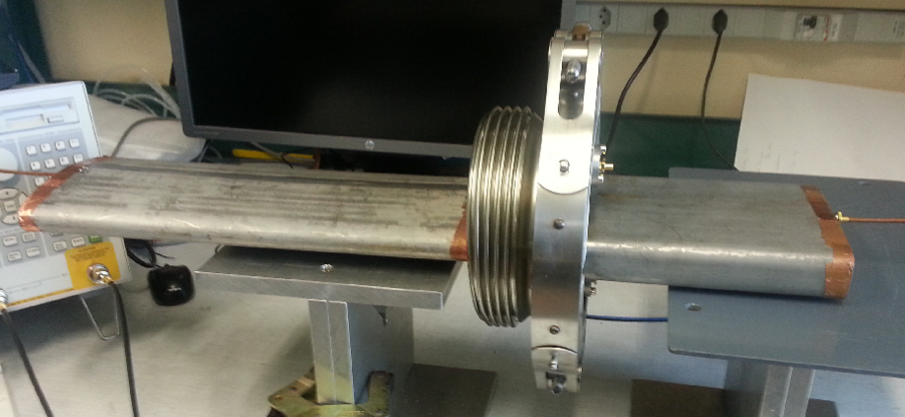
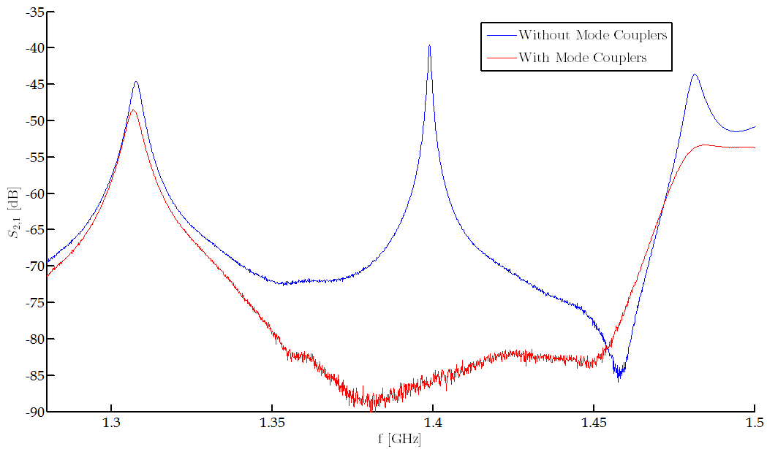
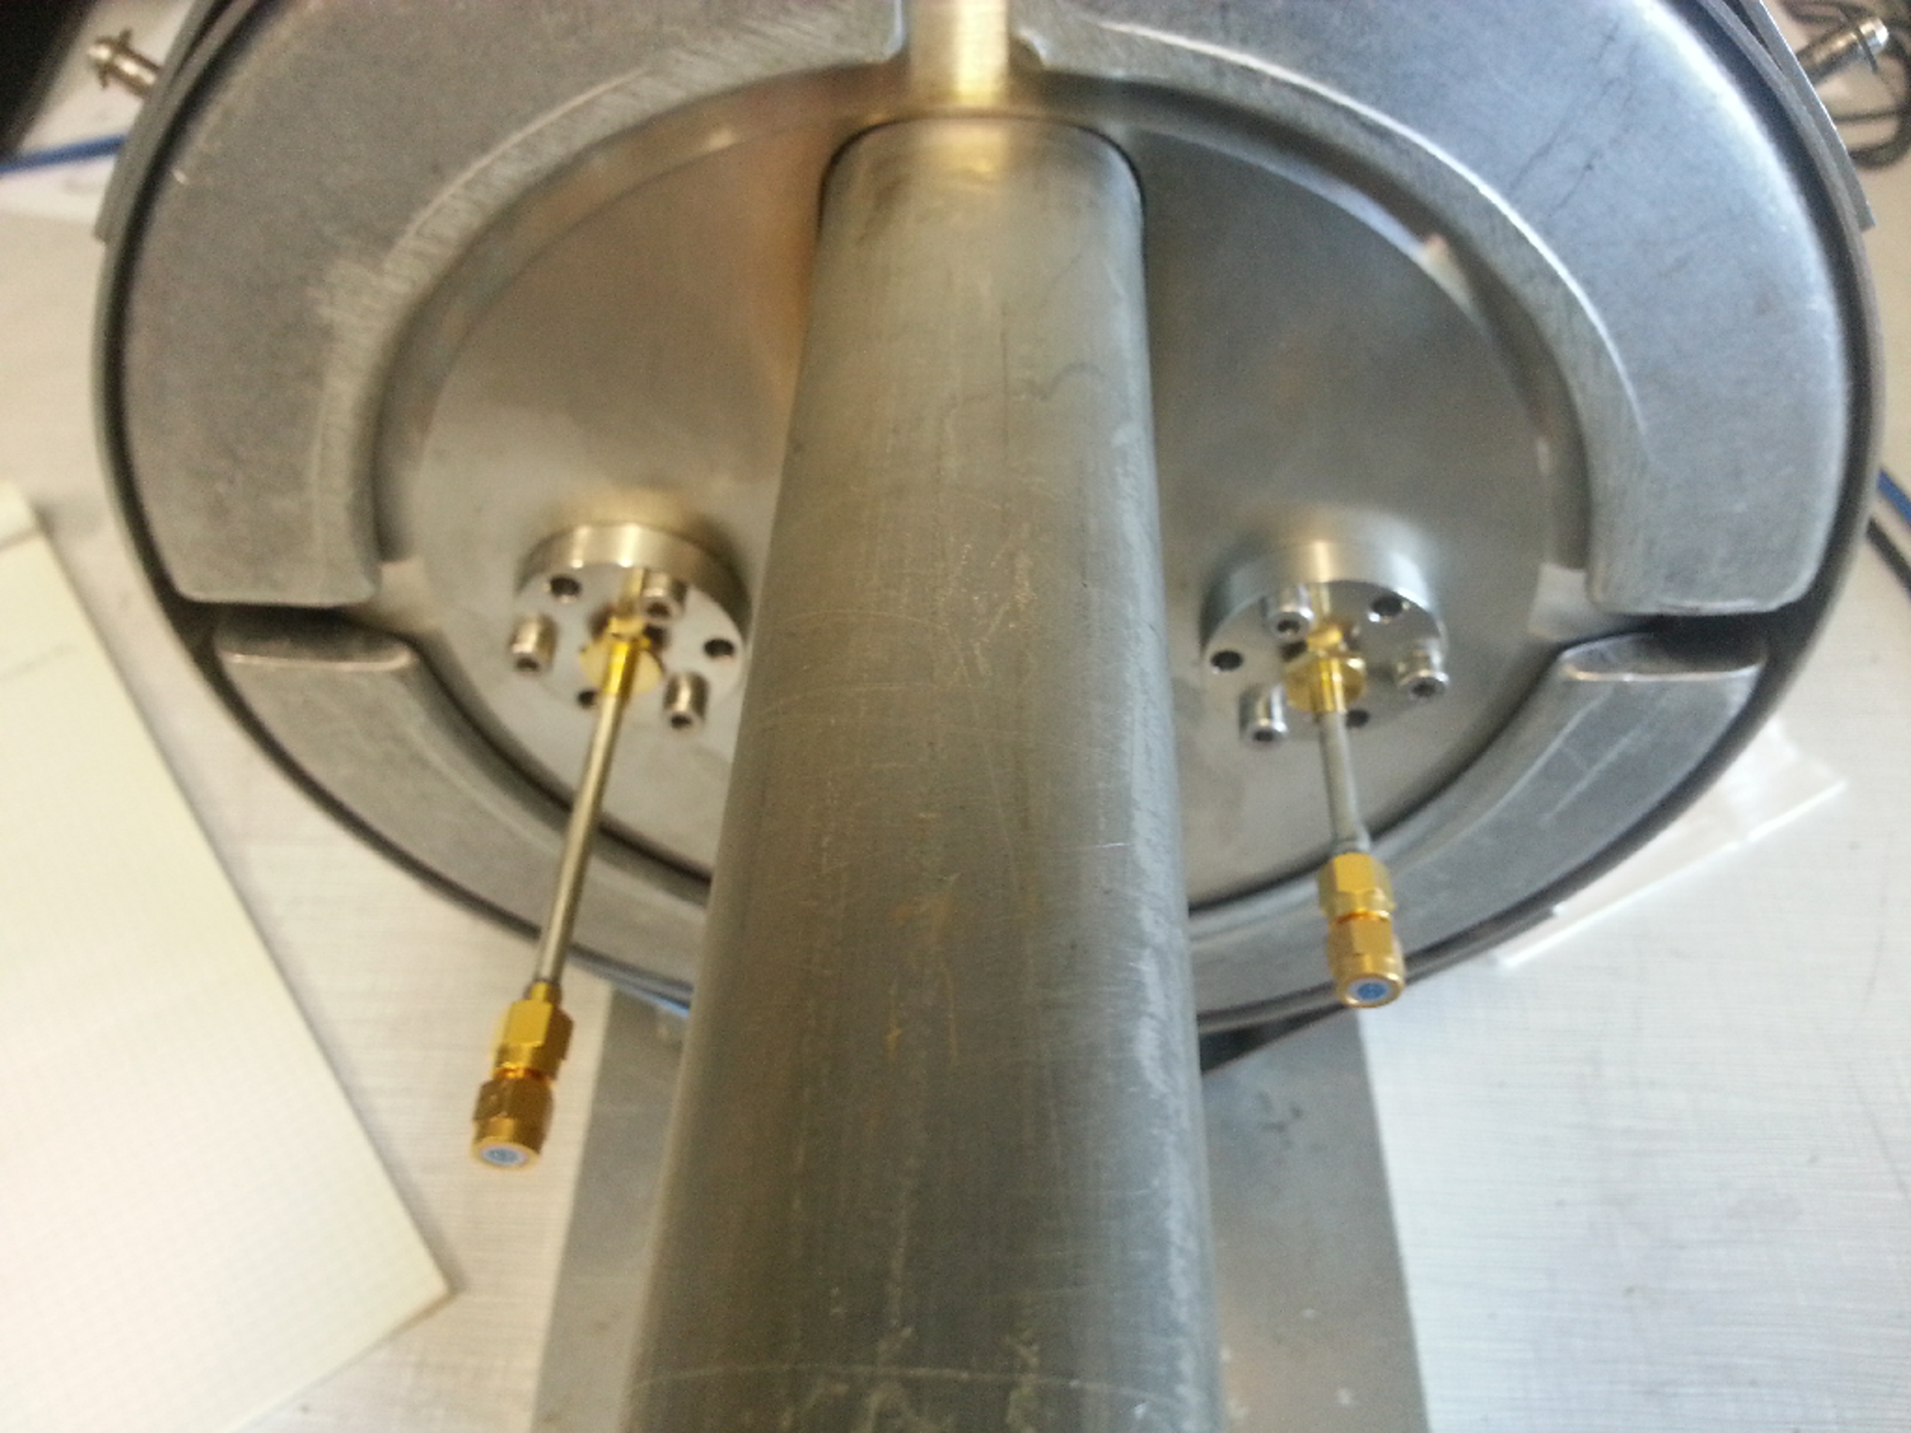
Mode Couplers (I)
Non-enamelled MBA-QF flange:
Without couplers Q = 1455 for the 1.4GHz resonance.
With couplers Q is unmeasurable.
Relevant modes probably hidden.
Further assessment needed.

Slide 15
Mode Couplers (II)
Non-enamelled MBA-QF flange:
Without couplers Q = 1455 for the 1.4GHz resonance.
As an alternative, Fritz proposed to use a resonating coupler.
Instead of connecting a load to the coupler one can terminate it with an open circuit.
The length of the line has to be adjusted so that the coupler ‘ensemble’ is resonant.
‘Strong Damping of Single-Cell Accelerator Cavities by Resonant Loops’, Wolfram Schminke, SPS/ARF/WS/gs/81-68.
This possibility will be looked into in the future.

Slide 16
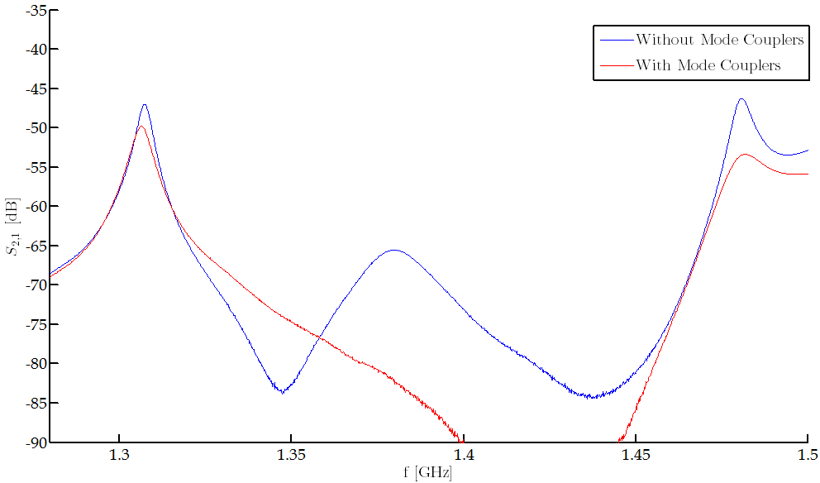
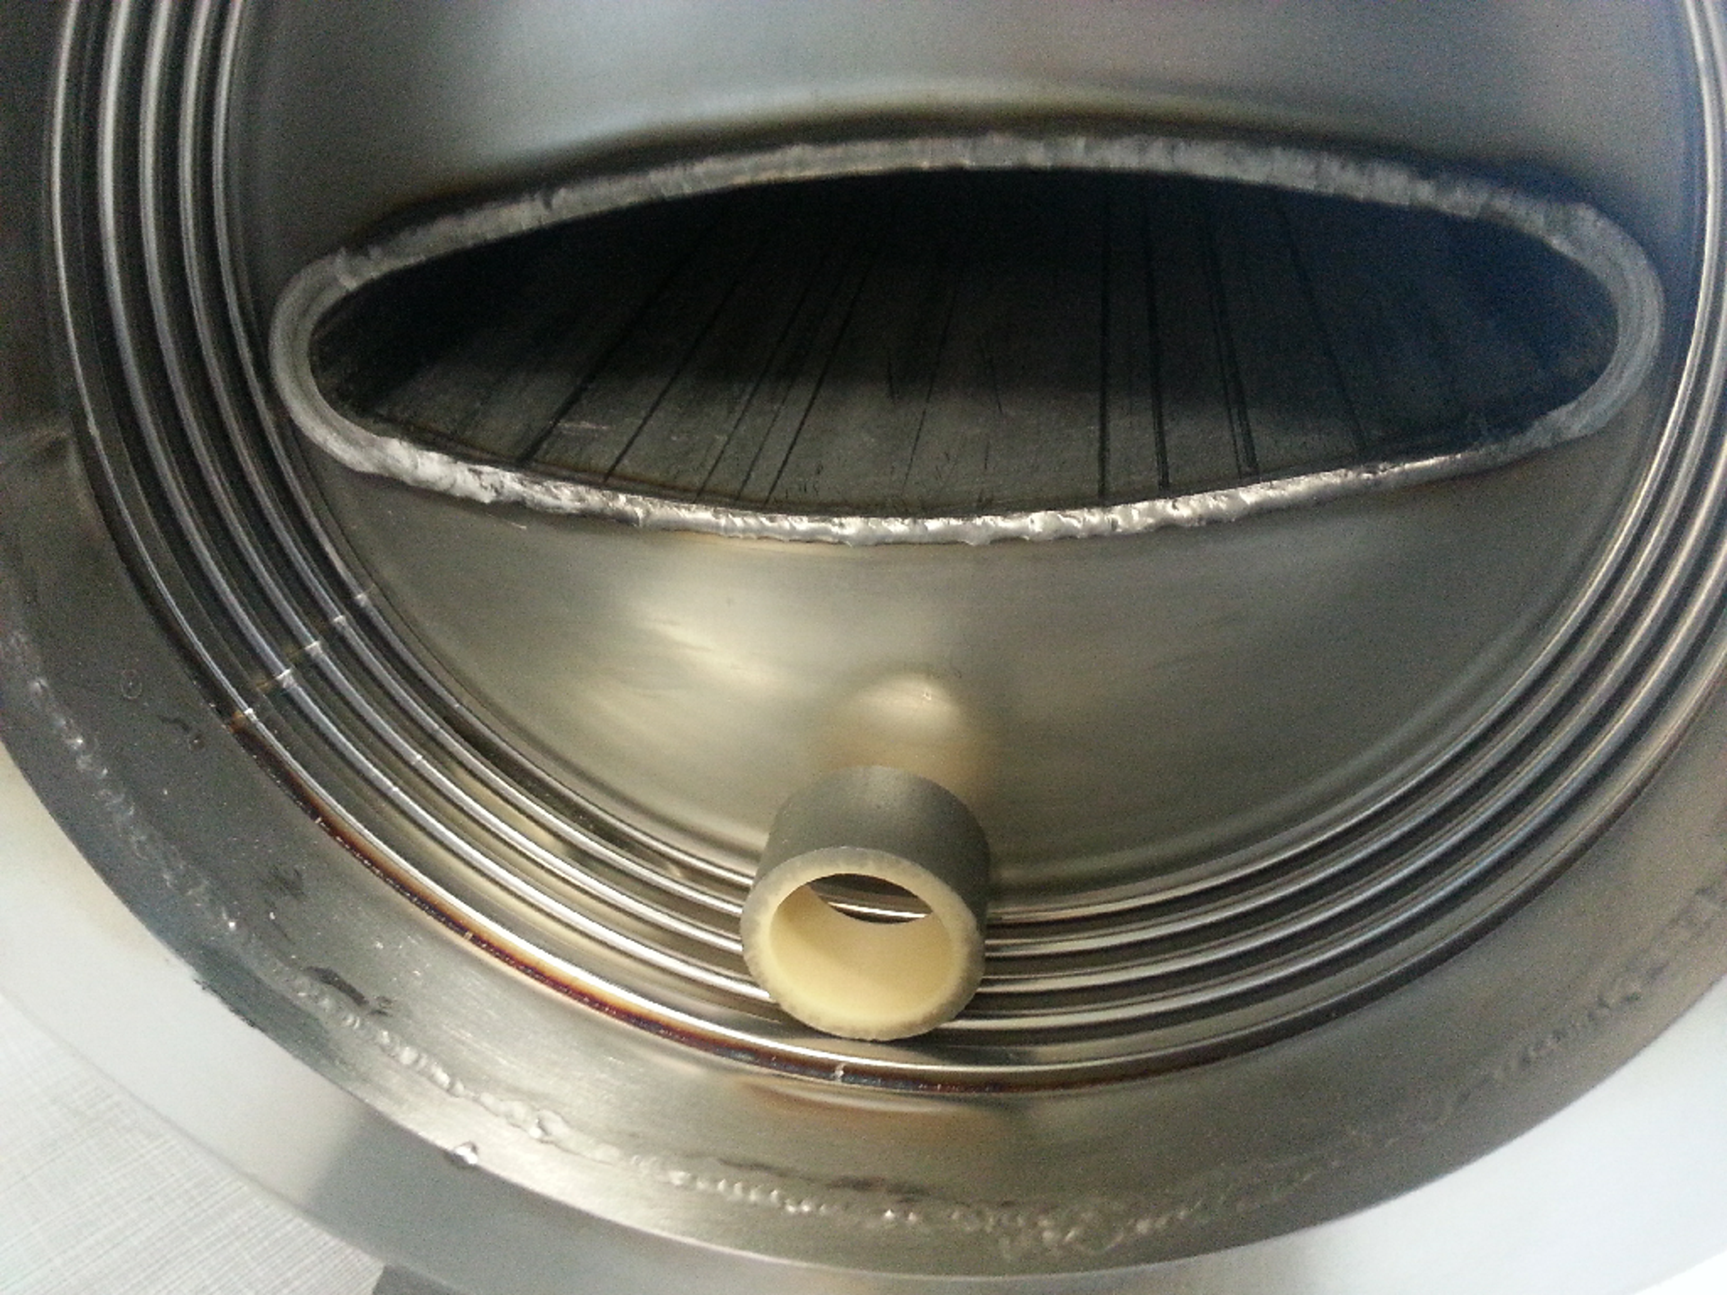
Mode Couplers (III)
Non-enamelled MBA-QF flange with damping resistor:
Without couplers Q = 200 for the 1.4GHz resonance.
With couplers Q is unmeasurable.
Relevant modes probably hidden.
Further assessment needed.

Slide 17
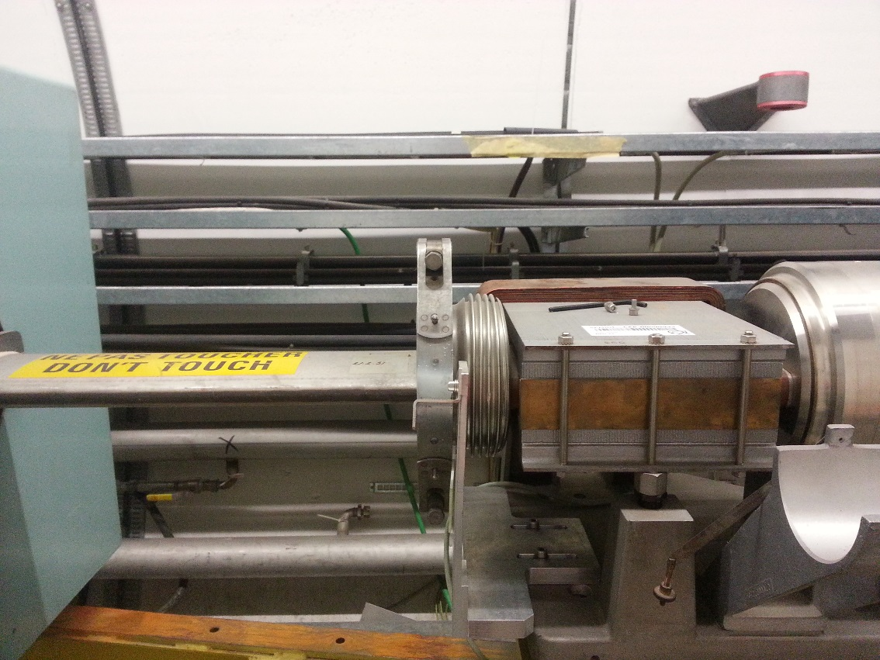
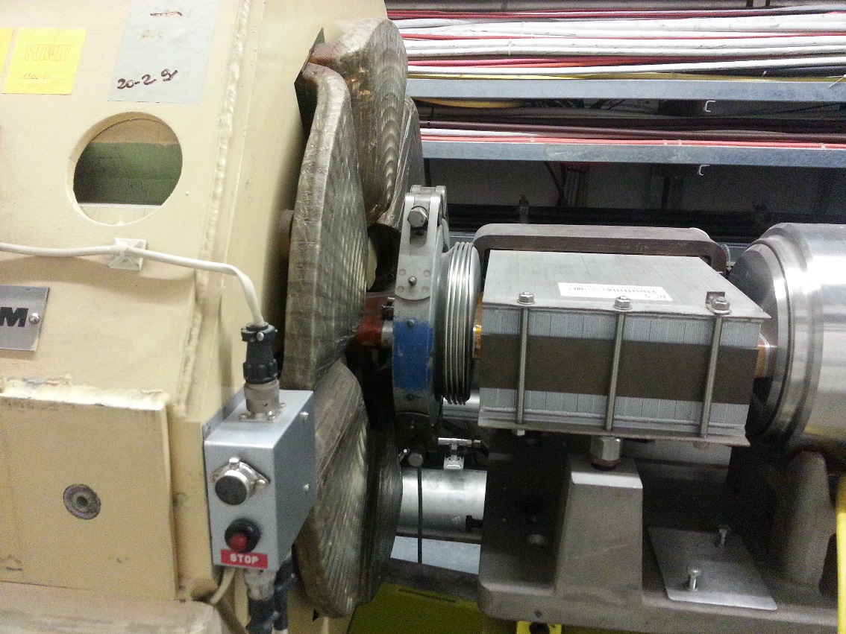
Mode Couplers (IV)
Additional considerations:
Is there enough space to put the feed-throughs?
Yes
Yes?/No?

Slide 18
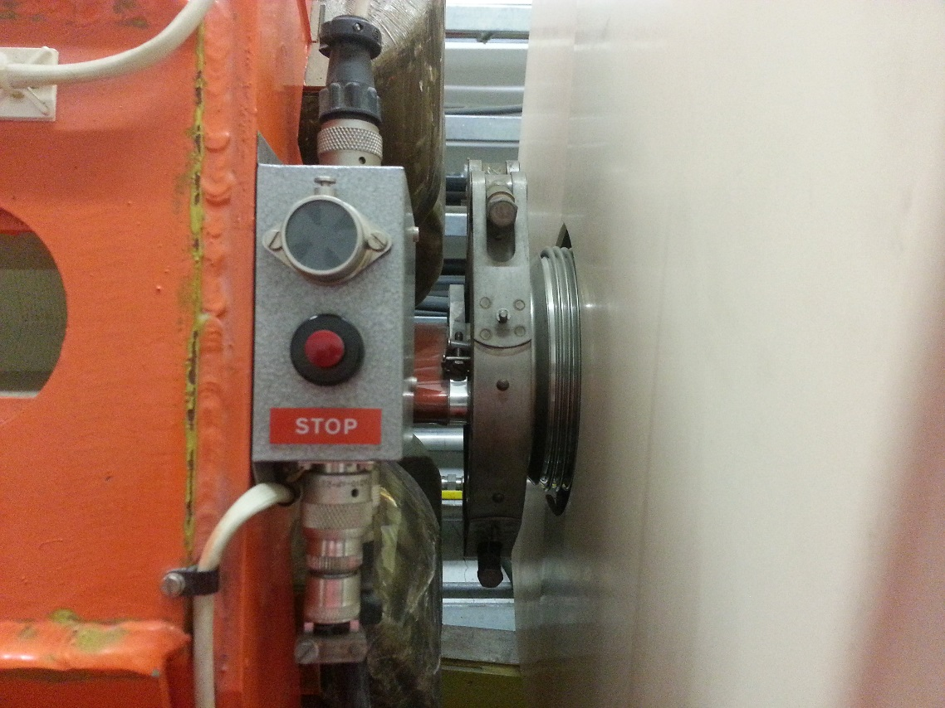
Mode Couplers (IV)
Additional considerations:
Is there enough space to put the feed-throughs?
Yes
Probably No

Slide 19
Mode Couplers (and V)
Additional considerations:
Is there enough space to put the feed-throughs?
Reliability issues?
Apparently none is the correct feed-throughs are used (Fritz).
Mechanical/vacuum restrictions?

Slide 20
Outline
Introduction
The SPS Vacuum Flanges
Impedance Reduction Alternatives
Damping
Shielding
Shielding + Damping
Flange Redesign
Conclusions

Slide 21
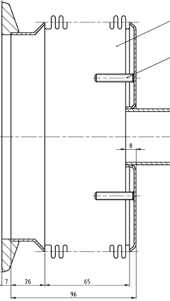
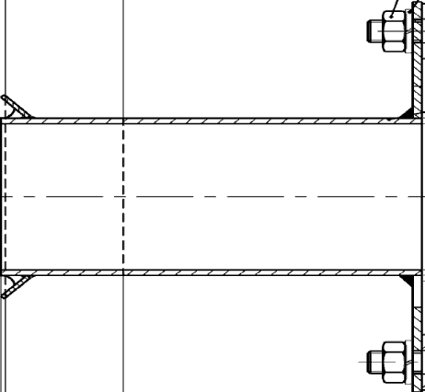
Shielding
Shielding of the vacuum flanges is, mainly, a mechanical problem.
The shield design has to be robust. If the fingers don’t touch appropriately, one can end up with a more harmful impedance spectrum.
Schematically, one would expect to have something like:
RF fingers
High-pass filter for enamelled flanges
Shield

Slide 22
Outline
Introduction
The SPS Vacuum Flanges
Impedance Reduction Alternatives
Damping
Shielding
Shielding + Damping
Flange Redesign
Conclusions

Slide 23
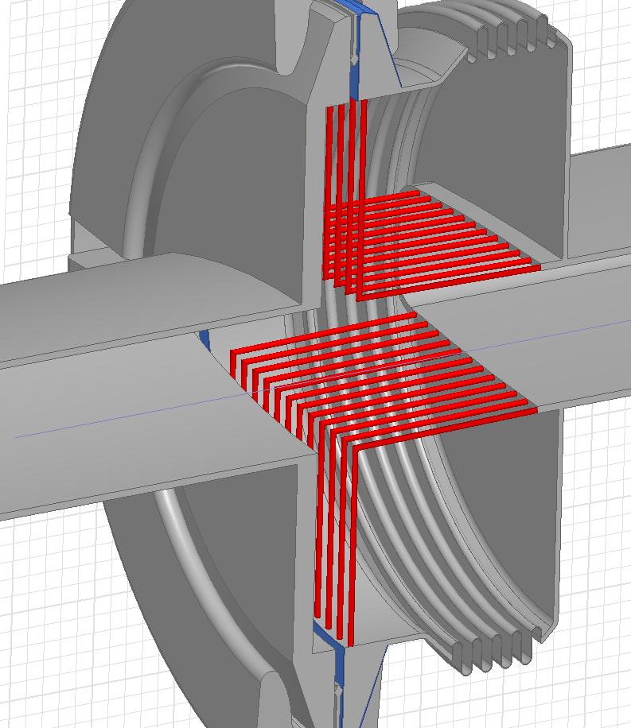
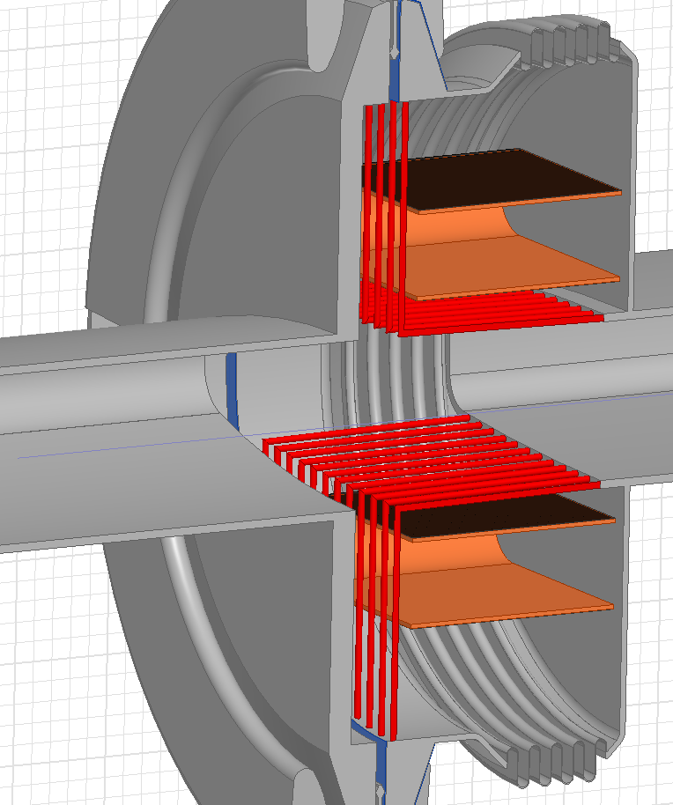
Shielding + Damping
An array of longitudinal wires should be able to act efficiently on longitudinal modes without restricting the bellows functionality.
Wire number & dimensions would need optimization.
Damping resistors should be placed in the remaining space.
Covering the gap on the left would help further.
Conceptual
Drawings

Slide 24
Shielding + Damping
An array of longitudinal wires should be able to act efficiently on longitudinal modes without restricting the bellows functionality.
Wire number & dimensions would need optimization.
Damping resistors should be placed in the remaining space.
Covering the gap on the left would help further.

Slide 25
Outline
Introduction
The SPS Vacuum Flanges
Impedance Reduction Alternatives
Damping
Shielding
Shielding + Damping
Flange Redesign
Conclusions

Slide 26
Flange Redesign
Redesigning the vacuum flanges is, again, a mechanical problem.
This solution minimizes the impedance and is enamel compatible.
Its cost is, on the other hand, the highest.
Schematically, one would expect to have something like:
Flanges without gap
MBA / QF Bellows

Slide 27
Outline
Introduction
The SPS Vacuum Flanges
Impedance Reduction Alternatives
Damping
Shielding
Shielding + Damping
Flange Redesign
Conclusions

Slide 28
Conclusions
The different possibilities to reduce the impedance of a subset of SPS vacuum flanges have been presented.
Impedance wise, the best option is to redesign and change the vacuum flanges (or buy a new machine). It is also the most expensive. Mainly mechanical restrictions to be considered.
If damping the 1.4GHz mode is good enough, redesigning the damping resistors and/or adding some creative ‘pseudo-shields’ seem to me the best alternatives.
Usually these solutions give rise to other modes.
Trade-offs have to be considered.
Different parameters need to be optimized.
The problem of how to accurately characterize/simulate the resistive coating needs to be solved.

