Slide 1
Longitudinal impedance identification
T. Argyropoulos, T. Bohl, J. E. Muller, H. Timko, E. Shaposhnikova
Thanks to H. Damerau for preparing the beam
LIU-SPS BD WG
25/04/2013

Slide 2
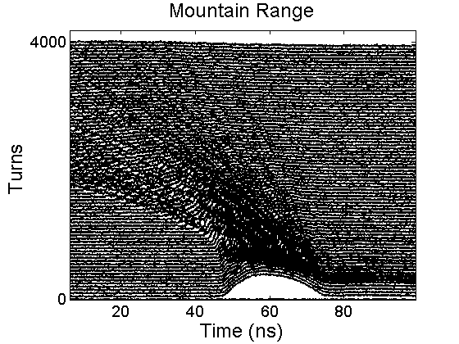
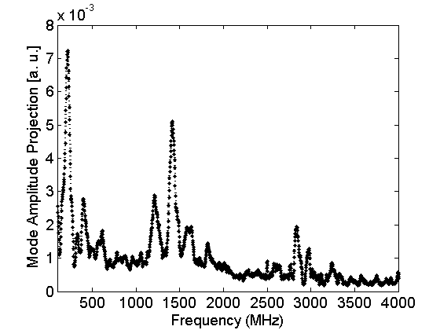
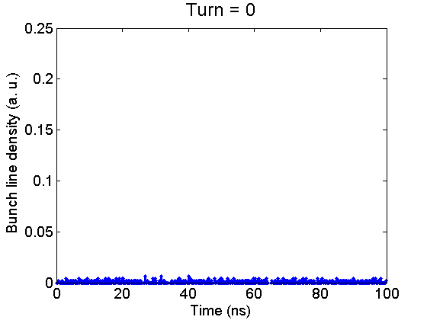
Measurements
Same method used in the past (Measuring the Resonance Structure of Accelerator Impedance with Single Bunches, T. Bohl, T. Linnecar, and E. Shaposhnikova, PRL, 1998)
Experimental conditions:
Long single proton bunches (ε_{L}(90%) ~ (0.23 – 0.26) eVs – τ_{inj}~ (25-30) ns)
Small momentum spread (to be unstable and de-bunch slowly)
Intensity scan from 0.5x10¹¹ to 2.0x10¹¹ p in Q26 and 1.3x10¹¹ to 2.7x10¹¹ p in Q20
SPS RF off
Method:
Acquisitions of beam profiles for a period of ~90 ms (Q26) ~40 ms (Q20) after injection
followed by a Fourier analysis → The presence of resonant impedances with high R/Q and low Q leads to line density modulation at the resonant frequencies
Example in Q26 with N_{p}=1.58x10¹¹ and τ_{inj}(4σ) = 28.5 ns
1.4 GHz
Video of bunch profile

Slide 3
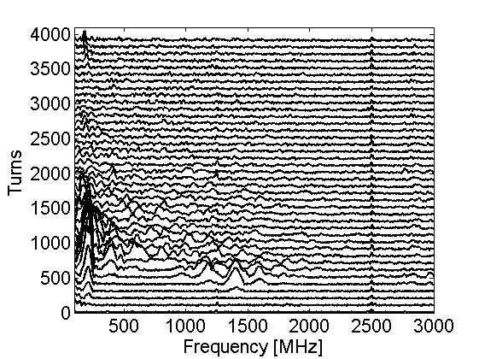
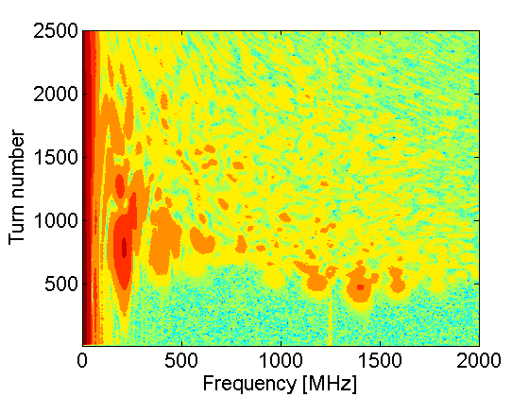
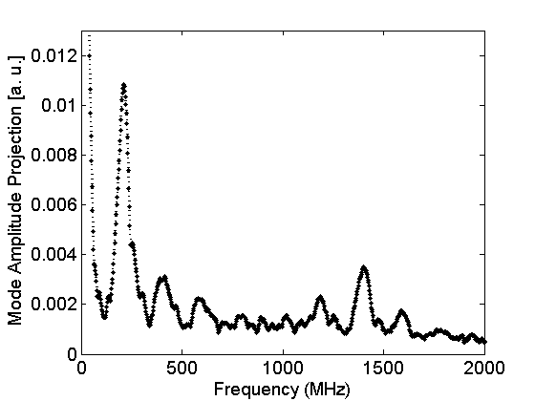
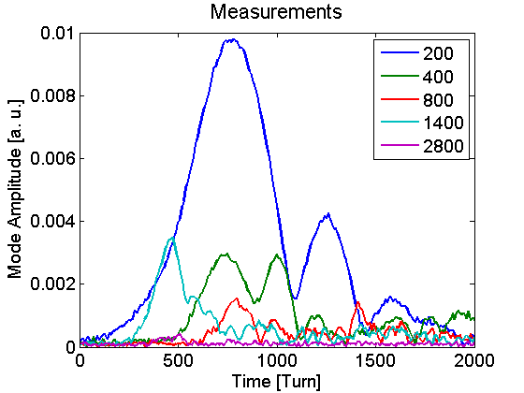
Example in Q26 with N_{p}= 1x10¹⁰
Mountain range
Contour plot
Projection
Mode Amplitude vs Time

Slide 4
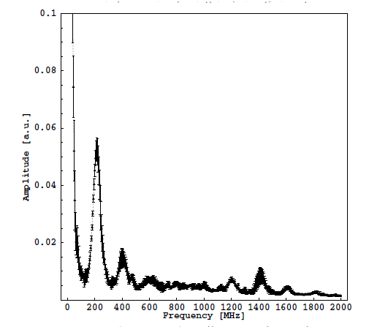
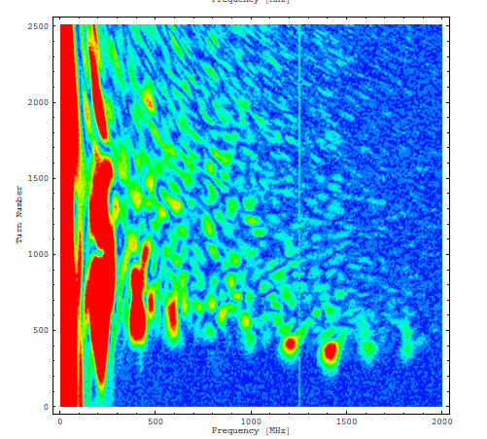
Comparison with old measurements
Projection
Contour plot
T. Bohl, 2007
N_{p} = 8x10¹⁰
?
2012

Slide 5
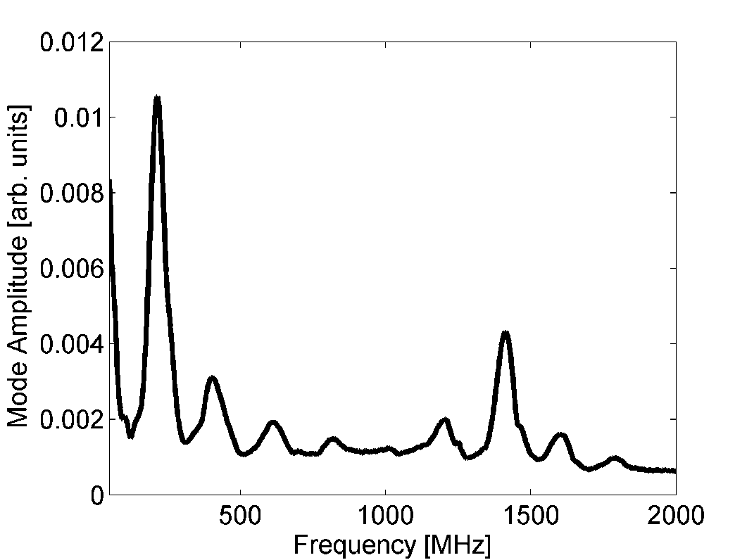
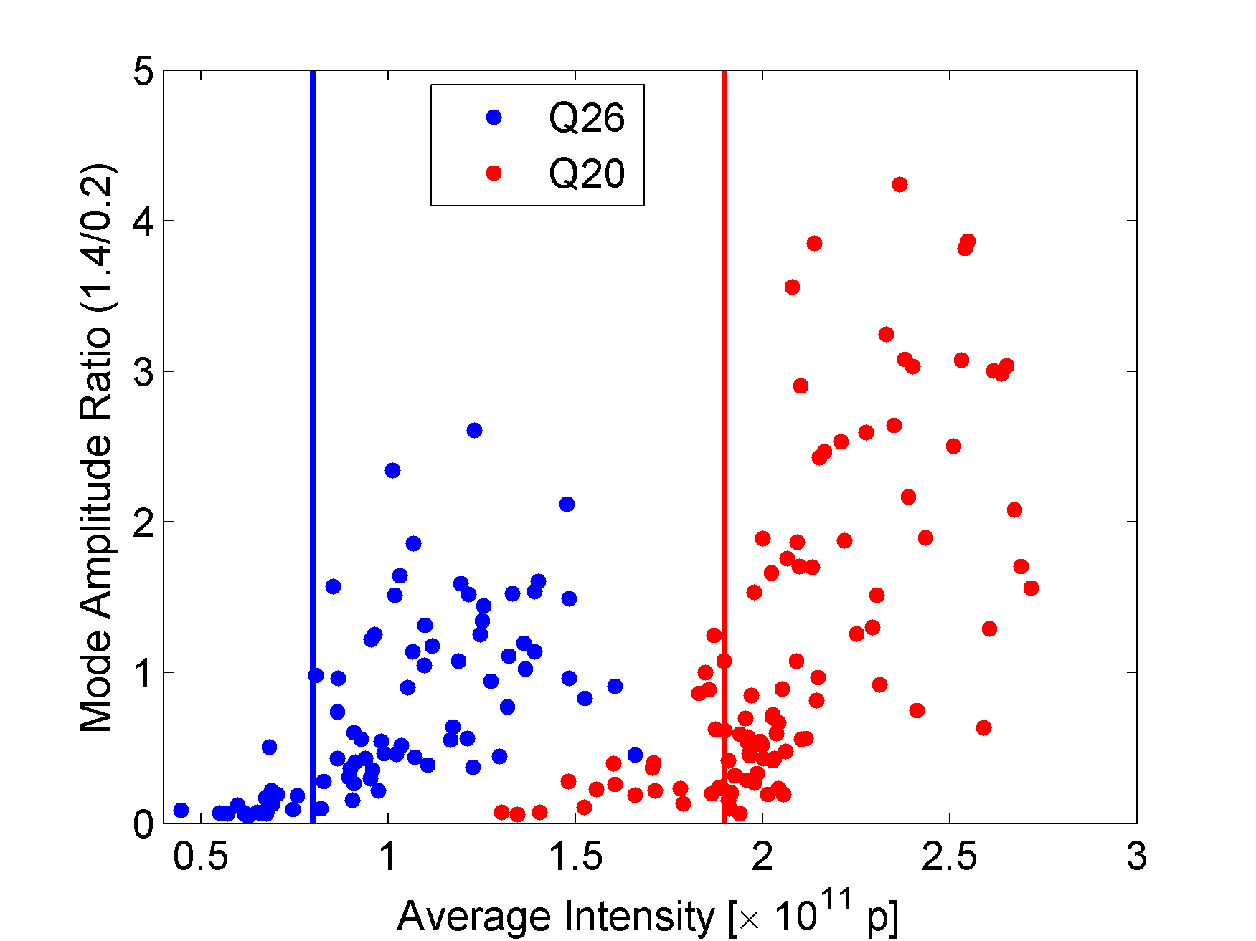
Comparison Q26 - Q20
Similar results as in Q26
Q20- mode amplitude projection
Mode amplitude ratio A₁₄₀₀/A₂₀₀ versus Intensity
N_{p} = 1.9x10¹⁰
It seems to be a longitudinal resonant impedance with high R_{sh}/Q and low Q that causes this instability

Slide 6
Simulations
Simulations to identify the parameter space of this impedance
      Using the present SPS longitudinal impedance model
        − RF systems (200 MHz + HOM (629 MHz), 800 MHz)
        − All kickers (from C. Zannini)
        − Resonance at 1.4 GHz (varying parameters, f_{r}, Q, R_{sh} )
      Initial distribution:
        Tomography in the PS→ESME simulations until extraction to SPS
      Simulations with 2 codes (code in Matlab and HEADTAIL not fully benchmarked)
    Parameters derived from simulations
f_{r} (GHz) | Q | R_{sh} (kΩ)
1.35 – 1.45 | 5 – 10 | 300 – 400

Slide 7
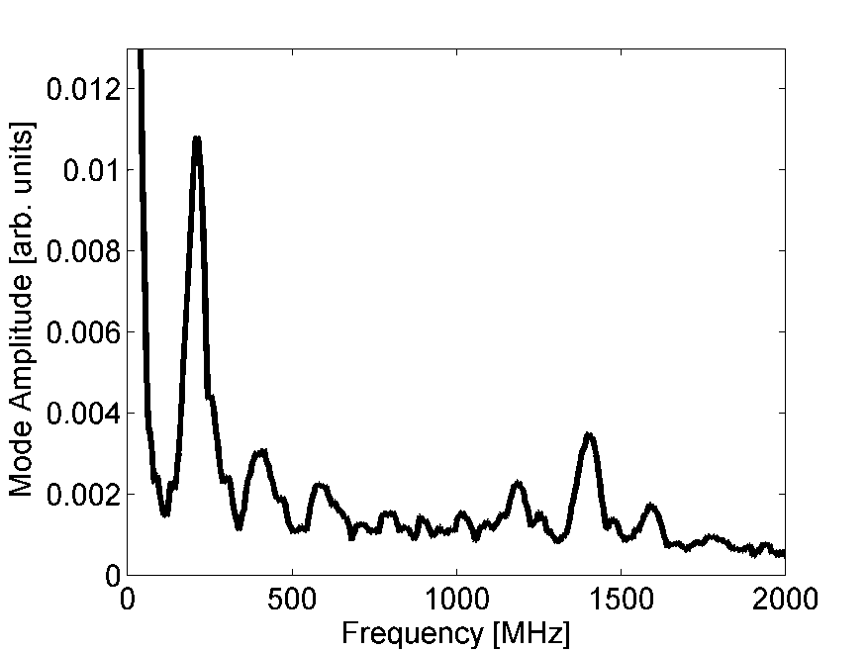
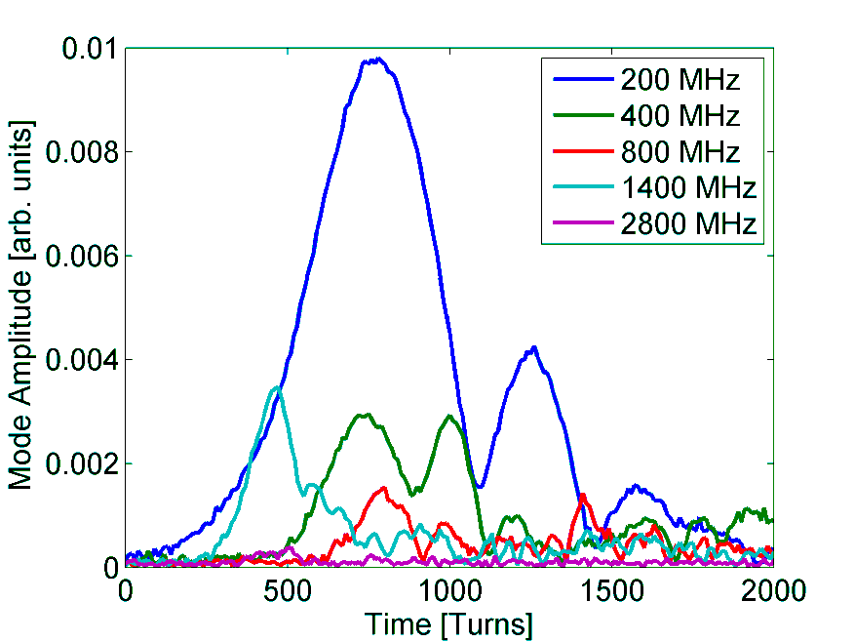
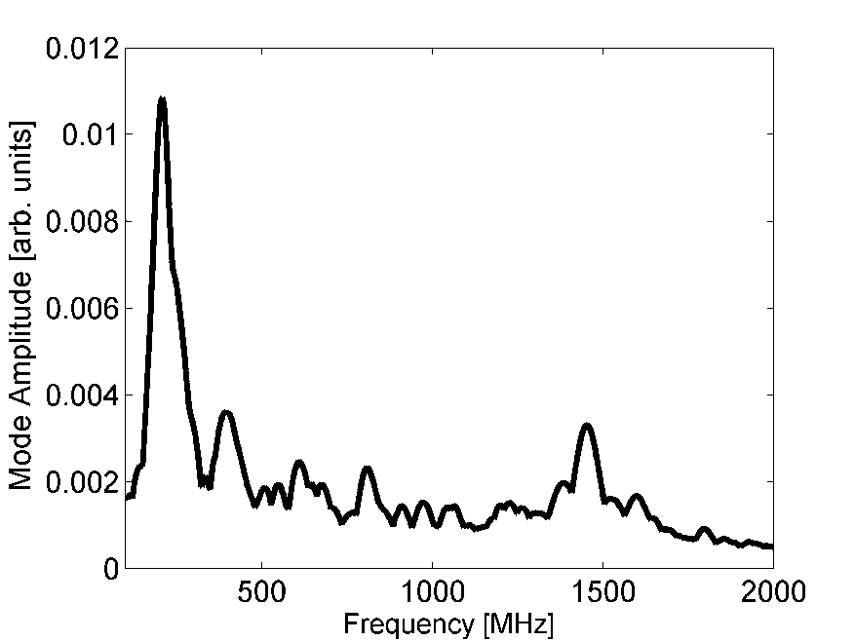
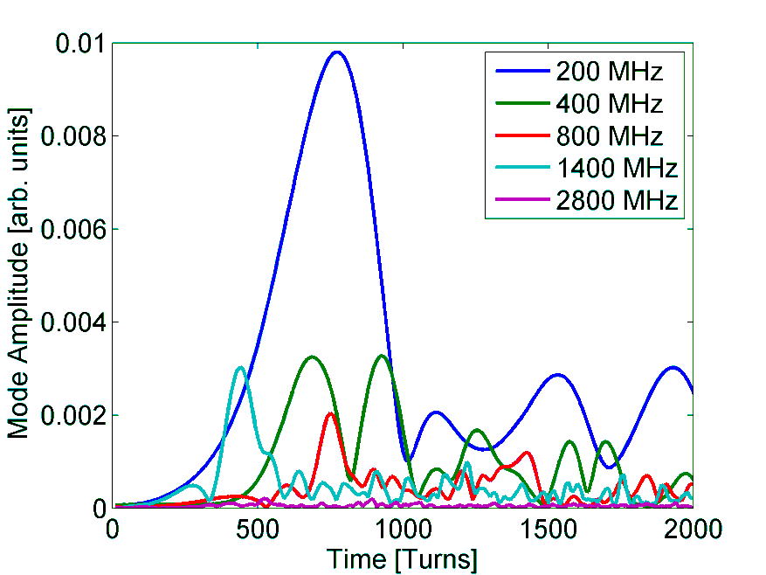
Measurements vs Simulations
Projection
Mode Amplitude vs Time
Measurements
f_{r}=1.42 GHz Q=10, R_{sh} = 400 kΩ
Simulations

Slide 8
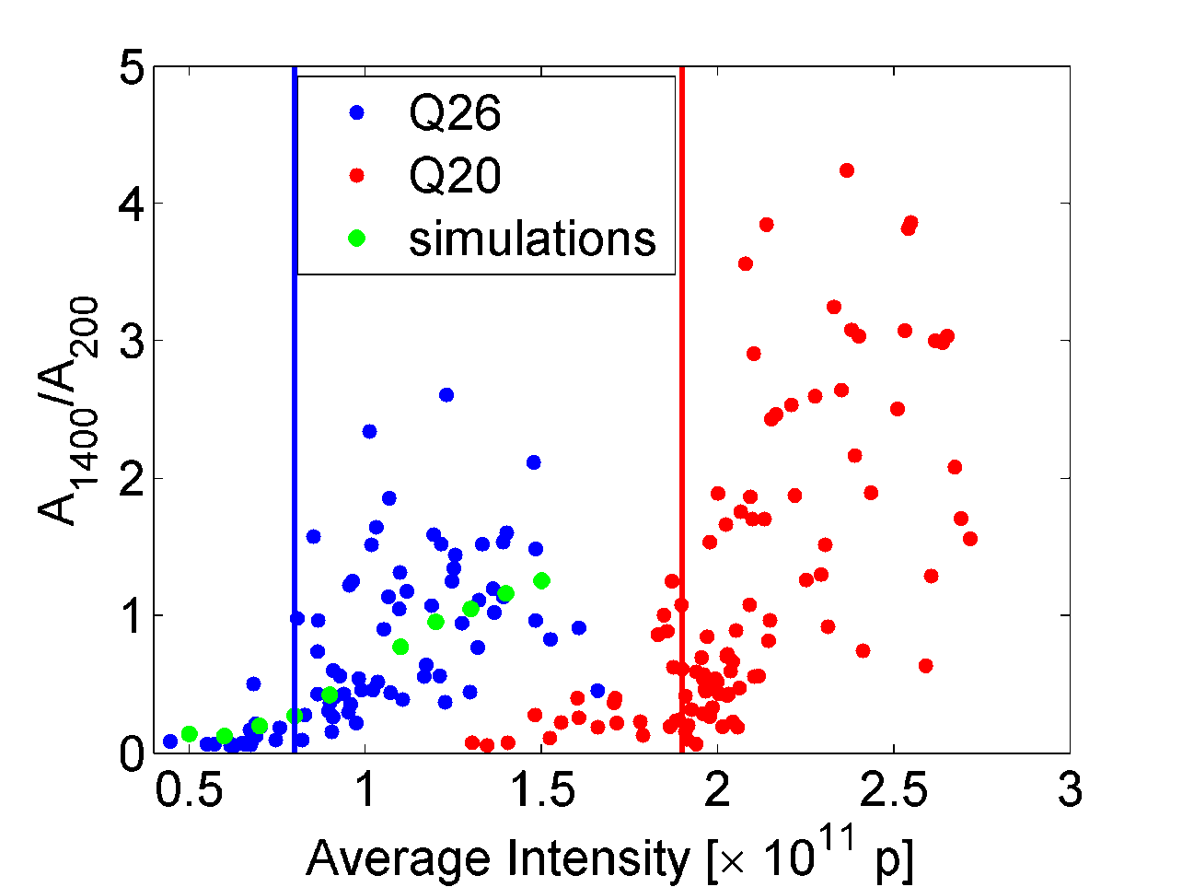
Measurements vs Simulations
Mode amplitude ratio A₁₄₀₀/A₂₀₀ versus Intensity
In simulations: f_{r}=1.40 GHz Q=10, R_{sh} = 400 kΩ

Slide 9
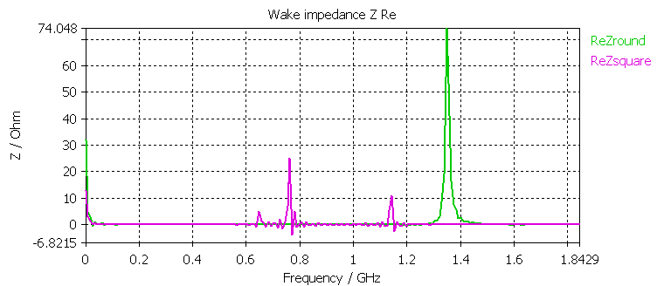
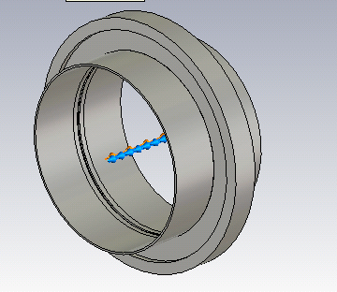
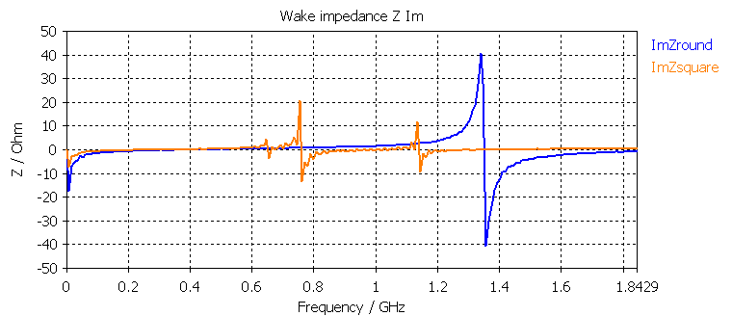
Possible impedance sources
HOM in the 200 MHz or 800 MHz RF systems
Enamel flanges at each side of each BPM in the SPS
Talk of B. Salvant, LIU-SPS BD WG 12/05/2011

Slide 10
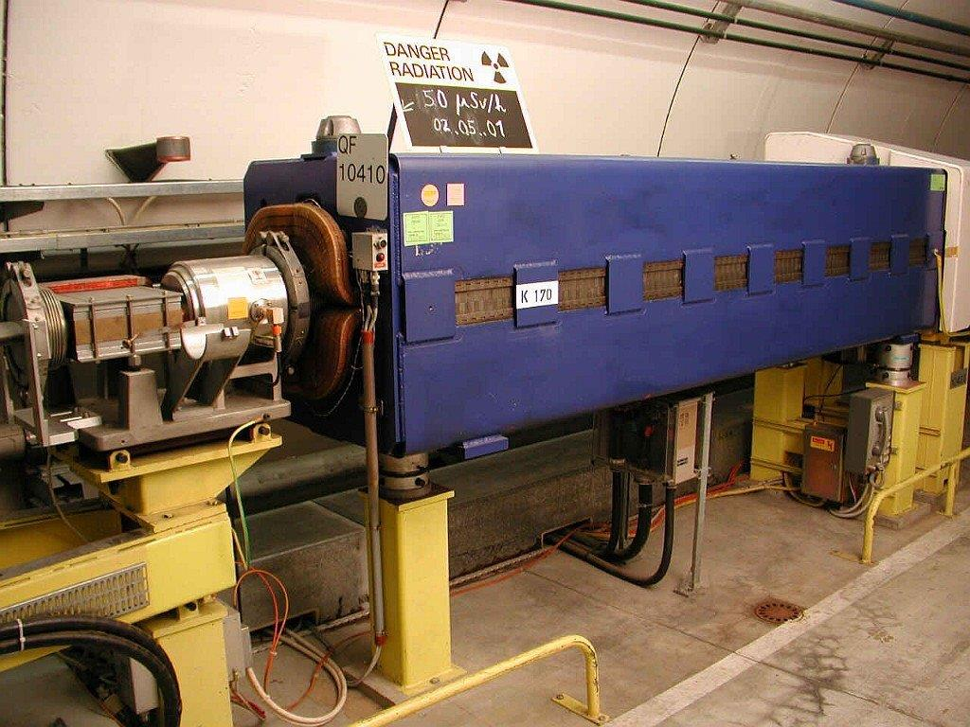
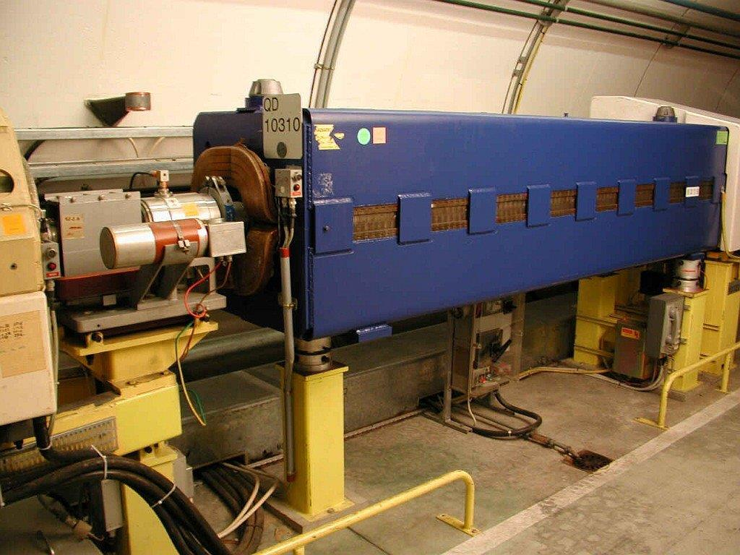
Vacuum (isolated) flanges
Around 440 in the ring
If for each one R_{sh}=75 Ω → total R_{sh}~33 kΩ << ~300 kΩ found from simulations
Example of a BPM – H
Example of a BPM – V

Slide 11
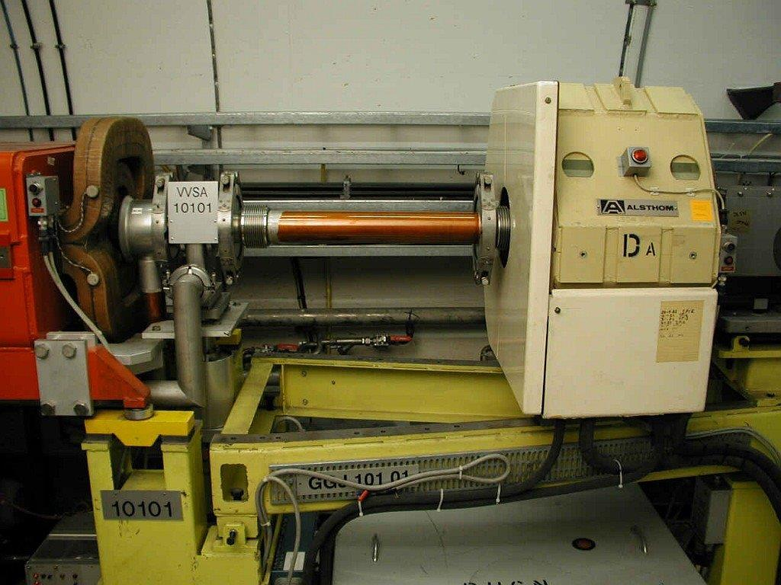
Vacuum flanges
Many more vacuum flanges in the ring of similar type but not isolated
How many of them ??
Example of a straight section

