Slide 1
Space charge in the CERN SPS
H. Bartosik, Y. Papaphilippou, G. Rumolo, F. Schmidt
and all members of LIU-SPS and OP crew
LIU-SPS-BD, 25.04.2013

Slide 2
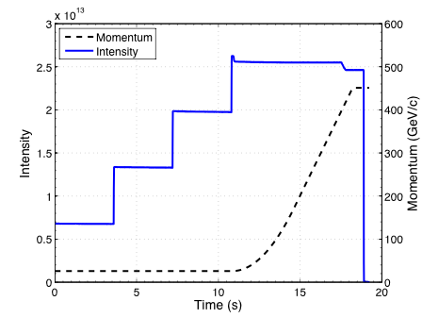
Introduction – SPS cycle for LHC beam
Long injection plateau (10.8s)
  4 injections, 26 GeV/c
  Maybe even longer in case of BCMS beam
Budget for total losses: 10%
  Losses at start of acceleration ~3-5%
  Scraping at flat top ~3%
Budget for emittance growth: 10%
  Small optics mismatch at injection
  Avoid different emittance per batch
Need to preserve high brightness for >10s with ΔQ>0.2 with “practically no degradation”

Slide 3
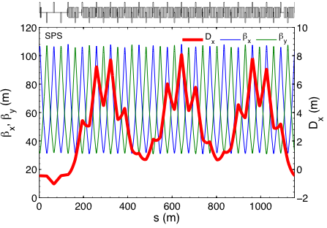
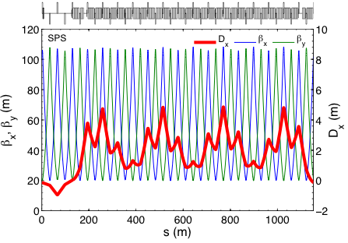
Q20 - low transition energy optics
Lower γ_{t} means higher slip factor η → instability thresholds scale proportionally!
  Lowering SPS working point by 6 units: “Q26” → “Q20” (γ_{t}=22.8 → γ_{t}=18)
  Significantly larger slip factor η (factor 2.85 at injection, 1.6 at extraction)
Implications for space charge
  Higher synchrotron tune (almost factor 3 higher at injection)
  Larger dispersion → smaller space charge tune spread
Q_{x}/Q_{y}=26.13/26.18 (“Q26”)
Q_{x}/Q_{y}=20.13/20.18 (“Q20”)

Slide 4
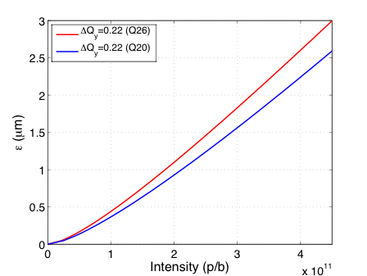
Brightness reach for given SC tune spread
Almost 15% higher brightness reach with Q20 for typical momentum spread and bunch length on injection plateau
Larger dispersion in Q20 = higher brightness reach for given Laslett tune shift

Slide 5
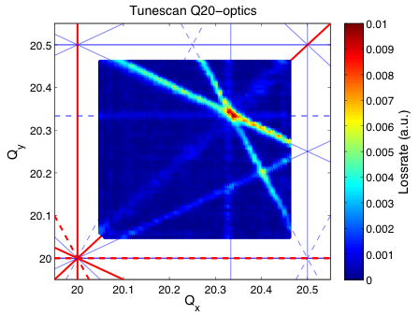
Tune diagram
Resonance scan with low intensity single bunch beam – average of scans in all directions

Slide 6
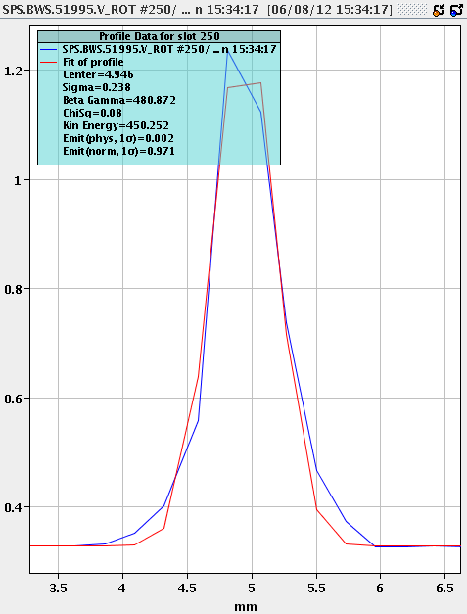
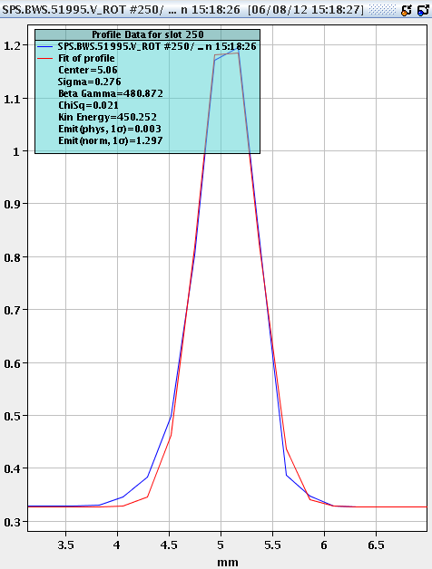
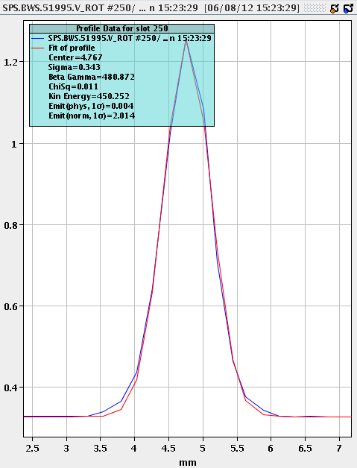
Emittance measurements – extraction energy
0.97μm
1.30μm
2.01μm
Low resolution due to small emittance (especially at flat top)
  Turn acquisition mode: single beam profile for all bunches (here 144)!
  Very view data points → large scatter in measurement, even in stable beam conditions
  In addition: systematic errors (calibration, beta-beat, …)
Combine several measurements (assuming beam is reproducible)
  Many measurements needed (typically 5-10) – but error significantly reduced
  Was implemented in control room application in September 2012

Slide 7
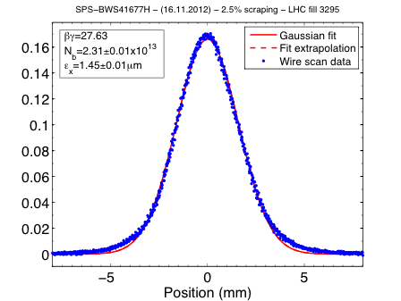
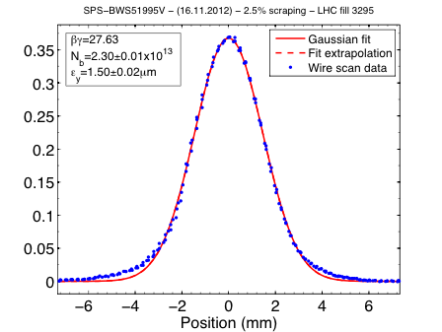
Emittance measurements – injection energy
Further improvement by measuring at the end of flat bottom instead of flat top
  Higher resolution due to larger beam size
  Good agreement with LHC measurements at injection (typically within 10%)
Method relies on reproducible beam parameters
  High brightness single bunch beam has large fluctuation in intensity and emittance
  Space charge studies with high brightness 50ns (BCMS) beam

Slide 8
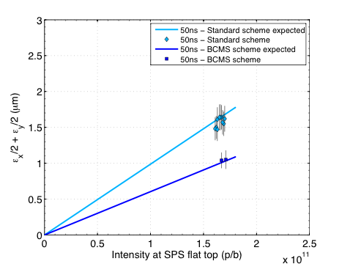
2012 achieved beam parameters – 50ns beam
Expected performance: Scaling PSB measurements with LIU budget for blow-up and losses
ΔQ_{x}/ΔQ_{y} ~ 0.08/0.13
ΔQ_{x}/ΔQ_{y} ~ 0.10/0.18
All measurements with Q20!
50ns standard scheme
  Regularly used to fill LHC since September 2012 using Q20 optics, at present PS intensity limit
50ns BCMS scheme
  Beam sent to the LHC once to check emittance preservation and luminosity gain in LHC

Slide 9
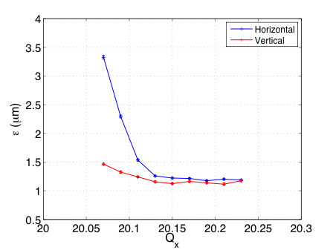
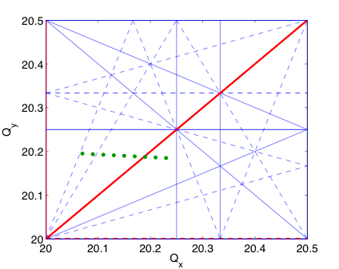
Space charge tune scan - horizontal
Machine setup for high brightness 50ns BCMS beam (1 batch of 24 bunches)
  N = 1.95x10¹¹ p/b (at injection)
  ε ~ 1.15μm
  Transmission up to flat top around 94% without scraping (very small losses on flat bottom)
  Combined emittance measurement of 5 shots at the end of flat bottom
  Error bars contain only fit uncertainty
  ΔQ_{x}/ΔQ_{y} ~ 0.10/0.18 (from Laslett formula)
Lossless blow-up of beam core
“no blow-up”
for Q_{x}>20.14

Slide 10
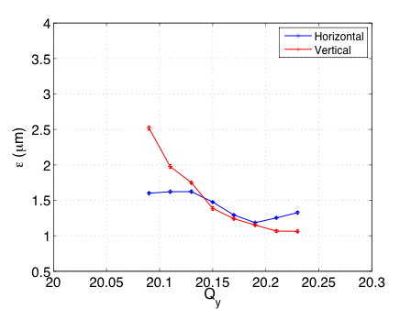
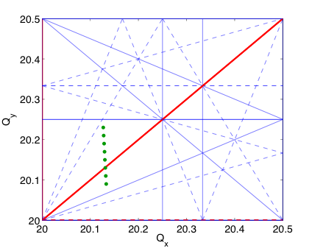
Space charge tune scan - vertical
Machine setup for high brightness 50ns BCMS beam (1 batch of 24 bunches)
  N = 1.95x10¹¹ p/b (at injection)
  ε ~ 1.15μm
  Transmission up to flat top around 94% without scraping (very small losses on flat bottom)
  Combined emittance measurement of 5 shots at the end of flat bottom
  Error bars contain only fit uncertainty
  ΔQ_{x}/ΔQ_{y} ~ 0.10/0.18 (from Laslett formula)
Lossless blow-up of beam core
”no blow-up”
for Q_{y}>20.20

Slide 11
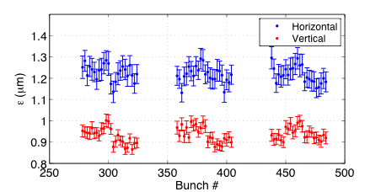
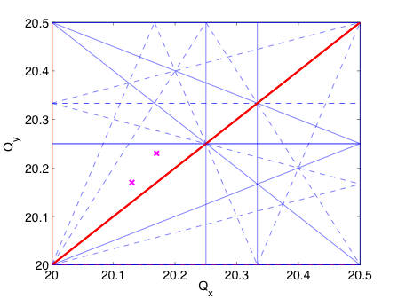
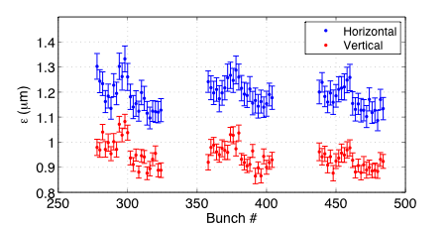
Bunch-by-bunch emittance measurement
High brightness 50ns BCMS beam (3 batches of 24 bunches)
  N = 1.95x10¹¹ p/b (at injection)
  ε ~ 1.15μm
  Bunch-by-bunch wire-scans: study relative blow-up due to different storage time per batch
  Single measurements at end of flat bottom (error bars include fit uncertainty only!)
  ΔQ_{x}/ΔQ_{y} ~ 0.10/0.18 (from Laslett formula)
Q_{x}/Q_{y}=20.17/20.23
Q_{x}/Q_{y}=20.13/20.19

Slide 12
Simulation studies - ideas
Study the shown observations
  Short term effects with PTC-ORBIT
  Frozen space charge model for long-term?
Emittance growth as function of time for tune close to integer resonance
  Data was taken – try to benchmark (although limited non-linear model)
Injection transients
  Generic study: possible blow-up from bunch length oscillation (injection into mismatched bucket)
  Difference for Q20 and Q26 due to different synchrotron tunes?
  Sensitivity to optics mismatch at injection in combination with space charge
Effect of different synchrotron tune in combination with resonance crossing
  Generic study of interplay with 4Q_{y}=81 (4Q_{y}=105) as possible limitation for acceptable tune shift
Development of non-linear model
  Using beam-based measurements of nonlinearities and orbit

Slide 13
Summary, conclusions and questions
Space charge is challenging for future LHC beams
  Long storage time at injection energy for multiple injections from PS
  Laslett tune shift larger than 0.2 will be required
Low γ_{t} optics Q20 (for increasing instability thresholds)
  Providing 15% smaller tune spread for usual longitudinal parameters due to larger dispersion
  Operationally used for LHC filling since September 2012
Emittance measurements in SPS – issues with resolution
  Combining several measurements for reconstructing profile reduces error
Experimental results
  Tune spread of 0.18 (estimated from Laslett formula) is acceptable
  Relative emittance growth on flat bottom can be observed on bunch-by-bunch wire scans
Question: Δq_{y}>0.25 and long (>10s) storage times “without” beam degradation?
  Demonstrated in existing machines?
  General feeling about feasibility?

Slide 14
Thank you for your attention!

Slide 15
Motivation for low γ_{t} optics
Motivation for lowering transition energy in SPS (Q20 optics)
  Larger slip factor η (factor 3 at 26GeV, 1.6 at 450GeV) → higher instability thresholds
  Transverse – TMCI at injection, electron cloud instability
  Longitudinal – multi bunch instability, loss of Landau damping
High intensity single bunch
  TMCI threshold in Q26 at around 1.6x10¹¹ p/b
  Up to 4x10¹¹ p/b without TMCI in Q20 with low chroma
Longitudinal stability
  Longitudinal instability threshold scales with slip factor η
  Clear improvement with Q20 optics wrt. Q26
    For single and multi bunch beams
  Less controlled longitudinal blow-up for same intensity in Q20
Important step in 2012: Q20 used in routine operation
  N_{th} ~ |η|ε_{l}/β_{y}
  N_{th} ~ |η|ε_{l}^{5/2}

