Slide 1
SPS achieved performance and beam parameters in 2012 – focus on 25ns beams (transverse aspects)
H. Bartosik, G. Iadarola, Y. Papaphilippou, G. Rumolo
T. Argyropoulos, T. Bohl, J. Esteban Muller, W. Hofle, E. Shaposhnikova, H. Timko
K. Cornelis and SPS OP crew
with the great help of many many colleagues from OP, BI, ABT, …
LIU-SPS-BD, 21. March 2013

Slide 2
Outline
Performance of operational beams with the Q20 optics (25ns + 50ns)
Standard production scheme
BCMS (h=9) production scheme
MD studies with the 25ns beam (nominal and higher intensity)
With Q26 optics on flat bottom
With Q20 accelerating to 450GeV

Slide 3
Operational performance - Introduction
Measurement points
Emittances deduced from combined wire-scans at end of SPS flat bottom (consistent with LHC measurements) for beams sent to the LHC using the Q20 optics
Error bars include statistical uncertainty (several measurements) and systematic uncertainty (10%)
Intensity measured at SPS flat top after scraping
Expectations (solid lines)
PSB performance in 2012 (Bettina’s plot from LIU Beam Studies Review Day) extrapolated to SPS flat top including LIU budgets for emittance growth and losses
LIU/HL-LHC goal at SPS extraction (dashed lines)
HL-LHC target values translated into LIU requirements at the SPS extraction

Slide 4
Achieved performance with Q20 in 2012 (50ns)
50ns – Standard scheme
Beam regularly used to fill LHC in 2012: rich statistics
Measurements in the SPS done with four batches
Beam constantly and carefully optimized/checked across the whole injector chain
50ns – BCMS scheme
Beam sent once to the LHC to verify the increase in luminosity due to lower emittances (only one batch per beam)
Measurements in the SPS done with three batches

Slide 5
Achieved performance with Q20 in 2012 (25ns)
25ns – Standard scheme
Beam used during the LHC scrubbing run & in several SPS MDs on e-cloud and longitudinal stability
Measurements in the SPS done with four batches
Maximum intensity reached at the SPS extraction was 1.4e11 ppb, but signs of e-cloud visible in bunch-by-bunch emittances + longitudinally not extractable
25ns – BCMS scheme
Beam used for the 25ns physics run of the LHC (injected into LHC in one or two batches)
Measurements in the SPS done with three batches

Slide 6
MD sessions with 25ns beam - historical
Scrubbing run and other MDs for e-cloud studies with Q26 optics
26-30.03.12 – Scrubbing run
25.04.2012 – Q26 on long Flat Bottom
21.05.2012 – Q26 on long Flat Bottom
25.06.2012 – emittance preservation on flat bottom
12.07.2012 – Lifetime as function of chromaticity on flat bottom
MDs with 25ns in Q20 optics
26.09.2012 – first setup of the Q20 25ns operational cycle
03.10.2012 – first session on high intensity 25ns with Q20 cycle, WS 519V broken
22.10.2012 – LL-RF optimization and longitudinal setup
05.11.2012 – high intensity with up to 4 batches, WS 416V broken
15.11.2012 – longitudinal studies only (no wire scanners …) up to 1.7x10¹¹p/b injected

Slide 7
Emittance along flat bottom – Q26
Intensity around 1.15x10¹¹ p/b – 25ns
Average emittance / batch using the Bunch-by-Bunch mode
Each data point is average of 3 measurements
Error bars include the spread along the batch for 3 shots (no systematic uncertainty)
No measurable emittance growth for nominal intensity!
Horizontal
Vertical

Slide 8
Lifetime on SPS flat bottom – Q26
Intensity around 1.20x10¹¹ p/b – 288 bunches 25ns
Vertical emittance up to ξ_{y}~0.3 acceptable wrt lifetime
ξ_{y}~0.2 optimal for stability and lifetime (for this intensity …)
Drastic increase of incoherent losses for ξ_{y}>0.3

Slide 9
MD on 03.10.2012 – 25ns – Q20 (I)
Setup of the Q20 cycle for 25ns
Nominal and higher intensity
Emittance measurements BbB on Flat Top!
OK (1.30x10¹¹ p/b injected)
Horizontal
1.30x10¹¹p/b
1.22x10¹¹p/b
1.45x10¹¹p/b
Vertical

Slide 10
MD on 03.10.2012 – 25ns – Q20 (II)
Setup of the Q20 cycle for 25ns
Nominal and higher intensity
Emittance measurements BbB on Flat Top!
OK (1.30x10¹¹ p/b injected)
BU at end of last batch (1.39x10¹¹ p/b injected)
Horizontal
1.30x10¹¹p/b
1.27x10¹¹p/b
1.45x10¹¹p/b
Vertical

Slide 11
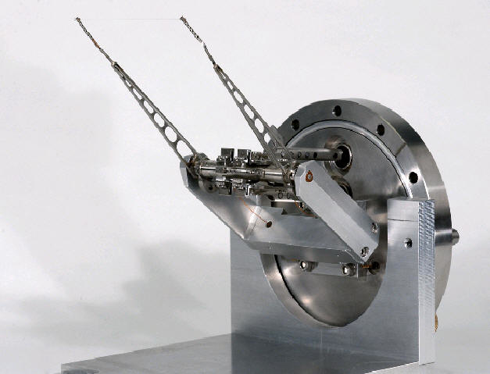
MD on 03.10.2012 – 25ns – Q20 (III)
Setup of the Q20 cycle for 25ns
Nominal and higher intensity
Emittance measurements BbB on Flat Top!
OK (1.30x10¹¹ p/b injected)
BU at end of last batch (1.39x10¹¹ p/b injected)
BU also on 3rd batch (1.45x10¹¹ p/b injected)
Soon after WS 519V broke …
Horizontal
“slow”
“fast”
1.31x10¹¹p/b
Vertical

Slide 12
MD on 22.10.2012 – 25ns – Q20 (I)
High intensity for LL-RF setup and longitudinal setup
Emittance measurements on Flat Bottom
With 2x72 bunches of 1.45x10¹¹ p/b injected
No instability or emittance blow-up along batch
Horizontal
1.30x10¹¹p/b
1.45x10¹¹p/b
Vertical

Slide 13
MD on 22.10.2012 – 25ns – Q20 (II)
High intensity for LL-RF setup and longitudinal setup
Emittance measurements on Flat Bottom
With 2x72 bunches of 1.45x10¹¹ p/b injected
No instability or emittance blow-up along batch
Evolution of emittance along flat bottom (similar to Q26 measurements, but only a single BbB acquisition per data point)
No emittance growth within measurement uncertainty

Slide 14
MD on 05.11.2012 – 25ns – Q20 (I)
High intensity MD (1.45x10¹¹ p/b injected) – enlarged flat bottom
Emittance measurement end of flat bottom
Some stable shots (when train has “holes” from PSB)
Horizontal
1.45x10¹¹p/b
1.28x10¹¹p/b

Slide 15
MD on 05.11.2012 – 25ns – Q20 (II)
High intensity MD (1.45x10¹¹ p/b injected) – enlarged flat bottom
Emittance measurement end of flat bottom
Some stable shots (when train has “holes” from PSB)
Unstable horizontally (when intensity “equal”)
Horizontal
1.45x10¹¹p/b
1.22x10¹¹p/b

Slide 16
MD on 05.11.2012 – 25ns – Q20 (III)
High intensity MD (1.45x10¹¹ p/b injected) – enlarged flat bottom
Emittance measurement end of flat bottom
Some stable shots (when train has “holes” from PSB)
Unstable horizontally (when intensity “equal”)
Increased horizontal chroma for 4th batch (Δξ_{x}=0.1)
Horizontal
1.45x10¹¹p/b
1.25x10¹¹p/b

Slide 17
MD on 05.11.2012 – 25ns – Q20 (IV)
High intensity MD (1.45x10¹¹ p/b injected) – enlarged flat bottom
Emittance measurement end of flat bottom
Some stable shots (when train has “holes” from PSB)
Unstable horizontally (when intensity “equal”)
Increased horizontal chroma for 4th batch (Δξ_{x}=0.1)
Less issues in vertical plane even for low chroma
WS 416V broke after a few measurements on flat top
Vertical
1.45x10¹¹p/b
1.25x10¹¹p/b

Slide 18
Summary - conclusions
Excellent performance for operational beams
Especially the 50ns beam was optimized carefully throughout the run in all machines
Good performance for 25ns nominal intensity
BCMS beam 25ns: twice higher brightness compared to standard scheme (as expected)
BCMS beam 50ns: further optimization in all machines to reach expected brightness increase
Accelerating high intensity 25ns beam with stable conditions is tough …
Maximal intensity with good beam quality around 1.25x10¹¹ p/b (288 bunches, 450 GeV)
Slow losses, “fast” instabilities in transverse and longitudinal instabilities for higher intensity
Further optimization of chromaticity and dampers for transverse plane needed
Is the observed transverse instability due to e-cloud?
Also longitudinal setup becomes difficult (see presentations of T. Argyropoulos et al. in SPS-BD meetings in Nov. and Dec. 2012)
BbB emittance measurements are indispensible for 25ns beams!
Measurements at flat top very noisy and above WS break limit → not possible on regular basis …
Measurements on flat bottom as alternative ok, but still checks at FT necessary
Wire-scanner hardware (+front ends) and OP tools to be prepared for BbB scans after LS1

