Slide 1
Latest results from simulations of intensity effects in the SPS
Theodoros Argyropoulos, Juan Esteban,
Elena Shaposhnikova, Helga Timko, Jose Varela
BE-RF-BR

Slide 2
Outcome of the previous meeting
Theodoros’ code
Headtail
fr = (1.35–1.45) GHz
Q = 5–10
Rs = (300–400) kΩ
R/Q < 40 kΩ
Q has a wide range
For Q = 10—20
R/Q = (20–30) kΩ
For Q = 600
R/Q = (10–15) kΩ
About a factor 2 difference in Rs between the two codes.

Slide 3
What’s new
Code-to-code comparison
We performed benchmarking simulations between Theodoros’ code, Headtail, and ESME
Within about ~10 %, we get the same spectra for de-bunching
Headtail-simulated values are confirmed
Changes in the impedance model
Updated impedance for BPMs and Zs
Preliminary model of flanges thanks to Jose’s simulations

Slide 4
SPS impedance model (1)
Cavity contributions
Kicker contributions
f_{r} (MHz) | R_{sh} (MOhm) | Q | R/Q (kOhm)
200.222 | 2.86 | 150 | 19.07
200.222 | 1.84 | 120 | 15.33
629 | 0.388 | 500 | 0.78
800.888 | 1.94 | 300 | 6.47
f_{r} (MHz) | R_{sh} (MOhm) | Q | R/Q (kOhm)
44 | 0.026 | 11 | 2.36
305 | 0.0025 | 12 | 0.21
570 | 0.038 | 1 | 38.00
1400 | 0.02 | 1 | 20.00
3000 | 0.018 | 1 | 18.00

Slide 5
SPS impedance model (2)
BPM + Zs contributions (preliminary)
f_{r} (GHz) | R_{sh} (MOhm) | Q | R/Q (kOhm)
0.885 | 0.0146 | 482 | 0.030
0.892 | 0.0198 | 493 | 0.040
1.052 | 0.1597 | 773 | 0.207
1.062 | 0.1903 | 773 | 0.246
1.069 | 0.0454 | 654 | 0.069
1.092 | 0.0570 | 667 | 0.085
1.185 | 0.0116 | 610 | 0.019
1.215 | 0.0012 | 624 | 0.002
1.598 | 0.0426 | 672 | 0.063
1.613 | 0.5975 | 686 | 0.871
1.859 | 0.2951 | 896 | 0.329
1.960 | 0.0721 | 1993 | 0.036
0.550 | 0.49 | 2500 | 0.196
1.050 | 0.49 | 2500 | 0.196
BPMs
Zs

Slide 6
SPS impedance model (3)
Flanges (preliminary)
f_{r} (GHz) | R_{sh} (MOhm) | Q | R/Q (kOhm)
1.28 | 1.03 | 400 | 2.496
1.41* | 1.76 | 285 | 6.167
1.41 | 0.297 | 285 | 1.040
1.41 ** | 3.91 | 1828 | 2.140
1.57 | 0.017 | 55 | 0.317
1.61 | 0.559 | 980 | 0.570
1.62 | 0.121 | 120 | 1.014
1.8 | 0.651 | 881 | 0.739
1.89 | 0.186 | 175 | 1.070
* Provisional value extrapolated from a reasonably similar simulation
** Due to damping resistors, the Q value is expected to be ~10 times smaller, why R/Q is expected to remain similar

Slide 7
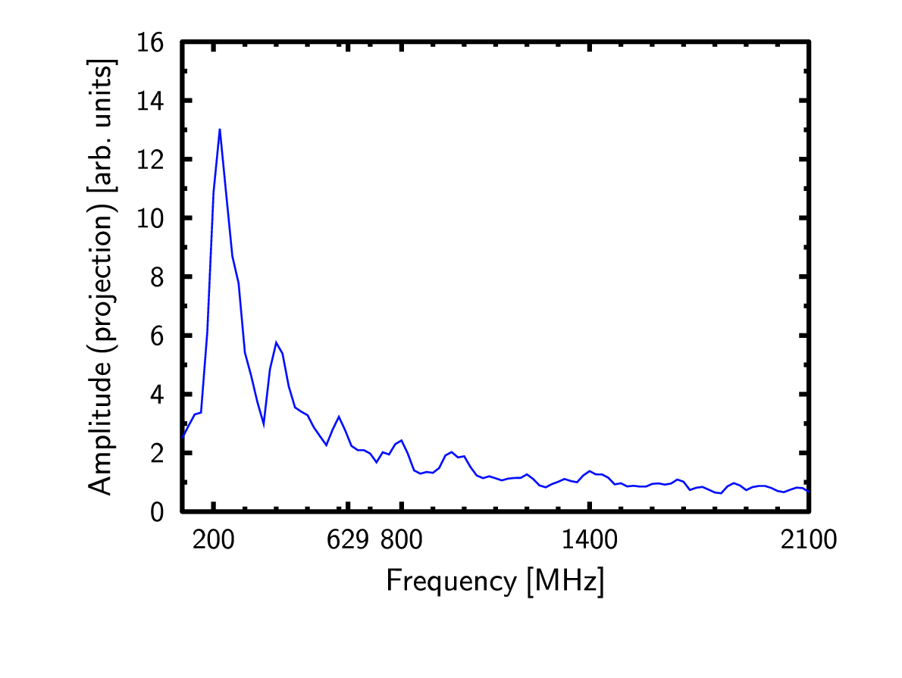
The effect of damping resistors
Without damping resistors
With damping resistors
f_{r} (GHz) | R_{sh} (MOhm) | Q | R/Q (kOhm)
1.41 ** | 3.91 | 1828 | 2.140
f_{r} (GHz) | R_{sh} (MOhm) | Q | R/Q (kOhm)
1.41 ** | 0.391 | 183 | 2.140
No damping increases the amplitude of the 1.4 GHz peak.

Slide 8
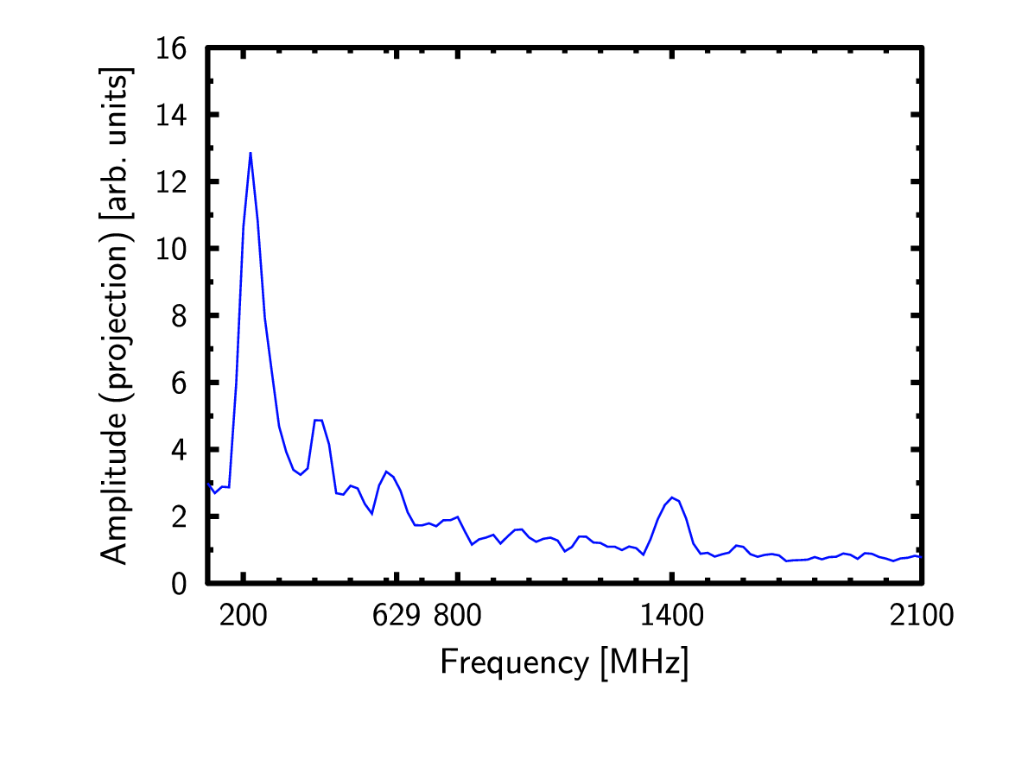
The effect of BPMs and Zs
With BPMs and Zs (and with damping resistors)
Without BPMs and Zs (and with damping resistors)
BPMs & Zs impedances sit in the range 1 GHz – 2 GHz, and can potentially damp the 1.4 GHz peak significantly. A precise knowledge of BPM and Zs impedance is required.

Slide 9
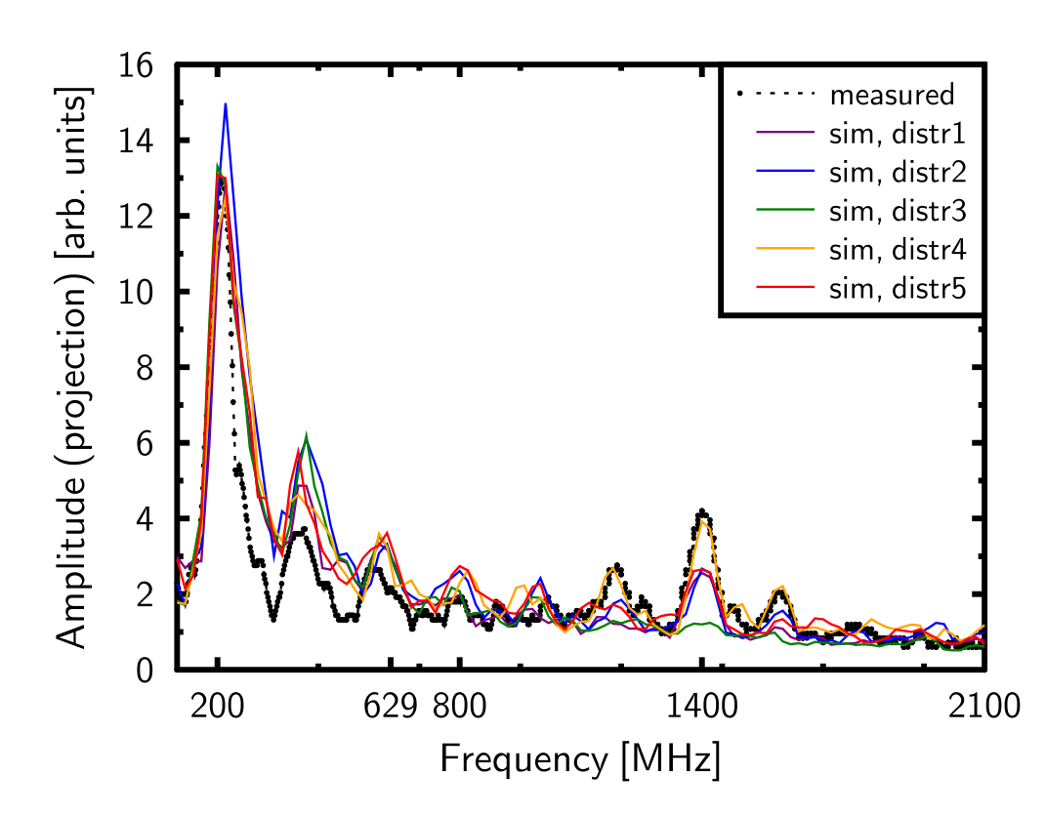
Different bunch distributions (1)
No BPM&Zs impedance
Damping resistors
Simulated with five different measured distributions
On average, we still miss some impedance

Slide 10
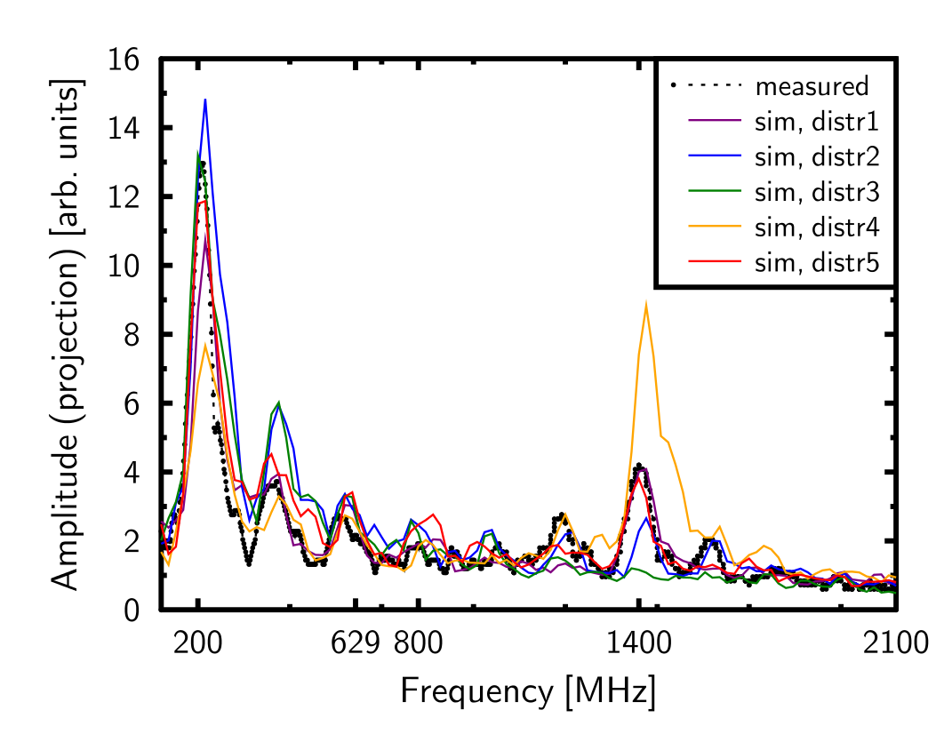
Different bunch distributions (2)
No BPM&Zs impedance
Damping resistors, w/ R/Q increased; ~15 % higher R_{sh} at 1.4 GHz
Simulated w/ different measured distributions
Fits on average
N.B. non-linear scaling between amplitude and impedance

Slide 11
Conclusions from de-bunching simulations
Measurements and simulations are close
Only a narrow band of 1.4 GHz R/Q fits the observations
Simulations using the flange impedance are close to observations
Still lack part of the impedance; how much exactly?
To pin down exactly the source of the 1.4 GHz peak
We still have too many uncertainties in our model
BPM and Zs impedance
The effect of damping resistors
Other similar elements in the ring that have not yet been counted
Error sources in the measured spectrum:
Fluctuations in intensity and bunch distribution

Slide 12
Bunch lengthening on flat top
Can bunch lengthening at flat top be explained by microwave instability?
And can our present impedance model explain it?
Simulations are not trivial because we don’t know the exact conditions at arrival to flat top
Bunches are stable at flat bottom even at 4×10¹¹ (but Landau damping can be lost and losses can be significant)

Slide 13
Plans
De-bunching simulations
For more precise estimates need to eliminate uncertainties
Benchmarking of codes increased our trust in the results
Other measurements we should exploit
Bunch lengthening at flat top (single bunches)
Single bunch instability thresholds at flat bottom/flat top
Longitudinal coupled-bunch instabilities
Simulations on all these are underway

