Slide 1
Microwave instability in the SPS
Beam measurements: T. Argyropoulos, T. Bohl, J.E. Muller, H. Timko, E. Shaposhnikova
Particle simulations: T. Argyropoulos, H. Timko
Lab measurements: J. Varela, F. Caspers
EM simulations: B. Salvant, J. Varela

Slide 2
Microwave instability in the SPS
The microwave instability was observed at SPS injection for > 20 years
In preparation of the SPS as LHC injector this instability was identified (measurements with RF off and simulations) to be caused by impedance of pumping-ports. In 2000 almost all PPs (~ 1000) were shielded
Measurements with long bunches and RF off in 2012 revealed again 1.4 GHz peak (seen in 2001&2007 => impedance was already there)
Recent measurements with single high intensity bunches (RF on):
strong bunch lengthening on the flat top in both Q20 and Q26 and 800 MHz on during MDs:
LHC (high intensity bunches with 7 MV)
AWAKE (bunch rotation with 2 MV->7 MV)
instability during ramp which could be cured up to certain energy by voltage reduction (increased Landau damping), but then strong particle losses would require to increase voltage again

Slide 3
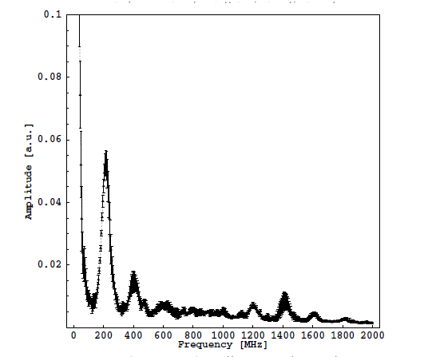
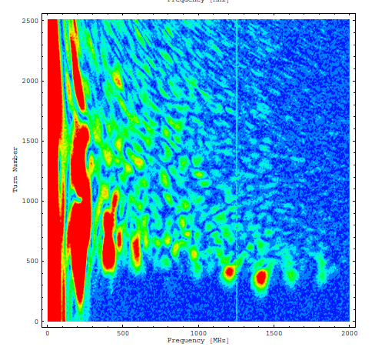
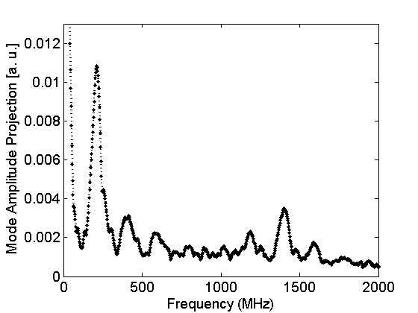
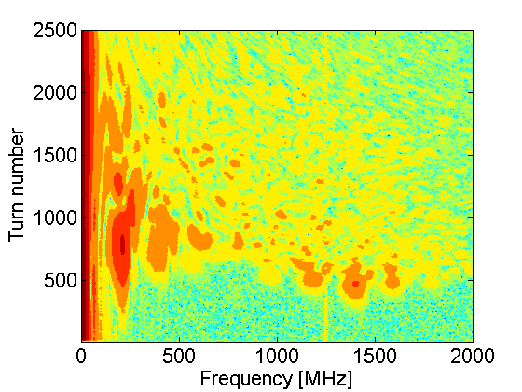
Beam measurements: RF off, long bunches
Projection
Contour plot
T. Bohl et al.
2001
2007
N = 8x10¹⁰
?
2012
T. Argyropoulos et al.
N = 8x10¹⁰

Slide 4
SPS longitudinal impedance budget
 | f_{r} [MHz] | n | R_{sh} [MΩ] | Q | R/Q [kΩ]
MKE serigraphy | 44.0 | 8 ? | 0.026 | 11 | 2.4
TWC200 – F (long) | 200.2 | 2 | 2.86 | 150 | 19.1
TWC200 – F (short) | 200.2 | 2 | 1.84 | 120 | 15.3
BPM V | 298.0 | 96 | 0.18 | 240 | 0.74
All kickers (approx.) | 600.0 | 20? | 0.042 | 0.7 | 60.0
TWC200 – HOM | 629.0 | 4 | 0.39 | 500 | 0.8
TWC800 - F | 800.8 | 2 | 1.94 | 300 | 6.5
BPM H | 1070.0 | 106 | 0.9 | 700 | 1.3
Pumping modules ZS | 1180.0 | 7 | 7.7 | 11000? | 0.45
“1.4” GHz impedance | 1400.0 | ? | 0.33? | 15? | 22.0?
BPM H | 1613.0 | 106 | 1.28 | 680 | 1.9
Refs. B. Salvant, K. Zannini, G. Dome, H. Timko, T. Argyropoulos

Slide 5
Loss of Landau damping (simplified scaling)
To avoid loss of Landau damping due to ImZ/n
$\frac{ImZ}{n}<F1 \frac{ E|η|}{eI0} {\left(\frac{Δp}{p}\right)}^{2}{\left(\frac{ΔΩ}{Ω}\right)}^{ }$(f₀ τ)
SPS:
For “1.4 GHz” impedance with n_{r}=32340, R_{sh} =330 kOhm and Q=15 contribution to ImZ/n = R_{sh}/(Q n_{r}) = 0.7 Ohm

Slide 6
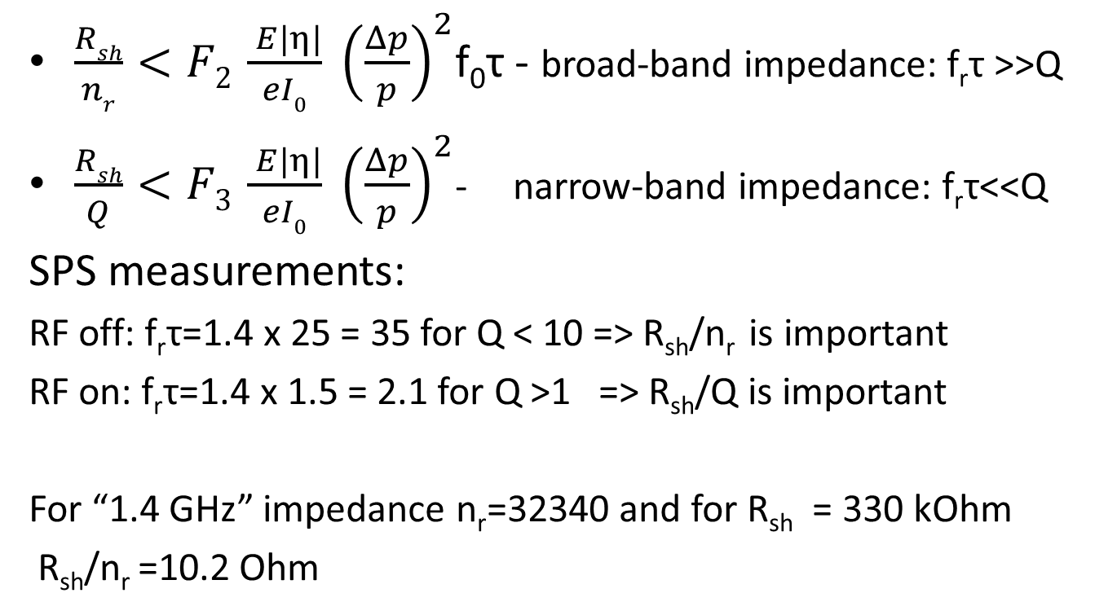
Microwave instability (simplified scaling)
$\frac{Rsh}{nr}<F2 \frac{ E|η|}{eI0} {\left(\frac{Δp}{p}\right)}^{2}$f₀τ - broad-band impedance: f_{r}τ >>Q
$\frac{Rsh}{Q}<F3 \frac{ E|η|}{eI0} {\left(\frac{Δp}{p}\right)}^{2}$- narrow-band impedance: f_{r}τ<<Q
SPS measurements:
RF off: f_{r}τ=1.4 x 25 = 35 for Q < 10 => R_{sh}/n_{r} is important
RF on: f_{r}τ=1.4 x 1.5 = 2.1 for Q >1 => R_{sh}/Q is important
For “1.4 GHz” impedance n_{r}=32340 and for R_{sh} = 330 kOhm
R_{sh}/n_{r} =10.2 Ohm

Slide 7
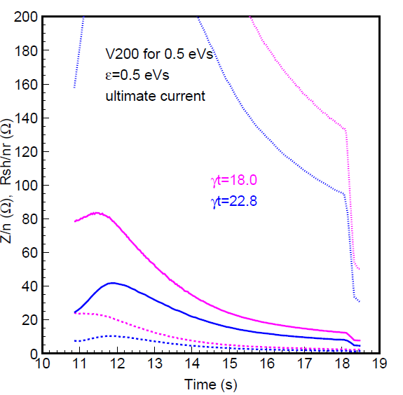
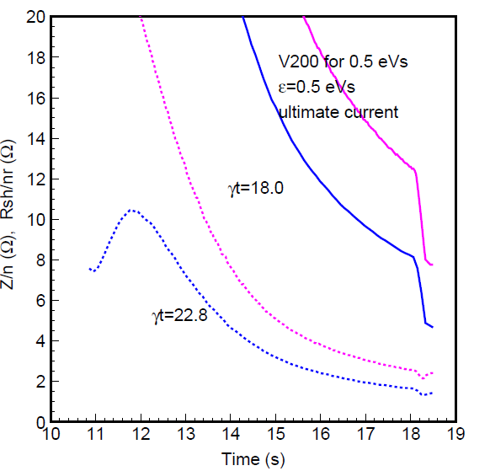
Microwave instability & loss of Landau damping (LLD) thresholds (V for const bucket area)
R_{sh}/Q
[kΩ]
Z/n [Ω]
(LLD)
R_{sh}/n_{r}
R_{sh}/n_{r} [Ω]
Mw instability threshold drops down at the end of the cycle

Slide 8
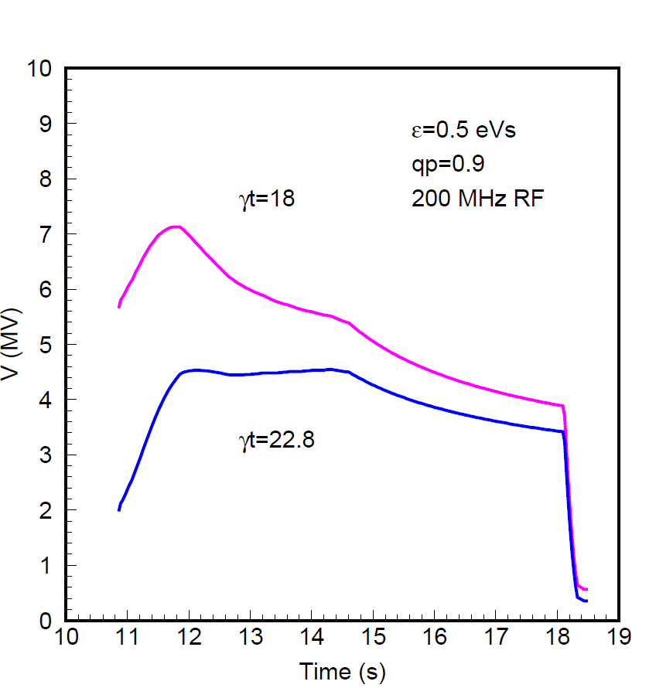
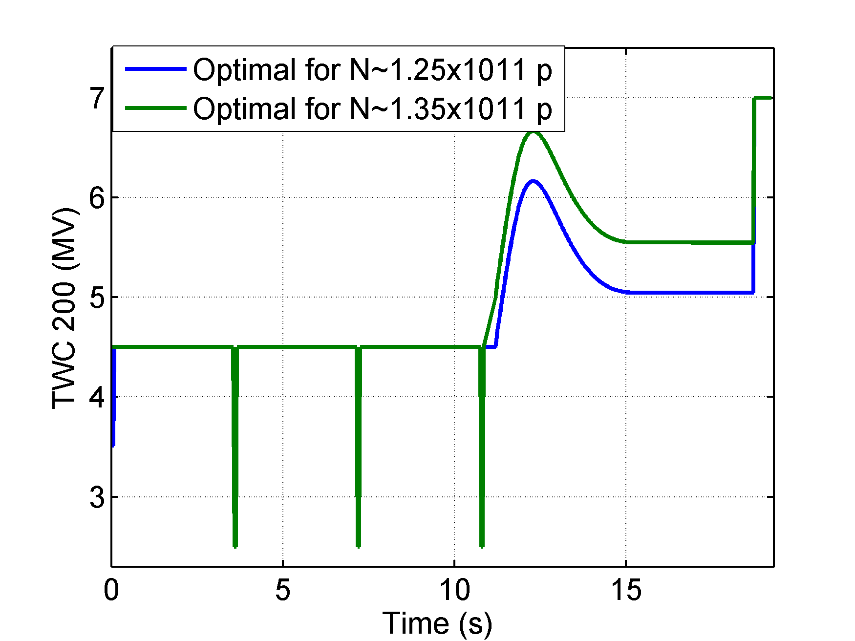
Voltage programs
V for constant bucket area
Operational V

Slide 9
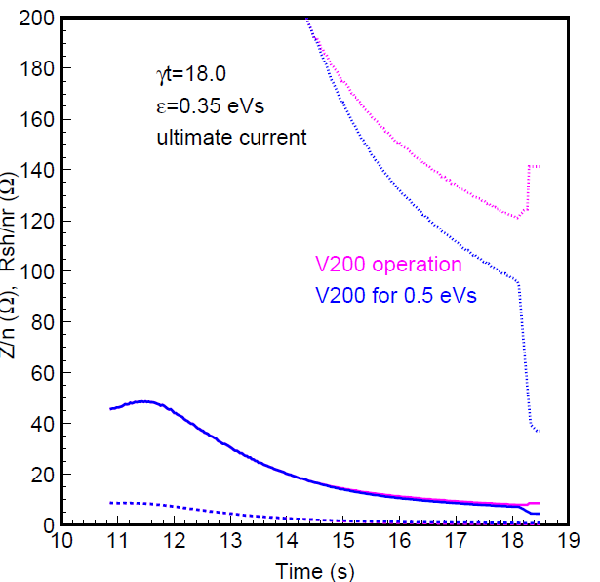
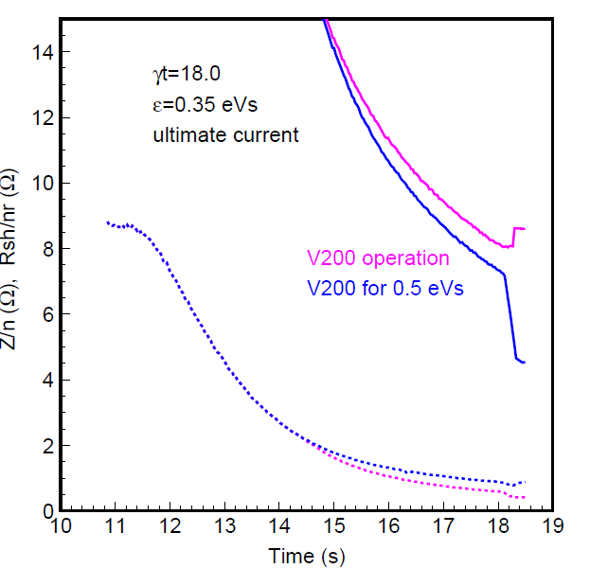
Microwave instability & LLD thresholds for two different voltage programs (Q20)
R_{sh}/Q
[kΩ]
R_{sh}/n_{r} [Ω]
Z/n [Ω]
(LLD)

Slide 10
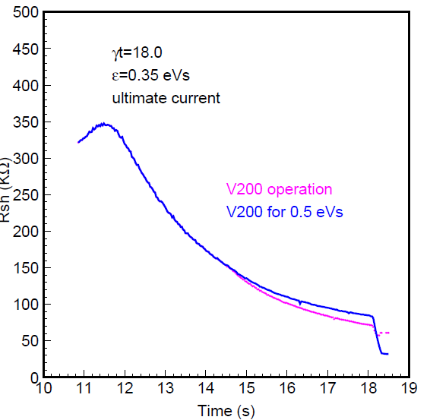
Coupled-bunch instability threshold for two different voltage programs (Q20)
With phase loop, FB, FF and longitudinal damper (and many different impedances in the ring) it is difficult to estimate the real threshold…
Plus 800 MHz in operation

Slide 11
Microwave coupled-bunch instability?
Experimental observations
Instability starts at energy ~1/N_{tot} => multi-bunch effect
Instability threshold (energy during ramp) is similar with 1, 2, 3 or 4 batches in the ring
Threshold of 6 bunches spaced by 50 ns is much lower than of a single bunch
In a single 200 MHz RF intensity threshold for 50 ns beam at flat top is factor 5 lower than for a single bunch (~1.1x10¹¹ )
Impedances of BPMs and ZS MPs are by orders of magnitude above thresholds of longitudinal coupled bunch instability (even taking into account dependence ~ f_{r}^{5/2})
Their parameters fit well observed features.
Example: impedance at 1.6 GHz with Q=700 => decay time Q/(π f_{r}) = 140 ns
Covers 3-5 bunches at 50ns and 25ns spacing
LHC beam: 225 ns gap between batches
Can we get better idea from simulations?

