Slide 1
SPS flanges Simulations & Measurements Update
Fritz Caspers and Jose E. Varela

Slide 2
Outline
Introduction
The ‘Thomas Bohl’
Simulations
Measurements
Next Steps
Conclusions

Slide 3
Introduction
We continue to search for possible causes of the suspected 1.4GHz microwave instability in the SPS.
The ‘Thomas Bohl’ has been completed.
We now have a list of the different flange setups, location and total number.
The three ‘most numerous’ flange setups have been simulated.
We have now impedance and R/Q.
More refined measurements have been carried out.
Still, one more version of the measurement set-up is under preparation (expected for mid September).

Slide 4
Outline
Introduction
The ‘Thomas Bohl’
Simulations
Measurements
Next Steps
Conclusions

Slide 5
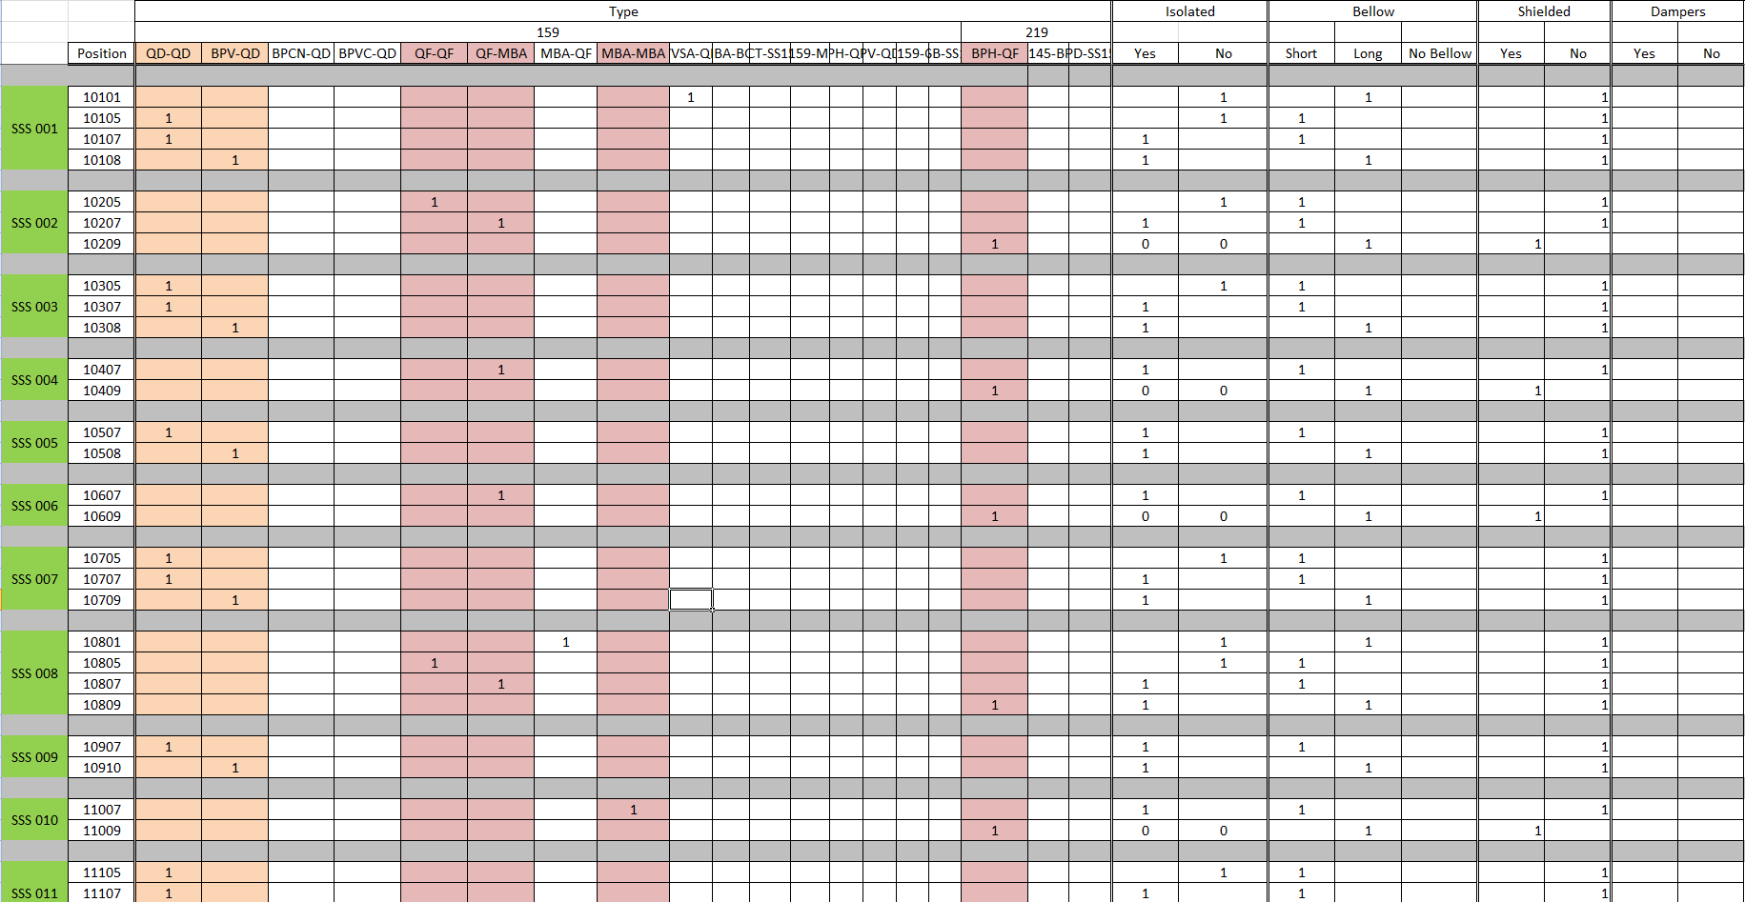
The ‘Thomas Bohl’
Disclaimer: The ‘Thomas Bohl’ does not include the LSSs

Slide 6
The ‘Thomas Bohl’
 | Flange | 1 | 2 | 3 | 4 | 5 | 6 | Total
156 | QF-MBA | 14 | 14 | 15 | 13 | 13 | 14 | 83
156 | MBA-MBA | 2 | 1 | 2 | 4 | 3 | 2 | 14
156 | QD-QD | 16 | 16 | 18 | 16 | 17 | 16 | 99
156 | QF-QF Non-enamelled | 8 | 8 | 5 | 9 | 9 | 7 | 46
156 | QD-QD Non-enamelled | 12 | 13 | 12 | 12 | 14 | 12 | 75
219 | BPV-QD | 14 | 15 | 16 | 15 | 17 | 13 | 90
219 | BPH-QF | 16/12 | 15/7 | 18/10 | 18/12 | 18/11 | 17/11 | 102/63
Analysed combinations

Slide 7
Outline
Introduction
The ‘Thomas Bohl’
Simulations
BPV QD-QD enamelled flange
BPV QD-QD non-enamelled flange
BPH MBA-MBA enamelled flange
Total Impedance so far
Measurements
Next Steps
Conclusions

Slide 8
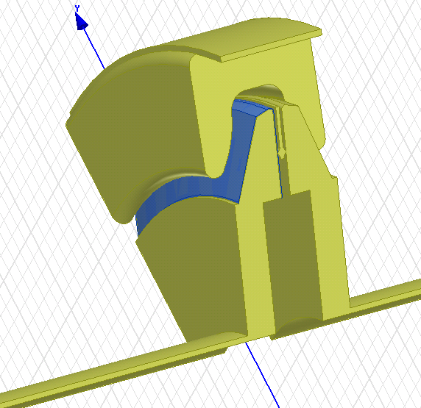
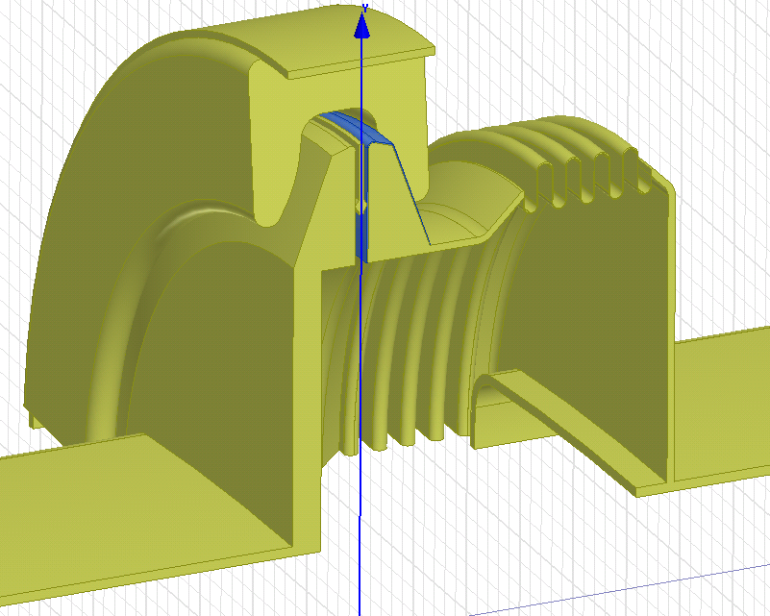
Simulations
HFSS models for the enamelled QD-QD and MBA-MBA+bellow flanges.
QD-QD
MBA-MBA

Slide 9
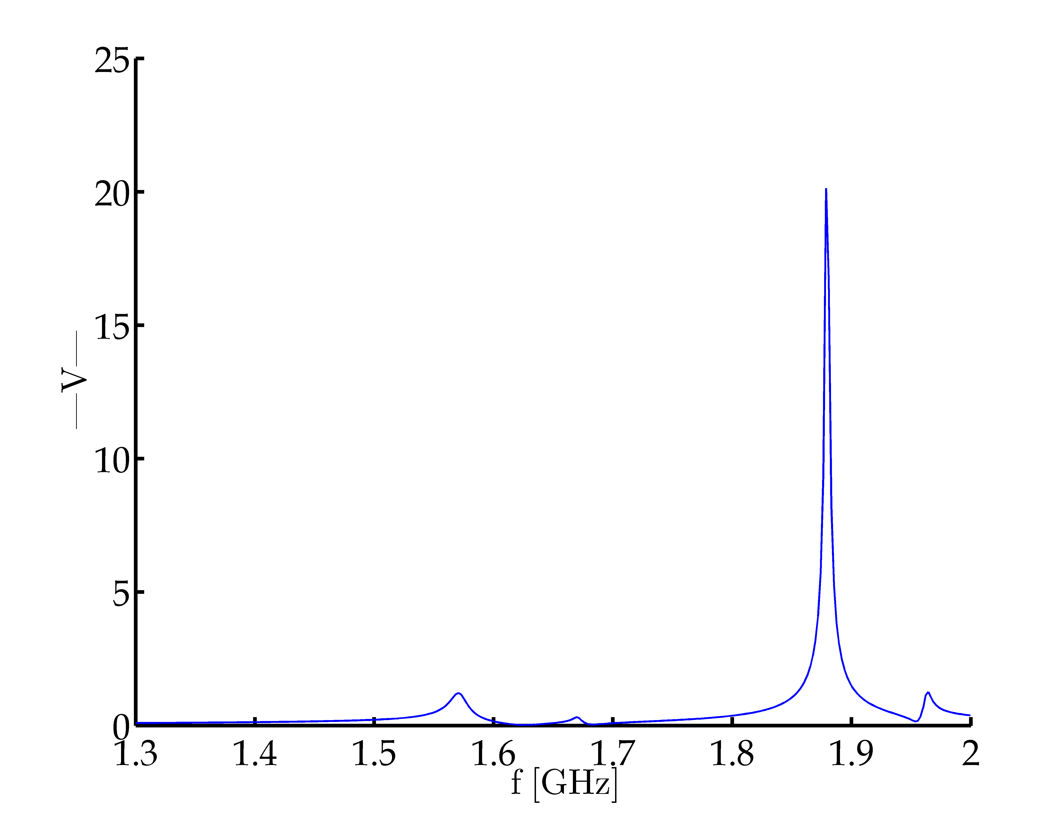
Simulations – QD-QD enamelled flange
Frequency [GHz] | Impedance | Q | R/Q
1.57 | 0.25kΩ | 138 | 1.8
1.89 | 5.5kΩ | 925 | 6
Modulus of the voltage for a 1W plane wave source.

Slide 10
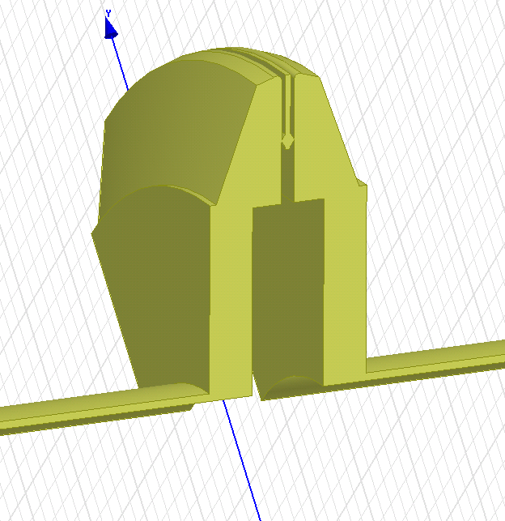
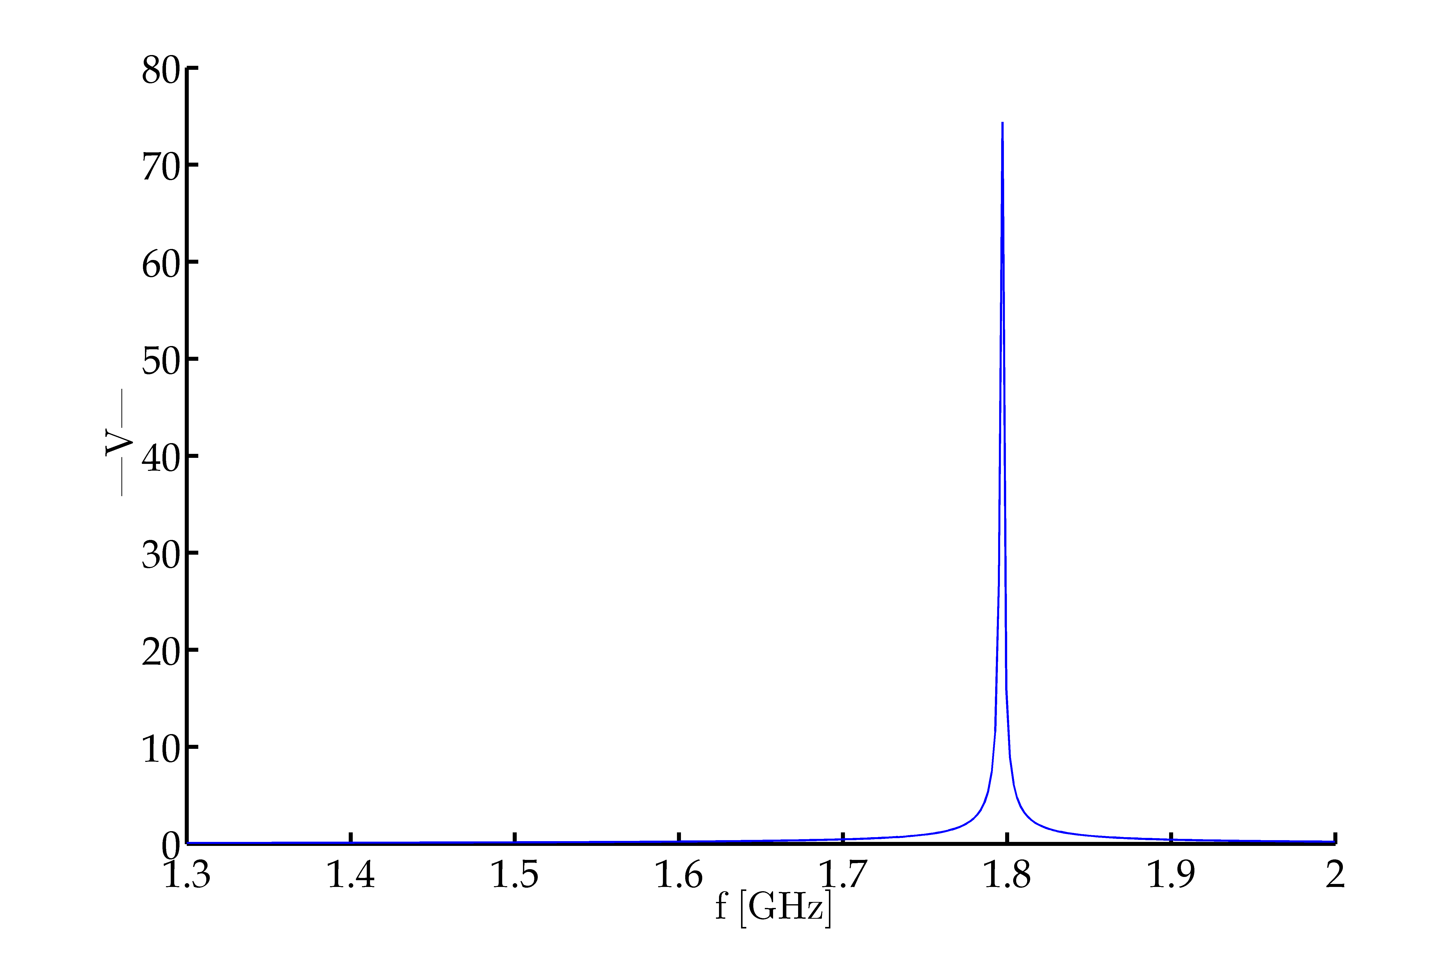
Simulations – QD-QD non-enamelled flange
Frequency [GHz] | Impedance | Q | R/Q
1.8 | 78kΩ | 9350 | 8.5

Slide 11
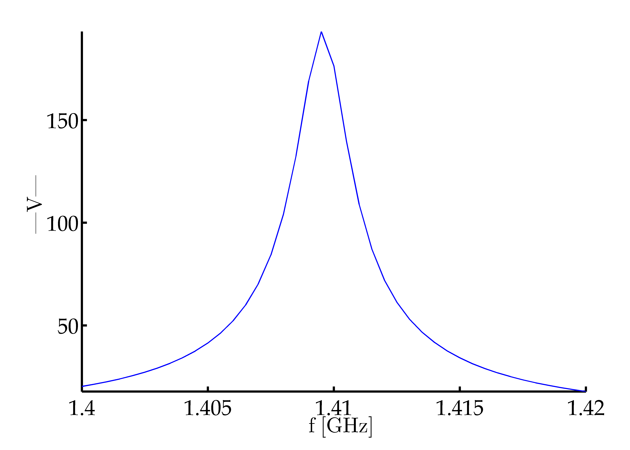
Simulations – MBA-MBA enamelled flange
Under sampled bell
Frequency [GHz] | Impedance | Q | R/Q
1.41 | 38kΩ | 1000 | 38

Slide 12
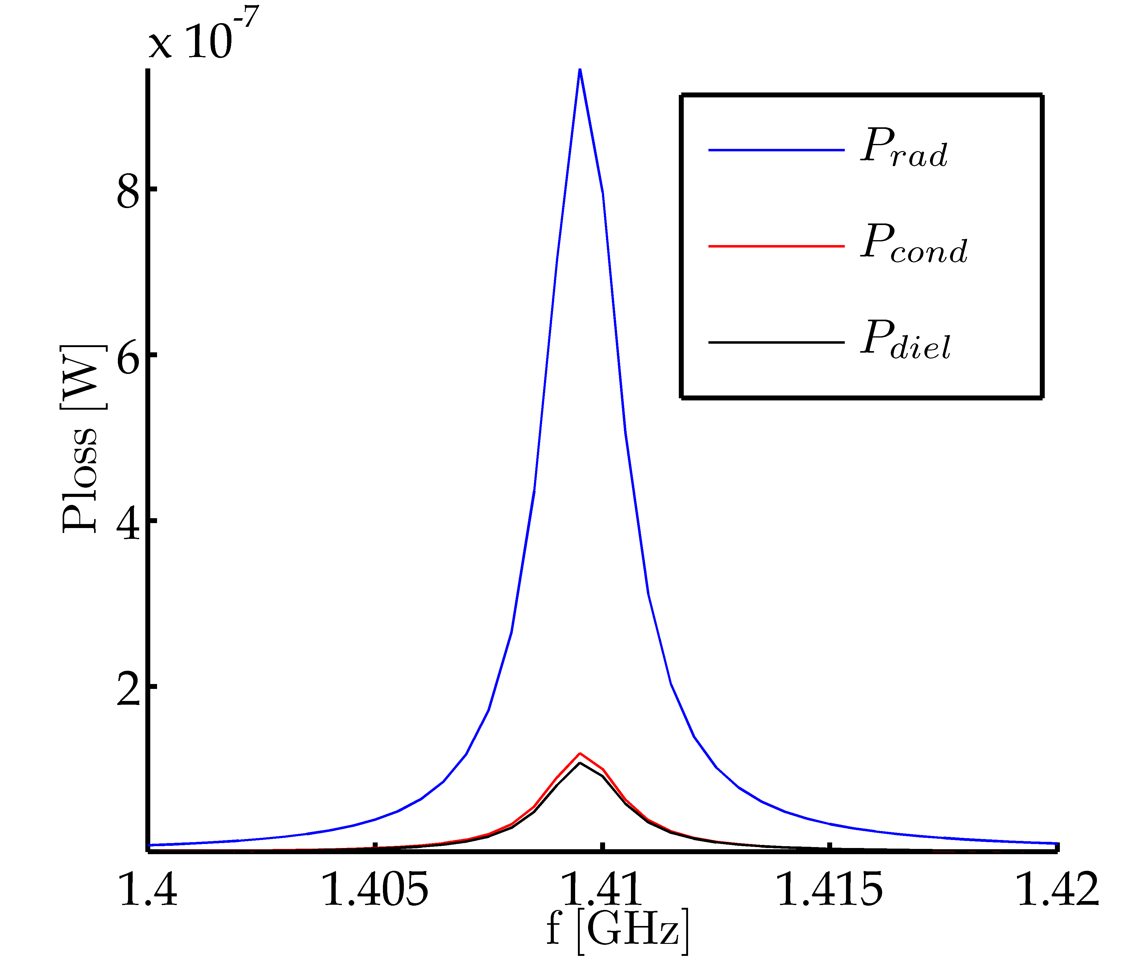
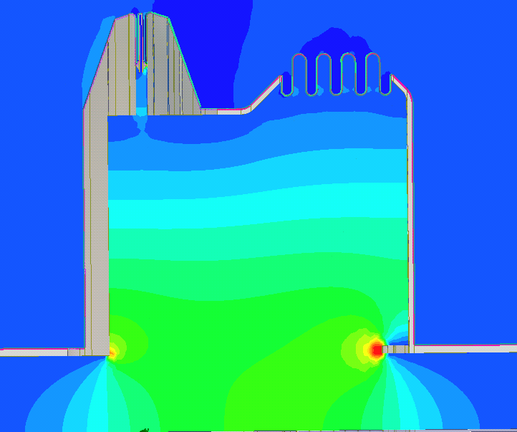
Simulations – MBA-MBA enamelled flange
Ez (t=0)

Slide 13
Simulations – Total Impedance so far
Freq [GHz] | Num. of elements | Impedance | R/Q
1.41 | 97 | 3.68MΩ | 3686
1.57 | 99 | 50kΩ | 178
1.8 | 75 | 5.85MΩ | 637
1.89 | 99 | 544kΩ | 594

Slide 14
Outline
Introduction
Simulations
MBA-MBA enamelled flange with bellow
Previous Wire Measurement
Shielded BPH Wire Measurement
Reflection Measurements
Next Steps
Conclusions

Slide 15
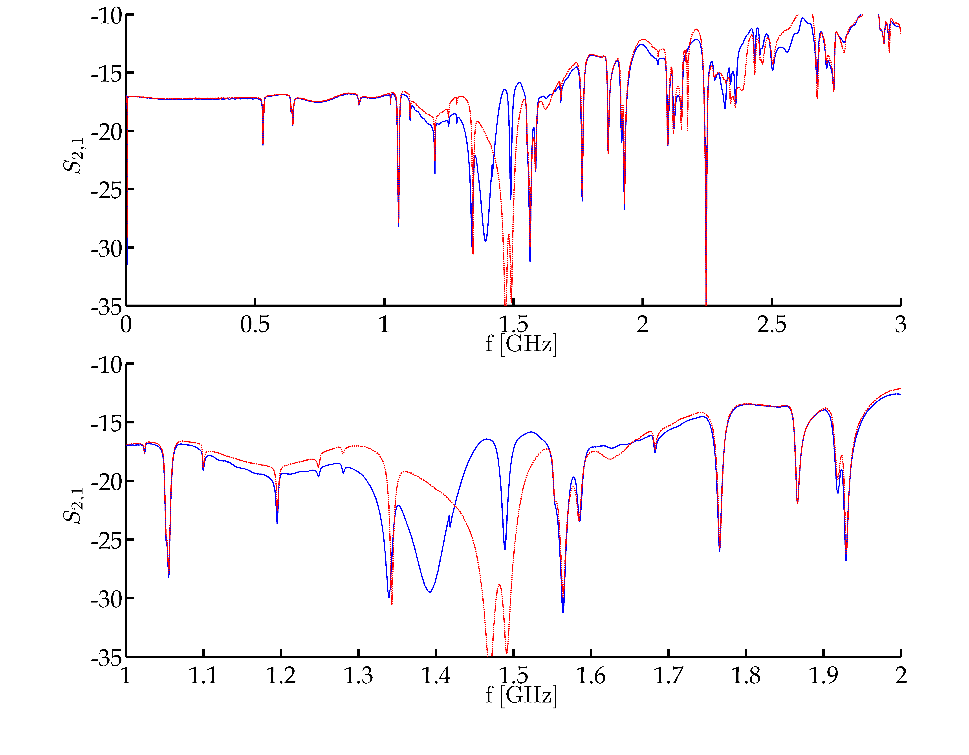
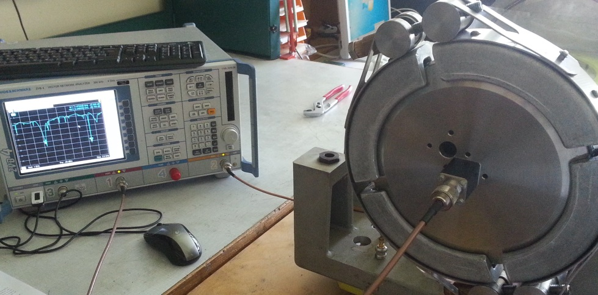
Measurements – Previous Meas.
Last meeting we showed a not so clear wire measurement of a BPH.

Slide 16
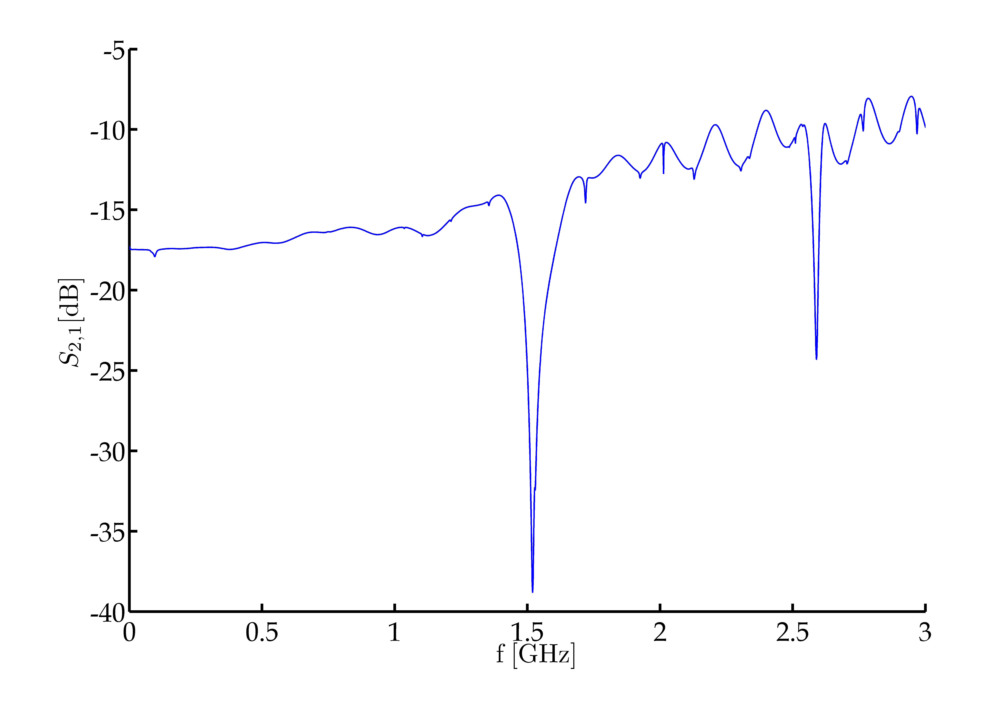
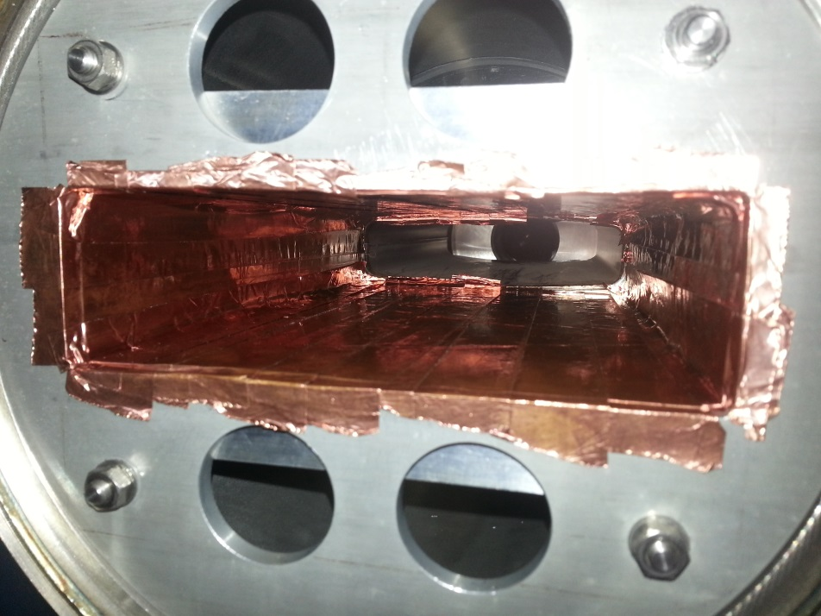
Measurements – Shielded BPH
New wire measurement once the pick-up has been shielded.
Very thin wire used. ≈0.1mm
Rappel: TE and TM resonant mode classification is only valid for ‘pillbox’ cavities.

Slide 17
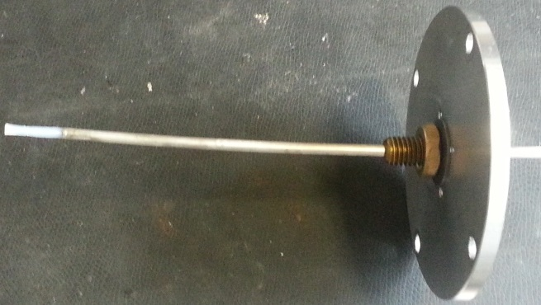
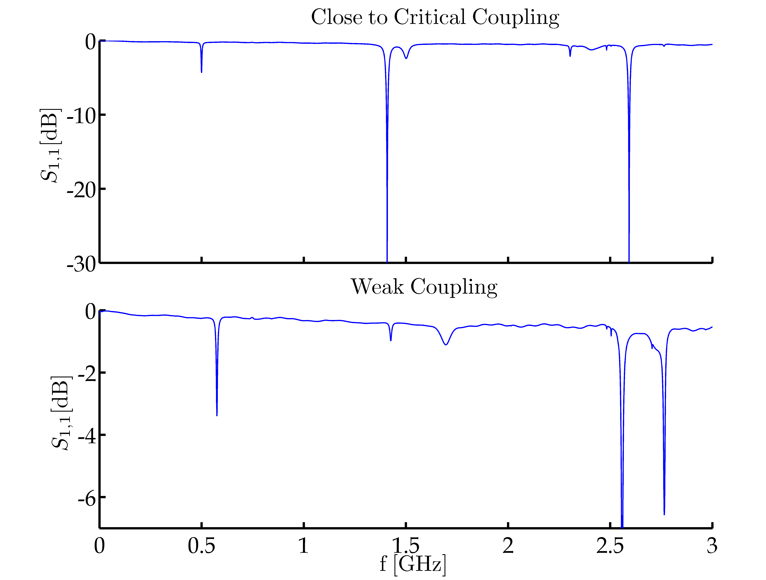
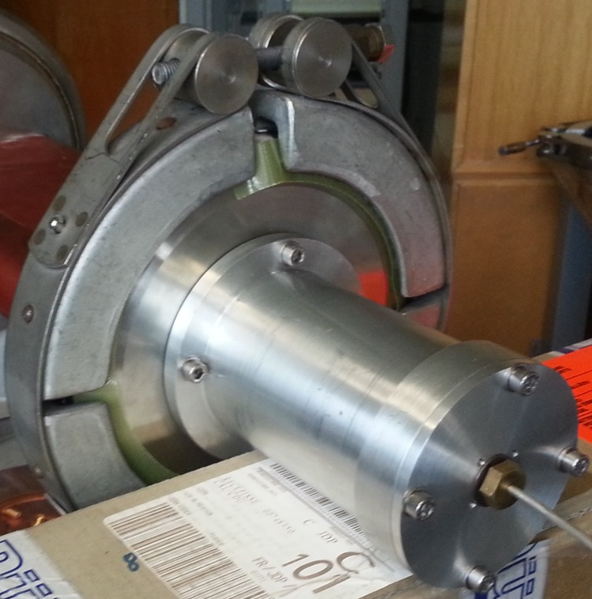
Measurements – Reflection Meas.
Reflection measurement with a probe.
Weak coupling checked via Smith Chart

Slide 18
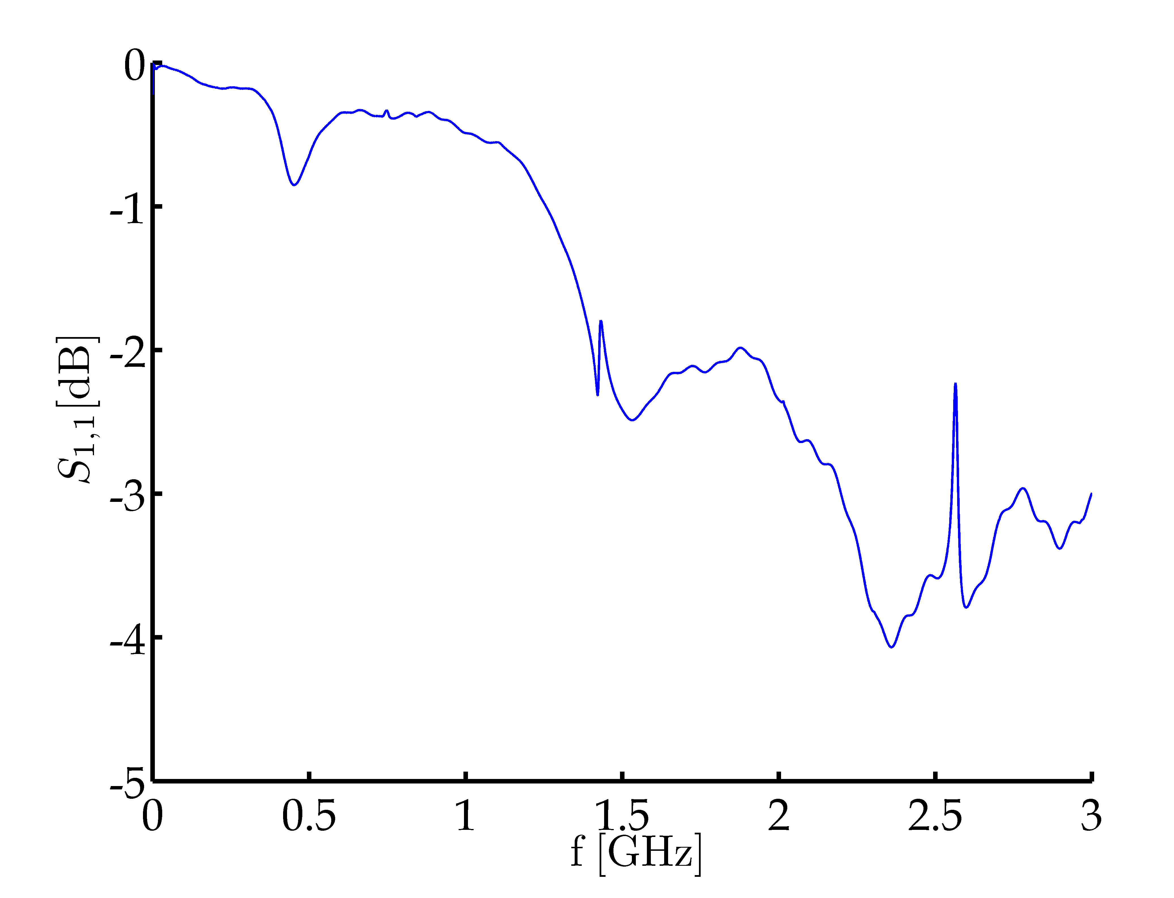
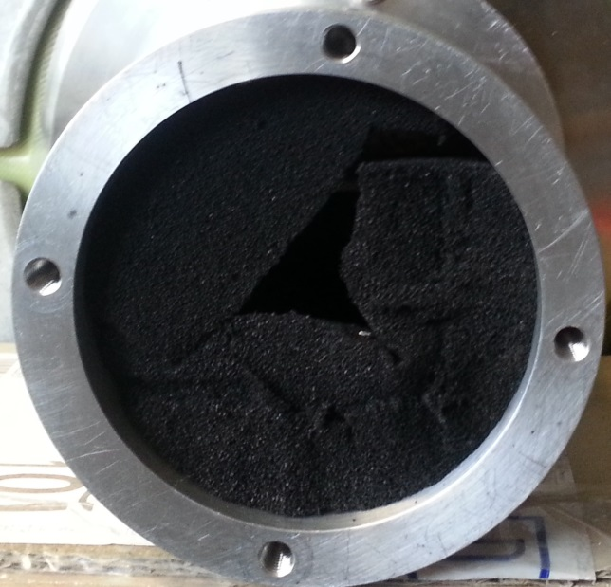
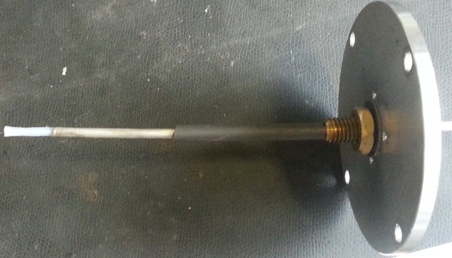
Measurements – Reflection Meas.
Reflection measurement with a probe. Coaxial mode damping.
Ferrite + foam to damp the coaxial resonances created by the probe.

Slide 19
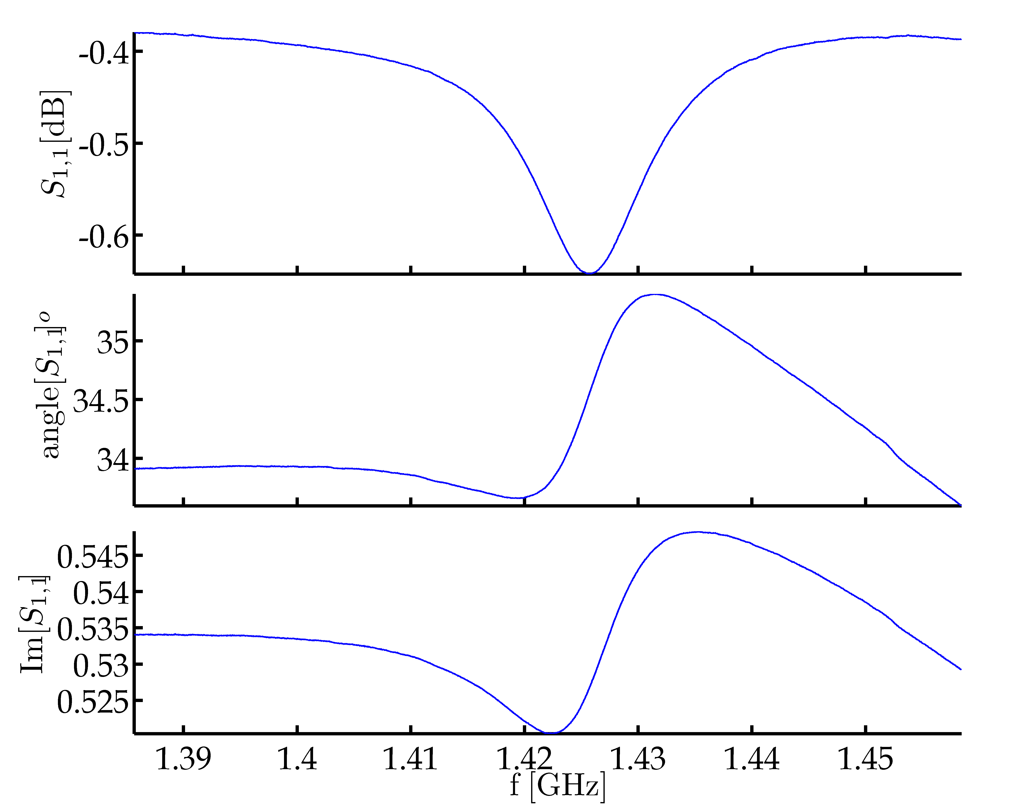
Measurements – Reflection Meas.
Reflection measurement with a probe. Q measurement.
Measured
Q = 110

Slide 20
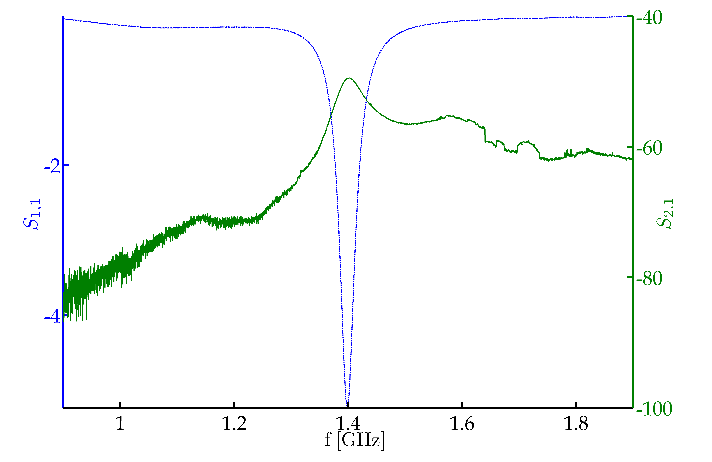
Measurements – Transmission Meas.
Transmission measurement with two probes.
Weak coupling checked via Smith Chart

Slide 21
Outline
Introduction
Simulations
Measurements
Next Steps
Conclusions

Slide 22
Next Steps
Simulations
Complete all possible flange combinations.
Special attention to the QF-QF non-enamelled case.
Find a way to overcome current limitations.
Measurements:
Wait for the new set-up. Expected for mid september.
Suggestions?

Slide 23
Outline
Introduction
Simulations
Measurements
Next Steps
Conclusions

Slide 24
Conclusions
We have values for the impedance and R/Q of three of the most numerous flange combinations.
After shielding the pick-up, the BPH flange measurements are cleaner. A Q of 120 has been measured for the 1.4GHz resonance.
Simulations and Measurements clearly show a 1.4GHz resonance.
Whether or not, this resonance is responsible for the instability is left for discussion.

