Slide 1
SPS de-bunching simulated with Headtail
Theodoros Argyropoulos, Thomas Bohl, Giovanni Rumolo, Elena Shaposhnikova, Carlo Zannini, Helga Timko
BE-RF-BR

Slide 2
Where are we now?
Some observational facts…
De-bunching of 25 ns long bunches:
Presence of an unknown 1.4 GHz impedance and its “sidebands”
Bunch length vs intensity on flat top for bunched beam:
Strong bunch lengthening effect, which cannot be explained by potential-well distortion alone; microwave instability?
Instability thresholds don’t scale as expected with energy:
Microwave instability at flat top could perhaps explain this…

Slide 3
SPS impedance model (1)
5 cavity contributions
fr (MHz) | Rsh (MOhm) | Q | R/Q (kOhm)
200.222 | 2.86 | 150 | 19.07
200.222 | 1.84 | 120 | 15.33
629 | 0.388 | 500 | 0.78
800.888 | 1.94 | 300 | 6.47
1400 | unknown | unknown | unknown

Slide 4
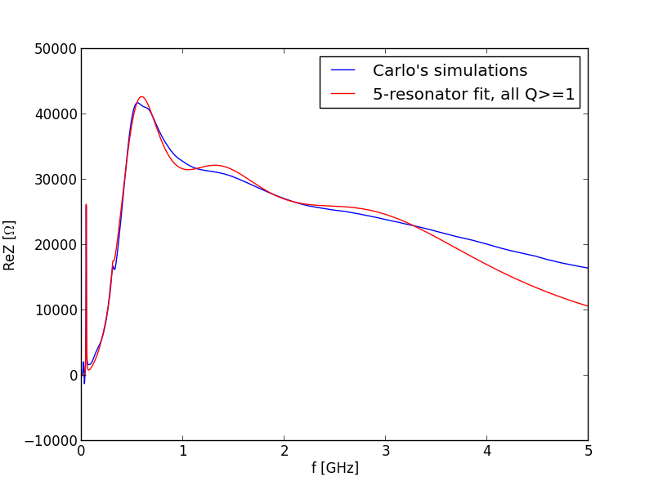
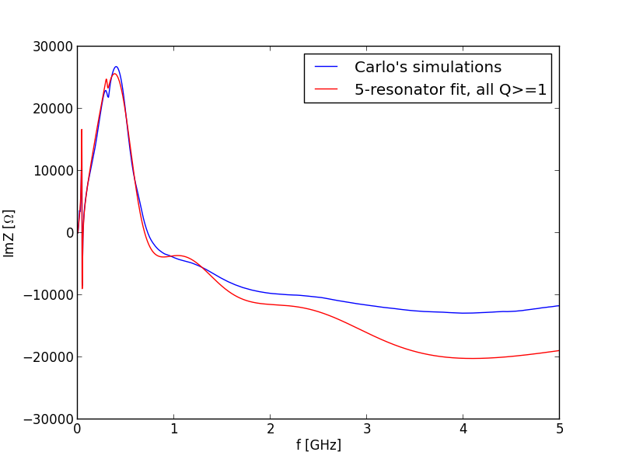
SPS impedance model (2)
5 kicker contributions
fr (MHz) | Rsh (MOhm) | Q | R/Q (kOhm)
44 | 0.026 | 11 | 2.36
305 | 0.0025 | 12 | 0.21
570 | 0.038 | 1 | 38.00
1400 | 0.02 | 1 | 20.00
3000 | 0.018 | 1 | 18.00

Slide 5
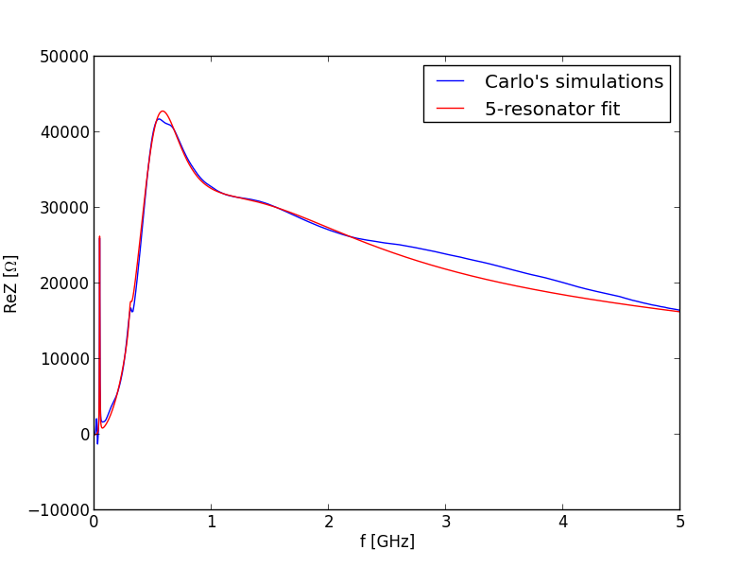
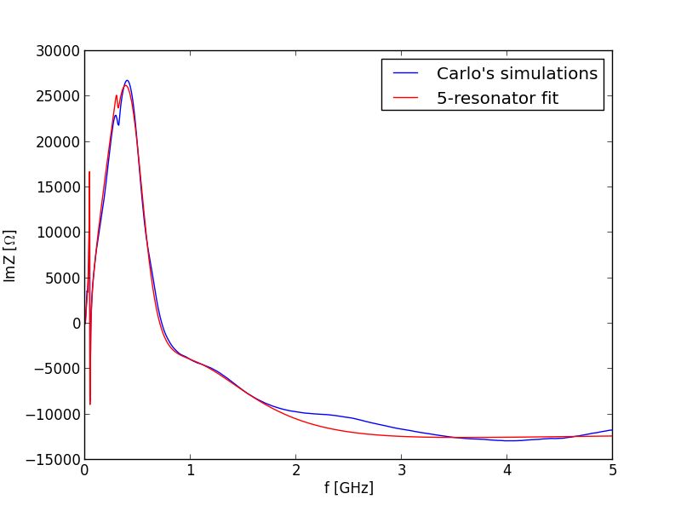
A more “perfect” fit to kicker data (not used in simulations)
5 kicker contributions
N.B. the over-damped 3 GHz
resonator…
fr (MHz) | Rsh (MOhm) | Q | R/Q (kOhm)
44 | 0.026 | 11 | 2.36
305 | 0.0025 | 12 | 0.21
550 | 0.032 | 1.1 | 29.09
1400 | 0.014 | 0.6 | 23.33
3000 | 0.014 | 0.25 | 56.00

Slide 6
SPS impedance model (3)
9 BPM + 1 Zs contribution
fr (MHz) | Rsh (MOhm) | Q | R/Q (kOhm)
265 | 0.187 | 260 | 0.72
295 | 0.162 | 240 | 0.68
890 | 0.069 | 490 | 0.14
1055 | 0.7 | 770 | 0.91
1080 | 0.205 | 660 | 0.31
1200 | 0.026 | 620 | 0.04
1600 | 1.28 | 680 | 1.88
1860 | 0.59 | 900 | 0.66
1960 | 0.144 | 2000 | 0.07
(Zs) 1180 | 6.6 | 14000 | 0.47

Slide 7
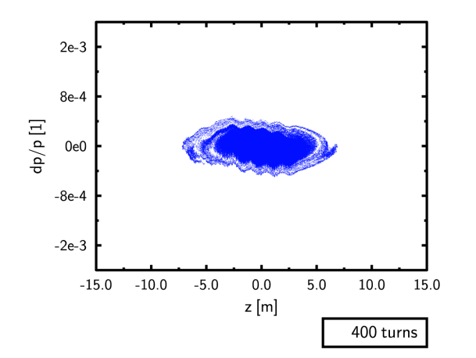
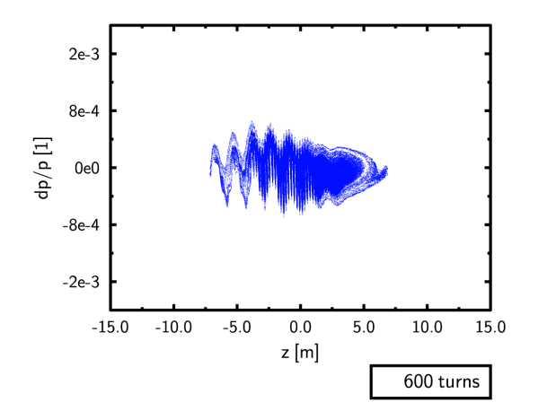
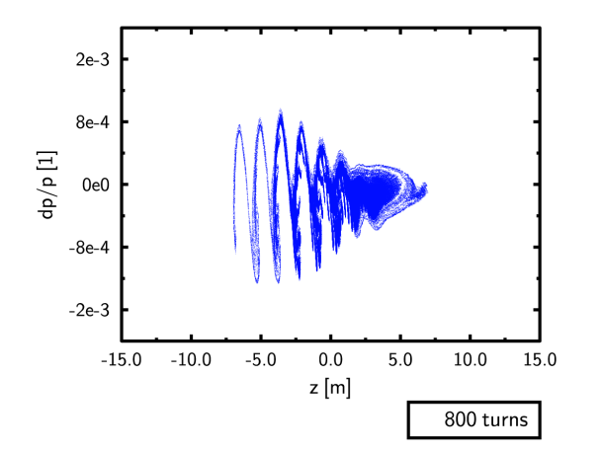
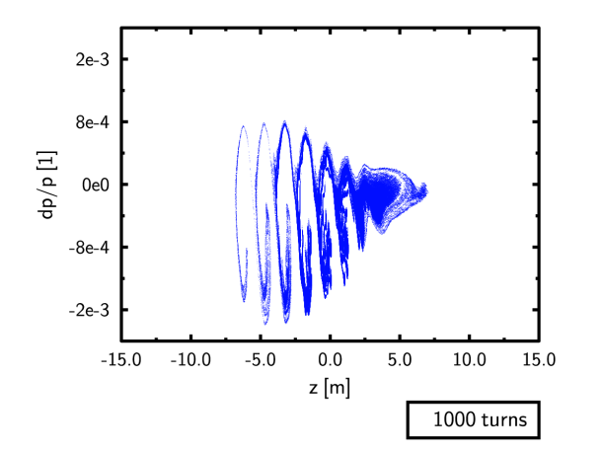
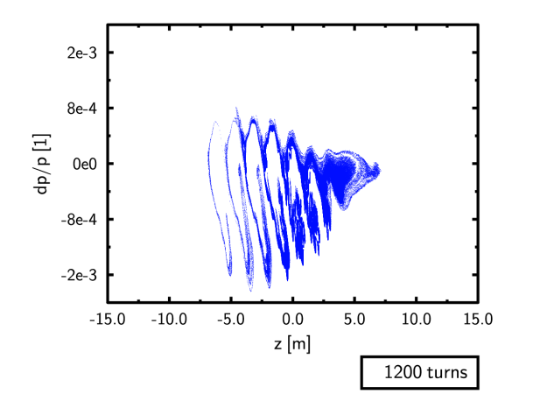
De-bunching of “long” bunches
Thanks for Headtail debugging to K. Li, N. Mounet, and G. Rumolo

Slide 8
De-bunching of “long” bunches
1.4 GHz & 200 MHz modulation

Slide 9
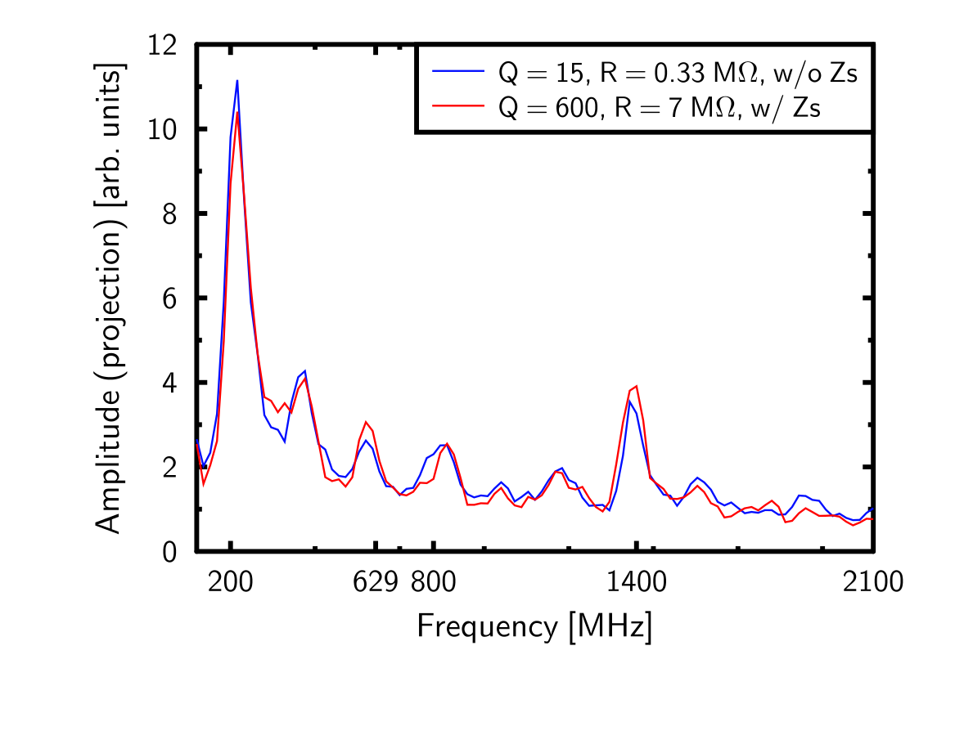
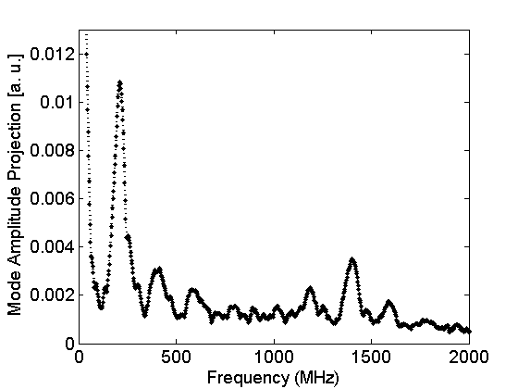
The 1.4 GHz impedance could have a high Q value
Cavities & kickers
Cavities, kickers, BPMs & (Zs)
Measured
‘Sidebands’ originate from the combination of 200 MHz and 1.4 GHz modulation

Slide 10
Possible 1.4 GHz characteristics
Theodoros’ code
Headtail
fr = (1.35–1.45) GHz
Q = 5–10
Rs = (300–400) kΩ
R/Q < 40 kΩ
Q has a wide range
For Q = 10—20
R/Q = (20–30) kΩ
For Q = 600
R/Q = (10–15) kΩ
For the same Q, we find a slightly different Rs. However, we use very different codes and we both find that the results are very sensitive to Rs (~10—20 %).

Slide 11
Conclusions
Comparing the two codes
Agree qualitatively
Still give up to a factor 2 different results for Rs
We have started benchmarking tests today
The 1.4 GHz peak’s Q value
Could be higher than we thought originally
Results to be checked with Theodoros’ code

