Slide 1
Uncontrolled emittance blow-up
Bunch length on FT
Results from the LHC MD on 21.04.2012

Slide 2
High intensity single bunches
Injected bunch intensity (2.0 – 2.2)x10¹¹
Extracted bunch intensity from 7x10¹⁰ to 2.2x10¹¹
Intensity changed in the SPS by horizontal (17620 -17740 ms, 404 GeV) and vertical (17740-17770 ms, 415 GeV) scraping – after controlled longitudinal emittance blow-up, transverse emittances ~2.0 μm, after maximum scraping ~1 μm, at this location dispersion - 0.11m.
800 MHz on in BS mode
1st fill: controlled emittance blow-up to 1.95 ns, (0.85 eVs)
2nd fill: noise off (no emittance blow-up): 1.0 ns for nominal intensity, but ~1.4 ns for 2x10¹¹
3rd fill: small controlled emittance blow-up: 1.1 ns for nominal intensity, but 1.5 ns for 2x10¹¹

Slide 3
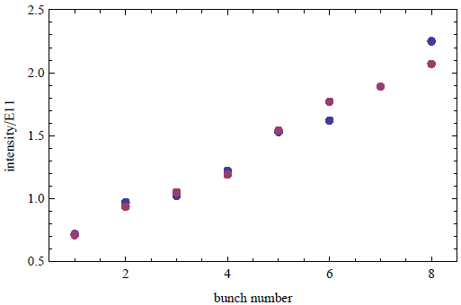
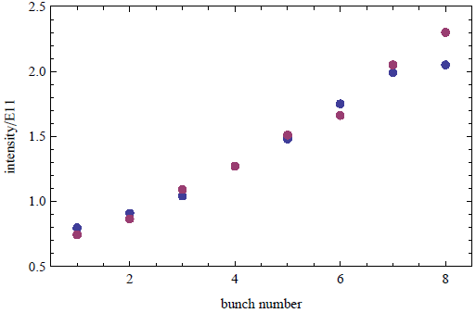
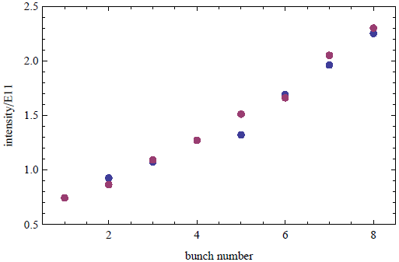
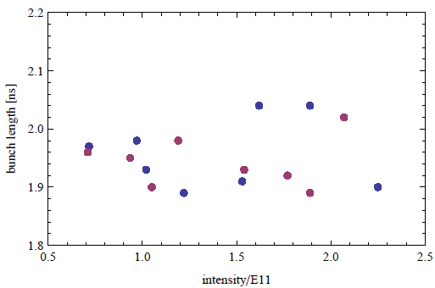
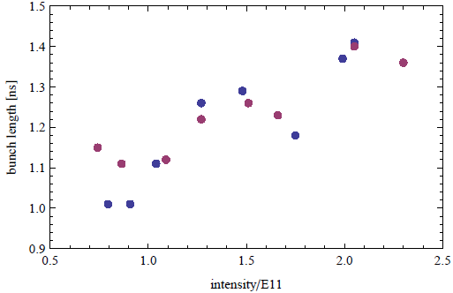
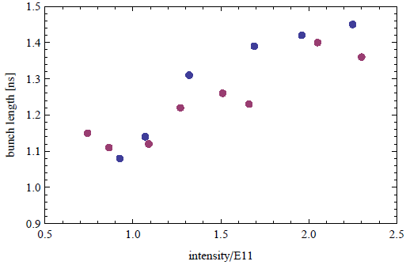
Bunches at 450 GeV
MD Fill 1
MD Fill 2
MD Fill 3
Beam 1
Beam 2

Slide 4
Conclusions
Longitudinal single bunch instability (?) puts a limit to the minimum longitudinal emittance at extraction (0.5 eVs) for intensity of 2.2E11
in the Q26 optics
Repeat these measurements with and without transverse scraping with bunch profile acquisition

