Slide 1
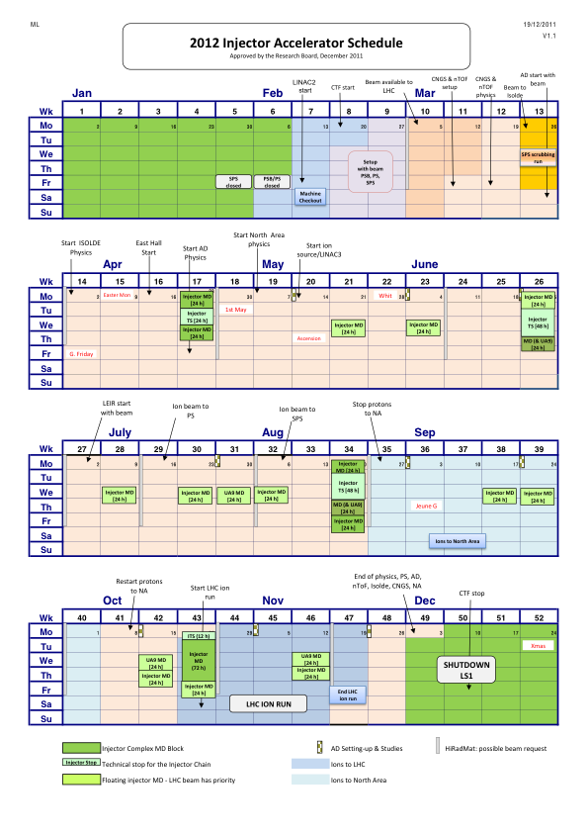
LOGISTIC DETAILS
Scrubbing week: requested in the frame of the LIU-SPS activities to produce inputs to answer the critical question: do we need coating or can we rely only on scrubbing for the SPS upgrade?
Parallel to LHC operation → 1) activities will have to be stopped when the LHC requests beam; 2) manipulations that imply changes of settings affecting LHC beams will certainly not be encouraged; 3) we can get parasitic electron cloud data with 50ns beams (up to high intensity?)
Allocated in Week 13, i.e. the last week of March – to avoid overlap with the Easter weeks (W14 and W15), when it could be more difficult to have experts available due to school holidays
In principle 5 full days to carry out studies and tests. If it turns out to be too long because it is impossible to make some of the tests, we will give the beam back to physics earlier

Slide 2
Goals of the 2012 SPS scrubbing week
Scrubbing the SPS further?
  Perhaps not too much time necessary for that, based on last year’s experience
  Anyway need to clean parts of the machine opened to air during Winter shut-down, or magnets that have been exchanged
Tests of electron cloud enhancement techniques that could be used in the future to achieve a desired degree of scrubbing of the machine (beyond operational). E.g.
  Exotic spacings
  Uncaptured beam
  Shortened bunches
Monitor and qualify beam induced scrubbing under different beam conditions
  Direct electron cloud observation (strip monitors, pick ups?)
  Evolution of some beam observables
Validate the existing simulation models and tools with controlled sets of machine data, especially to answer some open questions
  Primary electron generation, how close can we get to catch the build up phase of the electron cloud formation correctly?
  Non-monotonic dependence of electron cloud on bunch intensity (SPS upgrade studies rely on the experimental verification of this prediction from simulations)
  Memory effect: reflectivity, uncaptured beam, multi-turn…

