Slide 1

2012 SPS Scrubbing Run
H. Bartosik, G.Iadarola
SPSU-BD Meeting
23-02-2012

Slide 2
Main goals of SPS 2012 Scrubbing Run
  Collect as much information as possible for:
  Identification of the present conditioning state of the SPS (and, possibly, of strategies to efficiently obtain further scrubbing)
  A quantitative characterization of the surface scrubbing process due to beam induced electron bombarding (for comparison with lab measurements data)
  Further conditioning of the machine will be achieved

Slide 3
Outline
    Electron cloud along the SPS ring
    Characterization of the scrubbing process
      Dedicated electron cloud experiments
      Parameter to be identified
      A possible estimation strategy
    Draft plan
    Other points for discussion

Slide 4
Outline
    Electron cloud along the SPS ring
    Characterization of the scrubbing process
      Dedicated electron cloud experiments
      Parameter to be identified
      A possible estimation strategy
    Draft plan
    Other points for discussion

Slide 5
Electron cloud in the “real” machine
  Try to enhance electron cloud activity in the SPS (looking for indication of threshold crossing):
    Using uncaptured beam to enhance memory effect
    Injecting 4 or more batches
    Increasing intensity
  Observations:
    Pressure rise
    Transverse tune shift along the batch due to ecloud
    Instability on last bunches of the train (effects on lifetime, bunch length, transverse emittance blow-up)

Slide 6
Outline
    Electron cloud along the SPS ring
    Characterization of the scrubbing process
      Dedicated electron cloud experiments
      Parameter to be identified
      A possible estimation strategy
    Draft plan
    Other points for discussion

Slide 7
Electron cloud dedicated experiments
  4 e-cloud monitors:
    Strip detector with StSt liner
    Strip detector with StSt liner and tungsten clearing electrode
    Detector for slow electron measurements
    Long term experiment for aC coating
  Shielded pick-up
  Microwave transmission setup
  aC coated long straight section
  Removable sample for SEY measurement

Slide 8
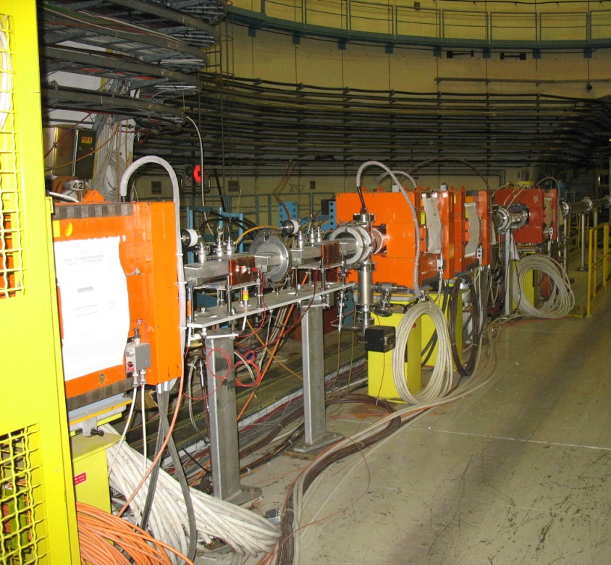
Electron cloud dedicated experiments
  e-cloud monitors
    4 C-magnets in a closed loop
    MBB like chamber
    During scrubbing to be kept by default at SPS injection field (B=0.12T)

Slide 9
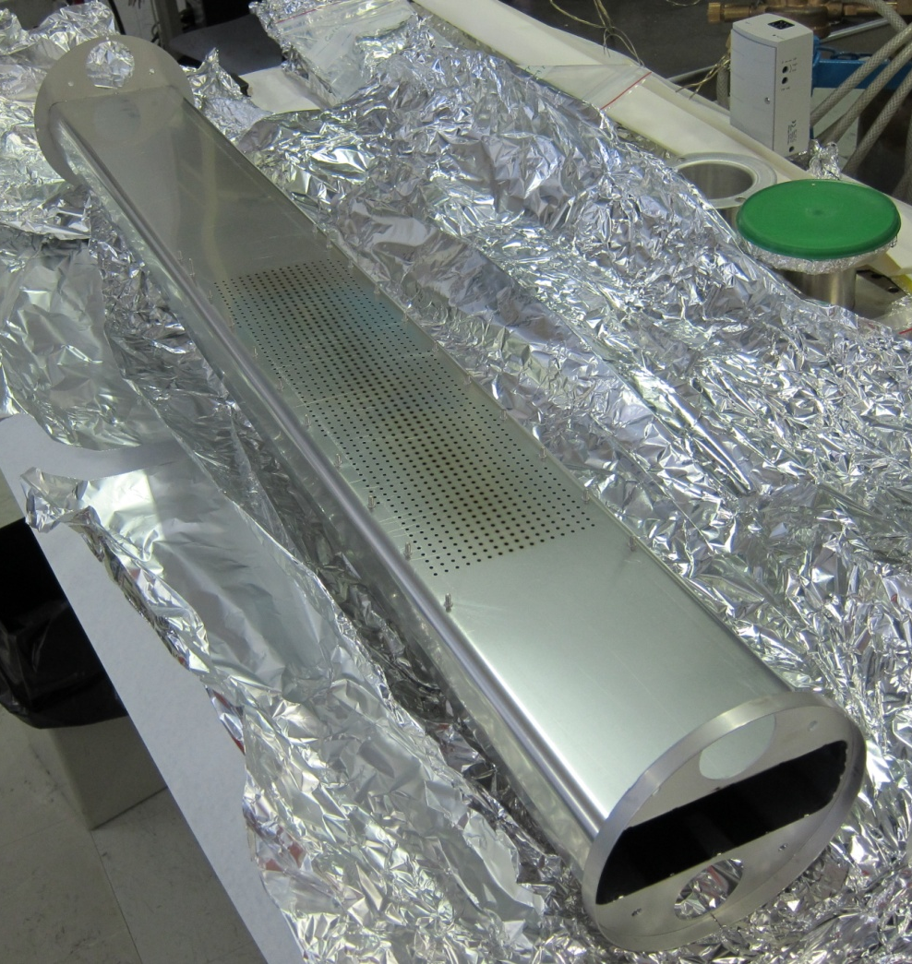
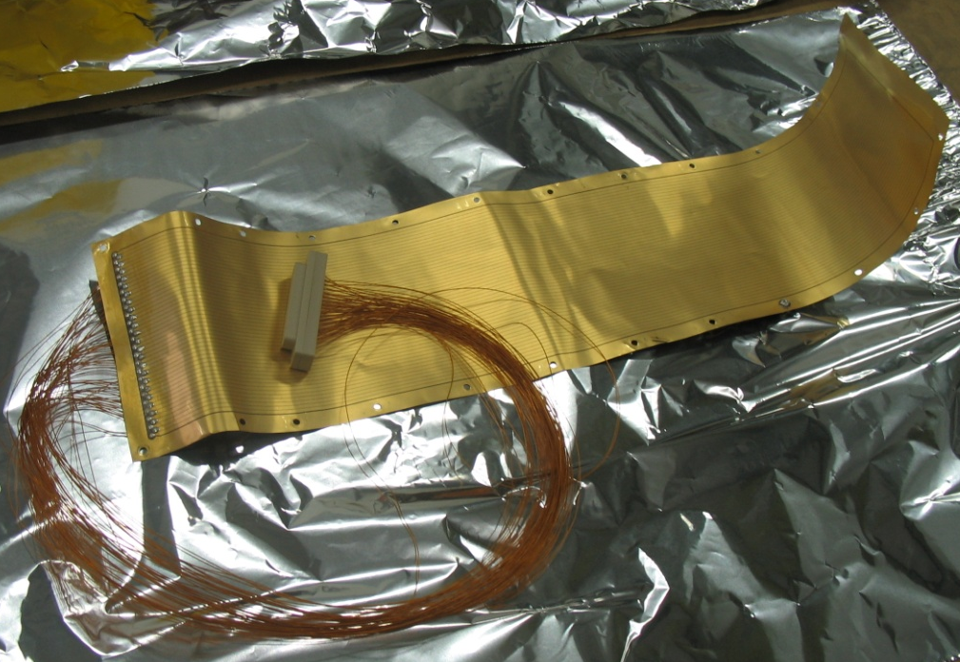
Electron cloud dedicated experiments
  e-cloud monitors
    Strip detector with StSt liner
    Strip detector with StSt liner and tungsten clearing electrode
    Detector for slow electron measurements
    Long term experiment for aC coating
    Information about the spatial distribution of the ecloud
    Signal integrated over many turns

Slide 10
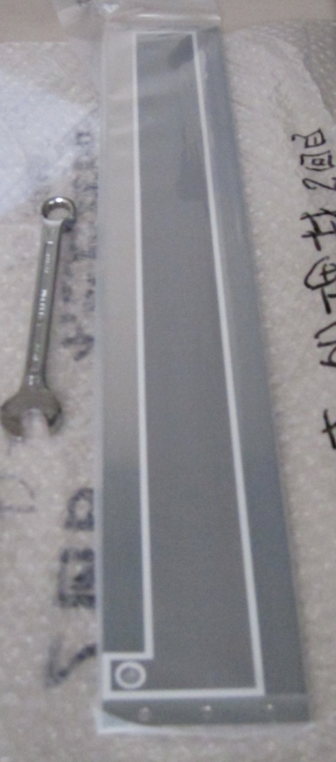
Electron cloud dedicated experiments
  e-cloud monitors
    Strip detector with StSt liner
    Strip detector with StSt liner and tungsten clearing electrode
    Detector for slow electron measurements
    Long term experiment for aC coating
    Information about the spatial distribution of the ecloud
    Signal integrated over many turns

Slide 11
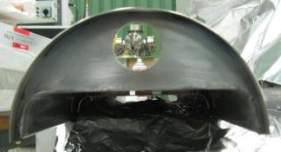
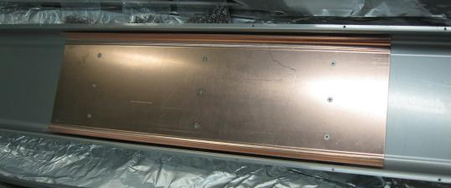
Electron cloud dedicated experiments
  e-cloud monitors
    Strip detector with StSt liner
    Strip detector with StSt liner and tungsten clearing electrode
    Detector for slow electron measurements
    Long term experiment for aC coating
    Electrode to be kept at zero potential during the beam passage and to be biased just after (rise time ~1μs) to collect e⁻ in the chamber
    Trigger can be moved to observe the ecloud dacay
    The electrode is made of copper

Slide 12
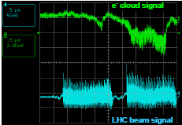
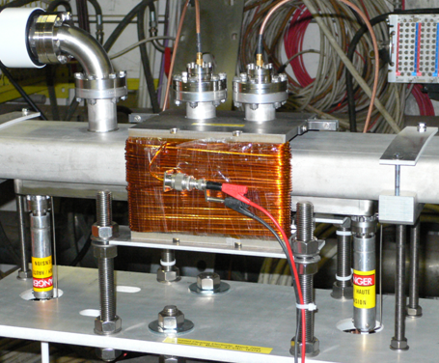
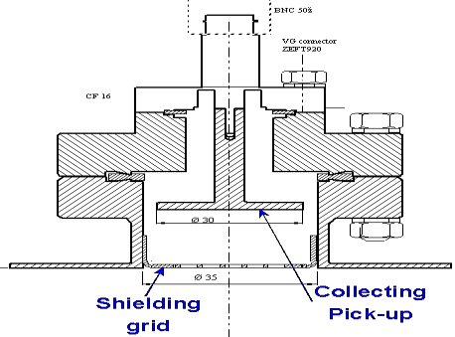
Electron cloud dedicated experiments
  Shielded pickup
    Allows bunch by bunch e⁻ flux measurement
    MBB chamber
    No magnetic field is applied
    One of the grid has been removed in order to get a synchronized beam signal

Slide 13
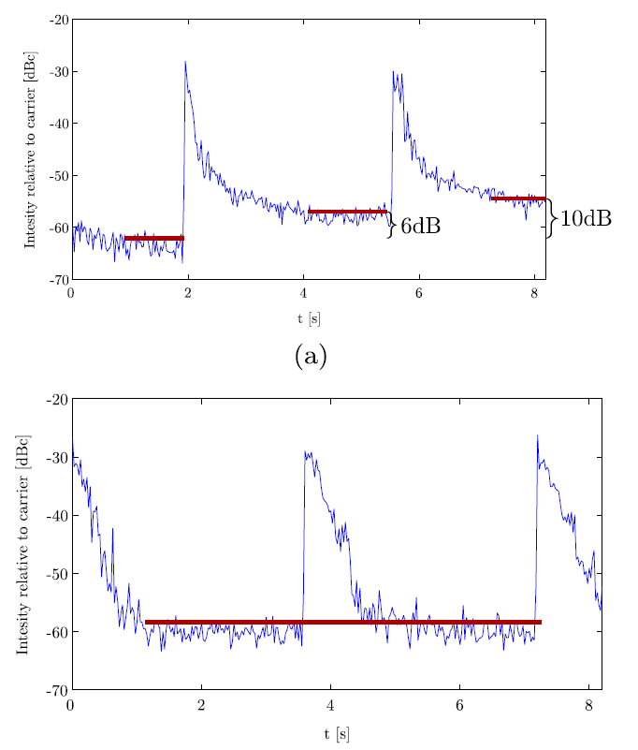
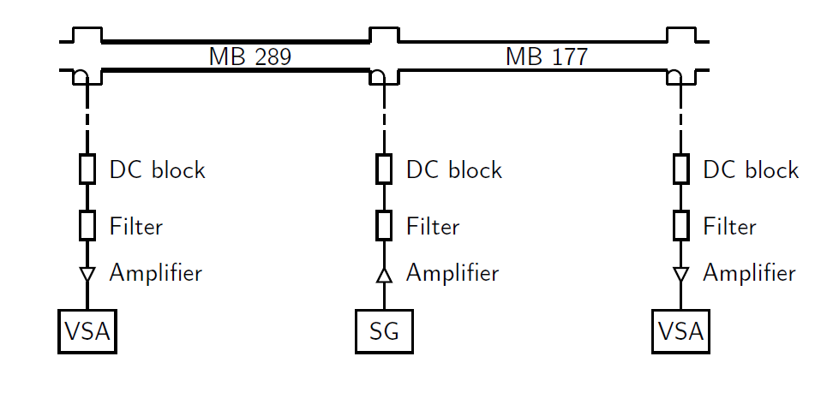
Electron cloud dedicated experiments
  Microwave transmission setup
    StSt
MBB (StSt)
MBB (StSt)
Increasing n. of batches
  Detects the phase modulation on a travelling wave due to the presence ecloud in the chamber
    aC
  F. Caspers, S. Federmann

Slide 14
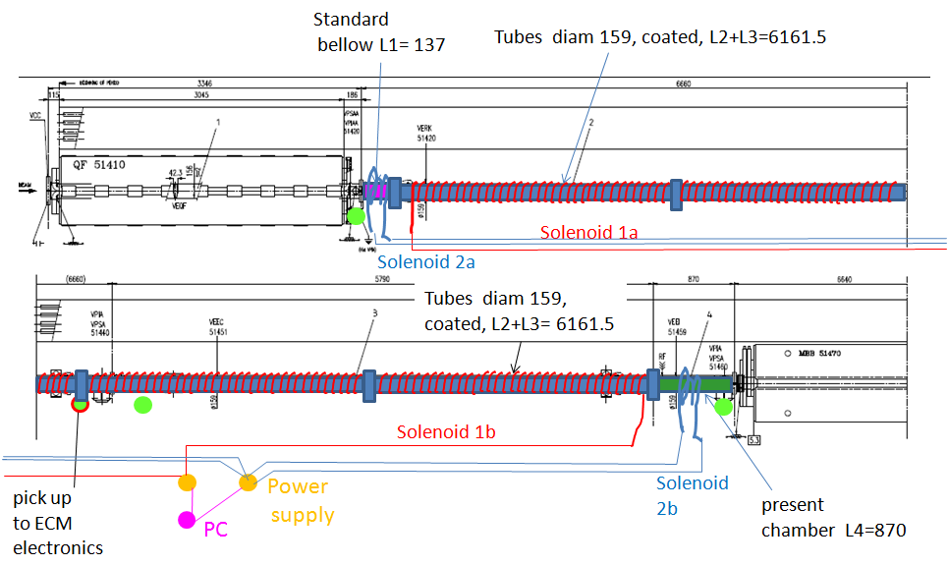
Electron cloud dedicated experiments
  aC coated long straight section
  Confirm that ecloud activity is suppressed (effect of current in solenoid on pickup and pressure signals)

Slide 15
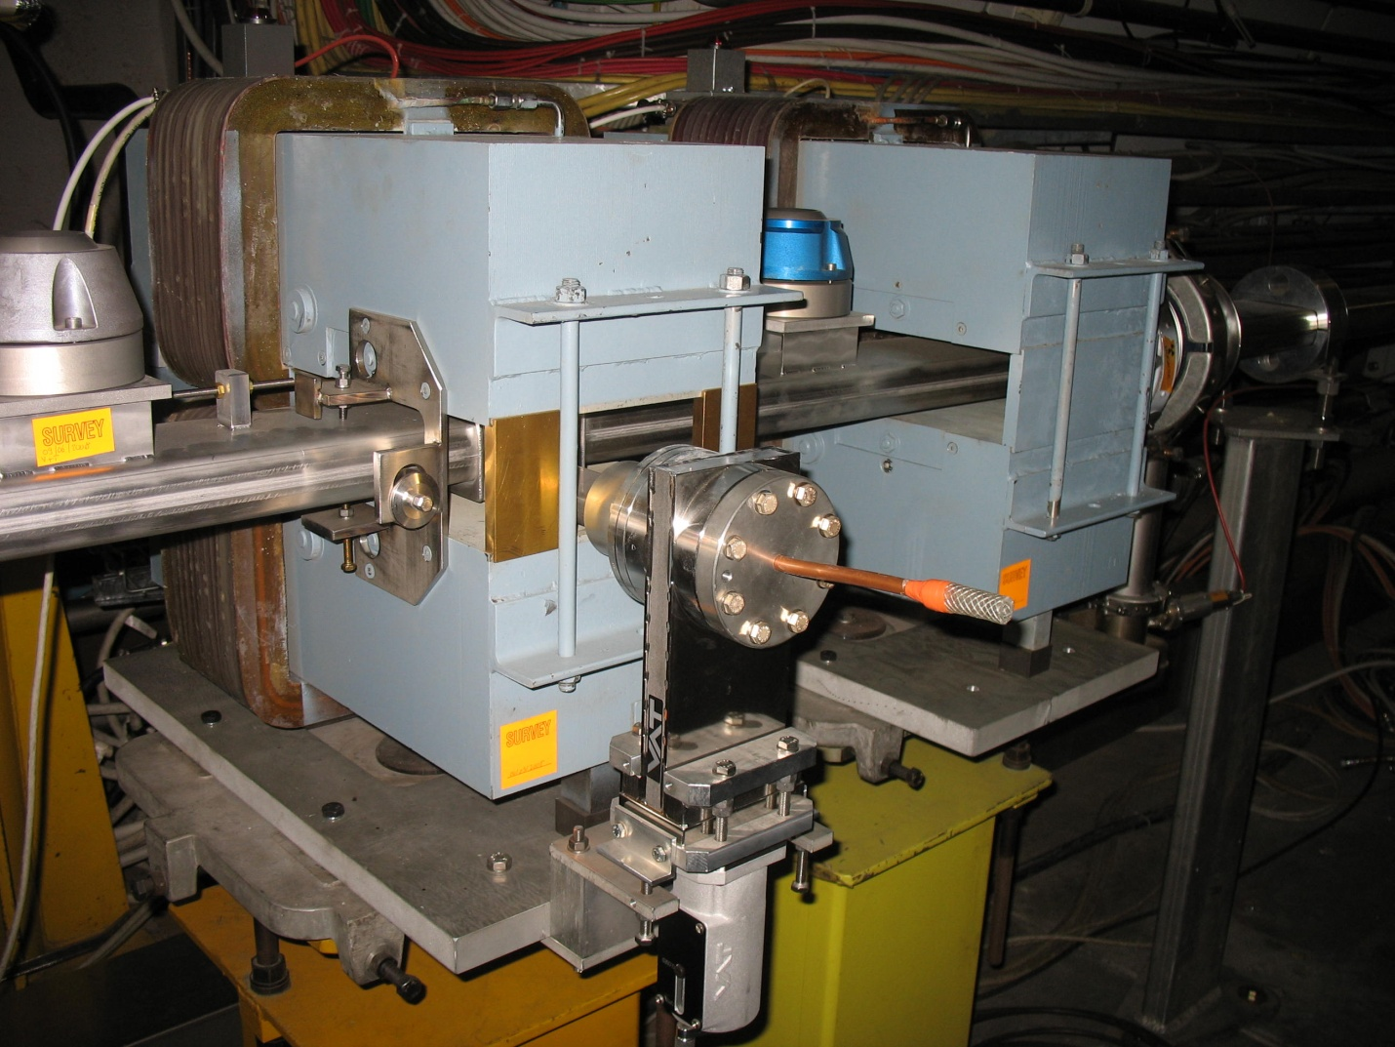
Electron cloud dedicated experiments
  StSt removable sample
    The StSt sample can transferred under vacuum to the lab. for SEY measurement
    Same magnetic field that is applied in the ecloud monitors
    We could assume that the measured SEY of the removable sample is quite similar to the SEY value of the StSt liner at the and of the scrubbing run
    Access needed for removing sample?

Slide 16
Outline
    Electron cloud along the SPS ring
    Characterization of the scrubbing process
      Dedicated electron cloud experiments
      Parameter to be identified
      A possible estimation strategy
    “Routine” measurements and other possible experiments
    Draft plan
    Other points for discussion

Slide 17
Scrubbing process characterization
Scrubbing run 2008
    From past scrubbing runs we expect a decreasing signal in the StSt ecloud monitors, qualitatively confirming that scrubbing is happening.
  Can we try to characterize this process in a more “quantitative” fashion?
  Try to estimate:
  Evolution of the accumulated e⁻ dose
  Evolution of the chamber’s SEY
  Is this data consistent with lab measurements and our model of e-cloud build-up?

Slide 18
Scrubbing process characterization
  No direct measurement of SEY and electron dose:
  Evolution of the accumulated e⁻ dose
  (No simple scaling rule to infer e⁻ dose from strip monitor signals because of the suppressing effect of holes in dipole fields)
  Evolution of the chamber’s SEY
  (No in-situ SEY measurement available)
  Collect data for fit with simulations

Slide 19
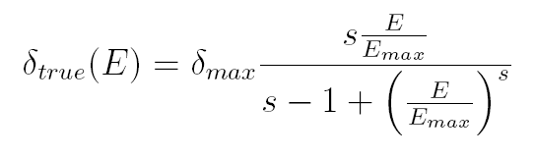
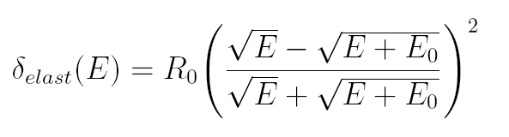
Secondary emission model employed in simulations
    The total SEY is the sum of two contributions:
    True secondary e⁻
    Elastically reflected e⁻

Slide 20
Secondary emission model employed in simulations
    The total SEY is the sum of two contributions:
    True secondary e⁻
    Elastically reflected e⁻

Slide 21
Secondary emission model employed in simulations
    The total SEY is the sum of two contributions:
    True secondary e⁻
    Elastically reflected e⁻
Parameters involved in the model:
+ energy spectrum of secondaries

Slide 22
Secondary emission model employed in simulations
    The total SEY is the sum of two contributions:
    True secondary e⁻
    Elastically reflected e⁻
Parameters involved in the model:
+ energy spectrum of secondaries
We have estimates from lab measurements
(E_{max} can be checked with e⁻ stripes position)

Slide 23
Secondary emission model employed in simulations
    The total SEY is the sum of two contributions:
    True secondary e⁻
    Elastically reflected e⁻
Parameters involved in the model:
+ energy spectrum of secondaries
Change during the scrubbing process
Strongly affect the e-cloud build up

Slide 24
Secondary emission model employed in simulations
Change during the scrubbing process and
strongly affect the e-cloud build up
δ_{max} mainly affects the e-cloud rise time
R₀ mainly affects the e-cloud decay time

Slide 25

A few words about seeds
The number of seed e⁻ per bunch is given by:
Very small numbers (1~100 e/cm³)
Do we have to consider other mechanisms?
What about their distribution?
Not so robust to rely on this estimate for benchmarking

Slide 26
Outline
    Electron cloud along the SPS ring
    Characterization of the scrubbing process
      Dedicated electron cloud experiments
      Parameter to be identified
      A possible estimation strategy
    Draft plan
    Other points for discussion

Slide 27
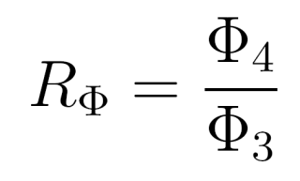
A possible estimation strategy
We have tried to define a measurement strategy following the work done by D. Shulte in 2002-2003.
72
8
72
8
72
8
72
Injections
simulated

Slide 28

A possible estimation strategy
We consider the quantity:
and we observe how it evolves when the last batch is shifted along the machine:
72
8
72
8
72
8
72
Injections
simulated

Slide 29
A possible estimation strategy
We consider the quantity:
and we observe how it evolves when the last batch is shifted along the machine:
72
8
72
8
72
23
72
Injections
simulated

Slide 30
A possible estimation strategy
We consider the quantity:
and we observe how it evolves when the last batch is shifted along the machine:
72
8
72
8
72
38
72
Injections
simulated

Slide 31
A possible estimation strategy
We consider the quantity:
and we observe how it evolves when the last batch is shifted along the machine:
72
8
72
8
72
53
72
Injections
simulated

Slide 32
A possible estimation strategy
We consider the quantity:
and we observe how it evolves when the last batch is shifted along the machine:
72
8
72
8
72
68
72
Injections
simulated

Slide 33
A possible estimation strategy
We consider the quantity:
and we observe how it evolves when the last batch is shifted along the machine:
72
8
72
8
72
83
72
Injections
simulated

Slide 34
A possible estimation strategy
We consider the quantity:
and we observe how it evolves when the last batch is shifted along the machine:
72
8
72
8
72
98
72
Injections
simulated

Slide 35
A possible estimation strategy
We consider the quantity:
and we observe how it evolves when the last batch is shifted along the machine:
72
8
72
8
72
105
72
If the first point is 1, saturation is reached within the first two batches, so R_{Φ} is independent on seeds number
Injections
simulated

Slide 36
A possible estimation strategy: a numerical experiment
  We have tried to understand what we can expect prom this approach, by a ‘simulated measurement’, that is:
  Simulate the situation δ_{max} =1.6 R₀ = 0.7
  Add some noise (to make the experiment a bit more realistic)
  Tried to reconstruct looking for the most similar simulation in certain feasible region for (δ_{max}, R₀ )

Slide 37
A possible estimation strategy: a numerical experiment
  We have tried to understand what we can expect prom this approach, by a ‘simulated measurement’, that is:
  Simulate the situation δ_{max} =1.6 R₀ = 0.7
  Add some noise (to make the experiment a bit more realistic)
  Tried to reconstruct looking for the most similar simulation in certain feasible region for (δ_{max}, R₀ )

Slide 38
A possible estimation strategy: a numerical experiment
  We have tried to understand what we can expect prom this approach, by a ‘simulated measurement’, that is:
  Simulate the situation δ_{max} =1.6 R₀ = 0.7
  Add some noise (to make the experiment a bit more realistic)
  Tried to reconstruct looking for the most similar simulation in certain feasible region for (δ_{max}, R₀ )
  Some ambiguities could appear (due to the fact that the effects of R₀ and δ_{max} can compensate each other)
  Possible solutions:
  Measurement with different beam conditions (seems hard)
  Indications on R₀ (from lab. measurements, slow electrons setup)

Slide 39
Outline
    Electron cloud along the SPS ring
    Characterization of the scrubbing process
      Dedicated electron cloud experiments
      Parameter to be identified
      A possible estimation strategy
    Draft plan
    Other points for discussion

Slide 40
Plan
  Measurements to be done:
  Measurements with last batch delayed (1h) - for SEY, R0 identification
  Provoke 5-10% uncaptured beam (increasing number of batches) (1 h) - to check and quantify the ecloud enhancement due to this mechanism
  Move trigger of slow electron setup (1h) - to acquire information about the ecloud decay time
  50 ns beam (up to 4 or more batches) (2h) - to try to identify thresholds
  Bunch length scan (1h) - to check and quantify ecloud dependence on b.l.
  Local pressure increase in strip monitors (1h) - do we see the effect of seeds?
  Transverse emittance blow up (1h) - to check and quantify ecloud dependence on this parameter
  Radial steering (1h) & Orbit bump in strip monitors (1h) - to understand how localized is the scrubbed region
To be done as often as possible
Bunch intensities, bunch lengths and transverse emittances should be monitored for a reliable benchmarking

Slide 41
Plan
  Other experiments:
  One day for measurements with different intensities (Thursday? Possibly for both 50ns and 25ns, a good conditioning should be achieved, experts needed)
  Study ecloud driven instability and emittance growth
  ( machine in coast for emittance growth, lower chromaticity for instability)

Slide 42
Plan
  Assuming supercycle composed of:
  Scrubbing cycles
  LHC filling cycle when requested
  Possibly some CNGS if need to decrease the duty cycle of LHC beams
  Needed machine cycles:
  Long flat bottom cycle (~20 bp total cycle length) to be used as default scrubbing cycle with 25 ns bunch spacing
  The rest of supercycle will be
    LHC filling cycle or pilot cycle depending on LHC request (possible to have them after the MD1 like cycle? Or dummy CNGS has to be inserted?)
    MD cycle of “LHC filling type” for studying electron cloud effects at higher beam energy or shorter bunches and to study beam quality at extraction in case of strong electron cloud effects
  Coasting cycle could be used at some point for studying evolution of beam quality and electron cloud build up for longer store times

Slide 43
Initial planning proposal
High inten.
Access?
Mon.
Tue.
Wed.
Thu.
Fry.
Setup + conditioning
Nominal 25ns available
ecloud measurements
  Expect to use roughly the first 1-2 days for setup of cycles and/or conditioning of new equipment installed in the machine (mainly kickers…) by “adiabatically” increasing total beam current; in parallel ecloud measurements with 2 - 3 batches
    Is it possible to have conditioning this before?
  On the third day we expect to have the nominal 25ns beam in a good shape → measurements with this beam and its variants (number of batches, uncaptured beam, variation of bunch length, … )
  Fourth day (→Thursday) could be used for studying bunch intensity effects (going to lower intensity, but mainly trying to push to maximal intensity available from the PS → will we see more electron cloud?), availability of PS experts is needed!
  Fifth day could be used to take final measurements for quantifying the evolution of the SEY and the overall scrubbing efficiency → compare machine conditions with the first days

Slide 44
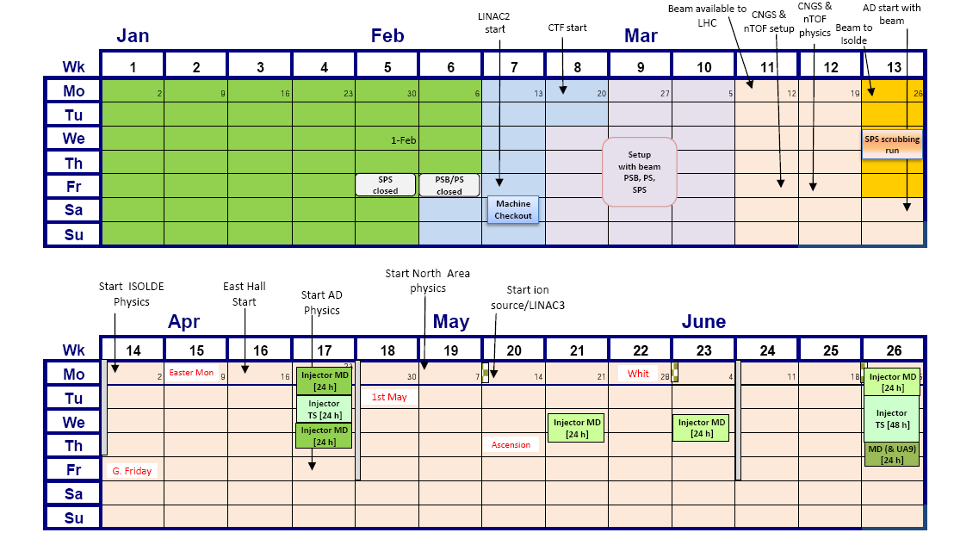
Points for discussion
  Dates for scrubbing run confirmed?
  Conditioning done before?
  Help needed for microwave (and maybe shielded pickup) measurements

Slide 45
Thanks for your attention!

