Slide 1
Evaluation of Microwave Transmission Measurements
MD run 27.03.-30.03. Fritz Caspers, Silke Federmann, Michael Holz

Slide 2
Overview
Experimental Setup
Results
New VSA
Old VSA
Summary

Slide 3
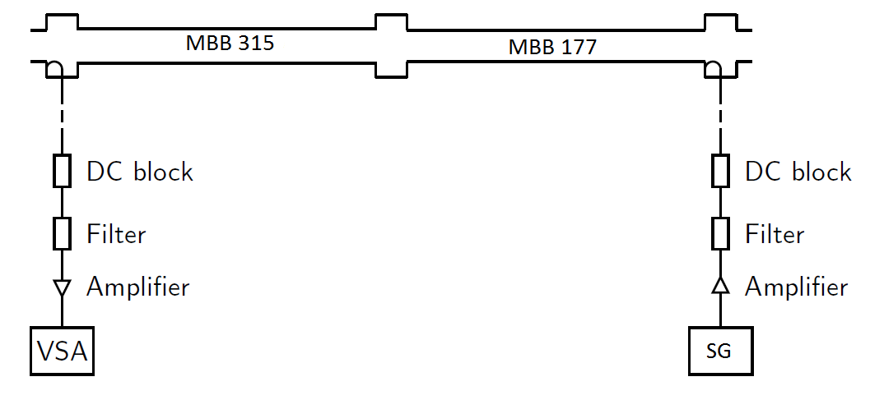
Experimental Set-Up 2012
We measure two consecutive, uncoated dipoles instead of one coated and one uncoated dipole
New spectrum analyser allows us to record a complete supercycle instead of just 10 seconds

Slide 4
MD Run 27.03.-30.03. (Week 13)
During the first measurements, we were limited in recording time to 8 seconds by the old vector spectrum analyzer (memory limitation)
Using an electronic signal to trigger the measurements was not feasible because there were two beams in one super cycle
We triggered manually just before every last injection to see the electron cloud signal at the maximum intensity available with the currently injected beam

Slide 5
Measurements with new spectrum analyzer
The new vector spectrum analyzer is basically the same model, but with a larger memory module (many thanks to M. Betz for providing the VSA)
This enables us to record the complete supercycles and no manual triggering is necessary anymore
After a careful check of the base levels and calibration signal levels, it was found that both models work with the same accuracy which means that the results from both models are directly comparable

Slide 6
Results
The results obtained with the new VSA were exactly as expected.
After the second injection, a nice electron cloud signature was visible:
1. injection
2. injection
2 batches, flat bottom, Total intensity: 2530.84x10¹⁰, 25 ns spacing (LHCMD1)
Measurement direction: upstream

Slide 7
Results
After the third injection, an additional increase of the signal is visible, which is again according to expectations:
1. injection
3. injection
2. injection
3 batches, flat bottom, Total intensity: 3639.26x10¹⁰, 25 ns spacing (LHCMD1), Measurement direction: downstream

Slide 8
Results
However, looking at the traces recorded with the old VSA, the results were rather puzzling:
From this trace, no increase can be seen!
And this trace was recorded for a beam with 4 batches
No correlation with beam intensity could be found
4 batches, flat bottom, Total intensity: 3455.57x10¹⁰, 25 ns spacing (LHCMD1), Measurement direction: downstream

Slide 9
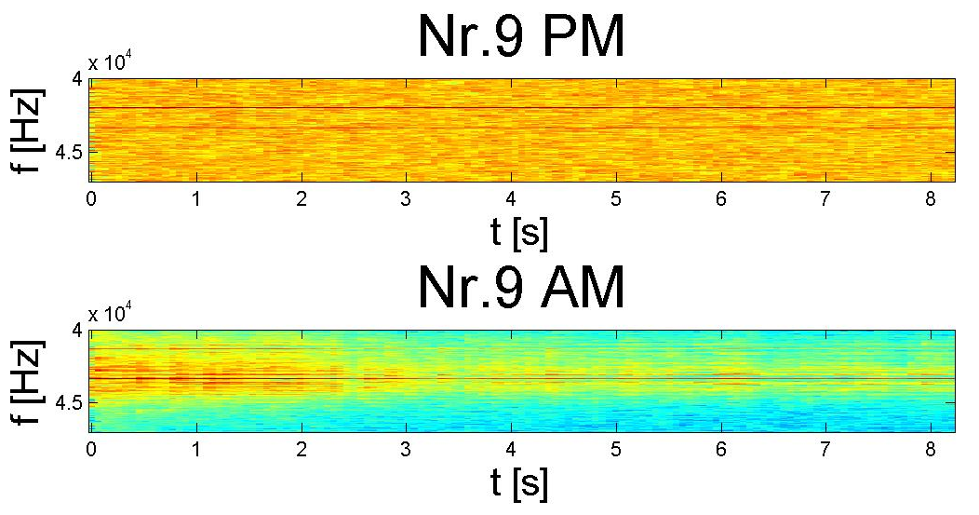
Results
PM Calibration signal
PM EC signal, clearly visible
Last injection
4 batches, flat bottom, Total intensity: 3455.57x10¹⁰, 25 ns spacing (LHCMD1), Measurement direction: downstream

Slide 10
Results
Solution: Missing base level due to shorter recording time!
The base level of the phase-demodulated signal can be obtained from dumped beams
In this case, we get a PM electron cloud signal (PM EC) at ~ -71 dB which is now used as the reference base level

Slide 11
Results
So compared to the base level, we get an increase of the PM signal from -71 dB to about -67 dB which is consistent with the results obtained with the other VSA

Slide 12
Summary I
We obtain clear electron cloud signals from the second injection on ( threshold intensity ~ 2530.84x10¹⁰ )
The new spectrum analyzer enables us to record complete cycles and to observe the rising edges after each injection
The base levels and the calibration signal levels are the same for both spectrum analyzer models. Results are directly comparable

Slide 13
Summary II
No difference has been found between measuring upstream and downstream
Comparing the results from the first high intensity beams to the results from the end of the MD, we cannot see any hint of a scrubbing effect with our set-up

Slide 14
Thanks for your attention!

Slide 15
Additional slides

Slide 16
Theoretical Basis
Principle: Measurement of the induced phase shift of a microwave going through a plasma filled waveguide
Phase shift is proportional to the electron cloud density:
Assumption: we have a complete transmission through the electron cloud (no resonances)

Slide 17
Experimental Set-Up 2011

Slide 18
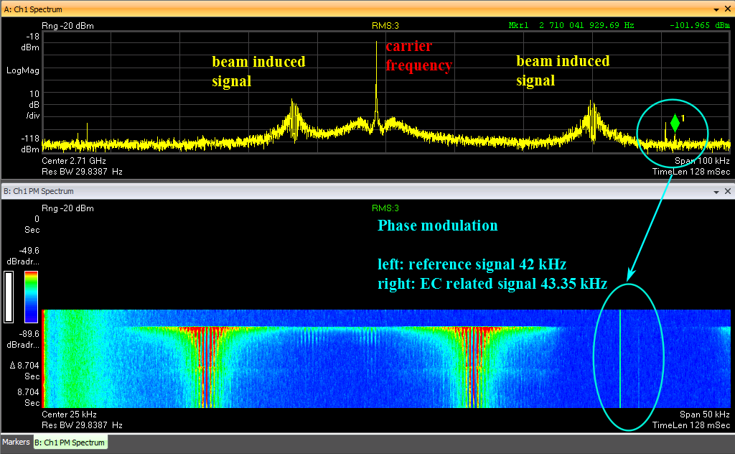
Example of the obtained results as seen on the Vector Spectrum Analyzer

Slide 19
Results
A slight increase is visible, however, the low intensity is not sufficient to produce a clear phase modulation
Point of injection (18 s)
1 batch, flat bottom, Total intensity: 1274.84x10¹⁰, 25 ns spacing (LHCMD1)
Measurement direction: upstream

