Slide 1
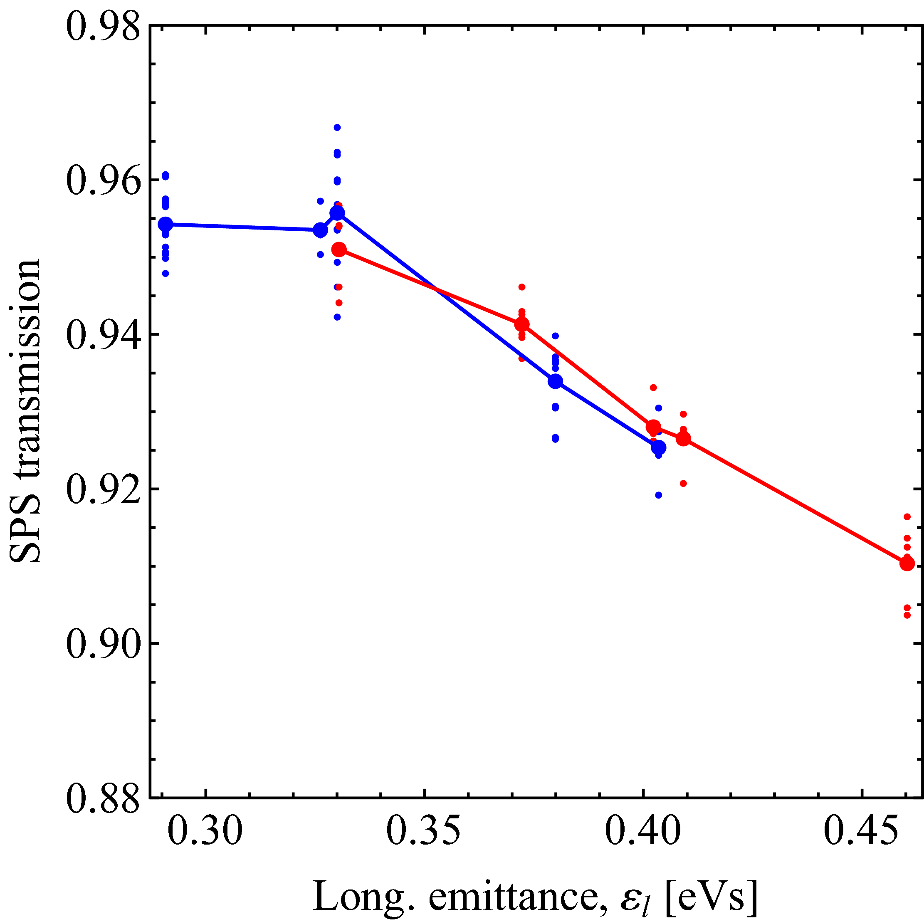
Transfer of LHC beams from PS to SPS
• Obviously, the PS would profit in longitudinal stability when delivering bunches with ε_{l} > 0.35 eVs
• SPS would also prefer larger ε_{l} for longitudinal stability
Can the SPS digest LHC-type beams with ε_{l} above nominal?
Benefit of using three 80 MHz cavities for final bunch rotation in PS?
Results from 1st MD with normal SPS capture voltage in July 2011: Transmission in SPS depends on emittance, not length of bunches
Goal of 2nd MD in November: Optimize capture voltage in SPS and re-measure (25 ns beam)
2x80 MHz → 600 kV
3x80 MHz → 900 kV
2004 25 ns data, AB-Note-2006-030
LHC50ns

Slide 2
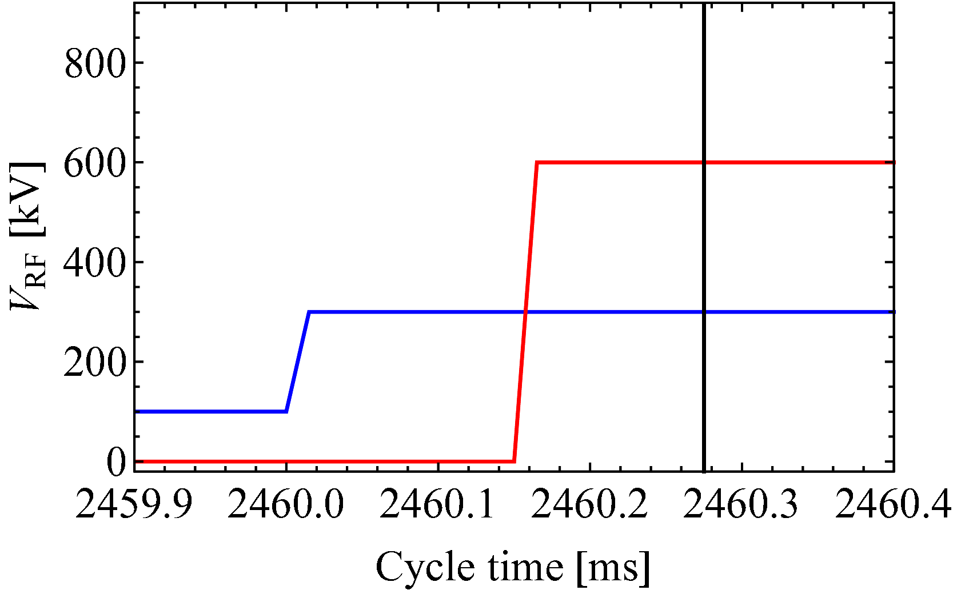
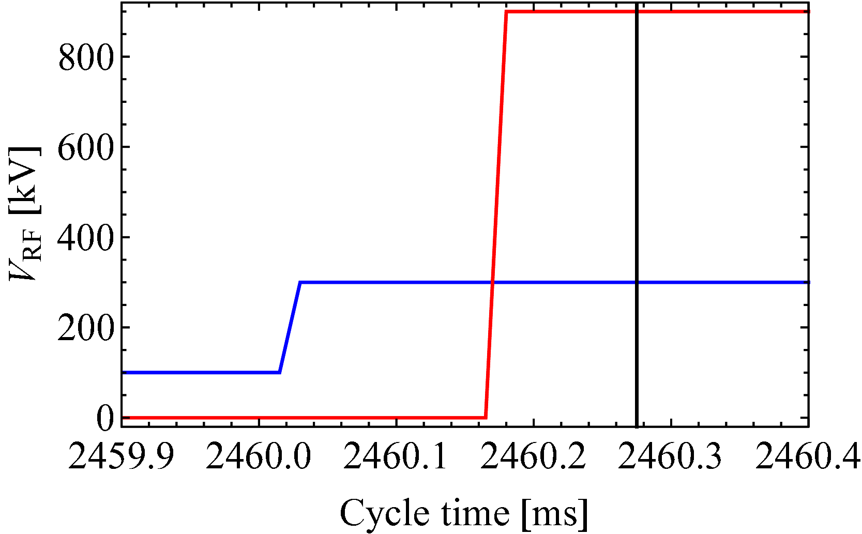
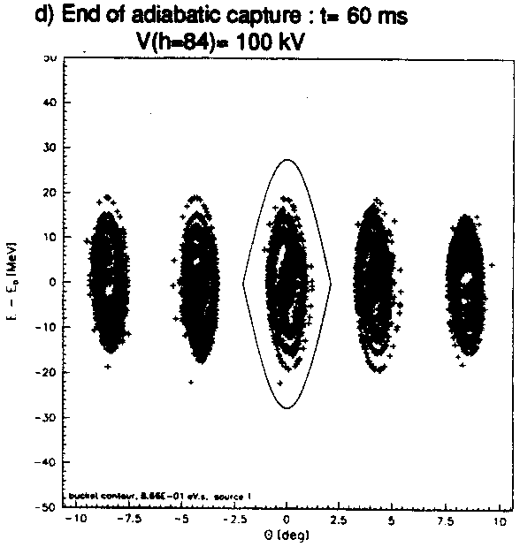
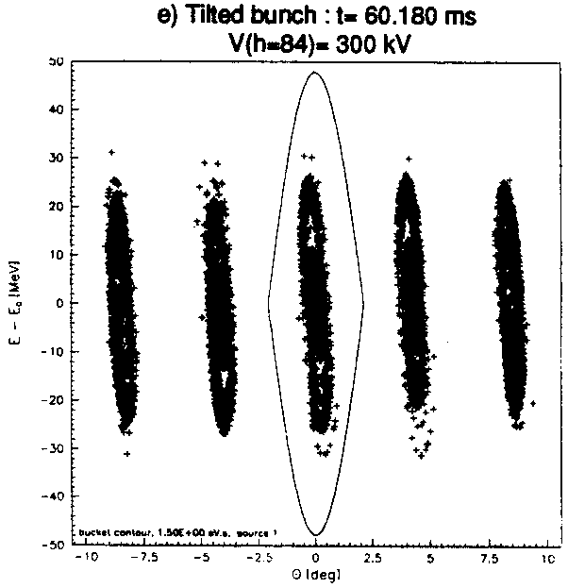
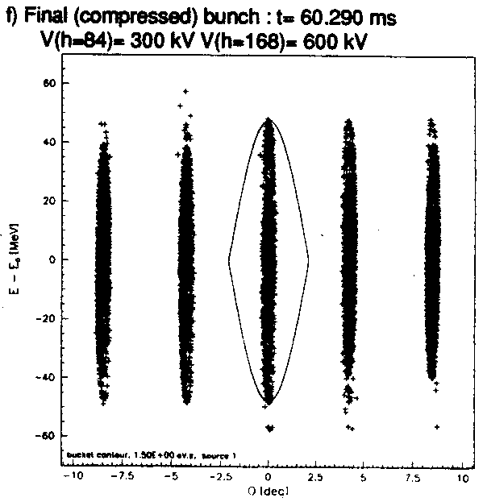
Bunch rotation conditions in PS
150 μs
Ejection
150 μs
Ejection
V_{RF} (40 MHz)
V_{RF} (40 MHz)
V_{RF} (80 MHz)
V_{RF} (80 MHz)
R. Garoby, CERN PS/RF/Note 93-17
4σ = 4 ns, ε_{l} = 0.35 eVs

Slide 3
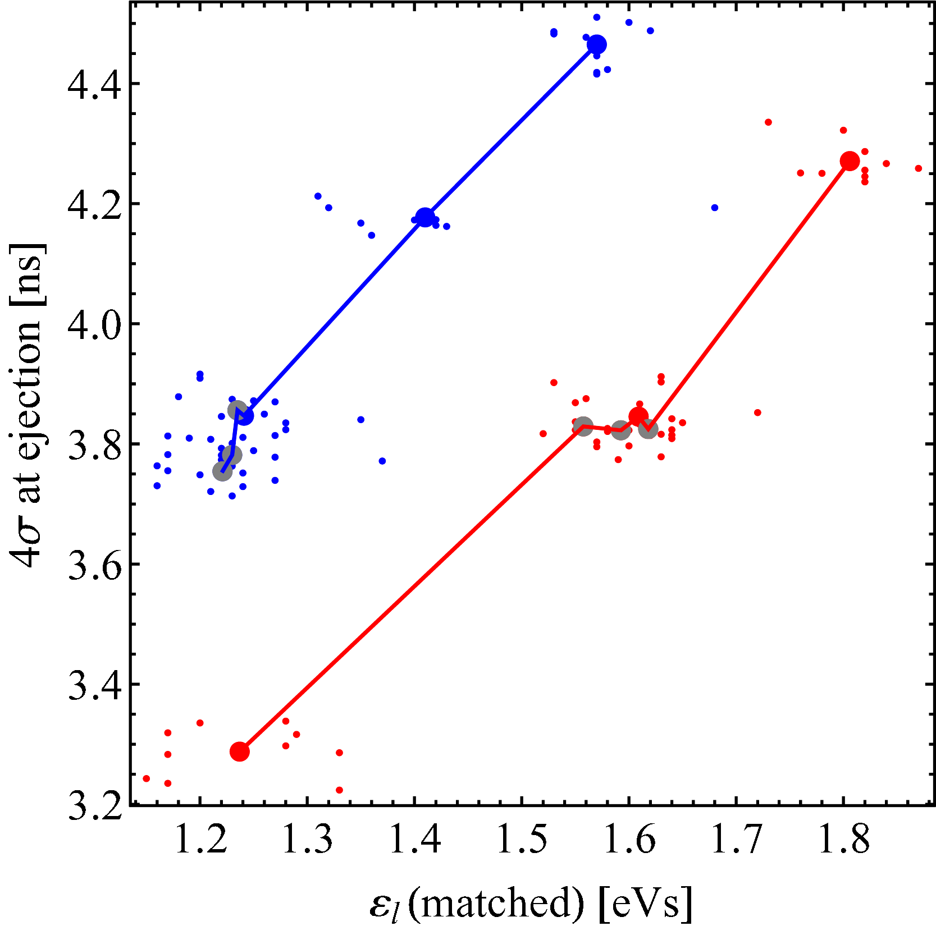
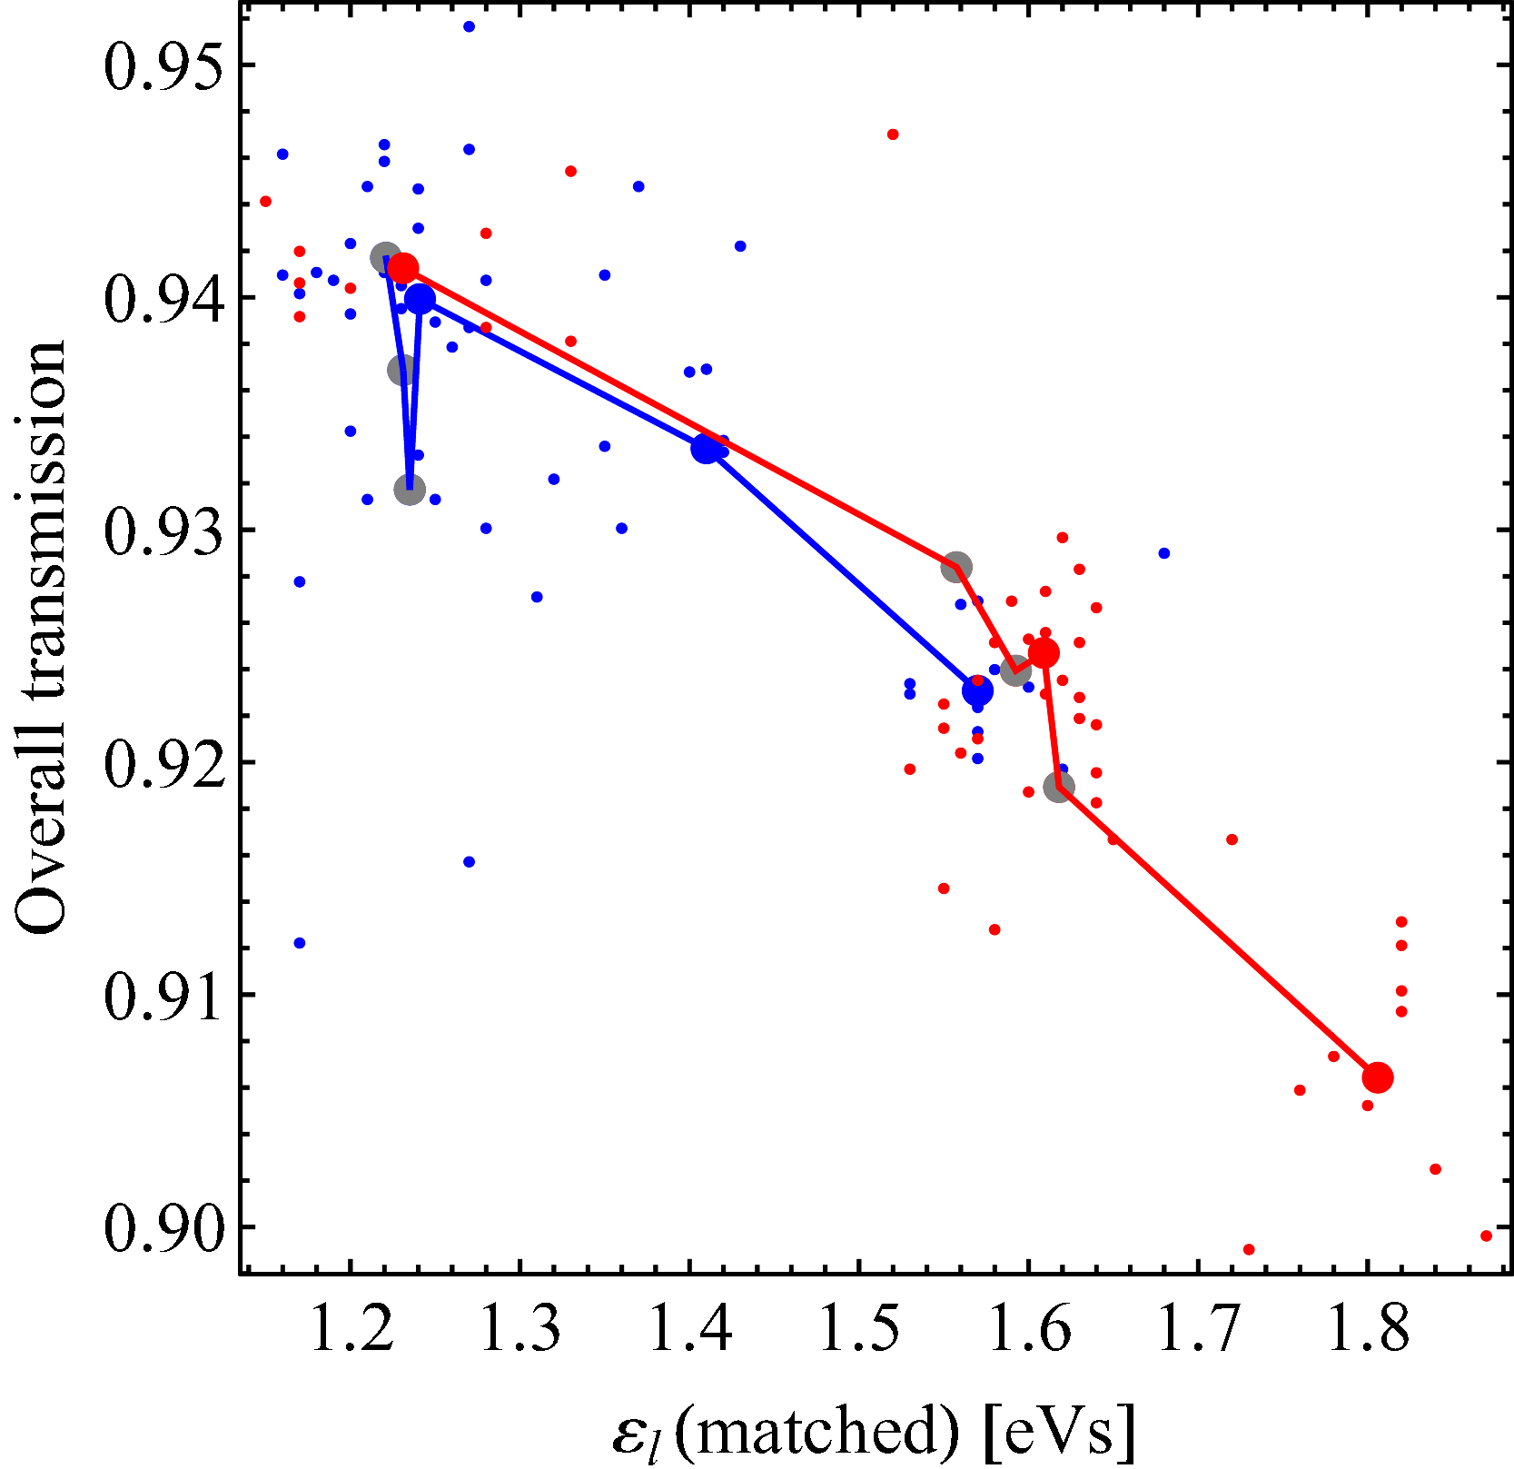
Bunch length and SPS transmission
Bunch length vs. emittance
SPS transmission vs. emittance
300 + 600 kV
300 + 600 kV
300 + 900 kV
300 + 900 kV
4 ×
4 ×
4σ Gaussian fit bunch length ~ 500 ps smaller with 900 kV at 80 MHz
No effect on transmission in SPS

Slide 4
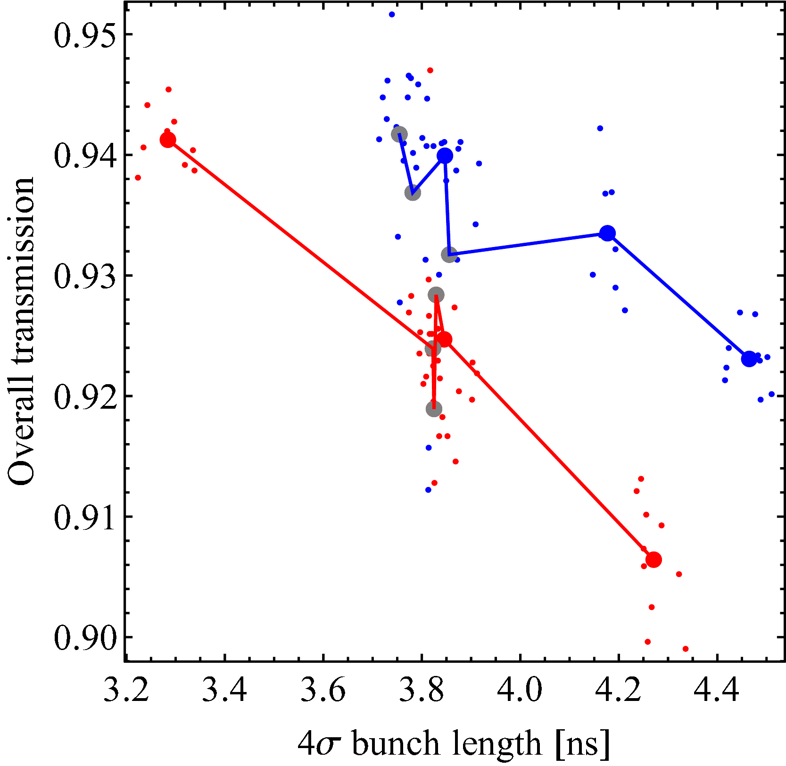
Transmission versus 4σ bunch length
300 + 600 kV
300 + 900 kV
Transmission in the SPS ~ 1-2% smaller for identical bunch length when final rotation with 900 kV at 80 MHz
As observed in July, transmission in SPS sensitive to ε_{l} from PS
What is the origin of additional losses? Distribution? Tails?
S. Hancock remarked that 40 MHz rotation timing was not optimized

Slide 5
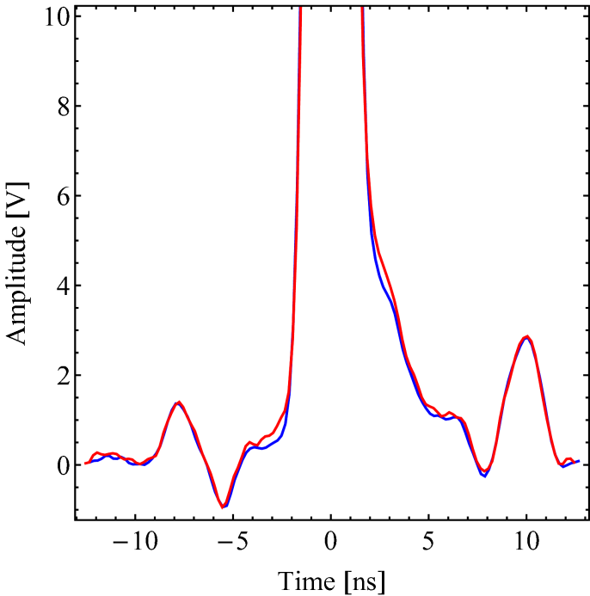
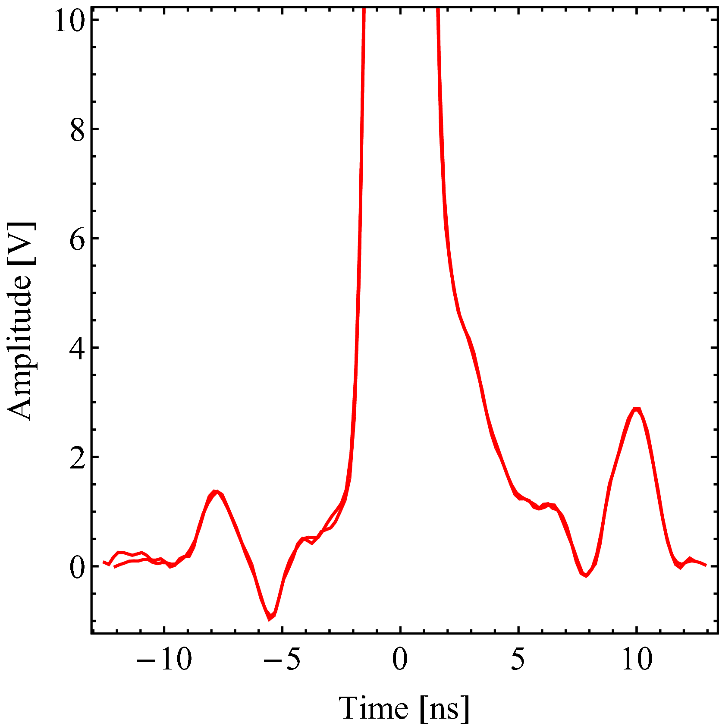
Tails due to non-optimum rotation?
• Compare averaged bunch profiles for identical bunch length cases
Average bunch profile
Profile reproducibility
300 + 600 kV
300 + 600 kV
300 + 900 kV
ΔT ≈ 2h
Indications that ~ 1% more particles in tails for 900 kV rotation
See Helga’s presentation for estimations from tracking

Slide 6
Summary and outlook
As observed during July MD but now also for 3 MV capture voltage in the SPS:
Transmission sensitive to ε_{l}
Different transmission (600/900 kV) for identical 4σ bunch length
Losses caused by tails from non-optimum first part of bunch rotation?
Bunch profile measurements indicate ~ 1 % tails with 900 kV at 40 MHz
Proposal from Steven for MD in 2012: Vary both rotation timings (40/80 MHz) and check transmission in SPS at constant ε_{l}
Effect of longitudinal distribution?
Something to gain for present operational beams?
Better transmission in SPS with longer bunches from PS?
Simulation studies for predictions → Helga

