Slide 1
Past work related to resistive wall instability
and damping in the SPS
preliminary collection of results and
experiences
W. Hofle
SPS Upgrade Studies Working Group
11. April 2011

Slide 2
Chamonix 1999

Slide 3
Chamonix 1999

Slide 4
Chamonix 1999

Slide 5
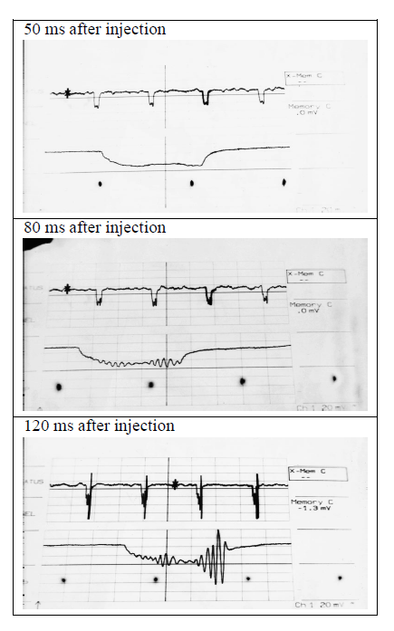
Tests with 2 μs batch
5 ns bunch spacing
Fast extraction from PS of beam
With 5 ns bunch spacing
1/11 of SPS filled
also 3/11, 5/11 tested in view
of LHC beam
one batch filling 1/11 was very unstable !
horizontal
damper PU
past growth rate and instability
measurements
before last damper upgrade
instabilities > 6 MHz
from end of batch
(6 MHz being limit of damper at the
time)
Chamonix 1999

Slide 6
Upgrade 1997-2001 → trade kick strength with bandwidth

Slide 7
τ = 3.6 ms
τ = 6.4 ms
same total intensity
factor ~2 difference in growth rate

Slide 8
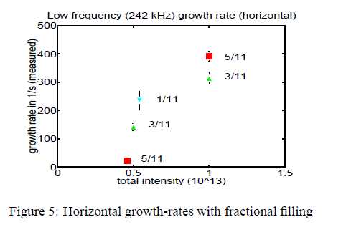
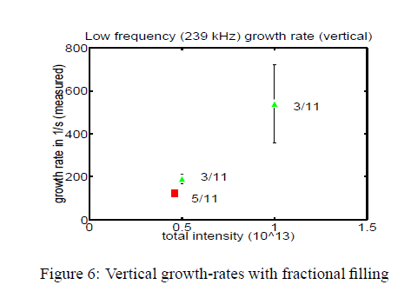
Growth rate measurements
growth rates for partial filling
measured in frequency domain
(spectrum analyzer)
switching off damper
(and then on again)
5 ns spaced bunches used
no e-cloud ? → handle
on resistive wall alone
repeat these experiments ?
Chamonix 1999

Slide 9
December 1998:
injection of LHC beam in SPS
already suffered e-cloud instability ?
← baseline issue with PU signals

Slide 10
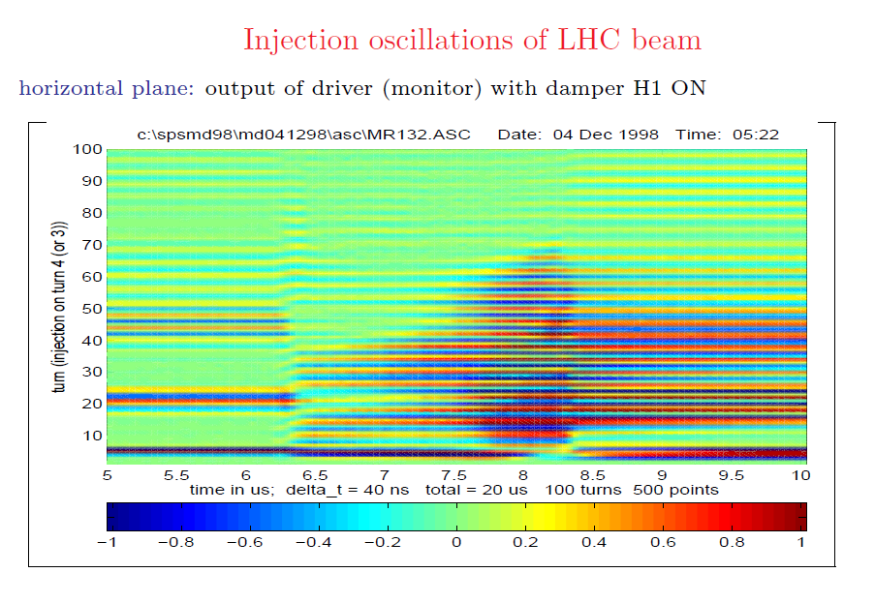
ecloud instability: in 1999 fully hit by ecloud, effort shifted dramatically to understand this instability and get control of it (i.e. nominal LHC beam), additional items were needed in transverse feedback

Slide 11
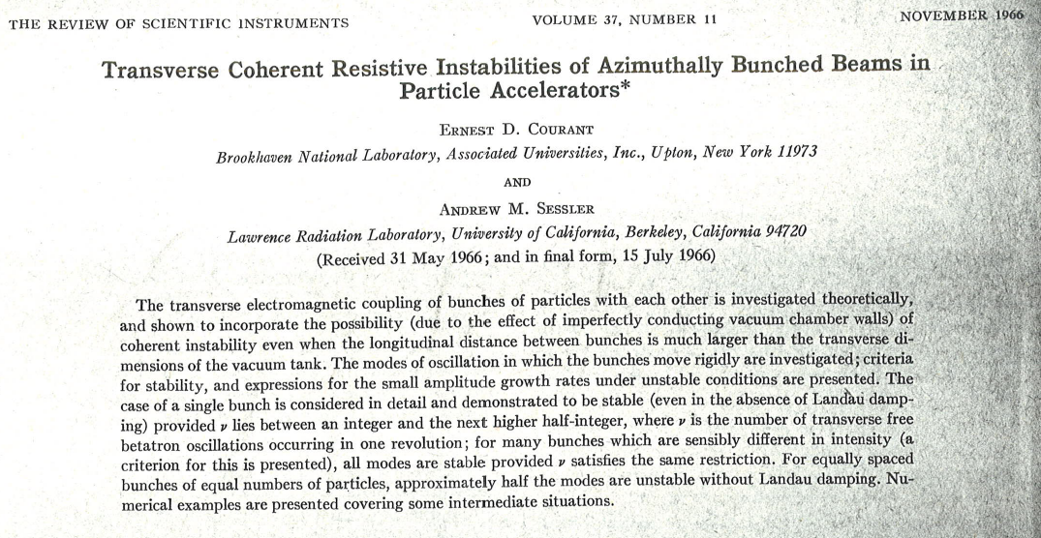
Step back to resistive wall instability
wake field proportional to s^{-1/2}
→ not what we have exactly
thinner wall & different behavior for
for very low frequencies

Slide 13
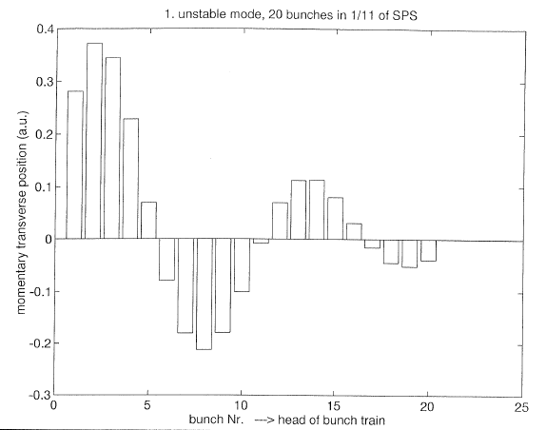

Slide 14
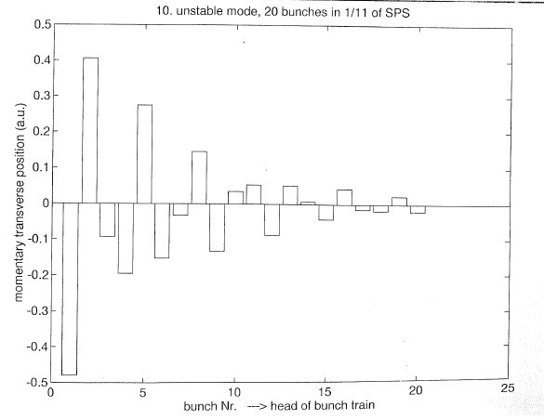

Slide 15
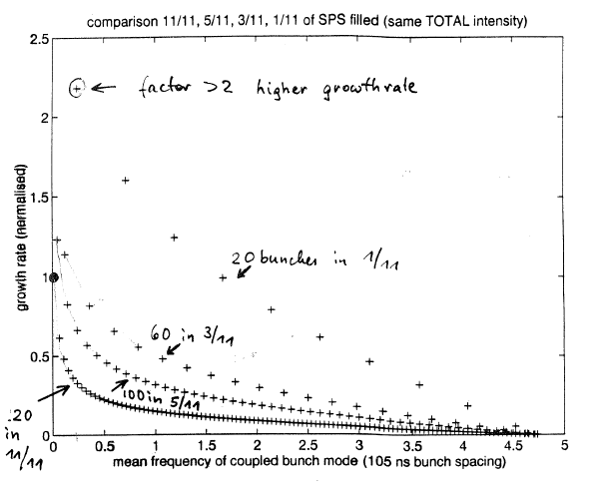
SPS parameters, but 105 ns bunch spacing, 220 bunches max
effect of filling pattern on growth rate
MHz
ideas to study this with RF off, long bunches can be injected, observe transverse
instabilities during initial part of debunching
(some issues with fast bunching @200 MHz) abandoned, but maybe worth to have a look again

