Slide 1
BEAM PARAMETERS AND PLANNING OF THE LHC INJECTORS UPGRADE
R. Garoby for the LIU Project Team
24/03/2011

Slide 2
LIU Project Team
Subject | Leader | Deputy
LIU management | R. Garoby | M. Meddahi
SPS | B. Goddard | E. Shaposhnikova
PS | S. Gilardoni | H. Damerau
PS injector | K. Hanke | B. Mikulec
Linac4 | M. Vretenar | A. Lombardi, S. Maury

Slide 3
Introduction
Plans for the injectors’upgrade
Estimated beam characteristics after LIU
Planning
Summary

Slide 4
Organization
Two projects have been created at the end of 2010 for studying and implementing the High Luminosity Upgrade of the LHC:
“HL-LHC” for the LHC itself
“This new study combines all work related to the provision of a peak luminosity of five times the design luminosity of the LHC (i.e. 5x10³⁴ cm⁻²s⁻¹) and with an enhanced luminosity lifetime by “luminosity leveling””.
“LHC Injectors Upgrade” (LIU) for the injector complex
“The LHC Injectors Upgrade should plan for delivering reliably to the LHC the beams required for reaching the goals of the HL-LHC. This includes LINAC4, the PS booster, the PS, the SPS, as well as the heavy ion chain.”

Slide 5
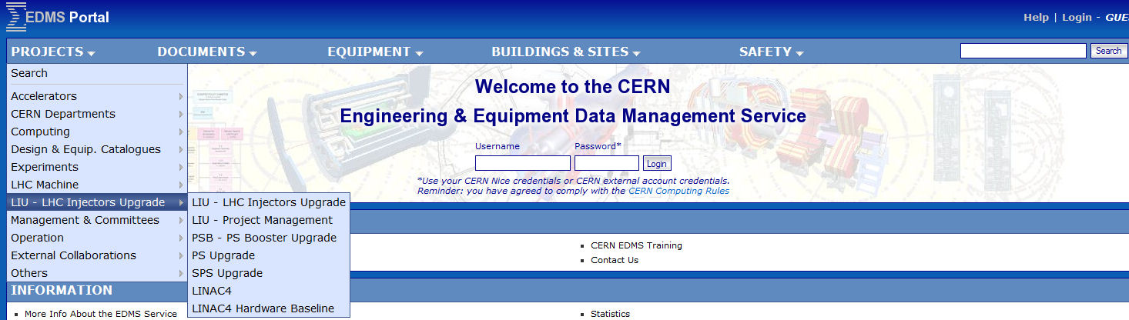
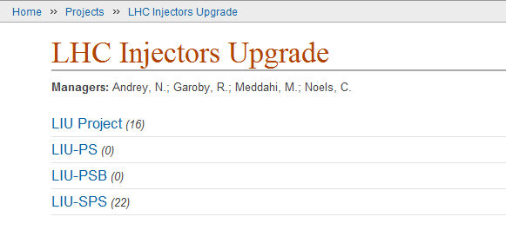
Project Tools
EDMS
Indico

Slide 6
Introduction
Plans for the injectors’upgrade
Estimated beam characteristics after LIU
Planning
Summary

Slide 7
Goals § Means
To increase performance
Brightness ä
Increase injection energy in the PSB from 50 to 160 MeV, Linac4 (160 MeV H⁻) to replace Linac2 (50 MeV H⁺)
Increase injection energy in the PS from 1.4 to 2 GeV, increasing the field in the PSB magnets, replacing power supply and changing transfer equipment
Upgrade the PSB , PS and SPS to make them capable to accelerate and manipulate a higher brightness beam (feedbacks, cures against electron clouds, hardware modifications to reduce impedance…)
To increase reliability and lifetime (until ~2030!)
(tightly interleaved with consolidation)
Upgrade/replace ageing equipment (power supplies, magnets, RF…)
Procure spares
Improve radioprotection measures (shielding, ventilation…)

Slide 8
Linac4
Milestones
End CE works: December 2010
Infrastructure: 2011
Installation: 2011-2012
Commissioning: 2013 till Q1-2014
Modifications PSB: Q1-2014
PSB commissioning: Q2-2014 ?
Operation: Q3-2014 ?

Slide 9
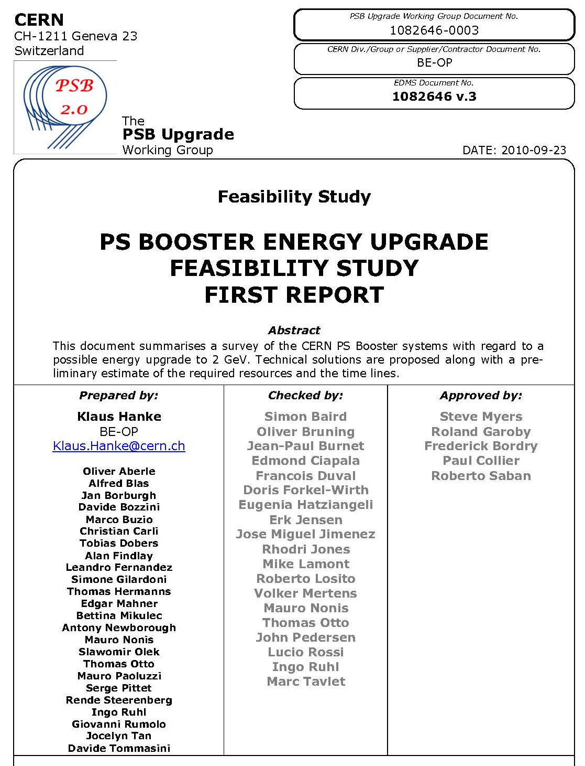
PSB Upgrade
K. Hanke
Items
(material cost in kCHF)
Magnets | 3445
Magnetic Measurements | 111
RF (High power and Low Level) | 14320
Beam Intercepting Devices | 700
Power Converters | 21100
Vacuum System | 100
Beam Instrumentation | 67
Commissioning | 50
Extraction, Transfer, Injection | 5763
Controls | 116
Electrical Systems | 1700
Cooling & Ventilation | 5500
Radio-Protection | 0
Transport and Handling | 680
Survey | 50
Total Project | 53702
Task Force

Slide 10
RCS option
Tentative RCS parameters
C. Carli
Energy range | 160 MeV to 2 GeV
Circumference | (200/7) π m ≈ 89.76 m
Repetition rate | ~10 Hz
RF voltage | 60 kV
Harmonics | h = 2 or 3
Frequency range | 3.48 MHz (h=2 at injection) to 9.5 MHz (h=3 at ejection)
Beam parameters for LHC (for lower emittances scale down intensity accordingly) | Intensity: up to 12×2.7 10¹¹ protons/cycle Transv. emittance: ε*_{rms} ≈ 2.5 μm Long. emittance: ε_{l} < 12×0.27 eVs (determined by acceptance for most cases)
Lattice | FODO with 15 cells and 3 periods, 4 cells in arc, straight with one cell
Tunes | 4 < Q_{H,V} < 5
Relativistic gamma at transition | ~4
Bending magnet filling factor | 56 %
Maximum magnetic field | 1.16 T
Benefits:
Competitive cost wrt PSB consolidation and upgrade (?)
Reliability (new hardware / modern design)
Commissioning decoupled from physics operation
Limited risk: Linac2 + PSB can remain available for a few years as back-up.

Slide 11
PS Upgrades
S. Gilardoni
Injection, magnets,
power converters…
RF
Priority | Item | When
[1] | New coupled-bunch FB | 2012
2 | Dedicated kicker cavity | 2015-2020
10 MHz
[1] | 1-turn delay FB | 2011
1 | Renovate FB amplifiers | 2011-2015 (?)
1 | Slow phase loops around each cavity | 2013-2014
2 | New power amplifier (1 tube/gap) | 2014-2018 (?)
20 MHz
1 | 1-turn delay FB | 2012
2 | Slow phase loops around each cavity | 2012
40 MHz
[1] | Automatic tuning system | 2011
1 | 1-turn delay FB | 2012
2 | New feedback amplifier in grooves | 2014
2 | Slow phase loops around each cavity | 2012
3 | Study more voltage per cavity | 2013
3 | New power supplies | 2014-
80 MHz
1 | 1-turn delay FB | 2012
1 | Automatic tuning system - PLC, prot./ions switching | 2011-2012
2 | Slow phase loops around each cavity | 2012
2 | New feedback amplifier in grooves | 2014
2 | Fast ferrite tuner | 2016
3 | Study more voltage per cavity | 2013
3 | New power supplies | 2014-
3 | Extra 80 MHz cavity | ???
System | Elements
Injection elements | Injection septum Injection bumpers Eventual extra kicker
Low energy correctors | 100 horizontal correctors 30 vertical correctors
Low energy skew quadrupoles | 45 magnets
Low energy quadrupoles | 40 magnets
Transverse damper | Power part of existing system
e-cloud attenuation system | Chamber coating or electrode Installation
Instrumentation | BWS, BCT, Orbit system, profile monitors.
Improved shielding on top of route Goward and on top of SMH16 | Shielding elements

Slide 12
SPS Upgrades
B. Goddard

Slide 13
Introduction
Plans for the injectors’upgrade
Estimated beam characteristics after LIU
Planning
Summary

Slide 14
Preliminary comments
Beam parameters are given at injection in LHC: beam loss and blow-up in LHC are not counted.
All proposed improvements are implemented in the injectors
Based on observations in 2010, the following estimates are made in the accelerator chain:
  PS: 5 % beam loss, 5 % transverse blow-up
  SPS: 10 % beam loss, 5 % transverse blow-up.
RF gymnastics being kept, imperfections are unchanged: +-10 % in all bunch parameters within a given PS bunch train. Traces of ghost bunches.

Slide 15
Beam parameters at LHC injection [25 ns]
LIU baseline goal
LIU stretched* goal
Beam
Parameters
at 7 TeV
?
?
* Feasible for the SPS injectors…

Slide 16
Beam parameters at LHC injection [50 ns]
LIU baseline goal
LIU stretched* goal
Beam
Parameters
at 7 TeV
?
?
* Feasible for the SPS injectors…

Slide 17
Introduction
Plans for the injectors’upgrade
Estimated beam characteristics after LIU
Planning
Summary

Slide 18
(Draft) Planning
 | Linac4 | PS injector, PS and SPS | Beam characteristics at LHC injection
2011 - 2012 | Continuation of construction… | Beam studies § simulations Investigation of RCS option Hardware prototyping Design § construction of some equipment TDR | 25 ns, 1.15 10¹¹p/b, 3.5 mm.mrad 50 ns, 1.7 10¹¹p/b, ≤3.5 mm.mrad 75 ns, 1.2 10¹¹ p/b, ≤ 2 mm.mrad
2013 – Q2/2014 (Long Shutdown 1) | Linac4 beam commissioning Connection to PSB ? | PSB modification (H⁻ injection) ? PSB beam commissioning ? Modifications and installation of prototypes in PS and SPS
Q3/2014 - 2016 | Progressive increase of Linac4 beam current Progressive increase of PSB beam brightness ? | Beam studies Equipment design § construction | Improved beam from PSB ? Some improvement of PS beam Little gain for the SPS (pending SPS hardware upgrades)
2017 – Qx/2018 (Long Shutdown 2) |  | Installation in PS and SPS Beam commissioning
Qy/2018 –2020 |  |  | After ~1 year: All beam characteristics expected for the HL-LHC…
SPS limitation
PS limitation

Slide 19
Introduction
Plans for the injectors’upgrade
Estimated beam characteristics after LIU
Planning
Summary

Slide 20
Summary
Experience with beam in the LHC and its injectors during 2011-2012 will help refine the needs of HL-LHC and the required upgrades.
Well-identified improvements shall be implemented as soon as possible to allow studying the other limitations (e.g. RF upgrade in the SPS).
Decision about connection of Linac4 to the PSB during the first long shutdown will be taken in the Summer as part of the plan for LS1.
The feasibility study of an RCS replacing the PSB will conclude in the Summer 2011. Decision in September.

Slide 21
THANK YOU
FOR YOUR ATTENTION!

