Slide 1
Update on impedance of enamel flanges in SPS
B. Salvant and V. Vaccaro for the ICE impedance team
12/05/2011
Many thanks to E. Shaposhnikova and M. Jimenez

Slide 2
Context
2 flanges coated by a small layer of isolating material (enamel+vetronite) at each side of each BPM.
Geometry is not trivial and small layers are hard to simulate with 3D codes
Theory of impedance of inserts has been recently implemented by Shobuda et al (HB2010).

Slide 3
geometry
Many warnings in CST due to mesh cells filled with PEC

Slide 4
Simpler geometry for a hexahedral mesh → square flange

Slide 5
Comparison between square and round (real longitudinal)

Slide 6
Low frequency peak?
More details in the talk with V. Vaccaro tomorrow at the impedance meeting
With longer bunch: wake looks like the charge and discharge of a capacitor: physical?

Slide 7
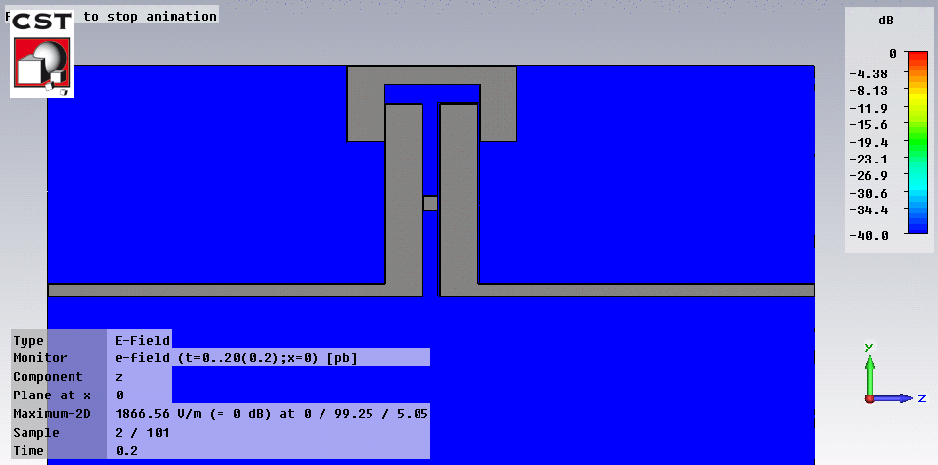
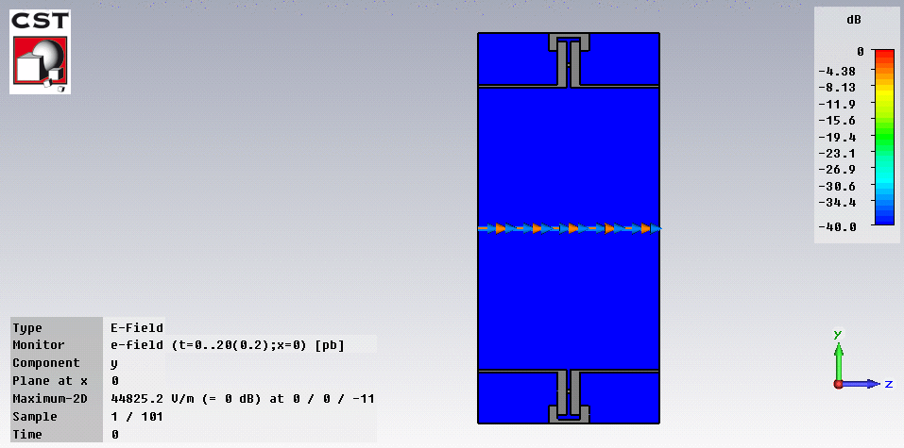
First tests indicate that peak at low frequency is proportional to the capacitance of the insert

Slide 8
Transverse impedance (for 5 mm displacement)
Peaks at about 200 MHz
For all 436 flanges.
Not accounting for the beta functions
Z(low freq)~ 0.3/0.005*436
~26 kOhm/m

Slide 9
Summary
Difficult simulations, should be crosschecked with ABCI and Shobuda’s formula.
What isolation is really in the machine (thickness? EM properties? Ageing?)
However:
Small transverse single bunch effects expected (as bunch length is small).
Longitudinal effects and resonances at ~200 MHz to be followed up.
These isolating inserts should be much more detrimental to machines with longer bunches

Slide 11
