Slide 1
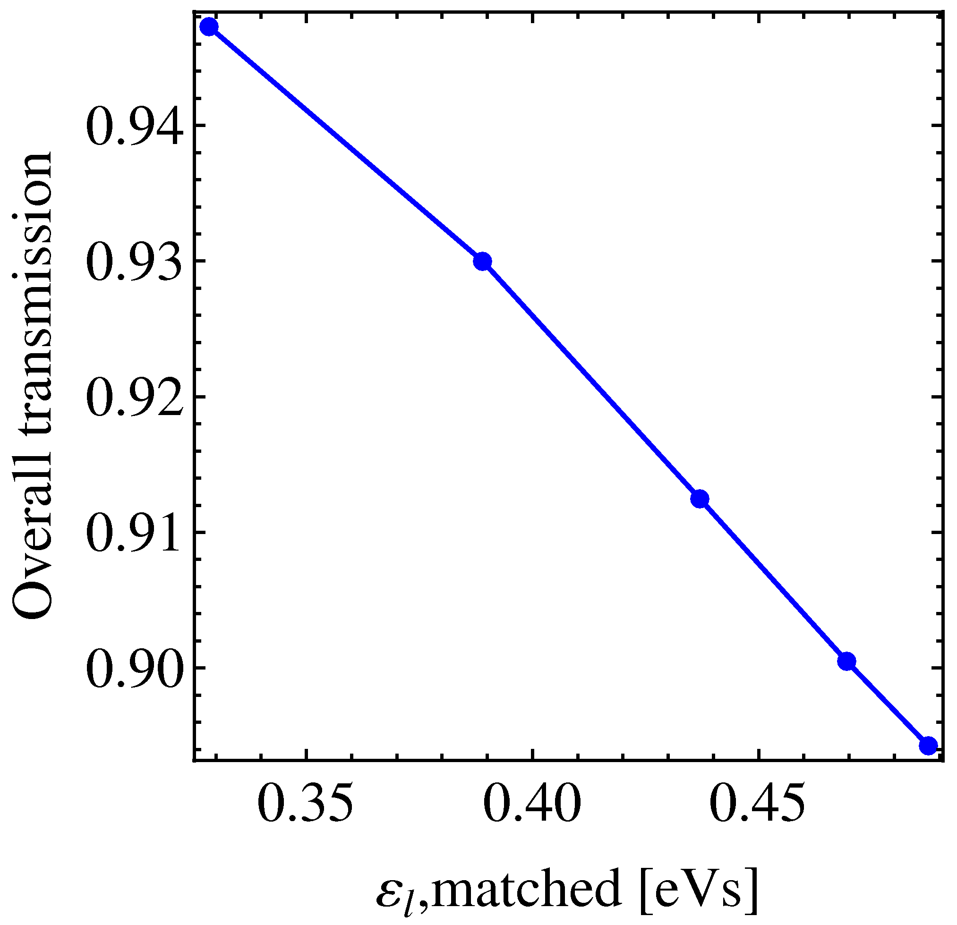
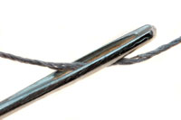
Transfer of LHC beams from PS to SPS
• Obviously, the PS would profit in longitudinal stability when delivering bunches with ε_{l} > 0.35 eVs
• SPS would also prefer larger ε_{l} as blow-up required for stability
Avoid producing dense bunches in the PS and blowing them up later, but beam must pass the eye of a needle at transfer
• First quick test with SPS in 2010
• Does not look very promising at first sight
• Bunch length grows with ~ √ε_{l}
Is bunch length or emittance the crucial parameter at beam transfer?
Transmission vs. emittance
N_{ej}/N_{inj}
nominal

Slide 2
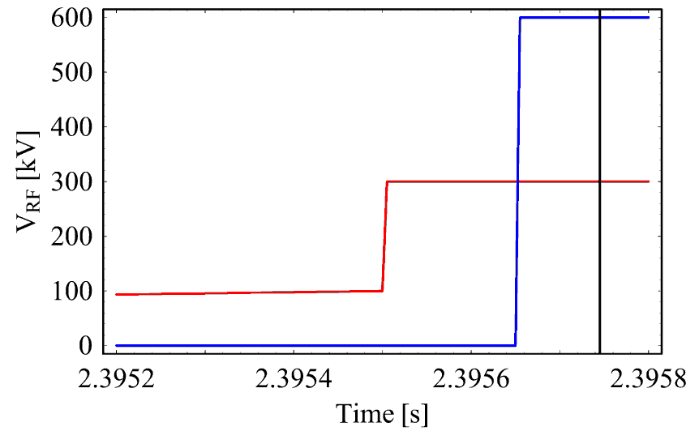
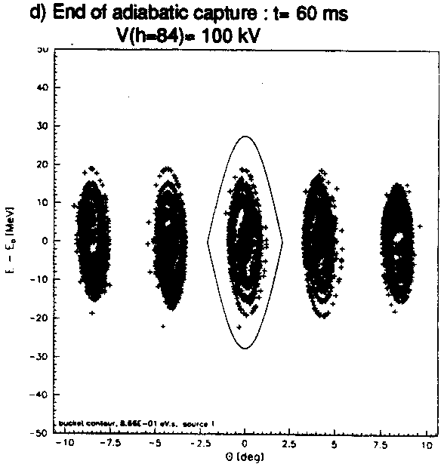
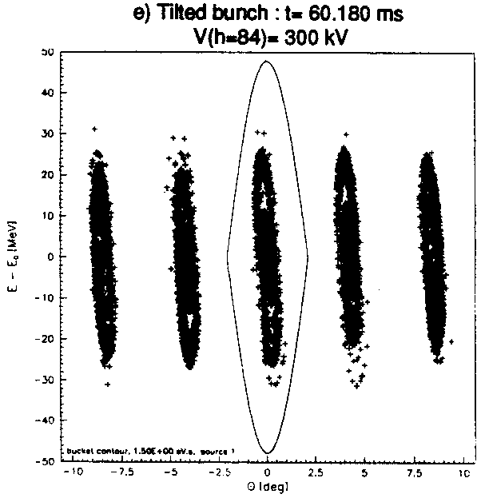
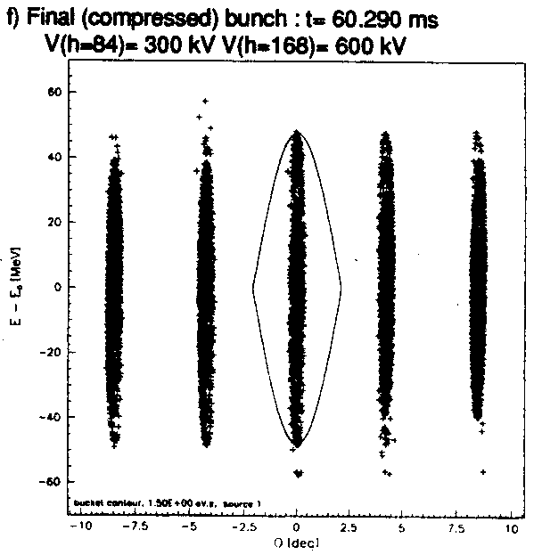
Non-adiabatic bunch rotation in the PS
Bunch rotation in two steps:
1. 290 μs before extraction:
h = 84 (40 Mhz): 100 → 300 kV
2. 90 μs before extraction:
h = 168 (80 Mhz): 0 → 600 kV
600 kV possible
900 kV possible
R. Garoby, CERN PS/RF/Note 93-17
4σ = 4 ns, ε_{l} = 0.35 eVs

Slide 3
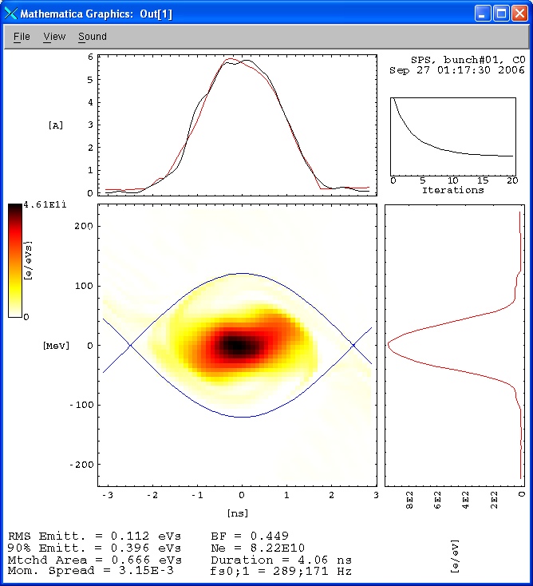
Capture in the SPS
Reminder
RF voltage to capture the PS bunches with 4σ = 4 ns, Δp/p = 10⁻³ ?
Matched voltage would be ~ 380 kV
BUT: ~ 2 MV at injection with rise to 3 MV between injections found as empiric optimum
T. Bohl et al., AB-Note-2006-30
E. Shaposhnikova et al., EPAC2004, p. 1906
T. Linnecar et al., 33rd ICFA HHH, 2004, p. 345
T. Bohl et a., CERN AB-Note-2007-010
V_{RF} = 2.3 MV
Nonetheless quadrupole oscillations and filamentation after injection

Slide 4
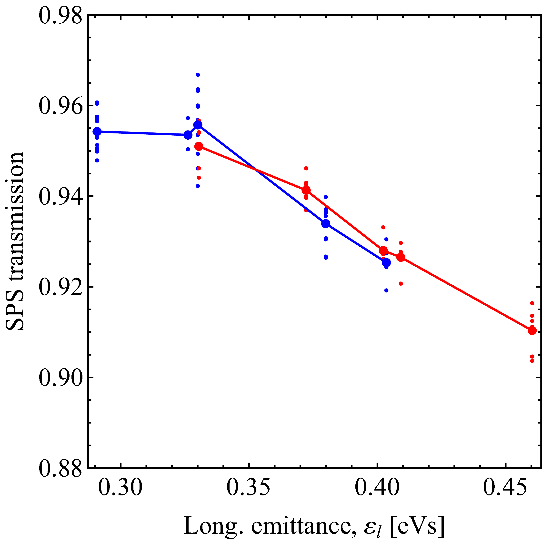
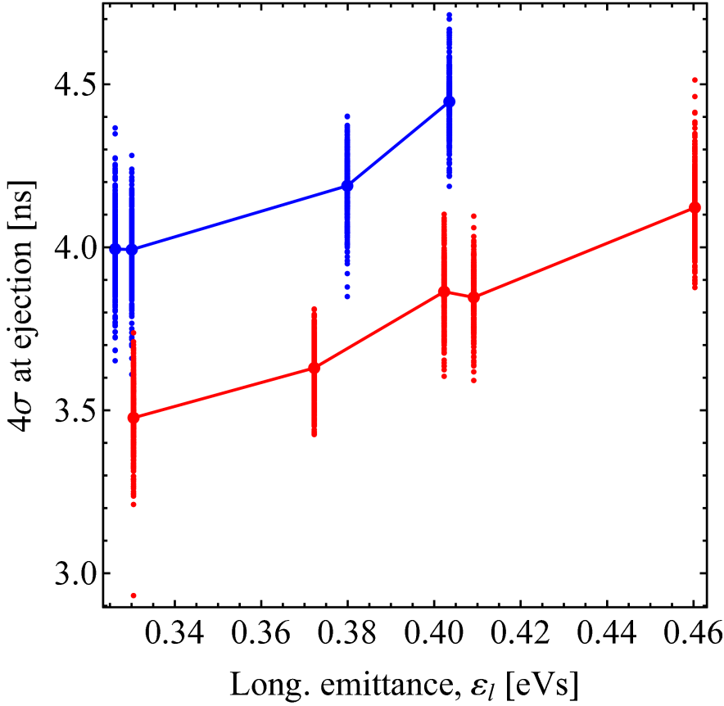
Recent transfer studies PS → SPS
Overall SPS transmission
Bunch length at transfer
2x80 MHz → 600 kV
3x80 MHz → 900 kV
2004 25 ns data, AB-Note-2006-030
2x80 MHz → 600 kV
3x80 MHz → 900 kV
Transmission in SPS does not increase with larger 80 MHz voltage, though bunch length decreases as expected
Repeat measurements with larger, optimized capture voltage in SPS
Do not forget longitudinal stability in the SPS → larger ε_{l} preferred

Slide 5
Summary
• PS and SPS both profit from larger longitudinal emittance, ε_{l}
• BUT: Without optimizing capture voltage, SPS is more sensitive to ε_{l} than bunch length at injection → Essentially no direct improvement due to shorter bunches
• Confirms first observations in 2004
• Try to optimize capture voltage and re-measure
• Overall transmission in SPS not the only criterion: Losses specific to capture? Maximum intensity versus longitudinal emittance in the PS?
• Re-do tomography at SPS injection?

