Slide 1
SPS impedance work in progress
SPSU meeting
August 11th 2011

Slide 2
Agenda
Updated TMCI thresholds for Q20 and Q26
Measured tune shift with intensity for Q20
Improving the SPS injection kicker (MKP) impedance model
Impedance of NEG and Carbon coatings for LHC and SPS

Slide 3
Updated TMCI thresholds for Q20 and Q26
Hannes Bartosik, Kevin Li, Giovanni Rumolo
Current impedance model (Tsutsui kicker models, beam pipe, BPMs, flanges, RF cavities) at injection
Headtail simulations accounting for the change in average beta functions for Q20 and higher RF voltage to be in comparable conditions (no direct space charge).
No chromaticity
Issue in the simulated intrabunch signals observed this morning (to be understood).

Slide 4
Updated TMCI thresholds for Q20 and Q26
Hannes Bartosik, Giovanni Rumolo
Q26: 2 thresholds 1.1e11 and 1.6e11
Q20: 2 thresholds 2.2e11 3.2e11
Unstable region for the Q20 should be within reach

Slide 5
Measured TMCI thresholds
Theodoros Argyropoulos, Hannes Bartosik, Juan Esteban Muller, Yannis Papaphilippou, G. Rumolo,
R. Steinhagen and OP team
TMCI threshold for Q26 was measured last year at ~1.6e11 p/b.
TMCI threshold for Q20 was not observed yet, despite heavy fine tuning of the chromaticity.
  Need to tune other parameters to reduce other damping mechanisms (octupoles, linear coupling, longitudinal matching).
Large losses were observed sometimes at injection (20 to 30%) and/or after the kick (>50%) with Q20, and they seemed to have a non monotonic relationship to the injected intensity.
Thanks to simultaneous analysis with the WCM, the losses at injection were found to occur before the first SPS turn and in the first few SPS turns
  Instability at injection is not a TMCI
  Now that the HT monitor is back in operation, we can analyze in detail these instabilities

Slide 6
Agenda
Updated TMCI thresholds for Q20 and Q26
Measured and simulated tune shifts with intensity for Q20
Improving the SPS injection kicker (MKP) impedance model
Impedance of NEG and Carbon coatings for LHC and SPS

Slide 7
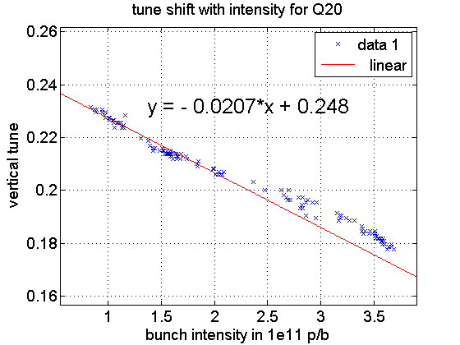
First attempt at measuring the tune and bunch length shifts with intensity for Q20
Theodoros Argyropoulos, Hannes Bartosik, Juan Esteban Muller, Yannis Papaphilippou, G. Rumolo
.
~20% decrease in tune shift
consistent with
the ~20% bunch length
increase
We observe almost constant bunch length
between 1 and 1.5e11 p/b → no scaling needed

Slide 8
Comparison with tune shifts from Headtail
Nominal gammaT - Q26
Low gammaT - Q20
- With simulated bunch length of 3.2 ns (4 sigma).
- Difference in tune shift consistent with change in beta function
- Scaling the measured tune shift (-0.02) between 1e11 and 2e11 by the bunch length
leads to a scaled tune shift of -0.016
- More measurements needed with Q26 with PS RF experts and lower intensities

Slide 9
Agenda
Updated TMCI thresholds for Q20 and Q26
Measured tune shift with intensity for Q20
Improving the SPS injection kicker (MKP) impedance model
Impedance of NEG and Carbon coatings for LHC and SPS

Slide 10
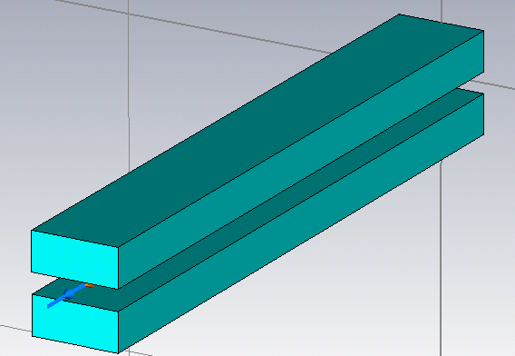
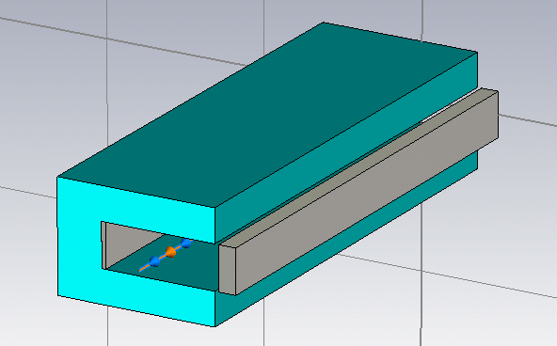
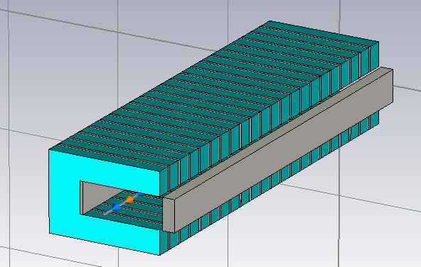
Improving the MKP impedance model
Carlo Zannini
The SPS impedance model assumes the
Tsutsui geometry for all kickers.
Need to assess the impact of refining
the model with CST wakefield simulations
see talk by Carlo at impedance meeting
Tsutsui
C shape magnet
C shape magnet
with segmentation

Slide 11
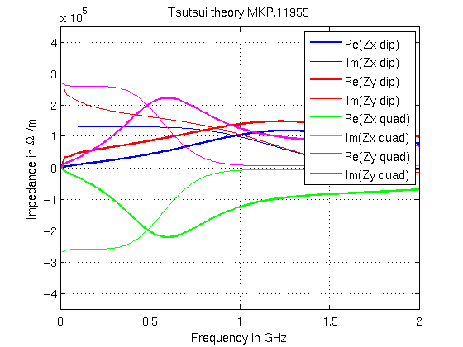
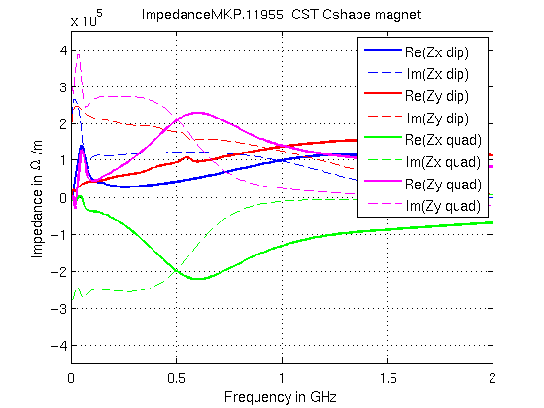
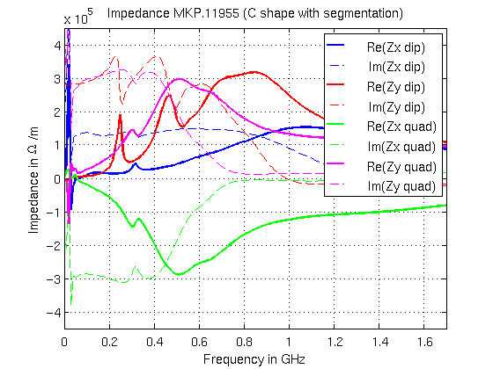
Comparisons of MKP model impedances for the same ferrite length
(i.e. kicker 18% longer)
Significant modifications
in the quadrupolar impedance with the
Cshape but dipolar vertical impedance
changes only with the segmentation

Slide 12
Tsutsui
C shape magnet
C shape magnet
with segmentation
Accounting for the error in ferrite length,
the impedance is actually 0.86 MOhm/m
(i.e. 23% increase from current model)
unstable

Slide 13
Summary
  MKP11955 simulated with CST and imported in ZBASE
  Changing from Tsutsui to Cshape magnet mainly affects the longitudinal and quadrupolar impedances (peak between 10 and 100 MHz). No clear impact on single bunch tune shift is observed.
  Changing to segmented model significantly increases the dipolar impedance and creates resonances within the SPS bunch spectrum (~250 MHz and ~470 MHz)
Next steps
  Simulate the other kickers with more realistic models (internal and external circuits, MKE with serigraphy, MKDH with laminated steel)
  Assess the new SPS impedance model
  Constant term in assymetric structures?

Slide 14
Agenda
Updated TMCI thresholds for Q20 and Q26
Measured tune shift with intensity for Q20
Improving the SPS injection kicker (MKP) impedance model
Impedance of NEG and Carbon coatings: the case of the SPS

Slide 15
NEG coatings for LHC and SPS
Alexey Burov, F. Caspers, Elias Métral, N. Mounet, Vittorio Vaccaro, Bruno Zotter
Context:
  Study for a new multilayer experimental beam pipe for ATLAS (NEG+Al+Carbon).
  NEG coating was found to significantly increase the imaginary part of the effective imaginary impedances of the aluminum 2.5mm radius pipe.
  One of the critical parameter is the coating EM parameters (in particular the conductivity, measured by D. Seebacher and F. Caspers)
layers | materials | Im(Ztrans) in kohm/m (for 160m) | Im(Zlong) in mOhm (for 160 m) | Power loss in W dissipated in a 1m length
1 | Al | 4.8 | 0.23 | 0.54
1 | NEG(3mic)+Al | 8.5 | 0.5 | 0.54

Slide 16
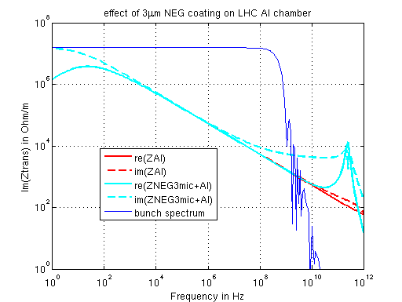
Transverse Impedance as a function of frequency
Impact of 3 μm NEG
on imaginary part visible
from 10 MHz
Skin depth in NEG at 10MHz
is 800 μm!!!
Impact of 3 μm NEG on real part visible from 10 GHz
Skin depth in NEG at 10GHz is 25 μm

Slide 17
Is this effect true?
Simple transmission line theory formula from Vittorio confirms the effect on imaginary part
Rebenchmarked with the Burov-Lebedev formula with 2 layers
Explanations from Alexey:
  image charges are located at the inner NEG surface while the image currents are located beyond the NEG, on the Al surface.
  This separation of image charges and currents generates EM fields in the NEG and therefore impedance.
  There is no energy dissipation in the NEG so that the real part has to be negligible
  For causality reasons, this added imaginary impedance term is a constant of frequency that depends on the thickness of the layer.
  The impedance is therefore converging to a constant at high frequency (until the image charges are not confined anymore at the inner surface of the NEG).

Slide 18
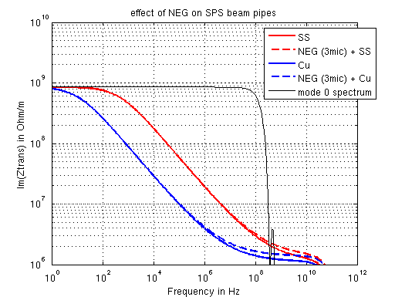
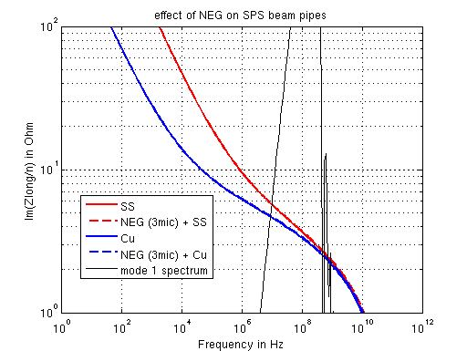
Implications for SPS
(at injection energy for the whole machine coated)
layers | materials | Im(Ztrans^{eff}) in MOhm/m | Im(Zlong/n^{eff} ) in Ohm
1 | SS | 2.8 | 0.66
2 | NEG(3mic)+SS | 3.0 | 0.67
2 | Carbon(3mic)+SS | 3.0 | 0.67
1 | Cu | 1.4 | 0.62
2 | NEG(3mic)+Cu | 1.6 | 0.63

Slide 19
Summary
Within our assumptions, NEG coating and carbon coating have an impact on the imaginary part of the longitudinal and transverse impedances in the frequency range of interest.
The effect at injection in the SPS is small (~1%)
At extraction

Slide 20
Material parameters used for the resistive wall impedance
• Beryllium:
– Resistivity: 4.24 10⁻⁸ Ω.m (from specifications)
– Permittivity: 1
• Carbon-carbon composite:
– Resistivity: 16 10⁻⁶ Ω.m (from specifications)
– Permittivity: 1
• NEG:
– Resistivity: 2.5 10⁻⁵ Ω.m (David Seebacher, F. Caspers, NEG properties in the microwave range, SPSU Meeting, 17th February, CERN)
– Permittivity: 10
• Titanium:
– Resistivity: 0.42 10⁻⁶ Ω.m (from specifications)
– Permittivity: 1
• Aluminum:
– Resistivity: 2.8 10⁻⁸ Ω.m (from specifications)
– Permittivity: 1

Slide 21
 | Sacherer Trans | Trapezes Trans 160m | For SPS
Al | 4.82e3 | 5.03e3 | 3.7e5
NEG+Al | 8.50e3 | 8.7e3 | 5.3e5

