Slide 1
Update of MD activity for high frequency SPS transverse feedback
W. Hofle
SPS Upgrade studies group
29.07.2010
Active participation at CERN from LARP
in July 2010 session:
John Fox, Alex Bullitt (SLAC)
Raphaello Secondo (LBNL)

Slide 2
Aims
Collect vertical instability data with multi-bunch and single bunch beams
for analysis by LARP team to extract growth rates and frequencies
single bunch TMCI
multi-bunch, 25 ns and 50 ns in presence of e-cloud effect
gain experience and make operational
the wide band pick-ups connected to OASIS

Slide 3
Planning and events
Week 28 and 29
Week 28: single bunch (parallel), beyond ultimate, OASIS digitizers, commissioning
some data, but need more time, use of FC cage scope for V-plane,
access prepared and done in week 29 to check BPW 319.31
Week 29: multi bunch (dedicated), 25 ns and 50 ns
25 ns beam, data taken in FC, vertical plane, achieved
a) e-cloud part
b) “coupled-bunch part”, i.e. with TFB off
Wednesday, daytime and night instead of Tuesday due to delays in MD
(magnet change on Monday and vacuum intervention on Tuesday)
50 ns MD cancelled due to dipole change
Single and multi-bunch MDs require disconnection of MOPOS system beyond
nominal intensity → cannot measure orbit with the high intensity,
cannot perform MDs outside working hours
being addressed by BE-BI

Slide 4
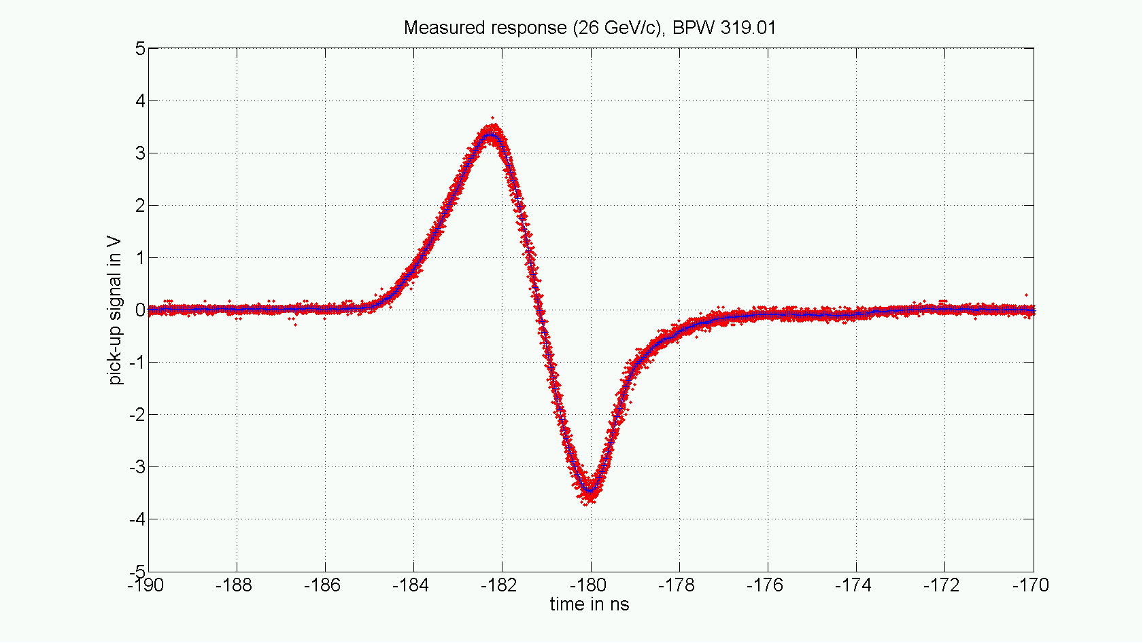
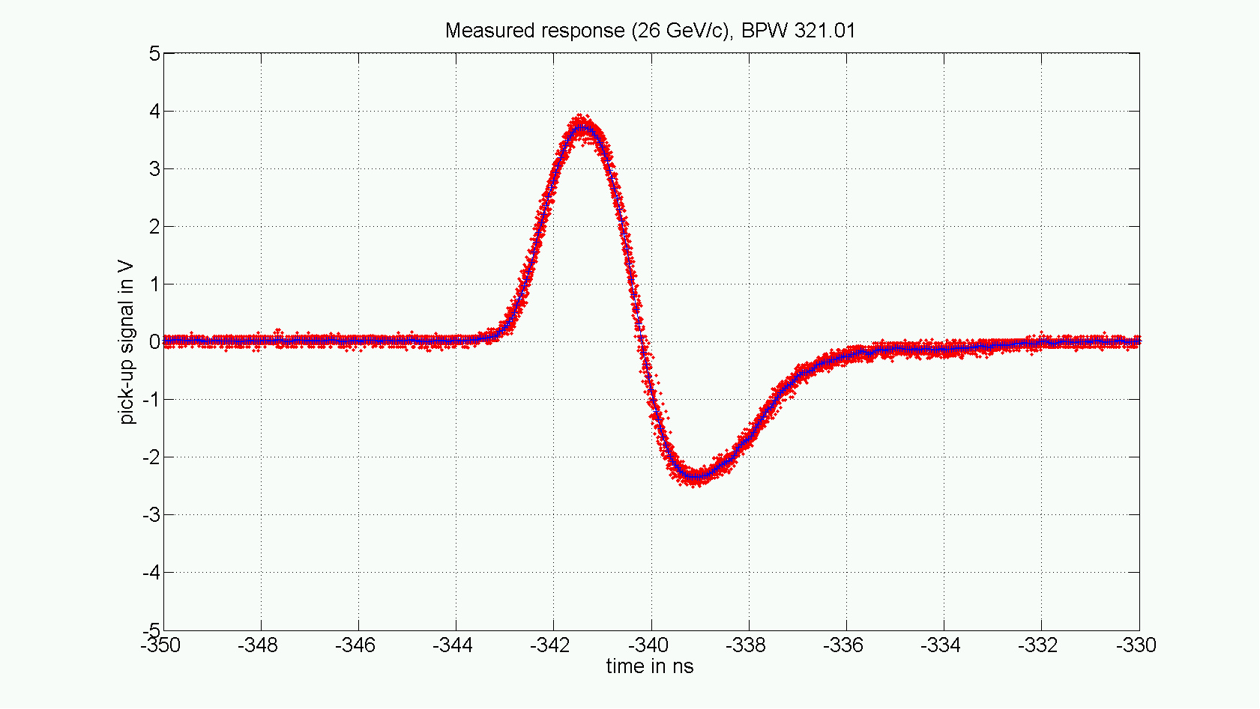
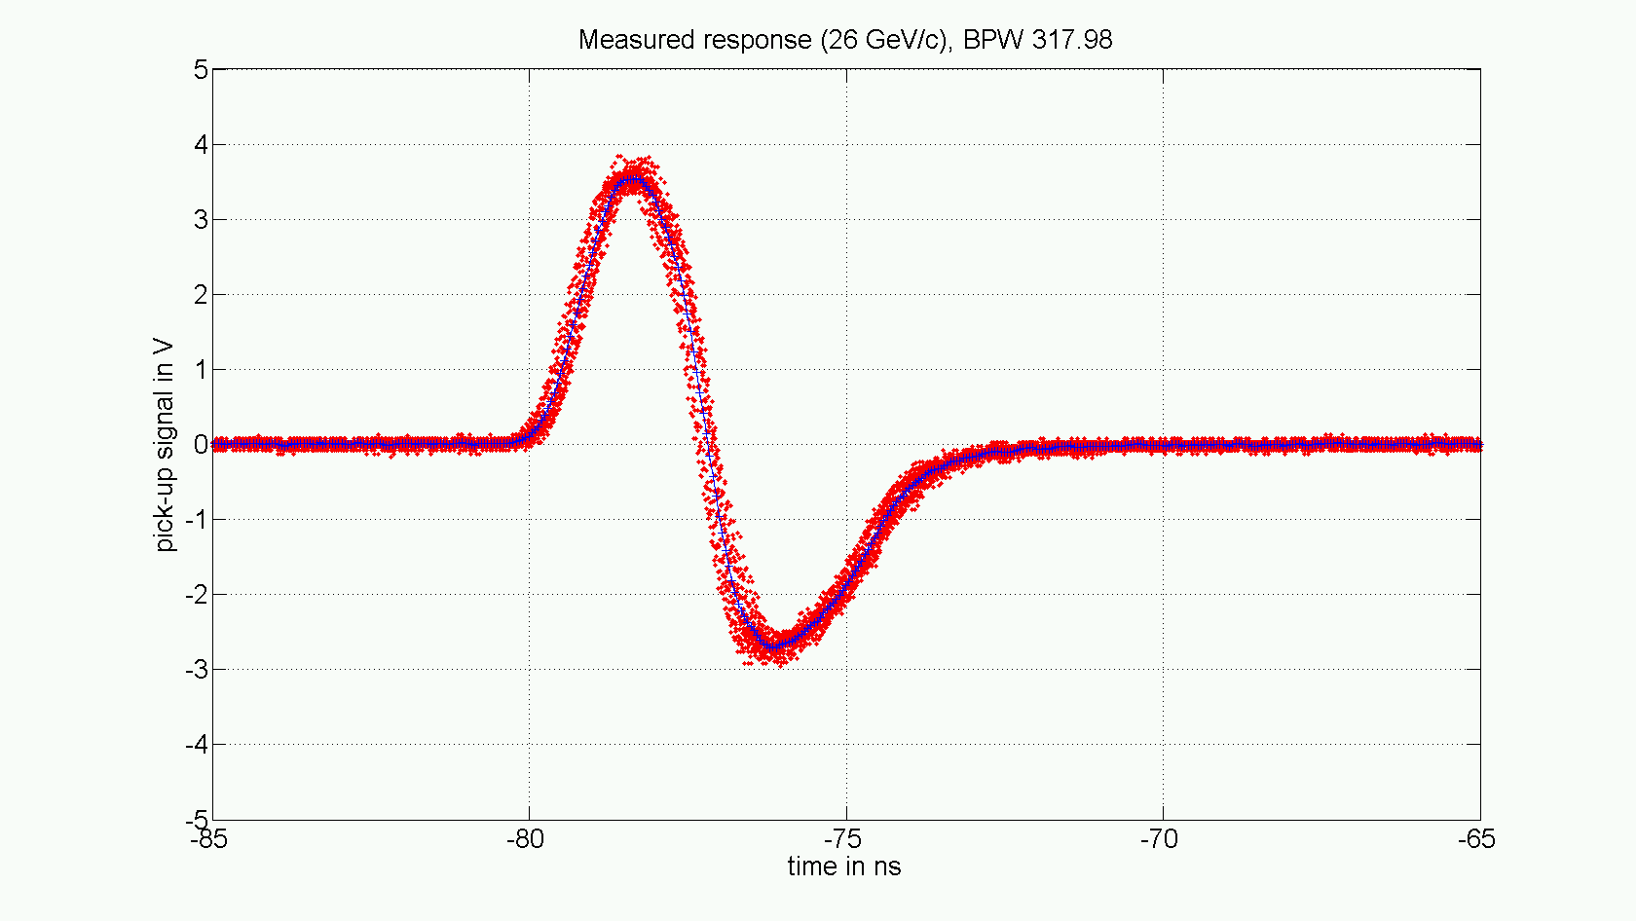
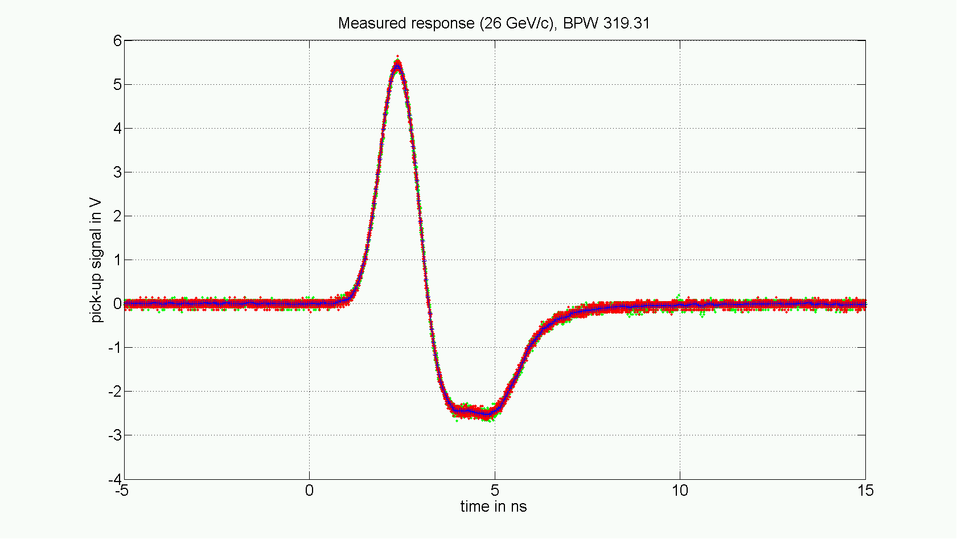
Reminder: 4 BPW pick-ups in SPS installed
measurements on all four exponential couplers in the SPS
(data from November 4th, 2008)
319.01
vertical BPWA,
small diameter
FC, resistive combiners
1st bunch of a train
PU backwards installed
(now) vertical BPWA,
small diameter
FC, resistive combiners
1st bunch of a train
PU forwards installed
321.01
slow rise-time
Now wired as vertical kicker
for kick response measurement
fast rise-time
Faraday Cage, vertical /
scope DPO 4054,
2 channels @20 GS/s
vertical
317.98
horizontal BPW,
large diameter
CCR, H-183 combiners
1st bunch of a train
PU forwards installed
vertical BPWA,
small diameter
CCR, H-183 combiners
single bunch (semi-short)
PU forwards installed
319.31
fast rise-time
on OASIS, CCR room
vertical, 8 GS/s
on OASIS, CCR room
horizontal, 8 GS/s
fast rise-time
saturation or cable?
1st bunch of bunch train oscillates -> jitter in measurement; single bunch -> no jitter

Slide 5
Comparison OASIS / Tektronix scope

Slide 6
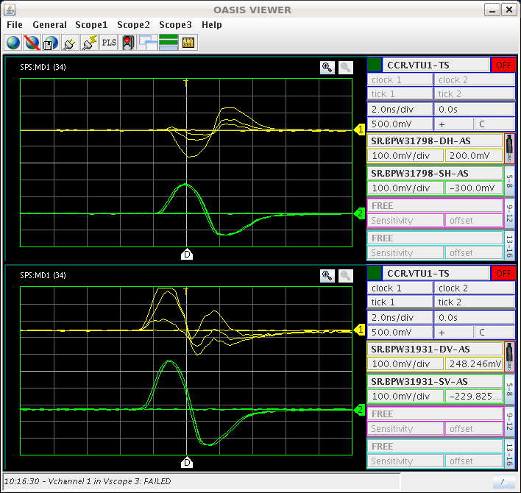
2.2x1011 injected, single bunch, 15.07.2010, stable

Slide 7
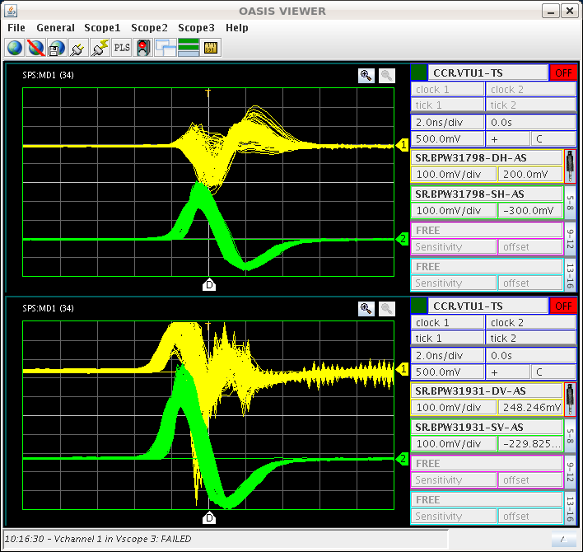
2.2x1011 injected, single bunch, 15.07.2010, unstable

Slide 8
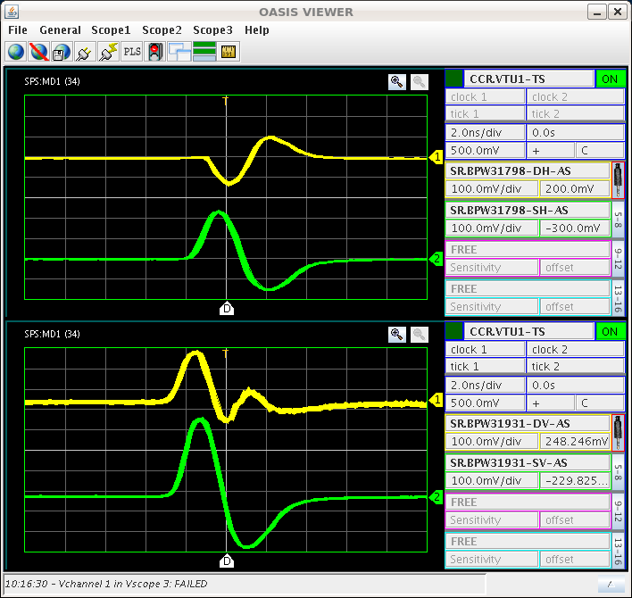
2.2x1011 injected, single bunch, 15.07.2010, stable
Response not understood, access done, hybrids / cables checked,
no anomaly found, installed additional attenuation, but no improvement
to be follow-up up (response different for indiv. strips ?

Slide 9
OASIS issues
Many, help from S. Degaye (new beta version used)
Main issues:
erratic sampling on one channel (hardware issue ?) to be followed-up
full data record cannot be exported, solution, small GUI by RF-CS
(Mic Jaussi, operational next week ?)
display slow, to be discussed with OASIS team

