Slide 1
Collimation in SPS?
R. Assmann
25.3.2010
Joint Meeting SPS Upgrade Study Group and SPS Task Force

Slide 2
Introduction
This is a brain-storming talk.
No detailed technical work done but enough to explore and discuss a collimation option for SPS.
If this should be considered seriously, then this is an excellent job for a fellow or similar, working with us.
SPS loss and collimation simulations fully operational with sixtrack and aperture model. Full 6D simulations.
Simulations were set up by us during 2005 for benchmarking programs with LHC prototype collimator in SPS.
All tools there to rapidly define a solution if required.

Slide 3
Collimation in Warm Accelerators
SPS is a room temperature machine, so no need to protect SC magnets!
Traditionally, room temperature accelerators require collimation to control and reduce background to experiments.
Recently, with higher power beams: room temperature proton accelerators invest a lot into collimation. Buzz words are…
“localization of radiation”
“hands-on maintenance”
“passive and active protection”

Slide 4
Does SPS Need Collimation?
Depends on beam loss assumptions, radiation analysis, maintenance scenarios and risk analysis.
To be addressed as integral part of an overall design.
Not for me to answer…
Let’s assume that collimation will be required for the SPS for the following arguments:
Localize SPS beam losses (transition, scraping, …) and activation to well controlled locations. Lower activation and longer component lifetimes elsewhere.
Use this system for clean scraping.
Provide passive protection for beam failures and avoid damage to machine.
Equip known loss locations with fast beam loss monitors for additional fast active protection.

Slide 5
How Should SPS Collimation Look Like?
System can be much simpler than LHC.
A simple “classical” two-stage collimation system is fully sufficient:
Betatron system:
Two primary collimators to cut in H and V phase space. Should be short length, ~mm (or low-Z). Can be used also for scraping as in Tevatron and RHIC.
Four secondary collimators to catch the scattered particles and showers. Should be large length (~0.5m) and high Z.
Momentum system:
One primary collimator to cut in momentum phase space. Should be short length, ~mm (or low-Z). Can be used also for scraping as in Tevatron and RHIC.
Two secondary collimators to catch the scattered particles and showers. Should be large length (~0.5m) and high Z.

Slide 6
Scope “Guess”
Collimators required:
Primary collimators: 3
Secondary collimators: 6
Assume 11 collimators constructed.
Guess based on LHC experience: 4 MCHF ± 2 MCHF
Does not come for free to get a state-of-the-art collimation system…

Slide 7
SPS Collimation Design Challenges
Conceptual collimation design “easy”.
Find space in SPS and integrate into machine.
Collimation efficiency, material/length choice, settings, … require simulations. Impedance should be OK but requires check.
Collimators:
Two-sided devices for constraining beam quality (position, size, tails) during whole cycle ➔ protection. LHC design reusable to some extent.
Jaw speed required: ~ 5 mm/s (LHC: 2 mm/s) Should be no big challenge.
Probably only major challenge: 500,000 cycles/year (LHC 30k over life) This is more like requirements for factories on mechanical parts.
Controls:
Can see you major issue but work by experts required.

Slide 8
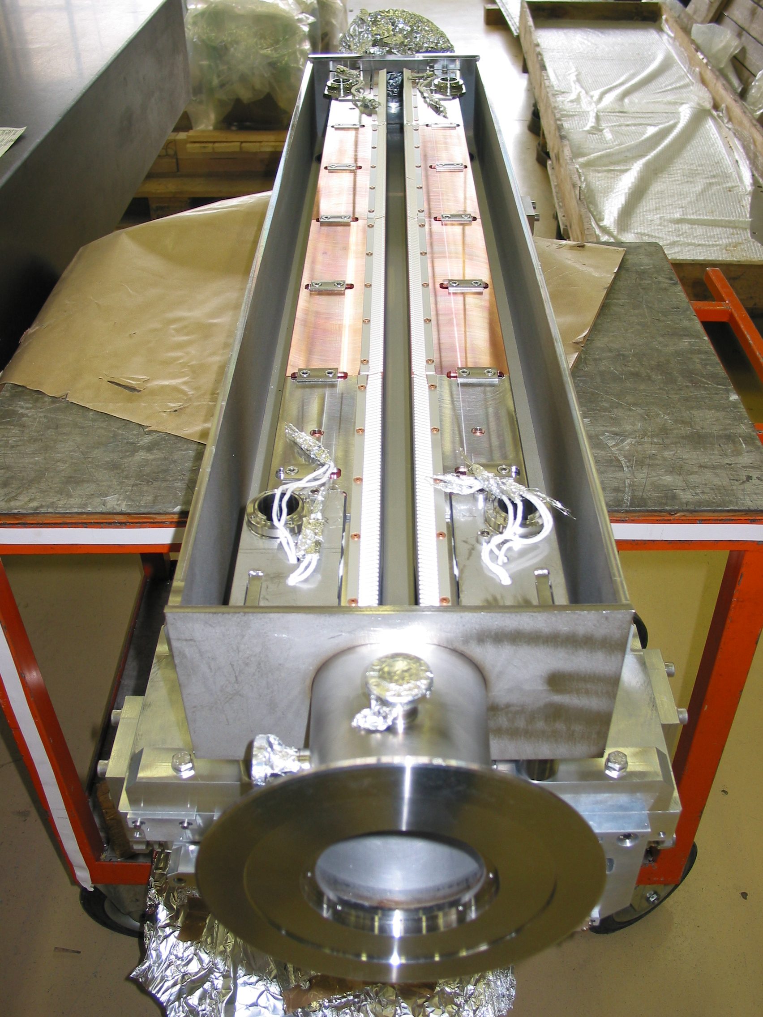
Two-Sided Concept is Important
LHC Collimator

Slide 9
Conclusion
LHC type collimator in SPS since 2004. No problem!
A two-stage collimation system can be designed without problems for SPS with efficiency > 99%:
Minimize radiation around the ring
Constrain beam quality during the cycle
Provide passive machine protection
Allow LHC type active machine protection
Provide clean scraping functionality
The 9+2 collimators will not come for free (4 ± 2 MCHF).
Need must be determined first and then real design work must start (1 person/fellow working with us).

