Slide 1
Electron cloud simulations for the SPS electrostatic septum (ZS) G. Rumolo, for the joint SPSU ST and TF meeting (22/04/2010)
Introduction and motivations
Behaviour of ZS with LHC type beams
Study of electron cloud build up thresholds in a ZS-like geometry with LHC25 beams:
Without external fields
With the voltage from the ion traps
With a solenoid field
Conclusions
⇒ Inspired by many individual discussions with G. Arduini, B. Bahlan, B. Goddard, E. Métral...

Slide 2
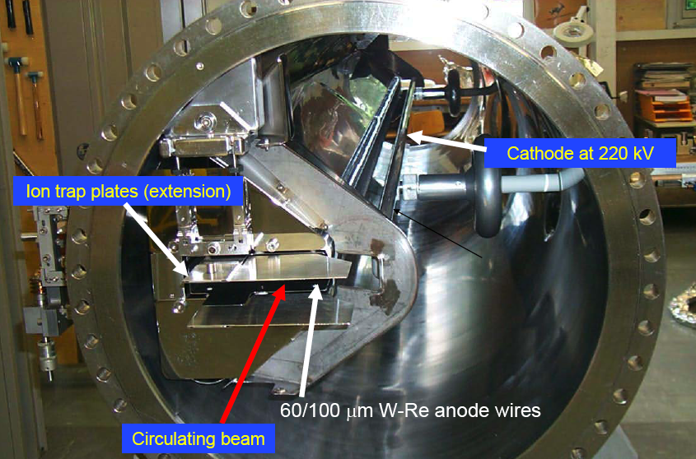
What the ZS looks like….

Slide 3
Some practical information on the ZS
Active length ~ 3 m (per septum).
Anode (grounded) :
Equipped with 2000 W_{.75}Re_{.25} septum wires.
Wire diameter 50 μm (first ZS) to 100 μm.
Wire spacing 1.5 mm.
Cathode at a voltage of -220 kV (110 kV/cm).
Anode-cathode gap : 20 mm.
Ion traps (circulating beam side):
Voltage of -3 to -6.5 kV
~ 2-3 kV diff. top/bottom
Sum of all voltage difference should be ~ 0 to avoid orbit distortions at low energy. Critical for leptons, usefulness less evident now…
Anode
Cathode
-3kV
-6kV
Ion-traps
-220kV
From J. Wenninger, Introduction to Slow Extraction to the North Targets

Slide 4
ZS during SPS operation with high intensity LHC beams
Following the 2002 incident with the ZS, operation still applies these instructions when high intensity LHC beams are in the SPS:
retracted girder (maybe not in the future to allow cleaning)
HV 0 kV;
ion traps on;
Observations at the ZS with 25 ns high intensity beam:
Above certain intensities (nominal beam, more than 1 batch injected) the vacuum in the ZS degrades.
The increased vacuum levels can provoke a vacuum interlock, which stops the ion traps and hence the beam in the machine. In this sense, “ZS limits the LHC beam”.
By increasing the bunch length the vacuum recovers again.
The beam has a non-negligible effect on the ion trap voltages, as the ion trap voltage drops and current is drawn off the plates.
Sparking does occasionally occur, but does not appear to be the principal problem
All this above suggests that we have e-cloud in the ZS, even if the presence of a voltage should clear from electrons….

Slide 5
Electron cloud simulations (I) the ZS geometry without external fields
λ_{ec} = 10¹⁰ e⁻/m
46 mm
140 mm
In absence of voltage from the ion traps
significant electron cloud builds up for δ_{max} > 1.7
the electron cloud between bunches is uniformly distributed over the chamber cross section

Slide 6
Electron cloud simulations (II) including the voltage from the ion traps
λ_{ec} = 10⁵ e⁻/m
46 mm
E
140 mm
Assuming a voltage of 3 kV between the bottom and top plates
the electron cloud is suppressed at least up to δ_{max} =2.0
actually electron clearing happens between bunches and there is no dependence on the SEY of the plate. A certain number of electrons survives between bunches, and also between batches, but it tends to saturate.

Slide 7
Electron cloud simulations (III) scanning the voltage values
Assuming δ_{max} =2.0 and scanning the voltage between the bottom and top plate
the electron cloud is found to be suppressed at for 500 V ≤ V < 4 kV
V=100 V is not sufficient and a strong electron cloud is formed
For V=100 V the SEY threshold lies between 1.6 and 1.7, and the electron cloud that builds up is stronger than in absence of voltage.

Slide 8
Electron cloud simulations (IV) scanning the voltage values
When we change the voltage, we actually change the clearing efficiency
electrons are cleared more efficiently (i.e. more quickly) with higher voltages
However, if the voltage becomes
too low (<500 V), no clearing happens and the voltage actually gives the electrons the additional energy as to slightly enhance the multipacting that would anyway occur without voltage applied
too high (>7 kV), some electrons can be accelerated to high enough energies as to multiply their number when hitting the plate during/after a bunch passage
the quoted clearing voltage values also depend on having assumed in the model a maximum SEY at E_{max}=230 eV

Slide 9
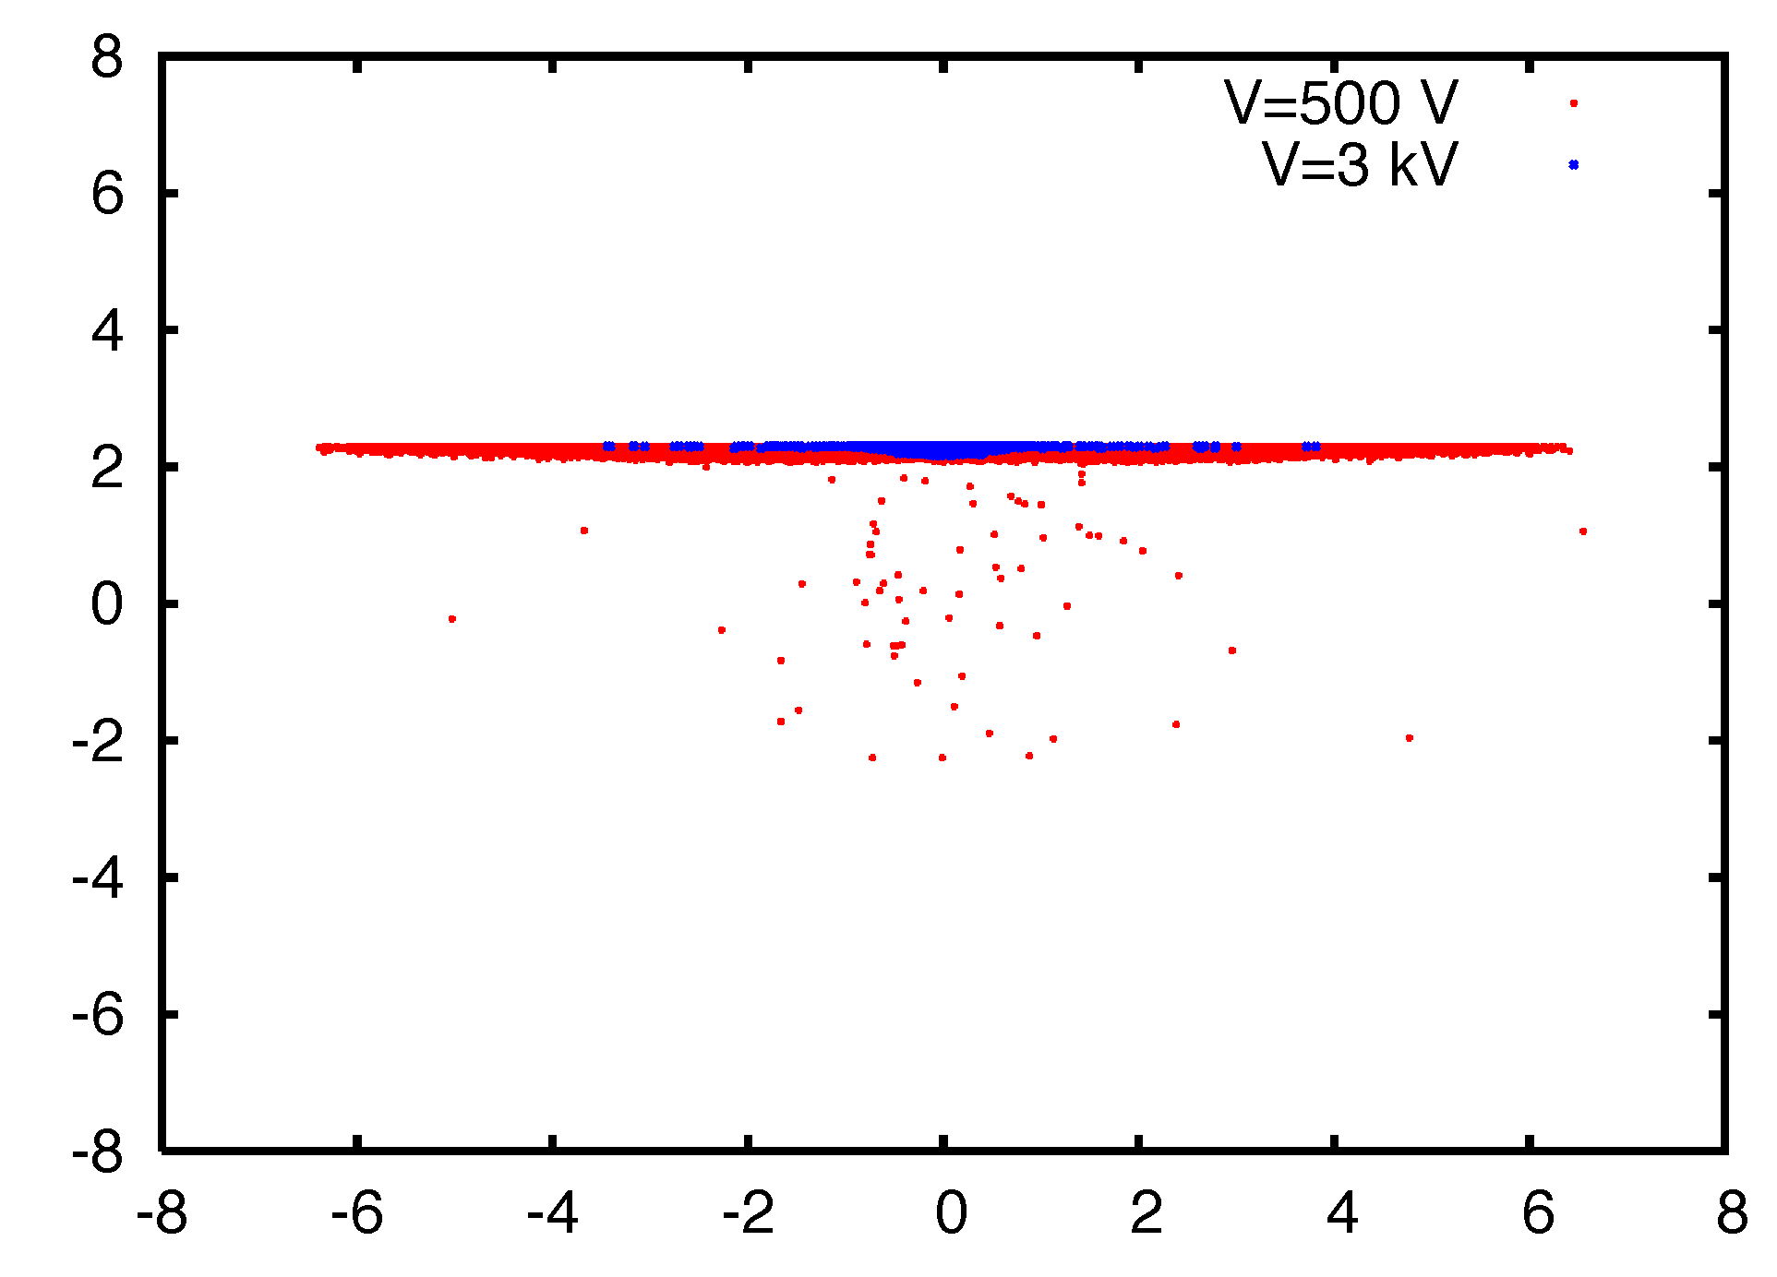
Electron cloud simulations (V) distribution of electrons with clearing voltage
y (cm)
x (cm)
Distribution of electrons inside the beam chamber (snapshot taken just before the passage of the last bunch of the second batch):
A certain concentration of electrons remains in the vicinity of the plate at higher potential (the higher the voltage, the more localized is the distribution)
The amount probably also depends on the model assumption of 0.7 probability of elastic reflection at low energy!

Slide 10
Electron cloud simulations (VI) effect of a solenoid field alone
λ_{ec} = 10⁵ e⁻/m
B
46 mm
140 mm
Assuming a solenoid field of 50G and zero voltage
The electron cloud is efficiently suppressed for δ_{max} at least up to 2.0
A certain number of electrons survives between bunches, and also between batches, but it tends to saturate

Slide 11
Electron cloud simulations (VII) scanning the value of the solenoid field
We have scanned the intensity of the solenoid field between 10G to 110G with δ_{max}=2.0 and zero voltage
Electron cloud suppression is efficient for all values, except B=10G
Best suppression seems to be reached for B=30G

Slide 12
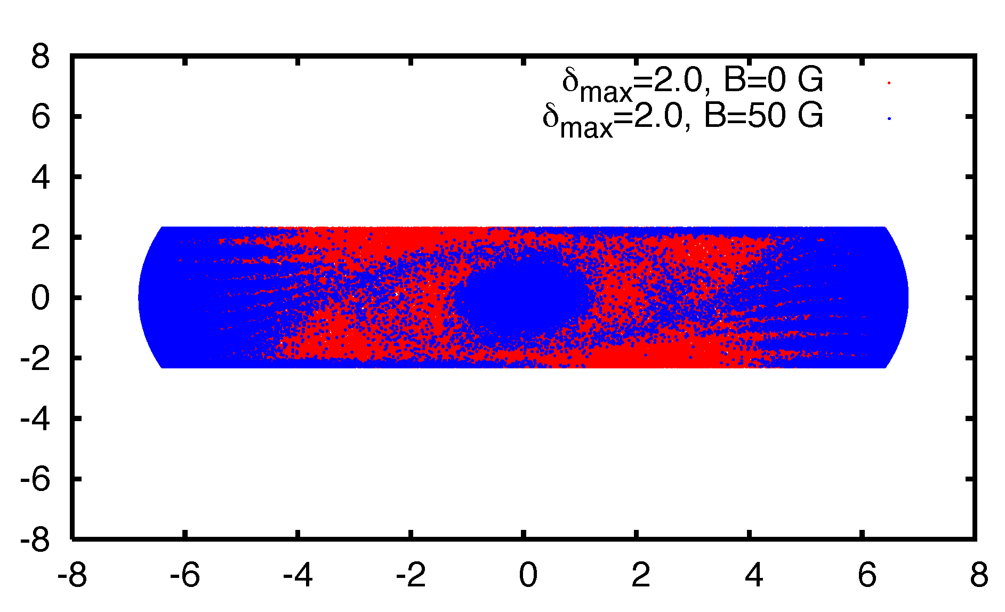
Electron cloud simulations (VIII) distribution of electrons with solenoid
y (cm)
x (cm)
Distribution of electrons inside the beam chamber with zero voltage:
For B=0, the electrons fill the beam chamber uniformly (red dots), while, due to the cyclotron motion of the electrons around the field lines, a solenoid makes secondary emission “inefficient”, as the emitted electrons bend back into the wall
The same line density as with clearing voltage translates into a lower electron volume density due to the larger cross section occupied (however, in this case there would be a higher central density!)

Slide 13
Electron cloud simulations (IX) voltage + solenoid
λ_{ec} = 10⁸ e⁻/m
E
B
46 mm
140 mm
The presence of a solenoid field with a voltage of 3 kV seems to enhance the electron production, partially removing the suppressing effect that both separately have
For B=50G, some spikes are created in the electron distribution vs. time
For B=110G, a more stationary cloud of electrons is created and survives through bunches

Slide 14
Electron cloud simulations (X) voltage + solenoid
We try to understand the reason of this behaviour
While the voltage alone can clear the electrons created by a bunch, the solenoid allows the electrons to gain more energy before they get to the wall, causing a “single bunch multipacting” (similar to trailing edge multipacting)
For B=50G, these electrons are more or less cleared by the arrival of the next bunch
For B=110G this effect persists through bunches giving rise to a significant cloud

Slide 15
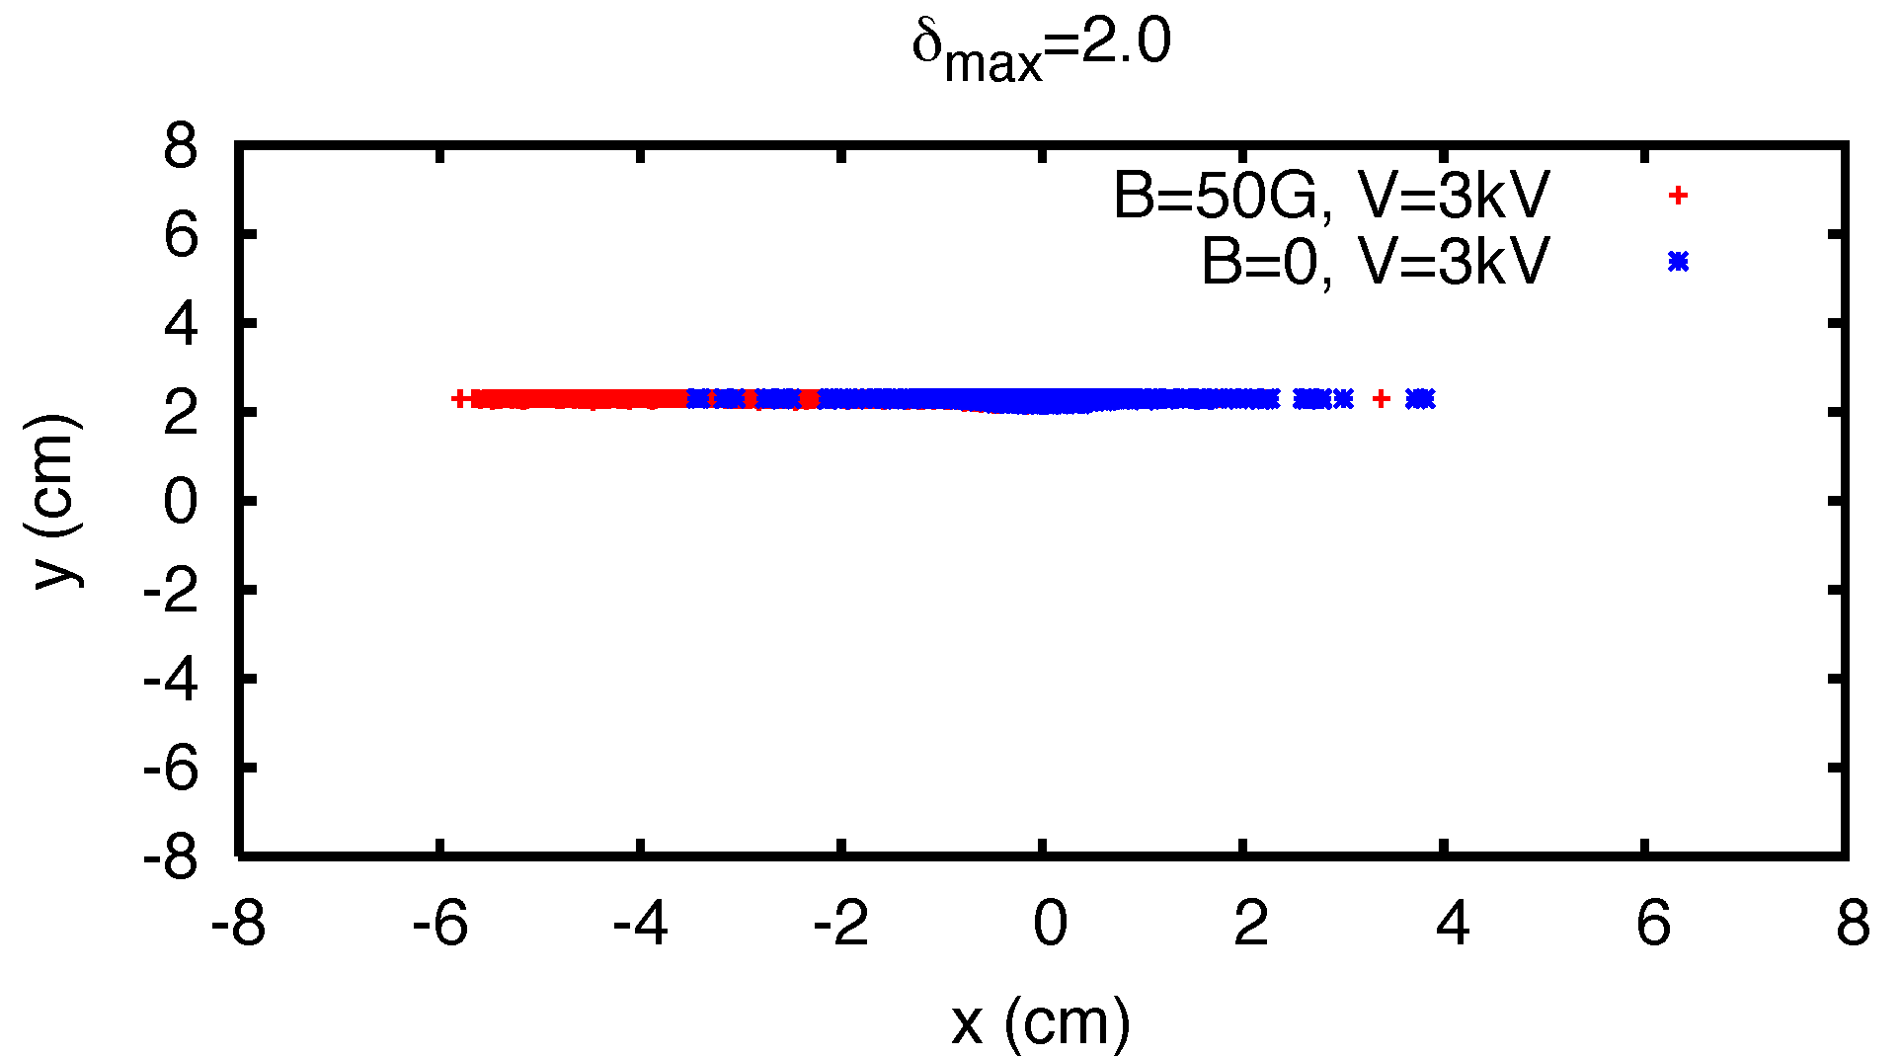
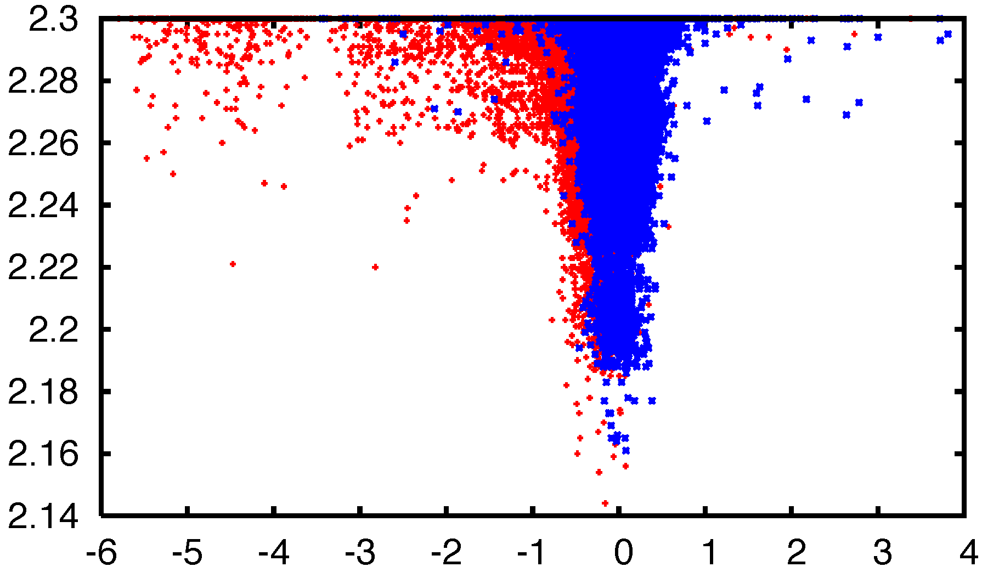
Electron cloud simulations (XI) distribution of electrons with voltage + solenoid
Zoom on the electrons!
Distribution of electrons inside the beam chamber:
As predictable, both with and without solenoid field the electrons accumulate in the vicinity of the plate at higher potential
We can observe that the distribution with solenoid field shifts leftwards and extends more on the left side, possibly as an effect of the E x B drift.

Slide 16
Summary and conclusions
The geometry of the ZS is prone to electron cloud build up with LHC25 beams at nominal intensity
in absence of the voltage from the ion traps, there would be electron cloud for maximum SEY above 1.7
A difference of potential between top and bottom plate should be effective to clear the electrons from residual gas ionization between bunches
voltage should be at least a few hundreds V (100V certainly not enough)
voltage should also be below ~7kV in order not to produce important single bunch electron multiplication
A solenoid field above 10G can also suppress the electron cloud in the ZS in absence of the clearing voltage
The combined effect of voltage and solenoid field can give rise to substantive electron cloud formation through the processes of single bunch multiplication and electron survival across bunches
Disclaimer: in all the study presented, no dynamic effects have been taken into account (e.g. voltage drop due to the passage of the beam, possible voltage change at the plates due to electron emission, etc.). It would be important to quantify the voltage change with passing beam

