Slide 1
Inspection of five liners extracted from the SPS
SEY meeting 2010-10-06
Christina Yin Vallgren

Slide 2
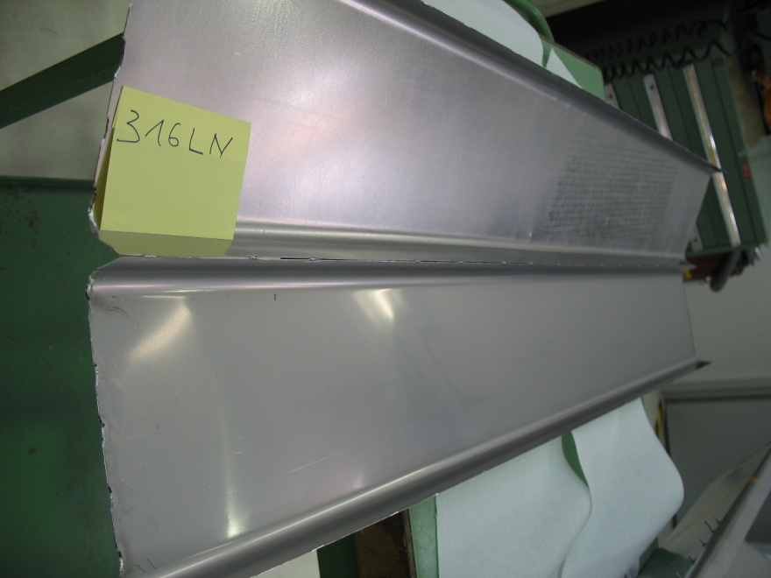
Stainless Steel
Reference

Slide 3
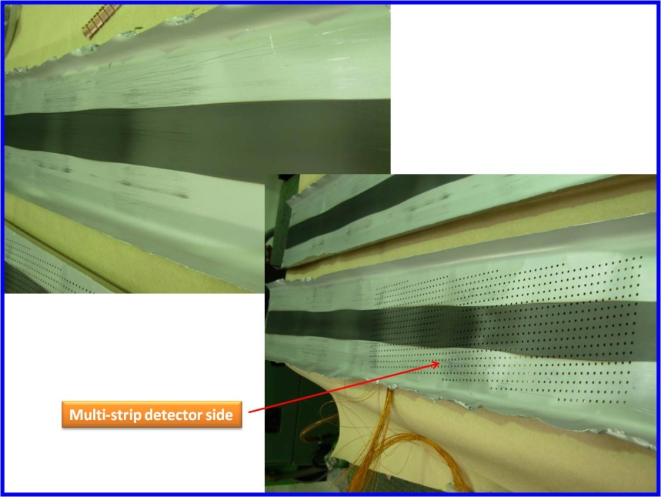
C-strip

Slide 4
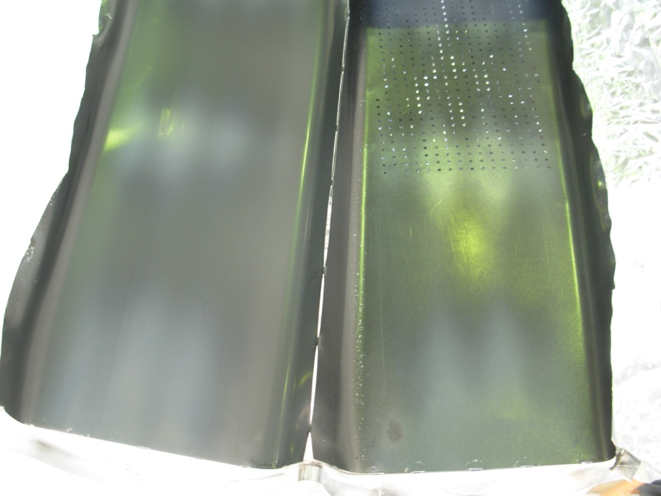
C-Zr
a-C on rough Zr coating

Slide 5
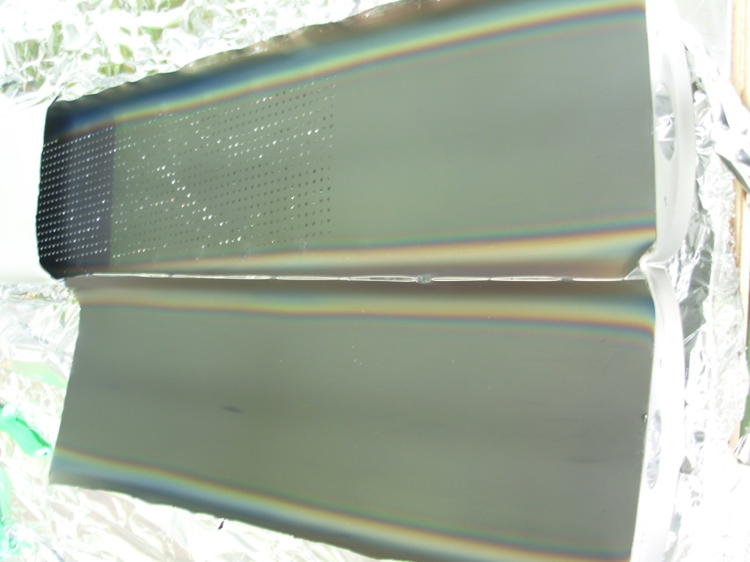
CNe64
a-C number 64

Slide 6
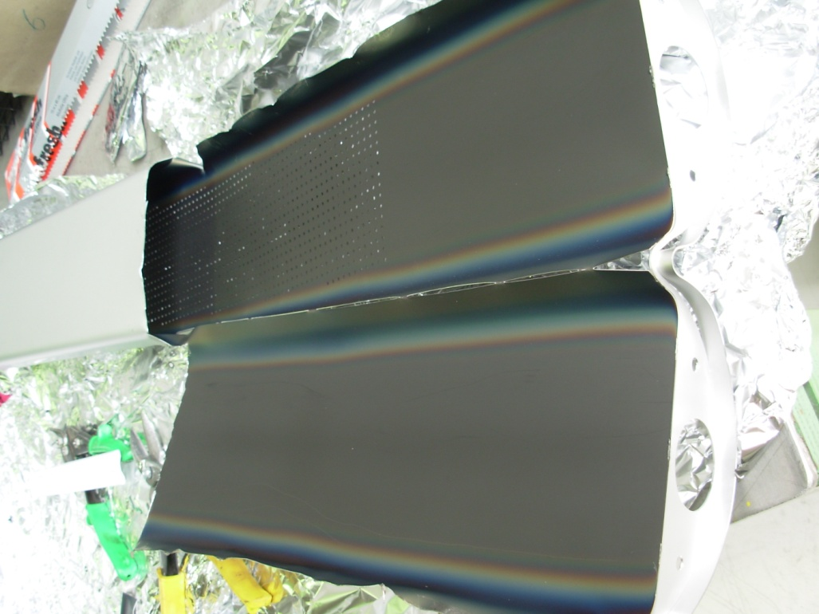
CNe65
a-C number 65

Slide 7
Liner | SPS operation time | δ _{initial} | δ _{extracted}
StSt (Ref) | 1 year (5 MD runs) | 2.25 | 1.72
C-strip | 1 year (5 MD runs) | 0.92 | 0.97
C-Zr | 1.5 years (9 MD runs) | 0.95 | 0.99
CNe64 | 3 months (2 MD runs) | 0.95 | 0.97
CNe65 | 3 months (2 MD runs) | 0.95 | 0.97

Slide 8
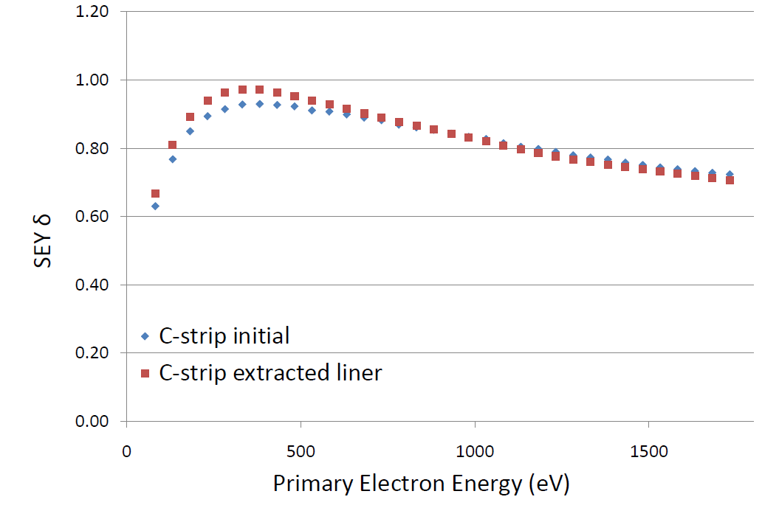
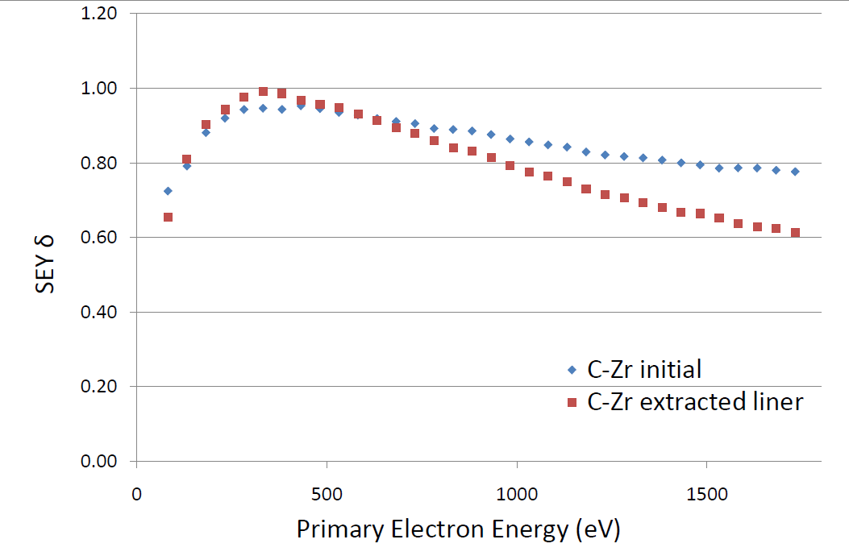
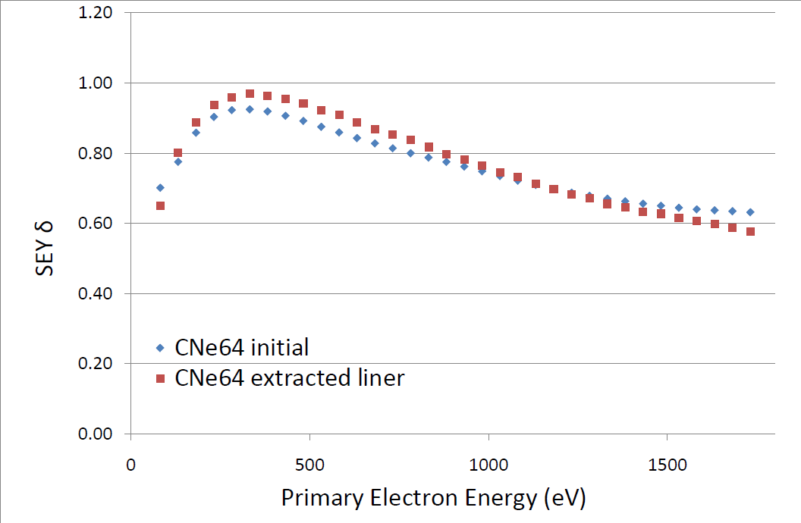
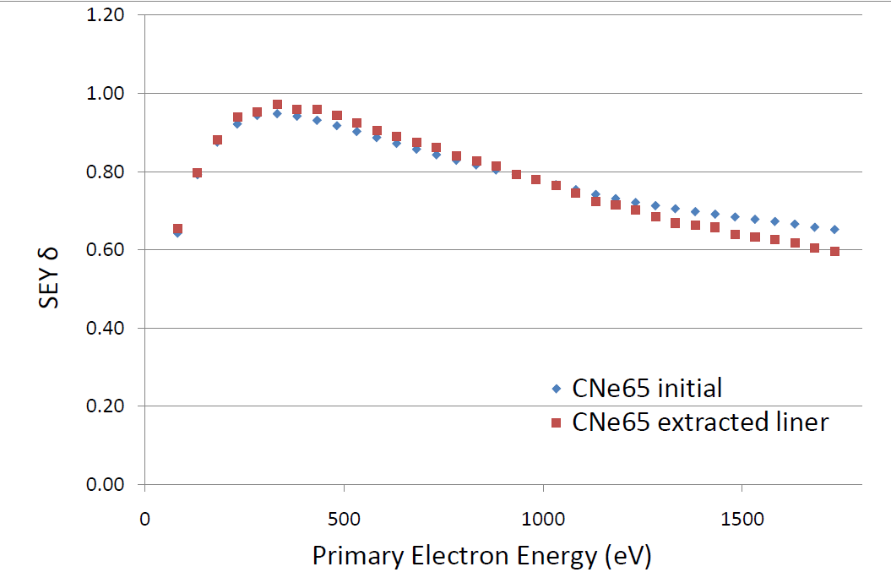
Summary: five extracted liners

Slide 10
C-strip
C-Zr
a-C on rough Zr coating
For confirming necessity of coating width
Stainless Steel
Reference
CNe64
a-C number 64
CNe65
a-C number 65

